Slide 1


The Donner Party
A Not So
Merry Christmas
Jamie Fearn Geog 90 Fall 2018

Slide 2
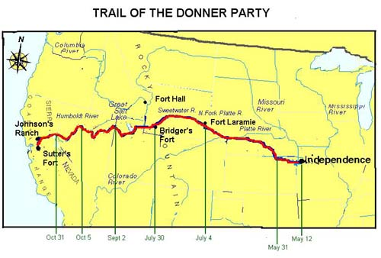
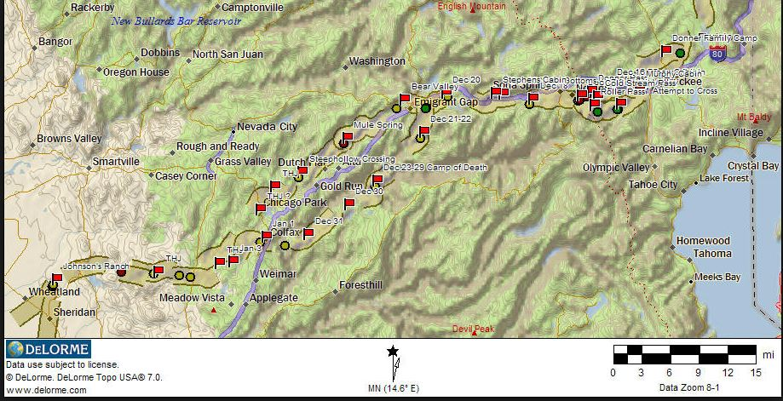

Inspiration
Last Podcast on the Left, Donner Party
Existing Maps of Donner Party routes
Create new data using historical references

Slide 3
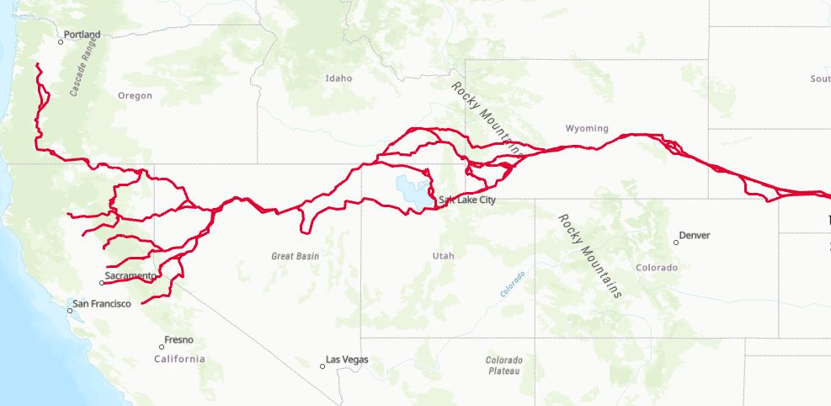
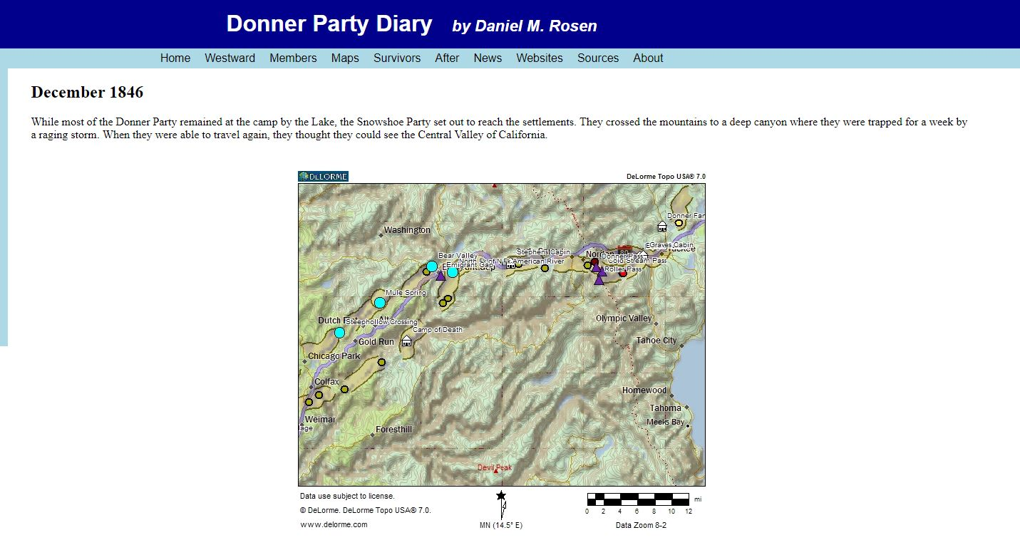
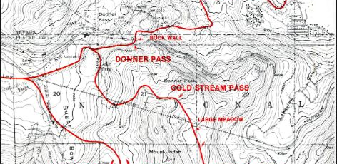
Data and
References
National Historic Trail data from the National Park System
GPS data from Daniel M.Rosen
  Donnerpartydiary.com
The Indifferent Stars Above by Daniel James Brown
Trail of the First Wagons Over the Sierra Nevada (A Guide) by Charles K. Graydon

Slide 4
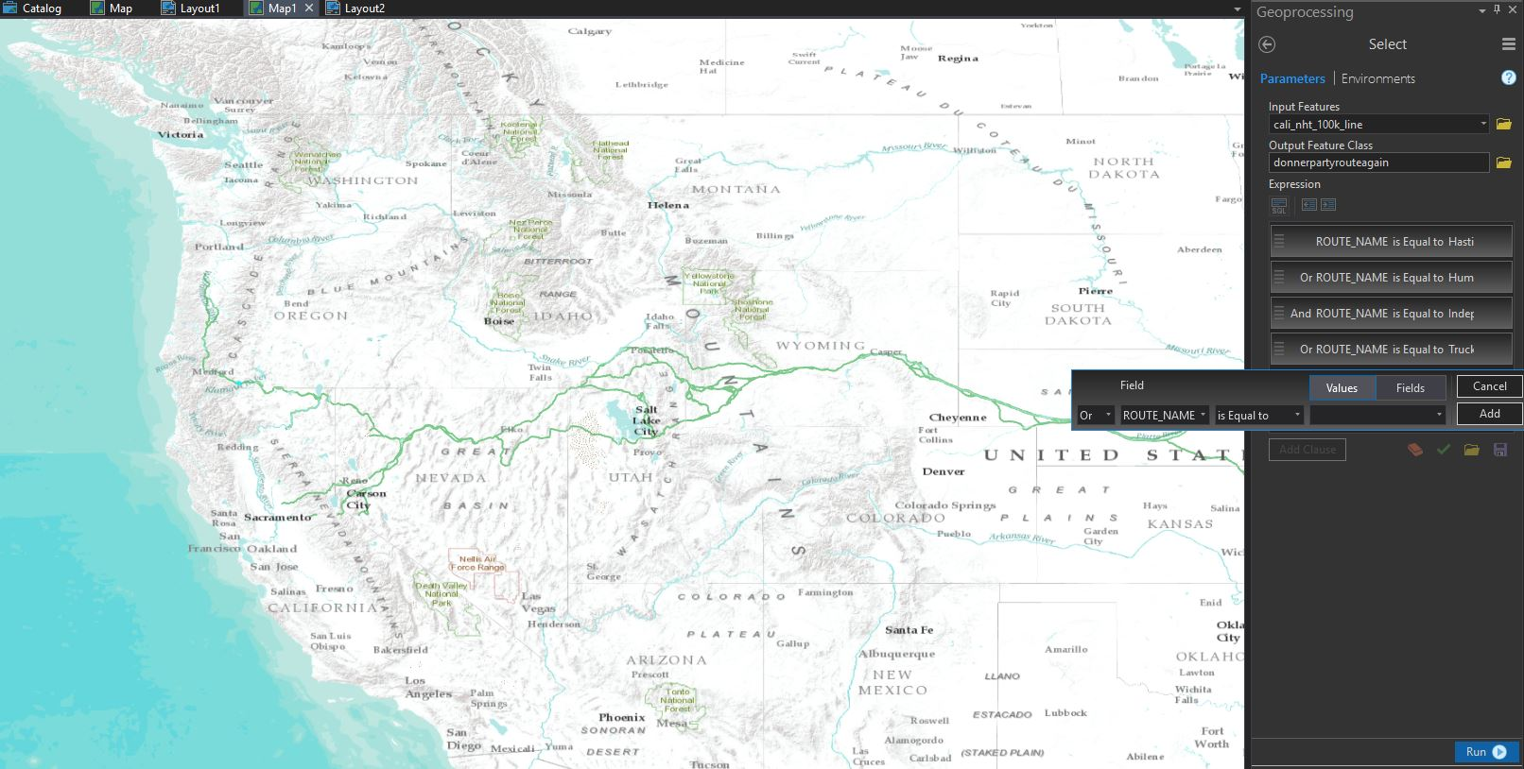
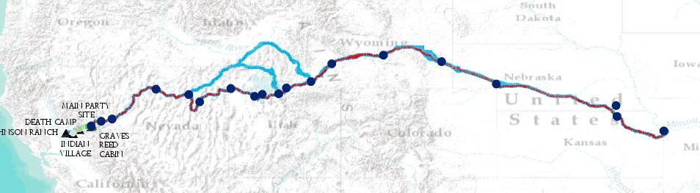
Tools
Clip NHT data by Route Name verify correct routes with GPS data
Notice mistake in screenshot?
Fill in Gaps within NHT data
Use out beyond to fix labeling in different scales

Slide 5
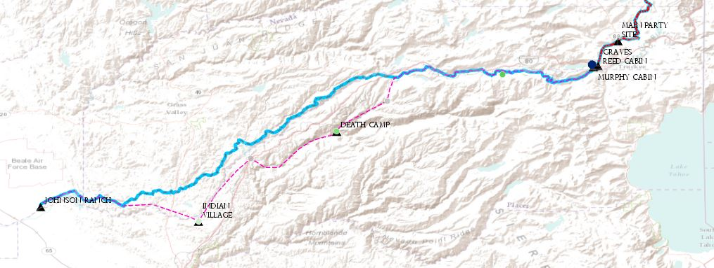
Route approximation
Used GPS data and NHT routes to verify primary route
Modified data in attribute table to create better labels
Used GPS data, historical references and topography to approximate Forlorn Hope

Slide 6
