Slide 1
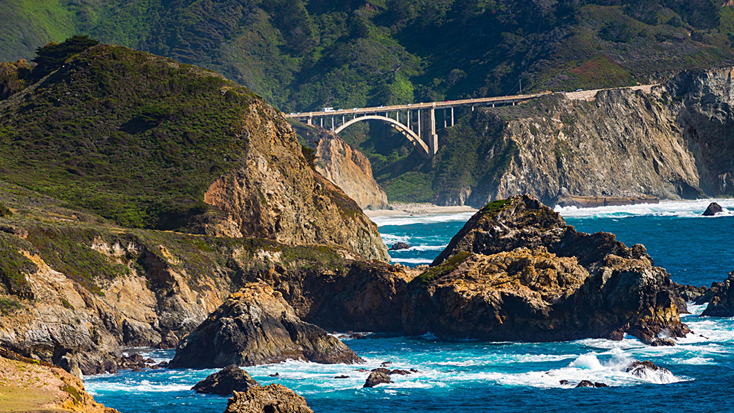
Sea Level Rise
Matthew Di Loreto

Slide 2
Disclaimer
Climate change is a hot subject, but long-term mitigation is necessary in any event.
This project isn’t meant to convince you or raise fear about the issue, but to raise awareness about potential changes in the future.

Slide 3

Background
My initial interest in the project was wanting to include California and its Water. (Huge policy area in our State)
At first the focus was on the State as a whole; however it would be practical to focus on a specific region in more detail.
This project was based on an Interactive map on the NOAA webpage, but it isn’t quite seamless as a static display.

Slide 4
Project Aims
Create a ‘clean’ version of the ArcGIS map for wider use.
Using elements of map making -make the map elements ‘user friendly’ for the general public.
Present the information in an understandable manner for the average person.

Slide 5
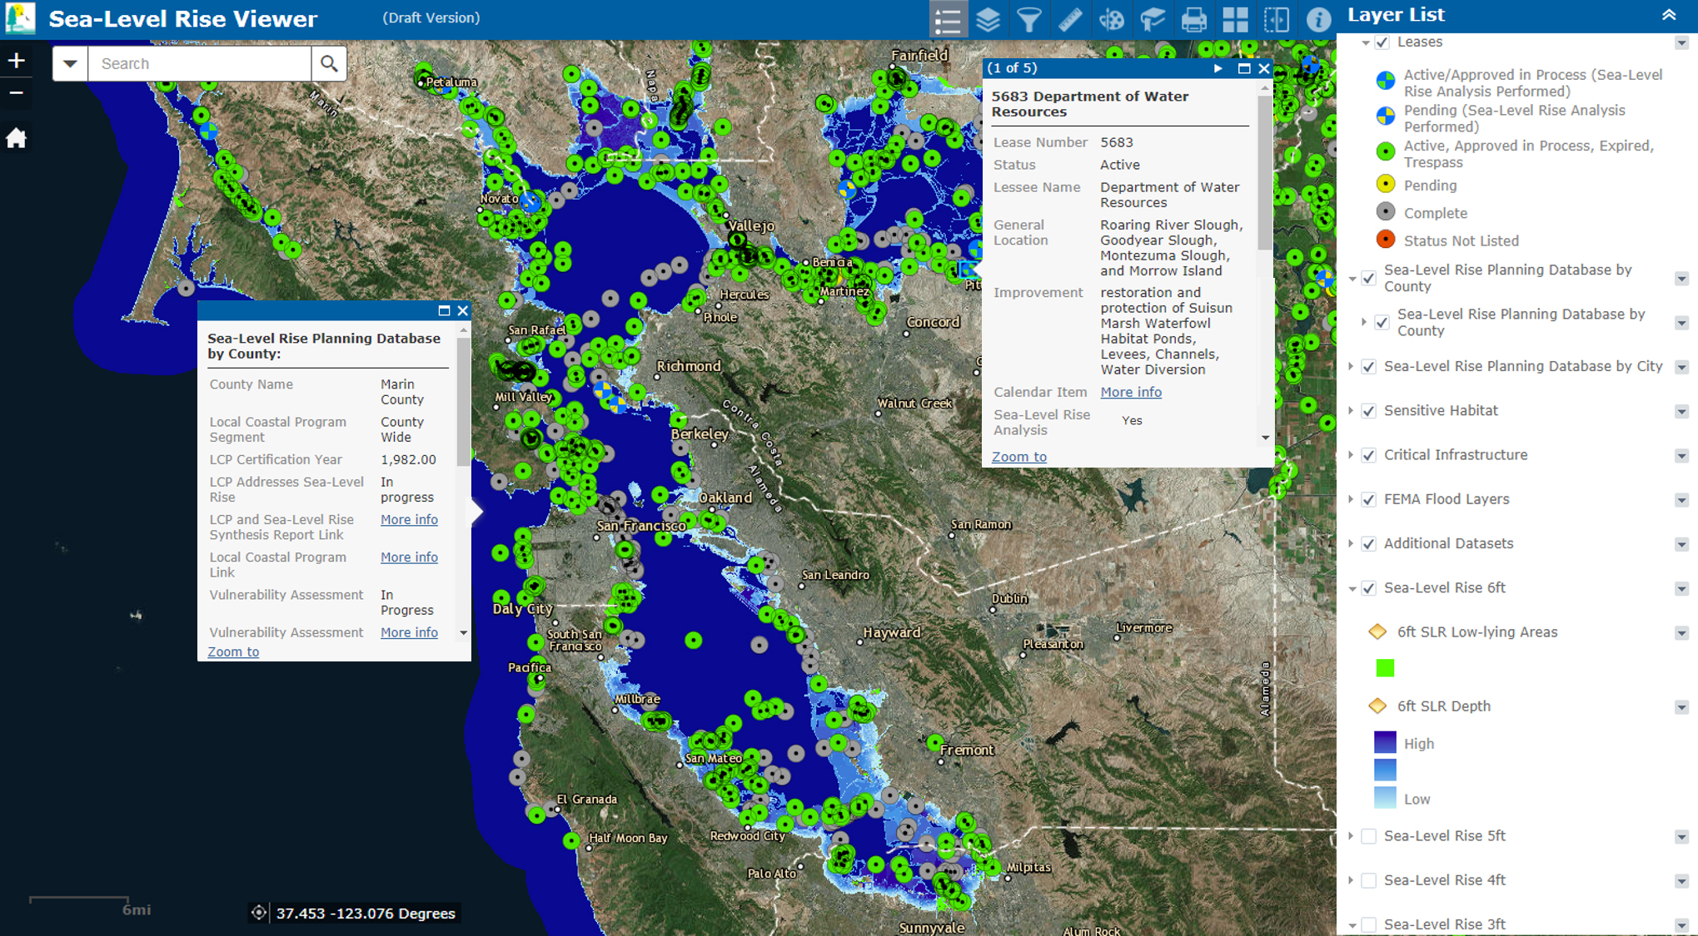
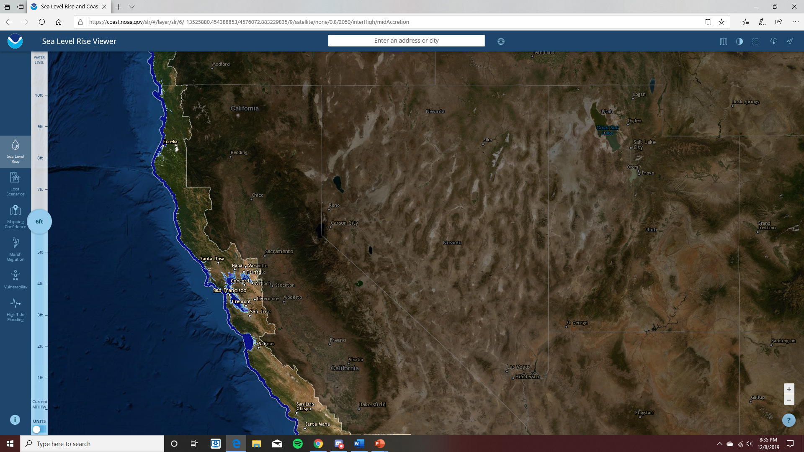
Previous versions of Map Data

Slide 6
Procedure
The first step in the map making process was one of the more challenging elements. There is a lot of Sea Level Rise region specific data… but for the East Coast especially the Carolinas. Fortunately, there is a NOAA map available in GIS through the California Land Commission that was open through the All-Portal.
With this map, the next step was to clear all the elements that added to the ‘chaos’. Outlines of every levee in the state, median river lines, power plants, hospitals, etc. giving the map a ‘busy’ feeling. These were cleared in order to save just the Sea Level Data.
The final step in the process was to use methods of cartography and map making in order to make a readable map for the viewer. Additionally, the Map Image Files had to be recolored to correspond with relevant sea level data. The map was then cropped to only include the area of concern.

Slide 7
Issues & Challenges
There were a few issues along the project that did make it at initial challenge, however, solutions were found to work around and make a respectable map.
The first issue was the lack of region-specific data, however, whole country data can be narrowed down to just include the region data. Unfortunately, the file I found wasn’t ‘editable’, so cropping was the only way to display relevant data on the map.
With the non-editable nature of the data, I did also have to manipulate some displays for simplicity purposes, and not have non-identifiable markings on the map (example: shaded green areas or other non-legend colors).

Slide 8
Learning Experiences
I learned that for projects, there isn’t a reason to reinvent the wheel all the time; it can be as effective to manipulate the data display for other purposes.
I also learned that when downloading files, to make sure its editable data, in this way I can have greater freedoms on the presentation aspect.
Simplicity can be better for general presentation – no need to present every single aspect or element that may or may not be relevant.

Slide 9
