Slide 1

Sacramento Vegan Spots &
Impossible Burger Locations
Web Map Application
Devin Byrne
GEOG 385

Slide 2
Web Map Application Capabilities
Online Map Application that informs users of vegan options and vegan “Impossible Burger” locations in downtown Sacramento
Filter which restaurants offer vegan options, and which offer the Impossible Burger, or neither
Filter common parking options based on the relative location of the restaurants
Directions option for each restaurant available in the Pop Ups ellipse icon, for each restaurant based on the current location of the user. Or the distance between two restaurants, or more
Web links to Yelp, Sacramento Vegan Facebook, and Impossible Burger website

Slide 3
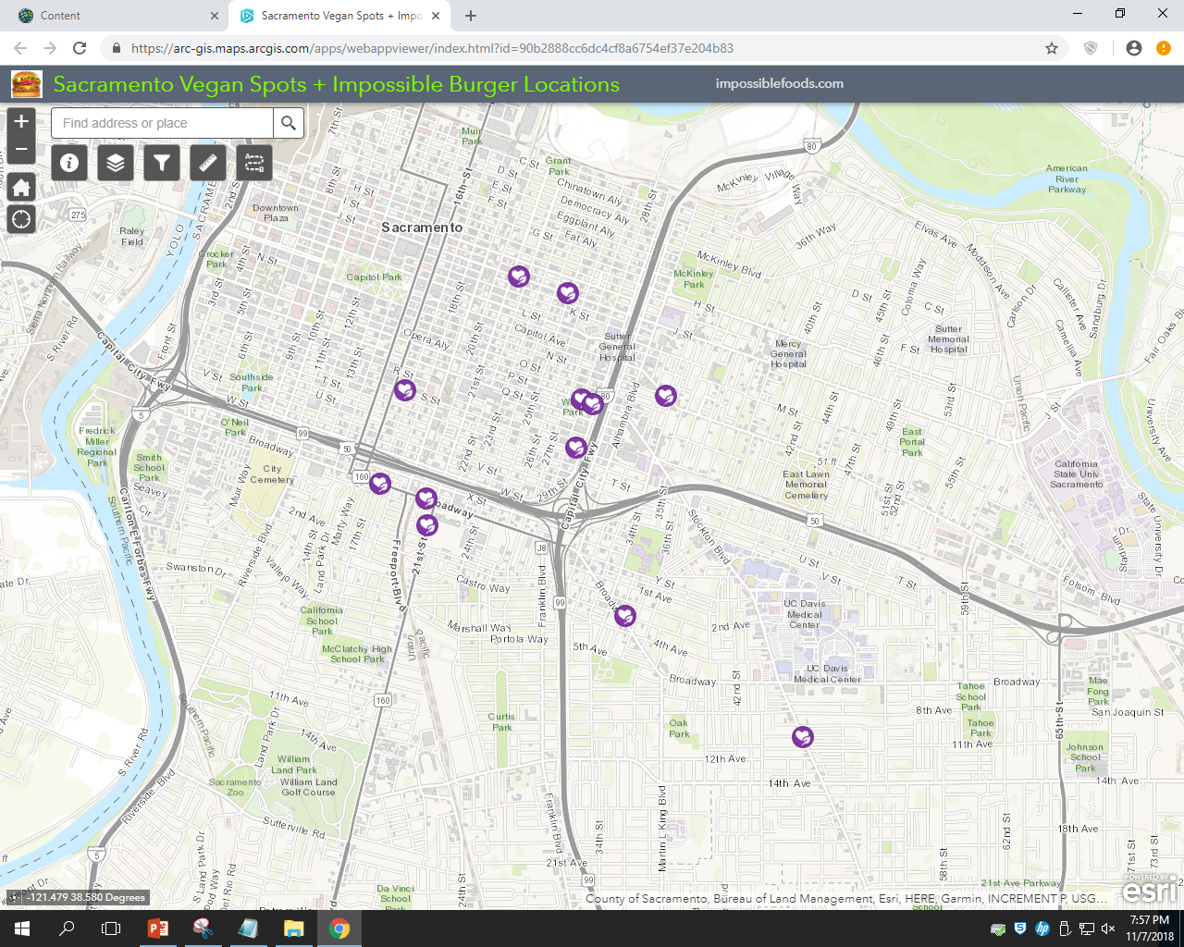
Vegan Restaurant App displays all restaurants as point features
Parking features can be activated in the Layers widget
App offers a “word-of-mouth” appeal to its design and purpose which makes the user feel like the recommendations are genuine, rather than Yelp influenced

Slide 4
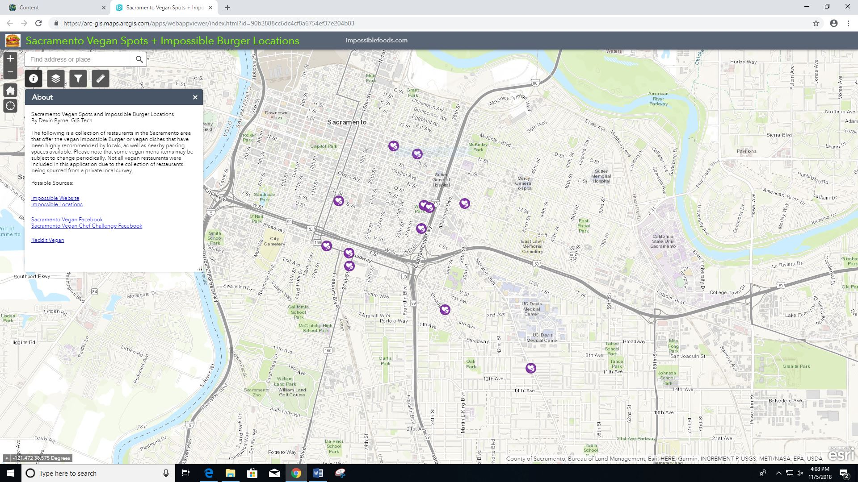
About Widget
A description summary of the map application’s purpose and disclaimers that set the context about the benefits of using this application

Slide 5
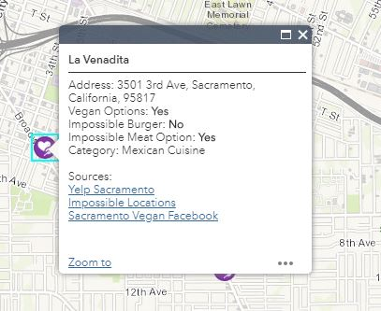
Pop Ups
Selecting a restaurant of interest displays a caption that will indicate vegan or Impossible Burger options in a Yes or No format
User can also click on a link to these relevant websites that offer “word-of-mouth” reviews about these restaurants

Slide 6
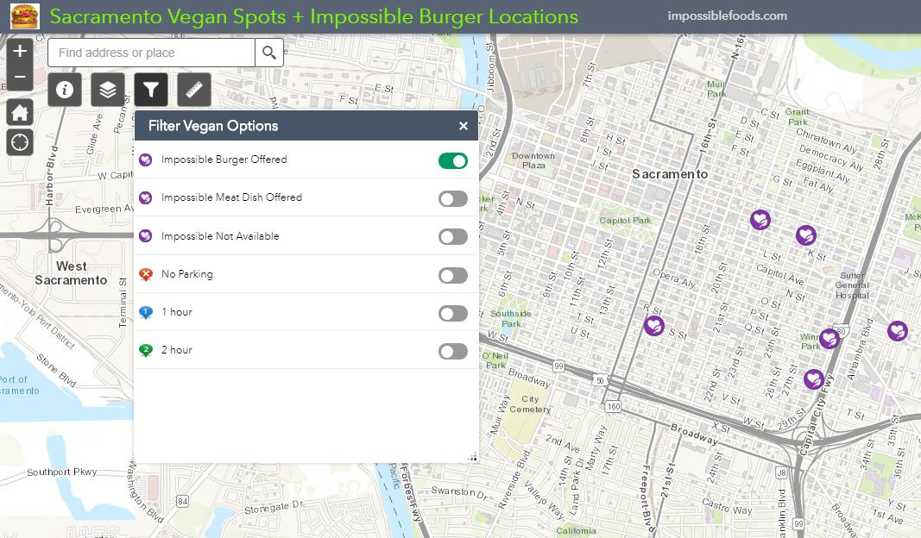
Filter Widget
Query expressions are customized in the Web Map in order to reveal specific restaurants when activated
Enables the filter widget to reveal specific restaurant options

Slide 7
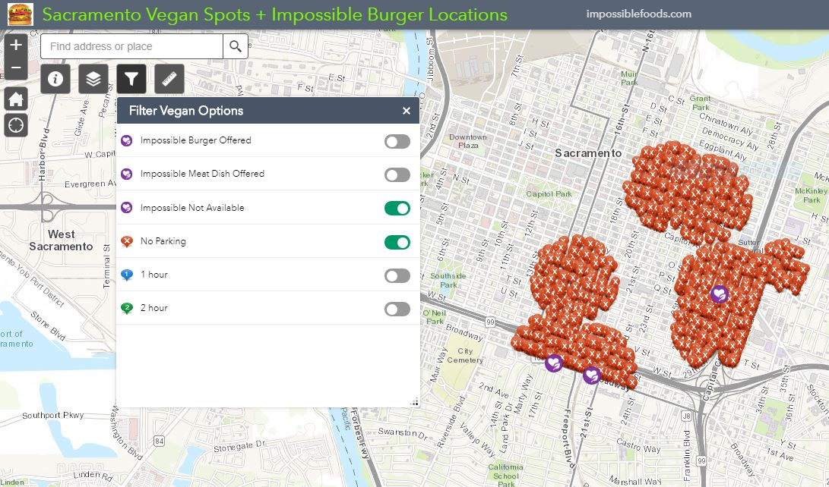
Filter Widget
Parking filter reveals the most common time limits for diners that can be revealed separately

Slide 8
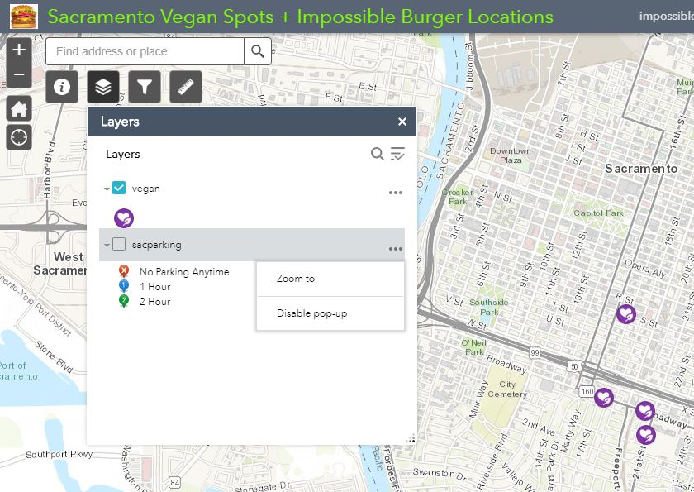
Layers Widget
Selecting the layers widget enables the user to have control over which spatial data layer is displayed
Parking layer is turned off by default upon opening the app in order to eliminate map noise
Pop Ups can also be disabled to eliminate cluttering when selecting a feature

Slide 9
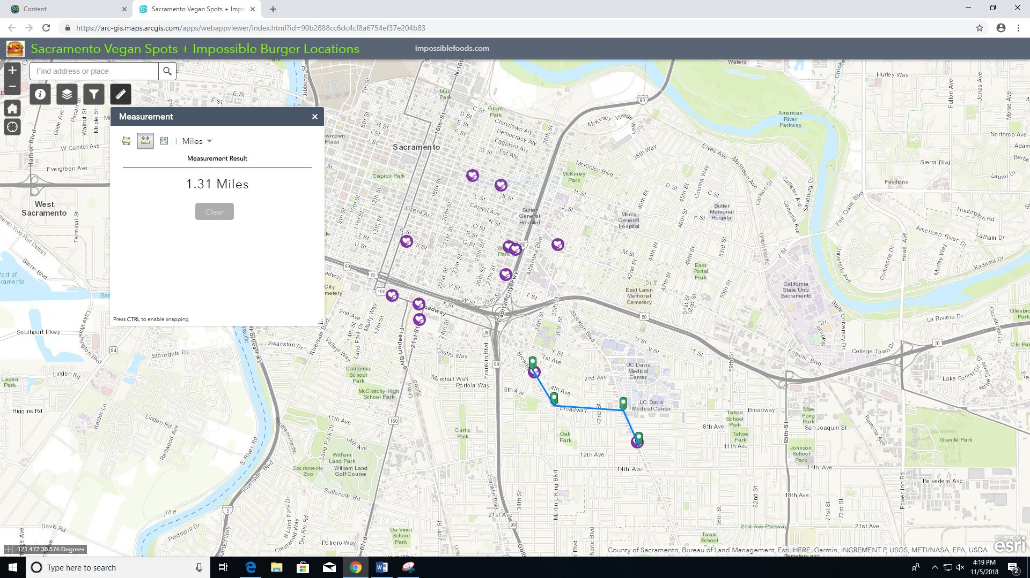
Measure Widget
Create a customized distance to a restaurant using the Measure widget in case the user is a local and prefers alternate routes
Click on an intersection while creating a line to change directions
Helpful if the user has friends or family visiting downtown Sacramento who have limited time, and they want to budget their time together

Slide 10
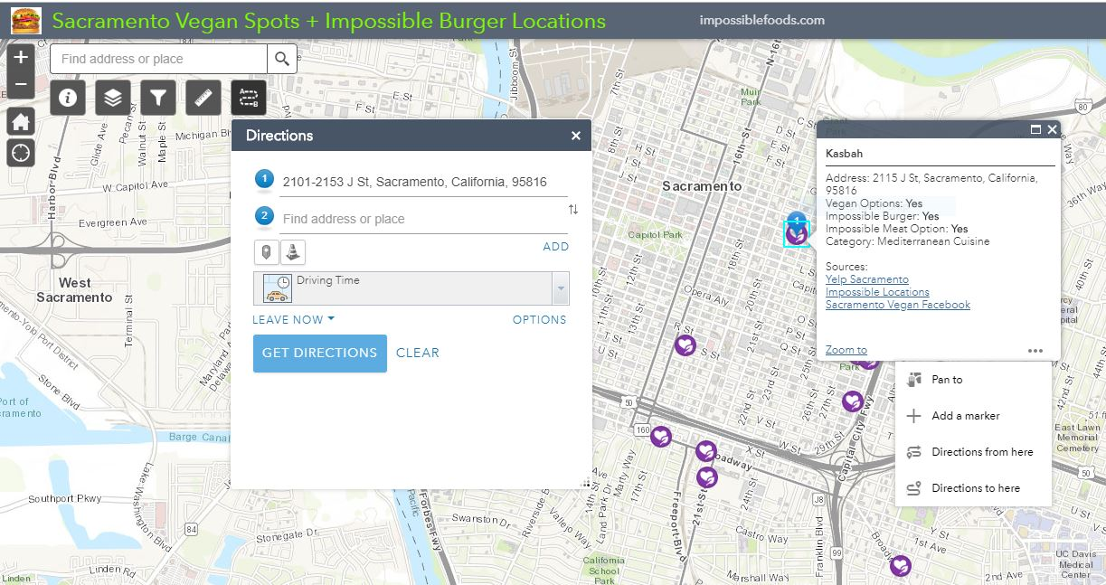
Directions
From Here
Directions widget allows users to create a route based on a current location or selected feature
Pop Ups also offer a quick way to get directions by selecting the ellipse, and choosing “Directions from here”

Slide 11
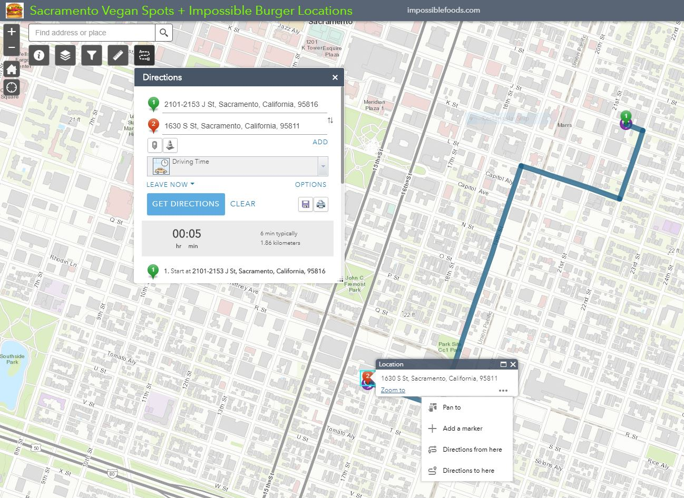
Directions
To Here
Allows users to create a route to a location from original selected location
Pop Ups also offer a quick way to apply a destination into the Directions widget
Either method works but some may prefer the Pop Ups method instead of opening the Directions Widget

Slide 12
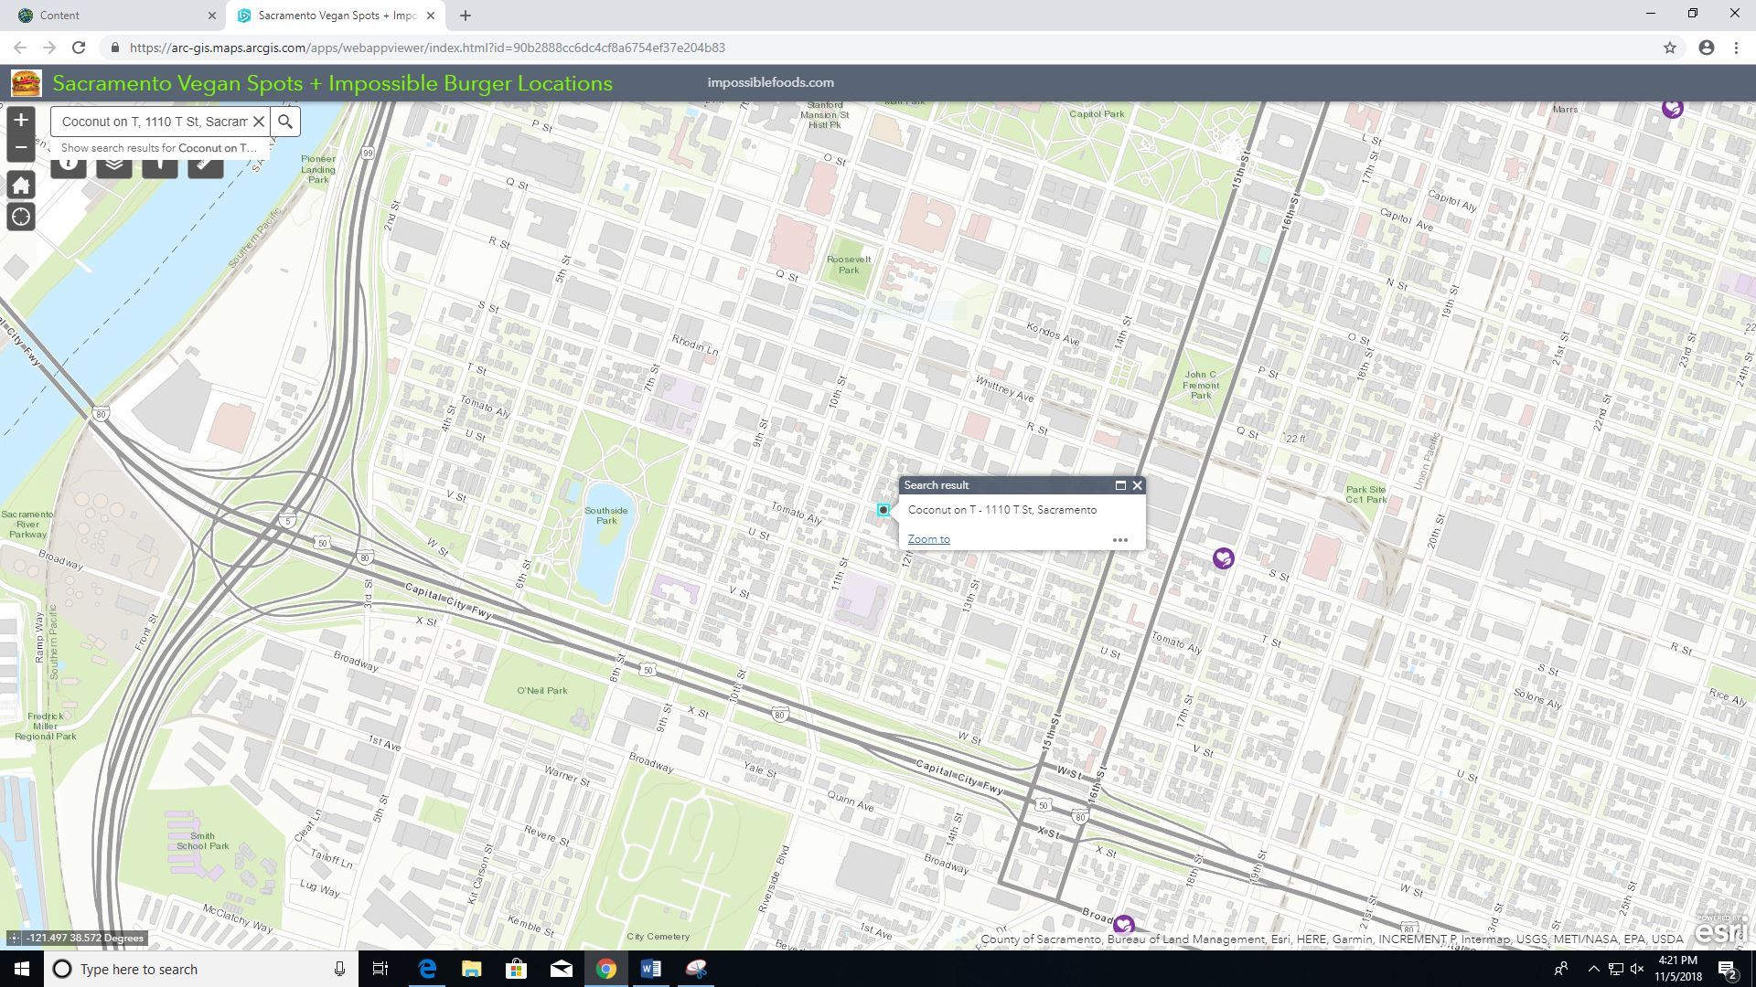
Search Option
Search option is available if a user wants to search for a specific restaurant or address, instead of the collection of restaurants available
However, the search result will not list vegan options in the attributes of that address, unless it is one of the restaurants from the collection provided
The slide shows a searched restaurant in downtown Sacramento that is known to have vegan options, however it was not part of the original survey

Slide 13
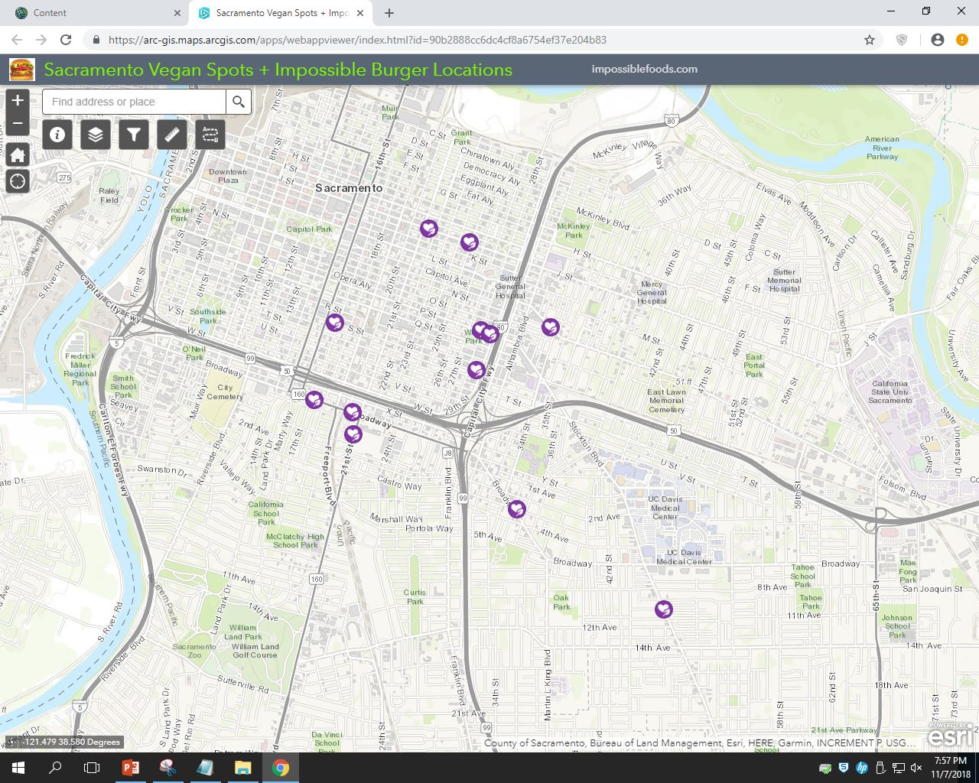
Objective
Create web map application intended for specific target market demographics = Vegans or “Impossible Burger enthusiasts”, ages 18-65, living or visiting near downtown Sacramento
Differentiate application to offer “word of mouth” recommended restaurants from social media instead of only Yelp or other services
Provide a filter option to determine which restaurants offer what type of vegan options
Consider city restrictions that influence recreation, such as parking limitations surrounding vegan restaurants

