Slide 1
HYDRANT MAINTENANCE IN AMERICAN CANYON FIRE PROTECTION DISTRICT
James Bryant’s Final Project for Geography 385

Slide 2
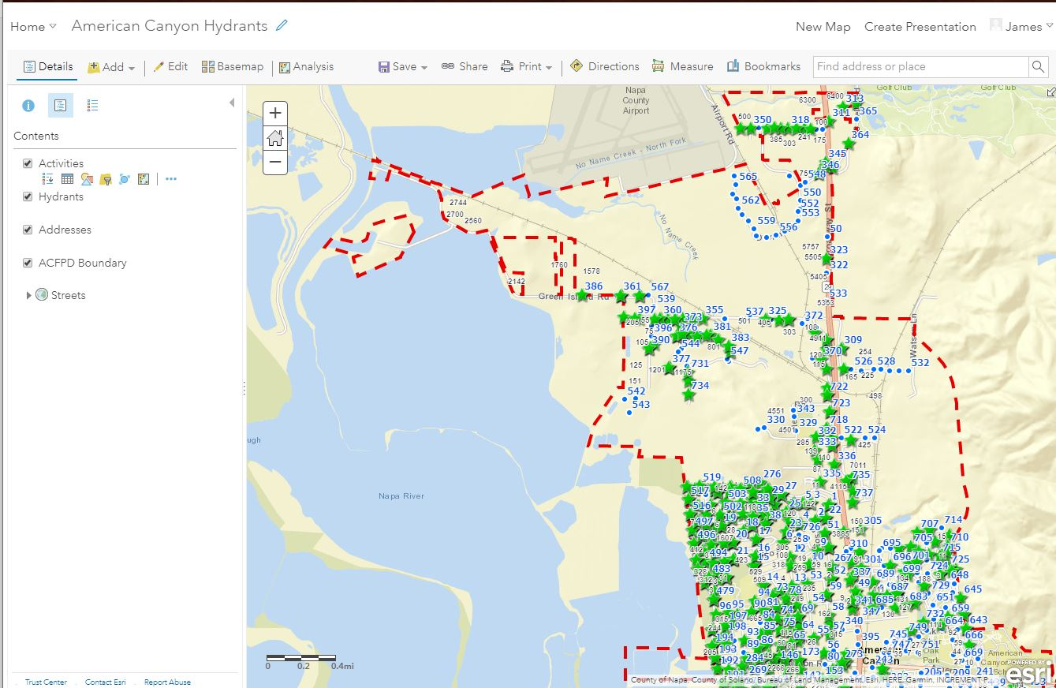
Web Map for American Canyon Hydrants

Slide 3
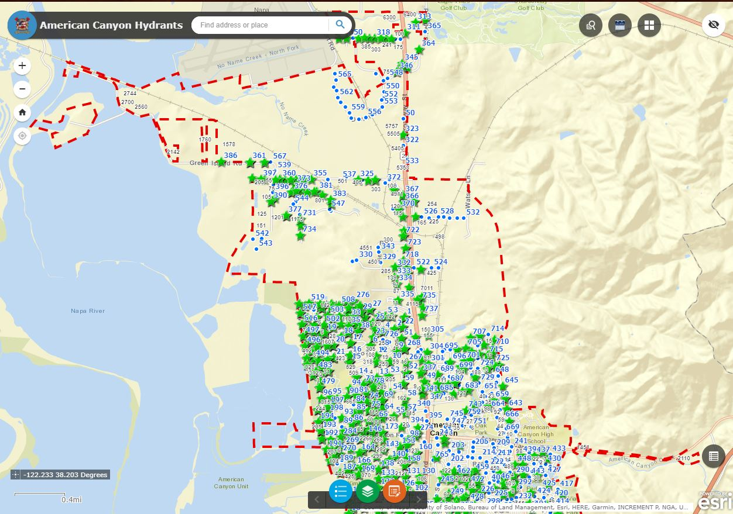
Web Application for American Canyon Hydrants

Slide 4
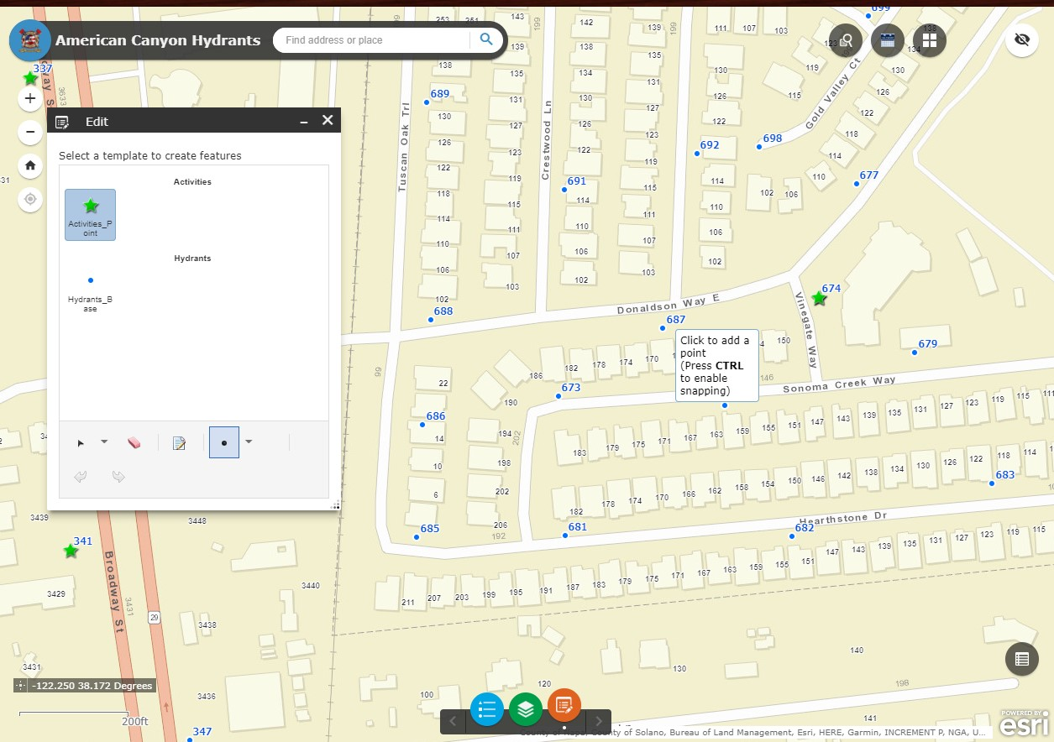
Editing in Web Application

Slide 5
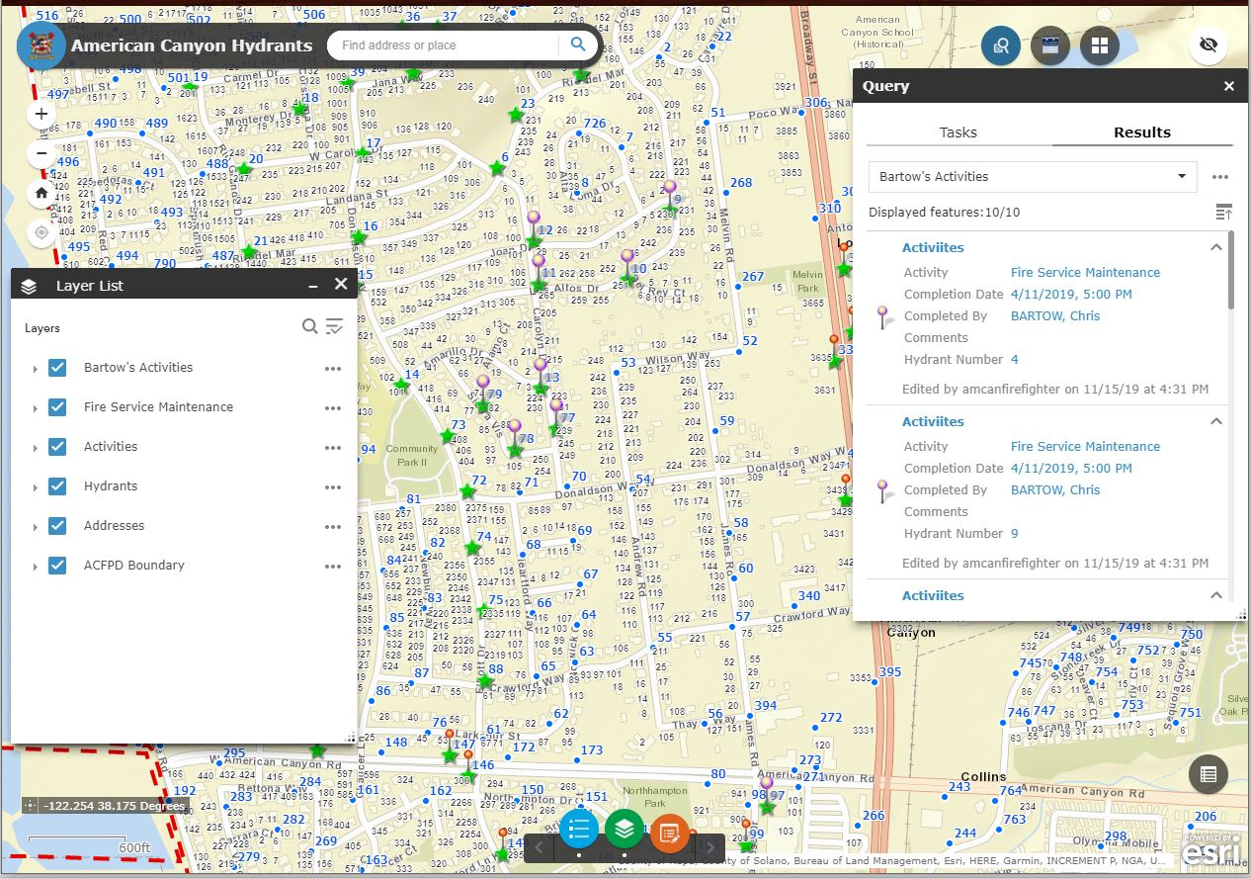
Querying Using the Web App

Slide 6
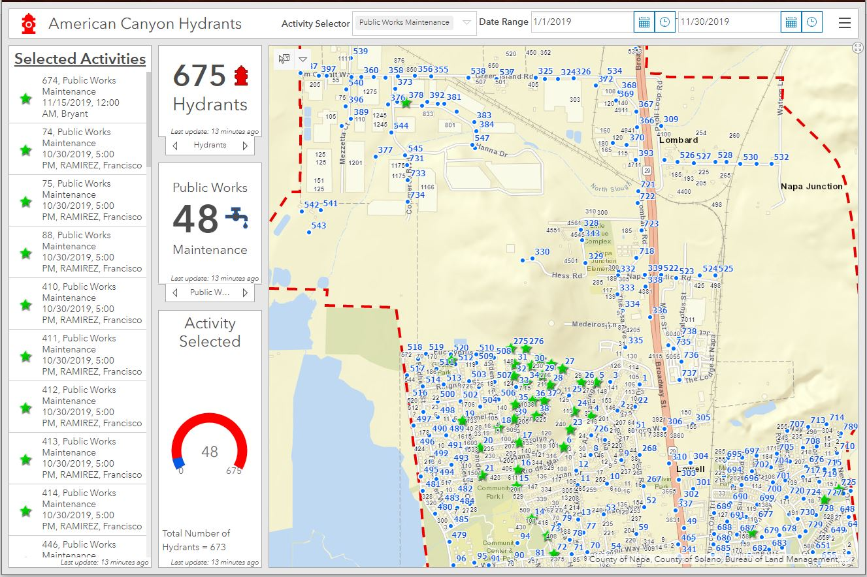
Web Dashboard for American Canyon Hydrants

Slide 7
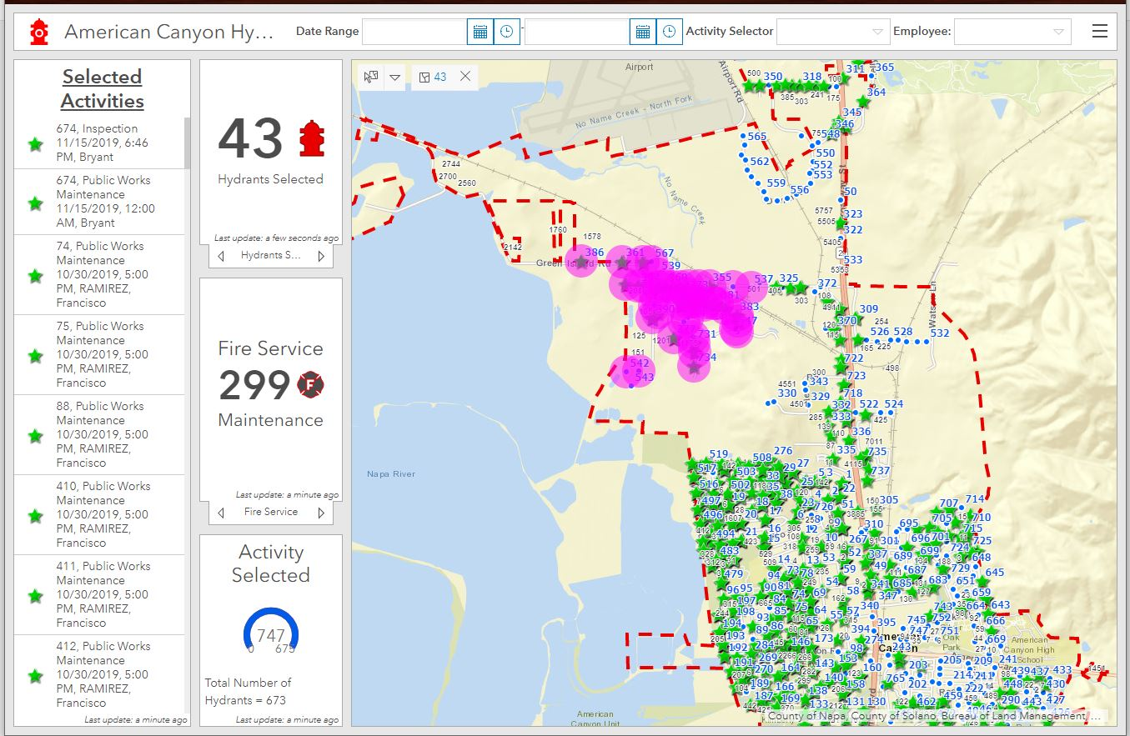
Map Selector Tool in the Dashboard

Slide 8
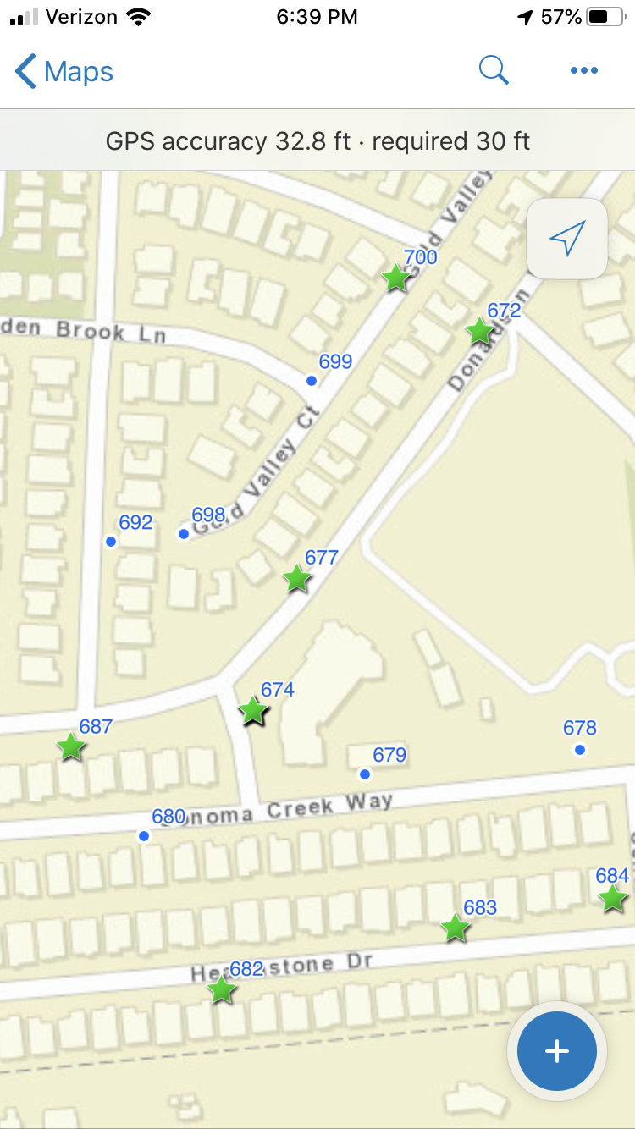
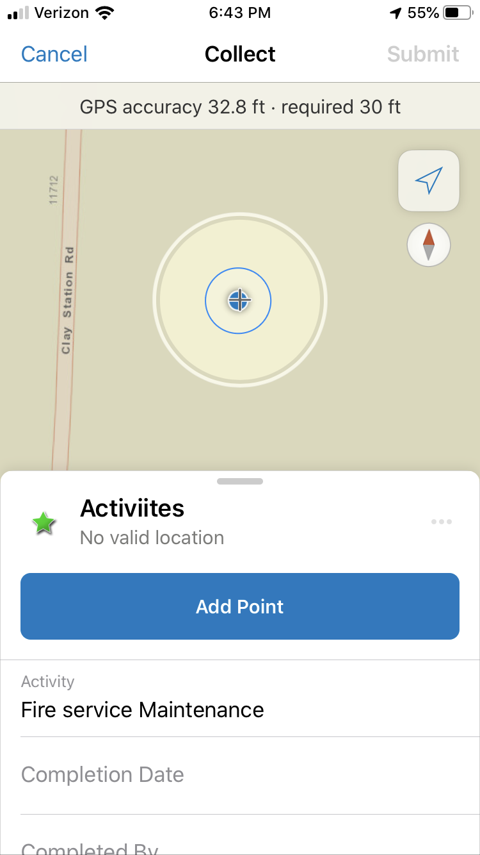
Collector Application

