Slide 1
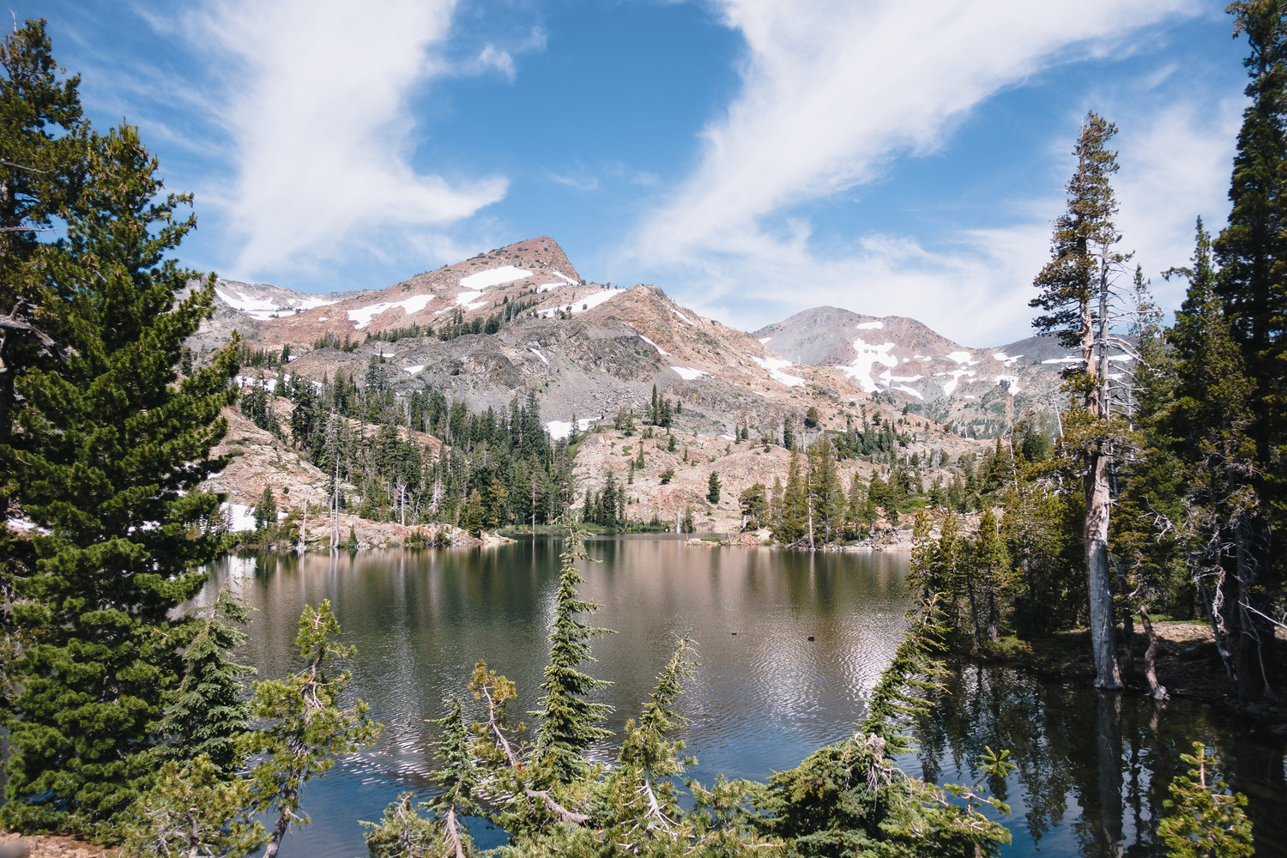
Desolation Wilderness MAp
GEOG-90

Slide 2
Project Summary
This project covers and highlights an area of land totalling approximately 63,960-acres referred to as the Desolation Wilderness. This area of land is federally protected and is located in the South Lake Tahoe Basin of the El Dorado National Forest. The Desolation Wilderness has long been a site for outdoor recreation activities such as backpacking and hiking. In this project, popular hiking trails and camping spots have been noted along with trailhead access points and frequented mountains.

Slide 3
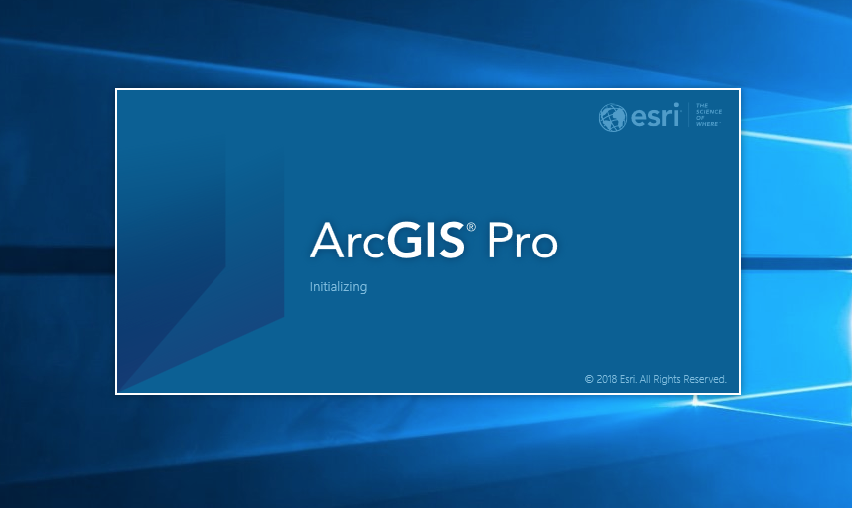
Starting off...

Slide 4
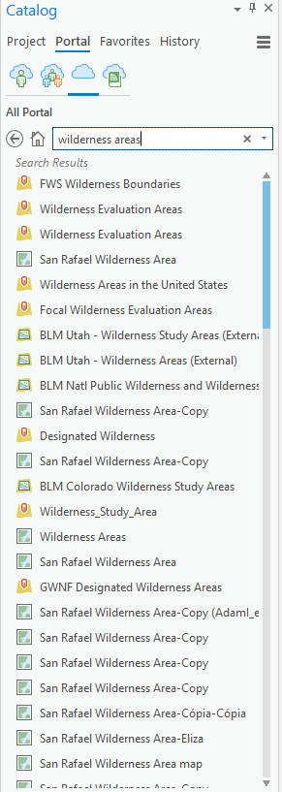
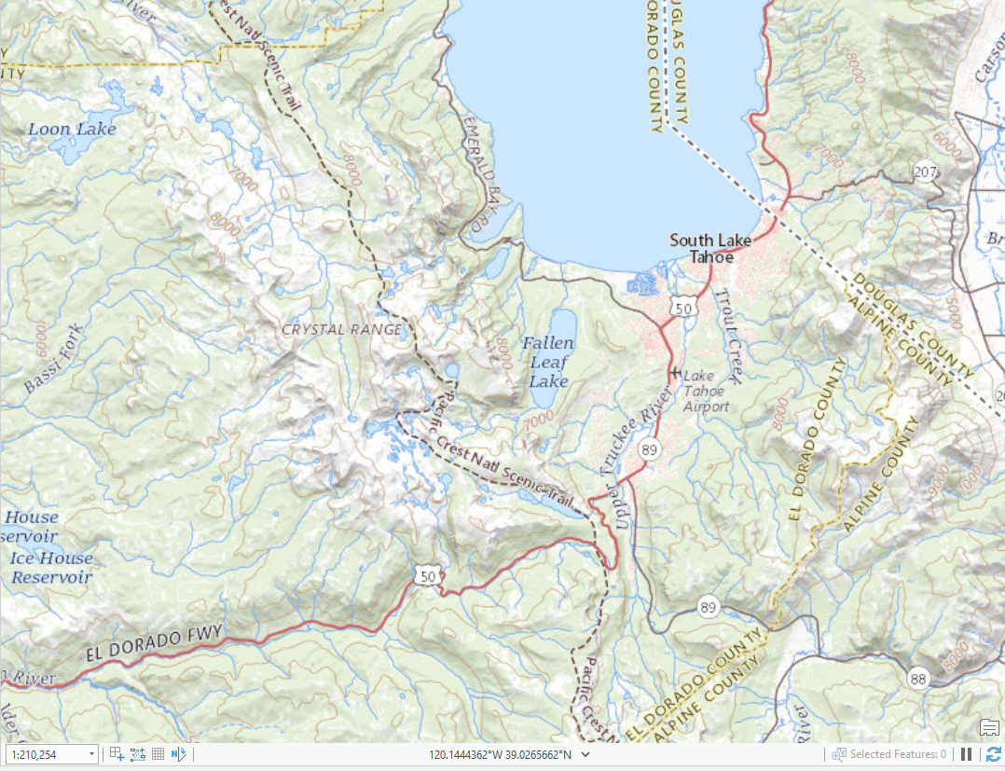
Creation of the Wilderness Area Boundary

Slide 5
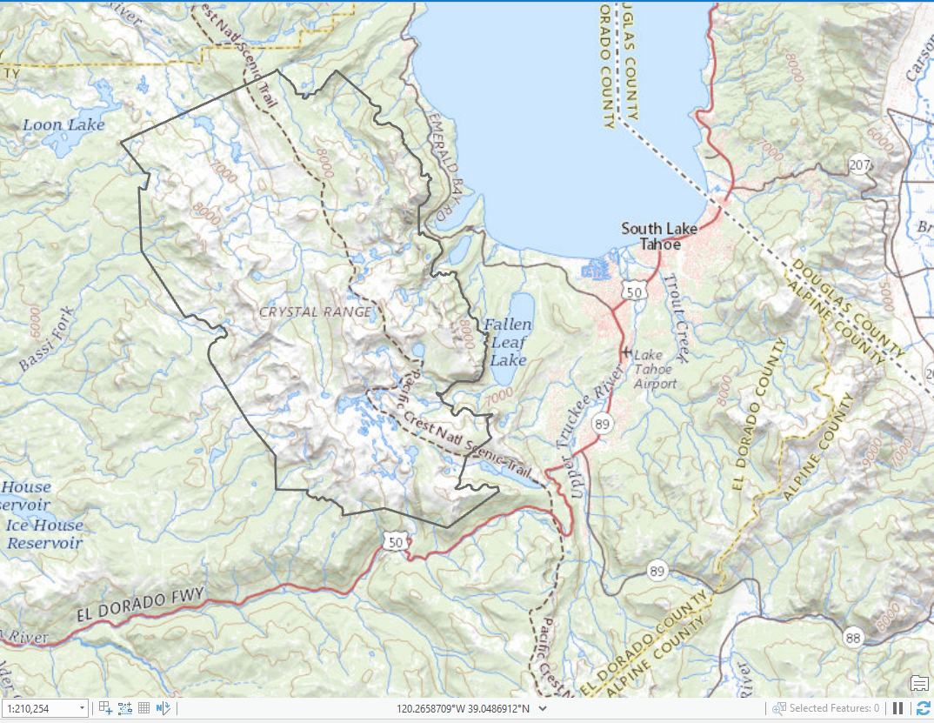

Slide 6
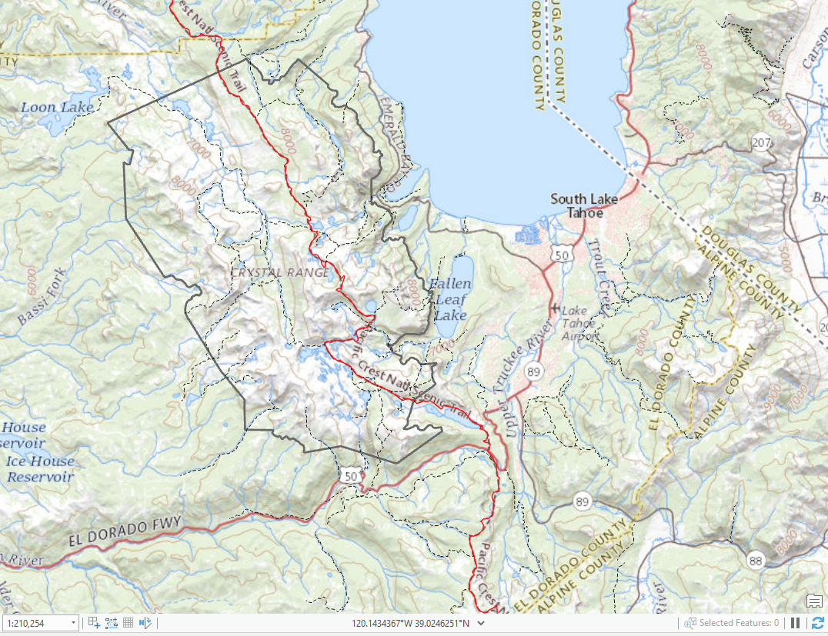
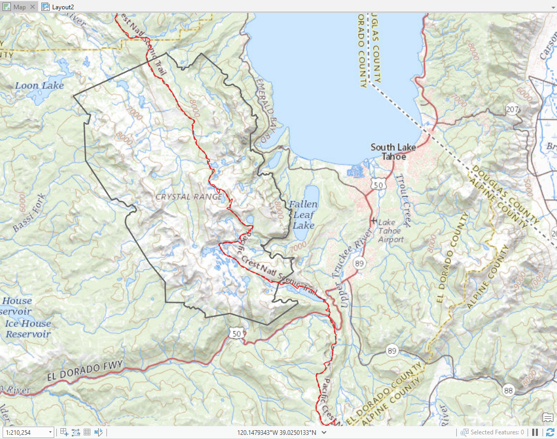
Adding Trail Data

Slide 7
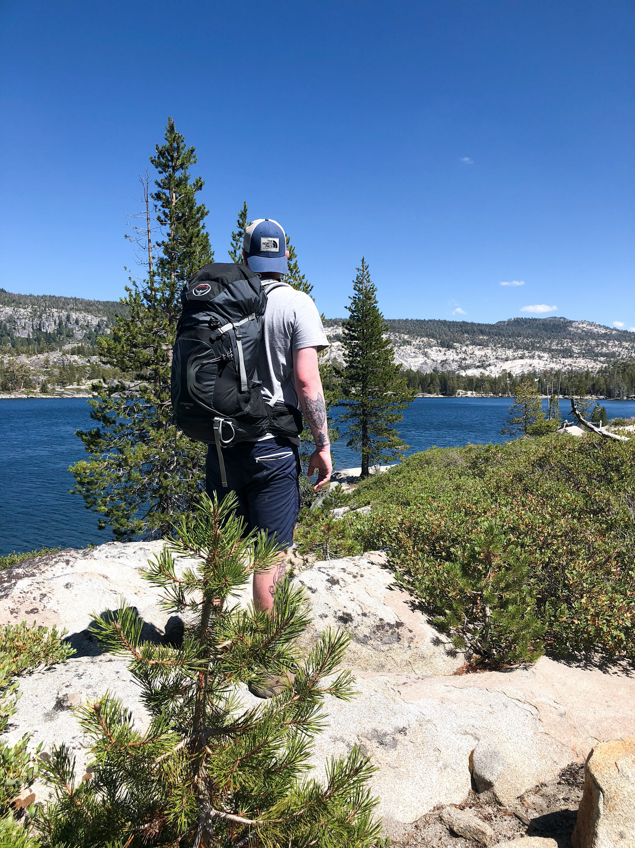
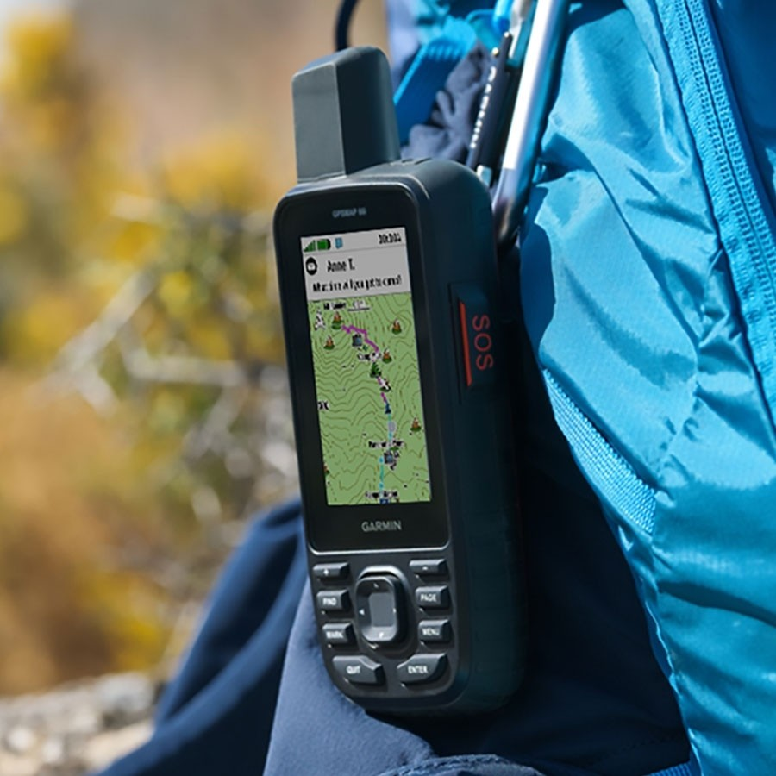
Waypoint Creation

Slide 8
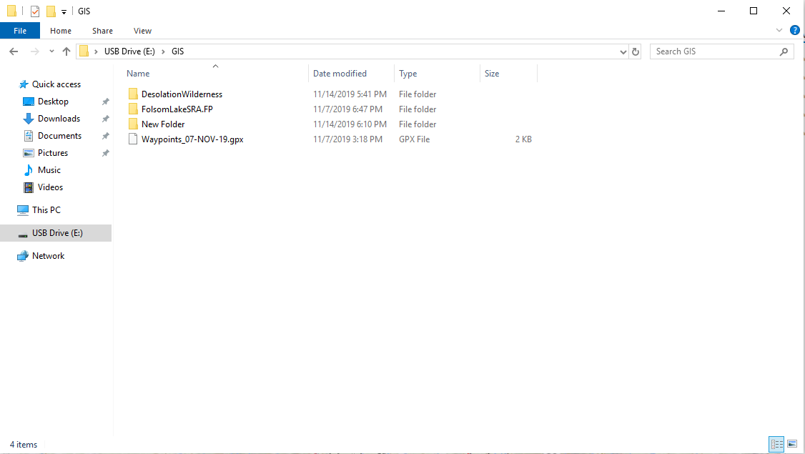

Slide 9
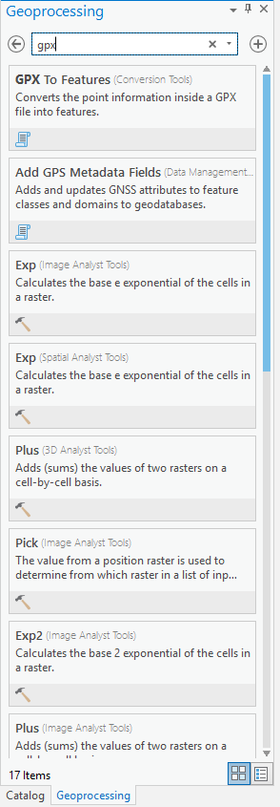
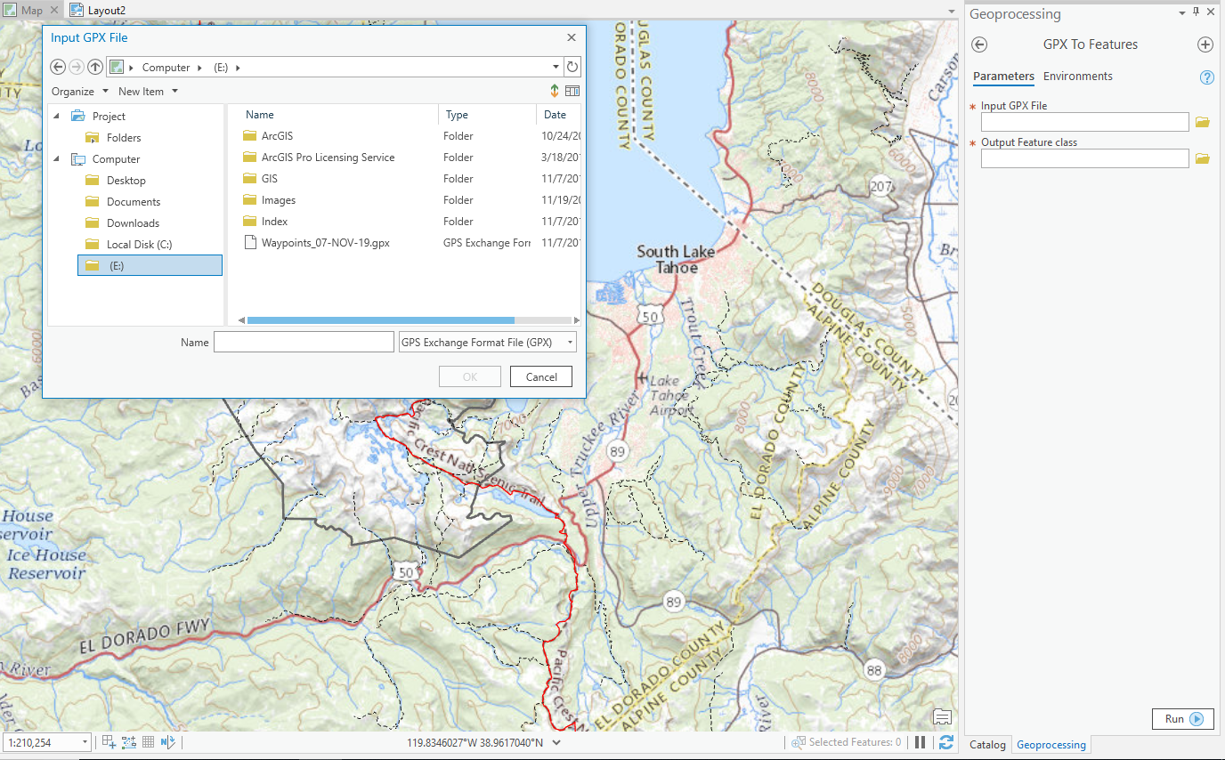

Slide 10
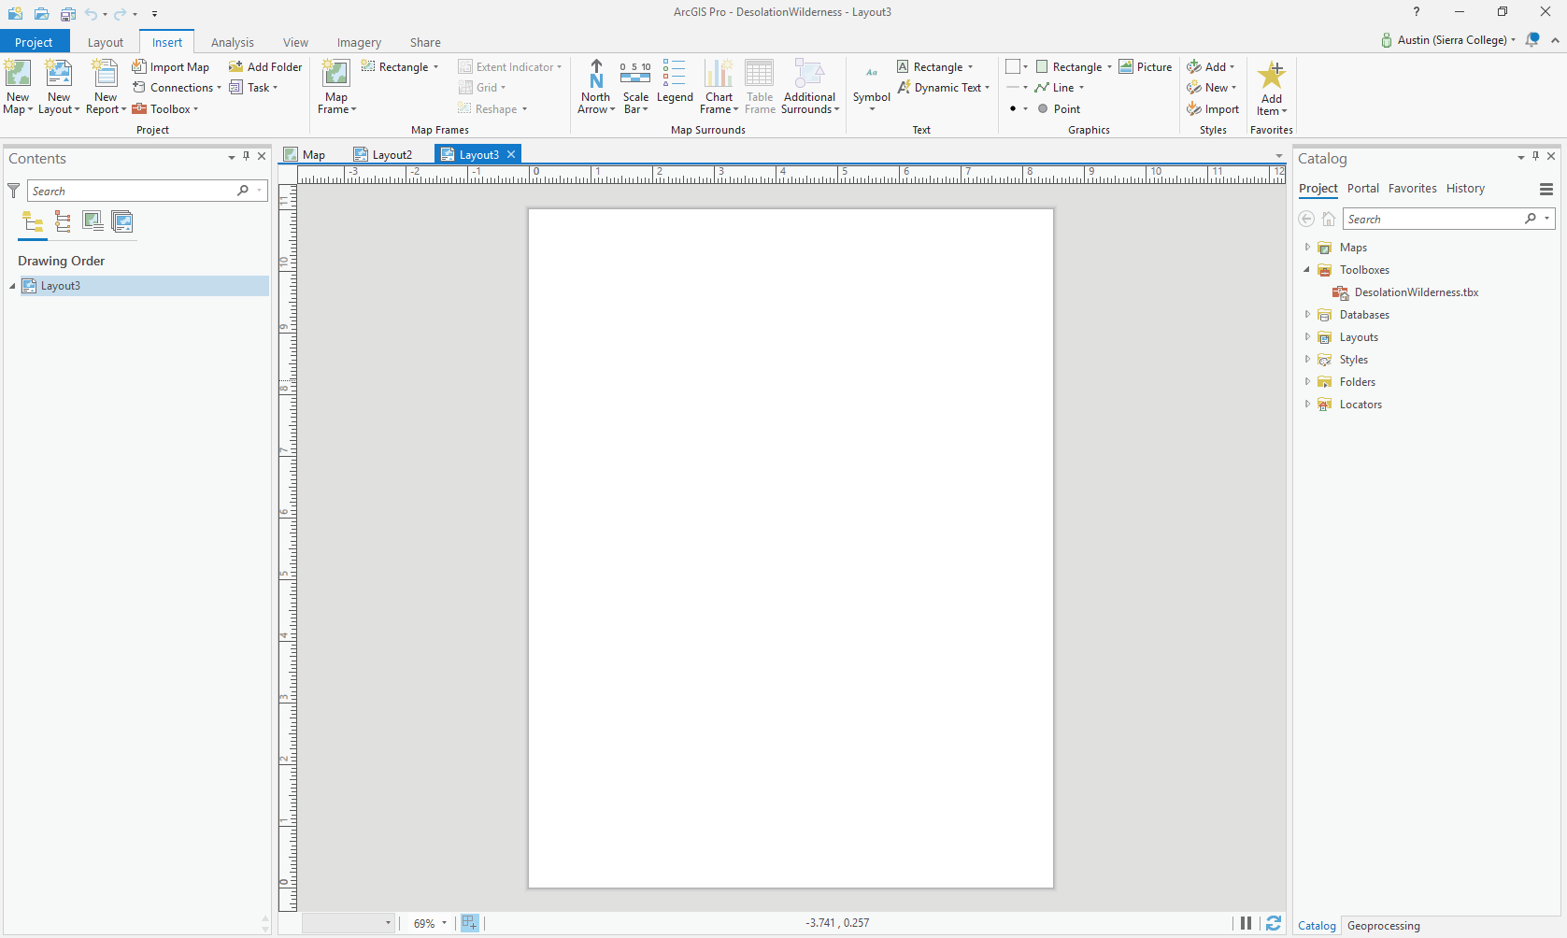

Slide 11
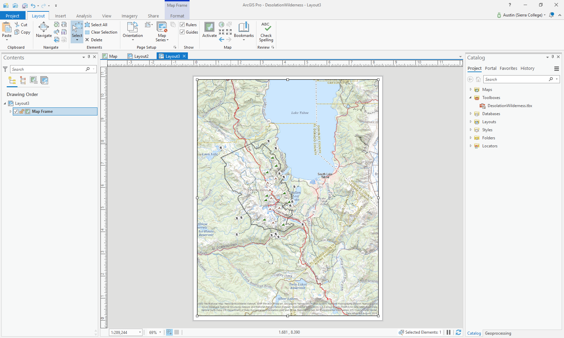

Slide 12
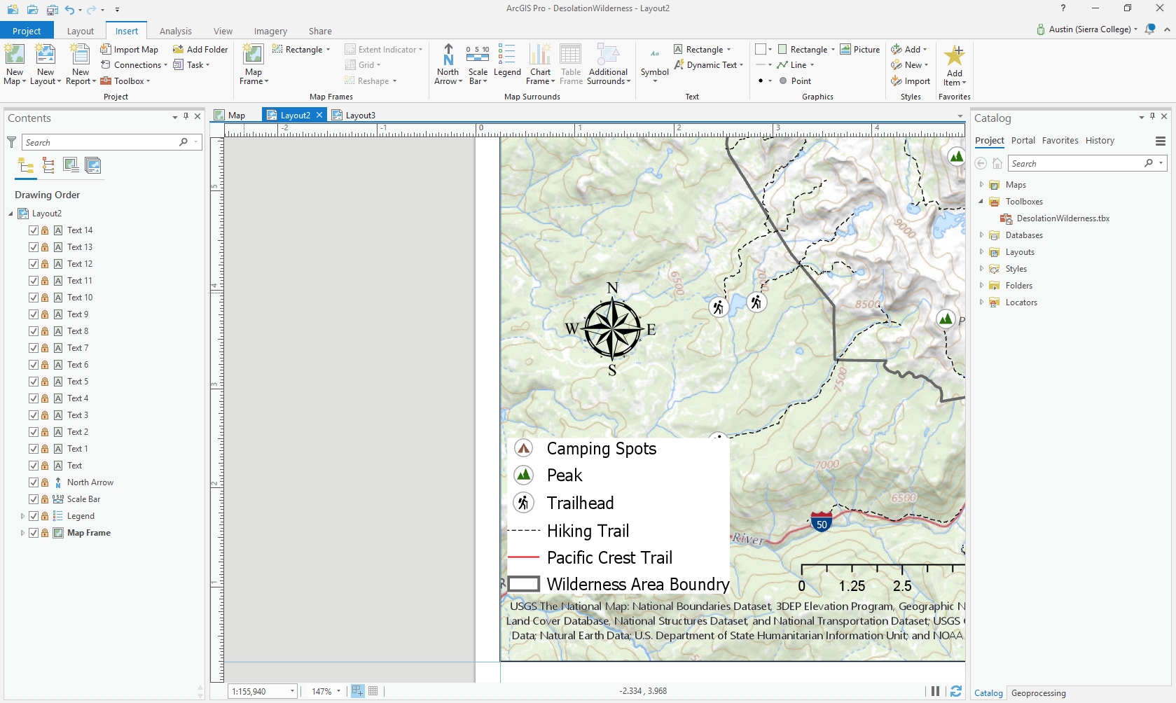

Slide 13
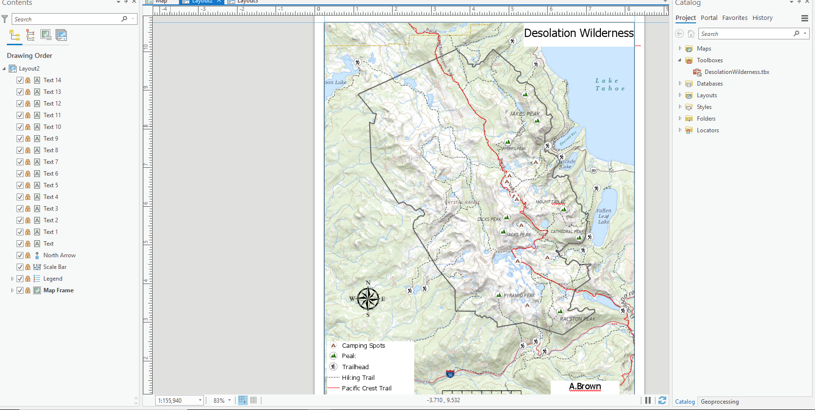

Slide 14
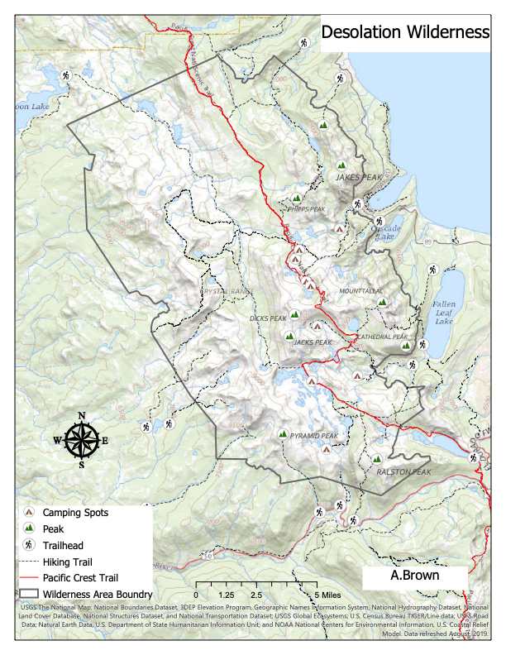
Final Map

