Slide 1
Geo 90 Arc GIS
Final Project
Presenter:
Michael Booth

Slide 2
Project Title:
Kayaking on the American River

Slide 3
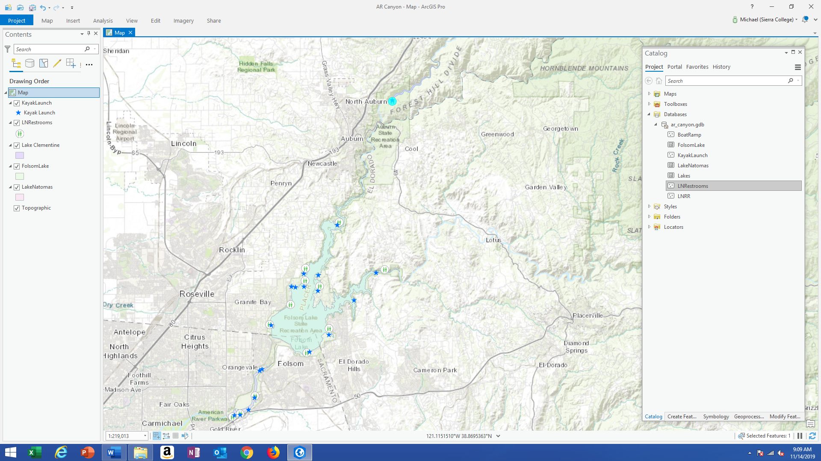
The Map

Slide 4
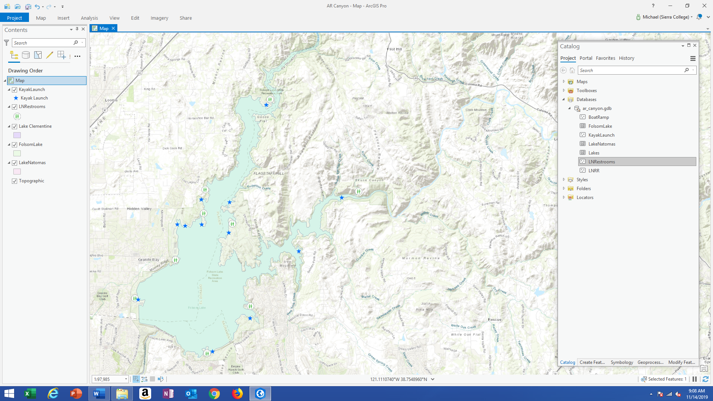
Creating Feature Classes

Slide 5
Creating Polygons
Folsom Lake Polygon

Slide 6
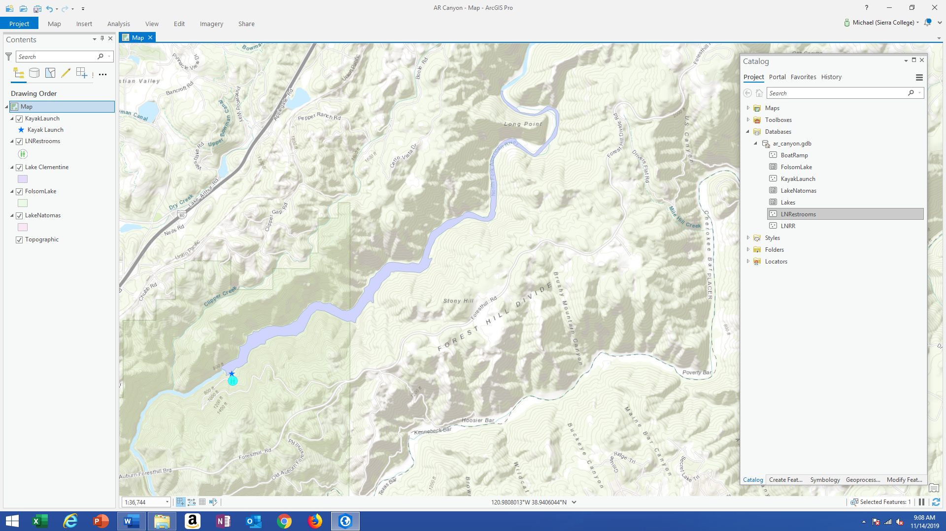
Lake Clementine Polygon

Slide 7
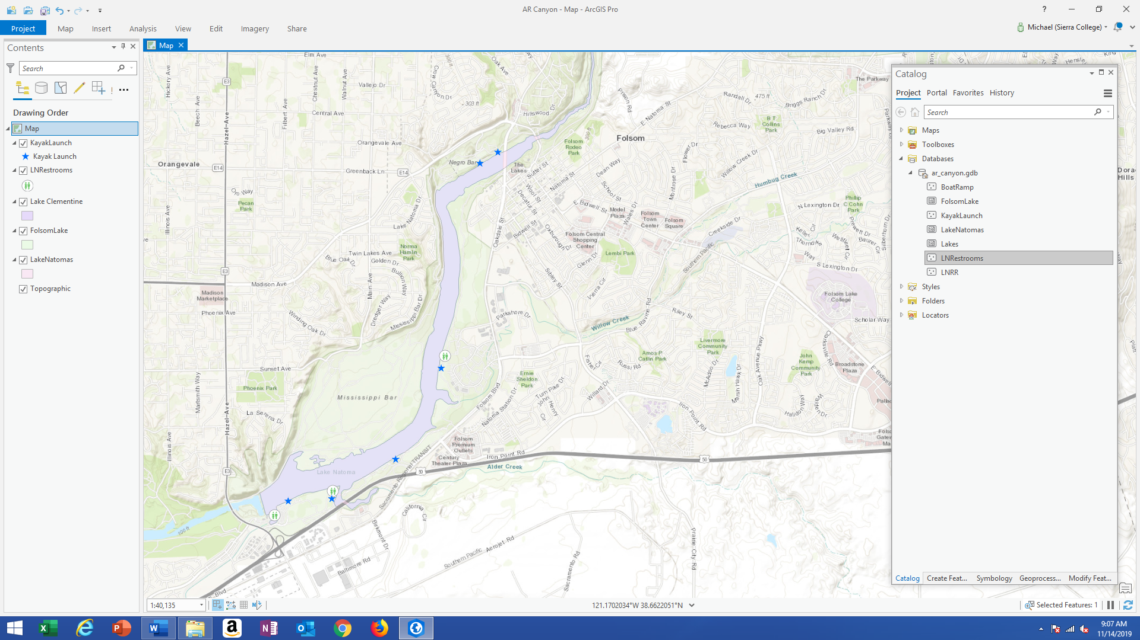
Lake Natomas Polygon

Slide 8
Create Kayak Launch Points
Blue Star Icons

Slide 9
Create Rest Rooms Points
Rest Room Icons

Slide 10
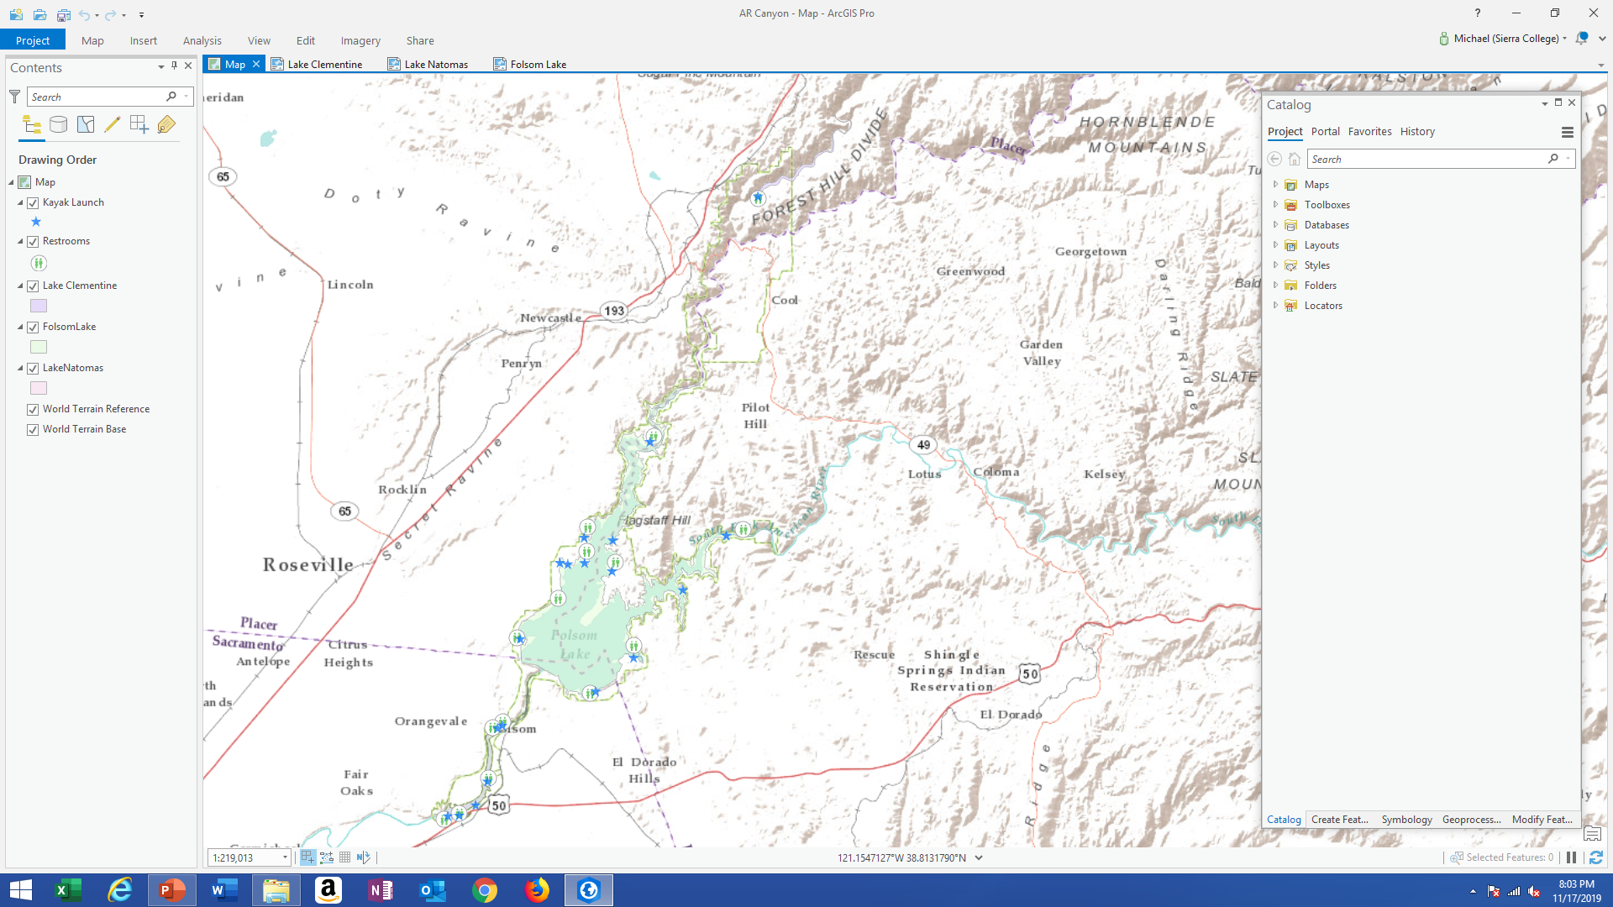
Final Map

Slide 11
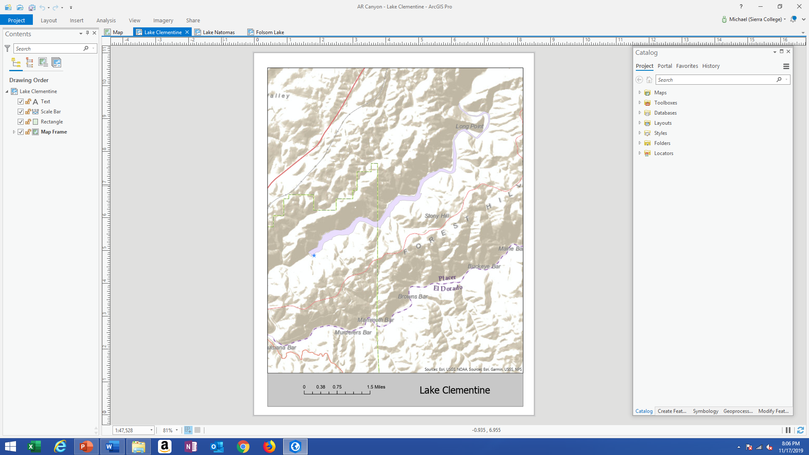
Lake Clementine Layout View

Slide 12
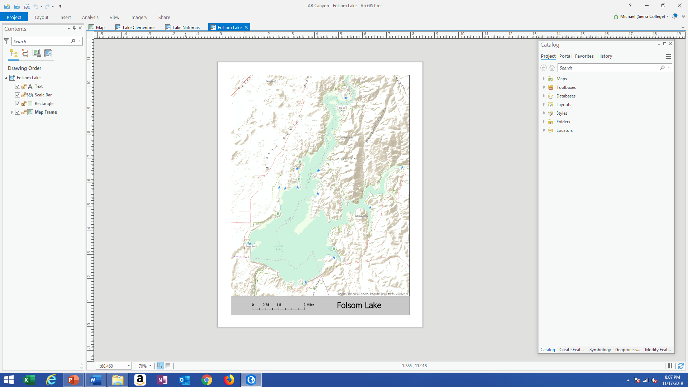
Folsom Lake Layout View

Slide 13
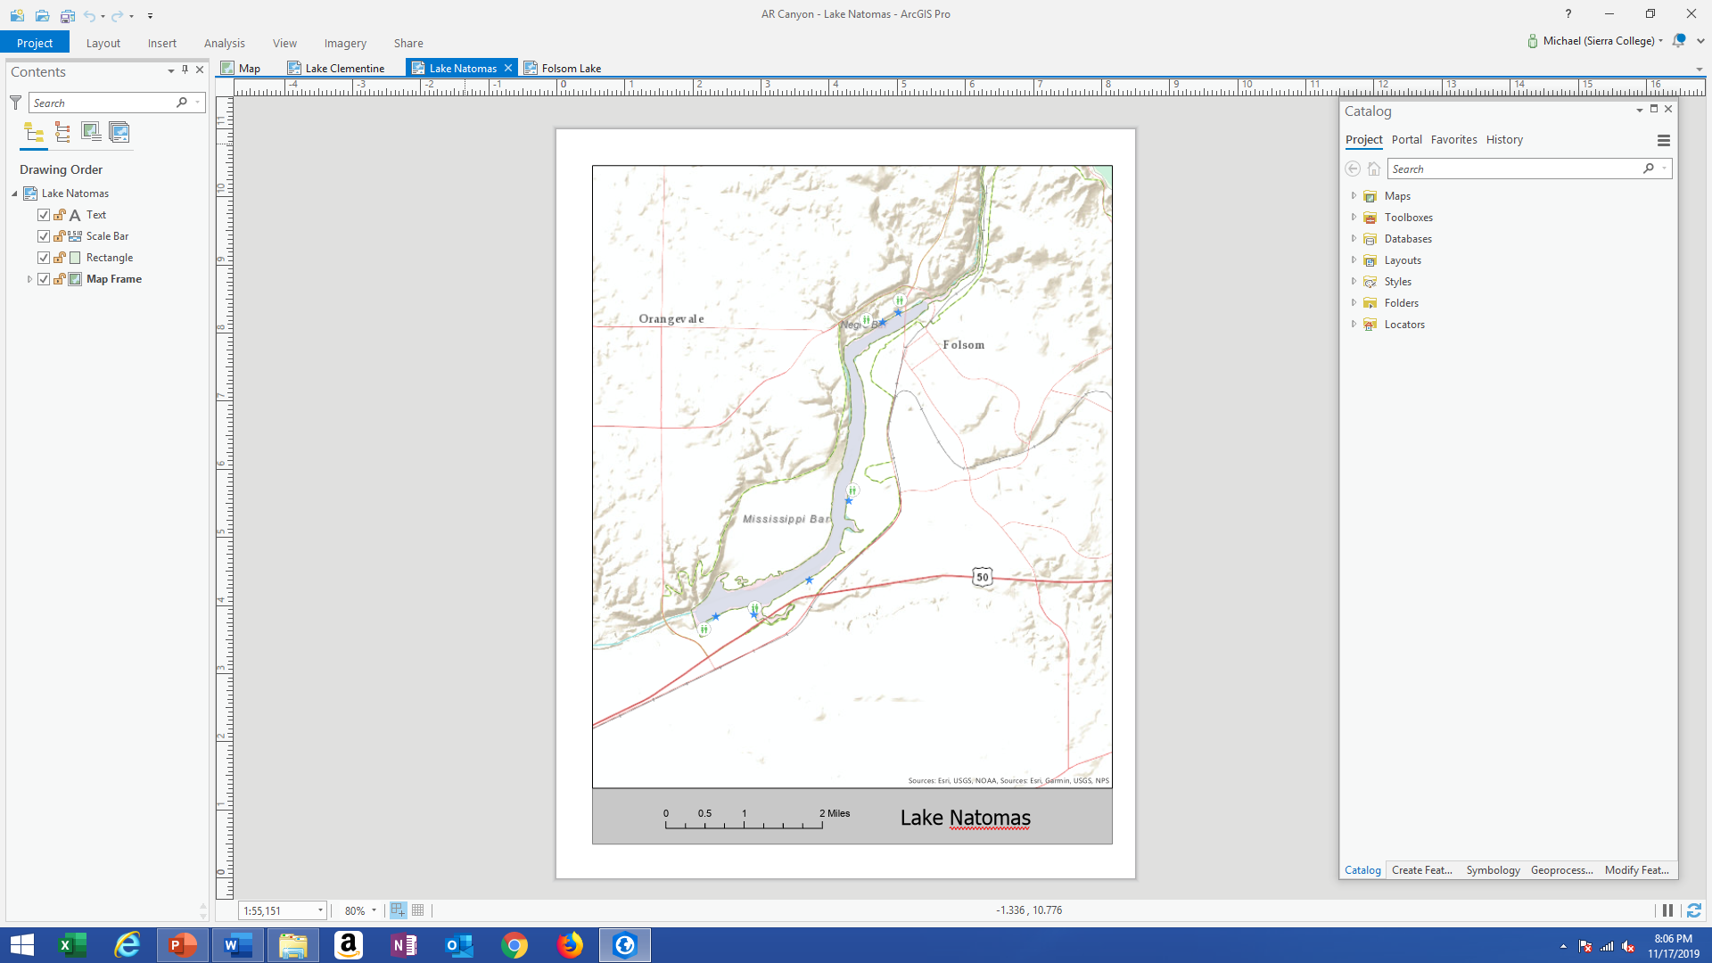
Lake Natomas Layout View

Slide 14
Thank You

