Slide 1
Pacific Crest Trail Permits Map
GEOG 385 Final Project
Cassidy Barkalow

Slide 2
Background
I work for the Pacific Crest Trail Association, and one of my primary responsibilities is answering questions about the trail.
People often wonder whether they’ll need a permit for their trip and have no easy way to find out.
People also want to know what map they’ll need, and official product descriptions are often difficult to find or reference place names that non-locals are not familiar with.
There is no existing map or service online that I know of which has this information at all, and there isn’t even a list that presents it in a simple, easy-to-understand format.

Slide 3
Objectives
The map should show the Pacific Crest Trail and all the major land management agency boundaries it passes through, as well as designated Wildernesses
Major landmarks and towns along the PCT that are familiar to trail users should be shown to help users navigate the map.
Each land management agency and Wilderness area should have information about whether permits are required and links to the website where they can be obtained.
Each segment of the PCT should include information about which map covers it in various map sets.
Users should be able to apply a filter to only see places where no permits are required.

Slide 4
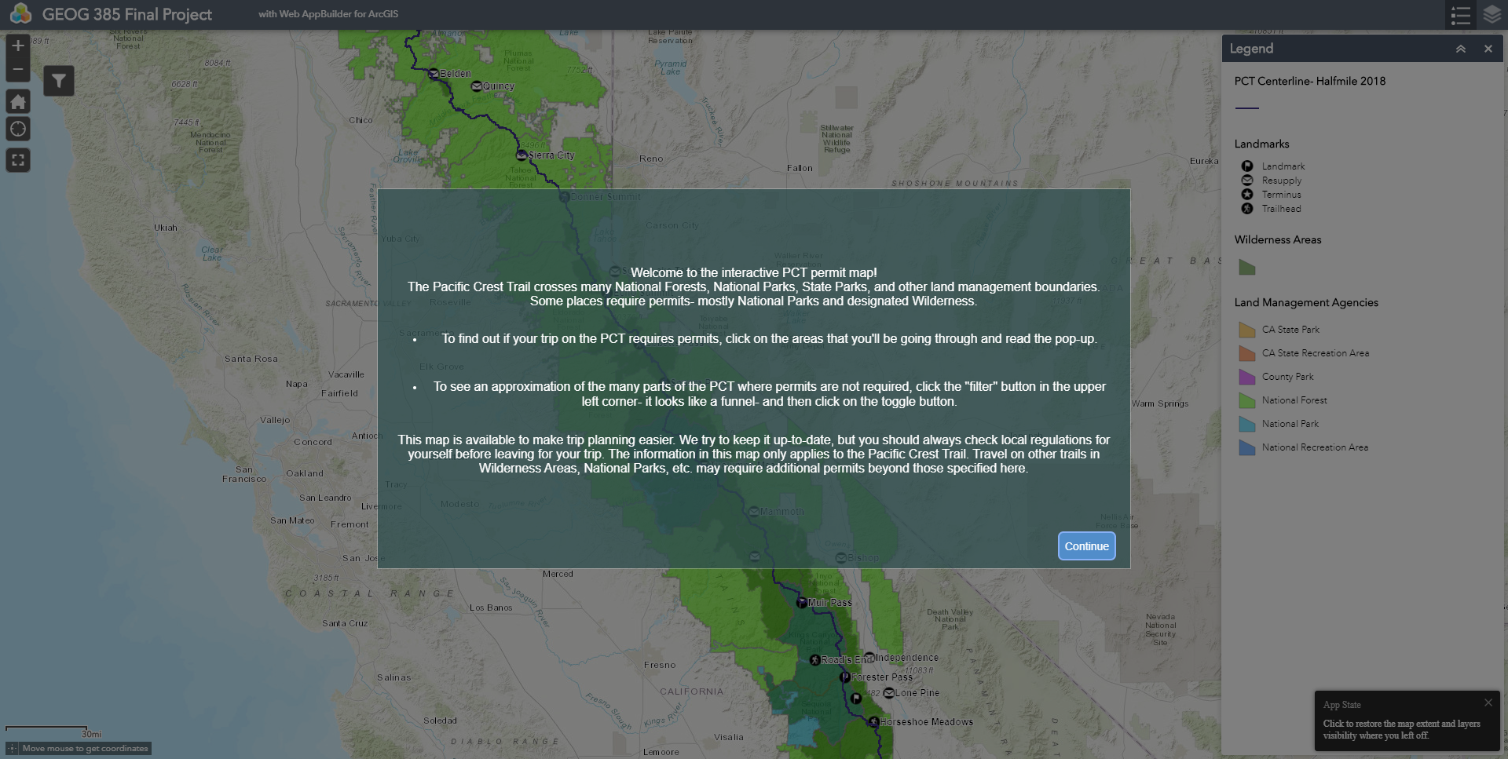
A splash screen welcomes users to the web app and provides basic directions.
The splash screen also warns that information presented here may not be definitive and that trail users should check with local land management agencies for local regulations before beginning their trip.
The legend is open by default to help users understand the layers more easily.

Slide 5
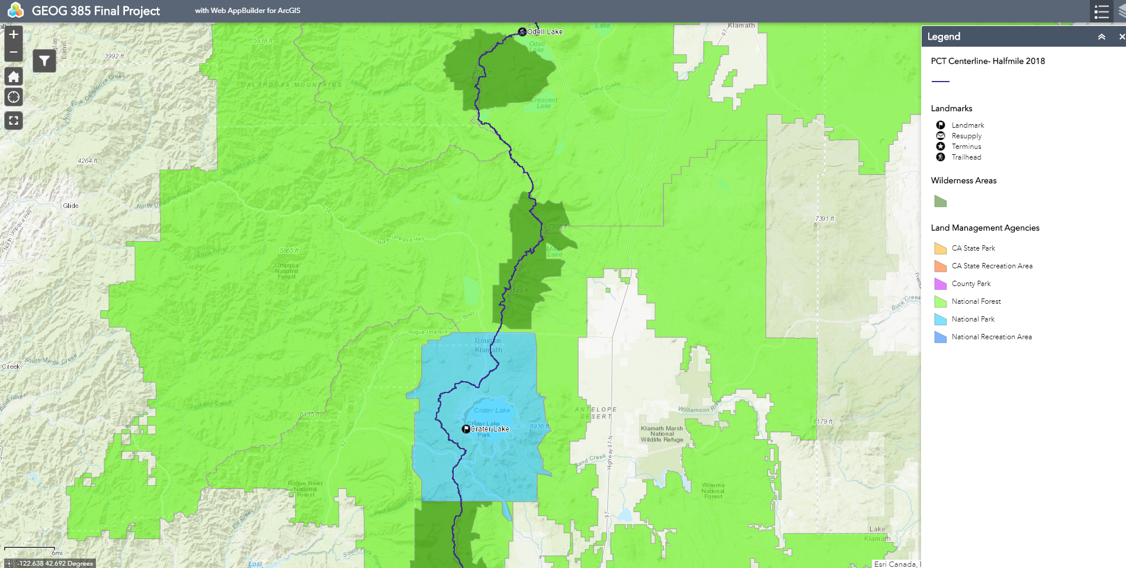
Each kind of land management agency is a distinct color, and Wilderness areas are easily visible where they overlap.

Slide 6
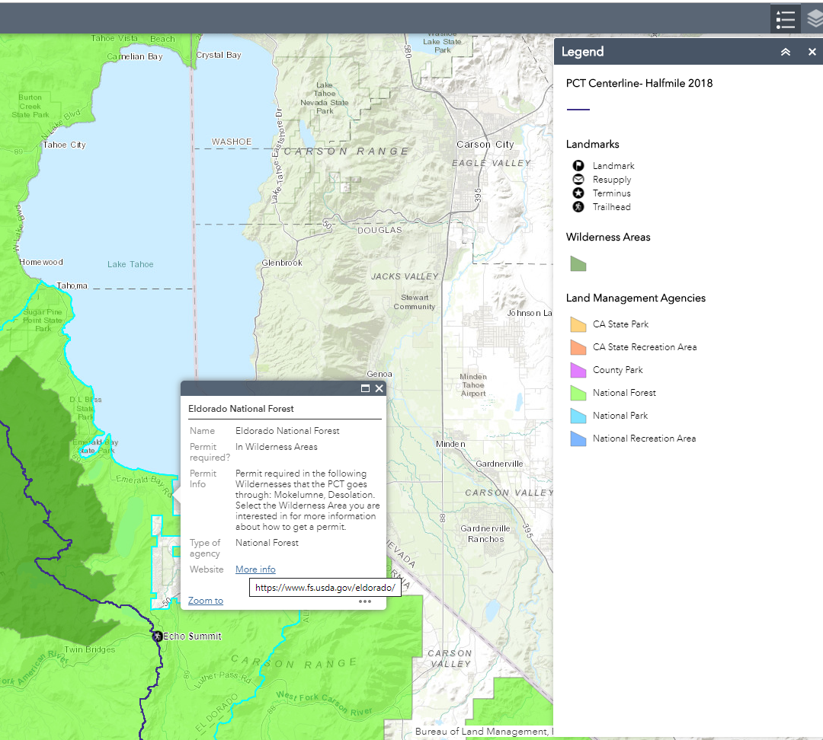
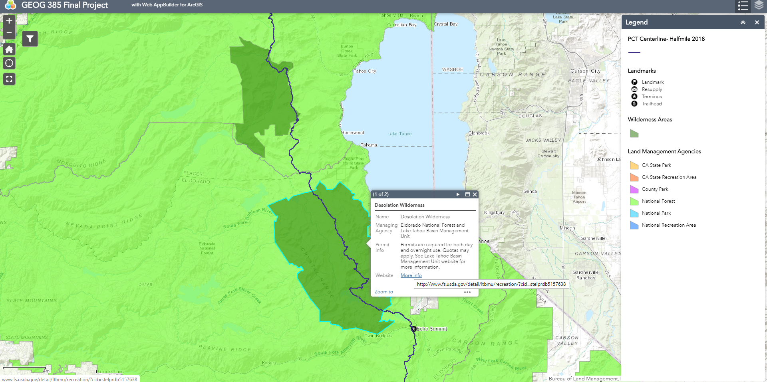
Selecting a national forest or a wilderness area brings up information about permit requirements and links to relevant websites.

Slide 7
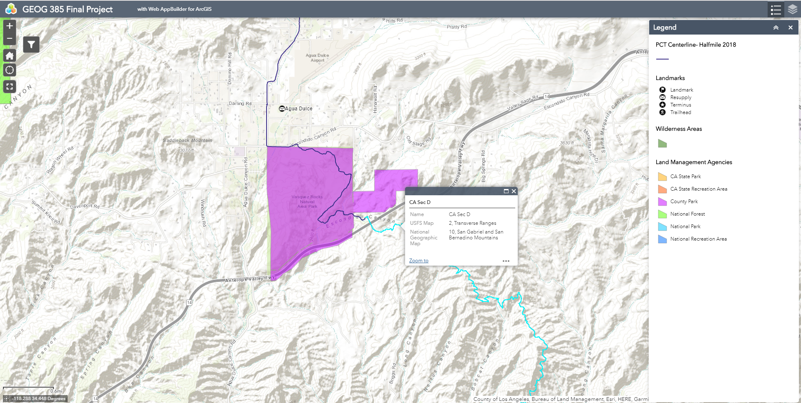
Selecting the PCT itself brings up information about which map of the PCT covers that area. California Section D is on the US Forest Service’s PCT Map 2, for the Transverse Ranges, and it is also on National Geographic’s Map 10 for the San Gabriel and San Bernadino Mountains. Note that both map sets use place names that are likely not familiar to anyone who isn’t a local- this is a real problem for people who want to buy the right map before their trip.

Slide 8
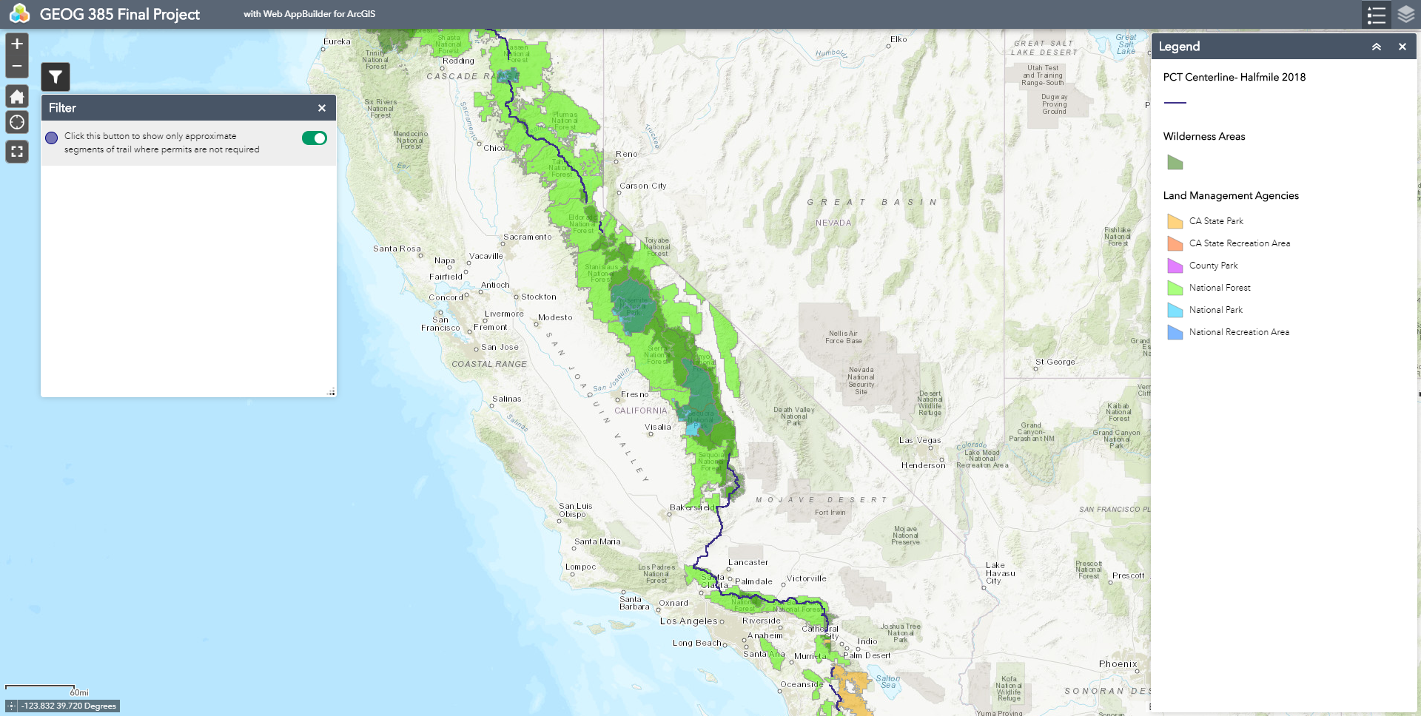
Turning on the filter shows only sections of the PCT where permits are not needed. This is admittedly imperfect because of the odd fragmentation of existing PCT centerline layers. With more knowledge about how to create or manipulate data, it would surely be possible to get a closer representation than this approximation.
Regardless, this is a useful tool that gives users a rough idea of where they can plan a last-minute, no-hassle trip.

Slide 9
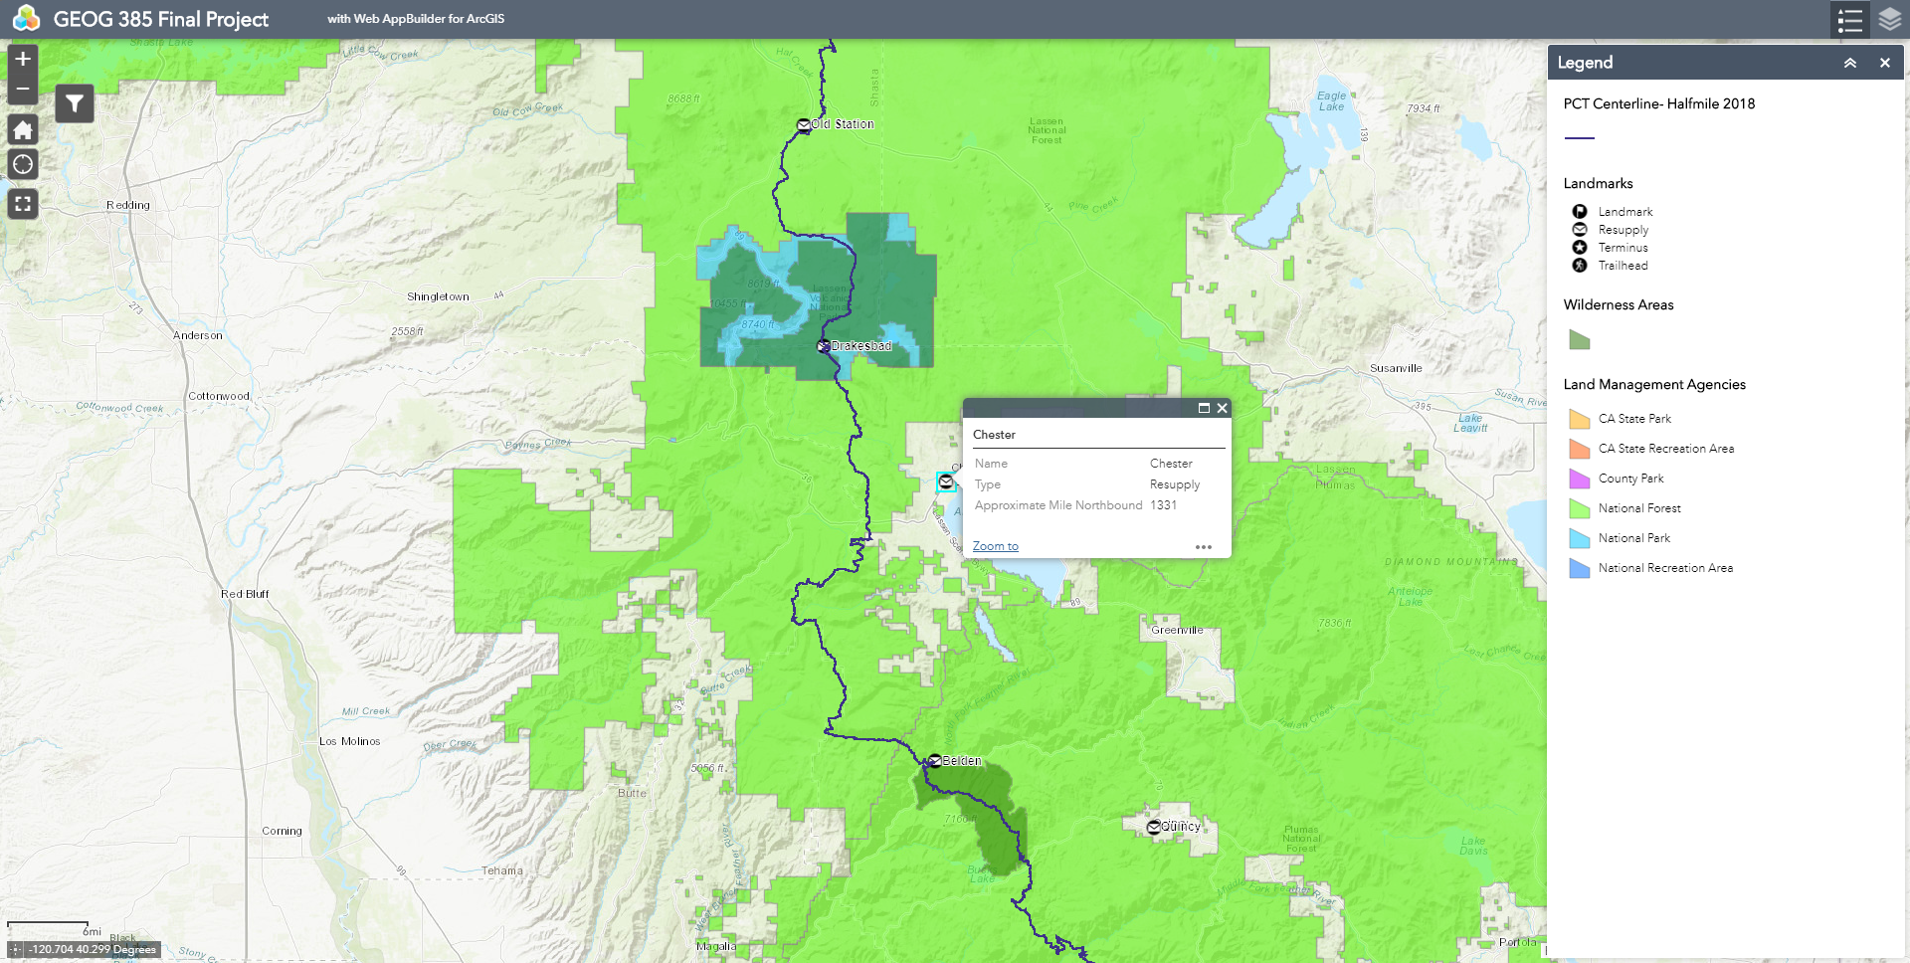
Bonus feature, with potential for a future project:
Each landmark is categorized by what it is and also notes the mile of the PCT it is at.
With further development and adding landmarks, this map could have further trip planning capabilities and be used as a resupply guide, helping users determine the length of their trip and what services they would have access to along the way.

