Slide 1
Utility Viewer
Former McClellan AFB

Slide 2
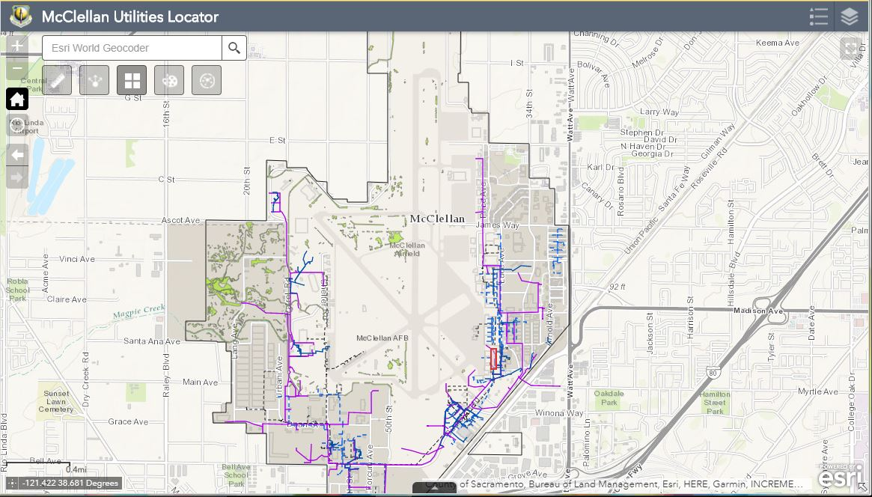
Web App Opening Page
Base map is a Street map for a clean view of McClellan
Primary utility layers visible
Logo and Title edited to reflect the application and use

Slide 3
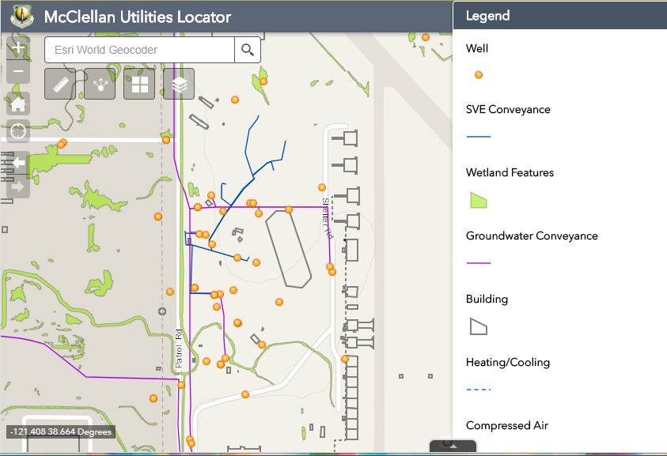
Mid-Zoom, Utility layers – Wells are turned-on
- Mid level zoom adds monitoring wells. There are many monitoring wells at McClellan and having them visible at small scales would obscure the map.

Slide 4
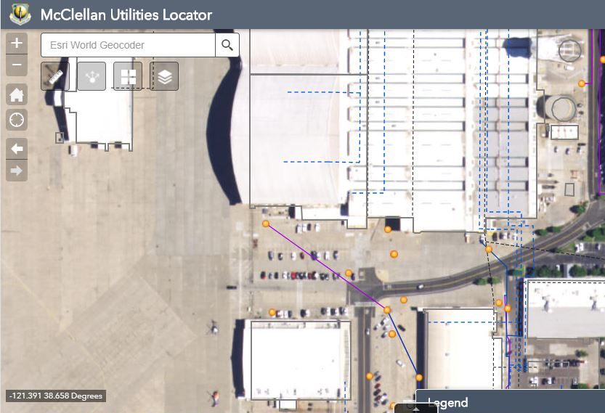
Street Level Zoom - Imagery turned-on
- At street level zoom magnification, satellite imagery is activated to show the user images of the areas of interest.

Slide 5
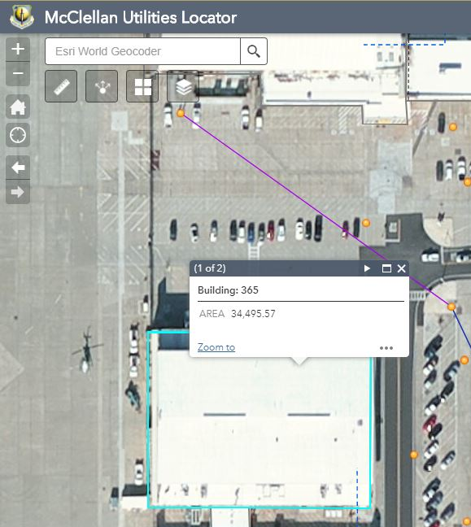
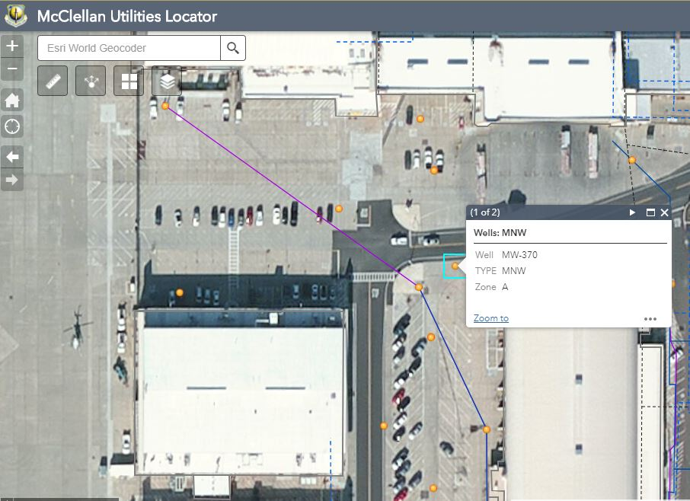
Data Pop-Ups
Wells and Building Numbers
- Popups were configured to show information about individual wells and buildings

Slide 6
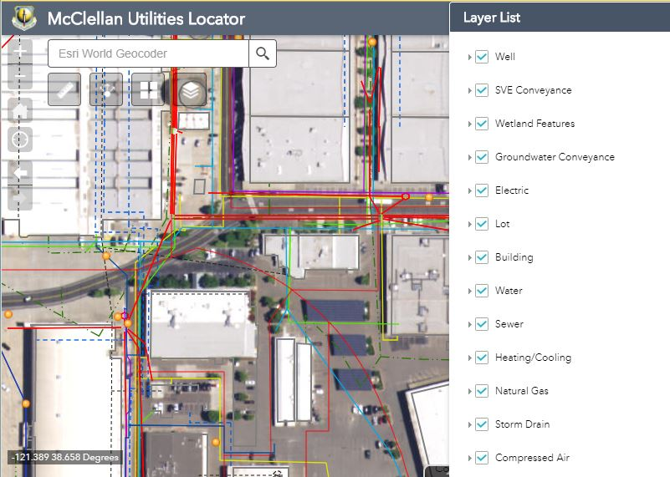
Additional Utility Layers optional
The initial set of map features are those the AF is most concerned and responsible.
Additional features are also available for viewing.

Slide 7
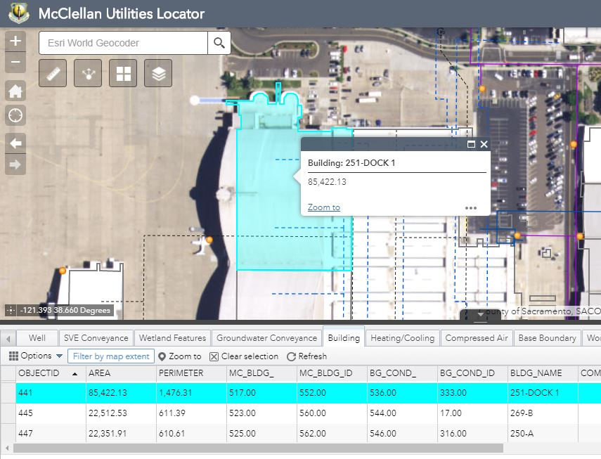
Data Tables Viewer
Data tables can be viewed from the arrow icon on the bottom of the application
Data can be sorted and viewed.
Areas of interest can be highlighted and zoomed to their location.

Slide 8
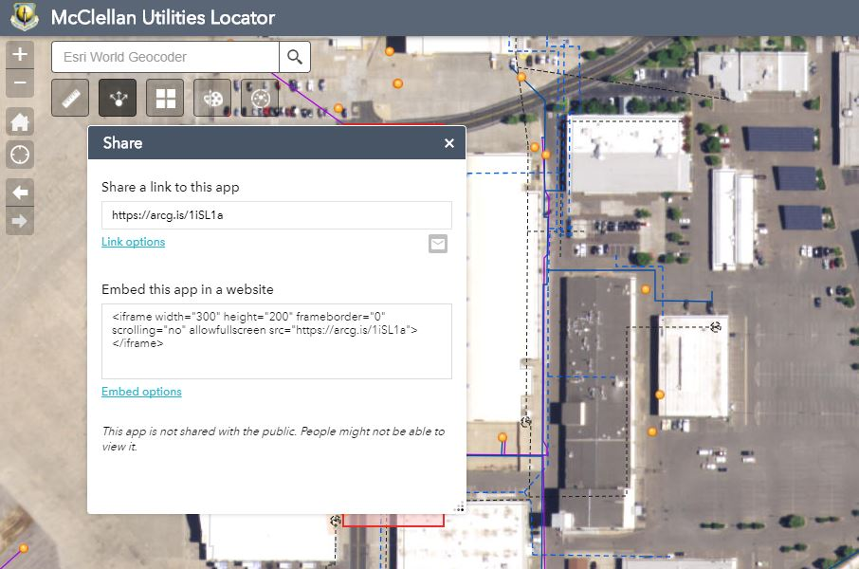
Widgets – Measure, Share, Draw, and Analysis (Extract Data)
Useful Widgets
Measure Tool – find distances from work areas to utilities
Share Tool – share maps with others
Drawing Tool – highlight areas of concern
Analysis Tool – report features within an area of concern

Slide 9
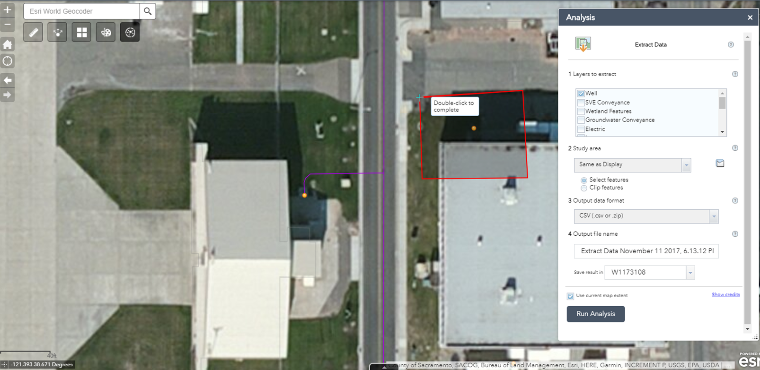
Image Analysis Widget
- Image Analysis Widget (Data Extract) tool can be used to find and list features within a boundary drawn that identifies areas of construction
- Output to a .csv or .zip file that lists the features identified.
Long | Lat | OBJECTID | NORTHING | EASTING | TYPE | STATUS | GRID | WCM_ZONE | LOCID
-121.39254 | 38.67100394 | 555 | 366378 | 2173741 | MNW | Active |  | A | MW-393

Slide 10
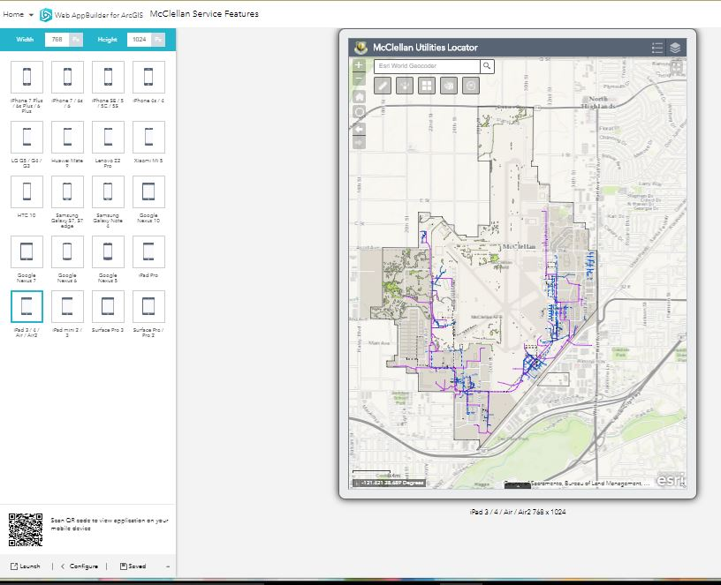
Viewed on different platforms (iPad3)
- Application was checked to see how the application would work on various platforms

