Slide 1
Biomass Study
Is there a correlation between annual rainfall and vegetation index using NDVI in a suburban area?
2009 - 2017

Slide 2
NDVI using NAIP imagery for California
(2005, 2009, then collected every 2 years from 2010, June - July)
2005 – 1m, Full Coverage, 3 Band Natural Color
2009 – 1m, Full Coverage, 4 Band Natural Color plus Near Infrared
2010 – 1m, Full Coverage, 4 Band Natural Color plus Near Infrared
2012 – 1m, Full Coverage, 4 Band Natural Color plus Near Infrared
2014 – 1m, Full Coverage, 4 Band Natural Color plus Near Infrared
2016 – 0.6 m, Full Coverage, 4 Band Natural Color plus Near Infrared
Downloads available USGS and Cal Atlas
NDVI – Normalized Difference Vegetation Index
NAIP – National Agricultural Imagery Program

Slide 3
NDVI (Normalized Difference Vegetation Index)
(NIR – Red)
(NIR + Red)
NDVI =
Produces number between -1.0 and 1.0
Bare soils < 0.1
Shrub and Grassland 0.2 - 0.3
Temperate and Tropical Rainforest 0.6 - 0.8

Slide 4
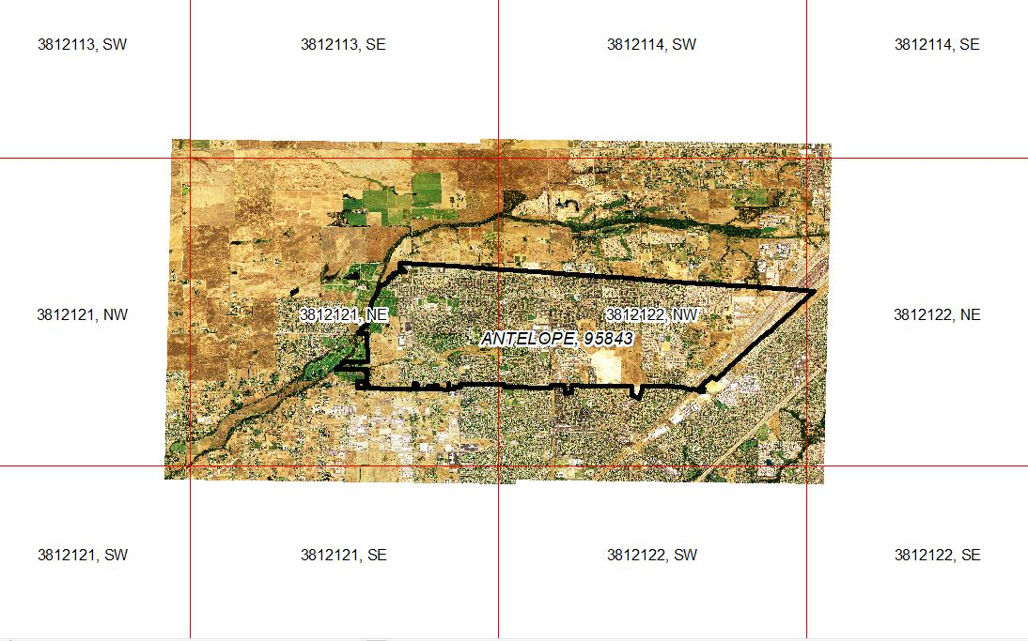
NAIP Panels for Study Area
Digital Ortho Quarter Quads (DOQQ)

Slide 5
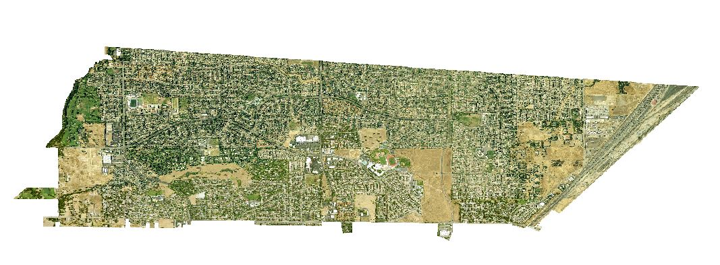
NAIP Image Data Clipped to Zip Code 95843

Slide 6
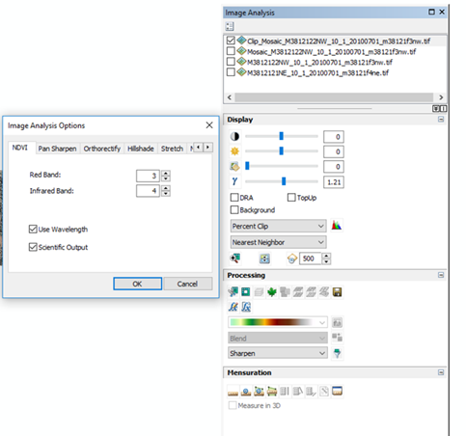
NDVI
Processing
Setup

Slide 7
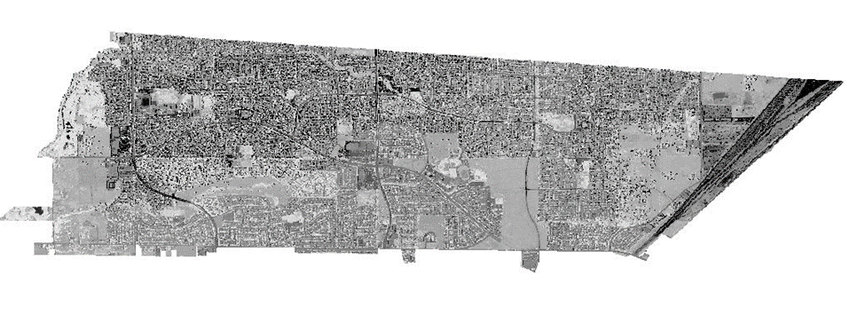
NDVI Results

Slide 8
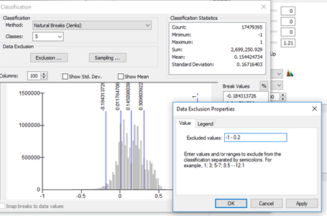
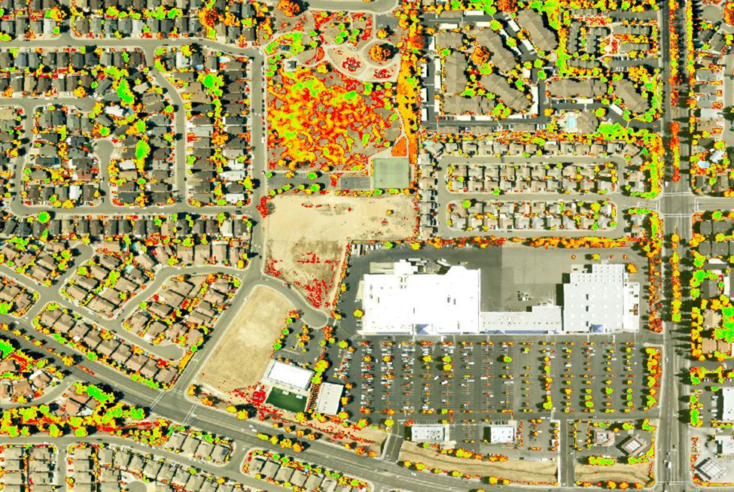
Classification Settings (NDVI Assessment)

Slide 9
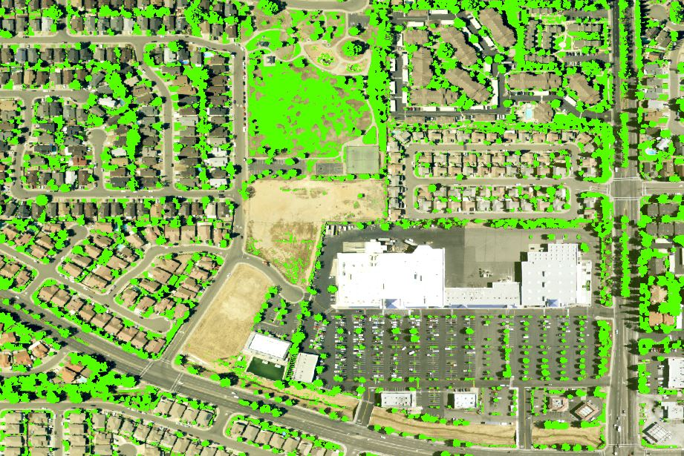
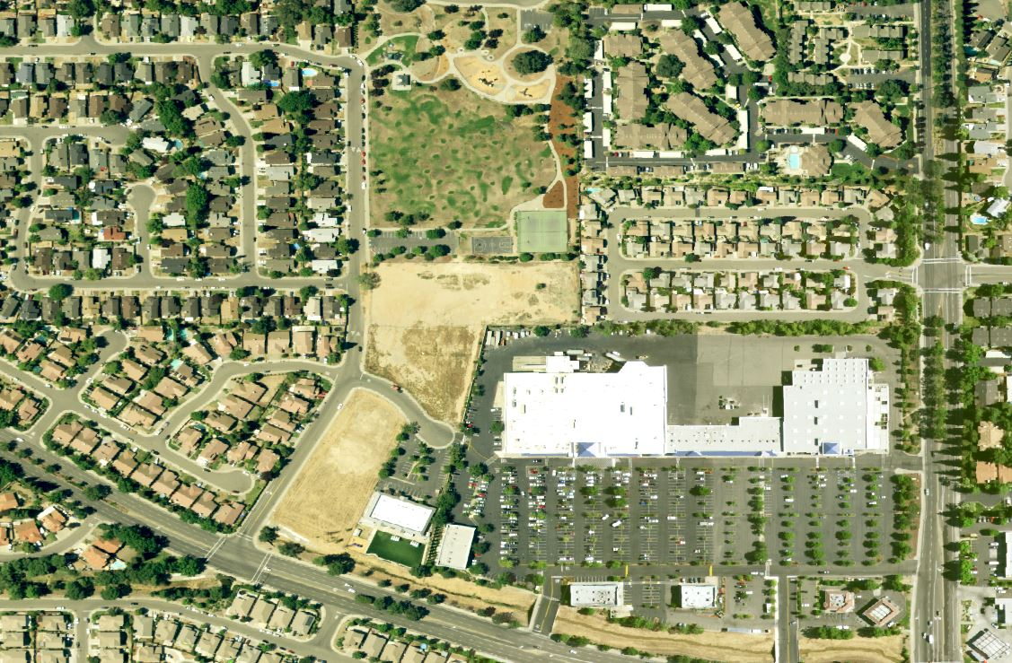
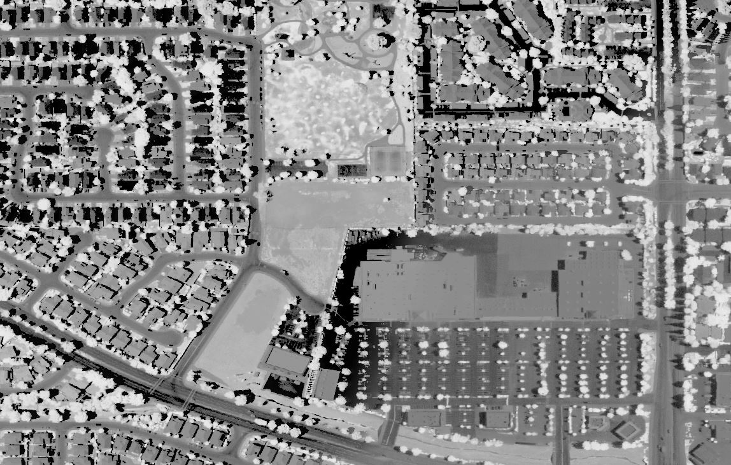
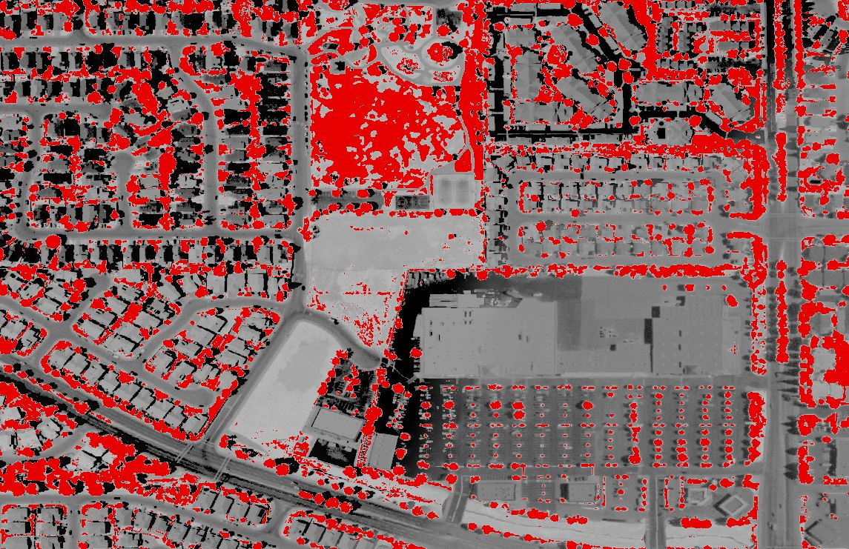
NDVI Workflow
Layer Property
Manual Classification
Exclude -1.0 to 0.2
“Retain NDVI Values”
NAIP 2016 Imagery
NDVI
Raster Calculator
NDVI Value > 0.2
“0 or 1”

Slide 10
Precipitation Data - Sacramento
(usclimatedata.com)
Ending Current Year
Starting Previous Year
Year | Jan | Feb | Mar | Apr | May | Jun | Jul | Aug | Sep | Oct | Nov | Dec
17 | 9.92 | 8.25 | 2.38 | 2.93 | 0.05 | 0.1 | 0 | 0 | 0 | 0.15 | 0 | 0
16 | 5.4 | 0.82 | 5.07 | 1.03 | 0.39 | 0 | 0 | 0 | 0 | 4.72 | 1.12 | 3.61
15 | 0 | 2.82 | 0.22 | 1.83 | 0.07 | 0.07 | 0 | 0 | 0.04 | 0.12 | 1.57 | 1.75
14 | 0.15 | 4.14 | 1.77 | 1.83 | 0 | 0 | 0.01 | 0 | 0.46 | 0.53 | 1.25 | 8.6
13 | 0.96 | 0.36 | 1.38 | 0.69 | 0.3 | 0.22 | 0 | 0 | 0.59 | 0 | 0.88 | 0.43
12 | 2.43 | 0.55 | 4.06 | 2.42 | 0 | 0.03 | 0.03 | 0 | 0 | 1.14 | 3.97 | 6.15
11 | 1.67 | 3.39 | 6.95 | 0.06 | 1.02 | 1.5 | 0 | 0 | 0.01 | 1.33 | 0.74 | 0.27
10 | 4.79 | 2.29 | 2.98 | 2.65 | 0.75 | 0 | 0 | 0 | 0.01 | 1.43 | 2.39 | 5.55
9 | 1.41 | 5.07 | 2.09 | 1.46 | 1.01 | 0.56 | 0 | 0 | 0.14 | 3.24 | 0.26 | 3.64
8 | 6.67 | 1.81 | 0.05 | 0 | 0.04 | 0 | 0 | 0 | 0 | 0.84 | 2.38 | 1.51
7 | 0.05 | 4.44 | 0.35 | 1.34 | 0.41 | 0 | 0.01 | 0 | 0.06 | 1.05 | 0.85 | 3.17

Slide 11
Data Analysis
Annual Rainfall (Blue)
Biomass Area from NDVI (Red Line)
Avg. Annual Rainfall (Yellow Line)
Below Average
Rainfall
Below Average Rainfall

