Slide 1
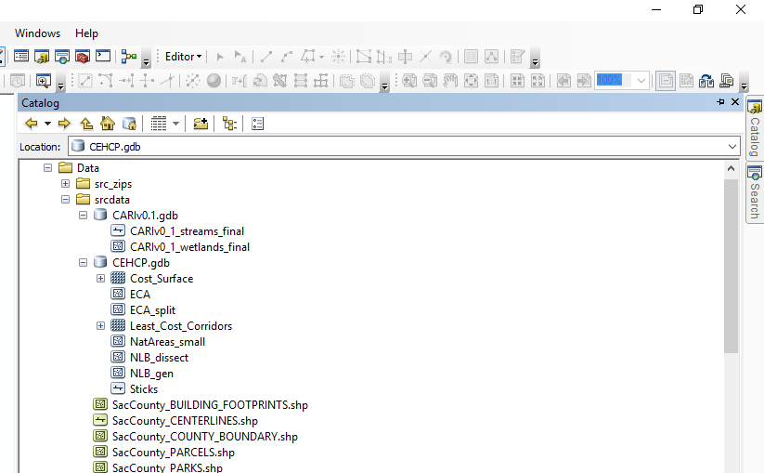
GregWroblicky_script_Part01.py
Source Datasets

Slide 2
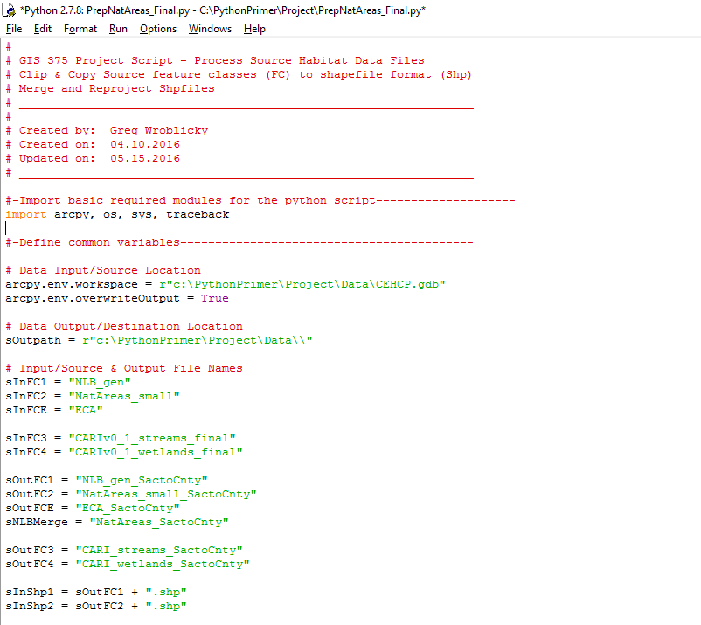
GregWroblicky_script_Part01.py
Input /Ouput Filenames

Slide 3
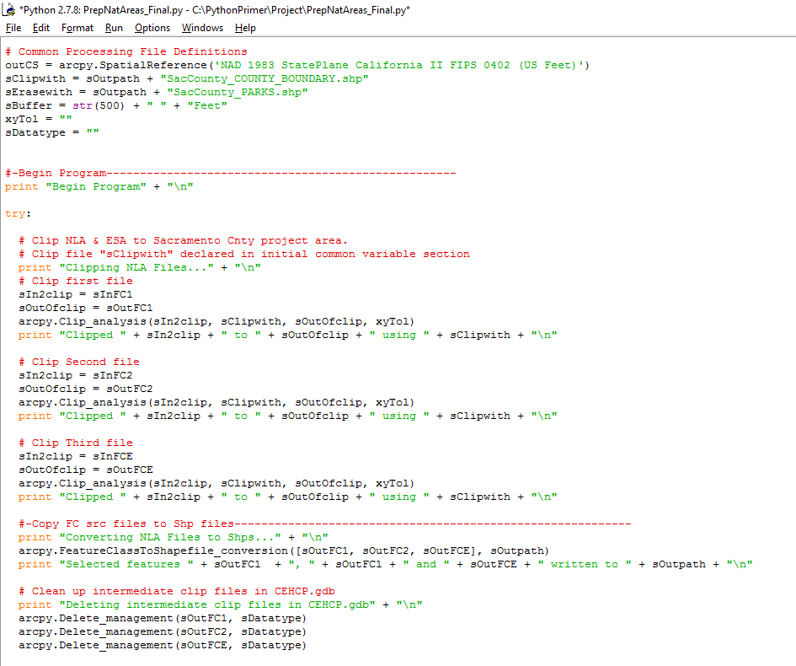
GregWroblicky_script_Part01.py
Clip Input Files, Copy to Shape files

Slide 4
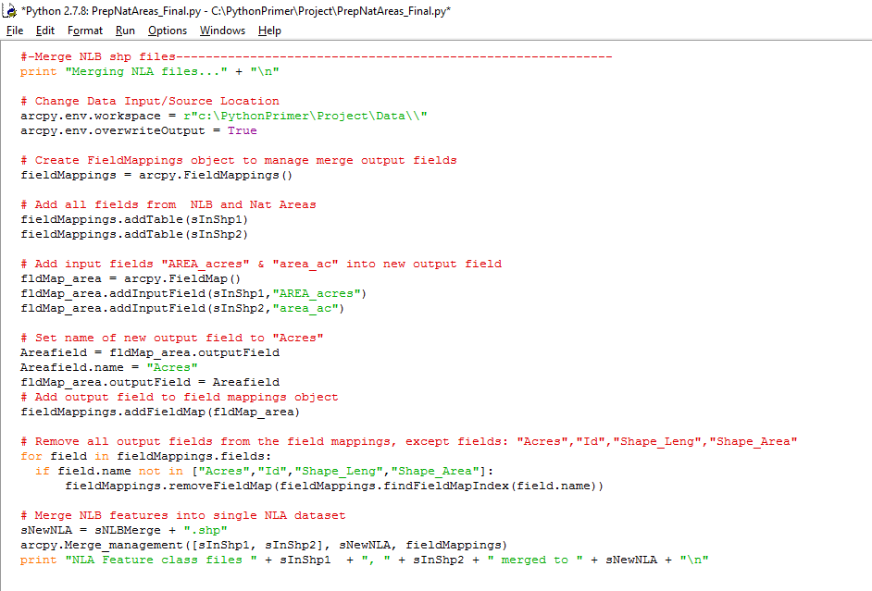
GregWroblicky_script_Part01.py
Merge Natural Habitat Input Files

Slide 5
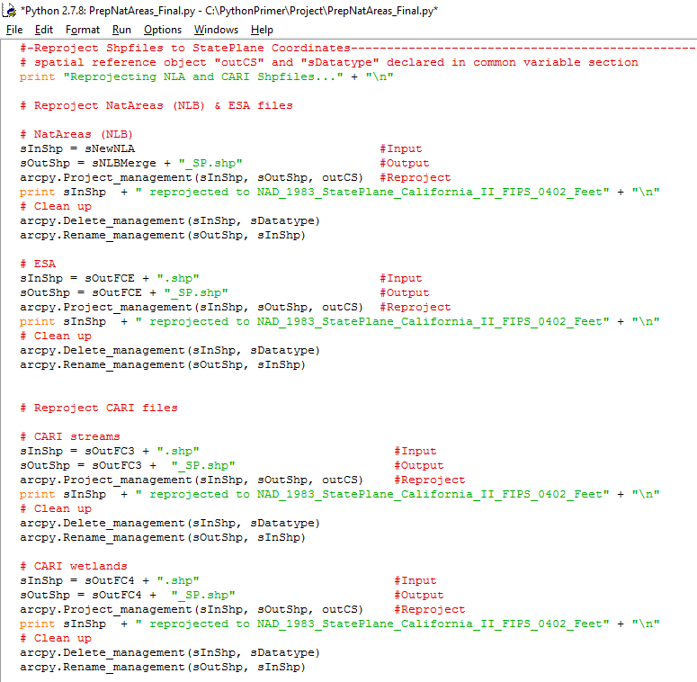
GregWroblicky_script_Part01.py
Reproject Input Files

Slide 6
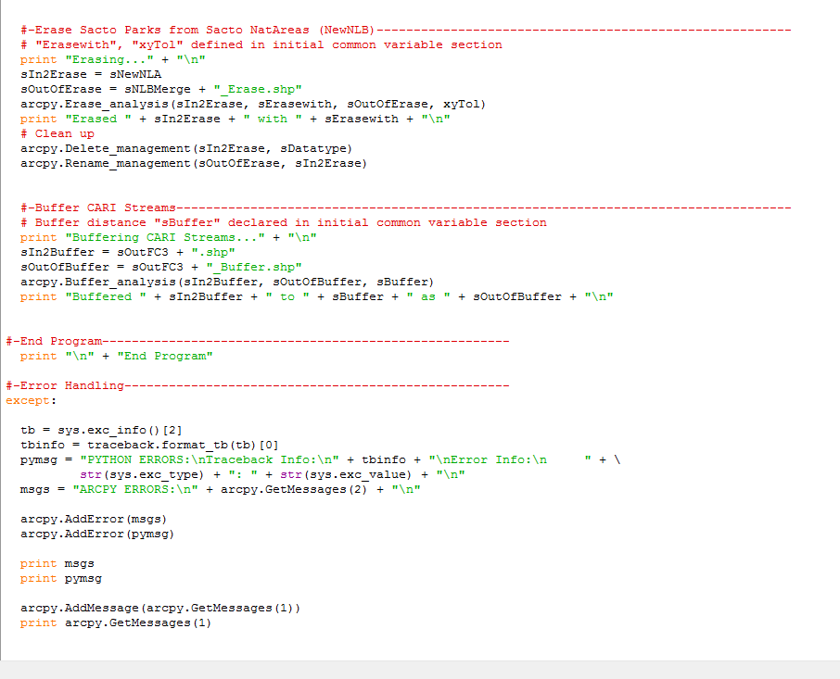
GregWroblicky_script_Part01.py
Erase Parks from Natural Habitat Areas, Buffer streams

Slide 7
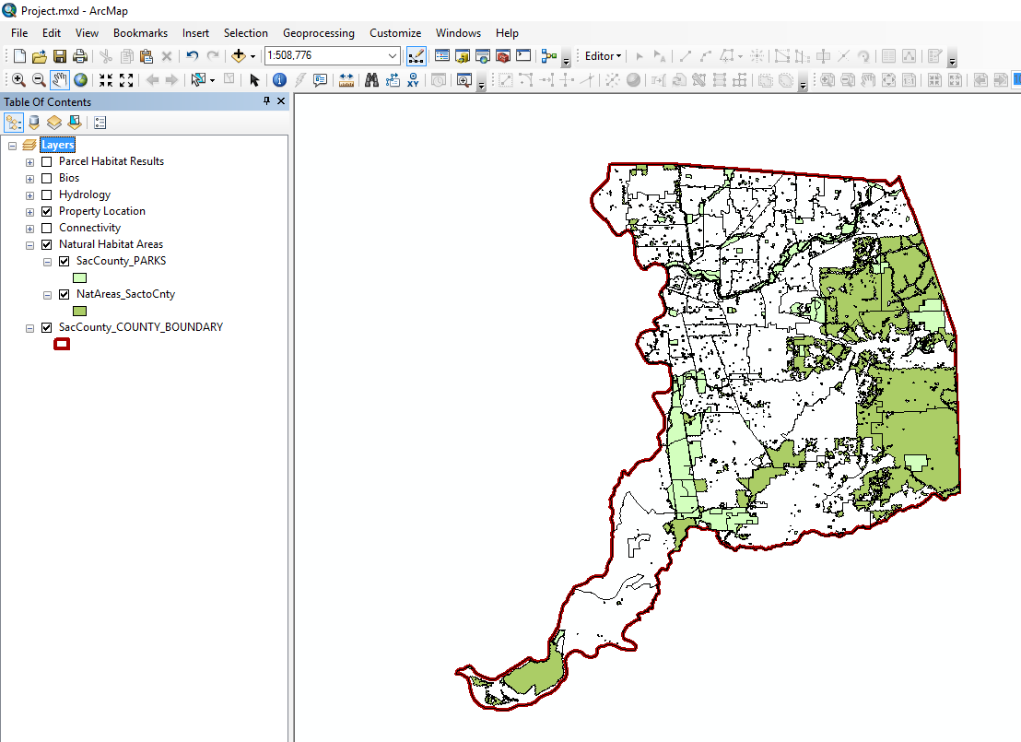
GregWroblicky_script_Part01.py
Source Data Script Results: Parks and Natural Habitat Areas, w/ Zip Code Areas for Reference

Slide 8
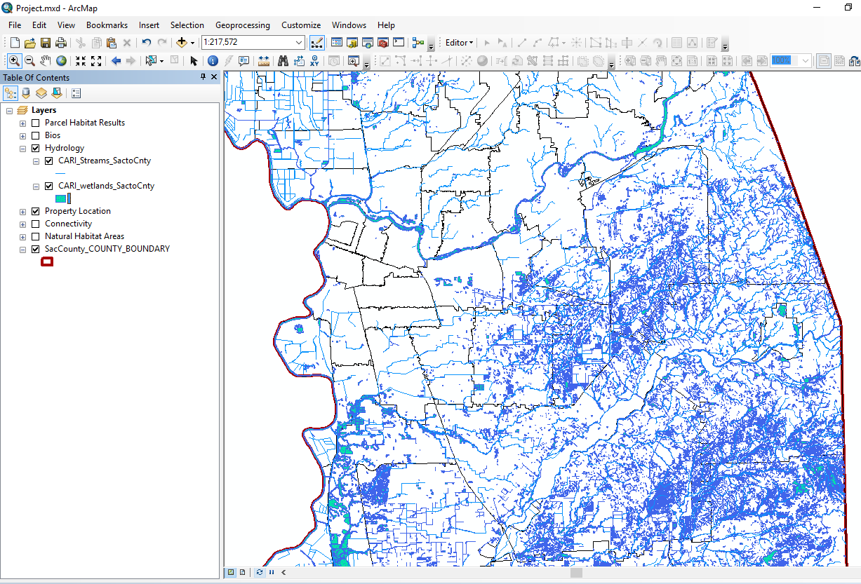
GregWroblicky_script_Part01.py
Source Data Script Results: CARI Streams and Wetlands Areas, w/ Zip Code Areas for Reference

Slide 9
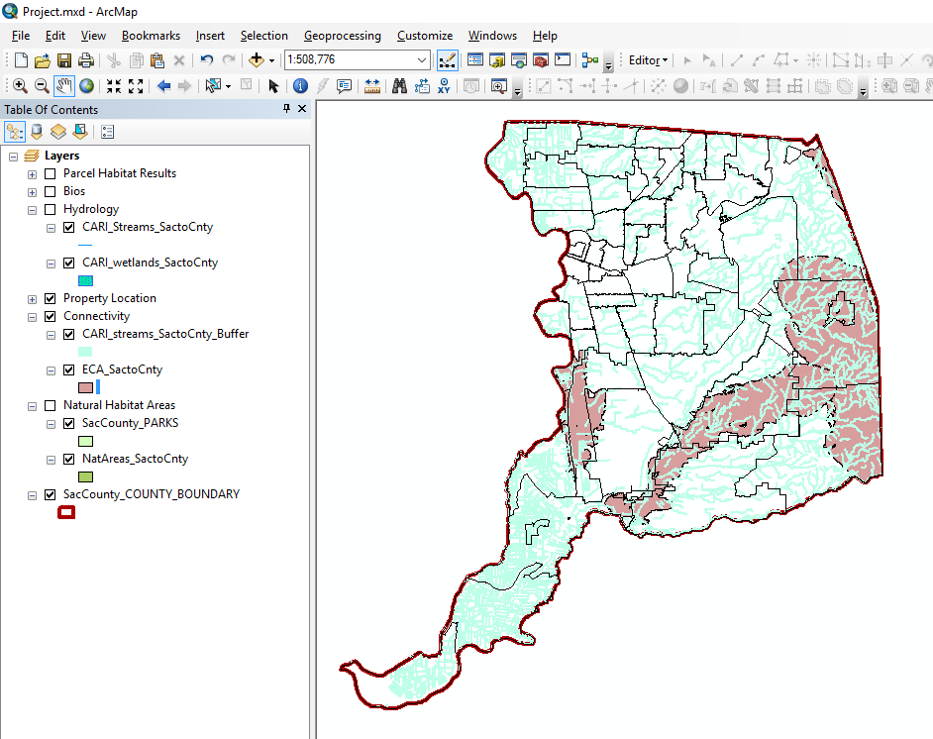
GregWroblicky_script_Part01.py
Source Data Script Results: Essential Connectivity Areas and Stream Buffer Connective Corridors w/ Zip Code Areas for Reference

Slide 10
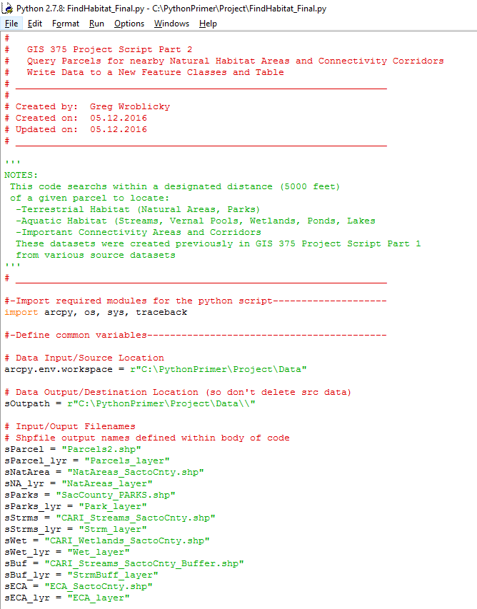
GregWroblicky_script_Part02.py
Input /Ouput Filenames

Slide 11
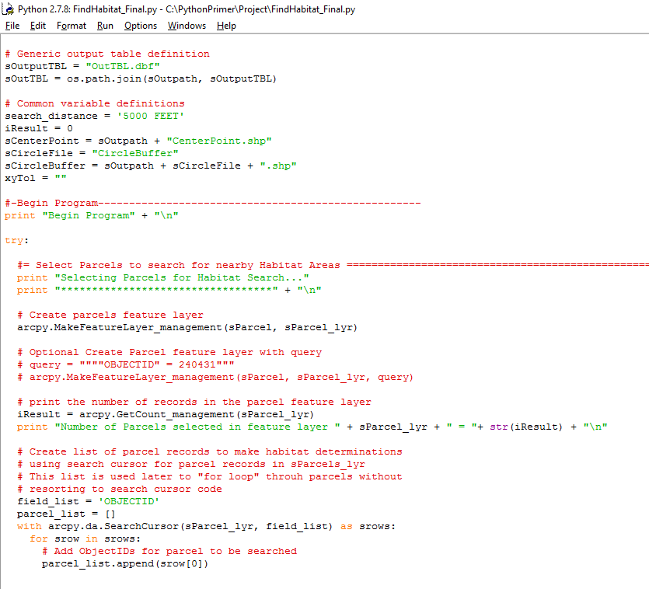
GregWroblicky_script_Part02.py
More initial variable declarations, then Create list of Parcels that will have Habitat Area Search performed.

Slide 12
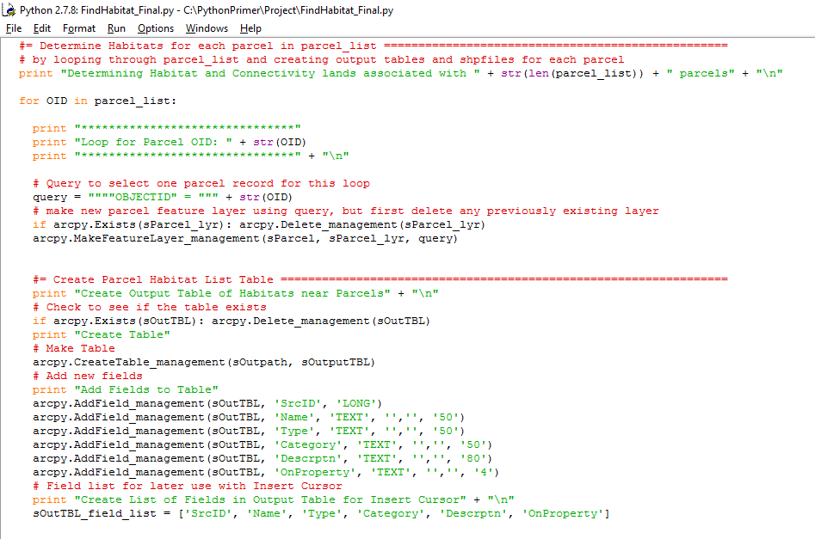
GregWroblicky_script_Part02.py
Begin Habitat Search, Create initial output table and fields for Parcel Habitat List Table

Slide 13
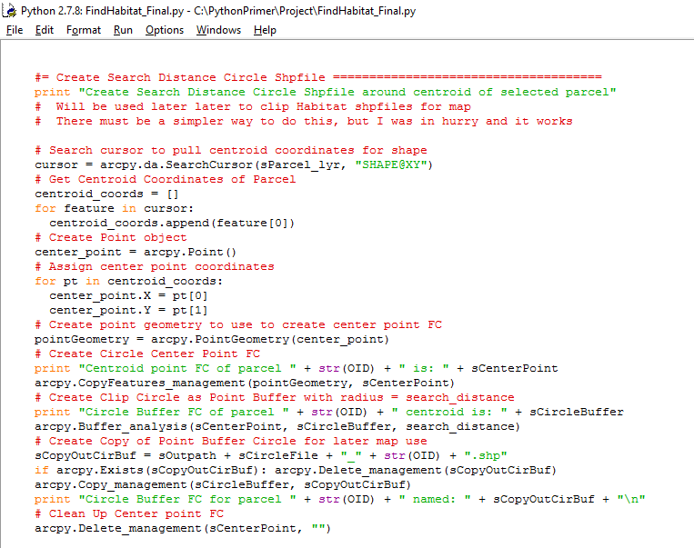
GregWroblicky_script_Part02.py
Create a circle buffer that represents search distance around each parcel.

Slide 14
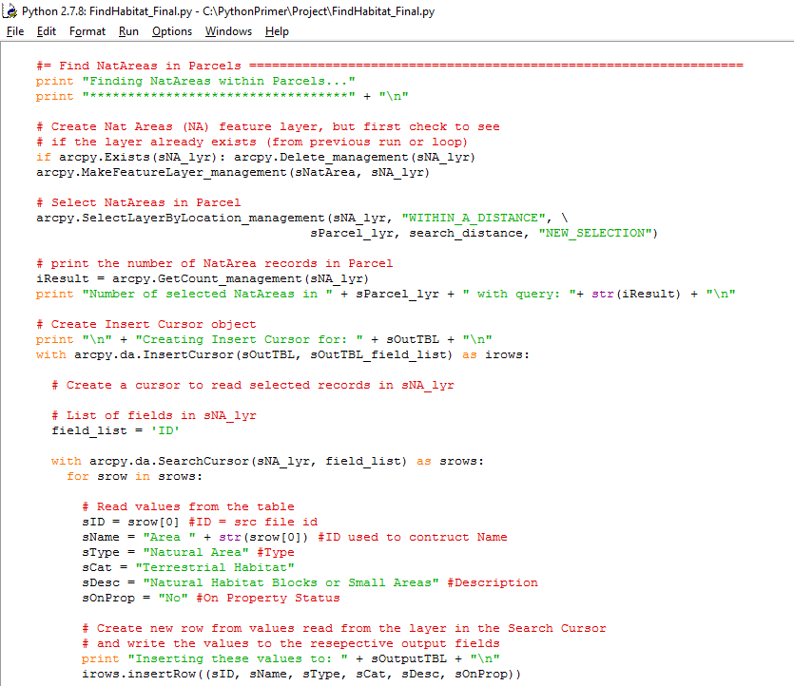
GregWroblicky_script_Part02.py
Search Natural Areas shape file and add data to previously created output table

Slide 15
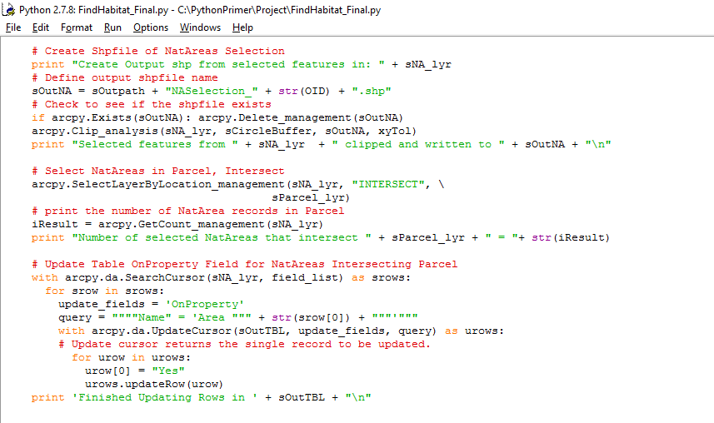
GregWroblicky_script_Part02.py
Create shape file of search results, determine Habitat Areas located within the parcel, update the output table records for these habitat area records.

Slide 16
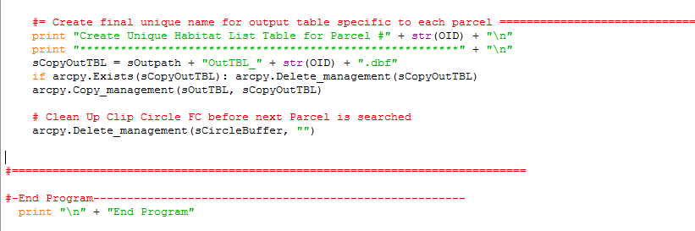
GregWroblicky_script_Part02.py
Repeat this same sequence of steps for other habitat area and connectivity corridor layers located near or within the parcel, update the output table records for these habitat area records which will will include:
Sacramento Parks, CARI_Streams, CARI_Wetlands, Stream Buffer Connectivity Corridors, and Essential Connectivity Areas (ECA)
Last, copy table with all habitat and connective corridor records to seperate file with parcel number designation before looping back to repeat the search for the next parcel.

Slide 17
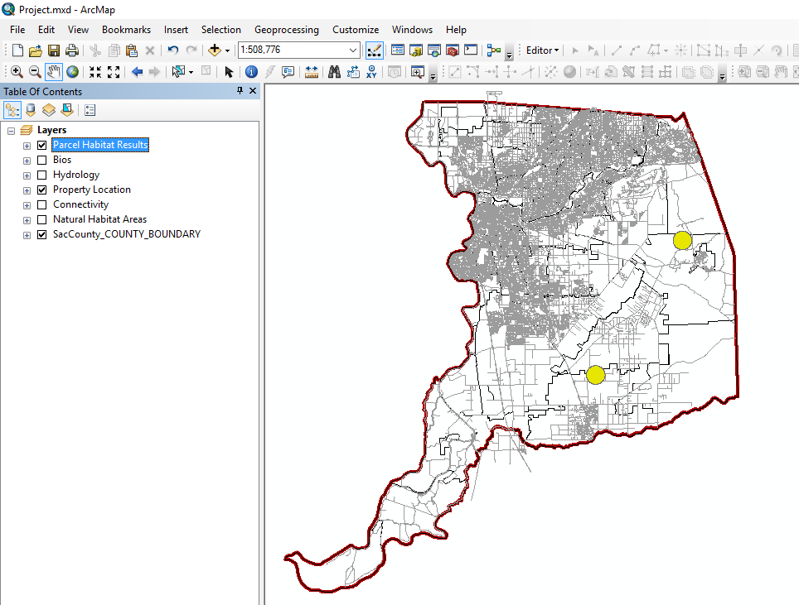
GregWroblicky_script_Part02.py
Location of two parcels for which the script was run to determine habitat and connectivity areas located within or adjacent to the parcel. The circles represent the areas within 5000 feet of the parcel centroids. Roads are included for reference

Slide 18
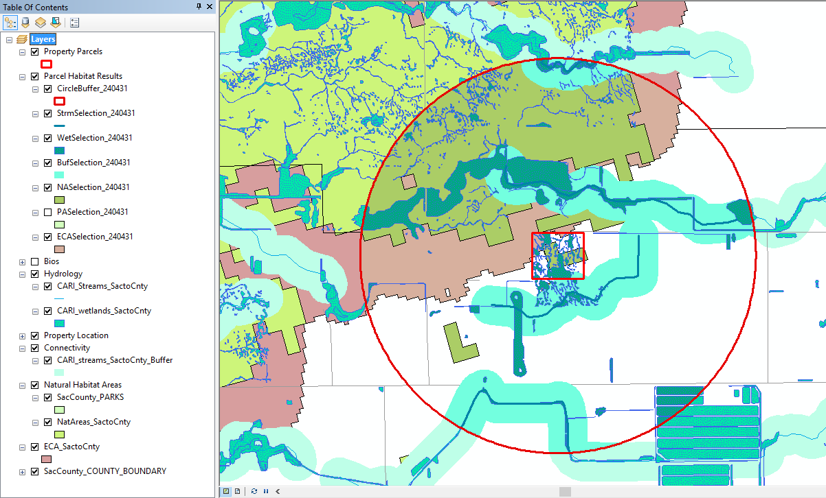
GregWroblicky_script_Part02.py
Example Parcel Search Results for Parcel 240431. Parcel and Search Radius are in Red

Slide 19
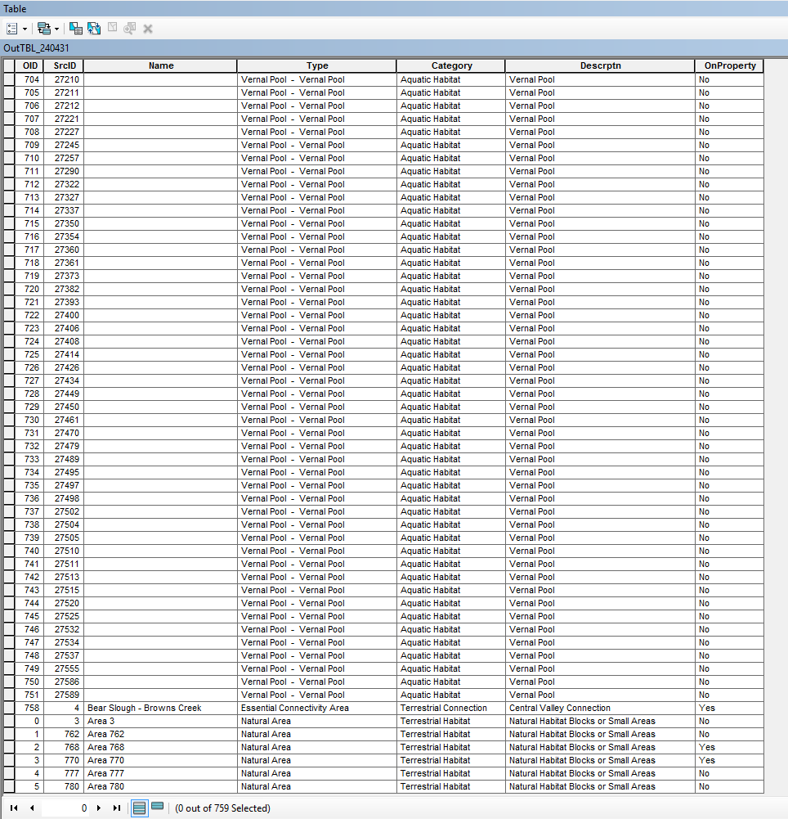
GregWroblicky_script_Part02.py
Example Output Table Results for Parcel 240431.

Slide 20
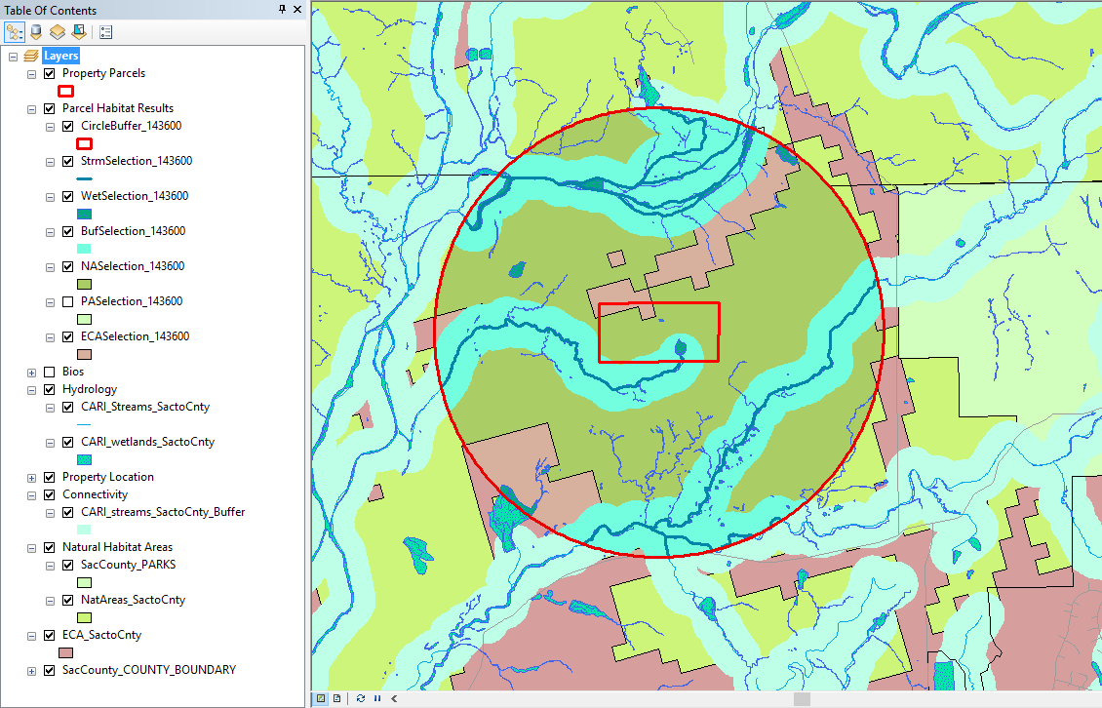
GregWroblicky_script_Part02.py
Example Parcel Search Results for Parcel 143600. Parcel and Search Radius are in Red

Slide 21
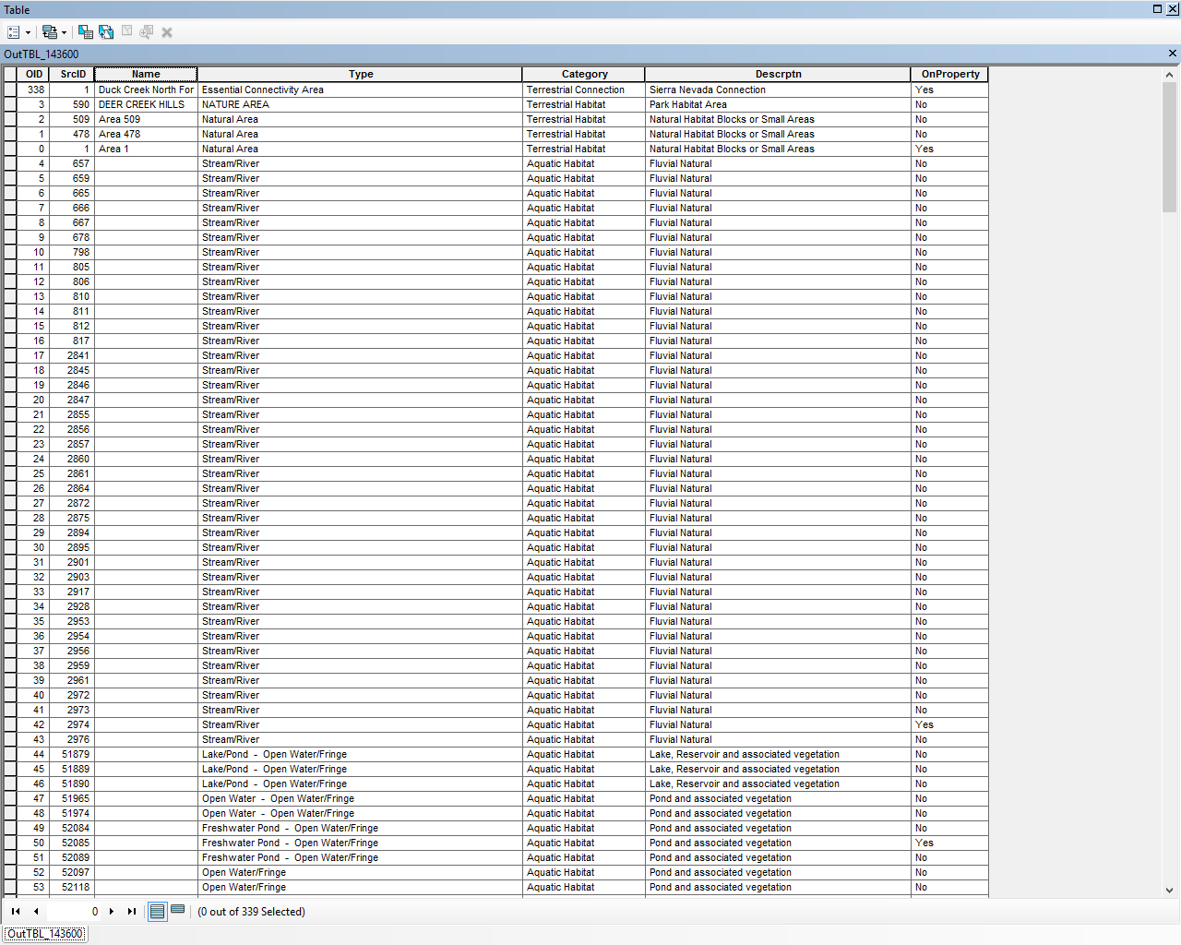
GregWroblicky_script_Part02.py
Example Output Table Results for Parcel 240431.

