Slide 1
Automating Student Yield Data Extraction
Geri Wickham
Geog 375 – Spring 2016

Slide 2
Overview
Student yield data is used in many areas of my job such as calculating development impact fees, determining the timeline for construction of new schools, determining whether attendance boundaries need to be adjusted, etc.
Calculating student yield data includes gathering student counts by grade level and parcel counts by dwelling unit type, and taking this information and separating it out by school attendance area.
I created a script to automate the collection of this data and create a “dot map” of students by elementary attendance boundary for visual reinforcement.

Slide 3
Data Layers and Map Documents Used
Student Layer
Contains:
Grade Level
Parcel Layer
Contains:
Parcel Polygons
Land Use Code
Boundary Layer
Contains:
Map Template
Map to be used to create dot maps
Geocoded Address
Boundary Polygons
School Assignments

Slide 4
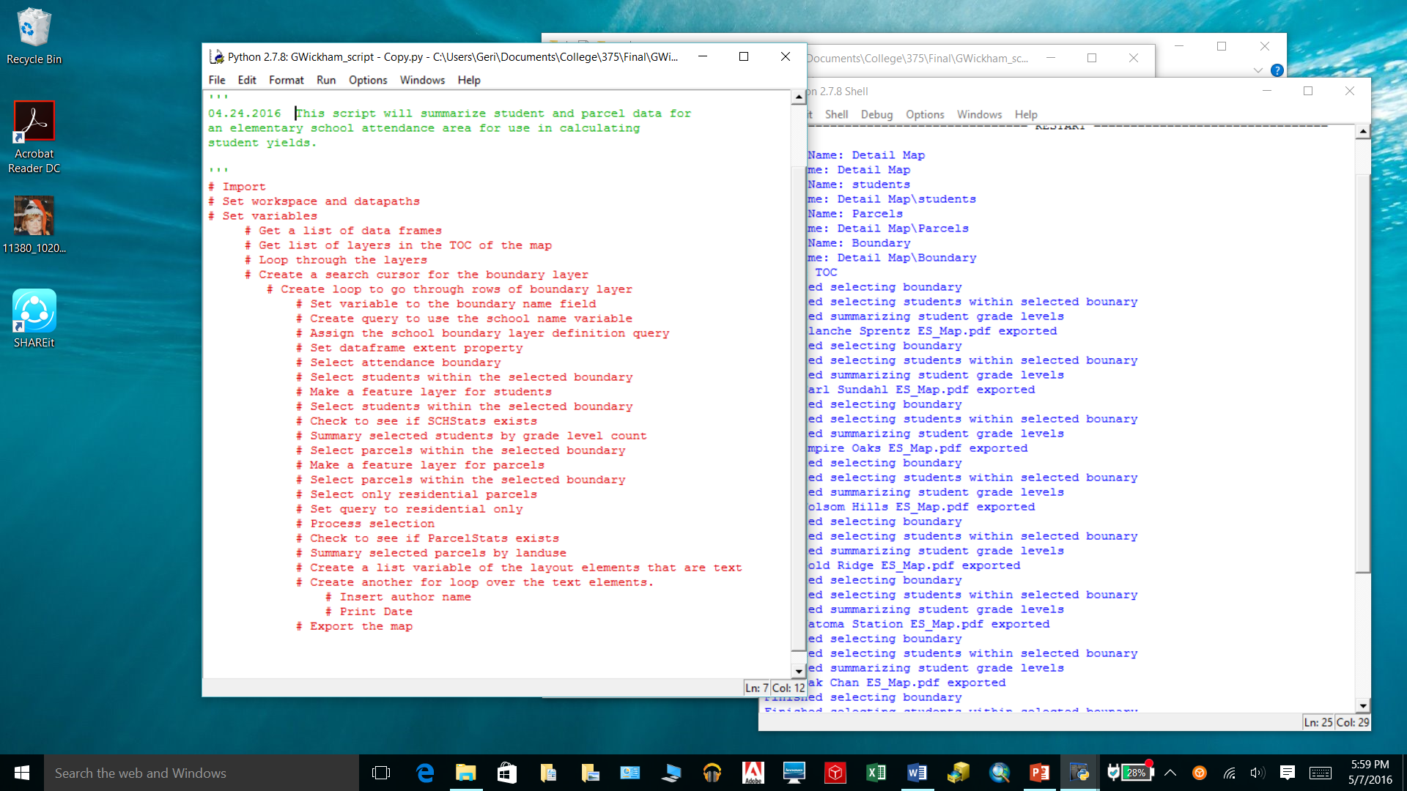
Pseudo Coding
This is my pseudo coding for the project.

Slide 5
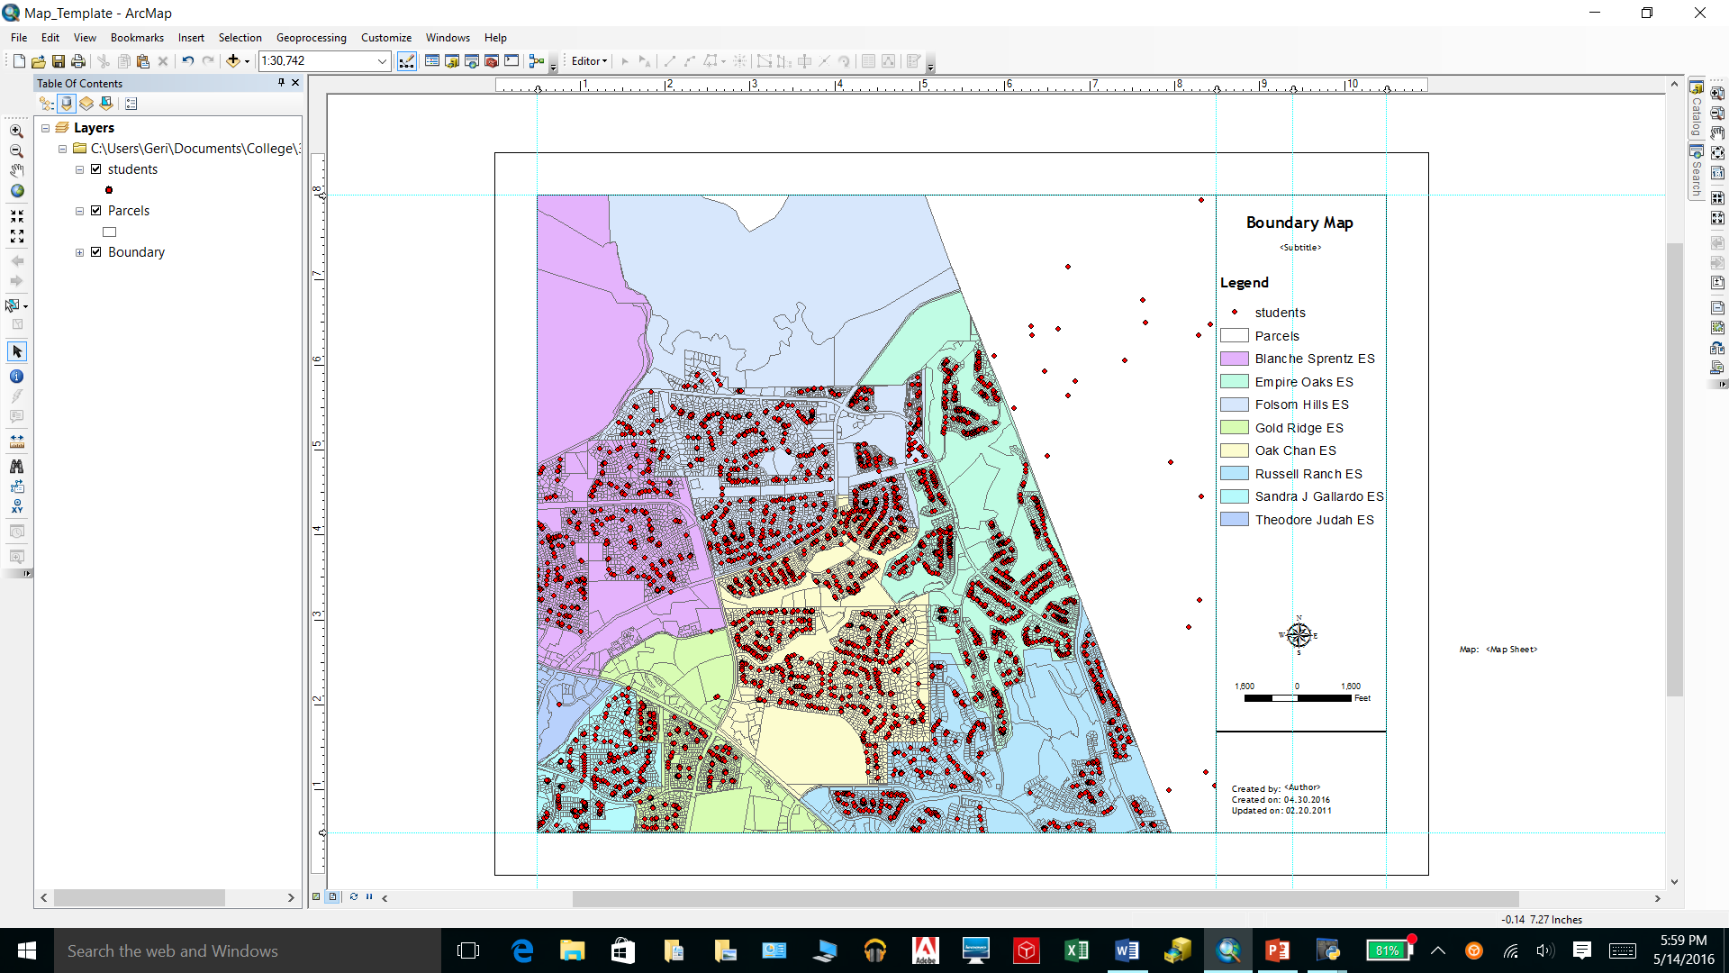
Map Template
Using the map template from our last exercise, I edited it to fit my needs for the dot map.

Slide 6
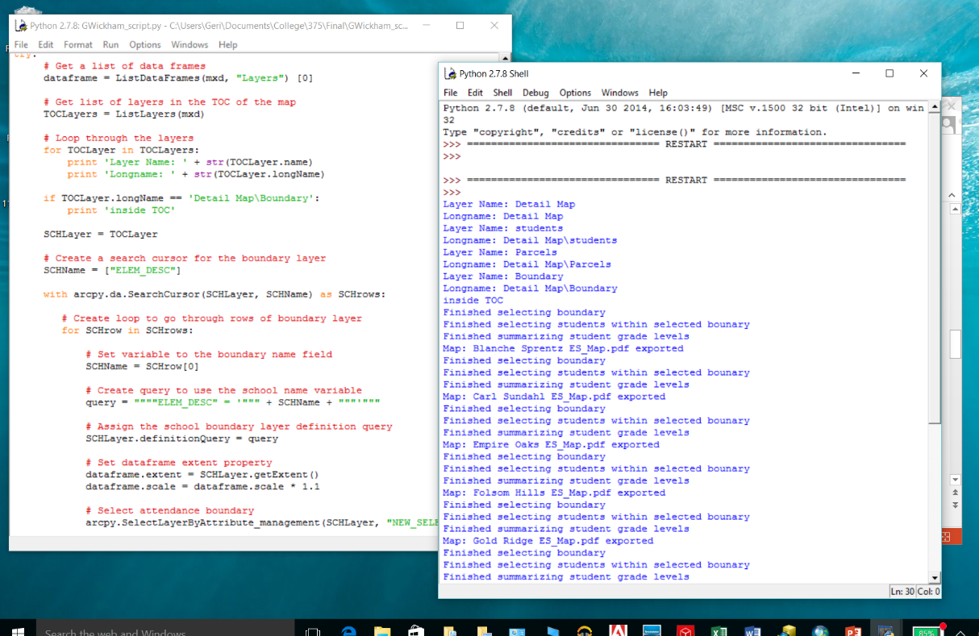
Loop Through the Table of Contents
The coding loops through the layer files and gets a list of the layers in the Table of Contents.
Print statements were added for informational and error checking purposes.

Slide 7
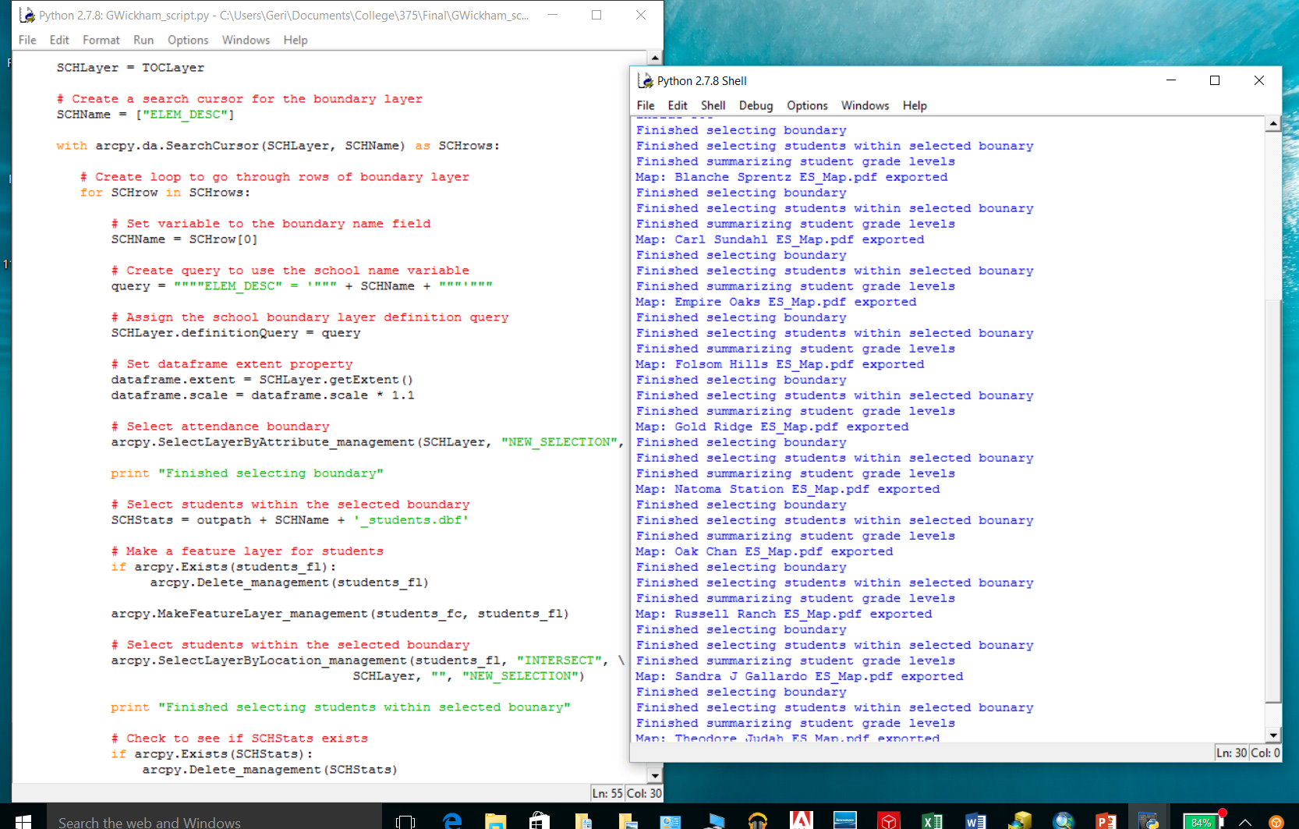
Select the Elementary Boundary from the Boundary Table
Next, the coding selects the next boundary within the boundary table.
Print statements were added to each task for informational and error checking purposes.

Slide 8
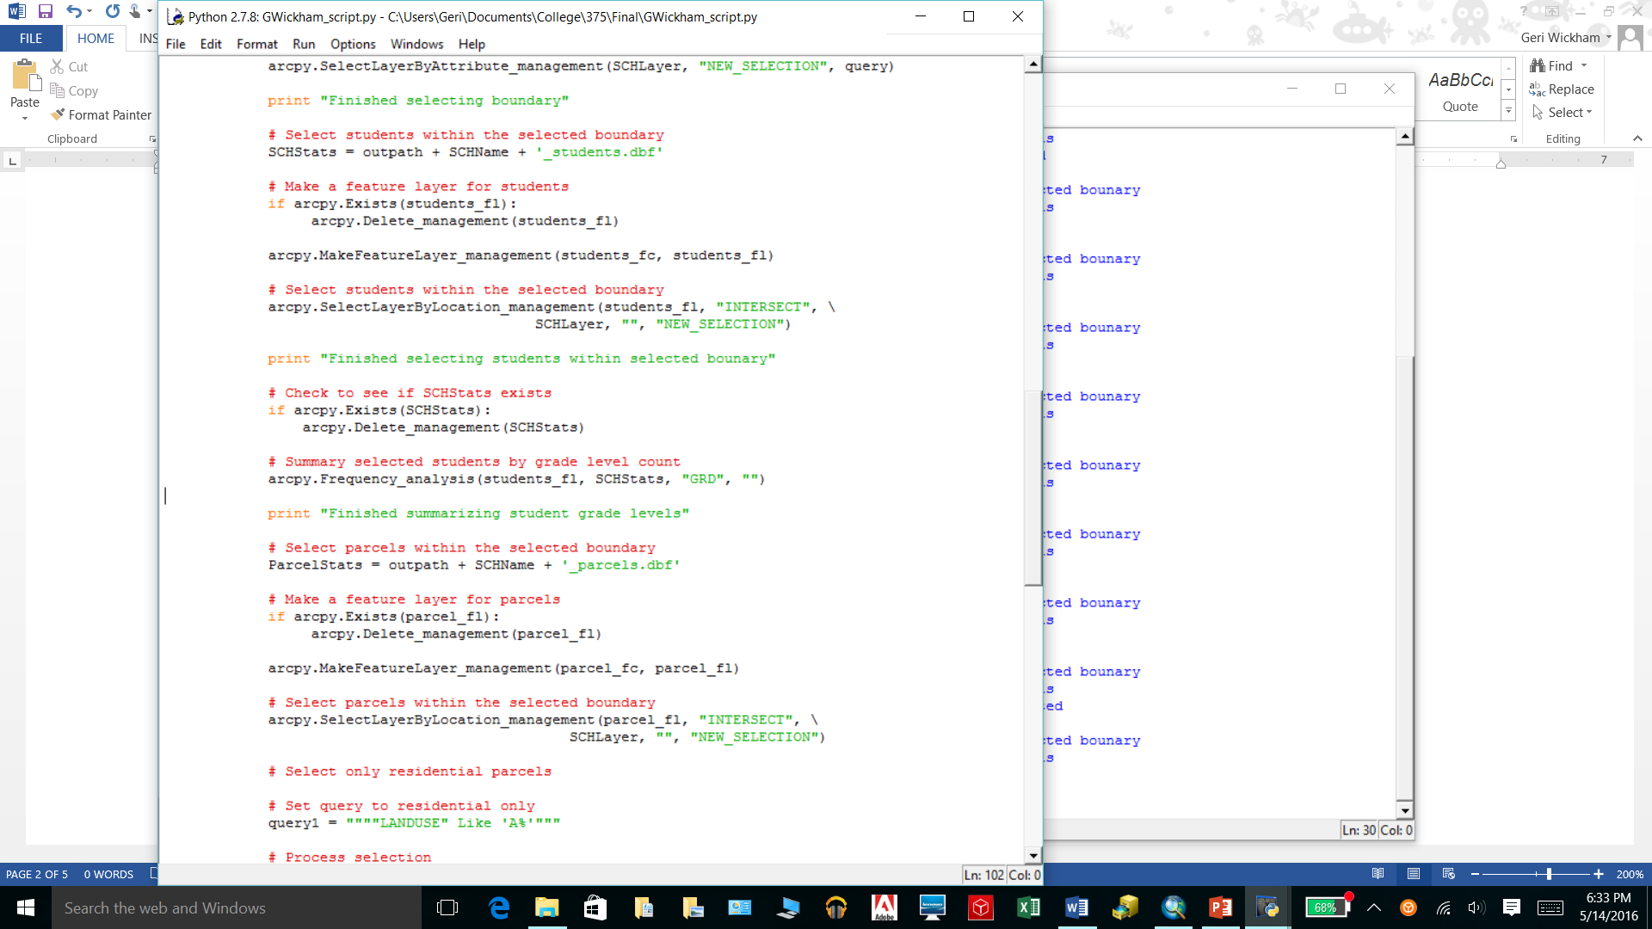
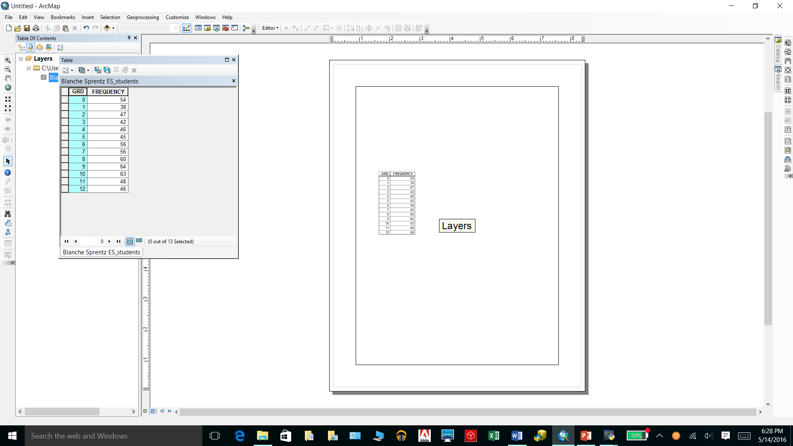
Select and Count Students Within the Selected Boundary
This portion of code selects the students that intersect with the selected boundary, creating a new selection. The selected students are then counted by grade level and exported to a table for use in calculations outside of ArcGIS.

Slide 9
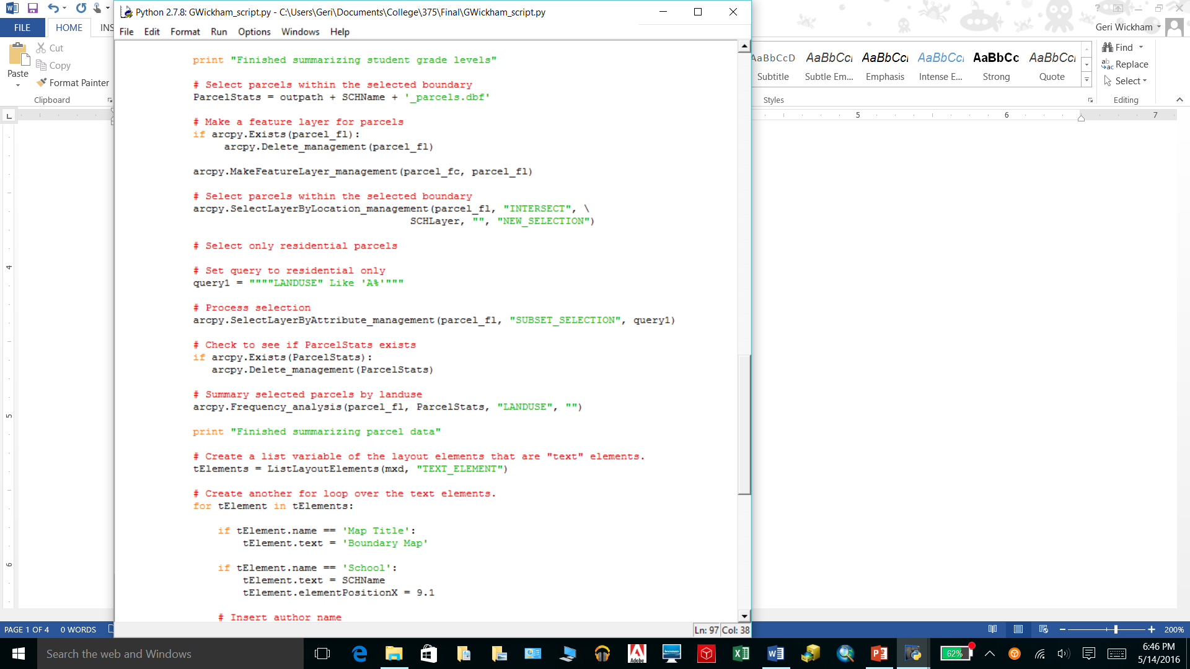
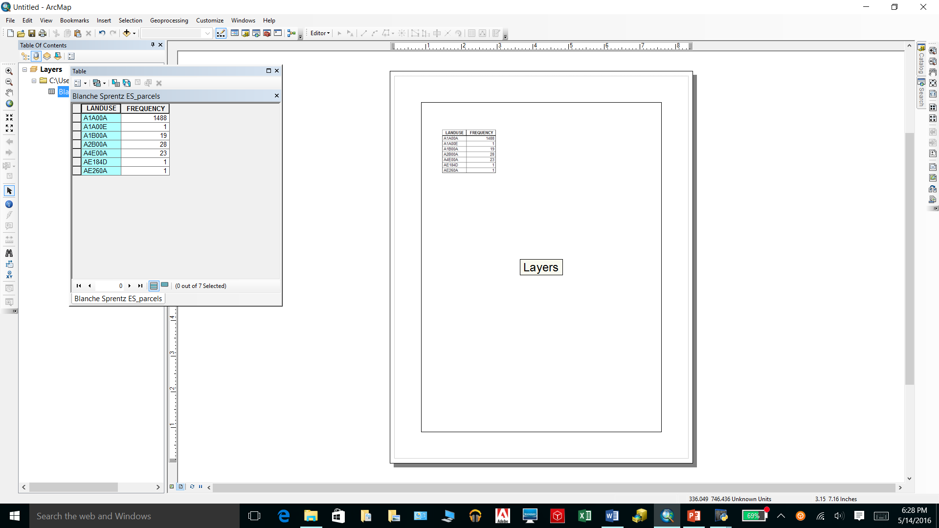
Select and Count Parcels Within the Selected Boundary
This portion of code selects the parcels that intersect with the selected boundary, creating a new selection. A subset of residential only parcels is created from the selected parcels. The parcel data is then summarized and exported into a table.

Slide 10
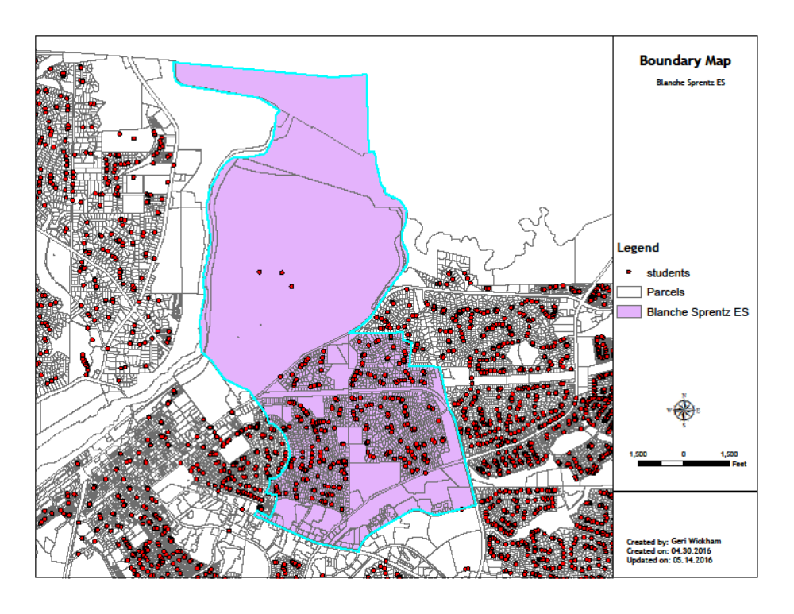
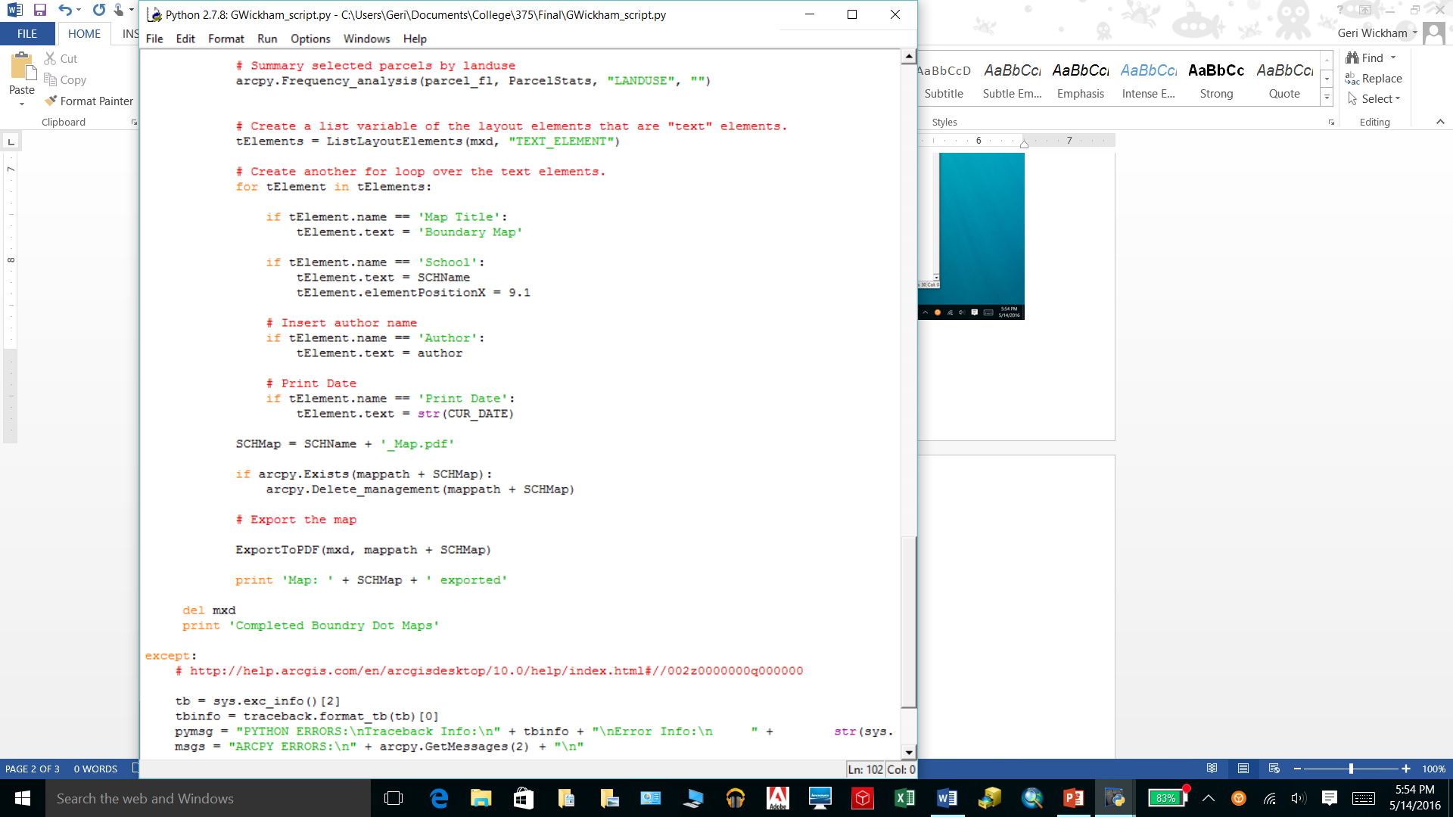
Create the School Boundary Dot Map
This portion of code creates a student dot map of the selected boundary. The map is then exported into a pdf document.

Slide 11
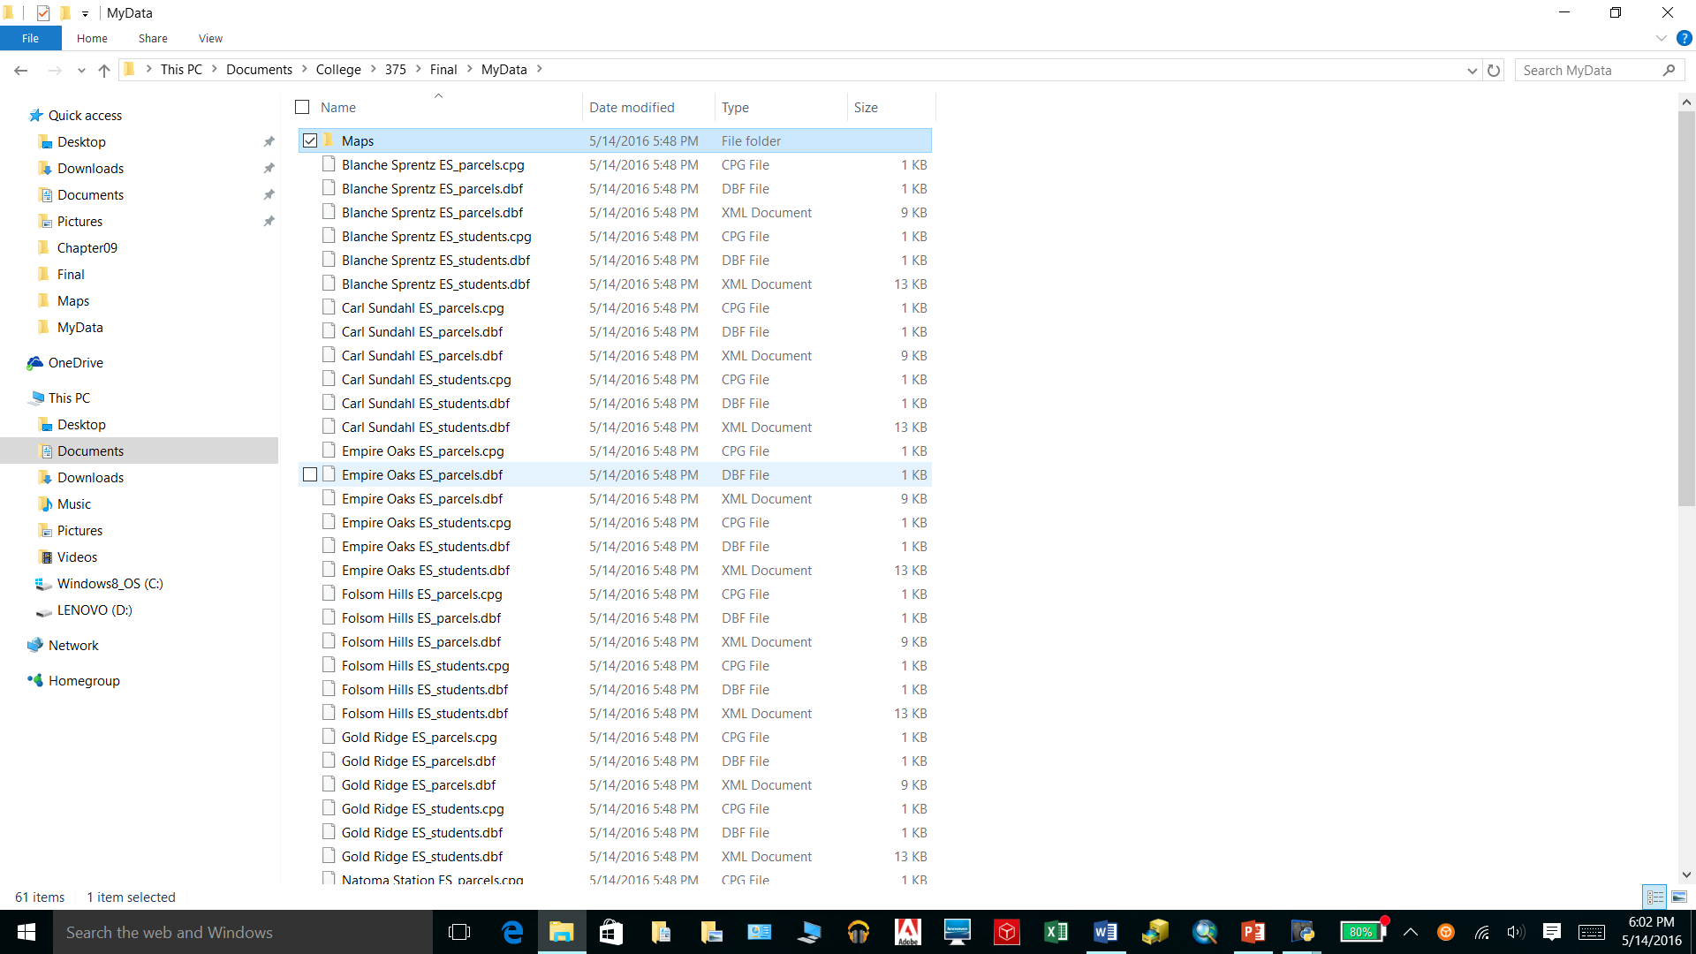
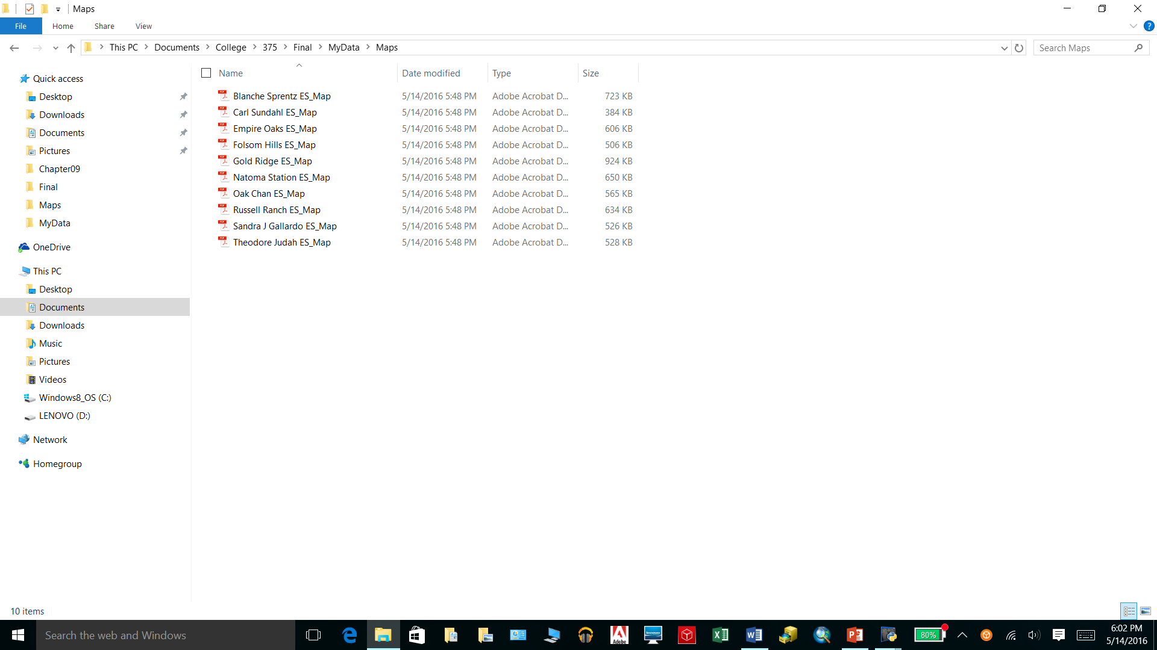
Create the School Boundary Dot Map
The following are the table files and pdf files created from the coding.

Slide 12
Geri Wickham
May 2016

