Slide 1
Touring Capitol Park
Sacramento, CA
Joseph Watkins
GEOG 385
Final Project

Slide 2
Background
Capitol Park sits in the heart of downtown Sacramento and consists of 30.5 acres that have been evolving for over 145 years. It now includes thousands of trees, shrubs, and flowers, along with over150 memorials and monuments offering education and outdoor exploration.
Objective
Build an interactive web map app that allows the user to:
  Visualize the parks development through use of the Time Slider.
  Filter results by zone, monument, and/or material.
  Create a route and measure distance.
  Link photos with Collector for ArcGIS.

Slide 3
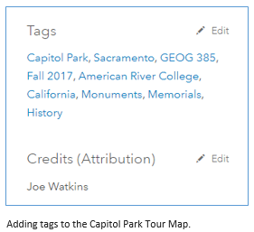
Project Development
Map Creation
  Add Feature Layers to AGO
    Leverage existing data from Dept. of Parks and Rec
    Heads up digitizing of Capitol Parks 10 zones
  Customize the Look and Feel
    Select Topographic basemap
    Set layer visibility range
    Edit feature pop-ups
    Protect from deletion
    Allow other users access
    Add tags

Slide 4
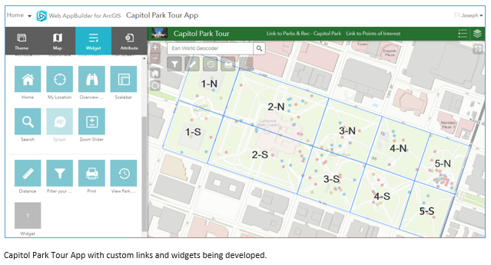
Project Development
Map App Creation
  Simple is better
    Chose the foldable theme (organic)
    Select a recognizable logo
    Add related links to the header
  Widgets
    Filter
    Measure
    Time Slider
    Print

Slide 5
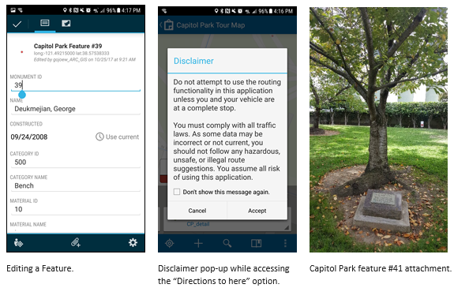
Project Development
Using Collector for ArcGIS
  Preparing the data feature layer
    Allow attachments
    Allow editing
    Protect from deletion
  Access from my phone
    Download app
    Sign in
    Select map
    Edit feature
    Add pictures

Slide 6
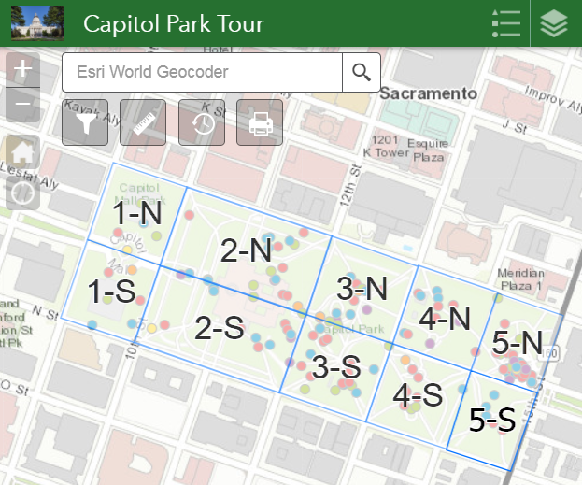
Challenges
Formatting the Date column
Uploading the point data (.xlsx vs .csv)
Limitations with the routing tool

Slide 7
Potential
Visually preserving history
Interactive learning platform
Easy to use
Cultivating curiosity
Expand to incorporate plant development
Use the model for other areas
Results
https://arc-gis.maps.arcgis.com/apps/webappviewer/index.html?id=443a5190af6540dabddecb254e3e58b5

