Slide 1
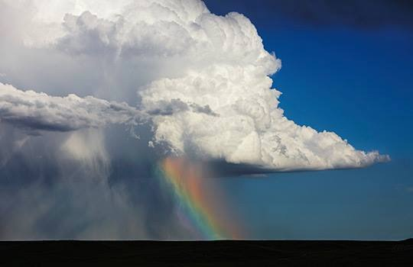
Processing of NOAA Precipitation Data and Thematic Map Generation
Shawn Stiver
ARC Spring Semester, 2015
Geography 375
Introduction to GIS Programming
Notes:
This template can be used as a starter file for presenting training materials in a group setting.
Sections
Right-click on a slide to add sections. Sections can help to organize your slides or facilitate collaboration between multiple authors.
Notes
Use the Notes section for delivery notes or to provide additional details for the audience. View these notes in Presentation View during your presentation.
Keep in mind the font size (important for accessibility, visibility, videotaping, and online production)
Coordinated colors
Pay particular attention to the graphs, charts, and text boxes.
Consider that attendees will print in black and white or grayscale. Run a test print to make sure your colors work when printed in pure black and white and grayscale.
Graphics, tables, and graphs
Keep it simple: If possible, use consistent, non-distracting styles and colors.
Label all graphs and tables.

Slide 2
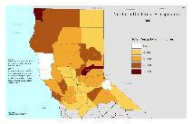
Project Concept and Goals:
California is currently in a drastic drought period, going back to 2012
National Oceanic and Atmospheric Adminstration (NOAA) maintains a vast database of meteorological records
This data is freely available to the public, but the format and sheer number of records makes that data difficult to interpret and manage
This project aims to process the data received and publish thematic maps for presentation of the data
Notes:
Give a brief overview of the presentation. Describe the major focus of the presentation and why it is important.
Introduce each of the major topics.
To provide a road map for the audience, you can repeat this Overview slide throughout the presentation, highlighting the particular topic you will discuss next.

Slide 3
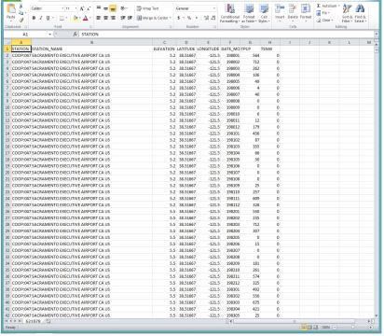
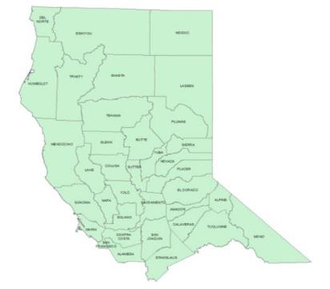
Source Data:
National Oceanic and Atmospheric Administration
Downloaded in CSV file format
36 Northernmost California Counties
One Collection Station Per County
Date Range: 1980 – 2014
13,833 lines of data
Notes:
This is another option for an Overview slides using transitions.

Slide 4
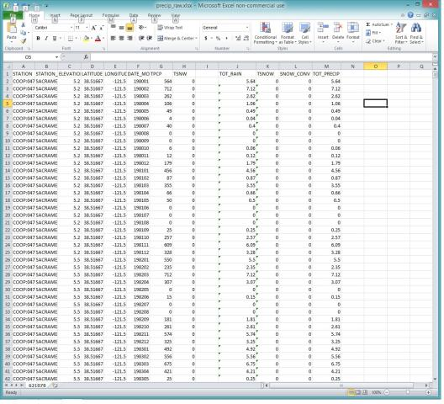
Data Preparation
Data Pre-Processing
Decimal conversion to place decimal values in proper place
Convert snow values to equiv. rain values
Sum totals
Save to DBF format

Slide 5
Method
Process In Two Steps:
Data Processing
Thematic Map Construction

Slide 6
Data Processing
Addition of Needed Modules and Variable Definitions
import arcpy, sys, traceback, datetime
from arcpy.mapping import *
from arcpy import env
author = 'Shawn Stiver'
CUR_DATE = datetime.date.today().strftime('%m.%d.%Y')
try:
# Variables Go Here
datapath = 'G:\\5th_Semester\\Python\\Python_Project\\Data\\'
scratchdata = 'G:\\5th_Semester\\Python\\Python_Project\\Data\\Scratch\\'
mydata = 'G:\\5th_Semester\\Python\\Python_Project\\Data\\MyData\\'
tablepath = datapath + 'Tables\\'
shapefilepath = datapath + 'shapefiles\\'
# Set the local variables
in_Table = tablepath + 'precip_Data.dbf'
x_coords = "LONGITUDE"
y_coords = "LATITUDE"
out_Layer = 'precip_Data_Layer_Test'
out_shapefile = 'precip_Data.shp'
precip_Layer = os.path.join(scratchdata + out_Layer)
precip_shapefile = os.path.join(mydata + out_shapefile)

Slide 7
Data Processing
# 1. Create XY layer from NOAA table
# Spatial Reference
spRef = 'C:\\Users\\shawn\\AppData\\Roaming\\ESRI\Desktop10.3\\ArcMap\Coordinate Systems\\NAD_1983_Albers.prj'
if arcpy.Exists(precip_Layer):
arcpy.Delete_management(precip_Layer)
# XY Event Layer
arcpy.MakeXYEventLayer_management(in_Table, x_coords, y_coords, precip_Layer, spRef)
# Print rows
print arcpy.GetCount_management(precip_Layer)
if arcpy.Exists(precip_shapefile):
arcpy.Delete_management(precip_shapefile)
# Save to a shapefile
arcpy.CopyFeatures_management(precip_Layer, precip_shapefile)
The NOAA table data is brought in, and the XY coordinates of the collecting
stations projected as an Event Layer
The layer was then saved as a shapefile for a permanent copy of the data

Slide 8
Data Processing
# 2. Create Year Counter and while loop
year = 1980
while year <= 2014:
field_list = ['LATITUDE', 'LONGITUDE', 'TOT_PRECIP', 'NAME_UCASE', 'DATE']
# 3. Create Selection query
query = """ "DATE" LIKE '%""" + str(year) + """%'"""
# 4. Select Layer By Attribute
arcpy.SelectLayerByAttribute_management(precip_Layer, "NEW_SELECTION", query)
print 'Features Selected: ' + str(arcpy.GetCount_management(precip_Layer))
# 5. Create Output Feature Class Name
out_fc_year = 'precipData_' + str(year) + '.shp'
print out_fc_year
# 6. Join output table name to Output Path
out_fc_year_path = os.path.join(mydata + out_fc_year)
print out_fc_year_path
if arcpy.Exists(out_fc_year_path):
arcpy.Delete_management(out_fc_year_path)
# 7. Create Output Shapefile
arcpy.FeatureClassToFeatureClass_conversion(precip_shapefile, mydata,
out_fc_year, query)
A while loop was used to loop the script for each year
A “LIKE” statement query was created to find the year value in the date field
and select the required rows
A file name variable was created to name shapefiles with a unique name by year,
and a new shapefile created containing only the data for that year.

Slide 9
Data Processing
# 8. Create Join Table
jointablename = 'Join_table_' + str(year) + '.dbf'
jointable_path = os.path.join(scratchdata + jointablename)
print 'Jointable: ' + jointable_path
if arcpy.Exists(jointable_path):
arcpy.Delete_management(jointable_path)
# 9. Summarize Precipitation Data
arcpy.Statistics_analysis(out_fc_year_path, jointable_path, [["TOT_PRECIP", "SUM"]], "NAME_UCASE")
print 'Statistics Analysis Completed'
# 10. Create New Field for Year Value
arcpy.AddField_management(jointable_path, "YEAR", "SHORT", 0)
print 'Year Field Added‘
# 11. Add year value to field
arcpy.CalculateField_management(jointable_path, "YEAR", year, "PYTHON")
A table was then created containing the precipitation data needed for
the thematic map for that year
The precipitation amounts for each county were then summarized to give an
annual total for that year
A new field was created and populated with the year value to make
future reference easier

Slide 10
Data Processing
# 12. Set up join to Counties shapefile
countyshape = 'NorCalCounties'
countyshape_name = 'NorCalCounties.shp'
countyshape_path = shapefilepath + countyshape_name
# 13. Create Indexes for shapefile and table
indexes = arcpy.ListIndexes(countyshape_path)
for index in indexes:
if (index.name == 'Feature_Index'):
arcpy.RemoveIndex_management(countyshape_path, 'Feature_Index')
indexes = arcpy.ListIndexes(jointable_path)
for index in indexes:
if (index.name == 'Jointable_Index'):
arcpy.RemoveIndex_management(jointable_path, 'Jointable_Index')
arcpy.AddIndex_management(countyshape_path, 'NAME_UCASE', 'Feature_Index', 'NON_UNIQUE', 'NON_ASCENDING')
arcpy.AddIndex_management(jointable_path, 'NAME_UCASE', 'Jointable_Index', 'NON_UNIQUE', 'NON_ASCENDING')
Next, setting up the data so a join between the map shapefile and the
precipitation data table is set up
Indexes are created for both the shapefile and table

Slide 11
Data Processing
if arcpy.Exists(out_FC_layer_year):
arcpy.Delete_management(out_FC_layer_year)
if arcpy.Exists(out_jointable):
arcpy.Delete_management(out_jointable)
arcpy.MakeFeatureLayer_management(countyshape_path, out_FC_layer_year)
arcpy.MakeTableView_management(jointable_path, out_jointable)
# 15. Join Layer and tableview
arcpy.AddJoin_management(out_FC_layer_year, "NAME_UCASE", out_jointable, "NAME_UCASE", "KEEP_ALL")
fields = arcpy.ListFields(out_FC_layer_year)
for field in fields:
print field.name
A new layer is created for the shapefile, and a new table view created
for the table
The layer and table view are then joined

Slide 12
Data Processing
# 16. Create Final Shapefile for Export
precip_final = 'NorCalFinal_' + str(year)
precip_final_path = os.path.join(mydata + precip_final + '.shp')
if arcpy.Exists(precip_final_path):
arcpy.Delete_management(precip_final_path)
arcpy.CopyFeatures_management(out_FC_layer_year, precip_final_path)
print precip_final_path + ' Saved'
A new naming variable is created, and used to create a new shapefile
permanently containing all the precipitation data for that year for each
county

Slide 13
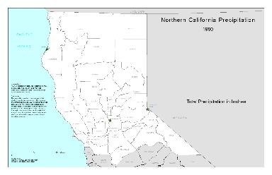
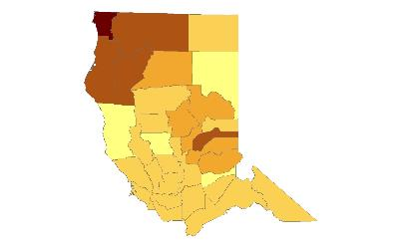
Map Creation
A generic thematic map template (MXD) was created, along with a template
layer containing classification and symbology values desired for layers added
during the process

Slide 14
Map Creation
pdfname = 'NorCalPrecip_' + str(year) + 'pdf'
pdfpath = datapath + '\Output_PDF\\'
pdfoutput = os.path.join(pdfpath + pdfname)
mxd = MapDocument(datapath + 'Project_Template4.mxd')
templatepath = shapefilepath + 'Template_Layer3.lyr'
legend = arcpy.mapping.ListLayoutElements(mxd,"LEGEND_ELEMENT")[0]
styleItem = arcpy.mapping.ListStyleItems("USER_STYLE", "Legend Items", "python_project")[0]
Variables are defined for the map template, document names, and paths

Slide 15
Map Creation
newlayer = arcpy.mapping.Layer(precip_final_path)
# 18. add the layer to the map in data frame
arcpy.mapping.AddLayer(dataframe, newlayer,"AUTO_ARRANGE")
# 19. List TOC Layers
TOCLayers = ListLayers(mxd)
# 20. Apply classification to layer and update legend style
for TOCLayer in TOCLayers:
print 'Layer Name: ' + str(TOCLayer.name)
if TOCLayer.name == precip_final:
updateLayer = arcpy.mapping.ListLayers(mxd, precip_final, dataframe)[0]
sourceLayer = arcpy.mapping.Layer(templatepath)
arcpy.mapping.UpdateLayer(dataframe,updateLayer,sourceLayer, symbology_only = True)
legend.updateItem(updateLayer, styleItem)
A new layer is created from the shapefile containing the precipitation
data for the year
Classification values are then applied from the template layer
Legend style is then updated to include only layers

Slide 16
Map Creation
TOCLayers = ListLayers(mxd)
# 20. Apply classification to layer and update legend style
for TOCLayer in TOCLayers:
print 'Layer Name: ' + str(TOCLayer.name)
if TOCLayer.name == precip_final:
updateLayer = arcpy.mapping.ListLayers(mxd, precip_final, dataframe)[0]
sourceLayer = arcpy.mapping.Layer(templatepath)
arcpy.mapping.UpdateLayer(dataframe,updateLayer,sourceLayer, symbology_only = True)
legend.updateItem(updateLayer, styleItem)
print 'Classification Applied to: ' + out_FC_layer_year
# 21. Modify layout elements
tElements = ListLayoutElements(mxd, "TEXT_ELEMENT")
for tElement in tElements:
if tElement.name == 'Subtitle':
tElement.text = year
A new layer is created from the shapefile containing the precipitation
data for the year
Classification values are then applied from the template layer
Legend style is then updated to include only layers
Map layout subtitle elements are then modified with the year value

Slide 17
Map Creation
# 22. Export mxd to PDF
if arcpy.Exists(pdfoutput):
arcpy.Delete_management(pdfoutput)
ExportToPDF(mxd, pdfoutput)
print pdfname + ' Saved'
if arcpy.Exists(pdfpath + "test.mxd"):
arcpy.Delete_management(pdfpath + "test.mxd")
mxd.saveACopy(pdfpath + "test.mxd")
# 23. Add 1 to year counter
year += 1
else:
del mxd
print "Program Finished"
The map is then exported out in PDF format
The year counter is updated by 1
When the counter reaches the max value specified at the top, an else
statement is used to delete the mxd variable to prevent data locks,
and “Program Finished is printed to alert the user the process is complete

Slide 18
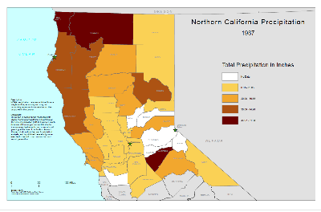
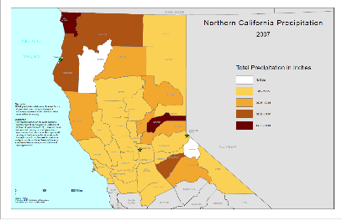
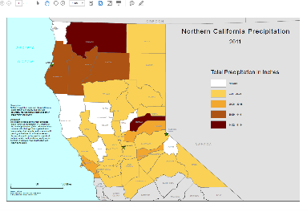
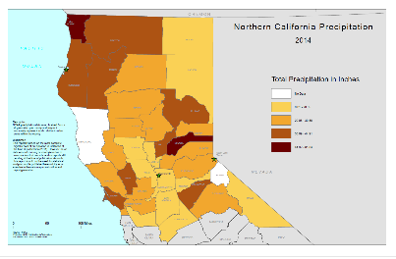
Results
Examples of Maps Produced

