Slide 1

Bald Eagle Territories
A Tour of the New App
By Kevin pinaglia

Slide 2
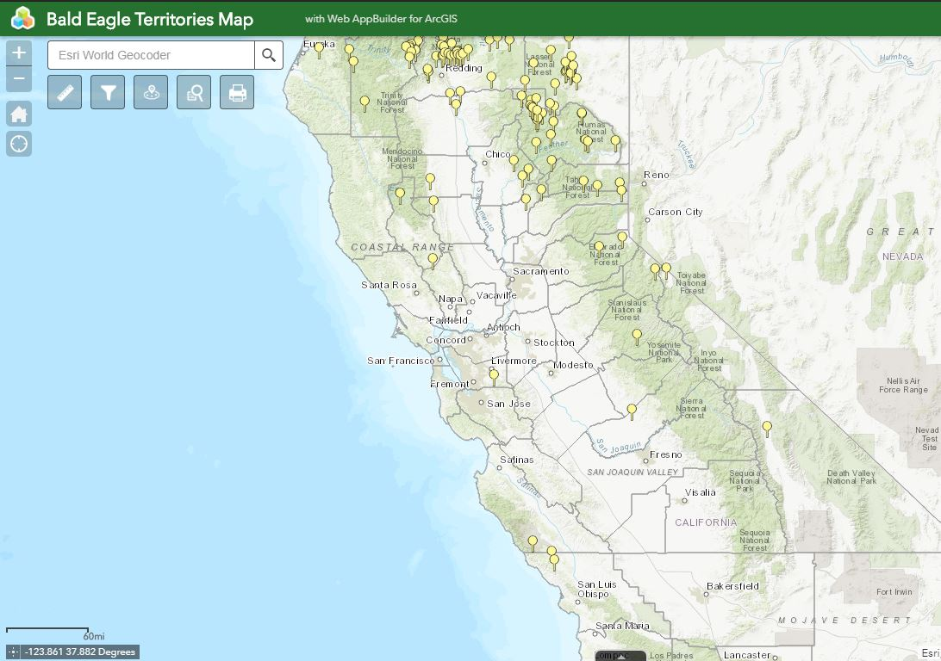
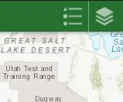
View of the full app
Widgets from left to right are: Measure, Filter, Near Me, Query, Print.
Upper right corner is a snip of the Legend and Layers selection widgets.
At the bottom there is a tab to view the attribute tables for each layer.

Slide 3
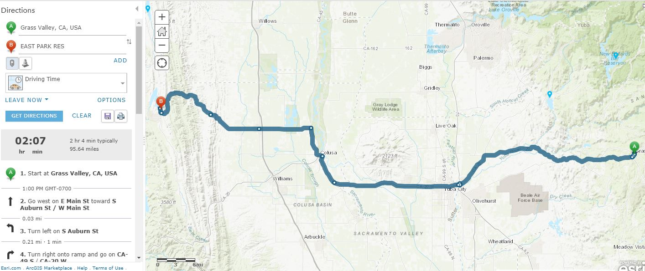
The directions tab in a pop-up is a useful tool:
Here we have directions from Grass Valley, CA to one of the many Bald Eagle Territories.
In the lower left you actually have a travel time and step by step directions.

Slide 4
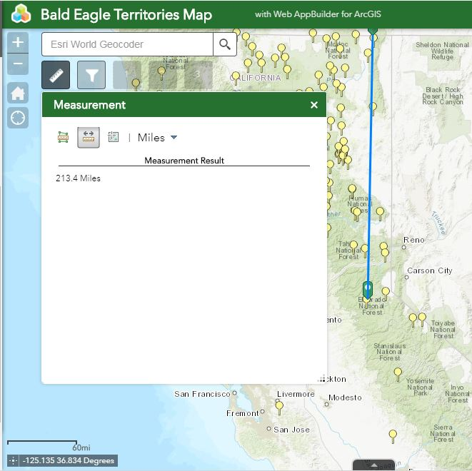
Measure Tool
Used to measure distance, area, and location.
From one Territory to another, including multiple territories at once.
To measure an area of a Territory.
Pick a location in Latitude and Longitude using a GPS.

Slide 5
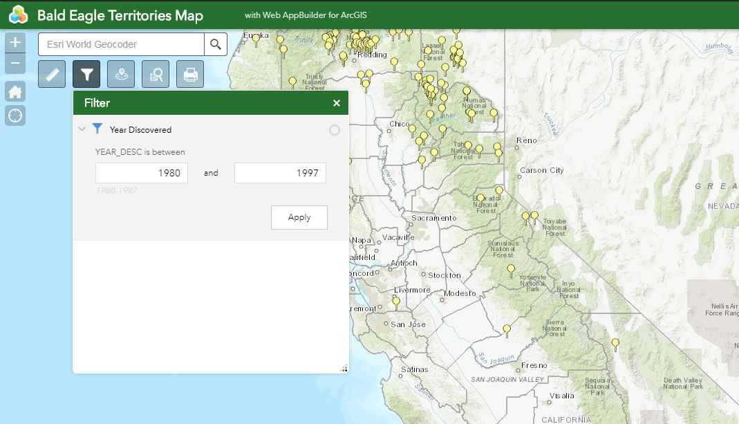
Enter a year to select territories.
Enter a range of years to select within that range.
A hint is given at the bottom in gray.
Once applied the selected territories are shown on the map.

Slide 6
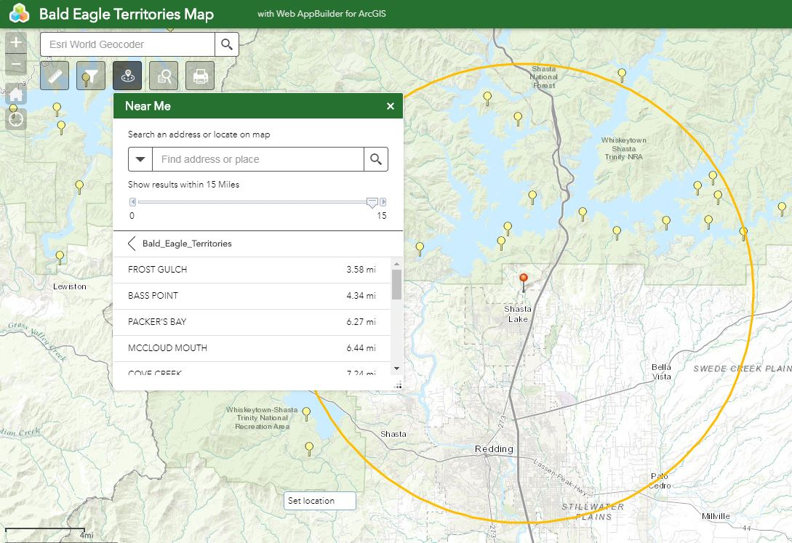
Near Me Tool is useful for finding territories along with counties.
Once activated, drop a pin (red) and the result will show all the territories and counties within a set range.
The range can be determined by moving the slider at top, (default in 15 miles).
Select from the list to highlight a territory to explore further.

Slide 7
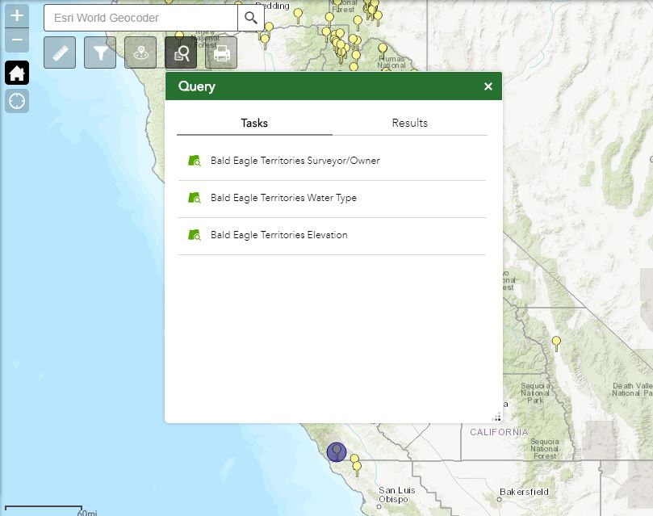
Query Tool
Shows a list of results by query type.
Pick a query from the Tasks menu and get results.
Once a questions has been selected and asked from the list, for instance “water type”, it will zoom to the selected features and create a list for further exploration.

Slide 8
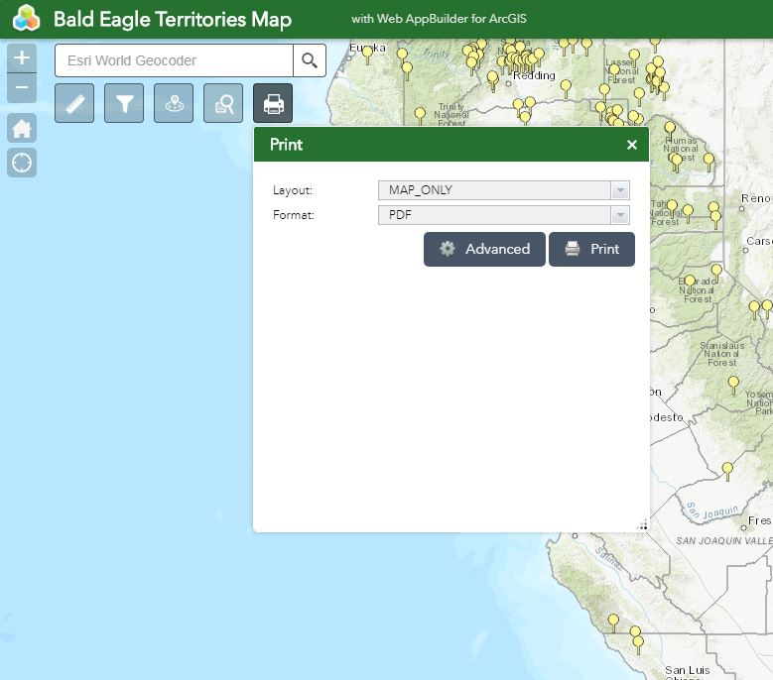
The Print tool can be used to print a hard copy of the map or even a digital copy in many different formats.
Layout can be selected for many different paper sizes.

Slide 9
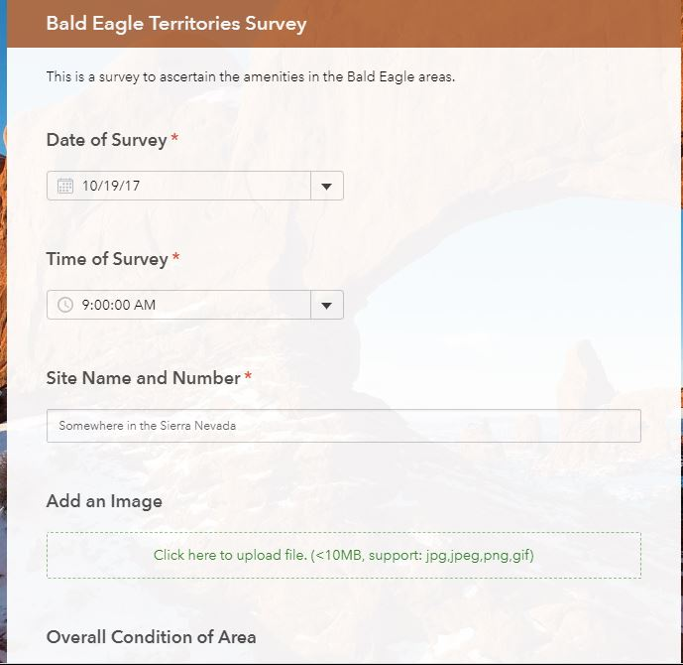
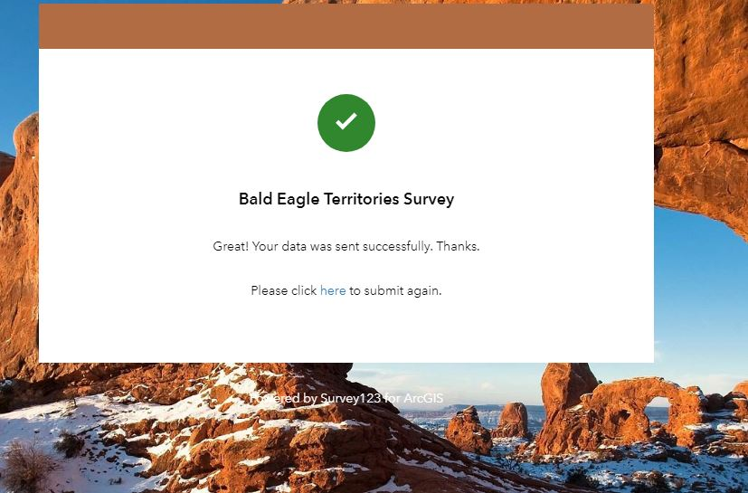
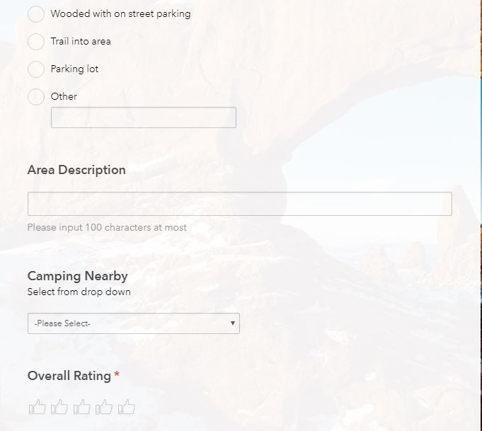
Within the pop-up there is a survey that can be taken to gather data about the particular territory visited.
Some questions are required
A picture can be added, which would help in describing the area and can be added to the pop-up when updates to the app are completed.
I added “Camping Nearby” so this too can be added to the pop-up information if a visitor wants to stay for a couple of days.
At the end, in the smallest slide, there is a “Thank You” for taking the survey.

Slide 10
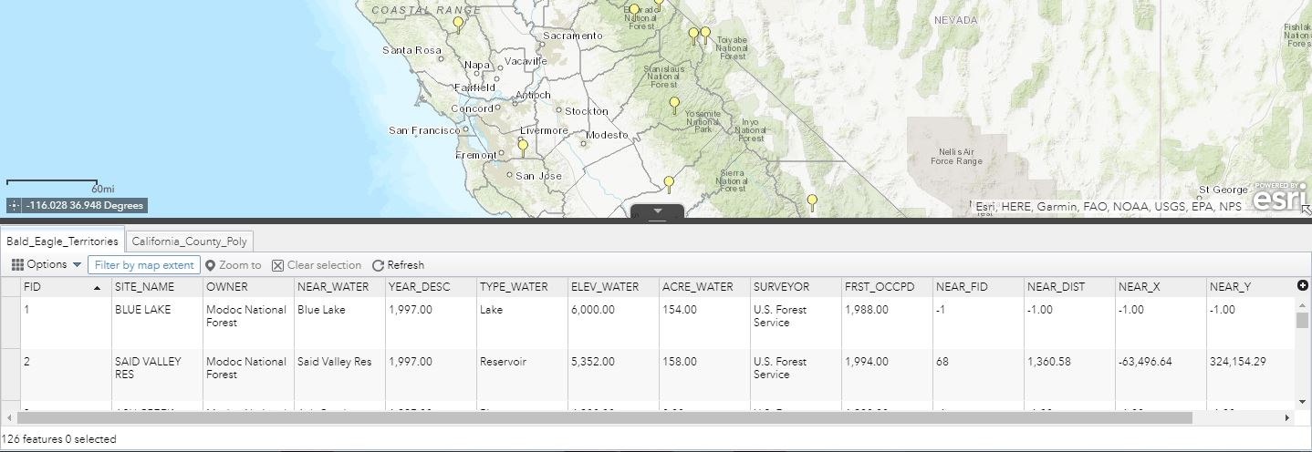
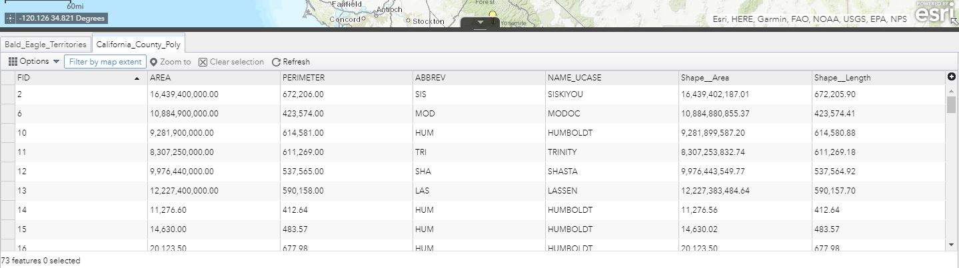
The Attribute Table Tab located at the bottom of the map window.
This area consists of the data that makes up the layers used for the app.
Bald Eagle Territories- all the data associated with this layer.
California County Poly- county name and area, perimeter and FID number to name a few.

