Slide 1
Plotting tritium data in California using python
By: Yu Liao Peng
GEOG 375

Slide 2
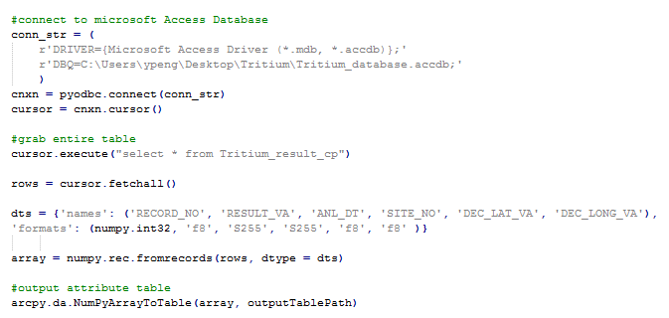
Python connecting to Microsoft Access
- SQL statements can be used to retrieve
pecific data or query statements
can be used when using search cursors
- Numpy module was used to create
an ArcGIS attribute table from MS Access
table

Slide 3
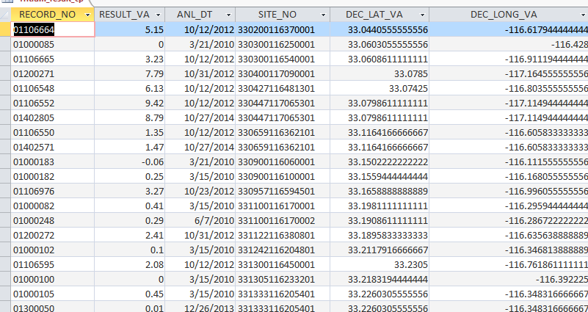
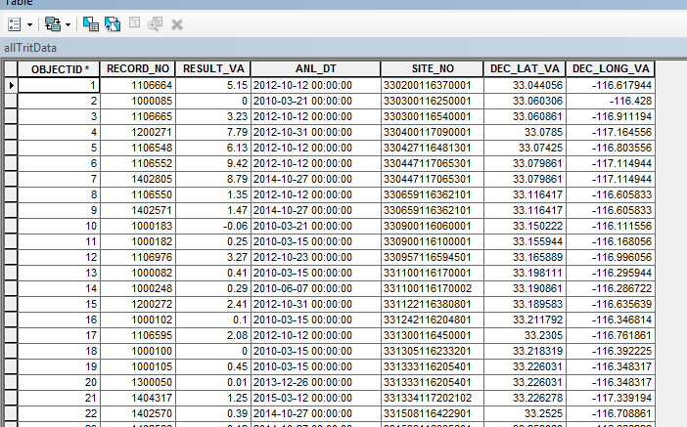
MS Access table to ArcGIS Attribute Table

Slide 4
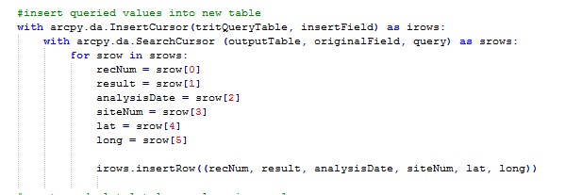
Search and insert cursor
Meaningful tritium data was
inserted into another table
using search and search cursors

Slide 5
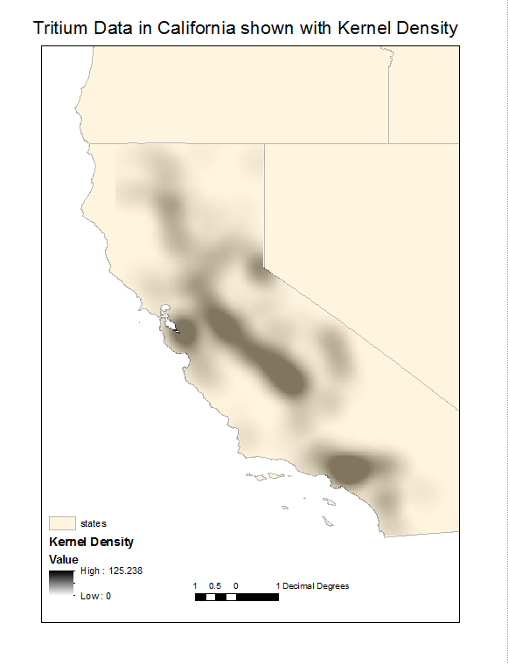
Result
Tritum distribution in California
to show groundwater age distribution
using kernel density

