Slide 1
Space Time Crime Patterns for the City of Sacramento
Fred Ortiz
Geography 385
American River College
December 12, 2017

Slide 2
Space Time Crime Patterns for the City of Sacramento
Step 1
Preprocessing to condense the Dispatch data
Platform: ArcGIS desktop version 10.5.1
Original dispatch data consisted of 327,354 records
Process:
Data filtering for non related criminal activities
Change the coordinate system
Exclude outliers
Convert text time to date datatype
Result: record set consisting of 178,234 rows

Slide 3
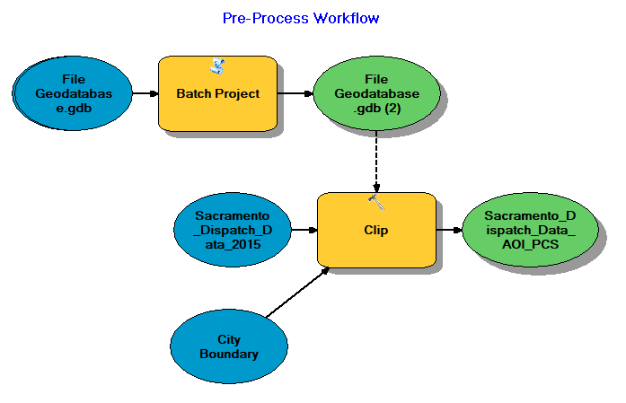
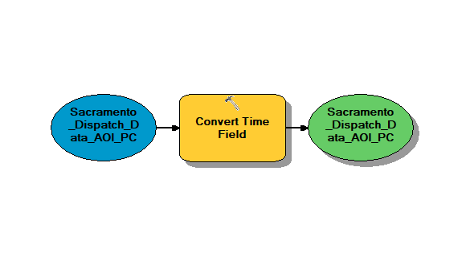
Desktop Tools for pre-processing dataset
ModelBuilder
for project documentation and tool re-use
2. Selection by Attribute query
to eliminate non-crime activities from dispatch calls
Notes:
Insert a picture of an animal and or plant found in your country.

Slide 4
Space Time Crime Patterns for the City of Sacramento
Step 2
Analysis of Dispatch data
Platform: ArcGIS Pro version 2.0.1
Iterative process for entire city scope
Geoprocessing tools utilized:
Create Space Time Cube by aggregation.
Emerging Hot Spot Analysis.
Enrich layer.
Ordinary Least Squares (OLS).
Result: record set consisting of 178,234 rows

Slide 5
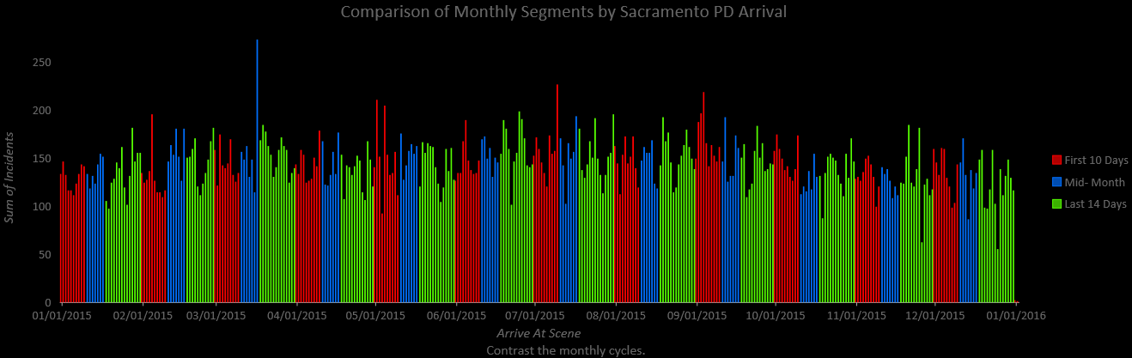
Space Time Crime Patterns for the City of Sacramento
Step 2 (continued)
Analysis of Dispatch data
Comparison of Monthly Time Intervals for Sacramento Incidents

Slide 6
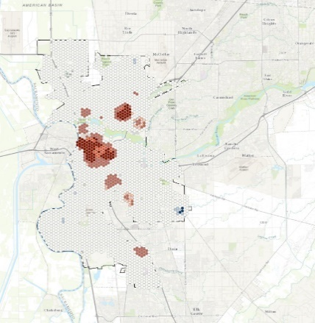
Space Time Crime Patterns for the City of Sacramento
Step 2 (continued)
Generating Hot Spots using geoprocessing tools in ArcGIS Pro
1. Space time cube by aggregation
Produces NetCDF file (extension .nc)
2. Emerging Hot Spot Analysis
Use NetCDF file as input
Notes:
Insert a picture of an animal and or plant found in your country.

Slide 7
Space Time Crime Patterns for the City of Sacramento
Step 2 (continued)
Enhanced Dataset using geoprocessing tools in ArcGIS Pro
1. Enrich Layer
Supplement data for analysis
Note: This geoprocessing tool charges credits
Requsted Data:
HasData - Value of 1 means a hexagon bin had data for at least one of the selected attributes.
MEDHINC_CY - 2017 Median household income value per hexagon bin.
MEDVAL_CY - Median home value per hexagon bin.
NLCDfrstPt - Percentage of land within each hexagon bin that is classified as forest land by the National Land Cover database.
PCI_CY - 2017 Per Capita Income.
RELSNAP - Food stamp recipients.
TOTPOP10 - 2010 Population count per hexagon bin. A bin may have a population of 0 because it is in an industrial area or in a park.
VACANT_CY - 2017 Vacant Housing Units.
Notes:
Insert a picture of an animal and or plant found in your country.

Slide 8
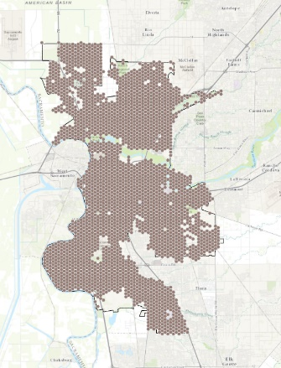
Space Time Crime Patterns for the City of Sacramento
Step 2 (continued)
Enhanced Dataset using geoprocessing tools in ArcGIS Pro
1. Enrich Layer
Supplement data for analysis
Notes:
Insert a picture of an animal and or plant found in your country.

Slide 9
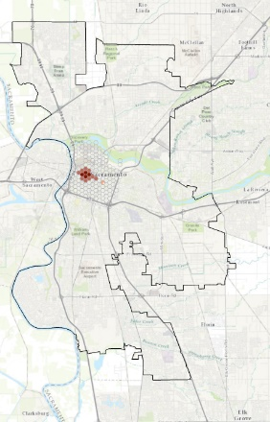
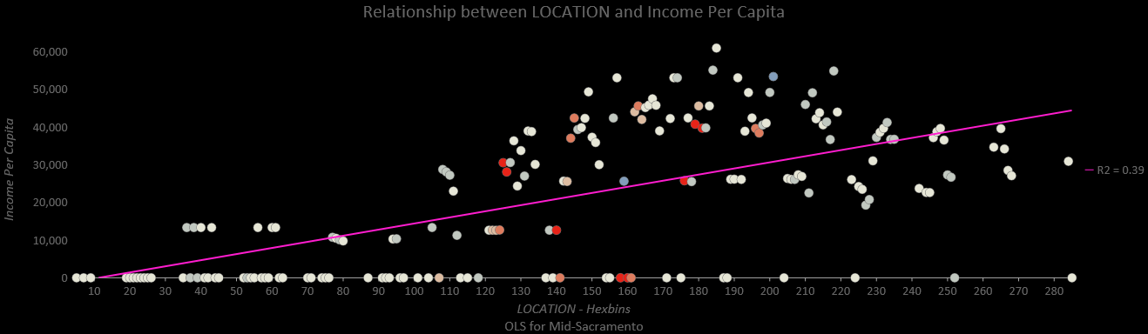
Space Time Crime Patterns for the City of Sacramento
Step 2 (continued)
Ordinary Least Squares (OLS)
Relationship between Locations and Income Per Capita

Slide 10
Space Time Crime Patterns for the City of Sacramento
Step 3
Share data via ArcGIS Portal
Platform: ArcGIS Online version - December 2017 update
1. 5 files published to ArcGIS Online
2. Instead entire project was published online
3. Titles of layers and tables were garbled
4. All symbology was accepted

Slide 11
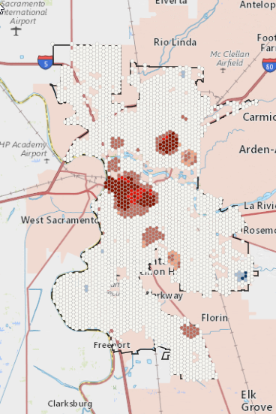
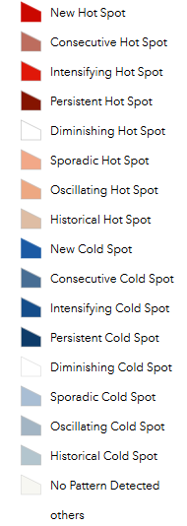
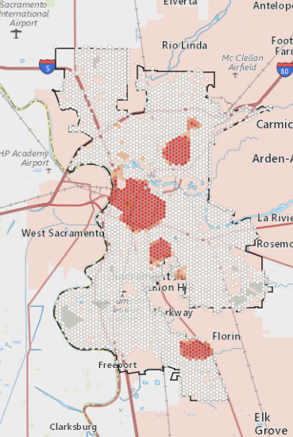
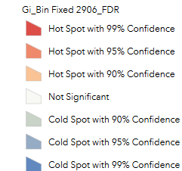
Hot Spot Analysis Comparison
ArcGIS Pro – Space Time Cube
ArcGIS Online
Notes:
Insert a picture of an animal and or plant found in your country.

Slide 12
Online Limits
Smaller dataset size compared with ArcGIS Pro
a) Rendering
b) Performance
c) May require preprocessing of larger datasets
Charting tools not compatible with ArcGIS Pro
a) Linear charting method with the option to select a series from one or more fields
b) Ordinary Least Squares
Notes:
Insert a picture of an animal and or plant found in your country.

