Slide 1
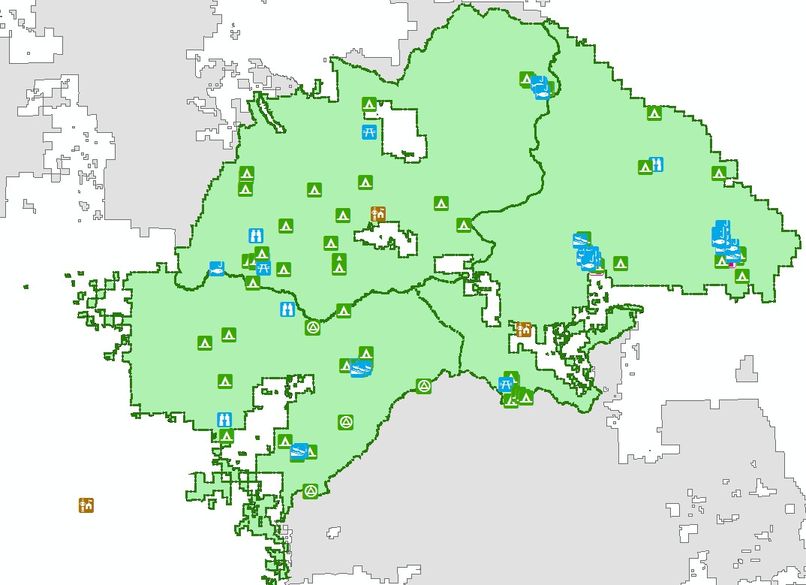
Plumas National Forest – Recreation Opportunities
Katie Miller
GEOG 385, Dec 13, 2016
Final Web GIS Project

Slide 2
Create a Web Map App for users
Recreation points can be edited by users
Domains allow for drop-down data entry during editing
Users can add new points of interest, edit existing data and add photos
Map can be updated as needed when feature attributes change (reservation fees, season open & close dates, and other information)
Reference layers do not allow user edits

Slide 3
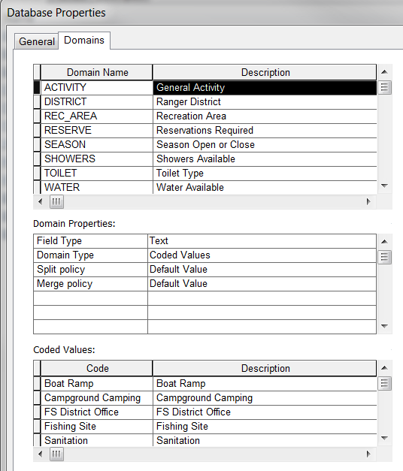
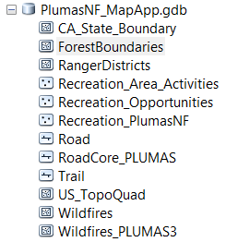
Data and domain creation
Created PlumasNF_MapApp.gdb
Edits allowed on feature layer
  Recreation
Non-edit feature layers
  Wildfire History (1987 – 2013)
  Ranger Districts
  Forest Service Road
  Forest Boundaries
  USGS: Topo Quad
  Basemap

Slide 4
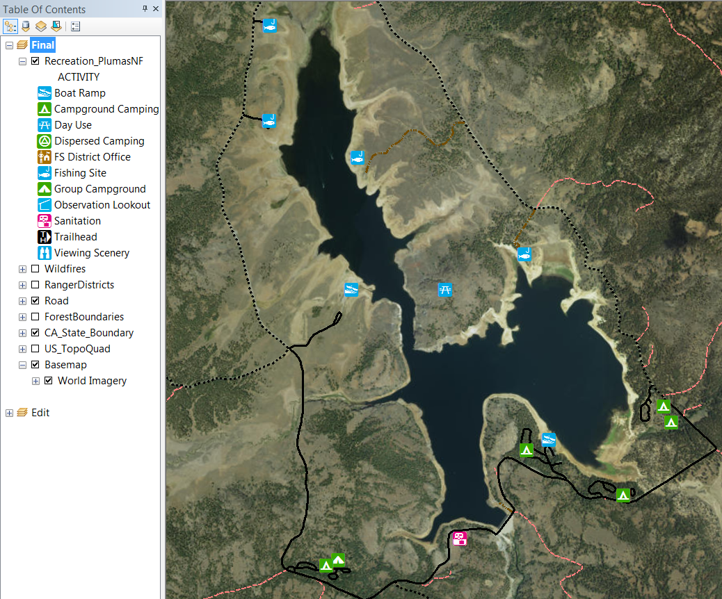
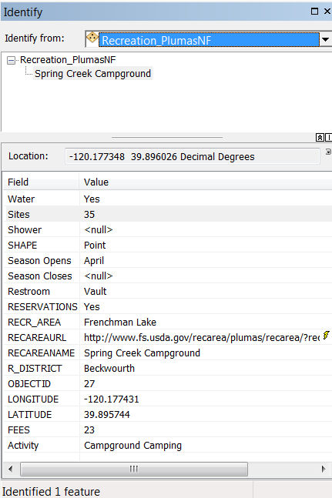
ArcMap: Attributes and feature symbology finalized

Slide 5
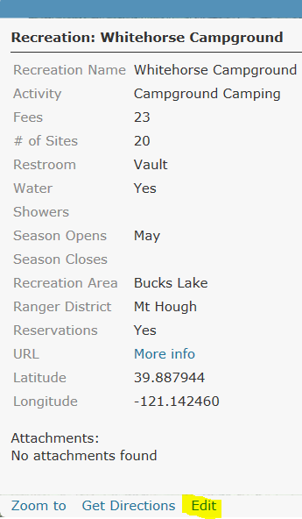
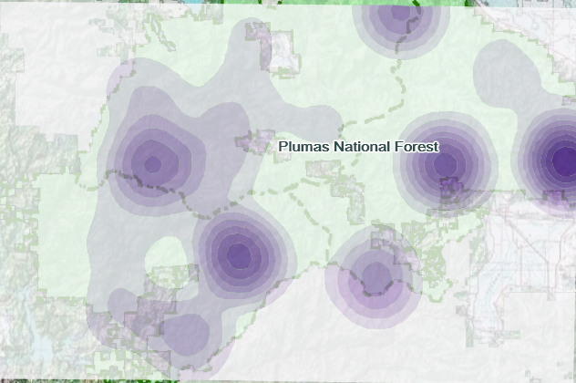
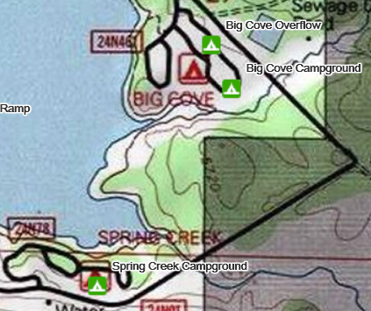
Create Web Map on arcgis.com
Set visibility range on each layer
Configure pop-ups
Manage labels and set visibility range
Perform analysis – analyze patterns, calculate density of recreation

Slide 6


Web App Builder
Choose template theme, style, layout
Set map extent
Set the widgets
Enter attributes for map – logo, title, subtitle, links
Configure search settings for feature layers in map
Widgets
  About
  Smart Editor
  Filter
  Time Slider
  Legend
  Layer List
  Basemap

Slide 7
Editing and Viewing Data
Smart editor is used to add new points or edit attributes of existing recreation points
Edit geometry allows the point location to be changed
Attachments can be added - photos preferred
The URL is a hyperlink that opens the USFS webpage for the feature
The search bar allows a search by name or activity

Slide 8
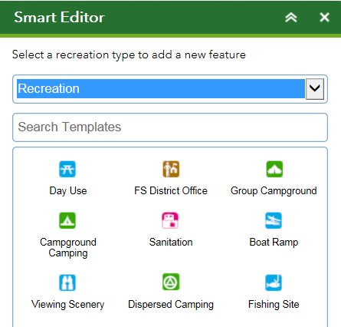
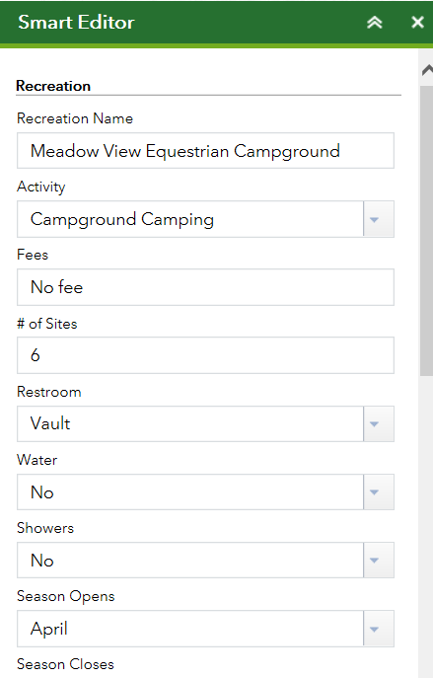
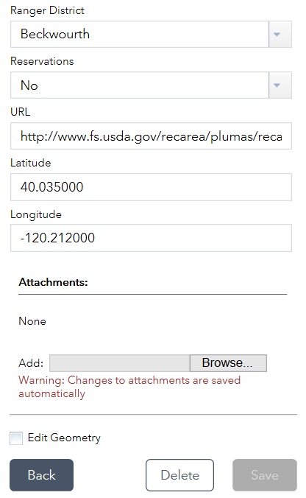
Smart Editor

Slide 9
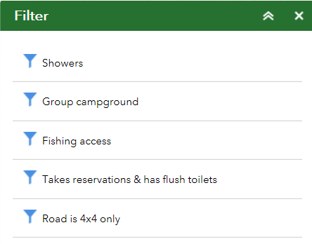
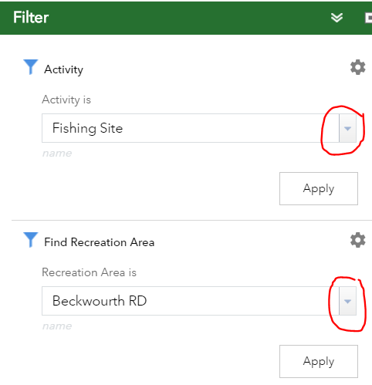
Filter
Preset filters allow users to quickly choose what they want to see, but are limiting as they can’t be edited or created by users
One or more filters can be selected at a time
Interactive filters created, Ask for Values

Slide 10
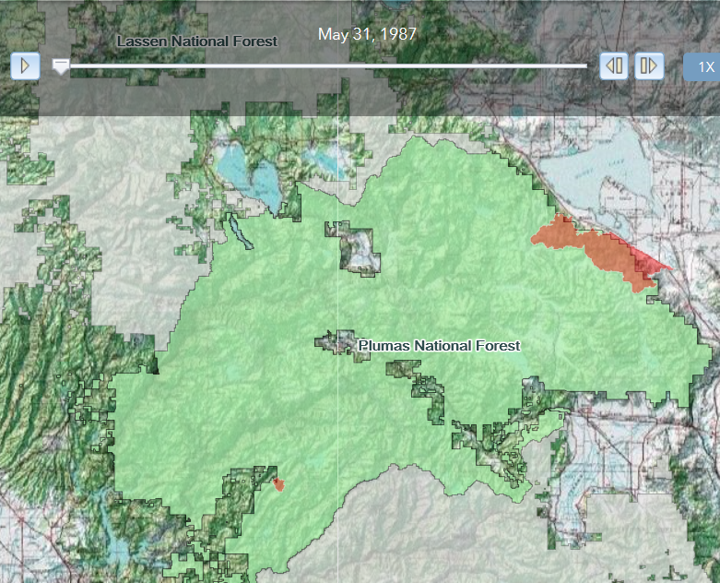
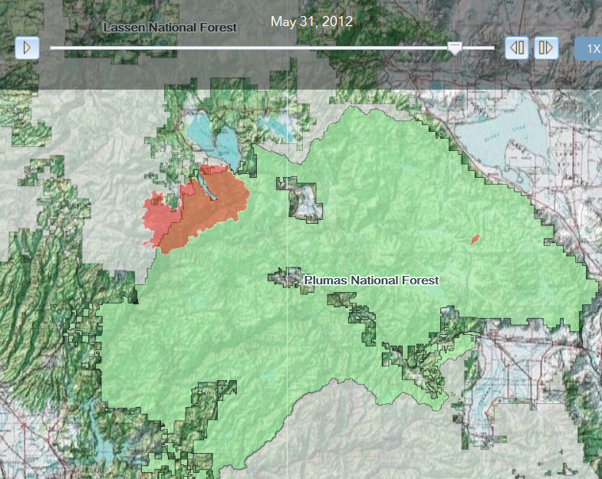
Time Slider
Shows wildfires by year from 1987 – 2013
Difficulty changing labels to only display the year instead of month day, year

Slide 11
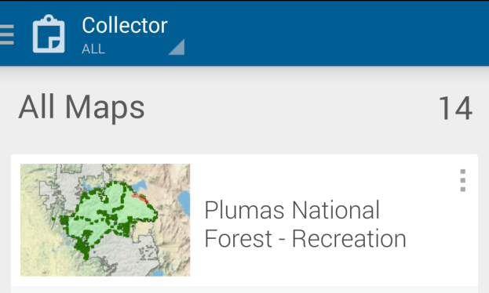
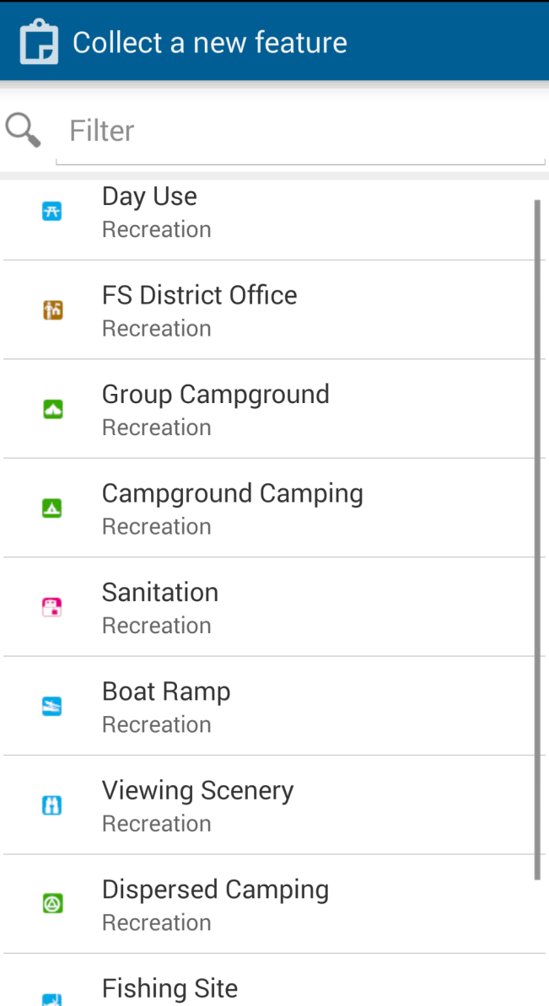
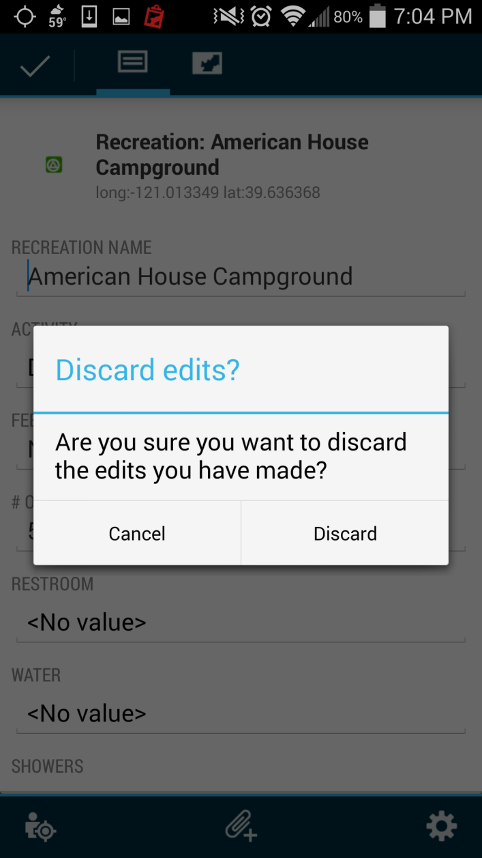
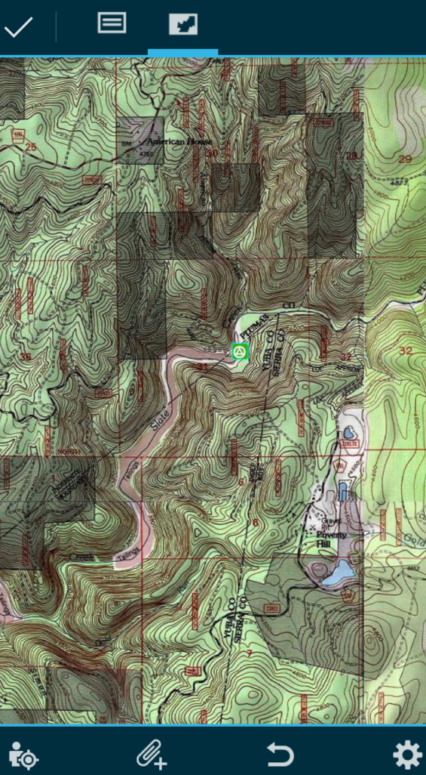
Collector App access via smartphone

Slide 12
Challenges
Map App Builder would not save my work several times. The save button would not work and I had to redo my work about 5 times
Updates in the Map App data did not update the Web Map App
Some features are not very easy to use
A few times I hit the back button on the web browser and lost some of my work
The worst problem was when the Save button was stuck on “Saved” and I could not save my work

Slide 13
Sources
https://data.fs.usda.gov/geodata/
http://www.fs.usda.gov/main/r5/landmanagement/gis
http://www.fs.usda.gov/main/r5/recreation
http://doc.arcgis.com/en/web-appbuilder/create-apps/make-first-app.htm
Link to web map app: https://arc-gis.maps.arcgis.com/apps/webappviewer/index.html?id=63e2184a5cfa4930966c151801f46742

