Slide 1
Processing Well Data Points to be Used in Google Earth
Katie Miller
kmiller74@mail.csuchico.edu
3/15/2016
GEOG 375

Slide 2
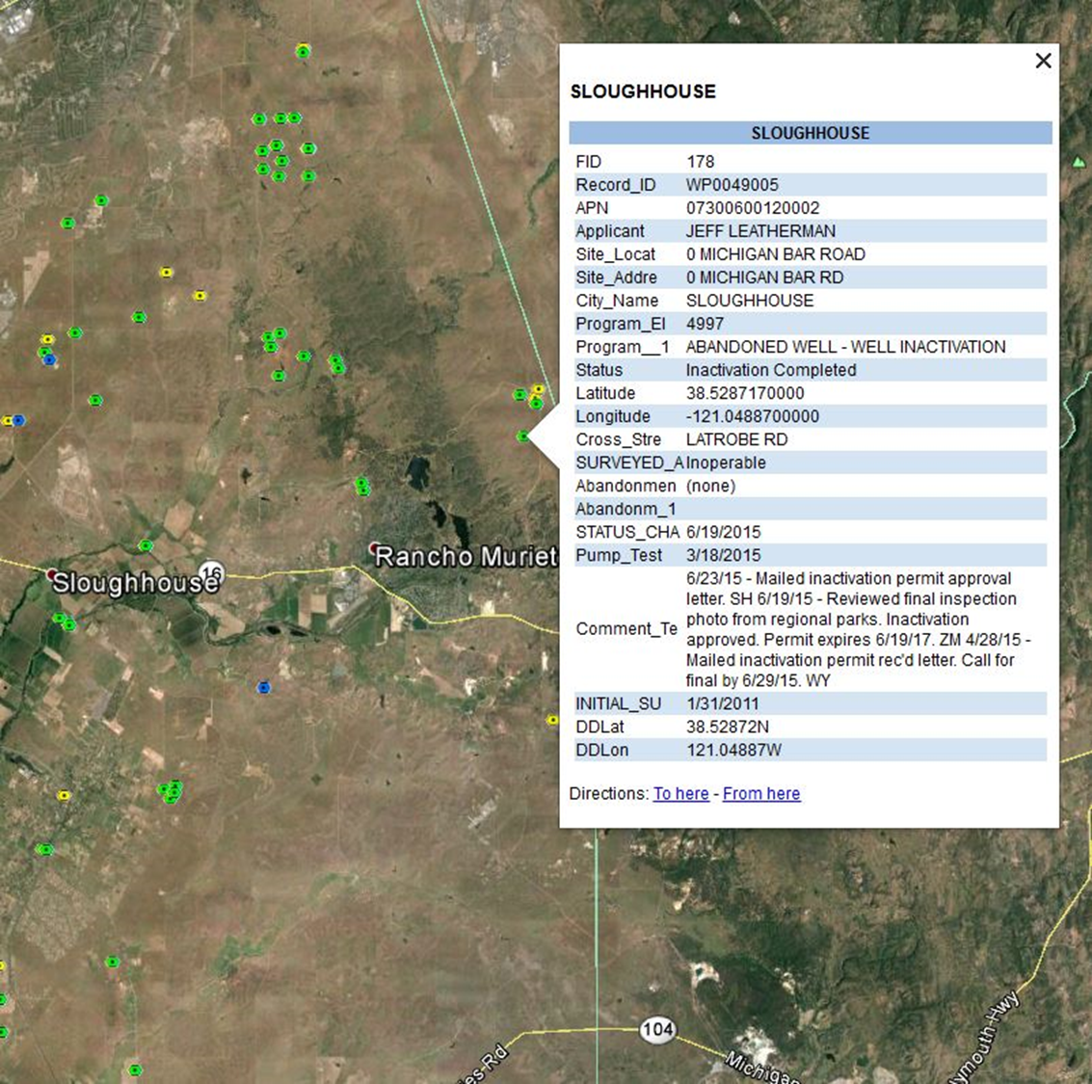
The Goal
Well points contain data from the project database
Project team members do not have GIS, so this format is used to distribute to the team on a monthly basis
Attributes for each point are displayed by clicking on the opint

Slide 3
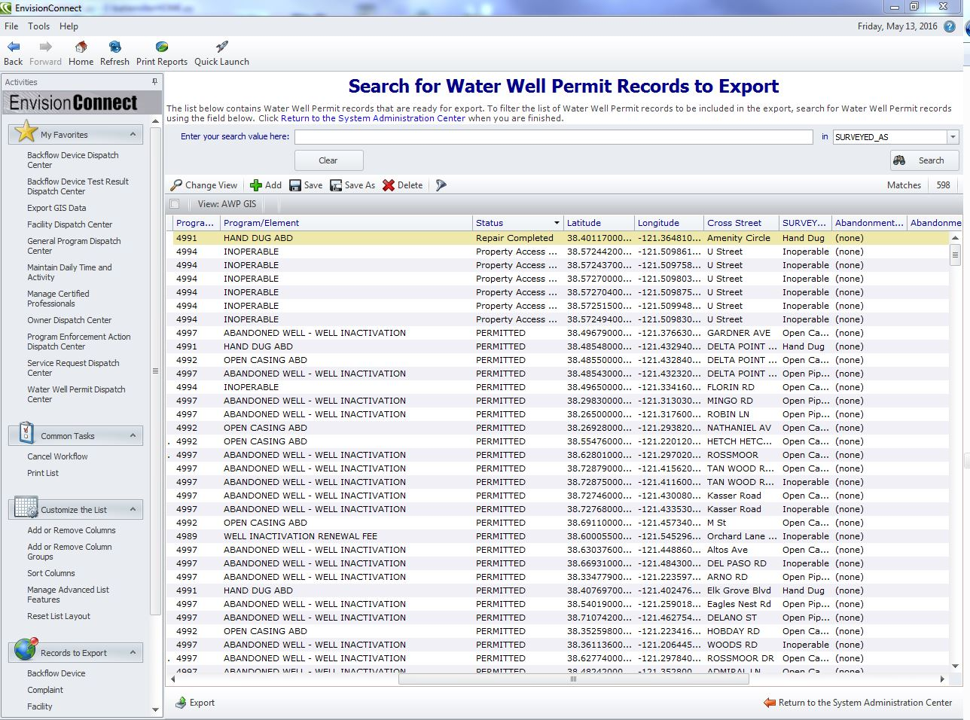
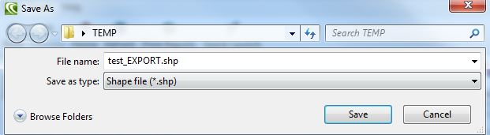
Export GIS Data from the EnvisionConnect Database
Use queries within the database to specify the data to export
Export the data and save as a shapefile
File saved

Slide 4
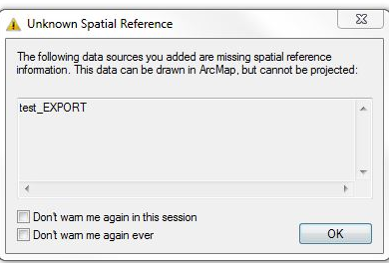
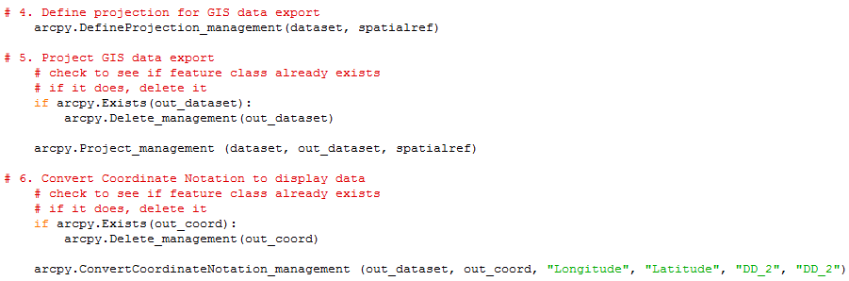
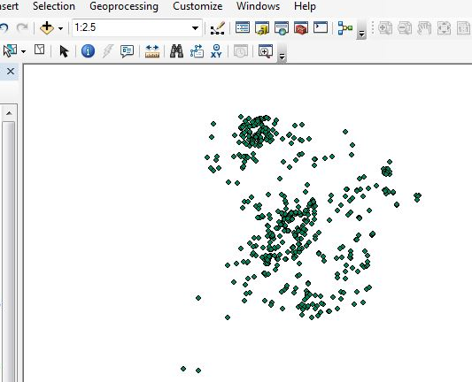
Shapefile has no Spatial Reference
Define Projection, Project, & Convert Coordinate Notation
Corrected data after running the above script. Now it matches up with County Boundary:

Slide 5
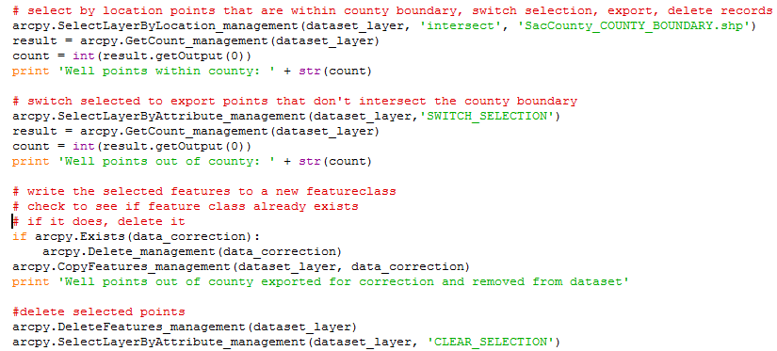
GPS Coordinates May Contain Errors
Check if any points fall outside of Sacramento County Boundary
Select County Boundary, Select Points within County, Switch Selection and Export points outside of the boundary to use for data correction
Delete selected points

Slide 6
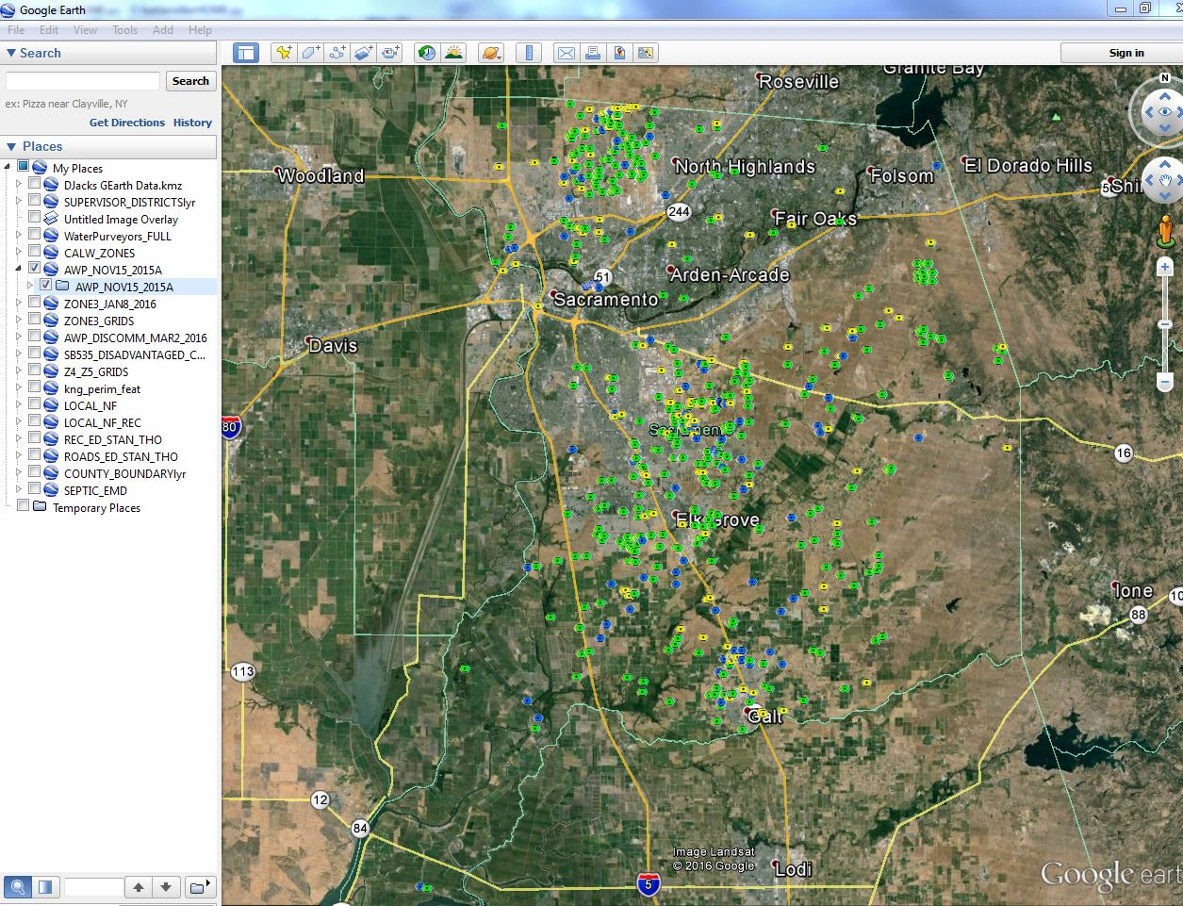
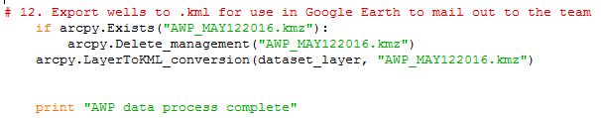
Export to KML and email file to team members

