Slide 1
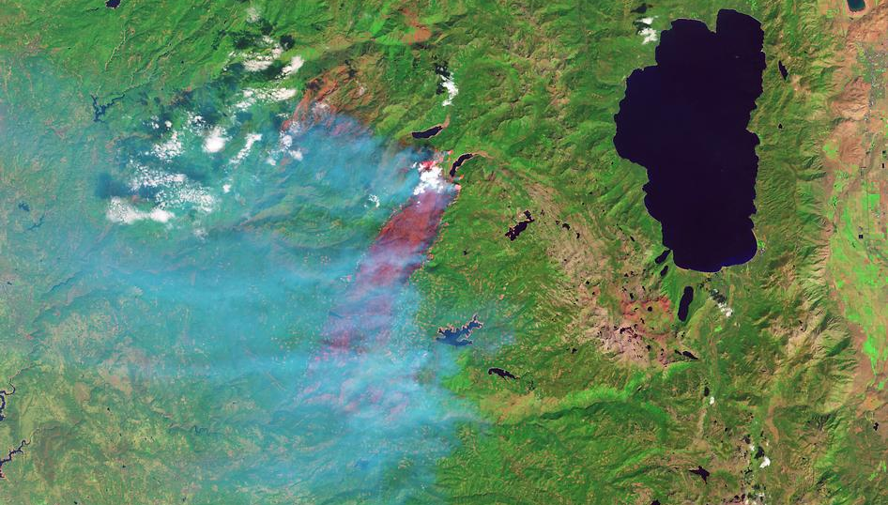
Remote Sensing
Landscape Changes
Before and After
King Fire 2014
Katie Miller
12/12/2016
kmiller74@mail.csuchico.edu
http://inciweb.nwcg.gov/photos/CAENF/2014-09-14-2321-King/picts/2014_09_26-10.46.15.396-CDT.jpeg

Slide 2
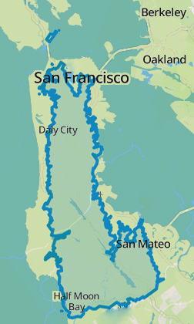
King Fire
Started September 13, 2014 by arsonist
100% contained October 9, 2014
97.717 acres burned
80 structures destroyed
12 injuries
El Dorado County near Pollock Pines
Dan Brekke/KQED

Slide 3
Landsat 8 OLI & TIRS
Operational Land Imager
Thermal Infrared Sensor
Sensors on the Landsat 8 satellite
  Launched February 2013
  Collects images of Earth on 16-day repeat cycle
30-meter pixel size
9 spectral bands, 2 thermal bands
Available from GloVIS or EarthExplorer

Slide 4
Band Designations for Landsat 8
Landsat 8 | Bands | Wavelength | Resolution
Operational |  | (micrometers) | (meters)
Land Imager | Band 1 - Ultra Blue (coastal/aerosol) | 0.43 - 0.45 | 30
(OLI) | Band 2 - Blue | 0.45 - 0.51 | 30
and | Band 3 - Green | 0.53 - 0.59 | 30
Thermal | Band 4 - Red | 0.64 - 0.67 | 30
Infrared | Band 5 - Near Infrared (NIR) | 0.85 - 0.88 | 30
Sensor | Band 6 - Shortwave Infrared (SWIR) 1 | 1.57 - 1.65 | 30
(TIRS) | Band 7 - Shortwave Infrared (SWIR) 2 | 2.11 - 2.29 | 30
 | Band 8 - Panchromatic | 0.50 - 0.68 | 15
 | Band 9 - Cirrus | 1.36 - 1.38 | 30
 | Band 10 - Thermal Infrared (TIRS) 1 | 10.60 - 11.19 | 100 * (30)
 | Band 11 - Thermal Infrared (TIRS) 2 | 11.50 - 12.51 | 100 * (30)
Source: https://landsat.usgs.gov/what-are-band-designations-landsat-satellites

Slide 5
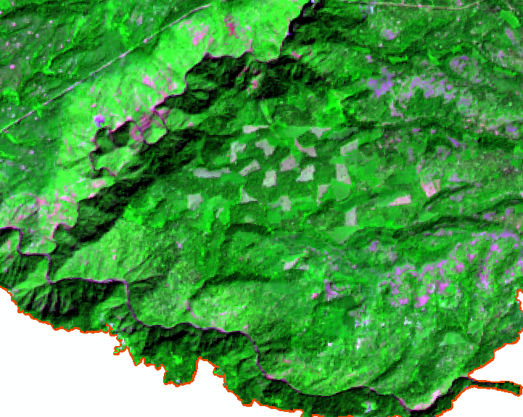
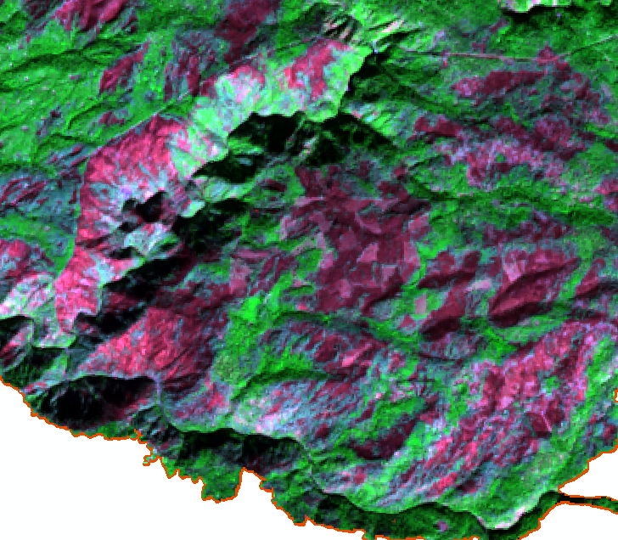
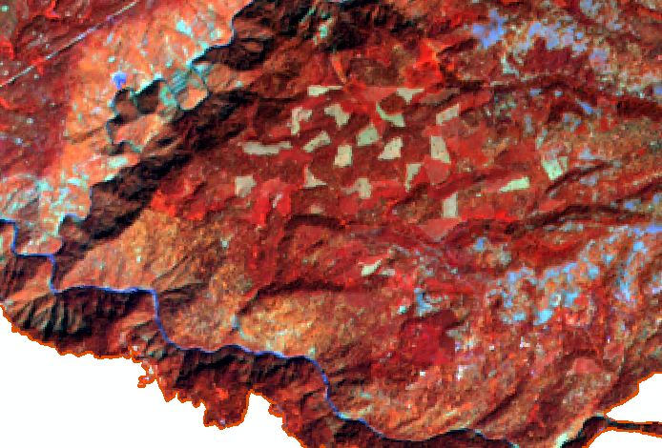
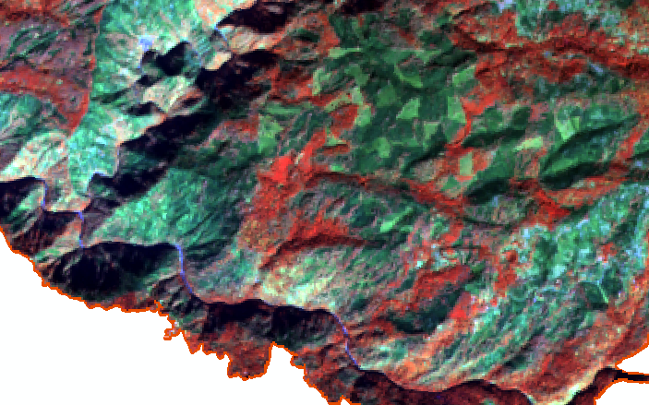
Band Combinations for Landsat8
Natural Color | 4 3 2
False Color (urban) | 7 6 4
Color Infrared (vegetation) | 5 4 3
Agriculture | 6 5 2
Healthy Vegetation | 5 6 2
Land/Water | 5 6 4
Natural With Atmospheric Removal | 7 5 3
Shortwave Infrared | 7 5 4
Vegetation Analysis | 6 5 4
b
a
b
a

Slide 6
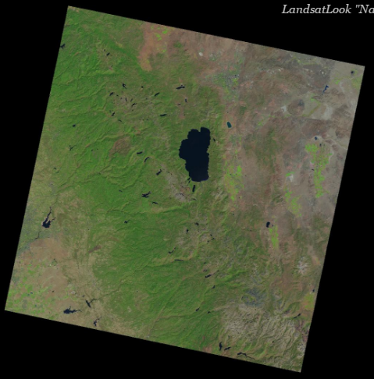
Before Fire 9/3/2014

Slide 7
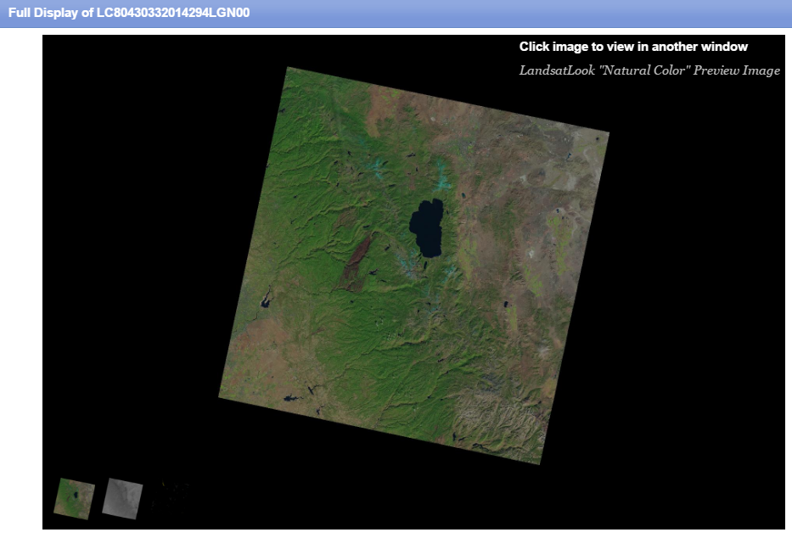
After Fire 10/21/2014

Slide 8
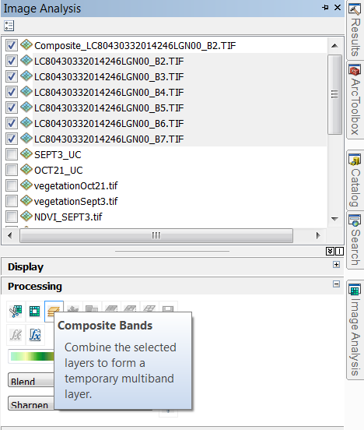
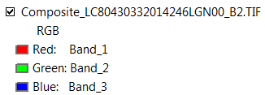
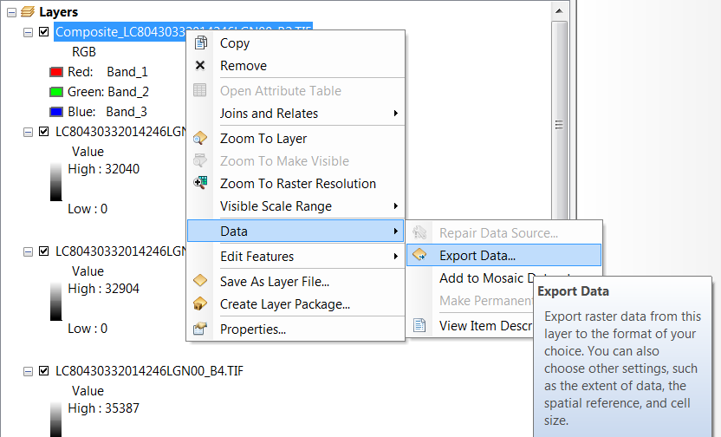
Add Landsat Bands, Create Composite

Slide 9
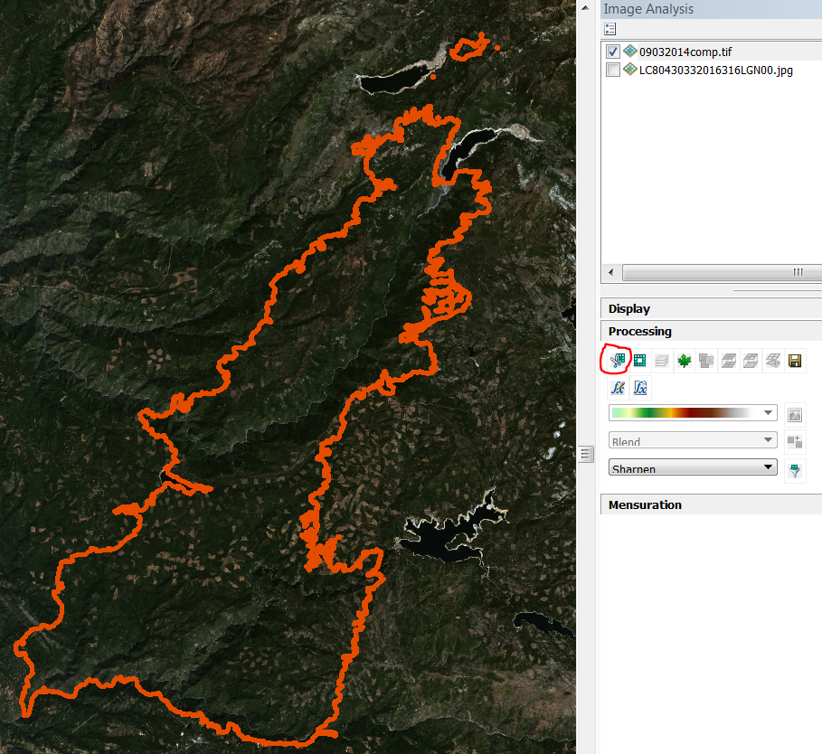
Image Analysis, Processing, Clip
Use King Fire boundary to clip Landsat 8 images
Exported each imaged to save as a clipped image for project area

Slide 10
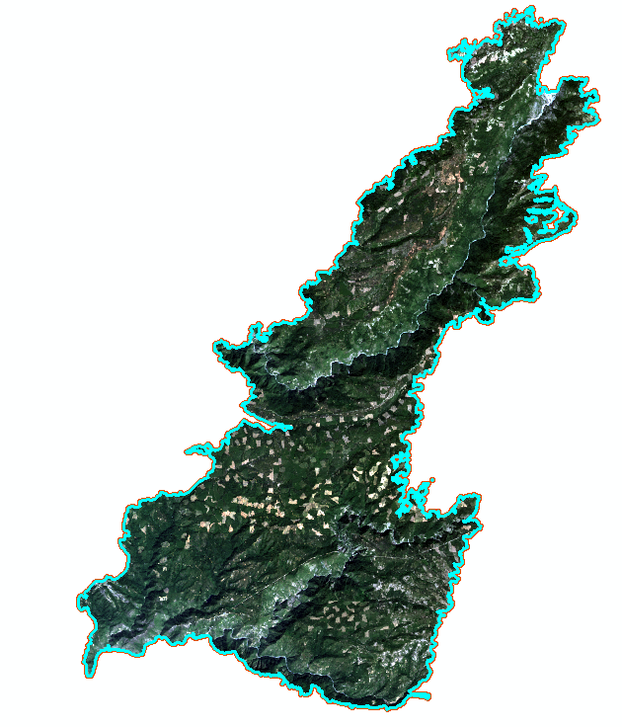
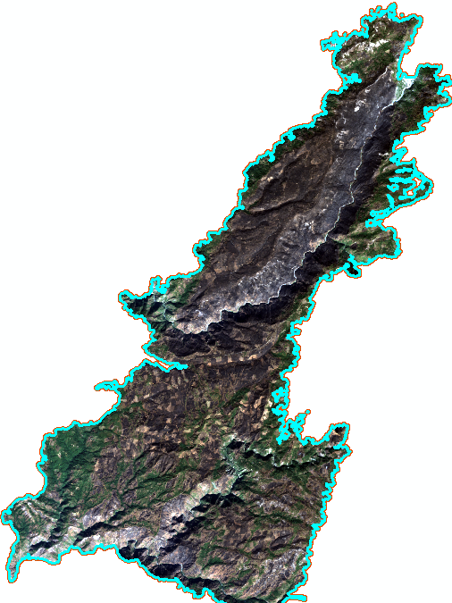
Landsat8 – True Color of Fire Area
September 9, 2014
October 21, 2014
Before Fire
After Fire

Slide 11
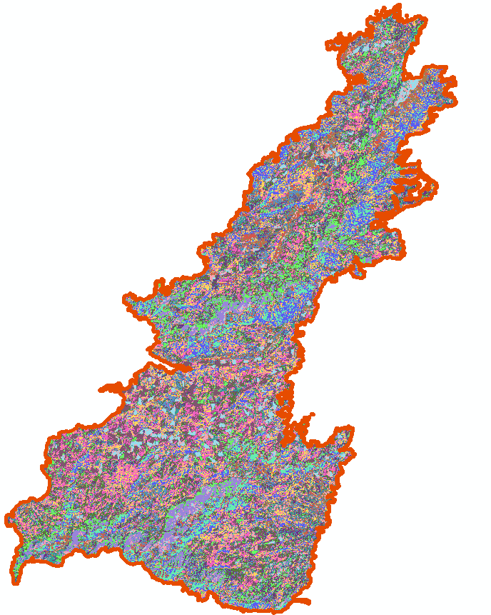
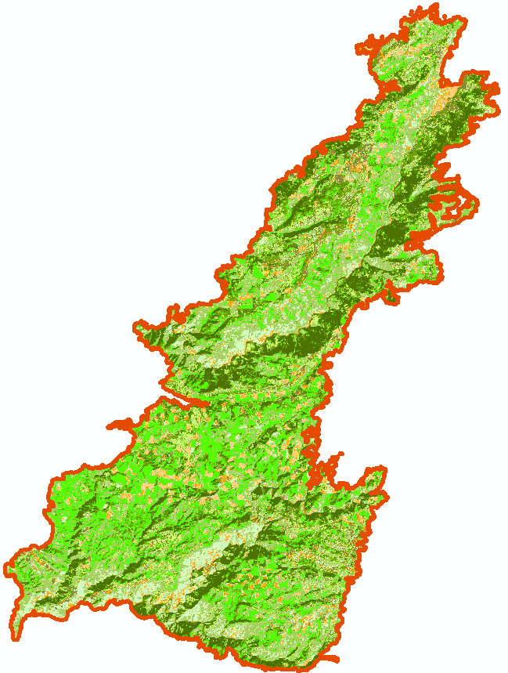
Unsupervised Classification, 15 classes
Before King Fire
Land Cover Types
High density forest
Med density forest
Low density forest
Regrowth
Shrubs
Barren
Sparse vegetation
Bare soil
Bare soil – water

Slide 12
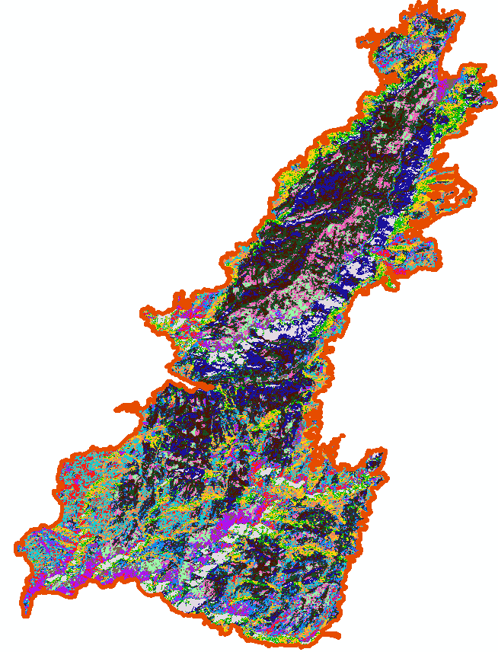
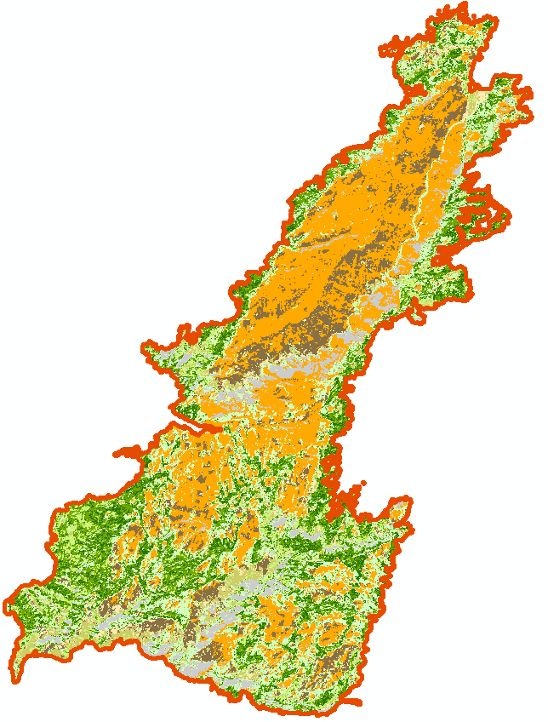
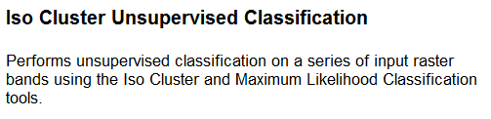
Unsupervised Classification, 15 classes
After King Fire
Land Cover Types
Shadow
High density forest
Med density forest
Low density forest
Shrubs
Barren
Sparse vegetation
Bare soil
Bare soil – water

Slide 13
Comparison of Unsupervised Classification
After Fire
Before Fire

Slide 14
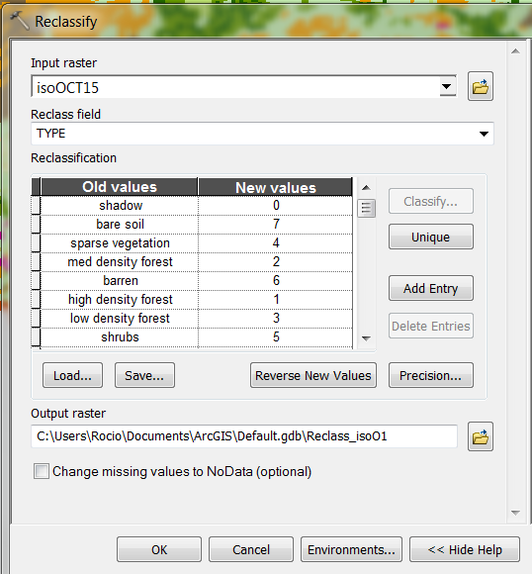
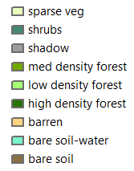
Reclassified using Same Land Cover Type

Slide 15
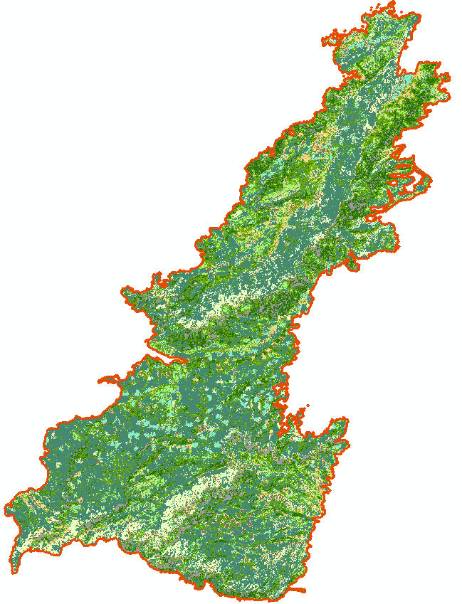
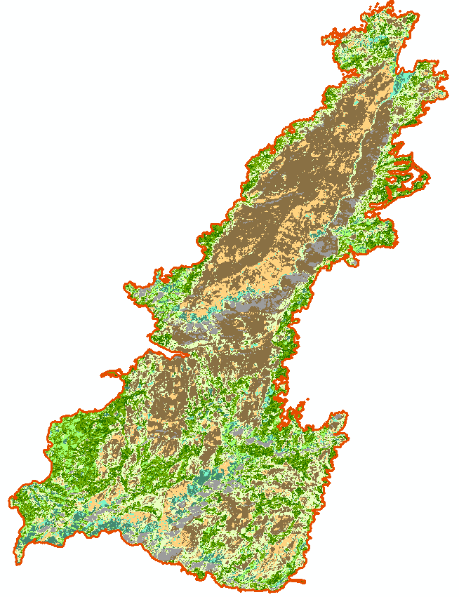
Symbolized by land cover type
Before Fire
After Fire

Slide 16
Comparing Cell Count and % Change for Land Cover Types
 | 9/3/2014, Before Fire |  |  | 10/21/2015, After Fire
Land Cover Type | Cell Count | % of Total | % Change | Cell Count | % of Total | % Change
Shadow | 19179 | 4.36 | -0.78 | 22615 | 5.15 | 0.78
High Density Forest | 45551 | 10.37 | 2.33 | 35320 | 8.04 | -2.33
Medium Density Forest | 72316 | 16.46 | 1.40 | 66163 | 15.06 | -1.40
Low Density Forest | 36139 | 8.22 | 3.96 | 18734 | 4.26 | -3.96
Sparse Vegetation | 39584 | 9.01 | -13.04 | 96890 | 22.05 | 13.04
Shrubs | 179932 | 40.95 | 36.55 | 19318 | 4.40 | -36.55
Barren | 17924 | 4.08 | -5.92 | 43937 | 10.00 | 5.92
Bare Soil | 17672 | 4.02 | -25.26 | 128695 | 29.29 | 25.26
Bare Soil-Water | 11145 | 2.54 | 0.77 | 7770 | 1.77 | -0.77
 | 439442 |  |  | 439442

Slide 17
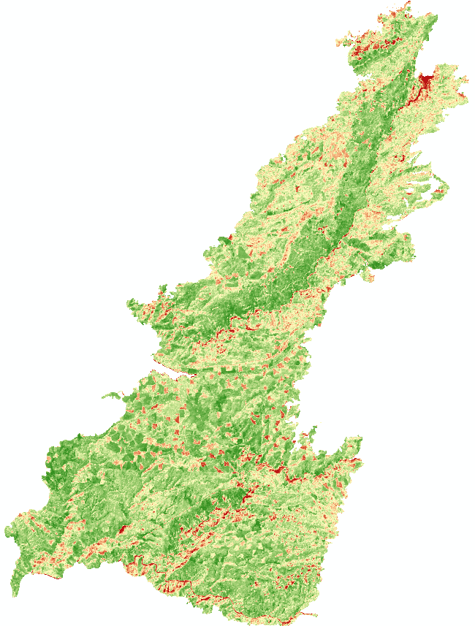
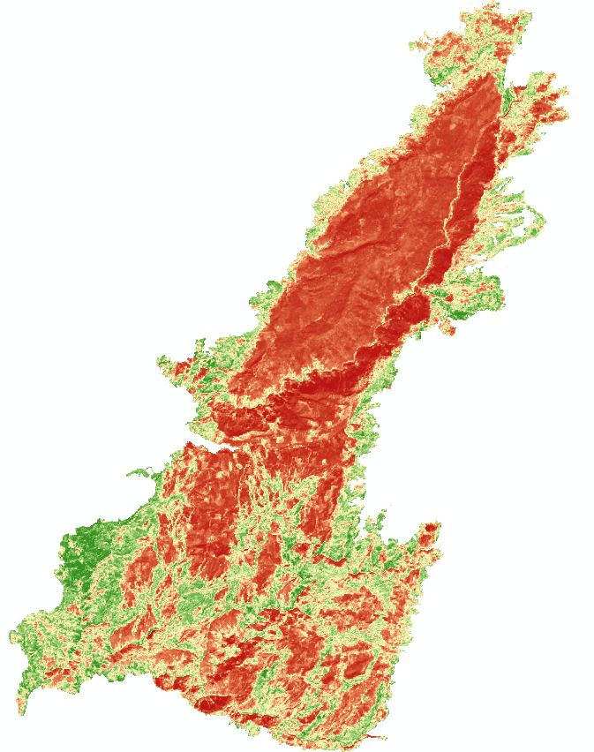
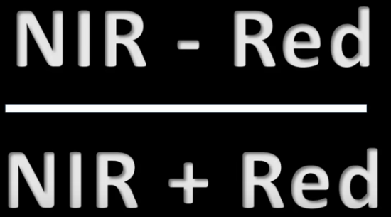
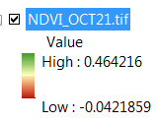
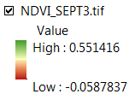
NDVI – Normalized Difference Vegetation Index

Slide 18
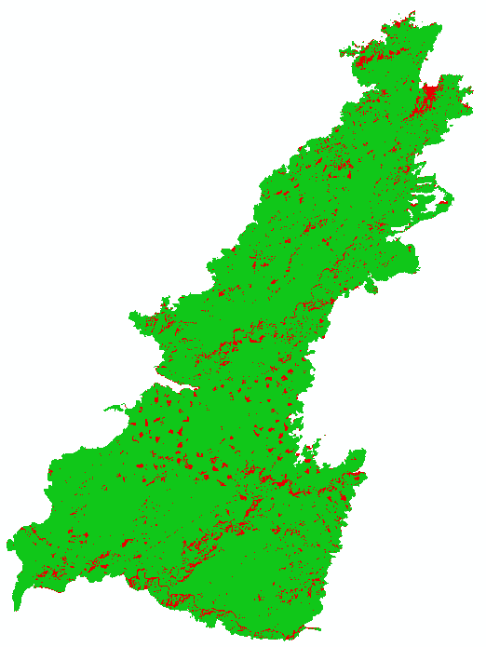
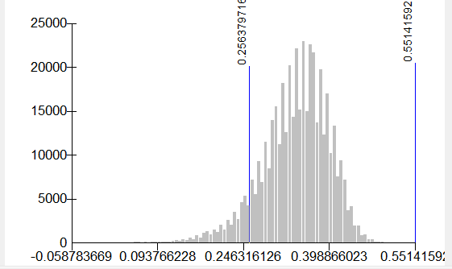

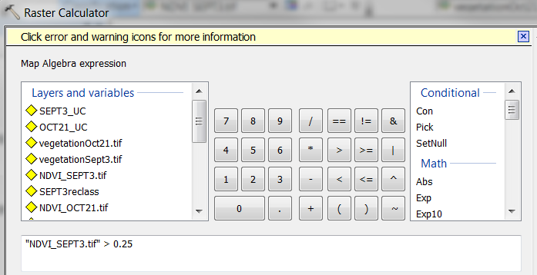

NDVI Reclassify for Comparison with Unsupervised Classification

Slide 19
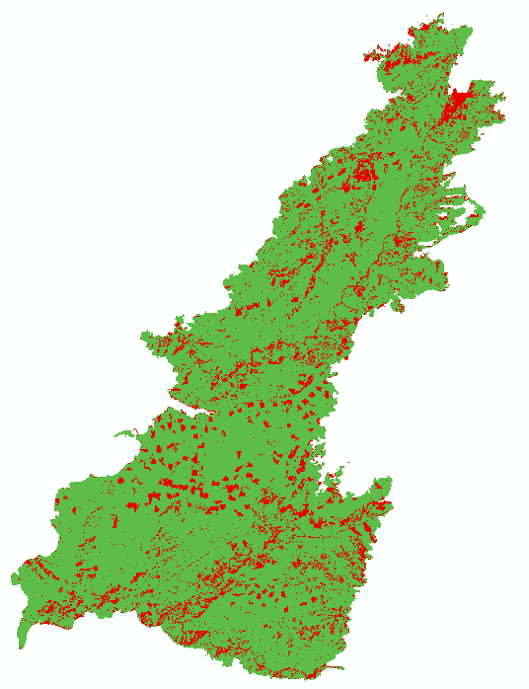
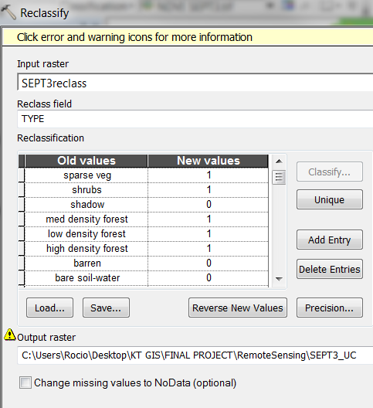
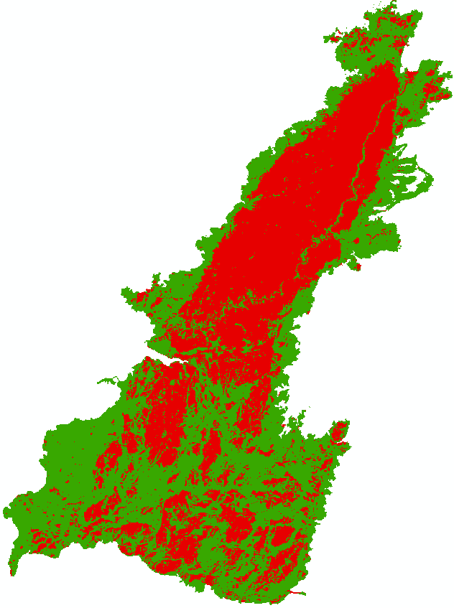

Reclassify Land Cover Types for Comparison with NDVI

Slide 20
NDVI vs. Unsupervised Classification
 | 9/3/2014, Before Fire |  | NDVI
Land Cover | Cell Count | % of Total | Cell Count | % of Total | % Differ
No Vegetation | 65920 | 15.00 | 32102 | 7.88 | -7.12
Vegetation | 373522 | 85.00 | 407340 | 92.69 | 7.70
 | 439442 |  | 439442
 | 10/21/2015, After Fire |  | NDVI
Land Cover | Cell Count | % of Total | Cell Count | % of Total | % Differ
No Vegetation | 203017 | 46.20 | 239597 | 54.52 | 8.32
Vegetation | 236425 | 53.80 | 199845 | 45.48 | -8.32
 | 439442 |  | 439442

Slide 21
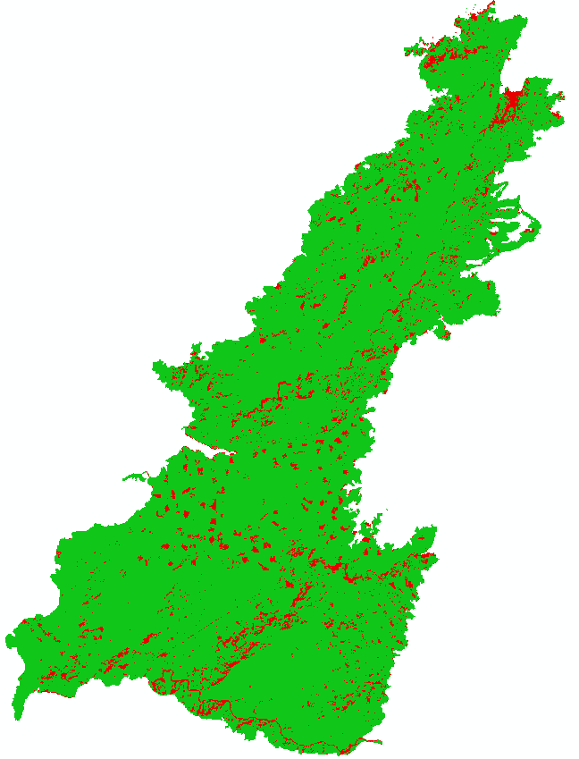
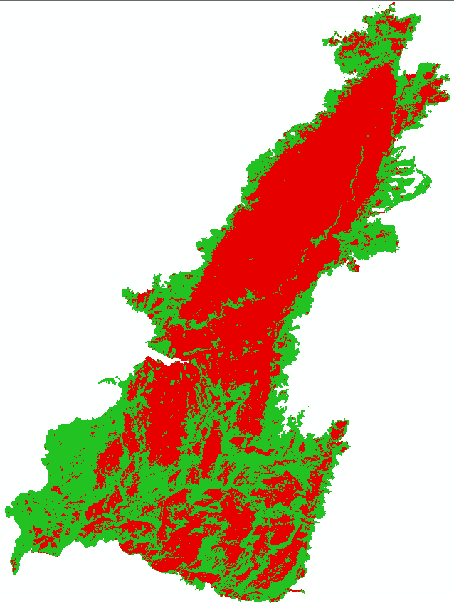
NDVI Before vs. NDVI After
 | NDVI, Before Fire |  | NDVI, After Fire
Land Cover | Cell Count | % of Total | Cell Count | % of Total | % Change
No Vegetation | 32102 | 7.88 | 239597 | 54.52 | 46.64
Vegetation | 407340 | 92.69 | 199845 | 45.48 | -47.22
 | 439442 |  | 439442

Slide 22
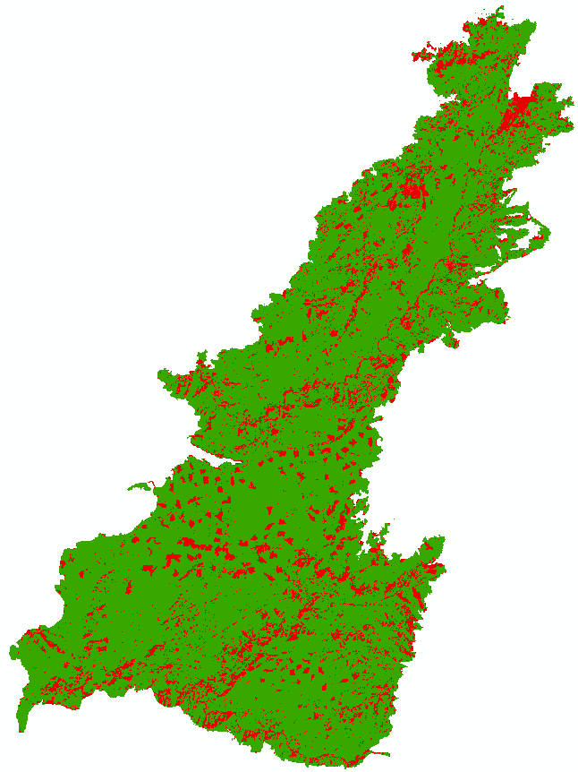
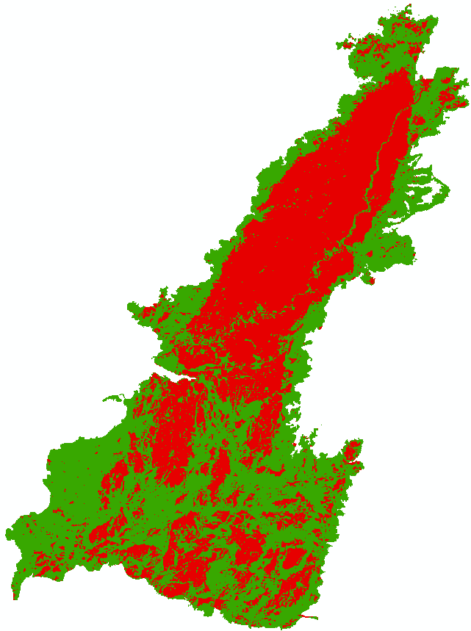
Overall Change in Vegetation
 | 9/3/2014, Before Fire |  | 10/21/2015, After Fire
Land Cover | Cell Count | % of Total | Cell Count | % of Total | % Change
No Vegetation | 65920 | 15.00 | 203017 | 46.20 | 31.20
Vegetation | 373522 | 85.00 | 236425 | 53.80 | -31.20
 | 439442 |  | 439442

Slide 23
Conclusions
Unsupervised Classification is a good starting point for comparing land cover types
NDVI provides index values ranging from -1 to 1
  Values close to zero represent rock and bare soil
  Values close to 1 represent healthy, dense vegetation
Unsupervised Classification & NDVI
  Less than 8.5% difference between output comparison
Shadows, water, and bare soil need more work
  Perform Supervised Classification
  Need Accuracy Assessment

Slide 24
Sources
Landsat 8 OLI & TIRS information, https://lta.cr.usgs.gov/L8
Image of King Fire overlaid on map of the South Bay, https://ww2.kqed.org/news/2014/09/18/king-fire-update-pollock-pines-el-dorado-county/
USFS Vegetation Burn Data, http://www.fs.usda.gov/detail/r5/landmanagement/gis/?cid=stelprd3805100
Earth Explorer, https://earthexplorer.usgs.gov/
Landsat Program information: http://gisgeography.com/landsat-program-satellite-imagery-bands/
Raster Calculator, http://desktop.arcgis.com/en/arcmap/latest/tools/spatial-analyst-toolbox/raster-calculator.htm
American River College, Geog 342 class materials

