Slide 1
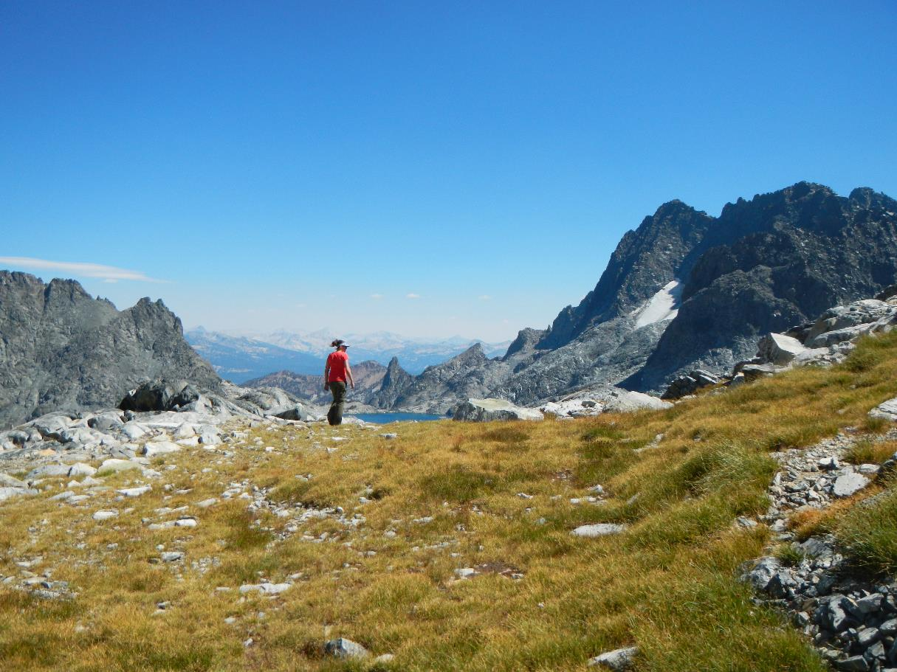
Central sierra backpacking
A resource for logging and planning outdoor recreation
James Lehmkuhl

Slide 2
Project goals
Keep track of past trip itineraries for sharing with others
Plan future trips
Qualitatively rate features so a “Best of The Sierra” list can be easily generated

Slide 3
Project description
A data set useful for backpackers including…
Digitized trail sections
Digitized Lakes
Prominent peaks
Ideal campsites along routes
Information regarding skill levels required for routes

Slide 4
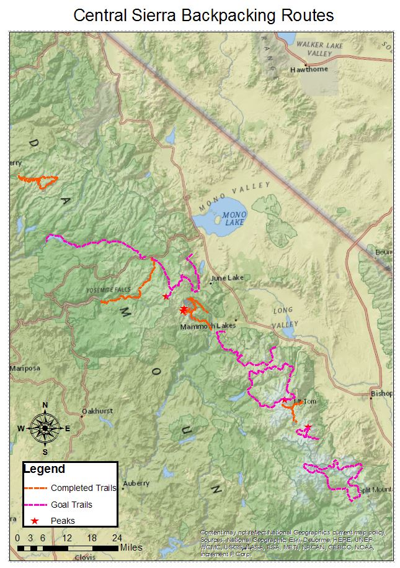

Slide 5
Creation process
Creating feature classes and attributes
Digitizing physical features
Entering data about features
Producing a map

Slide 6
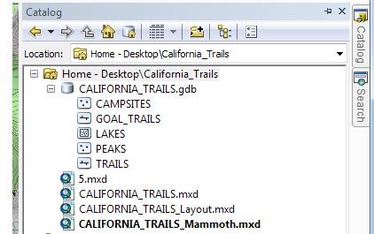
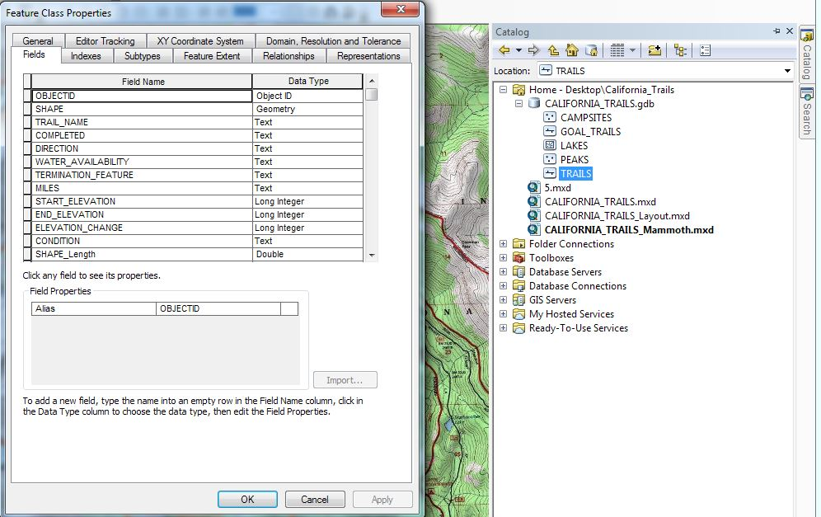
Creating feature classes and attributes
Choose Feature types to include
Choose attribute types to include

Slide 7
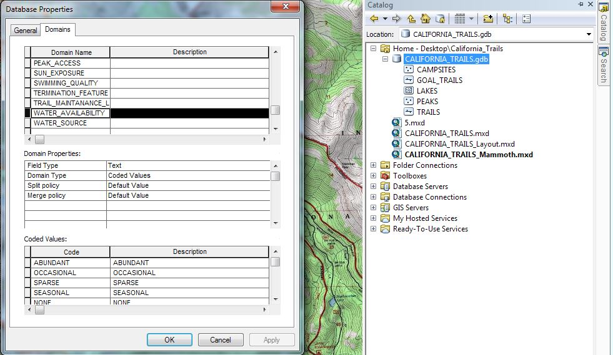
Creating feature classes and attributes
Creating drop down menus

Slide 8
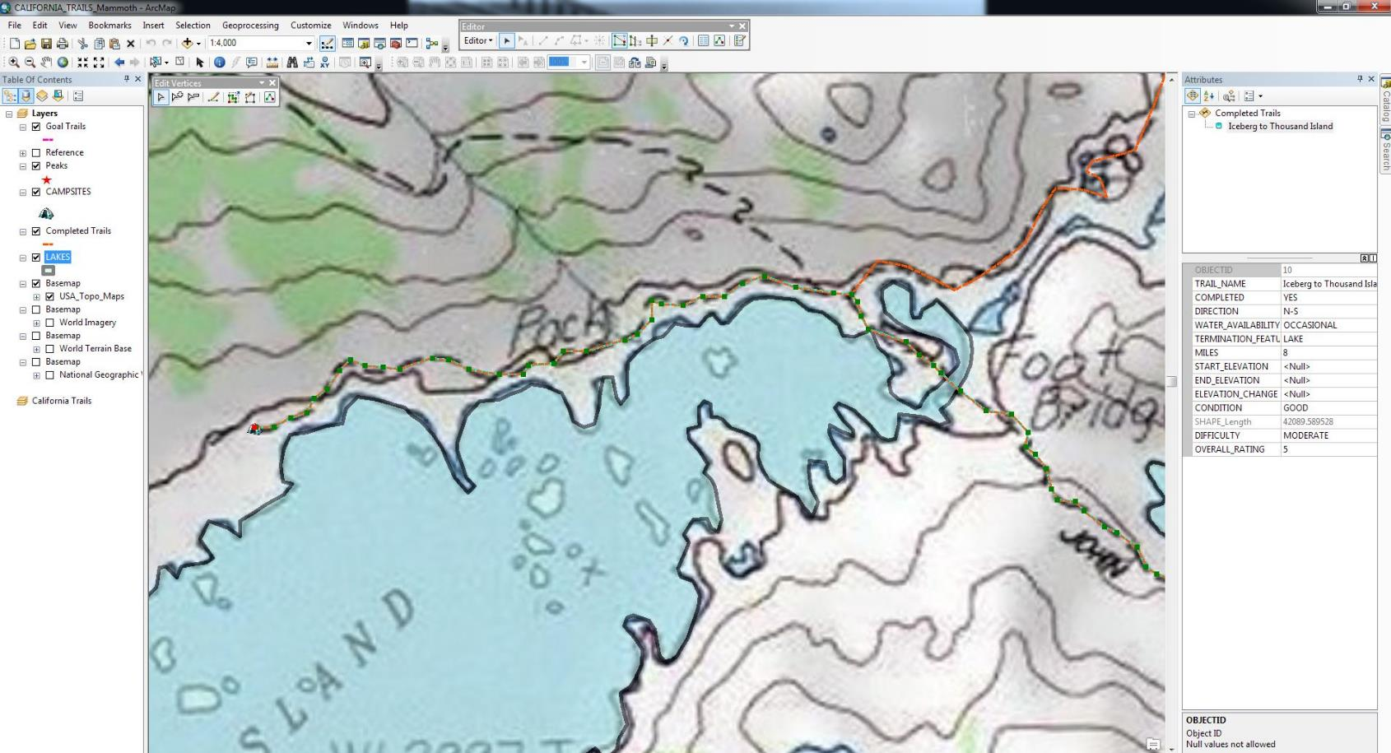
Digitizing physical features

Slide 9
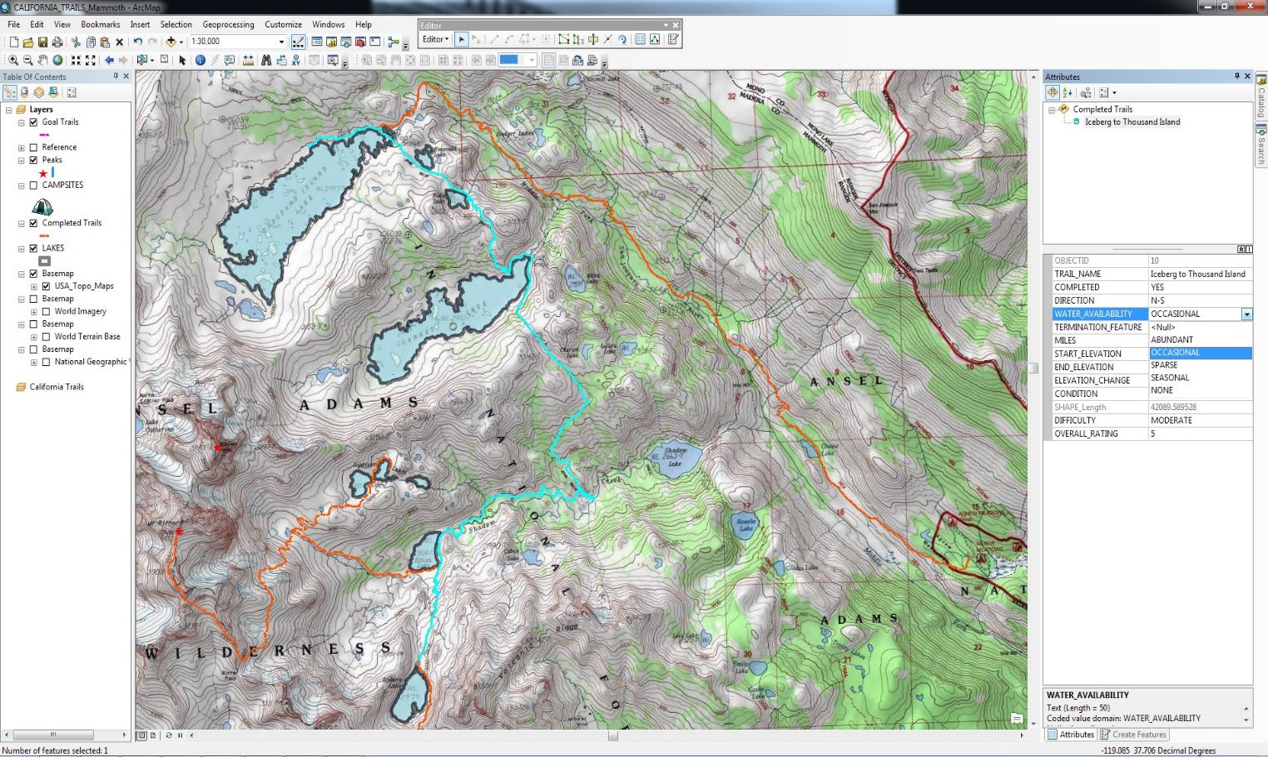
Entering data about features
Drop downs streamline and normalize data entry
Consistent data aids in query process
Additional fields may be created

Slide 10
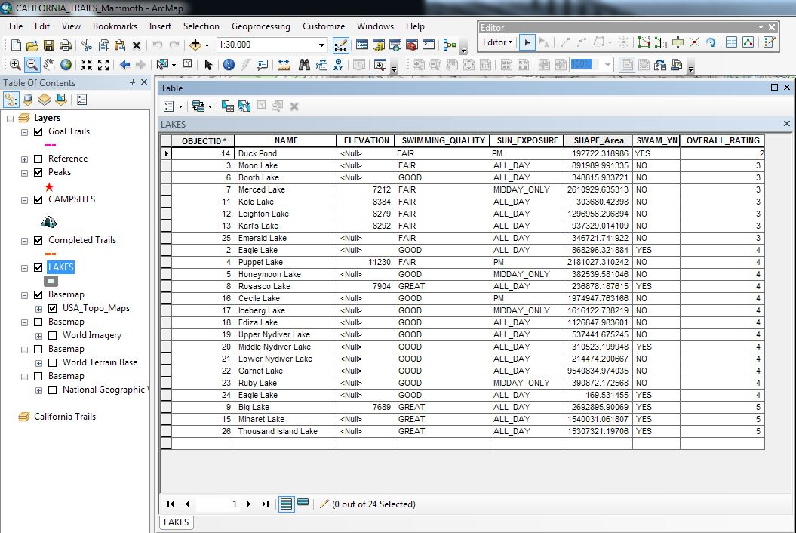
Entering data about features
Useful information
Log of personal experience

Slide 11
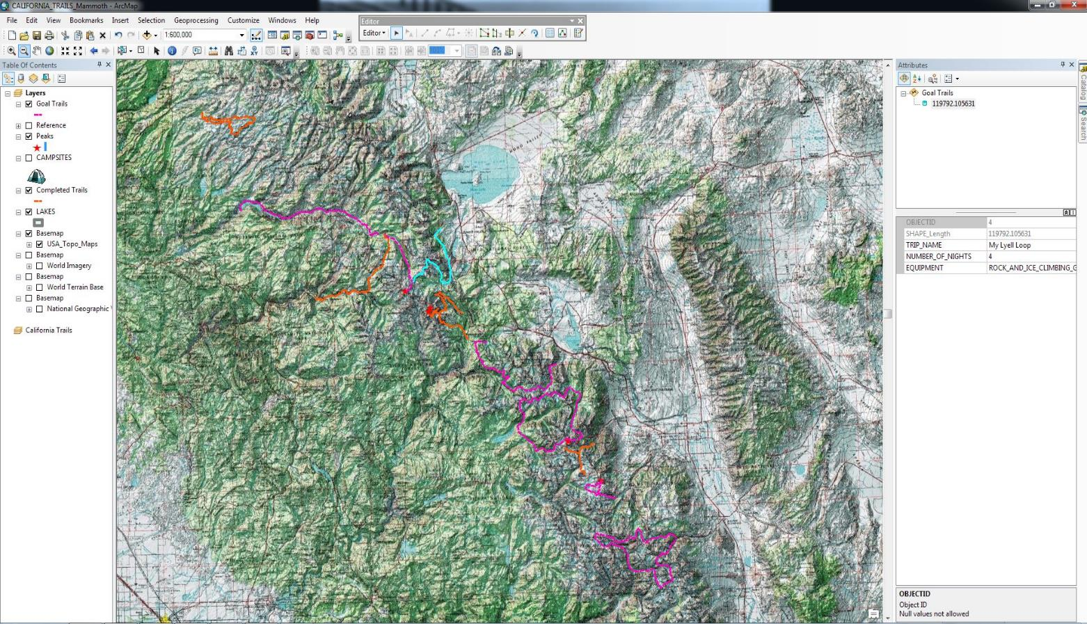
Using the resource
Choosing a route
Location
Duration
Special equipment considerations

Slide 12
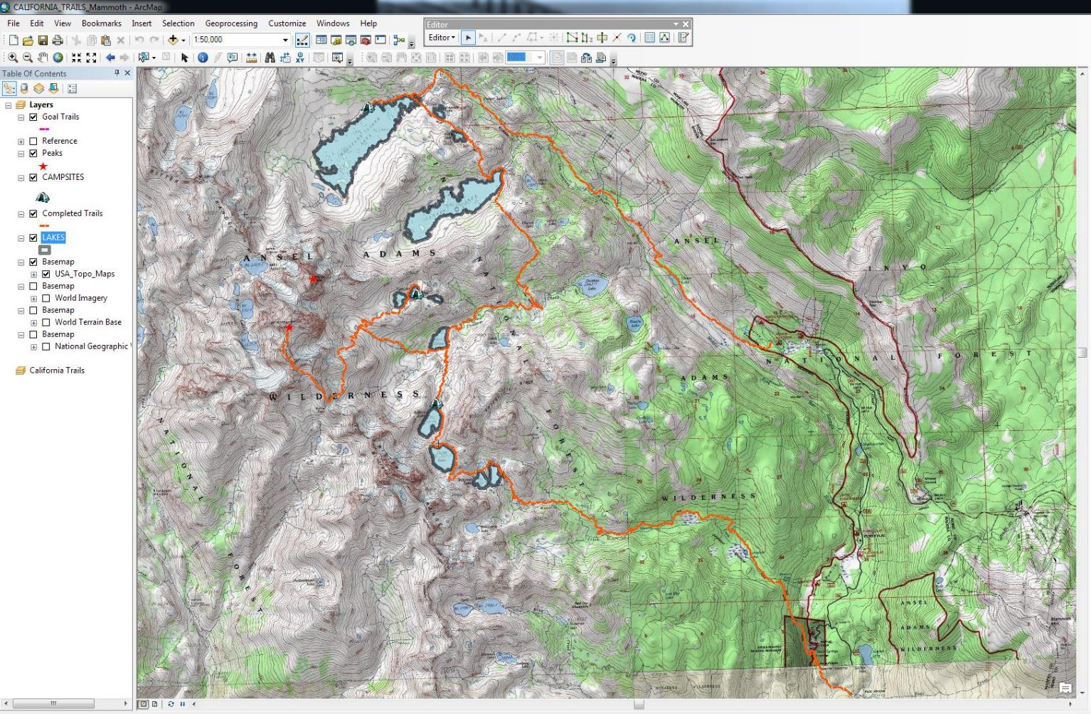
Using the resource
Entire route
Optional side trips
Ideal campsites
Information about lakes

Slide 13
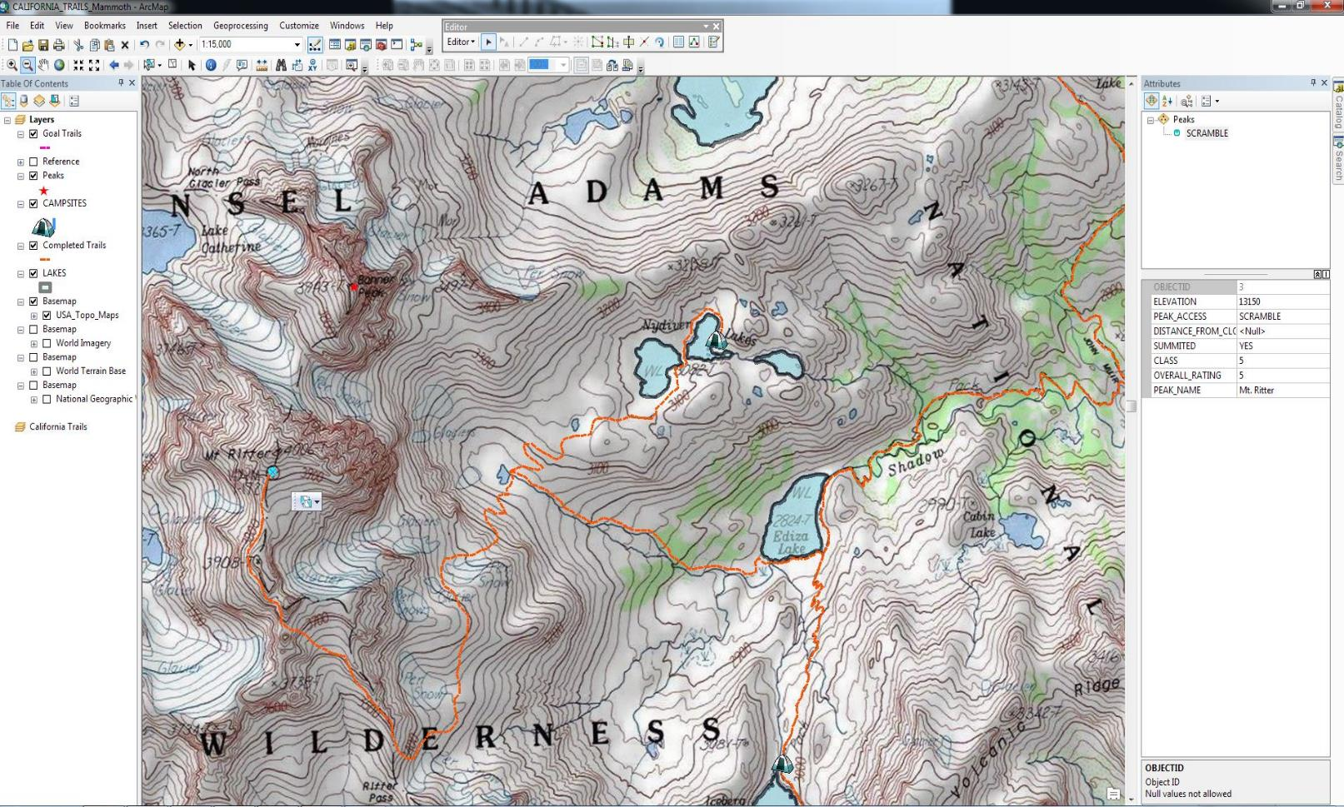
Using the resource
Optional cross country routes
Peak access information

Slide 14
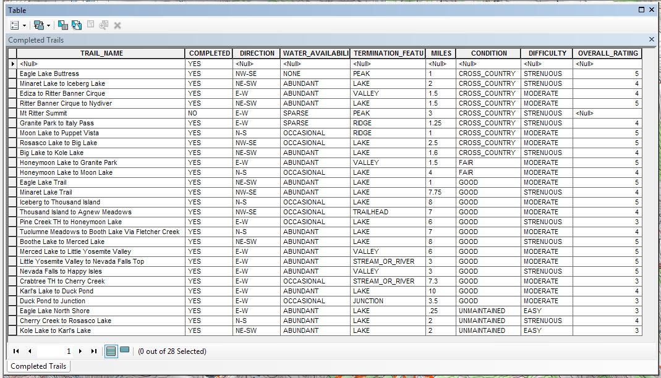
Using the resource
Sorting
Planning with distances
Planning with trail type

Slide 15
difficulties
File and database structure
Coordinate systems
Base map selection

Slide 16
Learning outcome
Familiarity with organizing databases
Digitizing is tedious but meditative
There are a lot of places I want to go!

Slide 17
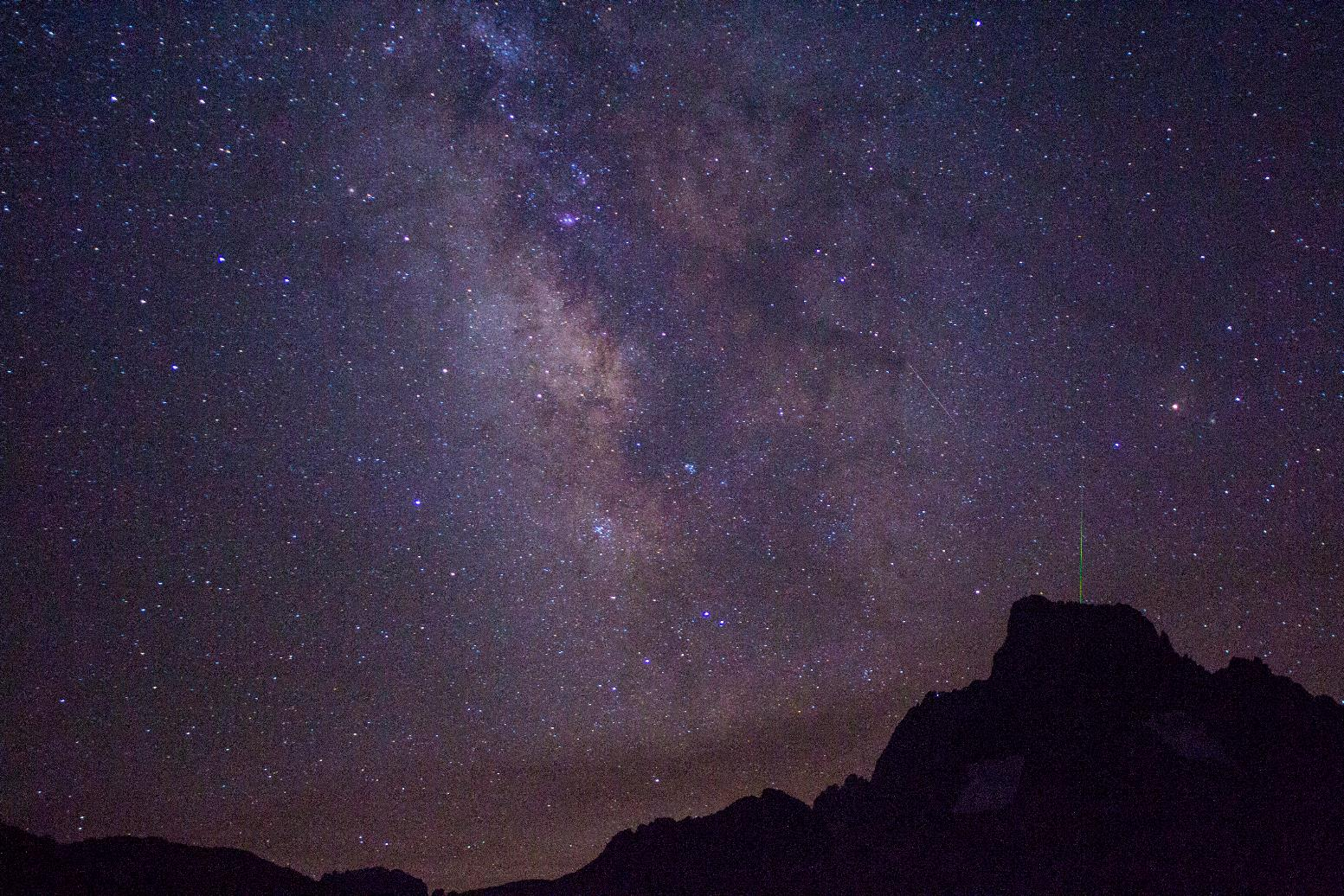
The end, thank you!
All photos by James Lehmkuhl

