Slide 1
(PUR) Pesticide Use Reporting Mapping Tool
Jazmin Gonzalez
Fall 2016-GEO 385

Slide 2
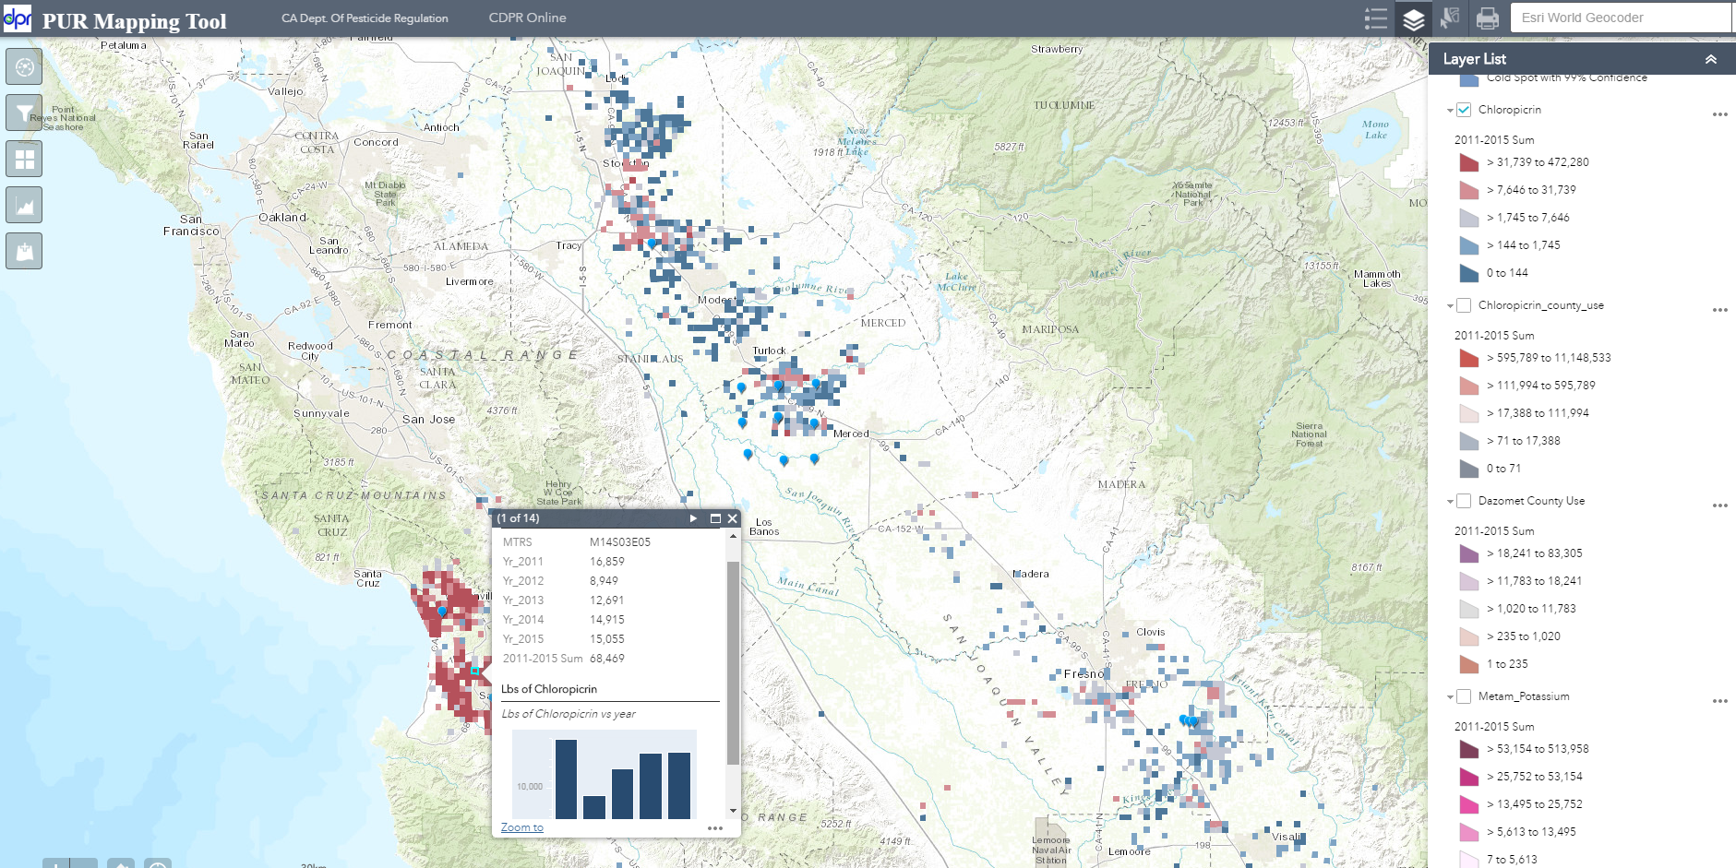
PUR Mapping Tool Web Application
-Chloropicrin (lbs) usage from 2011-2015
-Pop up window depicting annual use in Lbs and a column chart

Slide 3
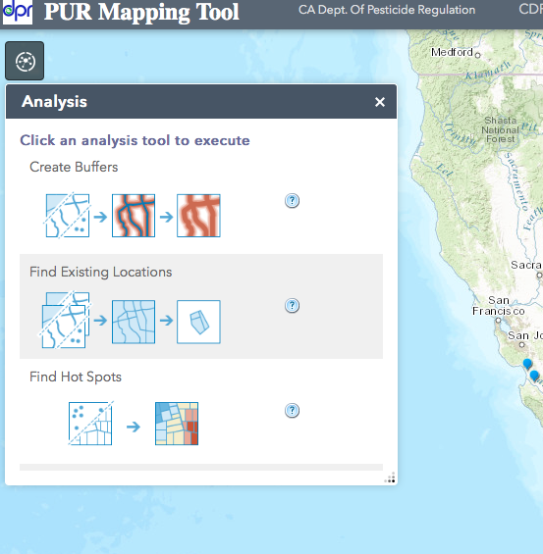
Analysis Widget
Create Buffer- useful to use with schools layer
Find Existing Location
Find Hot Spots
Find nearest
Merge Layer
Overlay Layers

Slide 4
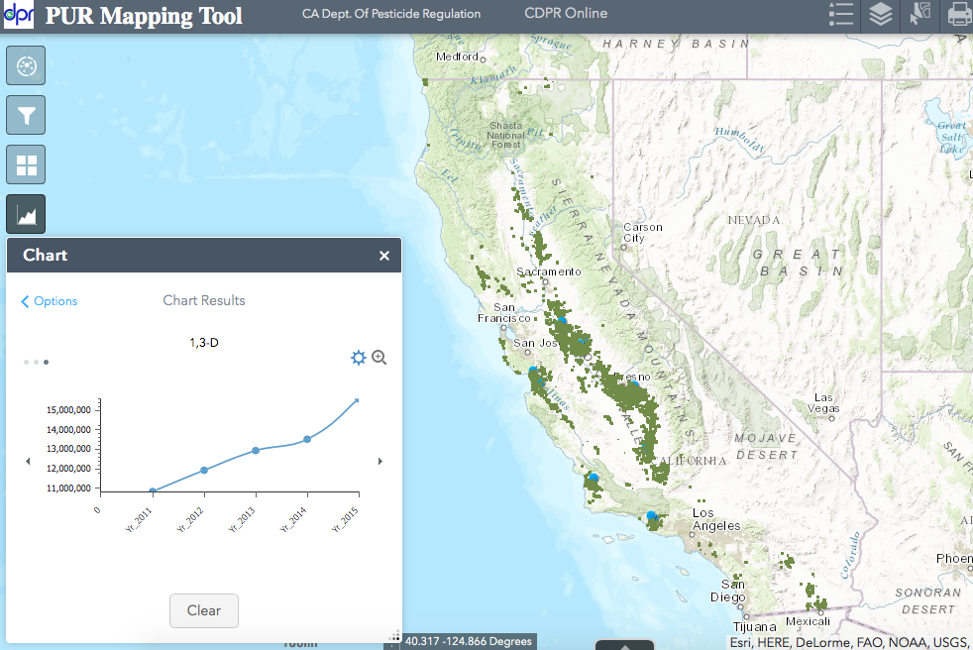
Chart Widget
Chart widget summarizes all total use for the various years in a line graph, column chart and a pie chart

Slide 5
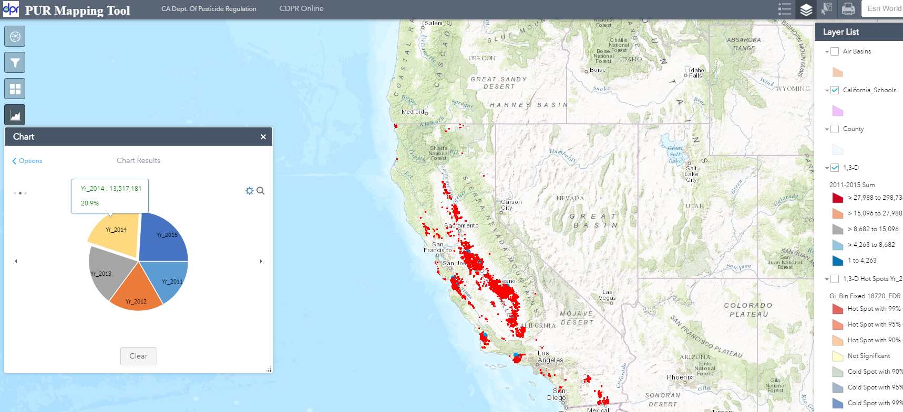
Chart Widget (Continued)
Pie Chart Summary depicting 1,3-d use for years 2011-2015

Slide 6
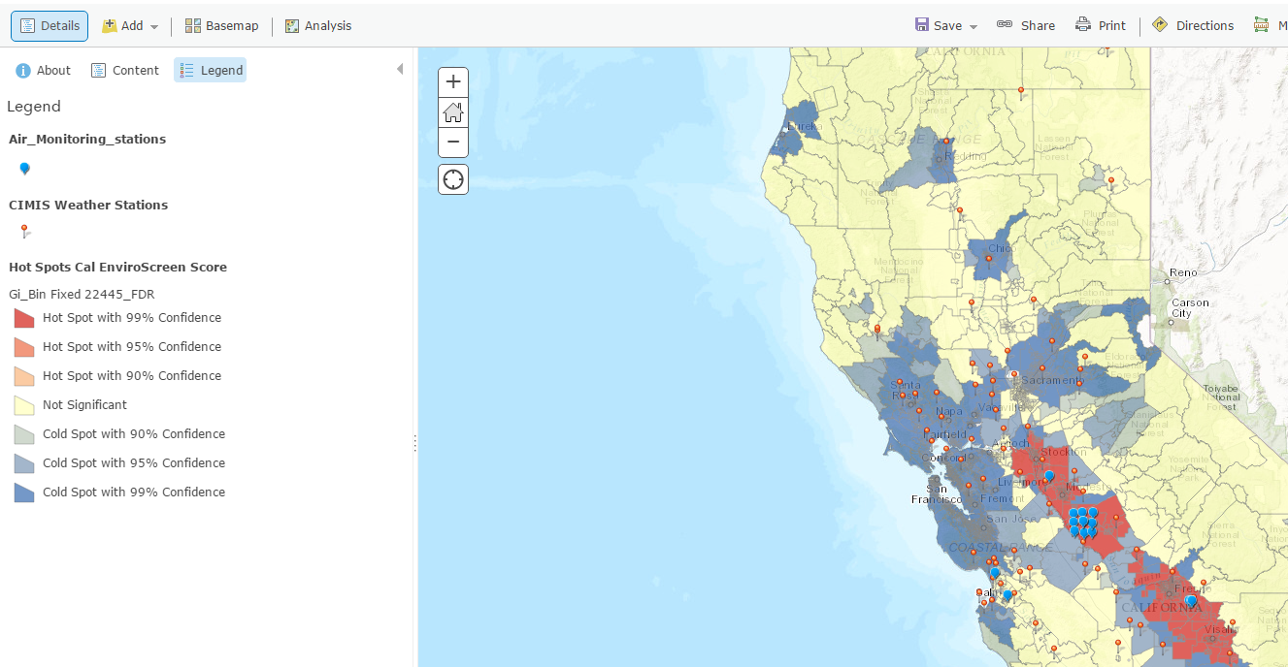
Geoprocessing
-Using OEHHA’s Cal Enviro Screen Score, a hot spot analysis was created
- Other hot spot analysis include 2015 1,3-D use

Slide 7
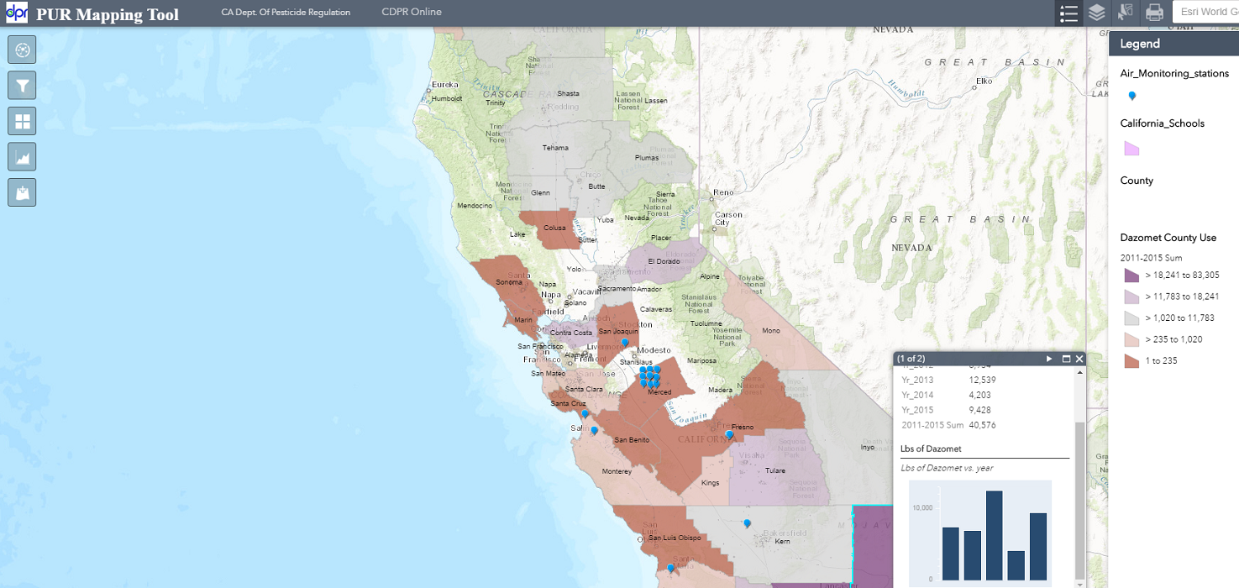
Dazomet County Use Summary

Slide 8
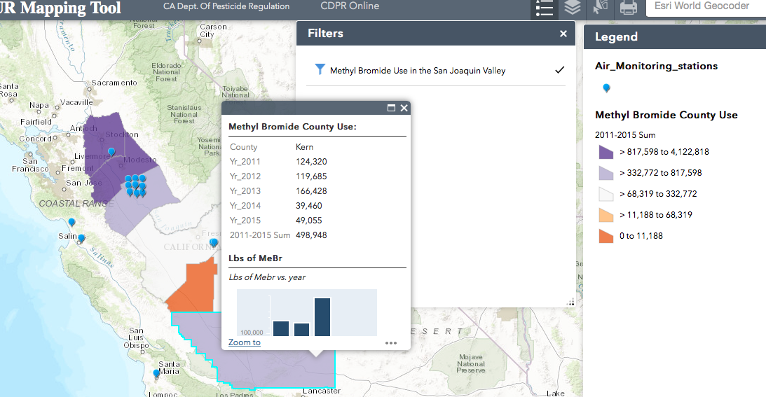
Filters
A filter showing Methyl Bromide Use just in the San Joaquin Valley

Slide 9
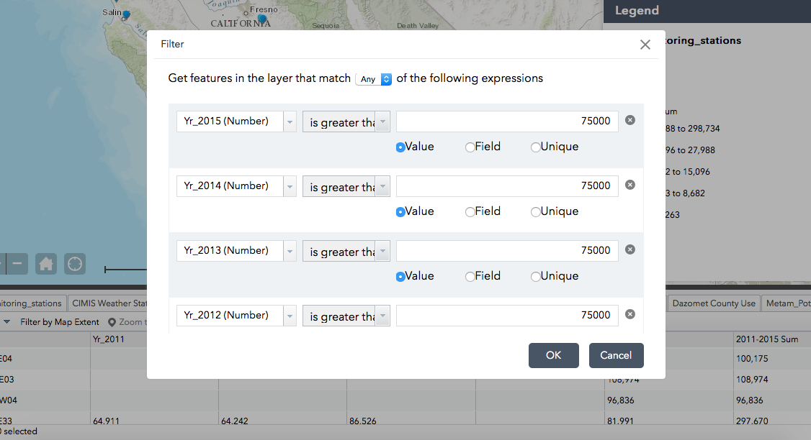
Other Filter Options
Using a custom filter, search for PLSS sections with more than 75,000 lbs of 1,3-d for 2011-2015

