Slide 1
The Use of Looping Code in Map Production
Micheal Finnell
W0400237
Geog 375 - Introduction to GIS Programming
Final Project
05/14/2016

Slide 2




THE CAUSE

Slide 3

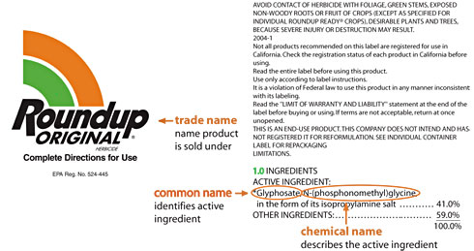
THE ENEMY
Active ingredient in this popular product

Slide 4
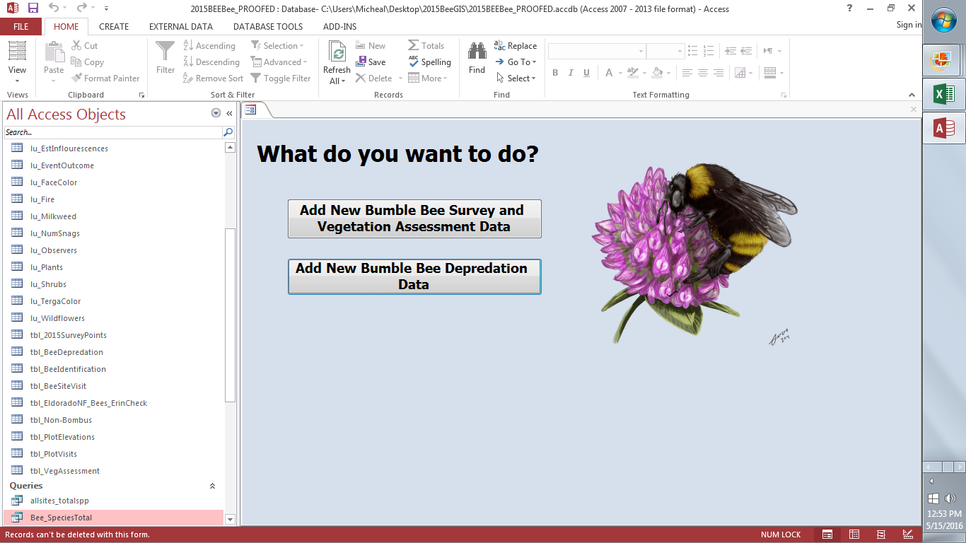
THE DATA
Data derived from 2015 bumblebee survey conducted in post-fire areas of the Eldorado National Forest
Data stored in access database
Query with xy coordinates and attribute data exported to excel then imported into ArcGIS

Slide 5
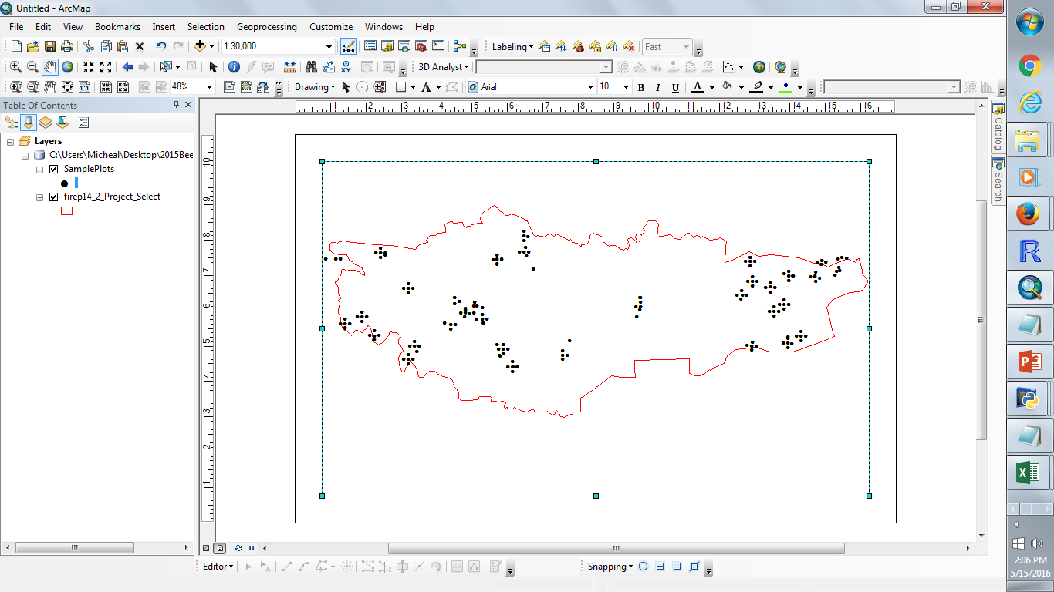
THE DATA
Sample plots added to map document as well as study area polygon
All bee related layers derived from this shape file and attributes

Slide 6
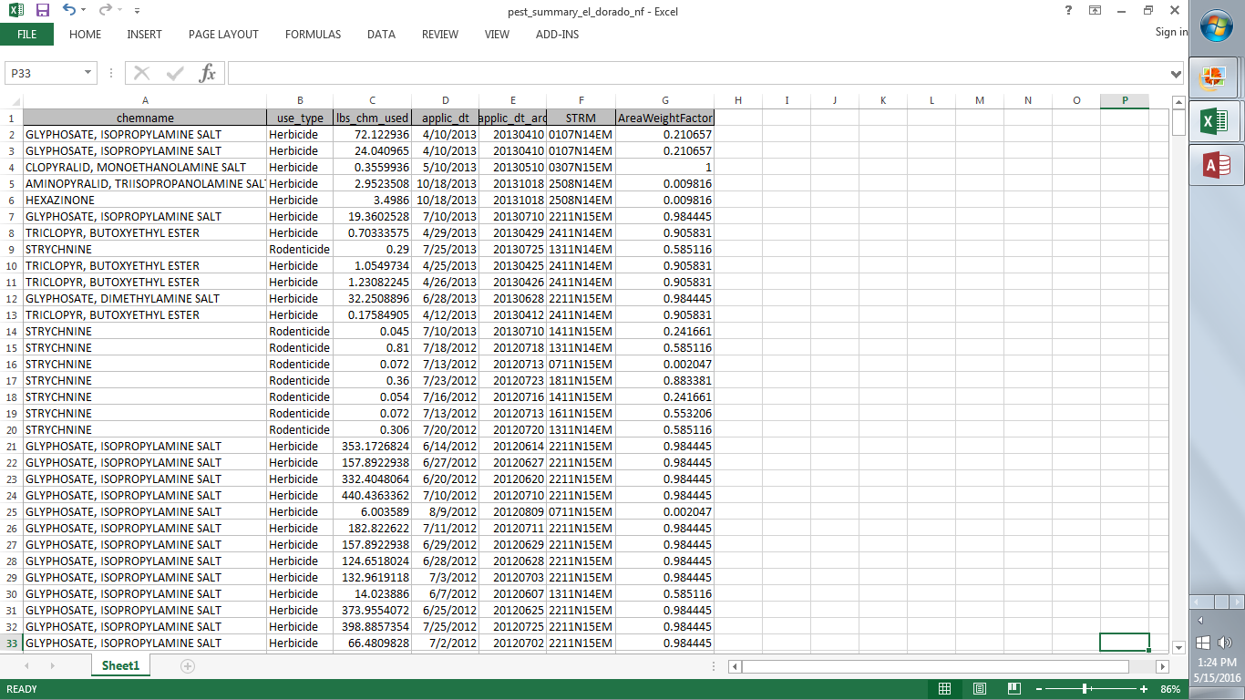
THE DATA
Data obtained online from the California Department of Pesticide Regulation. This table is a summary of chemicals used on public lands between 2002 – 2013
Filtered the data and exported it into a geodatabase and joined it to a polygon feature class to get an average amount per application within my study area

Slide 7
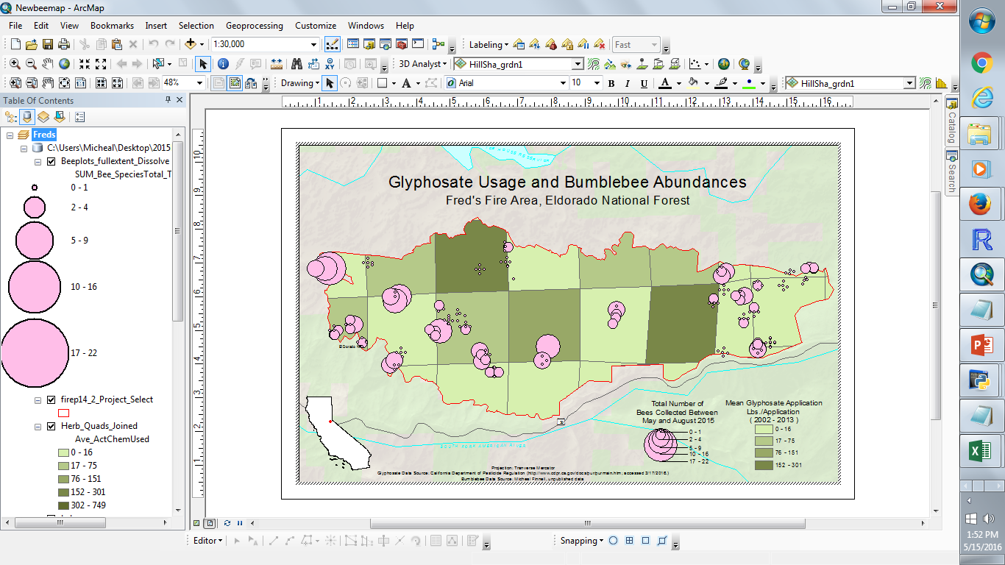
Created and symbolized map document showing relative bee abundances at sample locations in correlation with herbicide applications in areas within study site

Slide 8


THE PROBLEM AND SOLUTION
How to automate the generation of maps showing sites where specific individual species occurred in relation to glyphosate usage
Used python scripting to perform a series of for loops and exported resulting maps as PDFs

Slide 9
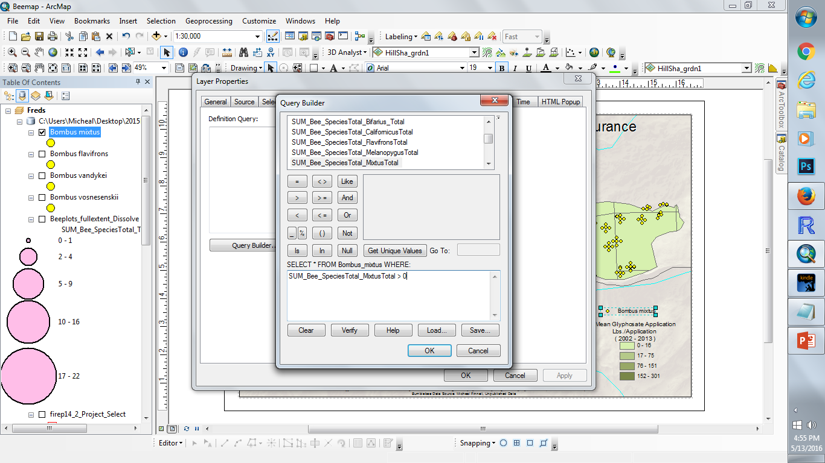
STEP 1
Perform a series of definition queries for each bee species layer
[species name] > 0
symbolize as pin map (rather than a graduated symbol map)
Construct simple legends for each layer

Slide 10
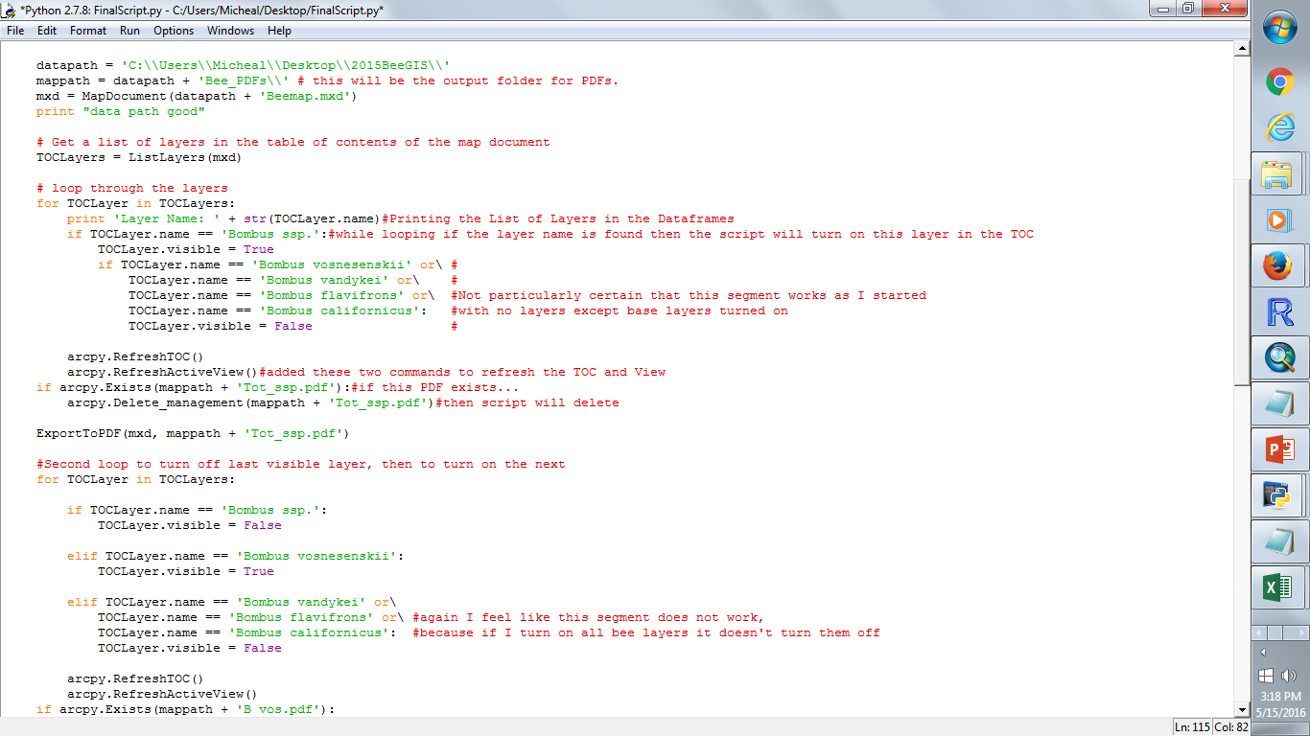
THE for LOOP
Loop was repeated for each bee species layer

Slide 11
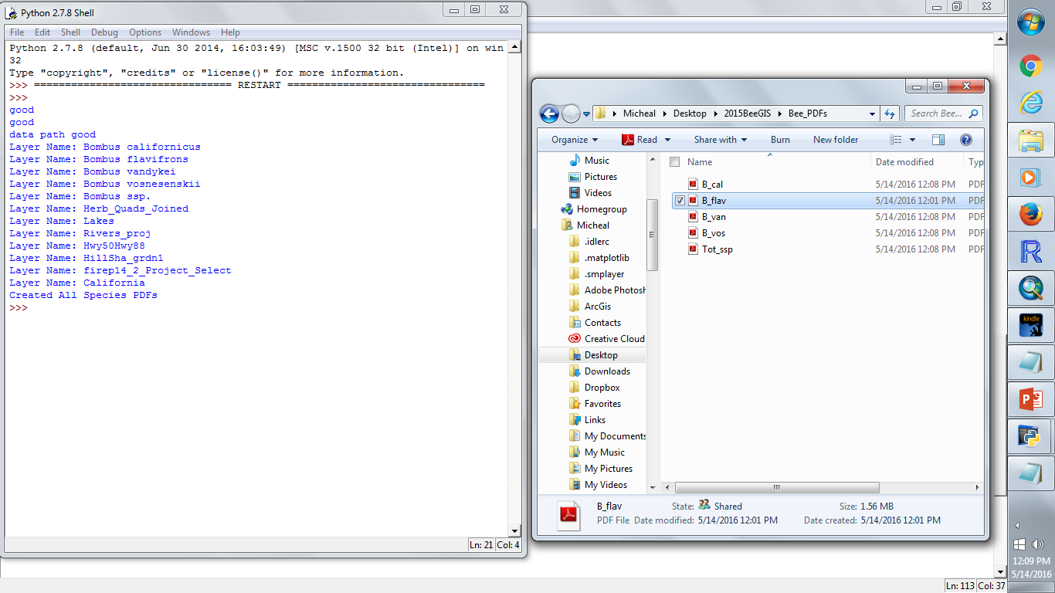
Script Success
Successful code generating looping sequences
Print statement showing a list of the layer names in the TOC of the .mdx file
Exportation of each individual PDF to proper folder

Slide 12
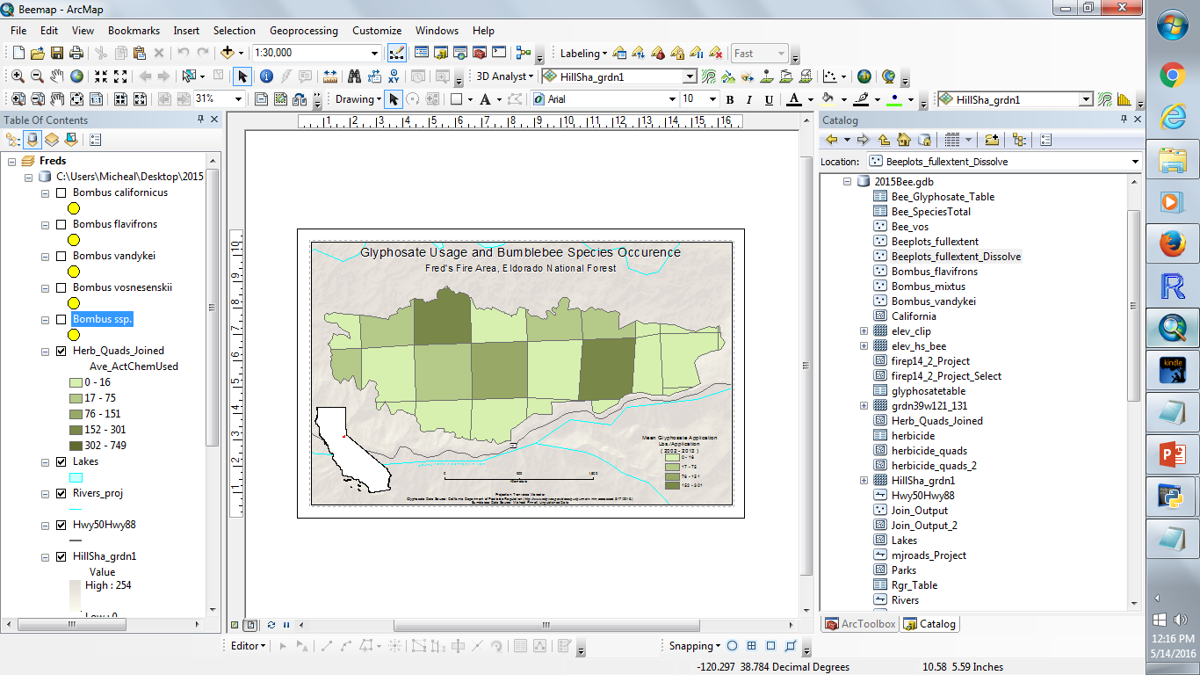
MAP TEMPLATE

Slide 13

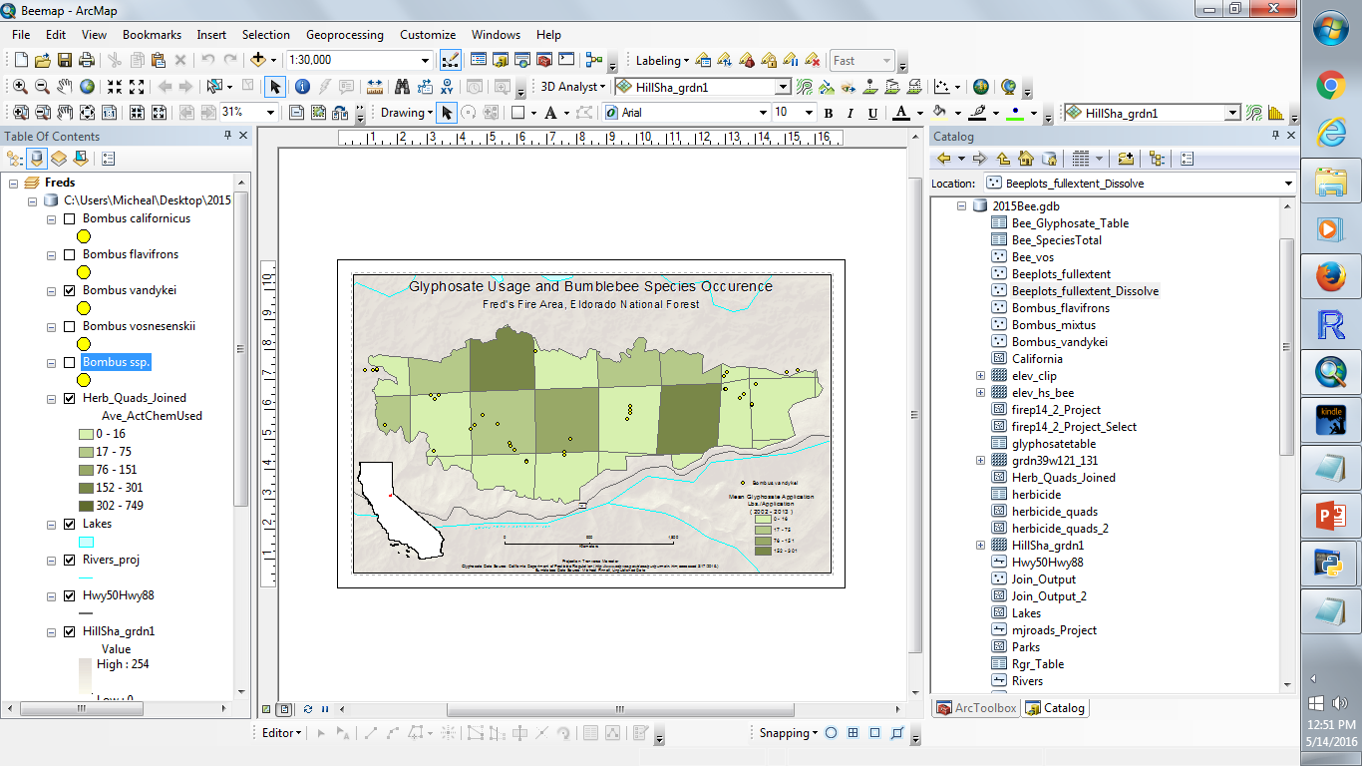

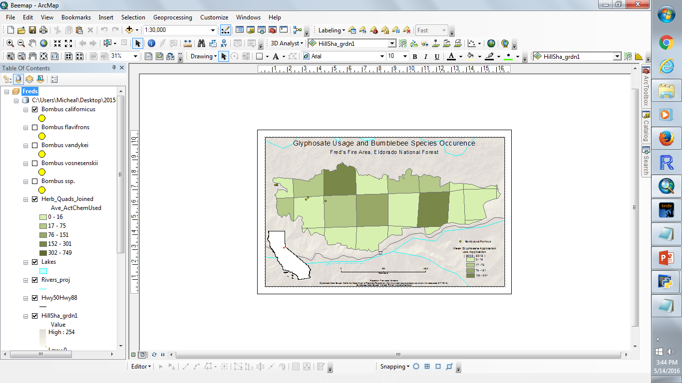
Final Map Output Examples

Slide 14
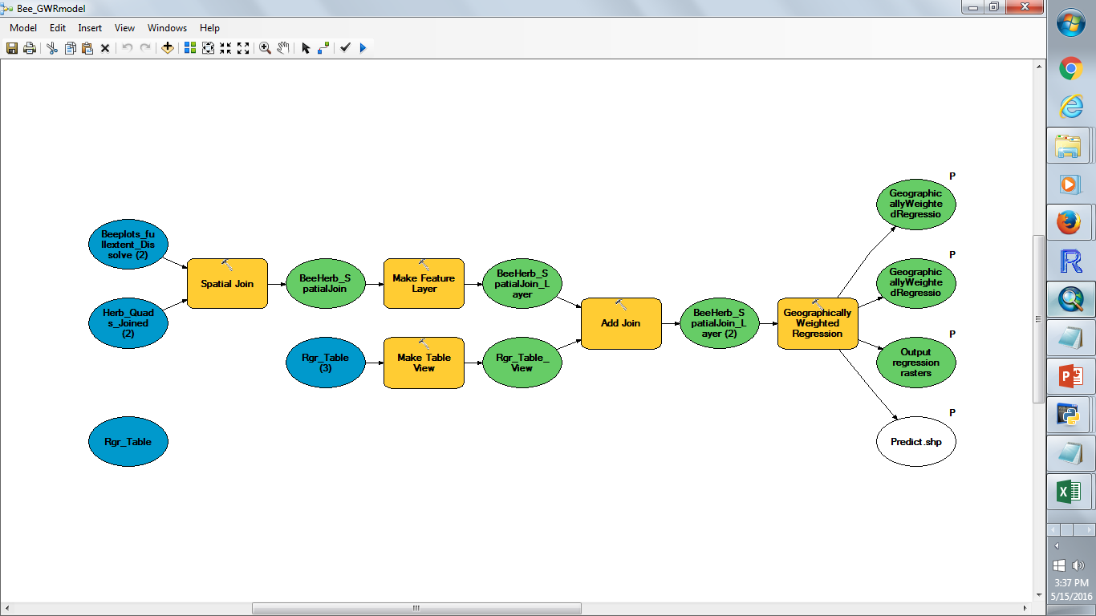
Supplementary Material
Created a small model using joining and Geographically Weighted Regression tools that I would export and edit into a stand alone script, but having trouble with outputs

Slide 15
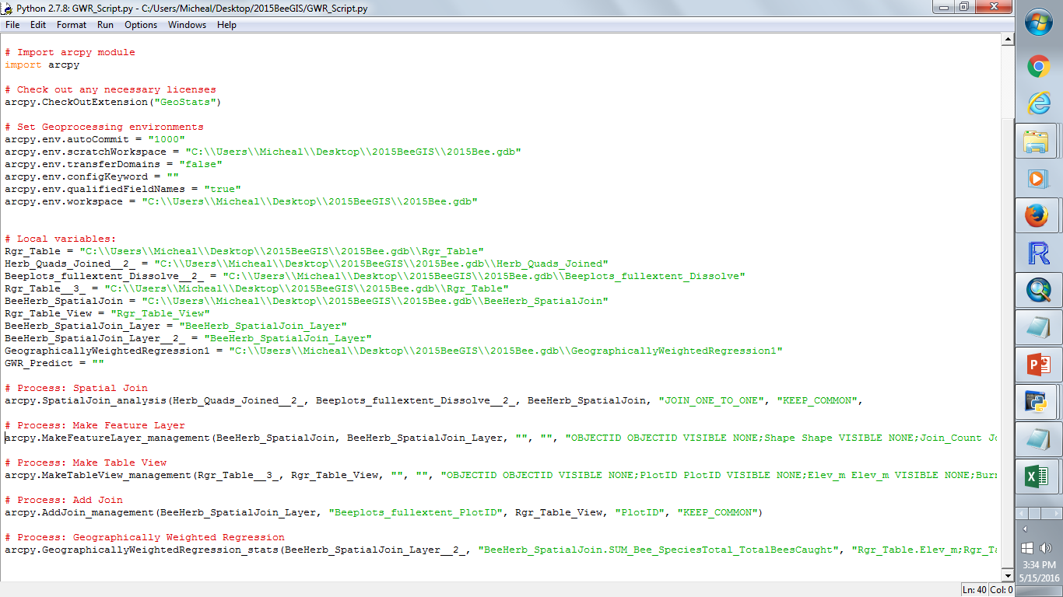
Successfully exported script for editing but need further instruction or data editing to get the model to work correctly

Slide 16
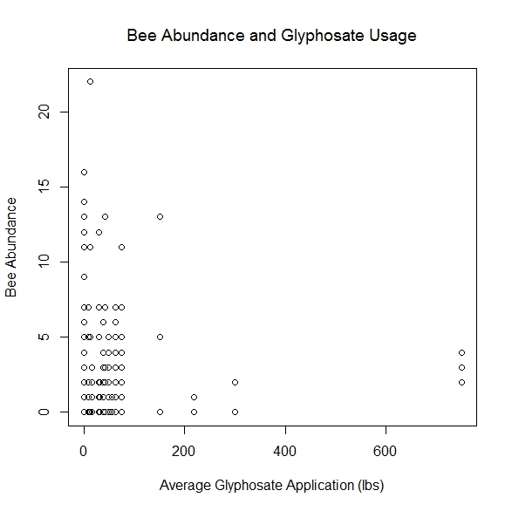
However, I was able to export data from my layer joins to perform a simple linear regression in R and produce this plot graph. P-value not significant, very low R^2, and Pearson’s correlation not significant given an analysis of the raw data. Would like to learn how to perform the GWR in ArcMap and use in python scripting

