Slide 1
Quantifying Efficacy of Submersed Aquatic Vegetation Management in the Sacramento-San Joaquin Delta
Micheal Finnell
California Department of Parks and Recreation
Division of boating and Waterways
Aquatic Invasive species Unit

Slide 2
Purpose
Use hydroacoustics to map Submersed Aquatic Vegetation (SAV) in the Sacramento-San Joaquin Delta
Use online GIS algorithm to process raw sonar files
Create a model that will process hydroacoustic data and produce raster-based map
Compare rasters over time and create quantitative metric from data
Provide measure of accuracy
Use metric for SAV management practices

Slide 3
Background
Division of Boating and Waterways designated state lead agency in controlling invasive aquatic plants in the Sacramento-San Joaquin Delta (Harbors & Navigation Code 64 & 64.5)
Invasive Submersed Aquatic Vegetation (SAV) clog waterways, eco-engineer environment, and displace native species (become monocultures)
Current method of control: Fluridone (herbicide)

Slide 4
Background
Three methods of monitoring and mapping SAV
Remotely sensed hyperspectral imagery from outside agencies
  Time intensive, costly
  Rigorous scheduling for imagery to be collected during low tide
  Questionable whether funding for Delta-wide project will continue
Hydroacoustic (sonar)
  DBW currently using commercial grade and online GIS platform, BioBase (www.cibiobase.com)
Field Surveys
  Only method that can determine exact species composition

Slide 5
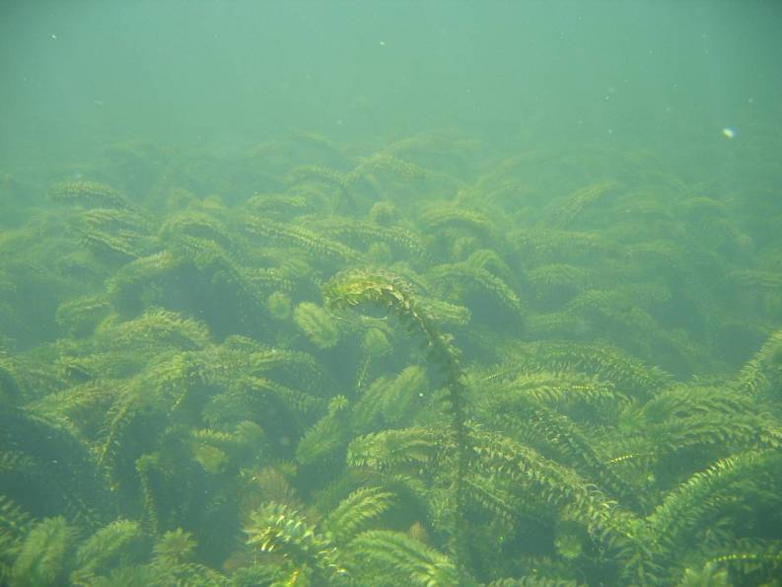
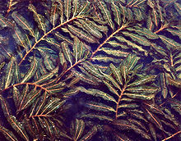
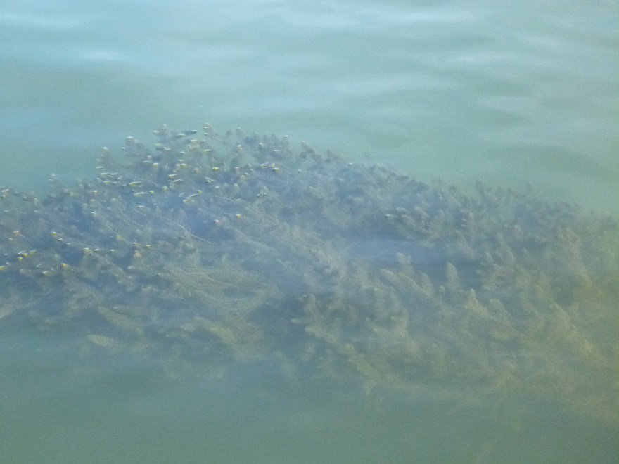
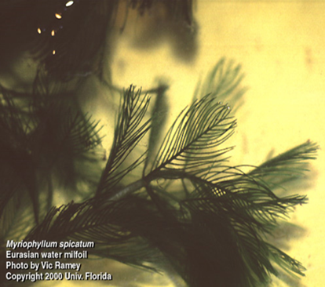
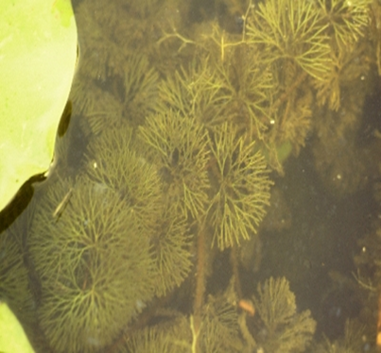
Invasive SAV Species
Brazilian waterweed
(Egeria densa)
curlyleaf pondweed
(Potamogeton crispus).
Coontail
(Ceratophyllum demersum)
Fanwort
(Cabomba caroliniana)

Slide 6
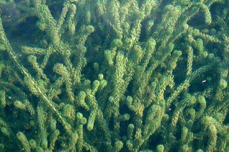
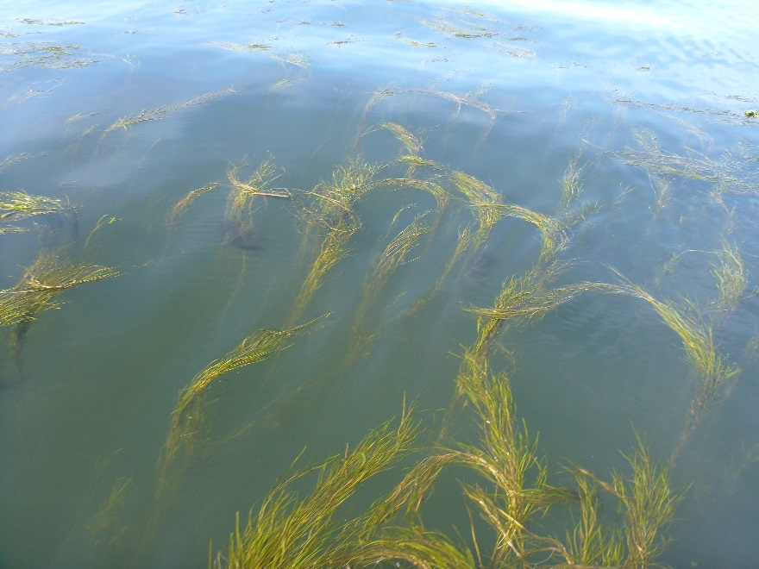
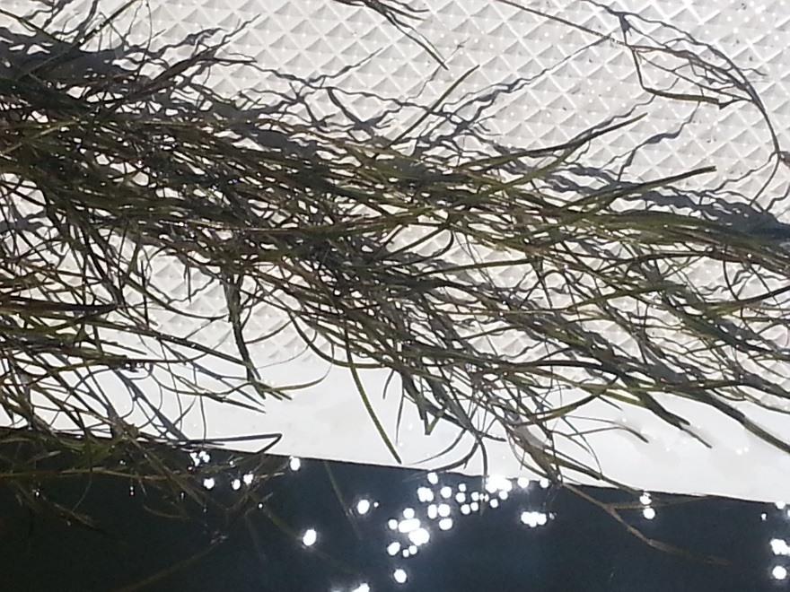
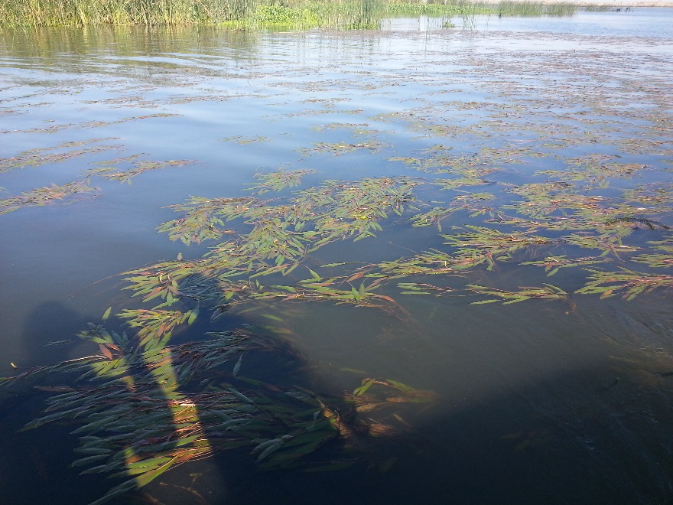
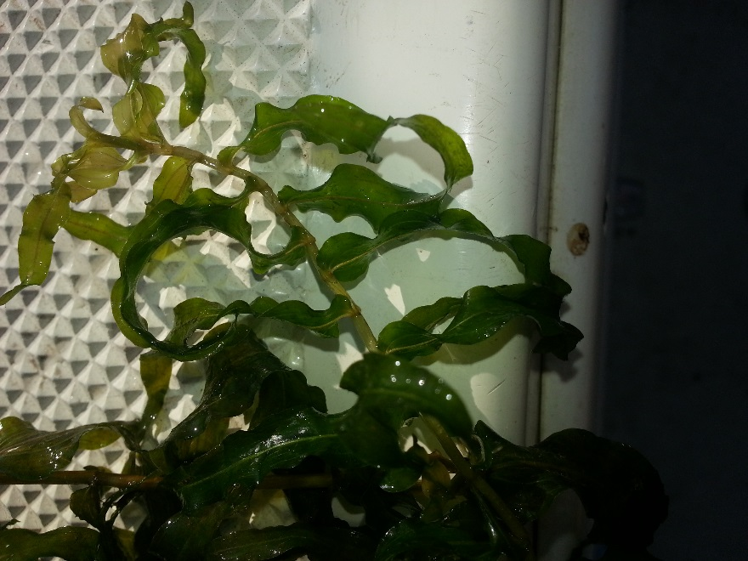
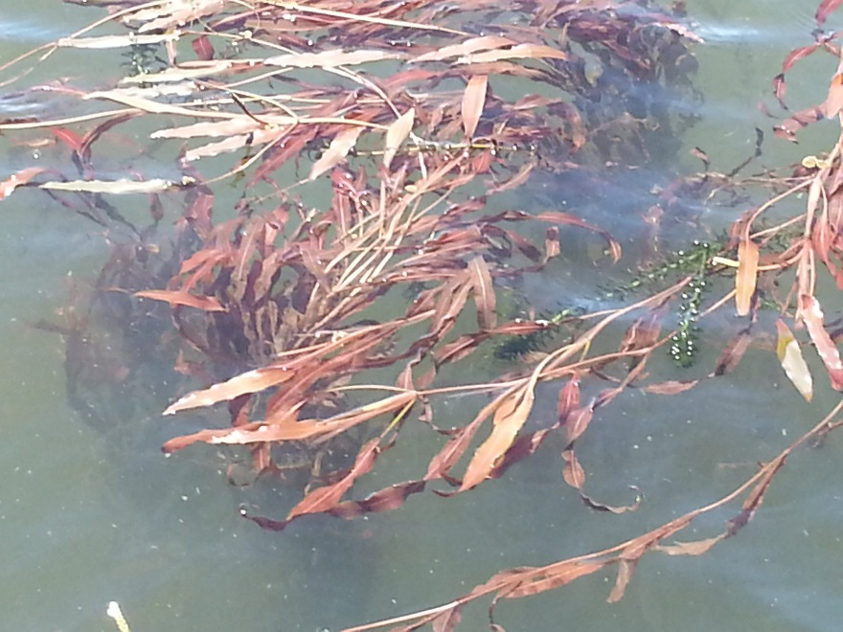
Native SAV Species
common waterweed
(Elodea canadensis)
sago pondweed
(Stuckenia pectinata)
Threadleaf pondweed
(Potomogeton diversifoliosus)
Photo by Ondřej Zicha
American pondweed
(Potamogeton nodosus)
Potamogeton richardsonii
Potamogeton sp.

Slide 7
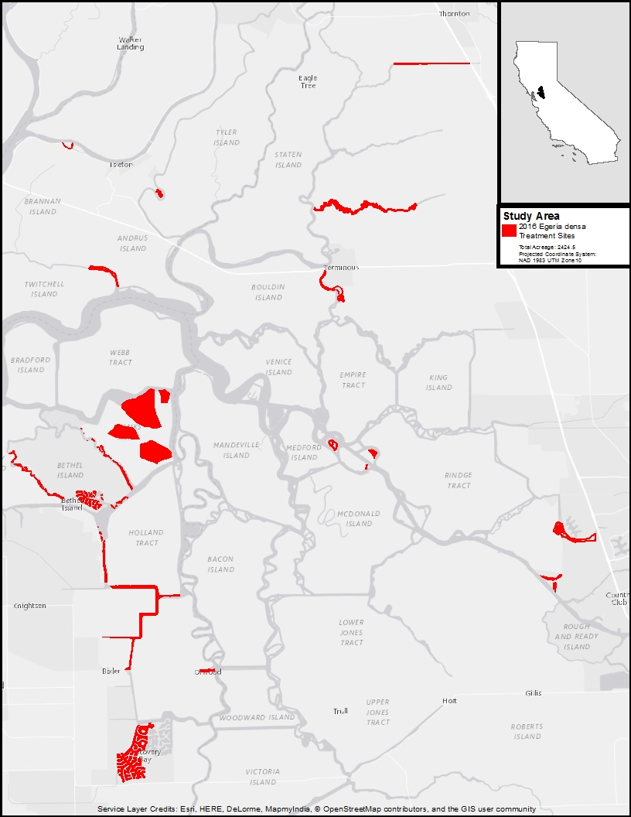
Methods
Study Area and Sites
Legal San Joaquin-Sacramento Delta
26 Sites
2424.5 surface acres

Slide 8
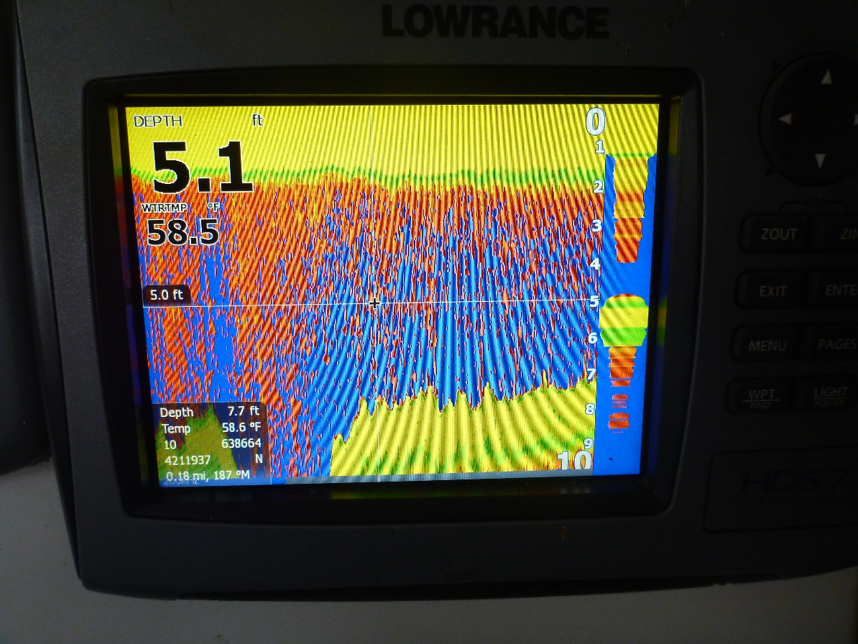
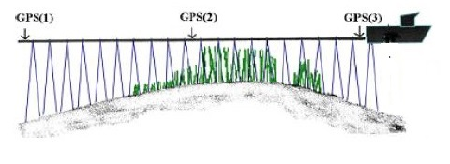
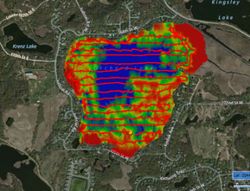
Methods
Lowrance HDS5 / HDS7
Consumer-grade echosounder
Single Beam 20 degree tranducer
Field transect design: 10 – 30 meters

Slide 9
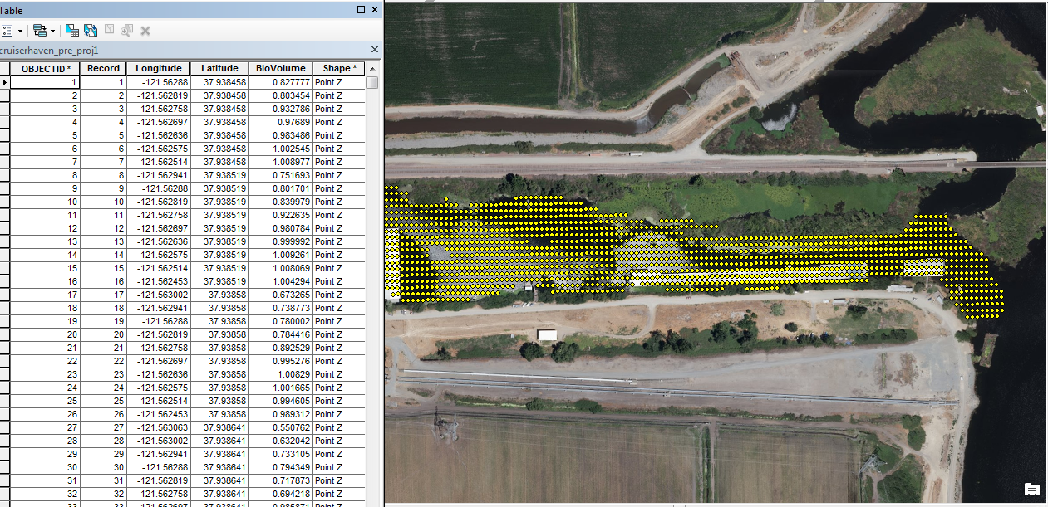
Methods: THE DATA

Slide 10
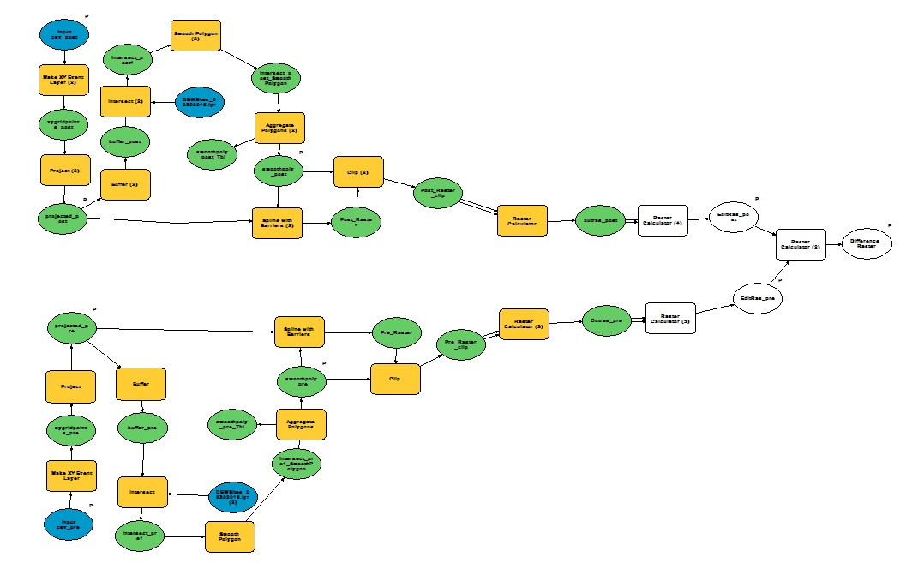
Methods: THE MODEL
Egeria Tool

Slide 11
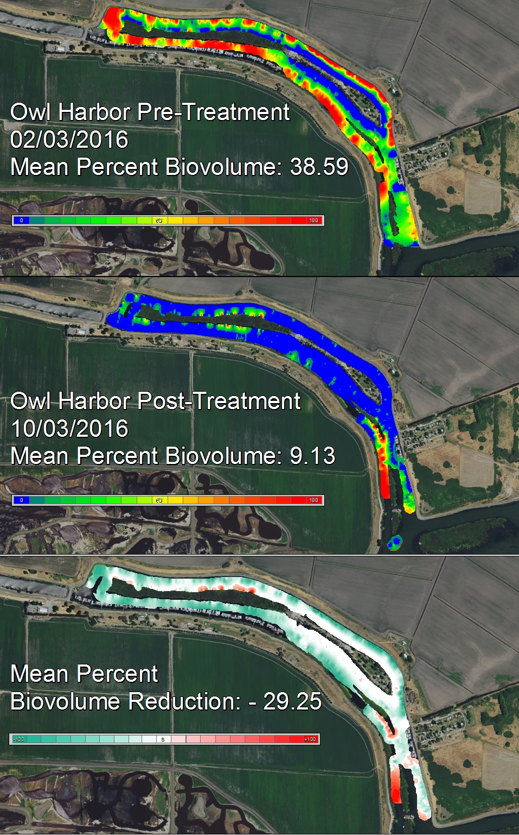
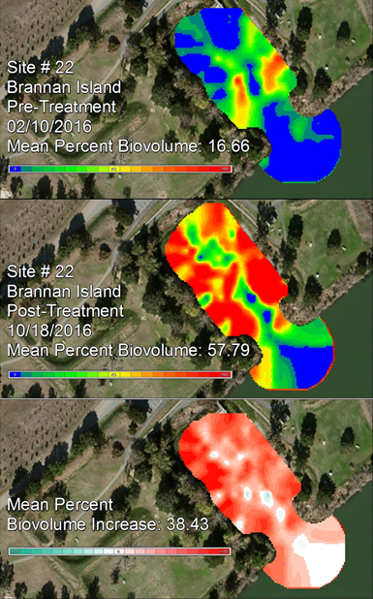
RESULTS

Slide 12
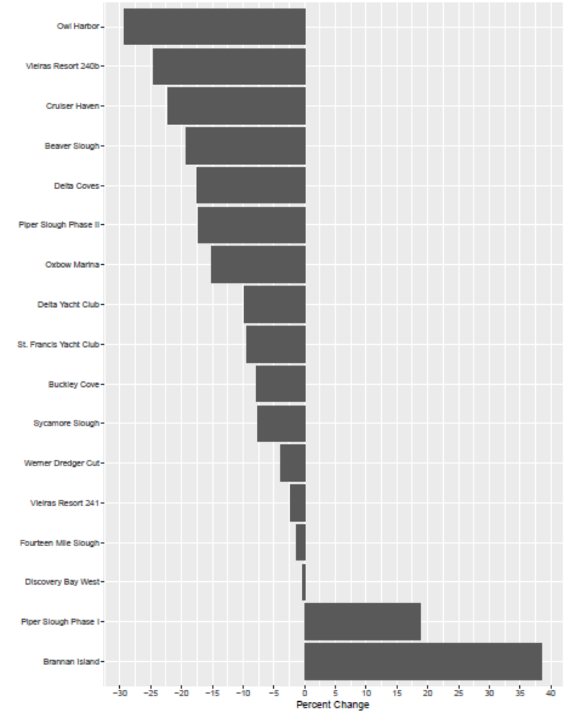
RESULTS
17 Sites Mapped for Pre-Treatment and Post-Treatment
15 Sites showed improvement (decrease in biovolume)
2 Sites showed increase in biovolume even after treatment
Overall Mean Percent Biovolume Reduction:
-7.65+ 8.44
(t = -1.9209, df = 16,
p = 0.07275)

Slide 13
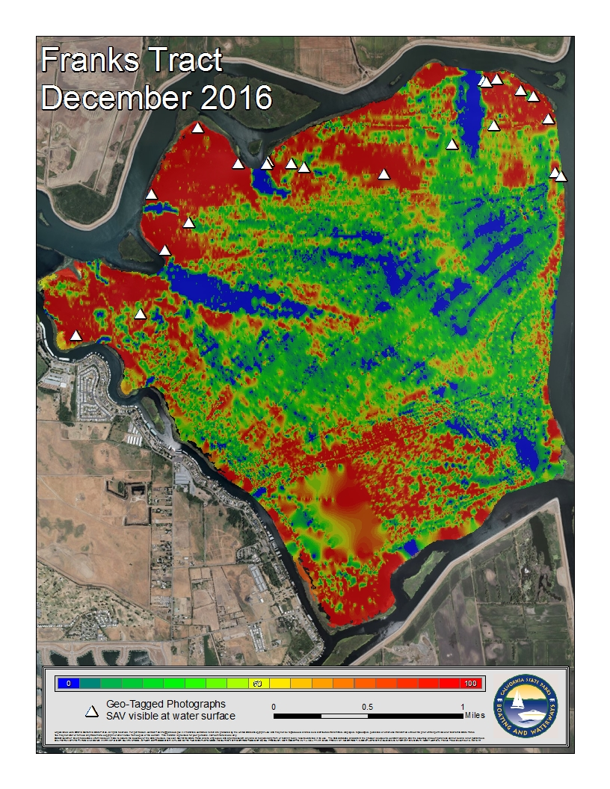
Results Accuracy
22 Geotagged Photos
Correspond with areas of high biovolume (>80%)

Slide 14
Conclusions and Considerations
First season results seem low, but sets baseline for future mapping and treatments
Hydrologic considerations
Comparison with recent hyperspectral imagery

