Slide 1


Food access in
Sacramento county
Elena Davert
Geography 385, Fall 2016

Slide 2
PURPOSE
Create a mock-up store locator tool
  Parse data from Sacramento Food Bank & Family Services (“Food Bank”) to create county-wide map and tables that can be easily queried
  Create a Web Map App through ArcGIS Online that allows users to explore SFBFS data via various widgets

Slide 3



Food bank History
2014: Merged with Senior Gleaners, Inc.
2015: Adopted partner agencies left behind after California Emergency Foodlink’s exit from Sacramento
2015: Joined the Feeding America Network

Slide 4
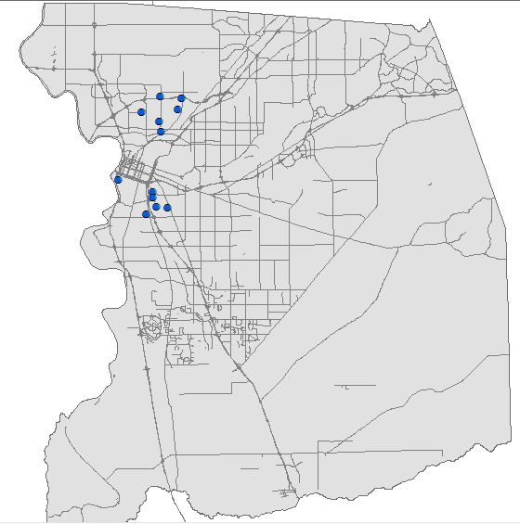
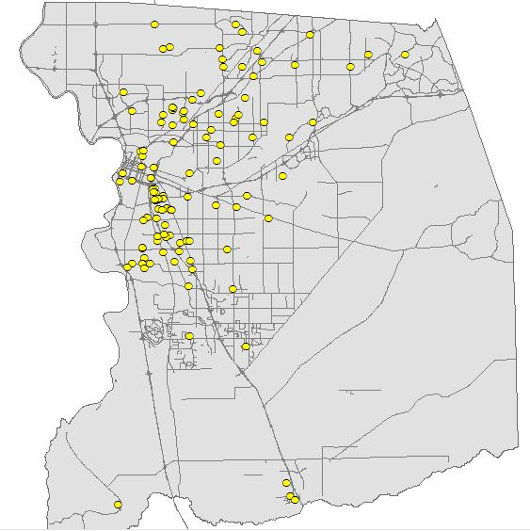
New partner agencies
2014:
12 distribution sites
Farmers market style events held in church and school parking lots
2015:
220 partner agencies (113 open to public)
Includes original sites plus churches, food banks, food closets, apartment buildings, etc.

Slide 5

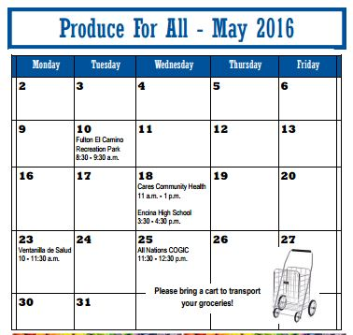
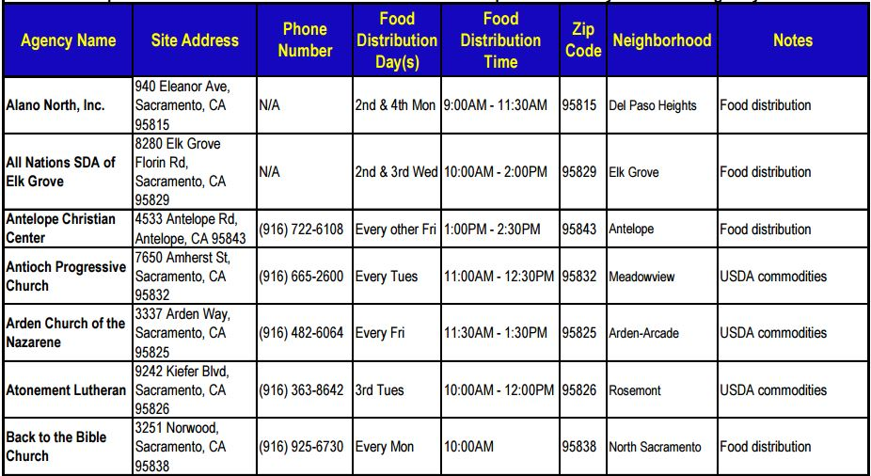
Unsearchable pdfs…

Slide 6
Questions to consider
Food bank clients want to know:
  What sites are open today/right now?
  What other sites are in this neighborhood?
  How do I get there?

Slide 7
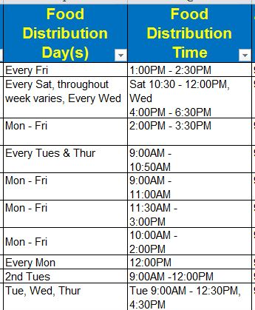
Data Acquisition: Food Bank
Translating Event information into fields that can be queried:
    2ND 2
    Monday M
    11:30 AM 1130
    2:30 PM 1430

Slide 8
challenges
Data format compatibility with AGOL
Using correct boolean operators
Creating a user-friendly interface

