Slide 1
Firewise Communities in Nevada County
Notes:
http://arcg.is/1LtWJUR
My name is Livey and I am the Office Manager at the Fire Safe Council of Nevada County.
One of the things we do at the Fire Safe Council is create Firewise Communities

Slide 2
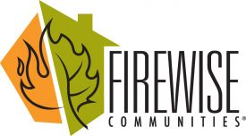
Firewise Communities
Firewise is a national program that takes creating defensible space to a neighborhood level instead of just a parcel-by-parcel level.
Currently, in Nevada County there are:
16 certified Firewise Communities
4 almost certified
11 were on the waiting list
3 new communities were added just this week for a total of 14 on the waiting list
Notes:
This program is one of my favorites.
Firewise creates a whole community of people looking at the fire issue not just on a parcel-by-parcel level but on a neighborhood level.
It is such a grass roots, neighbor to neighbor effort that has proven very successful in increasing awareness and actual work on the ground to help prevent catastrophic wildfire.

Slide 3
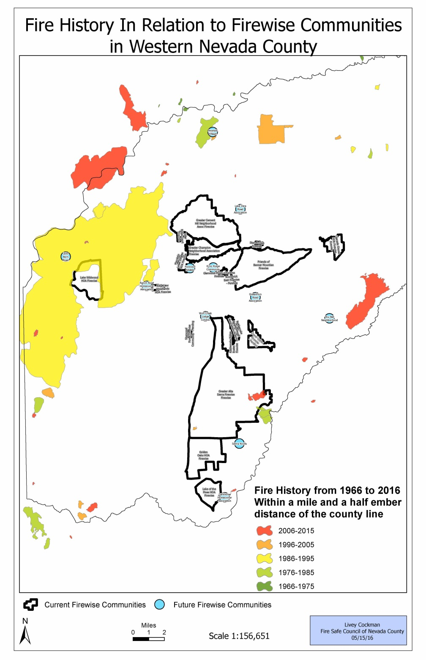
Notes:
In Nevada County Cal Fire has rated the fire danger as mostly high to severe with some areas of moderate danger.
It is the biggest threat we face from nature. Yet there are lots of things we can do to minimize this risk.
One of the things I wanted to figure out is where the Firewise Communities were in relation to the fire history for the last 50 years.
Are we covering the right areas? Do we need to do more outreach and educate in any areas?
I found a few areas that could use a Firewise Community to help address the fire danger. We could really use some more communities in the footprint of the 1988 ‘49er fire. (point out area)

Slide 4
Nevada County by Acres
Notes:
Nevada County is made up of about 623,769 acres
Firewise Communities makes up about 41,000 acres of that or only about 6%

Slide 5
Nevada County by Parcel
Notes:
When you look at it by parcel then 35% of the parcels in Nevada County are within the boundaries of a Firewise Community

Slide 6
Nevada County by Parcels With Improvements over $10,000
Notes:
If you look at just the parcels with improvements over $10,000 then the percentage of parcels in a Firewise Community goes up to 39%

Slide 7
Firewise Community Sizes
Community Name | # of Parcels | # of Parcels Improved over $10,000 | # of Unimproved parcels | Total Acres by Boundary
Brunswick East Condominiums | 28 | 27 | 1 | 4.44
Cascade Shores Homeowner’s Association | 526 | 418 | 108 | 757.00
Friends of Banner Mountain | 2056 | 1740 | 316 | 4,807.74
Glenwood-Maidu-Charlene Neighborhood | 96 | 84 | 12 | 103.21
Golden Oaks Homeowners Association | 214 | 169 | 45 | 2,859.72
Greater Alta Sierra Firewise Community | 5360 | 4353 | 1007 | 12,855.43
Greater Cement Hill Neighborhood | 603 | 438 | 165 | 5,103.33
Greater Champion Neighborhood Association | 625 | 461 | 164 | 1,838.09
Lake of the Pines Association | 2036 | 1862 | 174 | 1,307.37
Lake Wildwood Homeowners Association | 3015 | 2835 | 180 | 2,268.27
Lower Colfax Firewise | 90 | 62 | 28 | 722.24
Mountain Lakes Estates Homeowners Assn | 69 | 51 | 18 | 351.14
Rattlesnake Neighborhood Association | 146 | 133 | 13 | 317.75
Rattlesnake Ridge Estates | 26 | 10 | 16 | 81.26
Ridgeview Woodlands Homeowner’s Association | 30 | 18 | 12 | 130.76
Sherwood Forest Firewise | 73 | 65 | 8 | 63.79
Stonebridge Homeowners Association | 36 | 32 | 4 | 63.79
Tahoe-Donner Association | 7093 | 5638 | 1455 | 7,011.45
The Gazebos | 44 | 41 | 3 | 4.47
Toller Ridge Court | 15 | 9 | 6 | 127.12
Total Acres: | 22181 | 18446 | 3735 | 40,778.37
Notes:
Firewise Communities are made up of all different shapes and sizes. Each community is unique onto itself.
Greater Alta Sierra Firewise is the biggest Firewise Community in Nevada County by acreage and contains almost 13,000 acres.
Tahoe-Donner Association has the most parcels in their Firewise Community at 7,093 parcels of which 5,638 have improvements to them.
Brunswick East is the smallest Firewise Community at only 4.44 acres and is also the first commercial property in the nation to go Firewise.
Toller Ridge has the least amount of parcels with only 15 in their community, 9 of those with improvements.

Slide 8
Fire Safe Program Activities
Notes:
At the Fire Safe Council we also have programs that help people with the defensible space around their homes.
Between July 1st, 2015 and April 30, 2016, there was more activity completed outside of the Firewise Communities then there was within.
I found this surprising because I thought it would be the opposite.

Slide 9
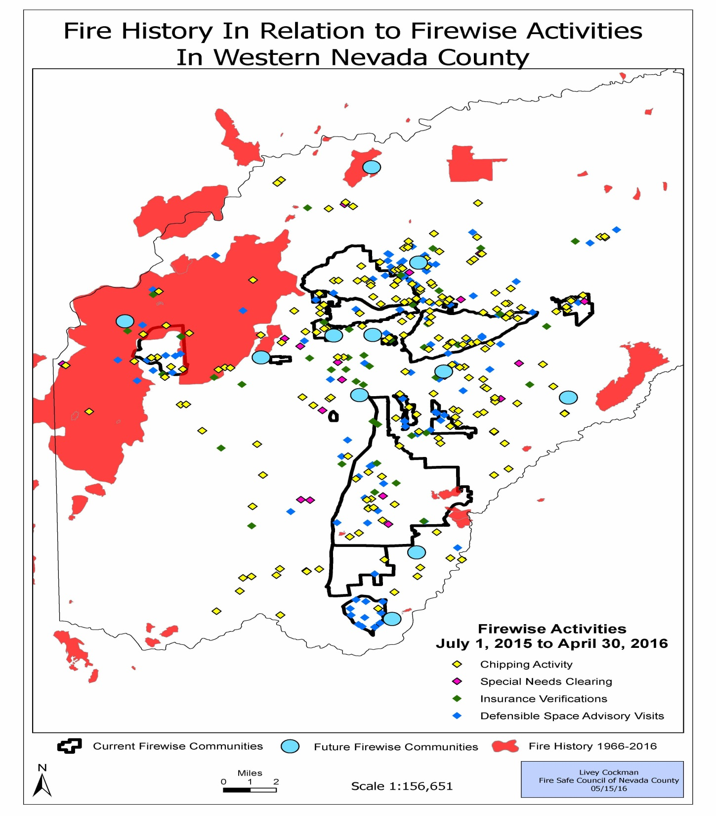
Notes:
On this map the diamonds show the Chipping, Special Needs Assistance Clearing, Defensible Space Advisory Visits and Insurance Verifications that were completed in that time frame
When you look at where the activities are taking place you can see in some areas were there is a community on the waiting list, such as Lake Vera up here, (Point to area) there is an uptick in activity as awareness increases.

Slide 10
Problems
Data management
Different versions of ArcMap
Duplicate entries in the parcel data
Story Map
http://arcg.is/1LtWJUR
Notes:
The biggest problems I ran across were data management, dealing with different versions of ArcMap and duplicate entries in the parcel data layer.
Data management: I had data from three different places on a flash drive that I was then accessing from three different locations. Since I viewed all of the files as being in a temporary location I didn’t follow the data management guidelines that I have in place at work. If I had taken the time to organize everything in the beginning I would have prevented a lot of problems I encountered.
Different Versions of ArcMap: At home I have AcrMap 10.1, at school it’s ArcMap 10.3 and at work half way to through the semester it went to ArcMap 10.4. This made it really difficult to manage the different mxds because if I worked on it on my work computer and didn’t save it into an earlier version then I was unable to work on it when I got to class or at home.
Duplicate entries in the parcel data: About halfway through I realized that I had duplicates in my parcel layer. This meant that any spatial analysis I had done using this layer was incorrect. Luckily there was a python code on ArcGis Online that allowed me to identify the duplicates so that I could get rid of them with out having to comb through 67,000 records.
It is really hard for most people to grasp the Firewise concept and what it is all about by just reading about it.
I created a story map to visually show what makes up the Firewise Communities throughout Nevada County.
http://arcg.is/1LtWJUR
The story map starts off with some information on what a Firewise community is
It then shows where all the certified communities are as well as the pending communities and the ones on the waiting list
It talks a little bit about the different sizes of the communities
And shows where the current boundaries are in relation to the fire history from the last 50 years as well as where future Firewise Communities are being created.
It then shows a little bit about the different communities.
Each certified community has a map and some pictures showcasing varies activities in there communities.
There is also a link that will take you to the hazard assessment report that was created when the community was certified.

