Slide 1
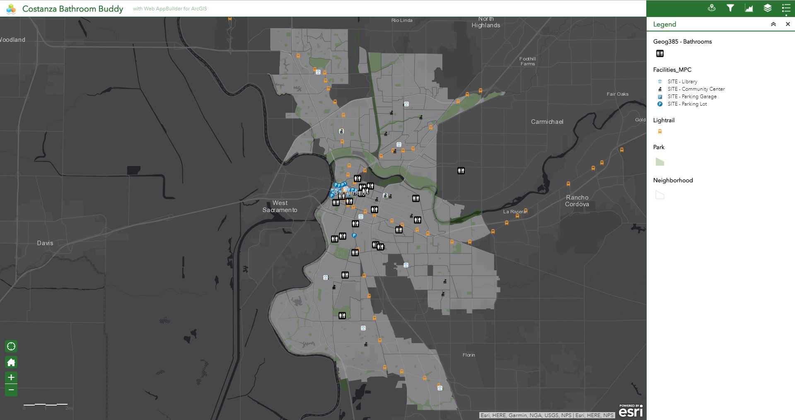
Full Map Extent
Chenaille
GEOG 385, Fall 2017

Slide 2
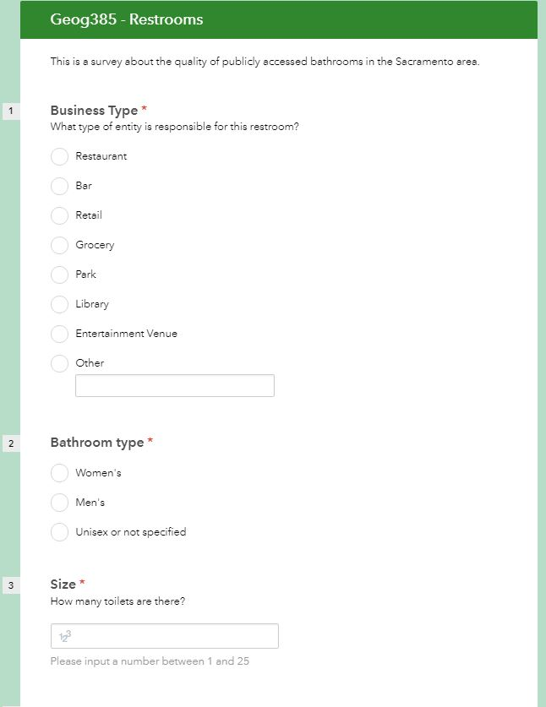
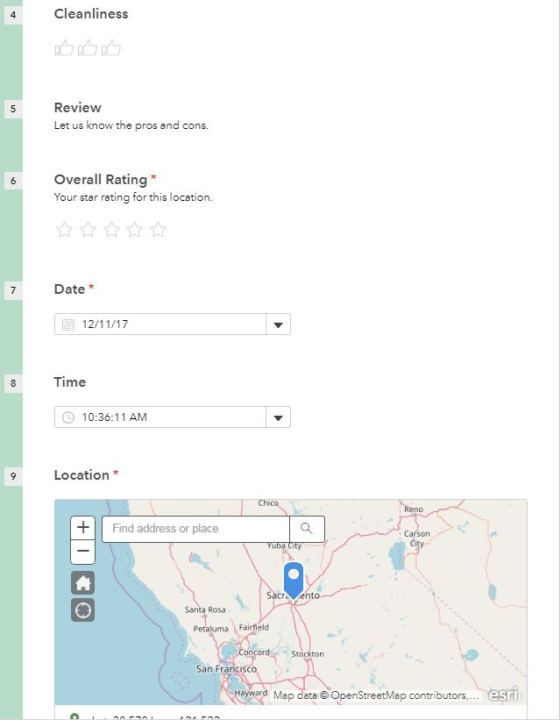
Survey123
Chenaille
GEOG 385, Fall 2017

Slide 3
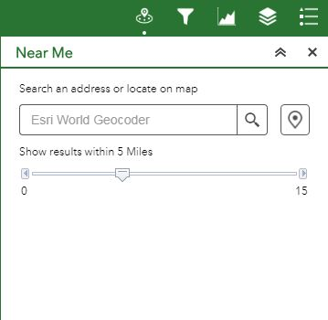
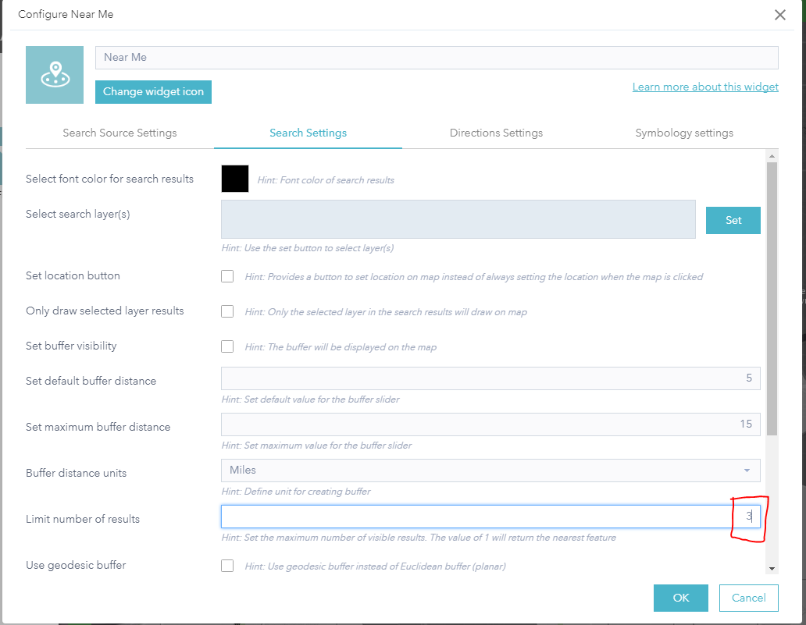
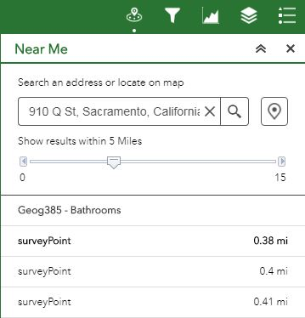
Chenaille
GEOG 385, Fall 2017

Slide 4
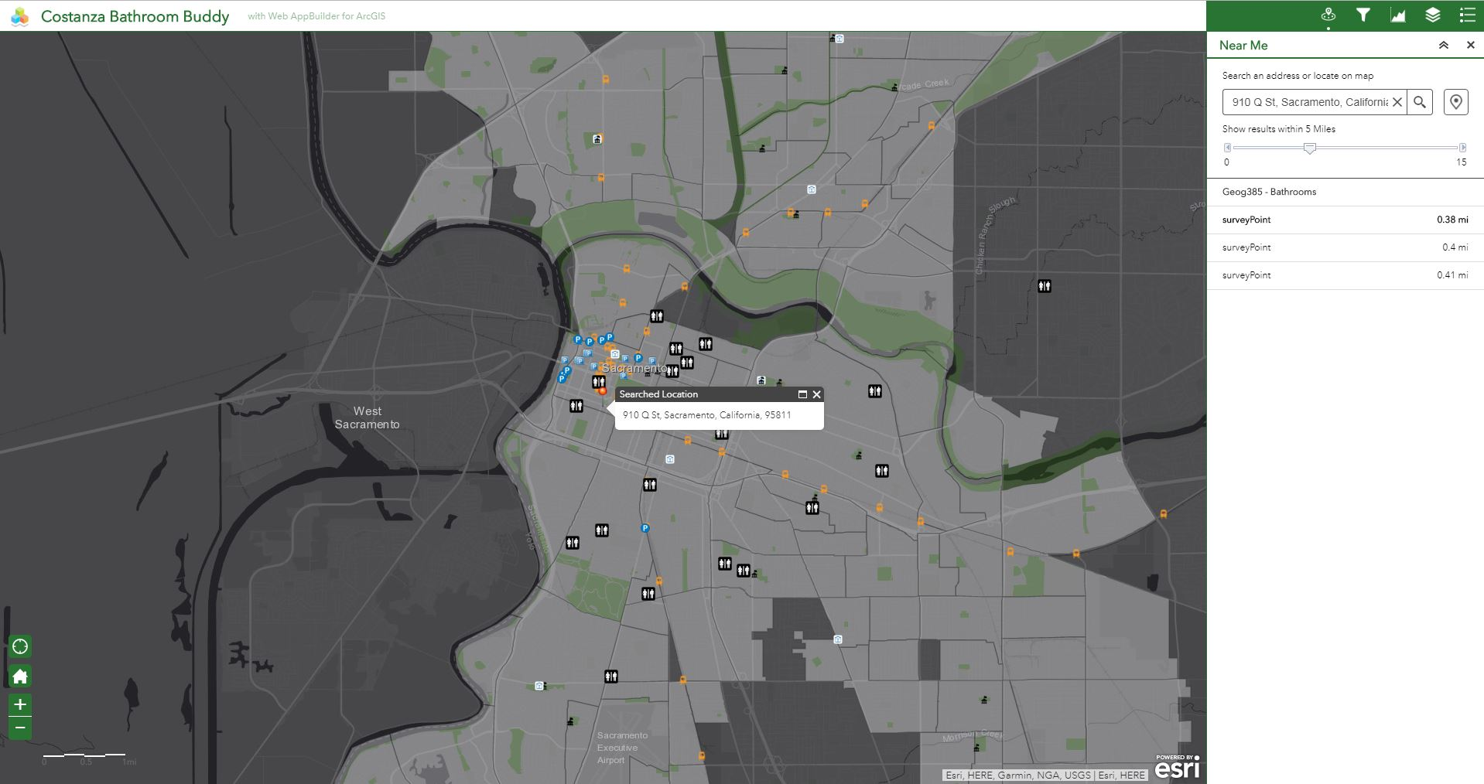
Chenaille
GEOG 385, Fall 2017

Slide 5

Chenaille
GEOG 385, Fall 2017

Slide 6
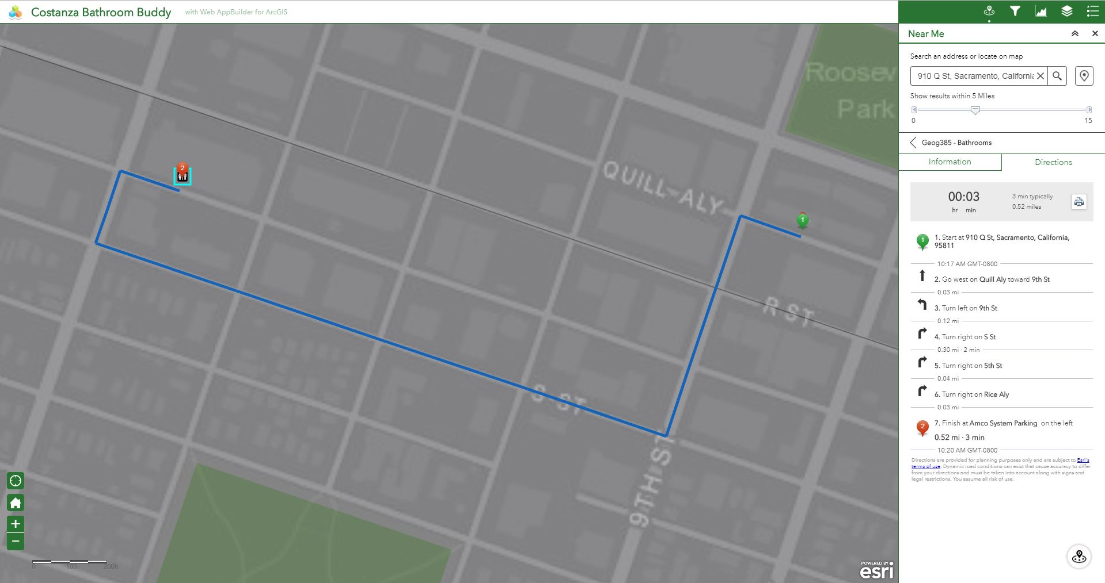
Chenaille
GEOG 385, Fall 2017

Slide 7
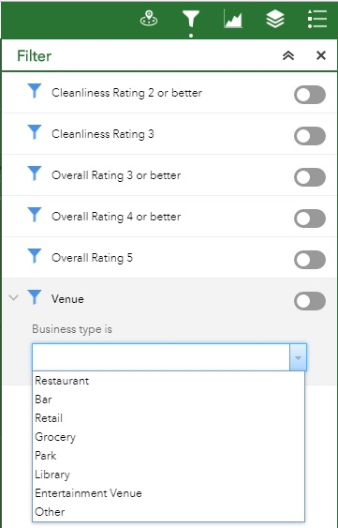
Options to filter out survey points displayed, charted, and as potential destinations based on specific attribute values
Chenaille
GEOG 385, Fall 2017

Slide 8
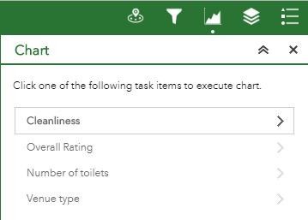
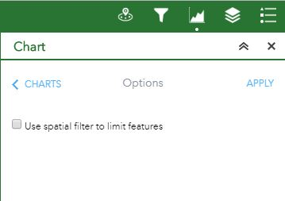
Chartable attributes
No spatial filter applied
Chenaille
GEOG 385, Fall 2017

Slide 9
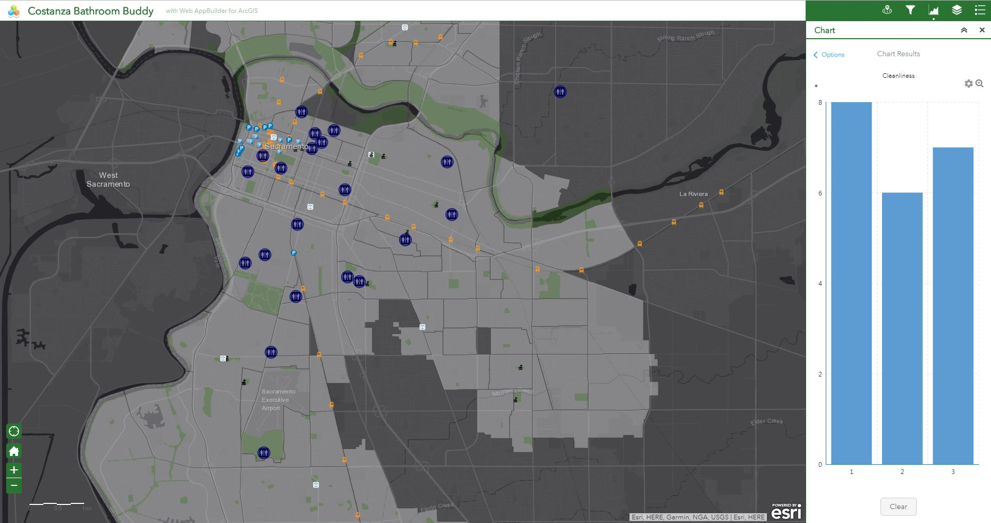
Chart with no spatial filter includes all survey points
Chenaille
GEOG 385, Fall 2017

Slide 10
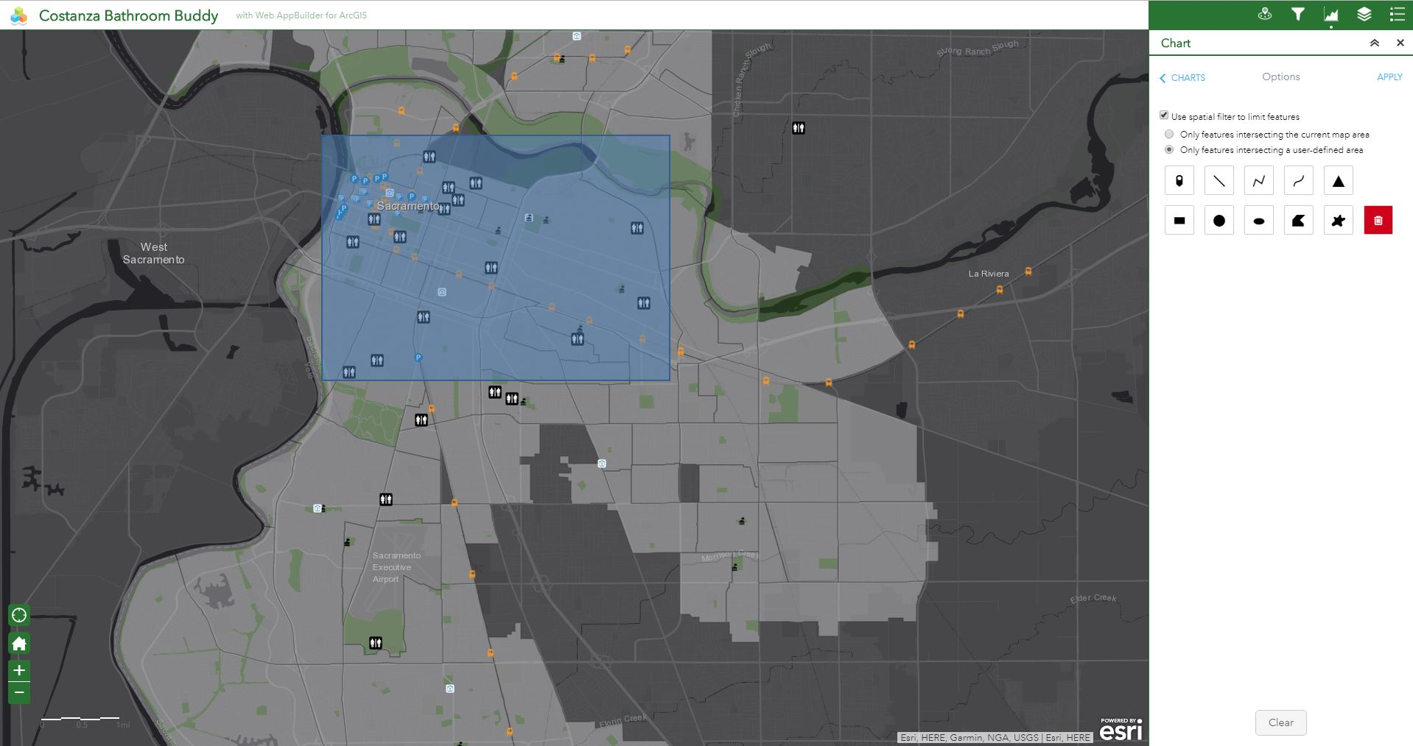
Various options to spatially filter out survey points, square box tool used here
Chenaille
GEOG 385, Fall 2017

Slide 11
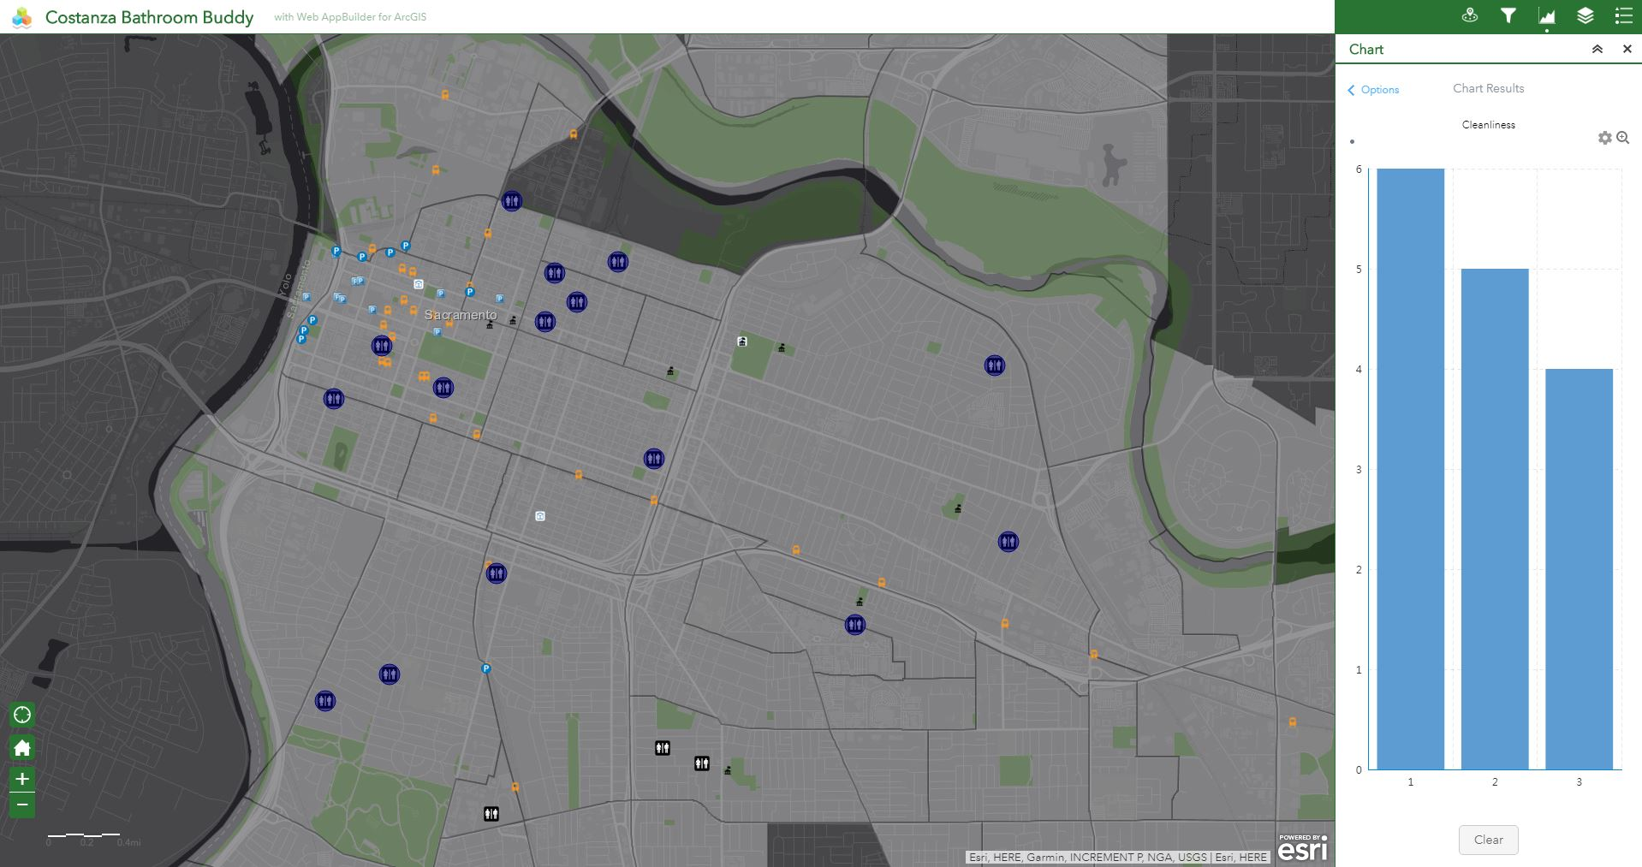
Only survey points within the bounding box of the previous slide are included in the chart statistics
Chenaille
GEOG 385, Fall 2017

Slide 12
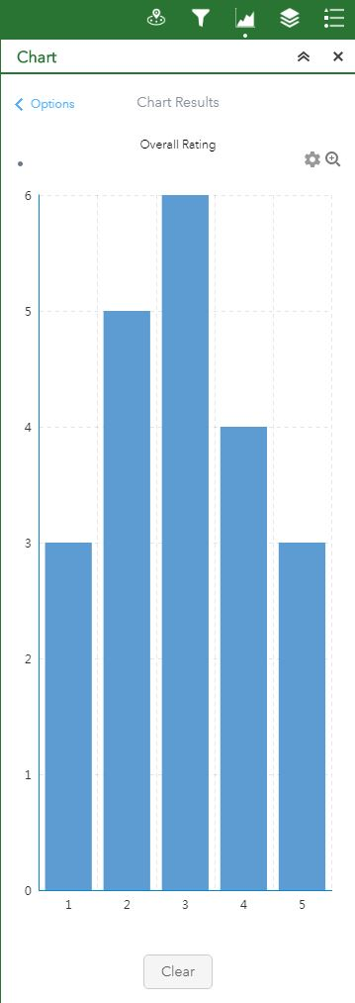
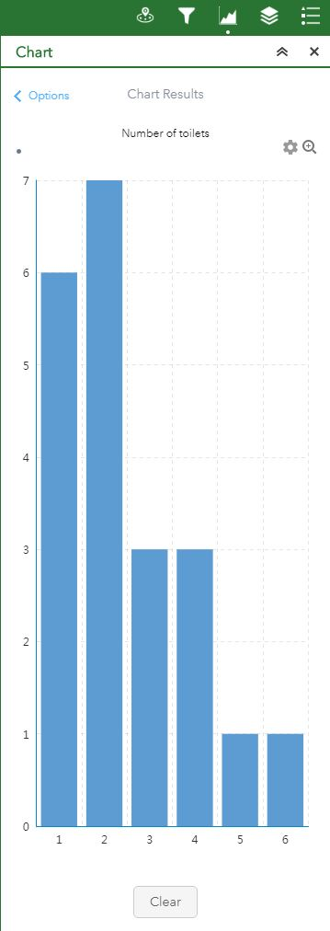
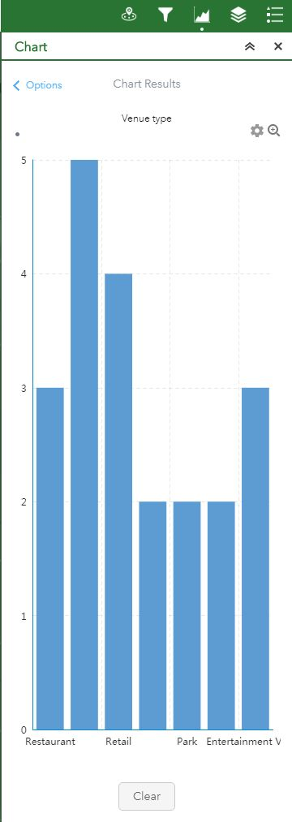
There are other chart types available such as pie or line charts, but since the values displayed for each attribute are just ‘count,’ I felt the bar graph best communicated the statistics.
Chenaille
GEOG 385, Fall 2017

