Slide 1
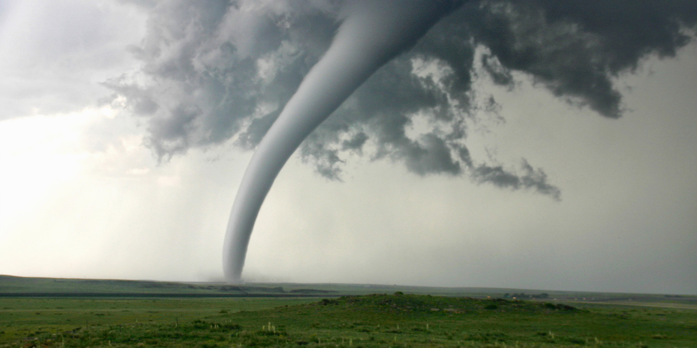
Final Project
GIS 0090
Instructor: Nate Jennings
Student: Jamie Brown
https://youtu.be/pSajNLBH7cA

Slide 2
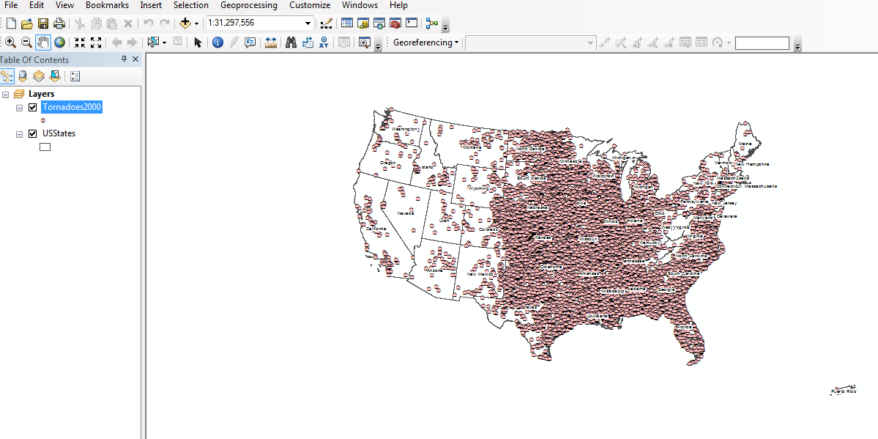
Tornadoes in United States 2000-2008
There were a total of 11,645 tornadoes that touched down between the year 2000 and 2008. Of those 11,645, 912 tornadoes had injuries or fatalities.
Notes:
Each dot on the map represents all of the tornadoes that touched down in the 8 year duration.

Slide 3
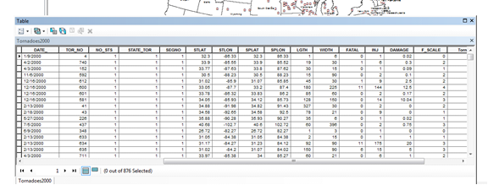
Attribute table

Slide 4
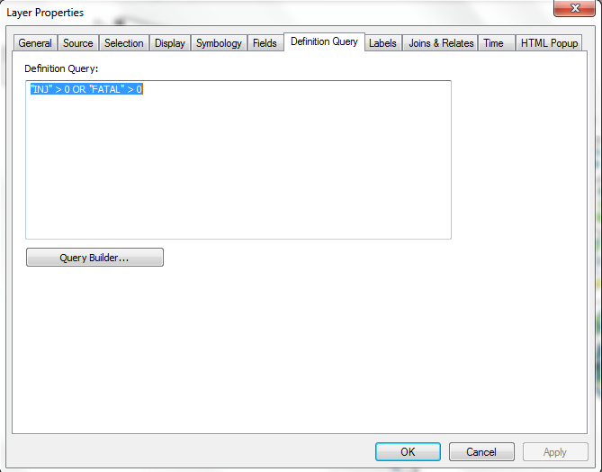
Definition query
Notes:
In order to find only the tornadoes that involved injuries or fatalities, I ran a Definition Query. I did this in the layer properties.

Slide 5
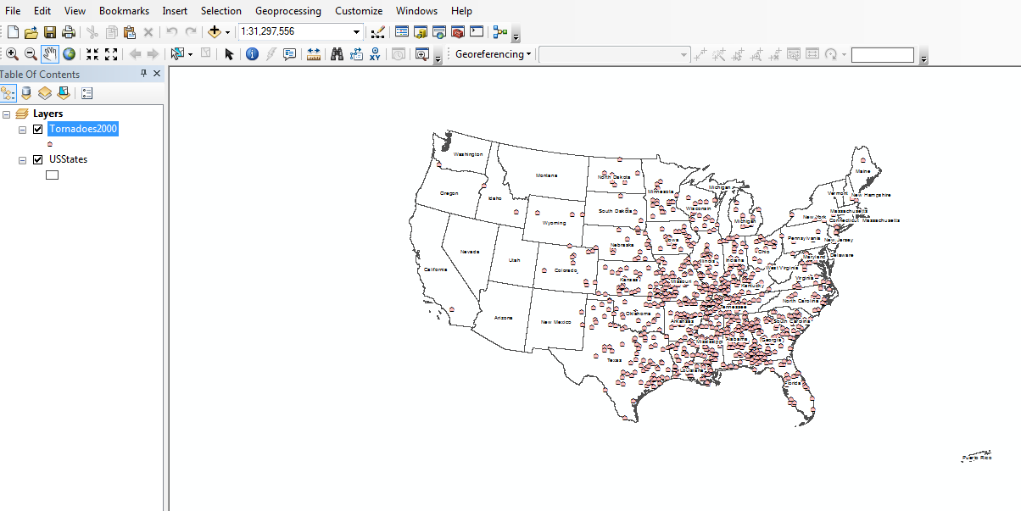
912 tornadoes involving injury or fatality

Slide 6
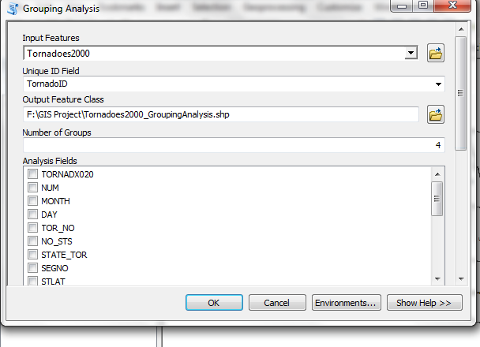
Cluster analysis
Notes:
In order to find the area where the most severe tornadoes occurred, we needed to run a cluster analysis of the data to sort it out. Using the Grouping Analysis (Spacial Statistics) tool, I separated tornadoes into 4 groups based on their f-scale, their fatalities and their injuries. The analysis tool gave each tornado severity ratings based on the data analysis

Slide 7
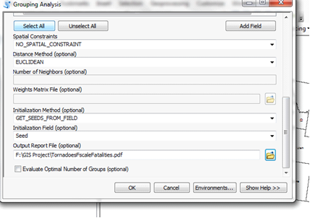
cluster analysis

Slide 8
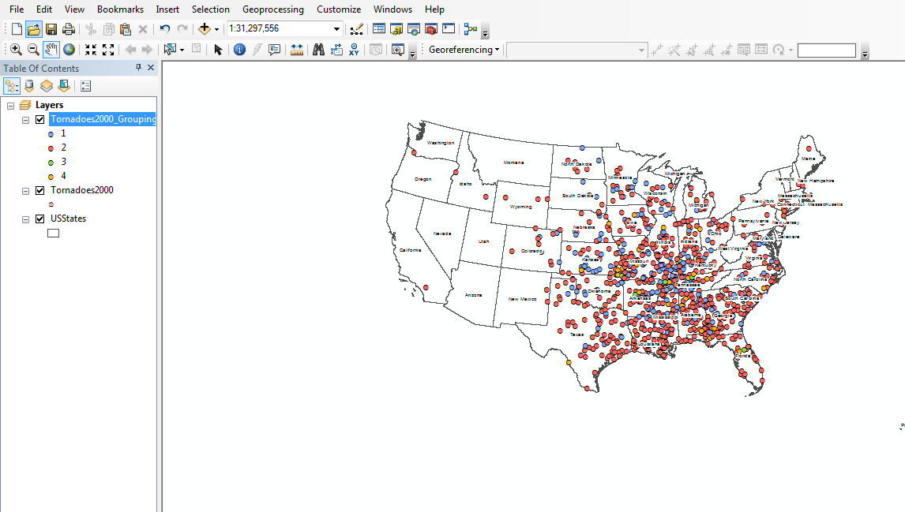
Cluster analysis

Slide 9
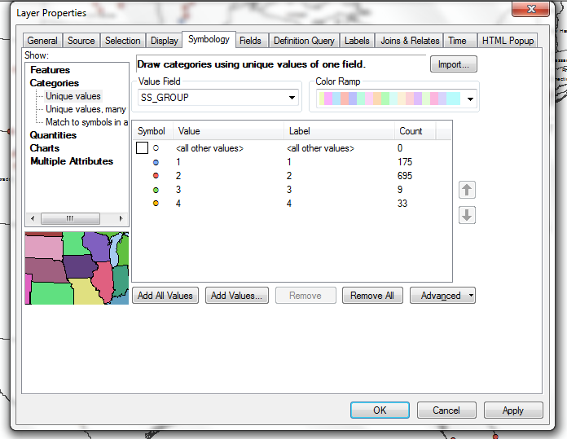

Slide 10
