Slide 1
Rural Elk Grove
Presenter: Loan Braswell GEOG 342 – Fall 2017

Slide 2
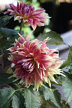

Project Purpose
Compare 2003 vs. 2014 rural area of Elk Grove
What land changes occurred between 2003 and 2014?
  Developed vs. Undeveloped
Software used
  ArcGIS Pro

Slide 3
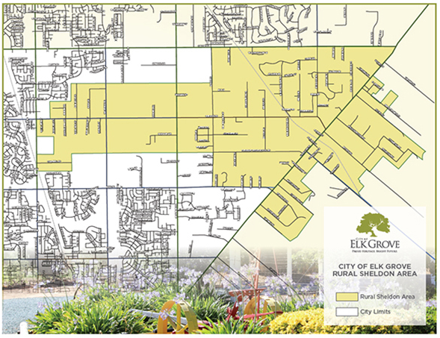
About Rural Elk Grove
This area once typified the entire community
Current City policy states that this area is to be preserved
~5,274 Acres
Source: http://www.elkgrovecity.org/visitors/about_elk_grove/rural_elk_grove

Slide 4
Imagery Used
Data Source: City of Elk Grove GIS

Slide 5
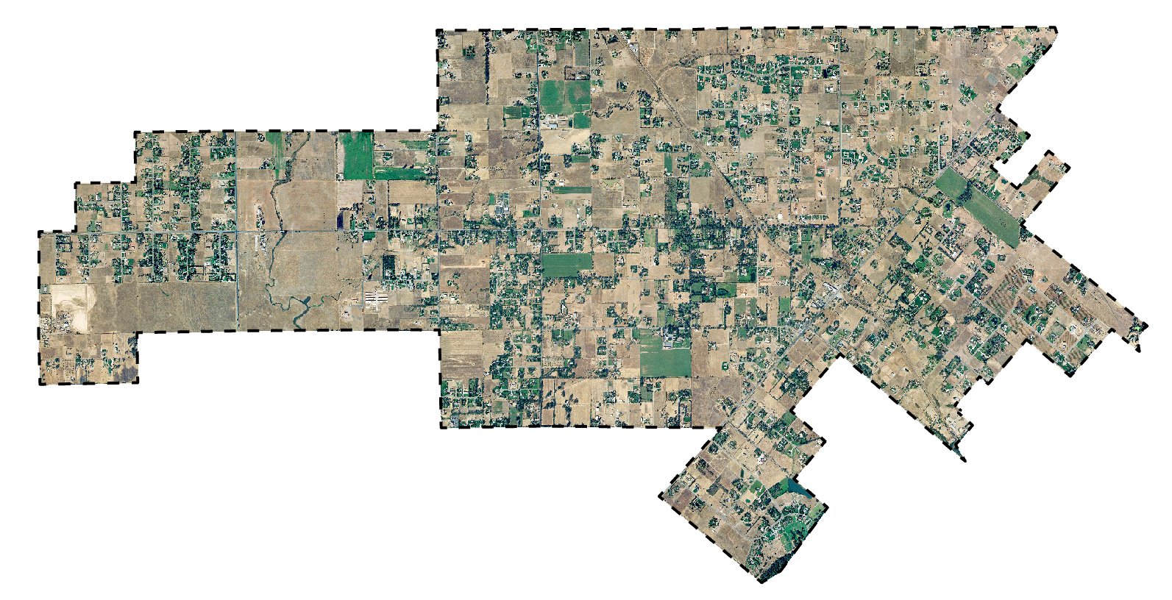
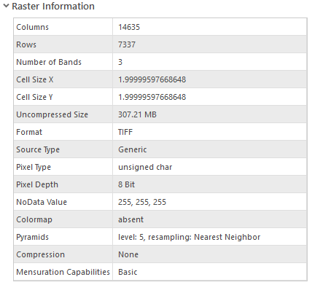
2003 Imagery
Notes:
Original extent was county-wide. I drew a rectangle and then used the Clip Raster function in the Imagery Analysis panel , then exported the image to a tiff file.

Slide 6
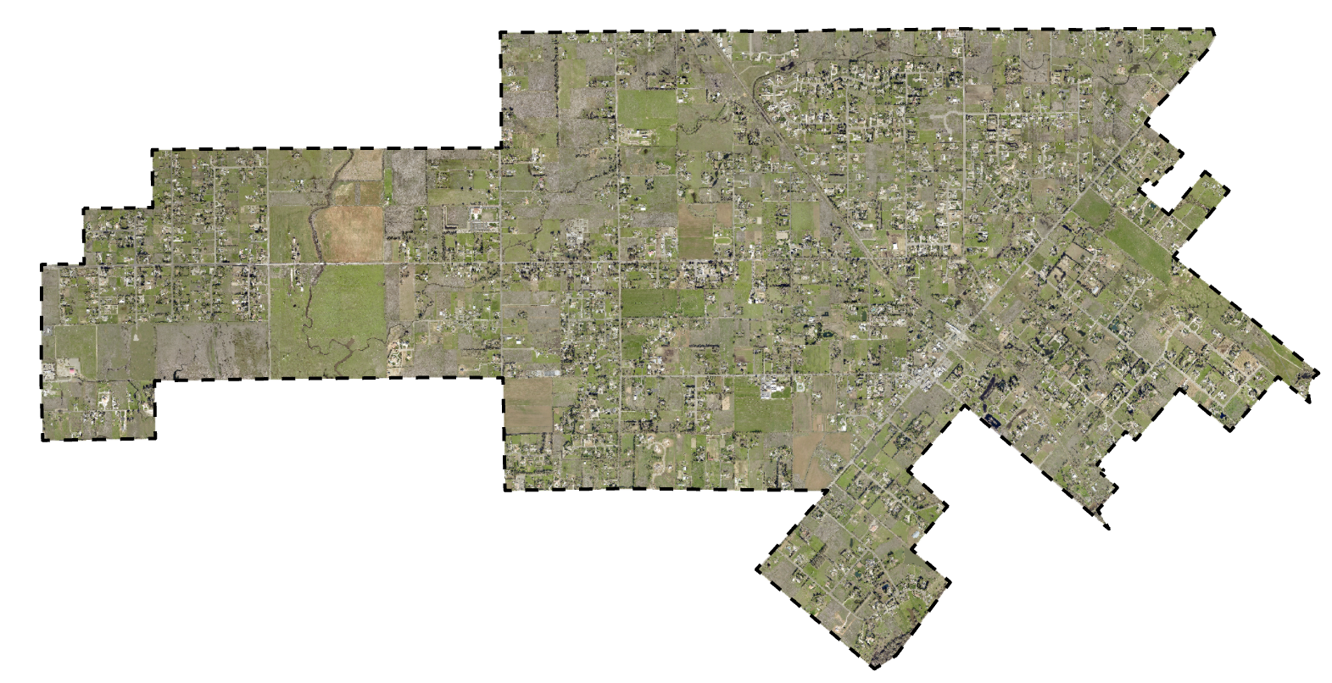
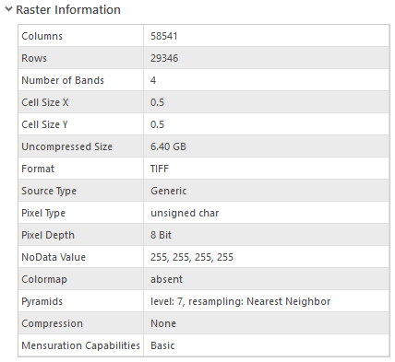
2014 Imagery

Slide 7
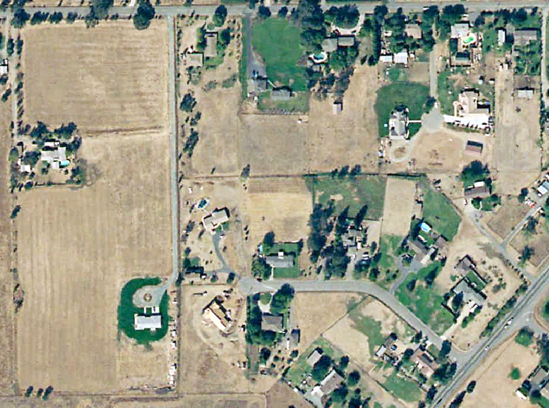
2003 Imagery

Slide 8
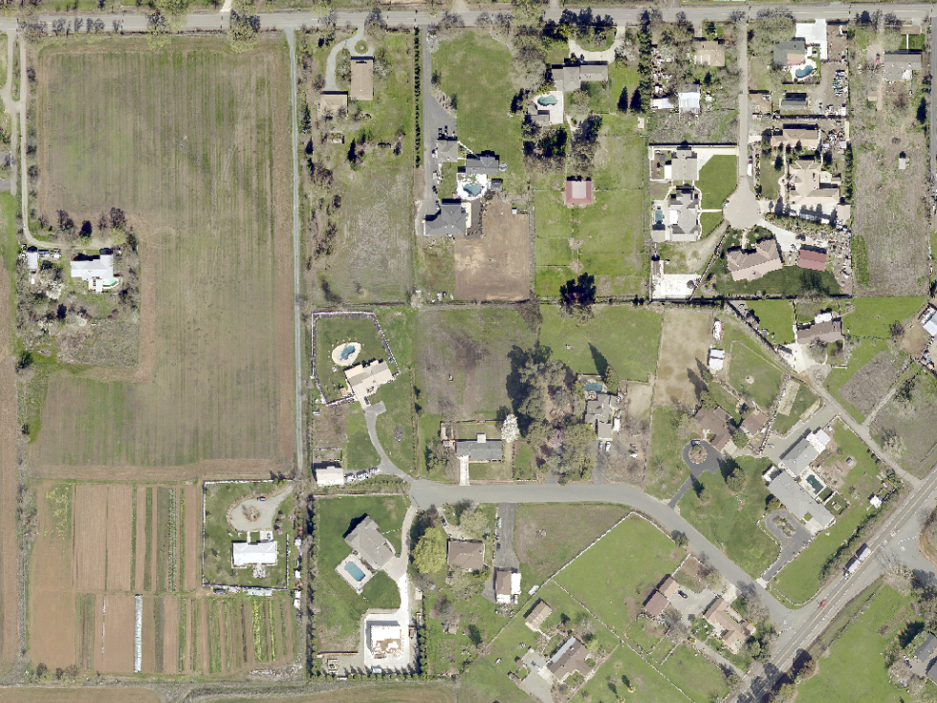
Developed
Since 2003
2014 Imagery
Notes:
These are areas developed since 2003

Slide 9
Image Classification Wizard
Supervised Classification Method

Slide 10
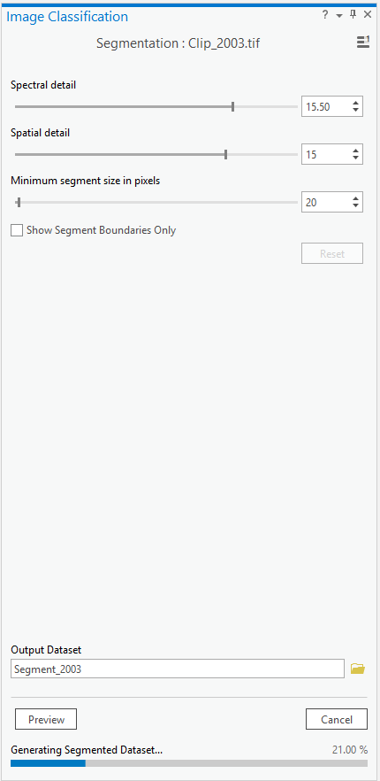
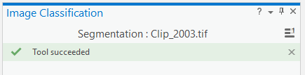
Segmentation
Segment images into spectrally & spatially similar areas
Notes:
Using the classification wizard, I conducted an unsupervised classification.

Slide 11
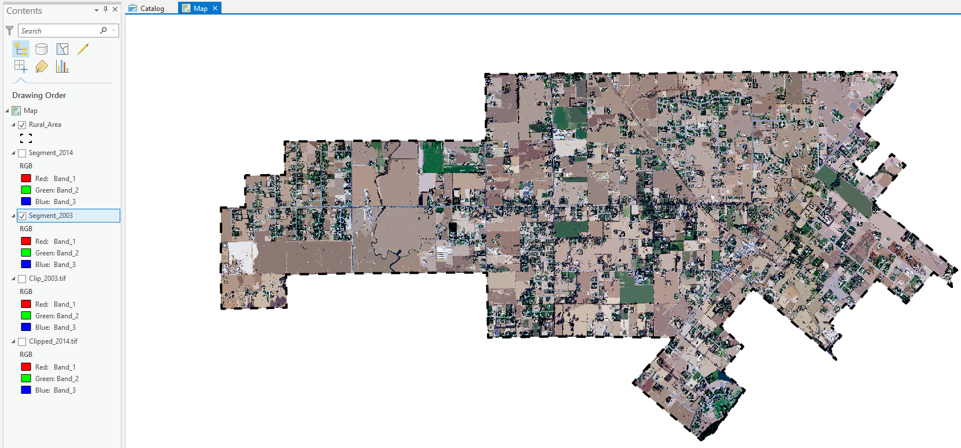
2003 Imagery

Slide 12
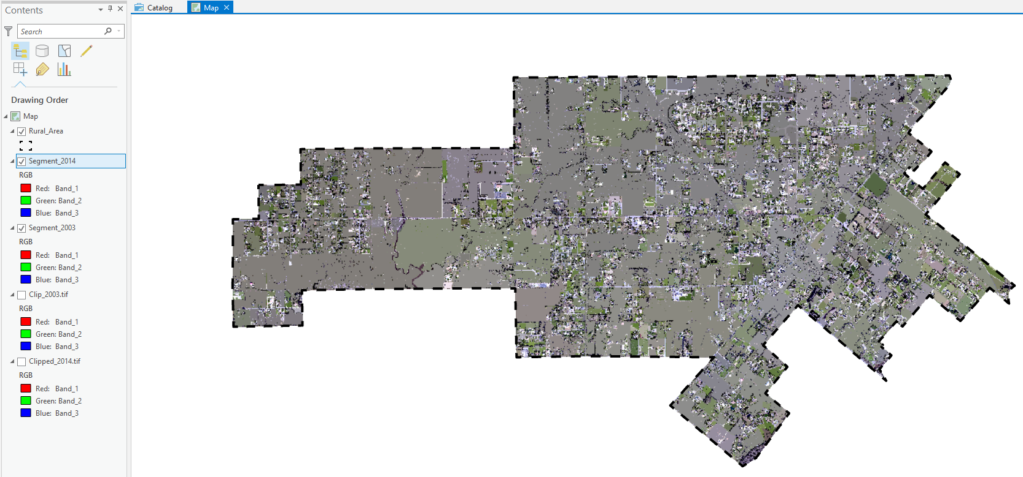
2014 Imagery

Slide 13
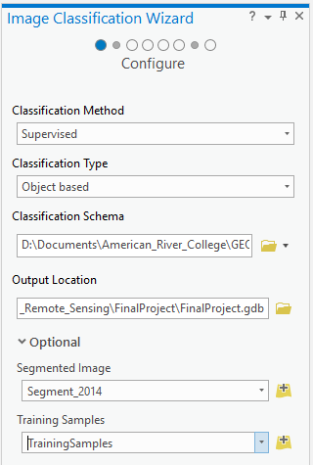
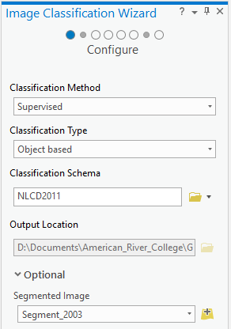
Supervised Classification
Notes:
Using the classification wizard, I conducted an unsupervised classification.

Slide 14
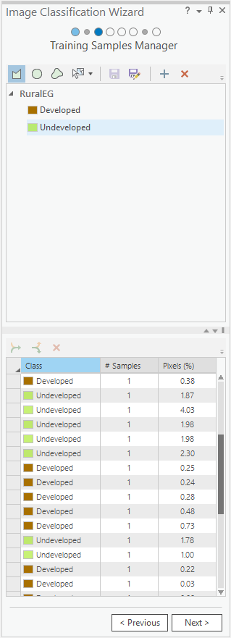
Supervised Classification
Let the picking begin….
Notes:
Using the classification wizard, I conducted an unsupervised classification.

Slide 15
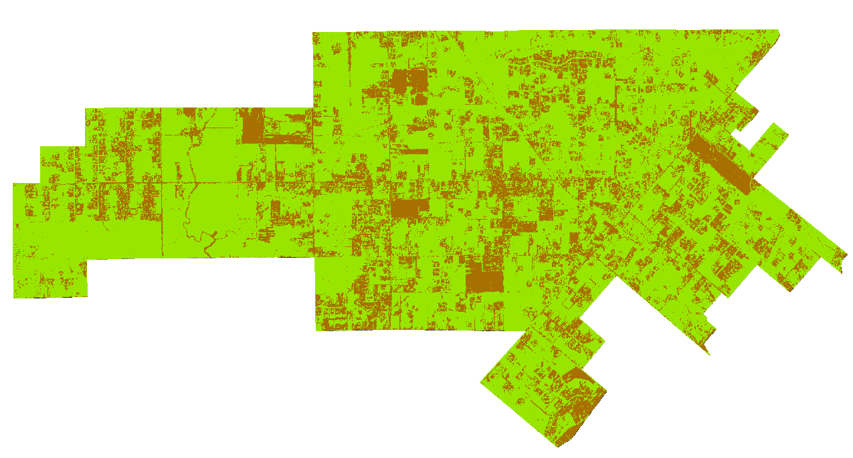

Supervised Classification
2003 Imagery
Notes:
Using the classification wizard, I conducted an unsupervised classification.

Slide 16
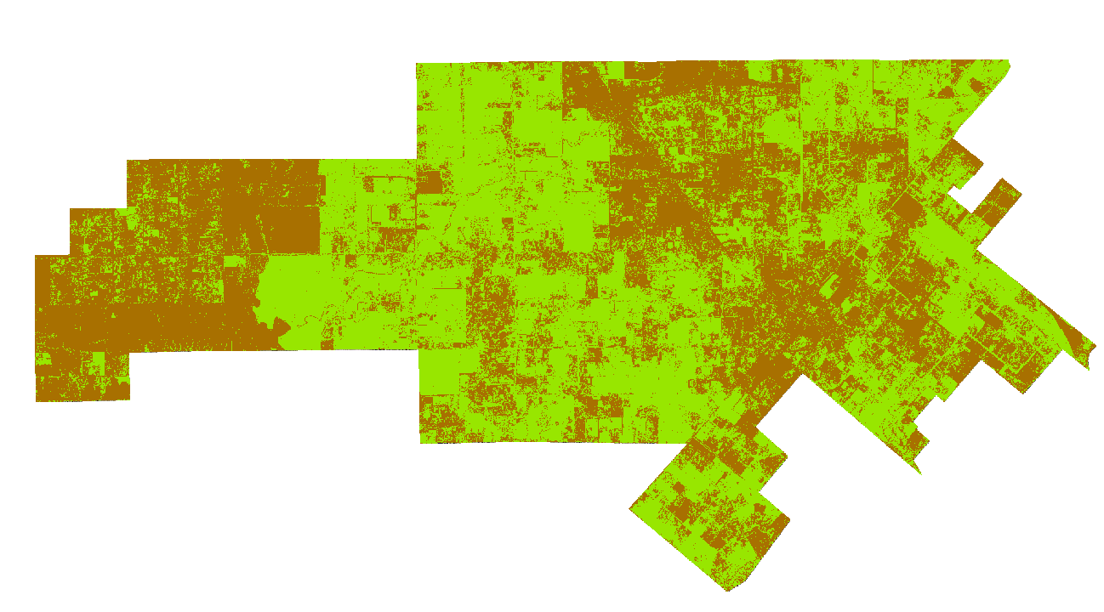
Supervised Classification
2014 Imagery
Notes:
Using the classification wizard, I conducted an unsupervised classification.

Slide 17
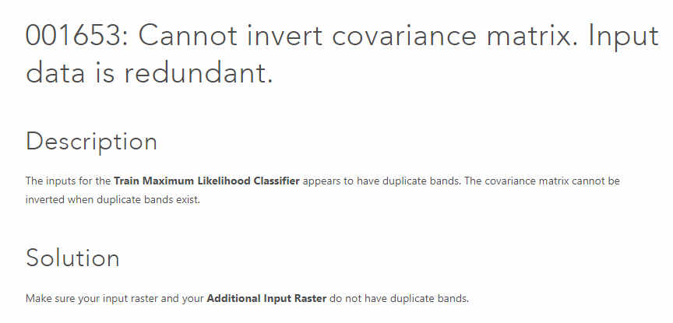

Difficulties/Issues Encountered
Tried to perform an unsupervised classification method first but tool failed.
This Photo by Unknown Author is licensed under CC BY-NC-ND

Slide 18

Difficulties/Issues Encountered
Acquiring desired imagery
Wait times while the tools ran…
  Segmenting the 2014 imagery took almost 2 hours
    2003 imagery only took 15 minutes
Classifying
  True color difficult to categorize because IR Bands were not present.
  Used other image reference materials such as Google Earth, NAIP (National Agriculture Imagery Program)
This Photo by Unknown Author is licensed under CC BY-NC

Slide 19

Project Takeaways
Pick more samples than you think you need
  2014 imagery was higher res quality than 2003
  Needed more samples for 2014 classification
Need to refine classification to get a better estimate of change from 2003 to 2014
  Rough estimate 10% increase to more developed
This Photo by Unknown Author is licensed under CC BY-SA

Slide 20

Future
Further re-classify
Ground-truthing
Accuracy assessment
This Photo by Unknown Author is licensed under CC BY-SA

Slide 21
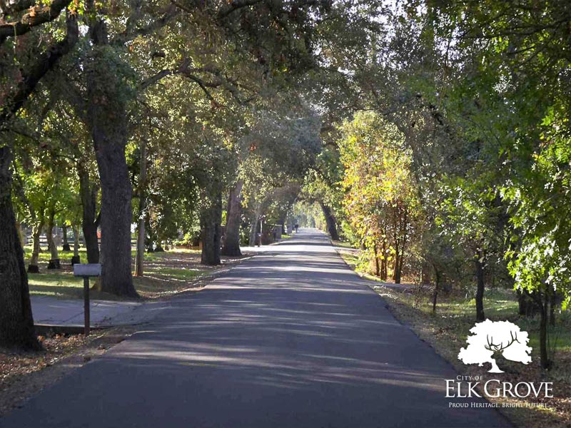
Thank you
Source: elkgrovecity.org

