Slide 1
Sacramento Food Trucks
Jasmyn Bragg
GEOG 385

Slide 2
Goal
Web application that allows users to find food trucks in Sacramento
Ability to update truck locations by date and time.
Search based on price level, food type and availability.
Links to Twitter, Facebook & Yelp

Slide 3
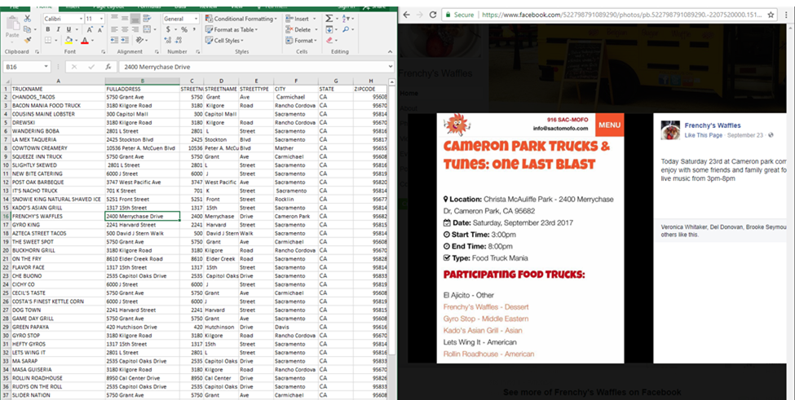
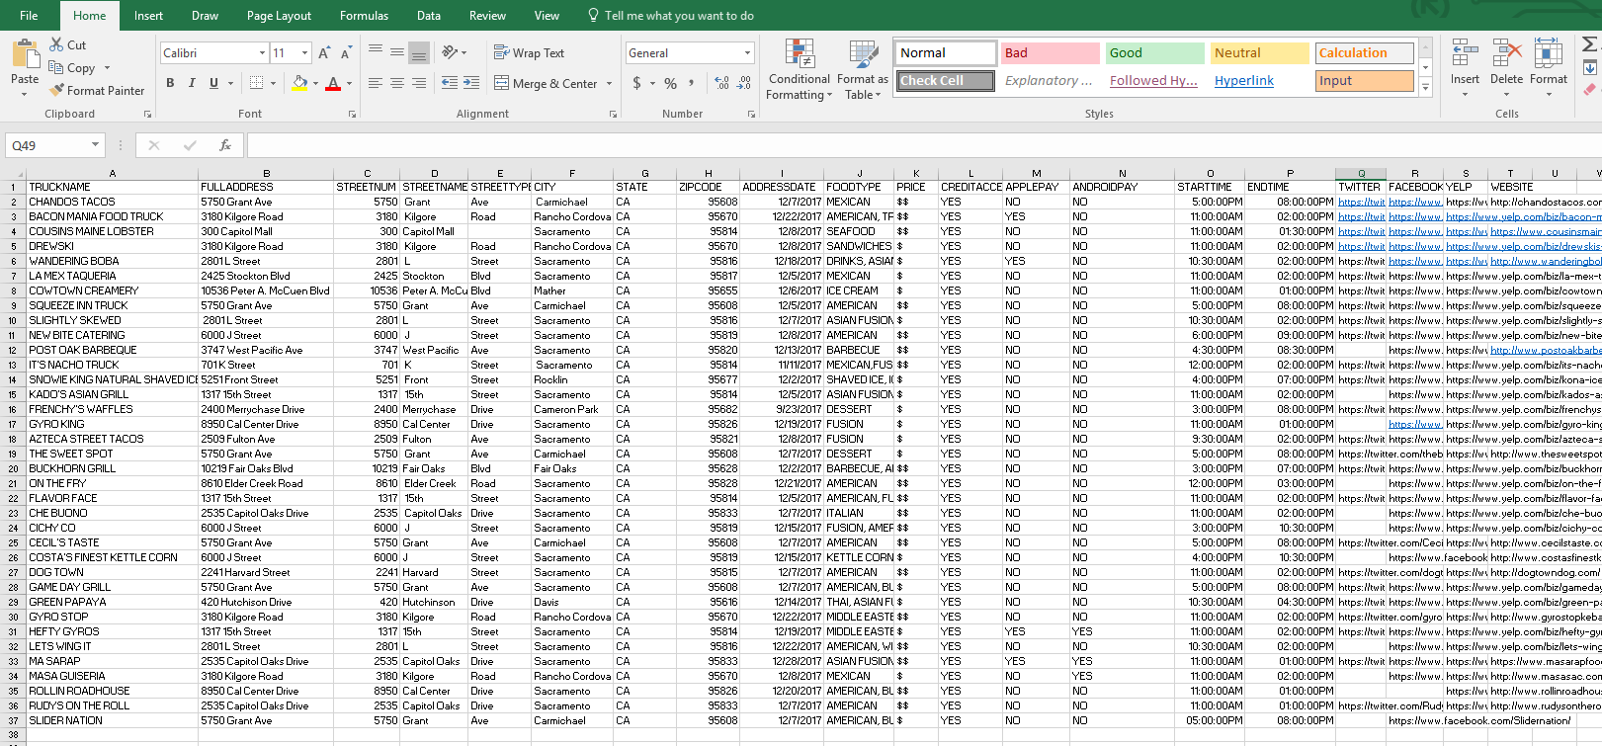
Data Development

Slide 4
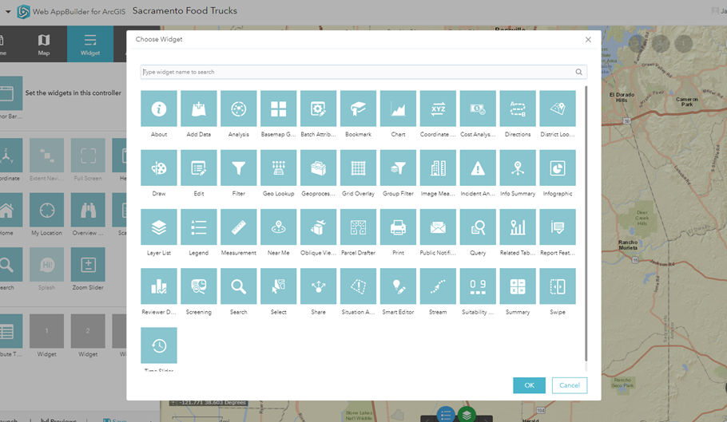
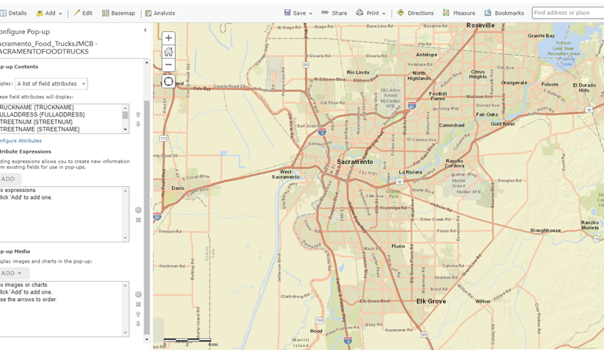
Web Application Development

Slide 5
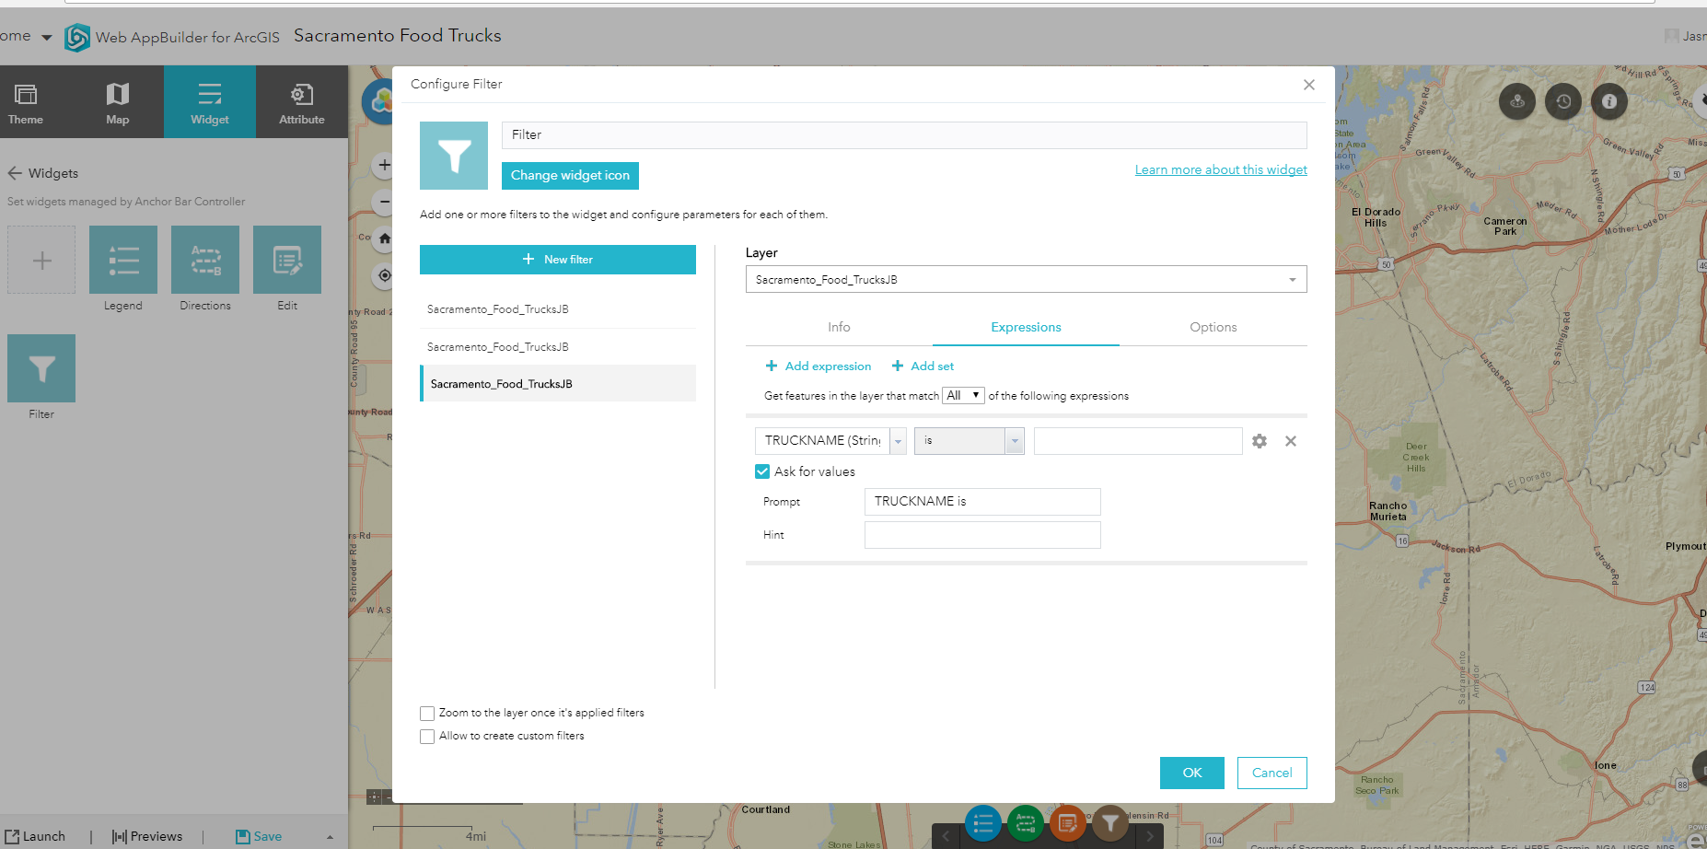
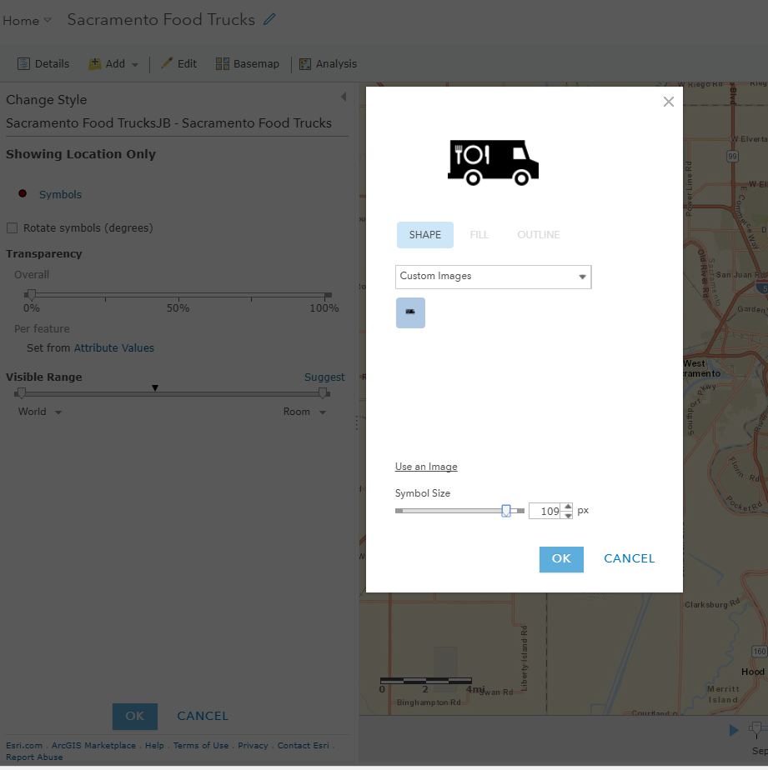
Web Application Development

Slide 6


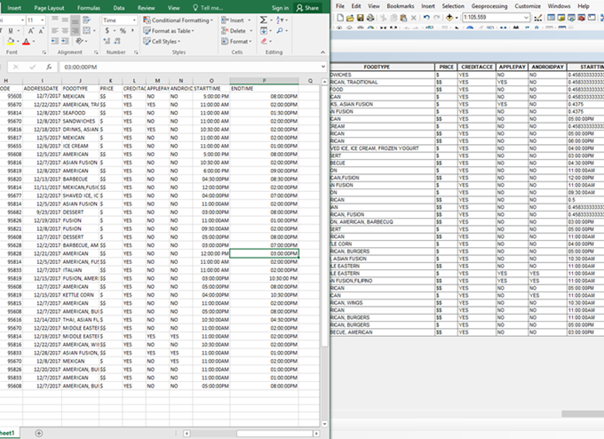

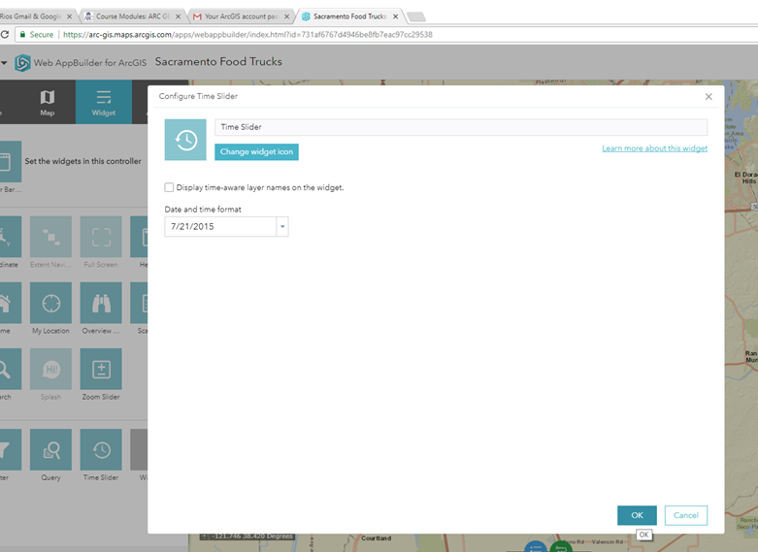
Difficulties
Date Time Formatting
Enable time slider
Social Media Links

Slide 7
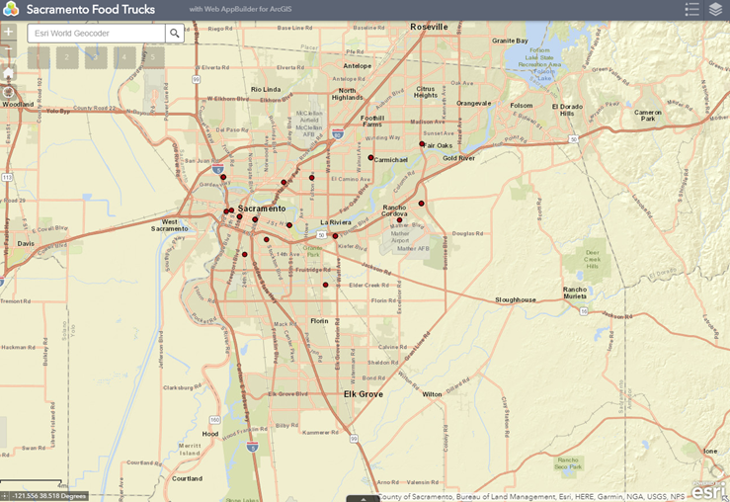
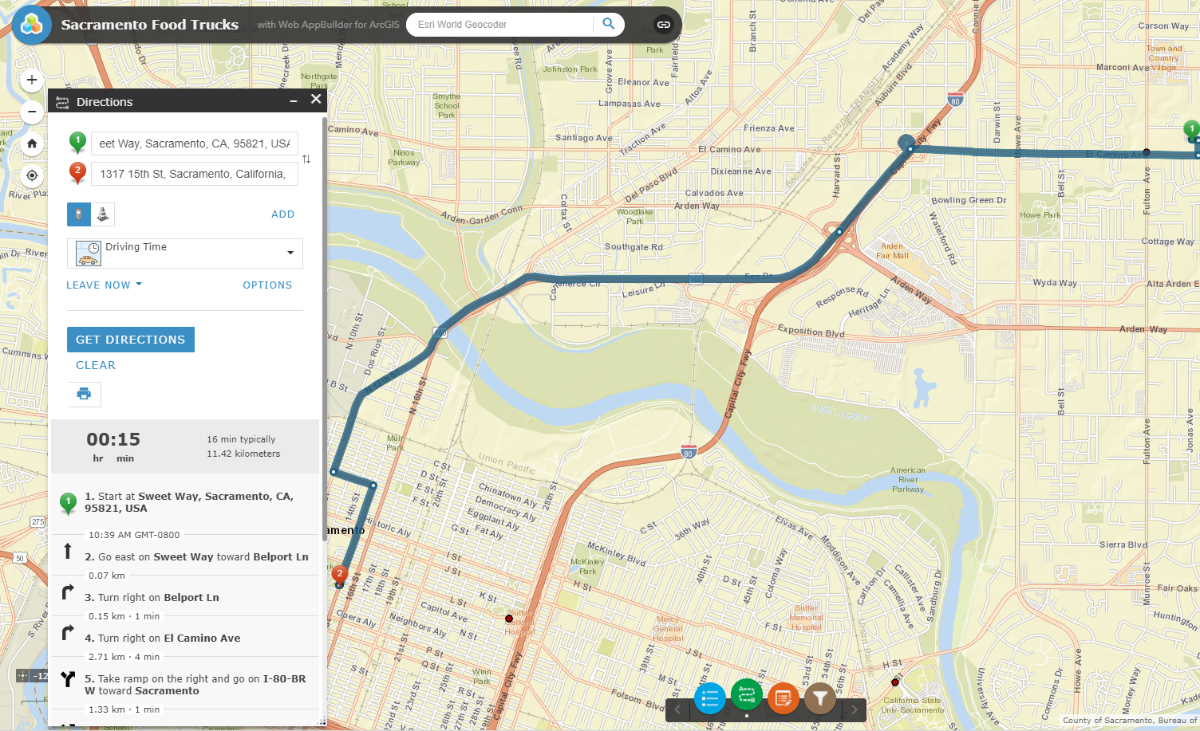
End Result

Slide 8
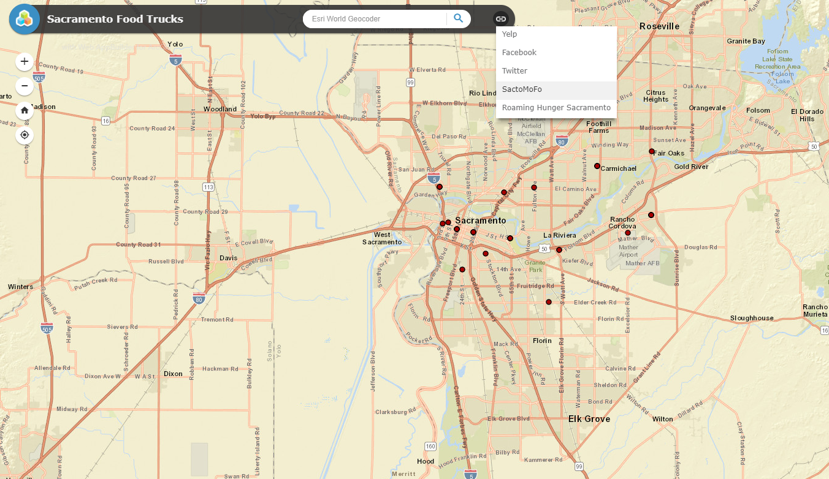
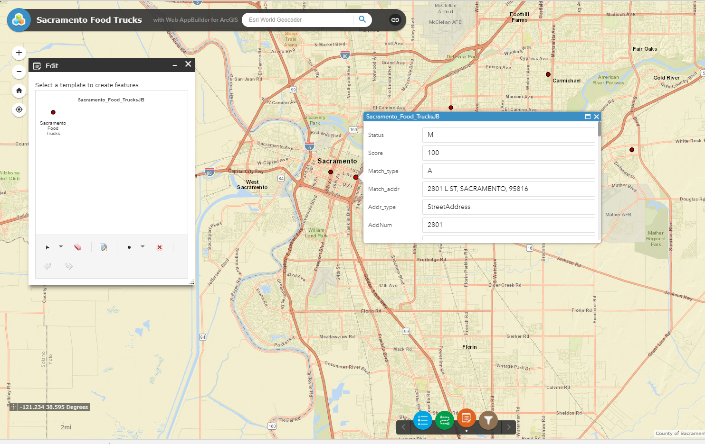
End Result

