Slide 1
Demographics of the North San Joaquin Valley
Looking At Multiple Data Indicators
Nahila Ahsan
Geography 385: Web GIS
Professor Nathan Jennings

Slide 2
Purpose/Goals
Display multiple indicators in areas of population, economics, education, housing, and income for the North San Joaquin Valley (NSJV). The NSJV is the primary study area for the project.
Allow users to explore indicators with clickable layers, filtering, and looking at data in tables. Also allow users to potentially add additional data and layers.
This type of data may be useful to analysts in government and business to inform planning and policy decisions. It can also be useful for non-profits to help them plan services. The general public may also find this data interesting.

Slide 3
Summary of Tasks
Download shapefiles and data from the Census Bureau
Prepare spreadsheets to be joined with shapefiles (for select indicators: education and homeownership). This included cleaning spreadsheets and calculating percentages.
Publish select shapefiles (study area boundary and census tracts) and census data to service to ArcGIS online
Search for additional indicators through Esri’s Living Atlas and Enriching data tool. Significant data is available through these tools that can be explored and visualized in multiple ways.
Customize/visualize data and make adjustments to display and legend
Add and adjust widgets

Slide 4
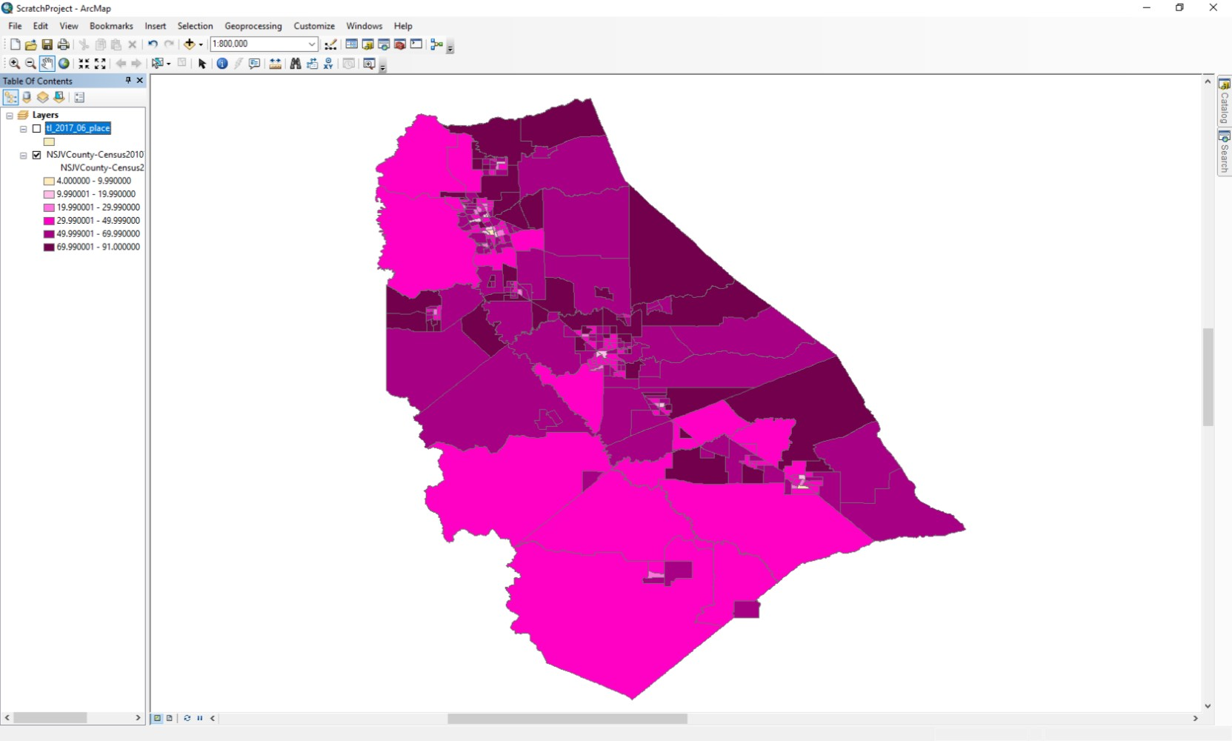
Working in ArcMap
Visualizing the data in ArcMap is not necessary and will be a waste of time as it will not carry over into ArcGIS Online. One can configure the display in the tools menu online.

Slide 5
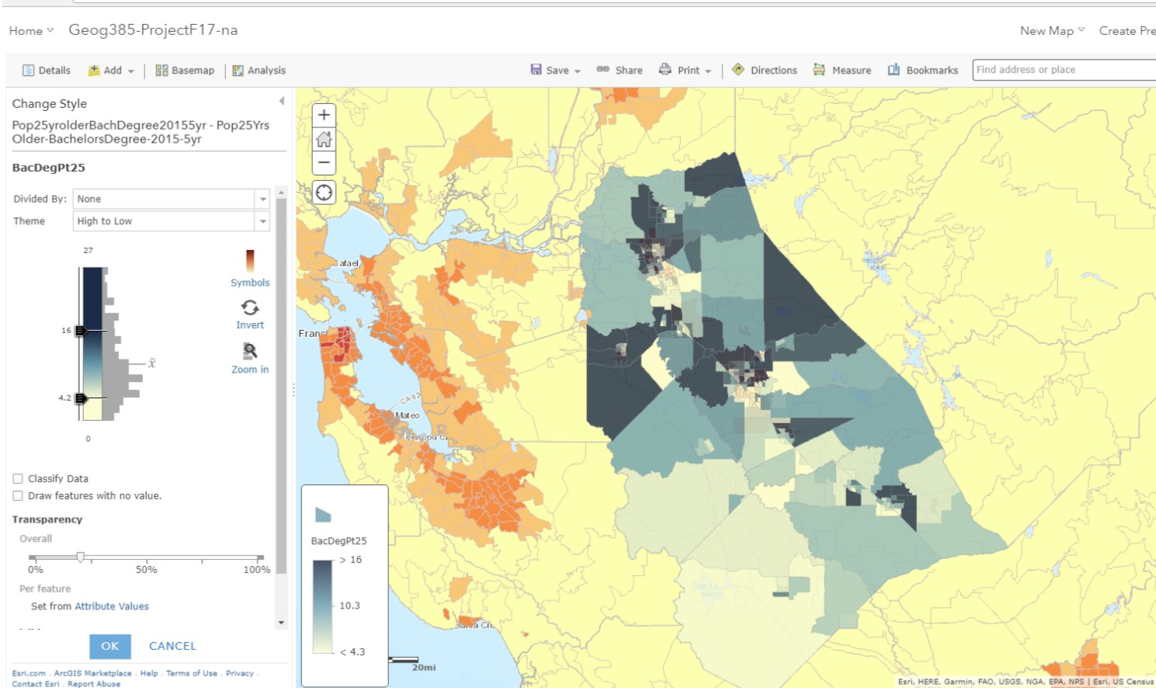
Configuring Style/Visualization

Slide 6
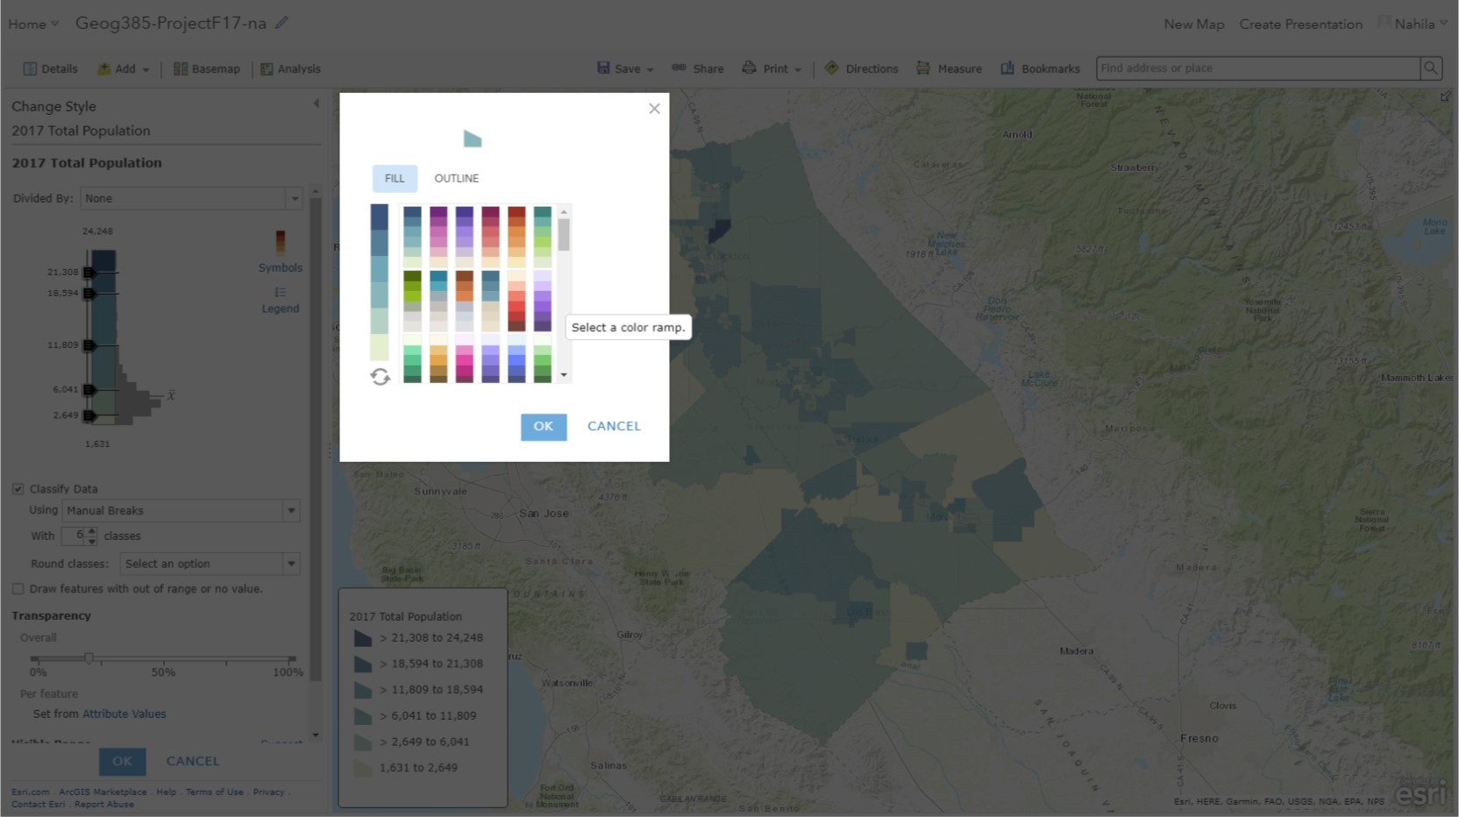
Color Ramps

Slide 7
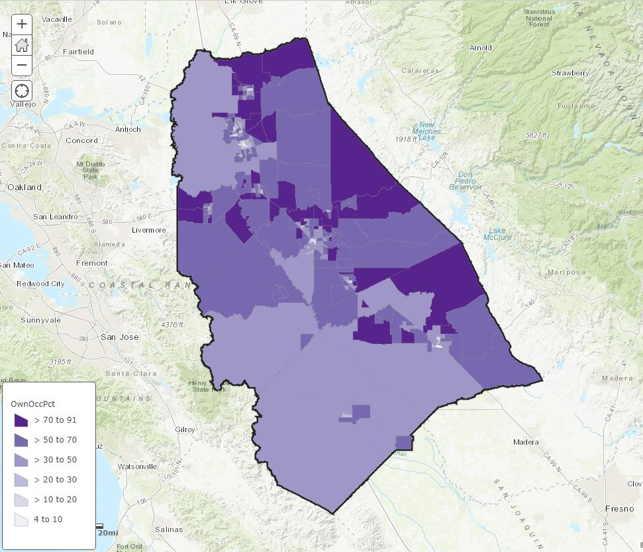
Web Map Visualization

Slide 8
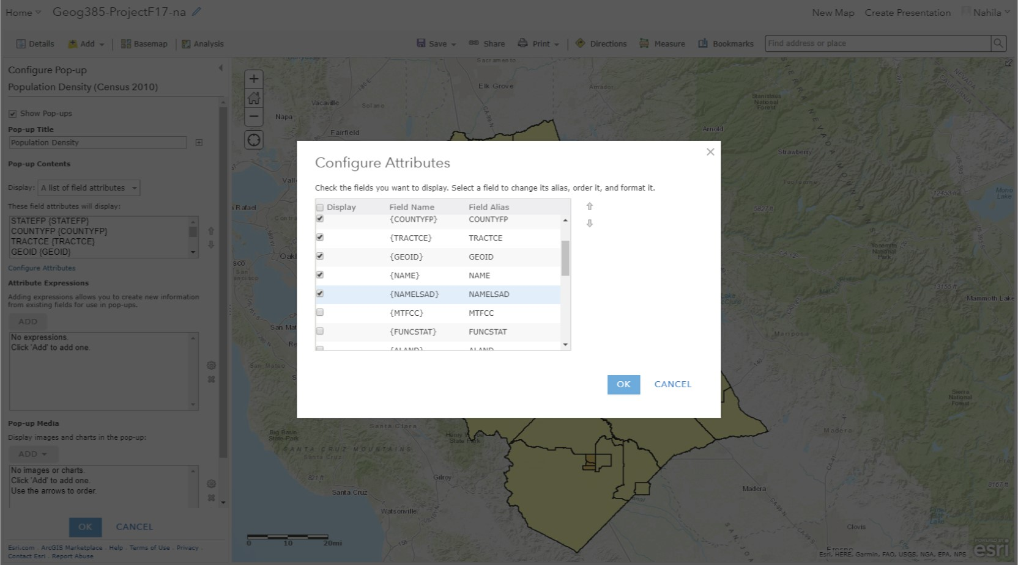
Configure Pop Up (Cleaning Up)

Slide 9
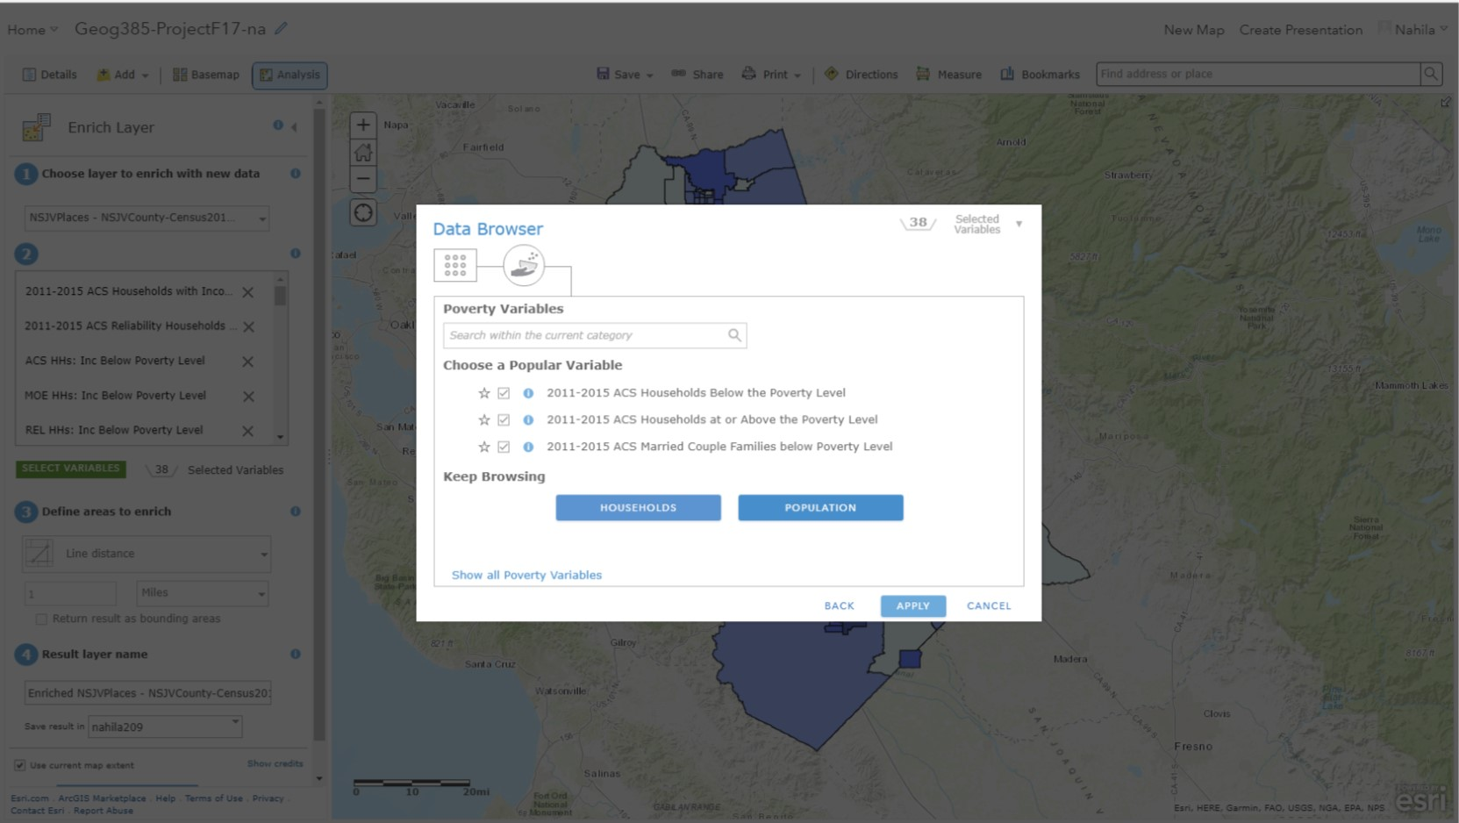
Data Enrichment Tool

Slide 10
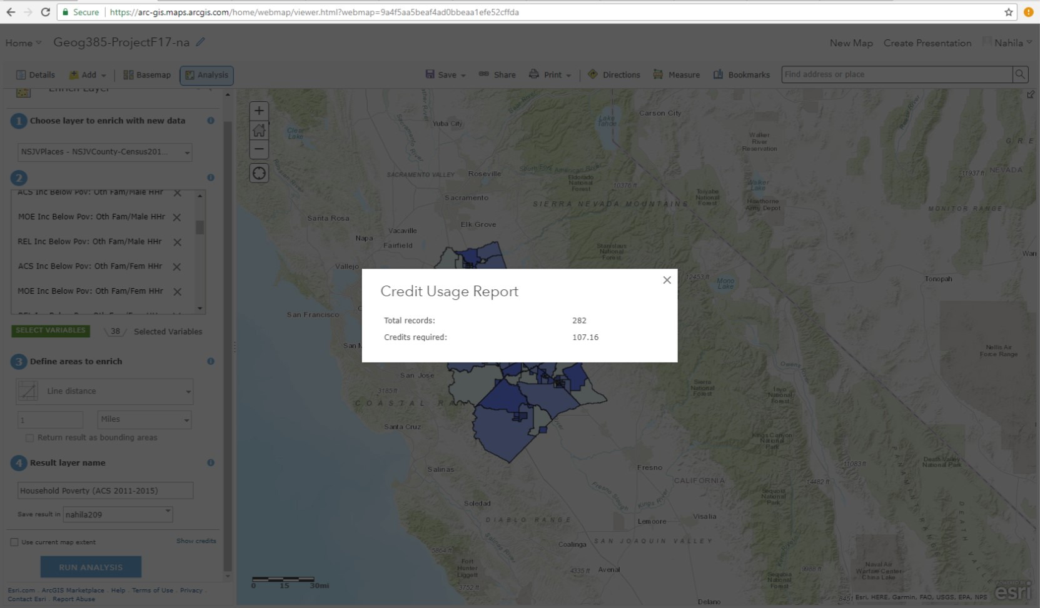
Credit Usage
Different indicators/data sets varied in credit cost.

Slide 11
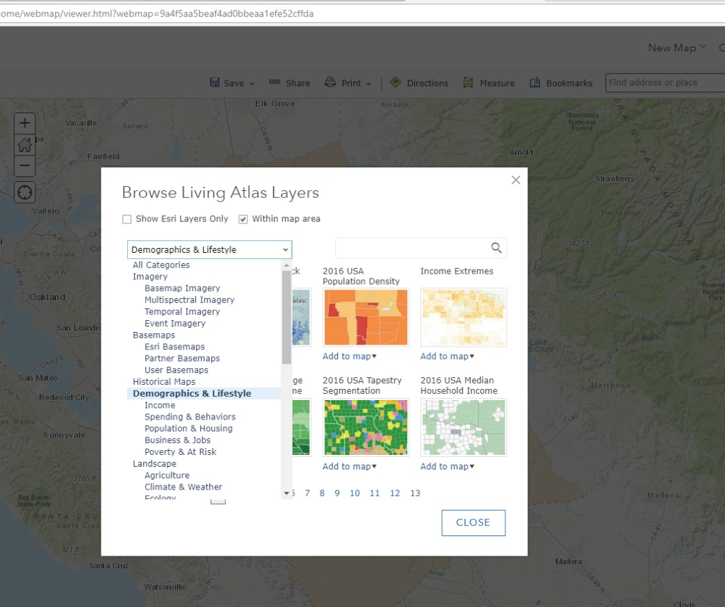
More Data: Esri’s Living Atlas

Slide 12
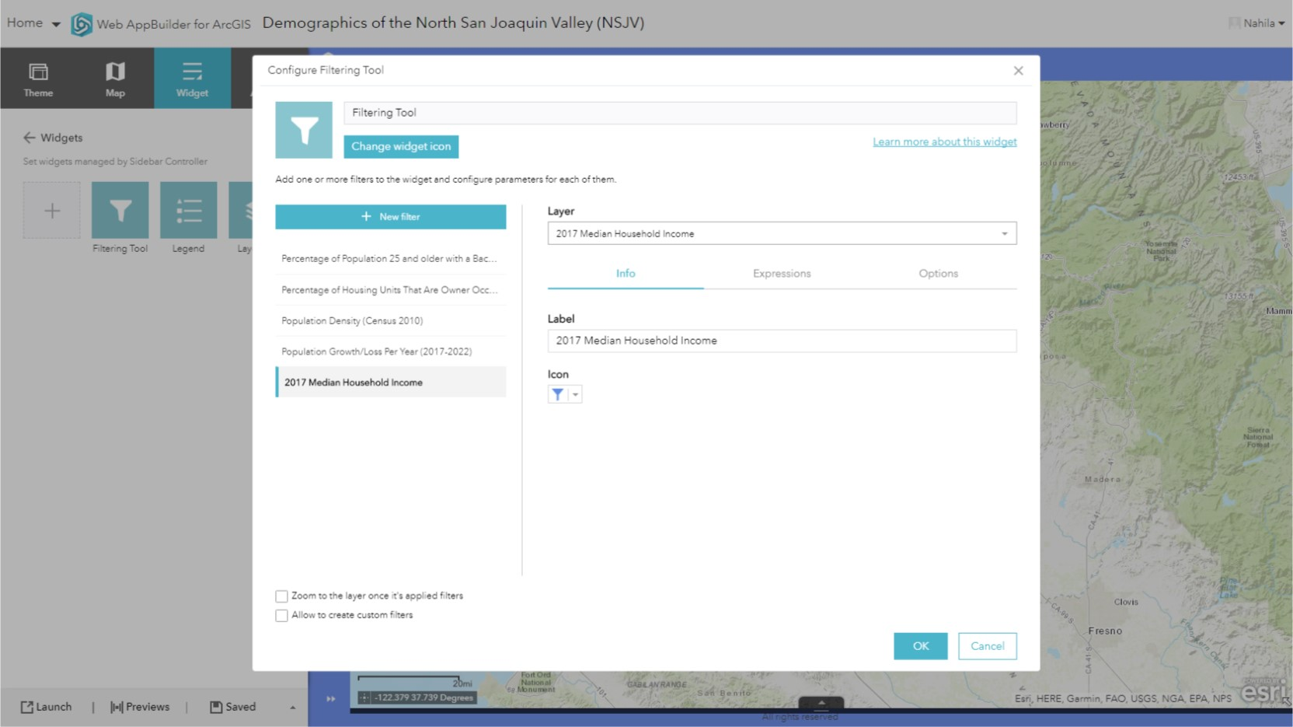
Setting Up the Filtering Widget

Slide 13
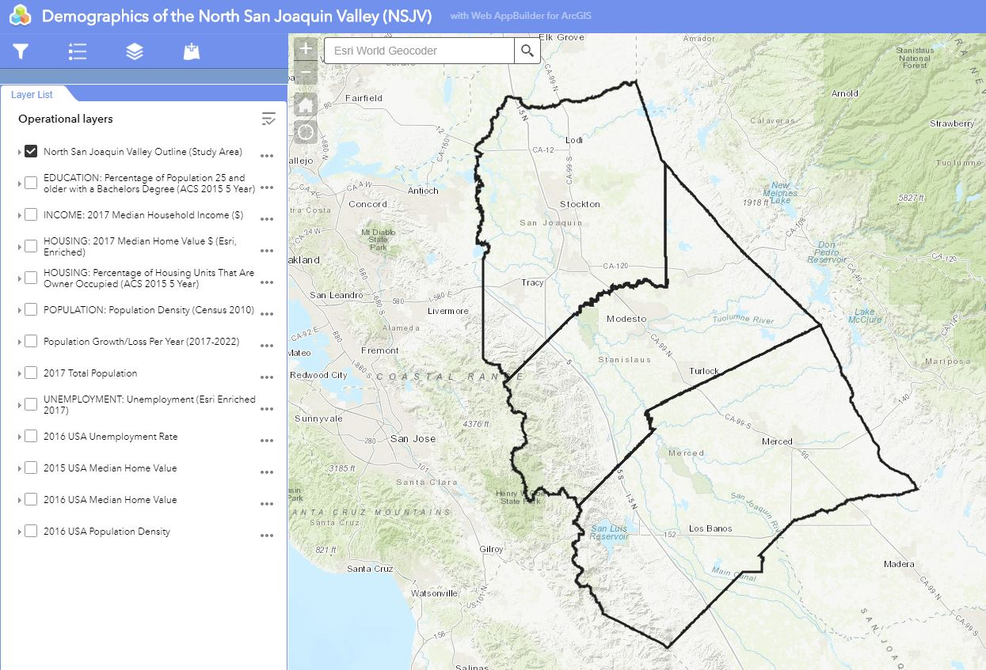
Study Area in Web Application

Slide 14
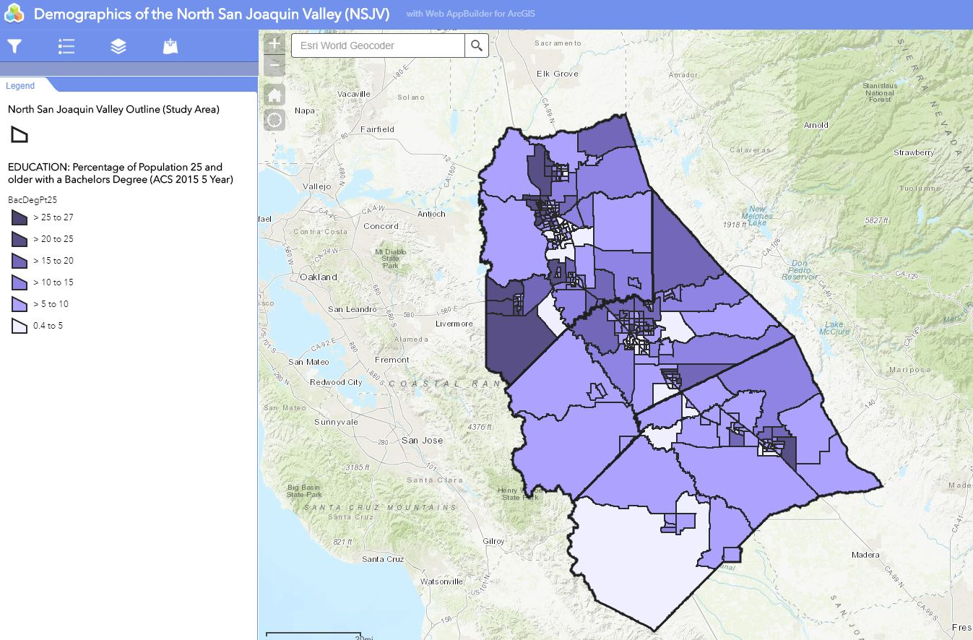
Legend Widget and Map View

Slide 15
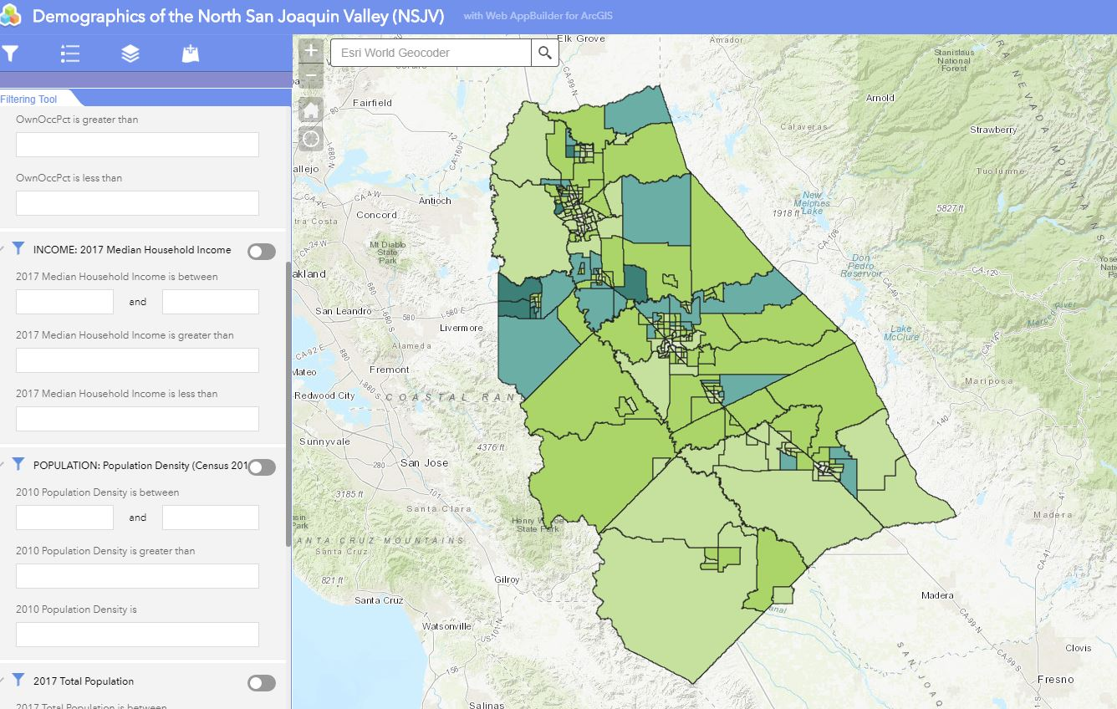
View of Income Data with Filtering Set Up

