Slide 1
GROUNDWATER RESOURCE
MANAGEMENT
BRYAN ZHOU
GEOG 385
FALL 2014

Slide 2
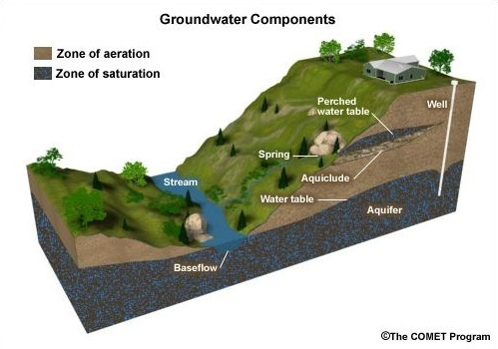
GROUNDWATER

Slide 3
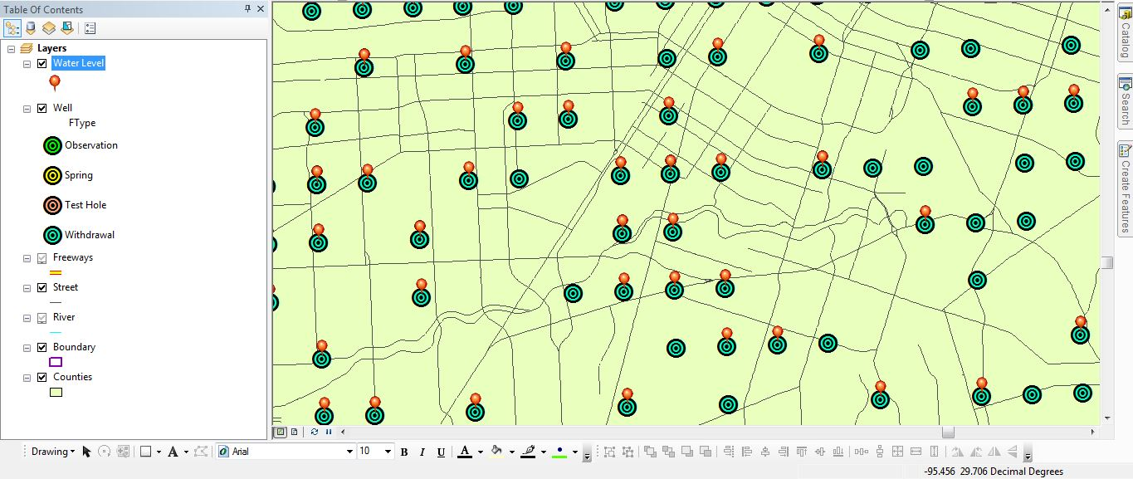
WELL

Slide 4
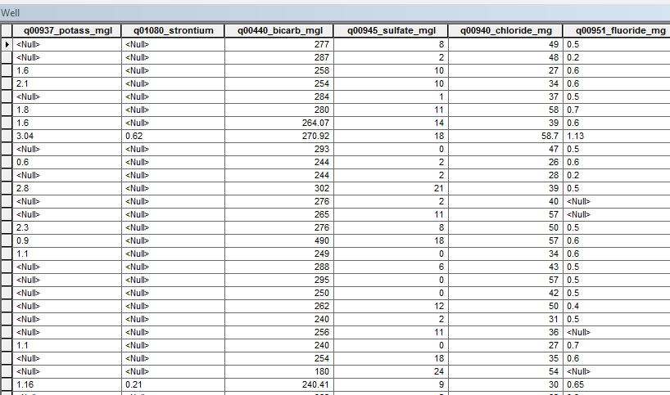
WATER QUALITY

Slide 5
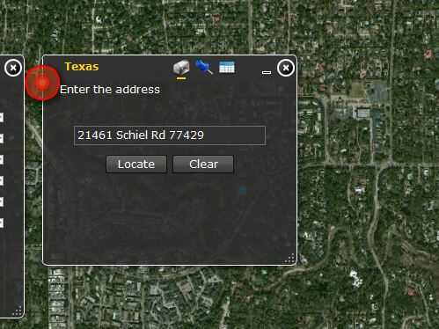
GEOCODING SERVICE
ADDRESS LOCATOR
US DUAL RANGE

Slide 6
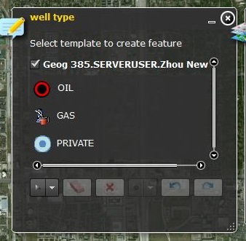
SDE FEATURE CLASS
POINT
SDE GDB
REGISTERED AS VERSION
EDITING TRACKING
SUBTYPE
  PRIVATE
  OIL
  GAS

Slide 7
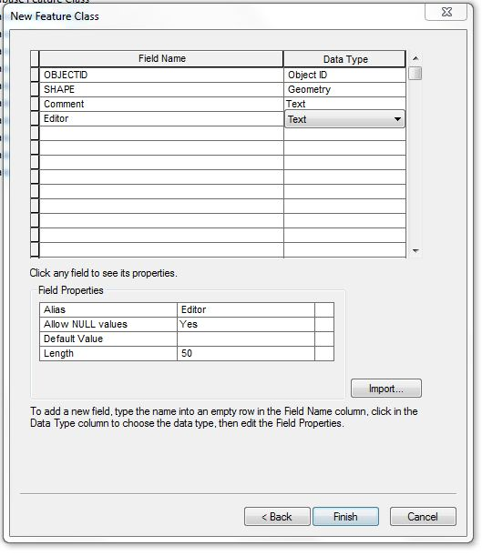
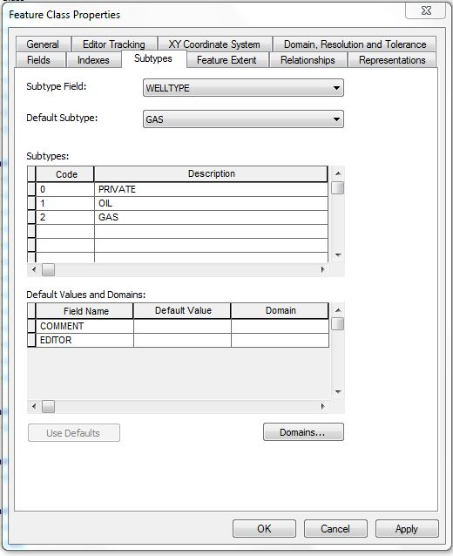
SDE FEATURE CLASS

Slide 8
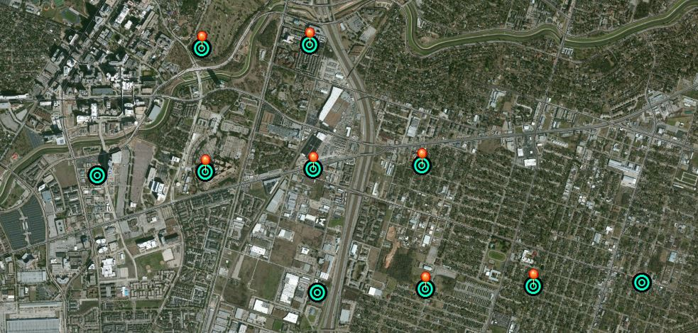
BASE MAP

Slide 9
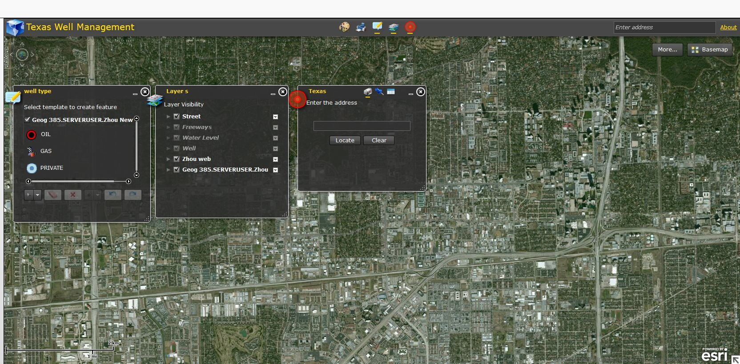
RESULT

Slide 10
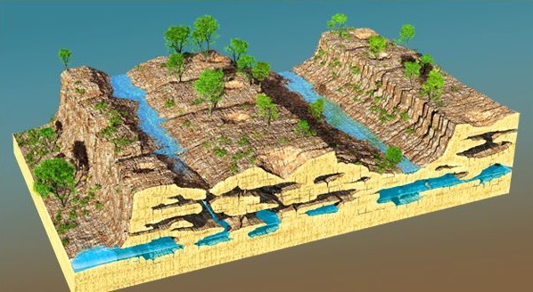
END

