Slide 1
GEO375
Final Project:
From Txt to Geocoded Data

Slide 2
Goal
My Final project is to automate the process of separating, geocoding and processing 911 data for the Sacramento Police Department’s Everbridge program provided in text file format by AT&T.

Slide 3
Basic Steps
Convert TXT file CSV format
Delete unneeded data
Convert to XLSX file
Delete unneeded columns
Add several new columns
Geocode the data
Convert back to CSV for upload

Slide 4
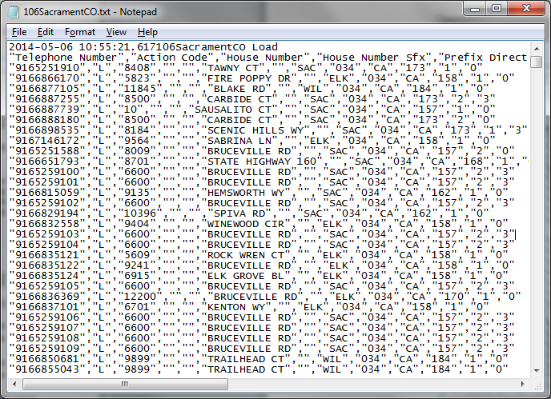
Initial text file
The initial text file is a TXT file. The first line must be deleted and the quotation marks removed in order for the conversion to go into XLS format correctly.

Slide 5
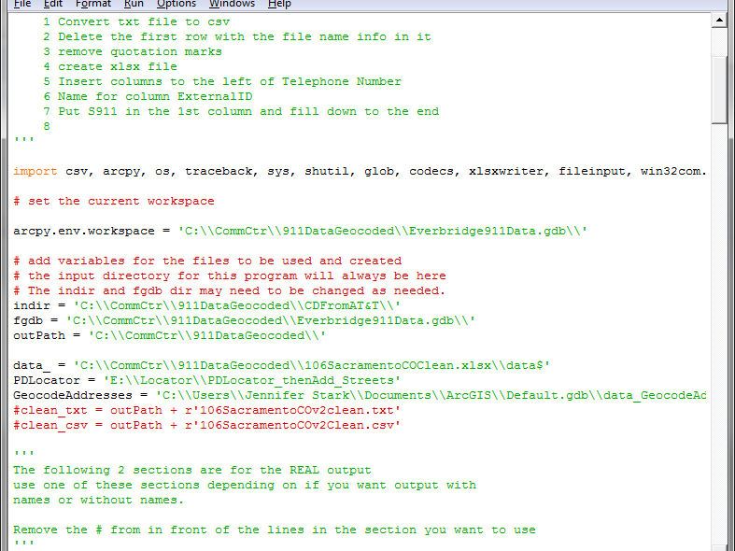
I had to set all the needed variables
There are several sections due to the size of the file (nearly 690,000 records) I created a subset of the file to use for testing the script. The variables for the test files and the “real” data files are all in the script.

Slide 6
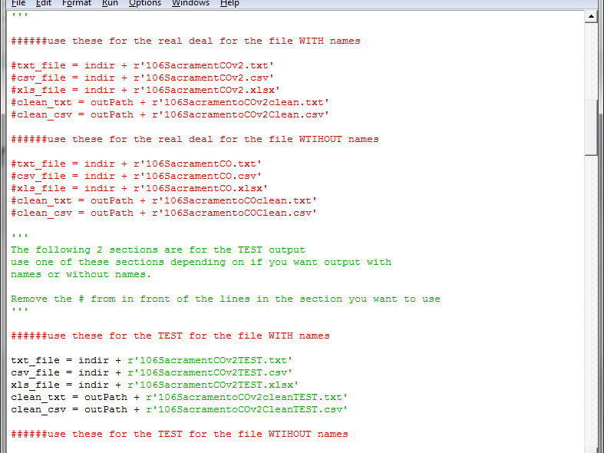
Variables
The picture above shows the different sections and variables for “real” data and test data.

Slide 7
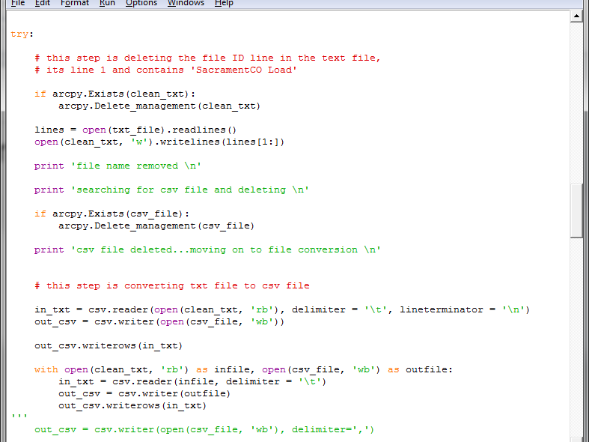
Section 1
First line of text is deleted and the file is converted to CSV using the csv module.

Slide 8
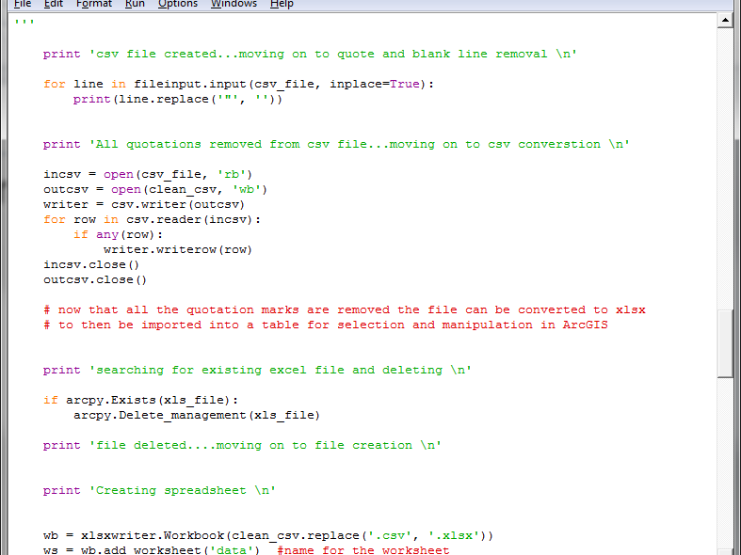
Quote marks create a problem
When attempting to convert the original text I ran into an issue with the quotation marks causing an extra blank line in the csv file and not letting it convert to excel correctly. Quote marks were searched and replaced.

Slide 9
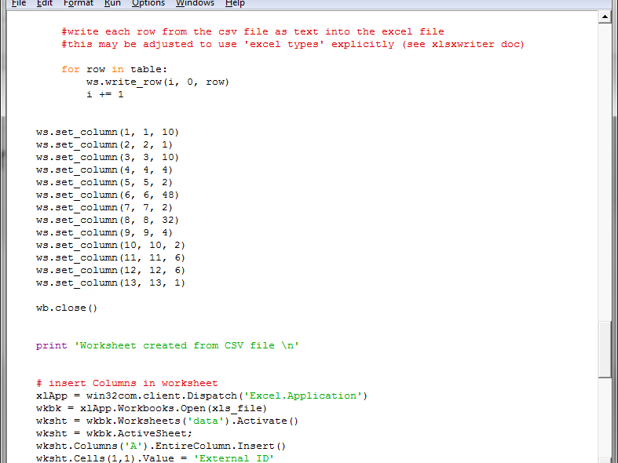
Set column widths
Column widths were set once the xlsx file was created and several new column and column headers were added.

Slide 10
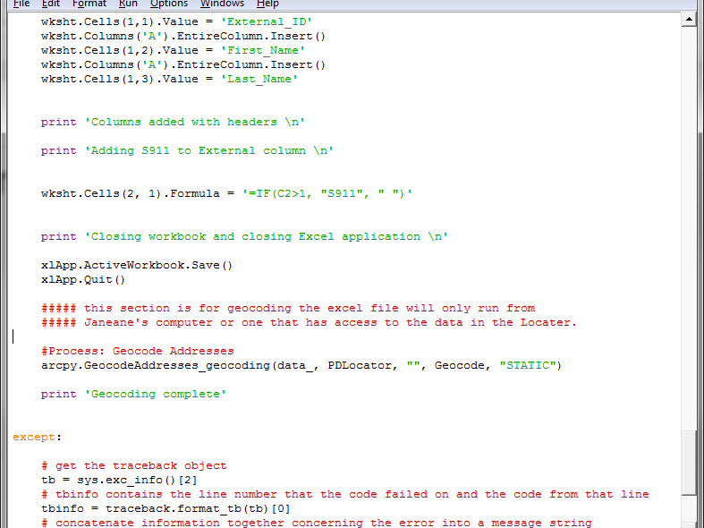
Geocoding section
Geocoding can only be done from Janeane Kuxhausen’s computer due to access restrictions to the locator created by Nate Jennings. She is also the only one who has ArcGIS and Python on her computer and has access to the data file.

Slide 11
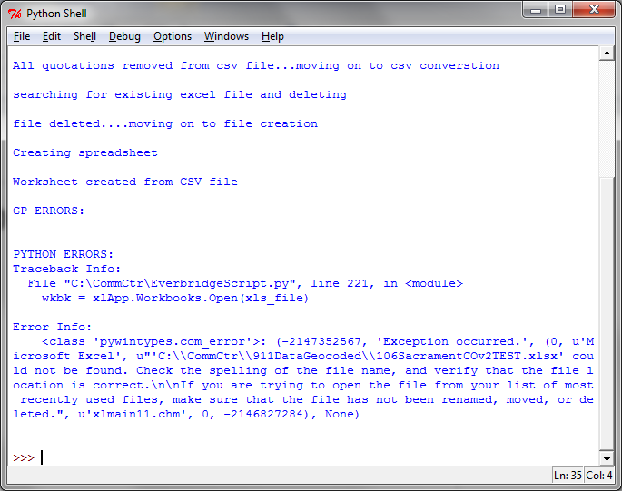
Error
One of the errors I ran into after changing a file name. I forgot to add TEST to the xlsx variable. Once that was changed I ran the file again.

Slide 12
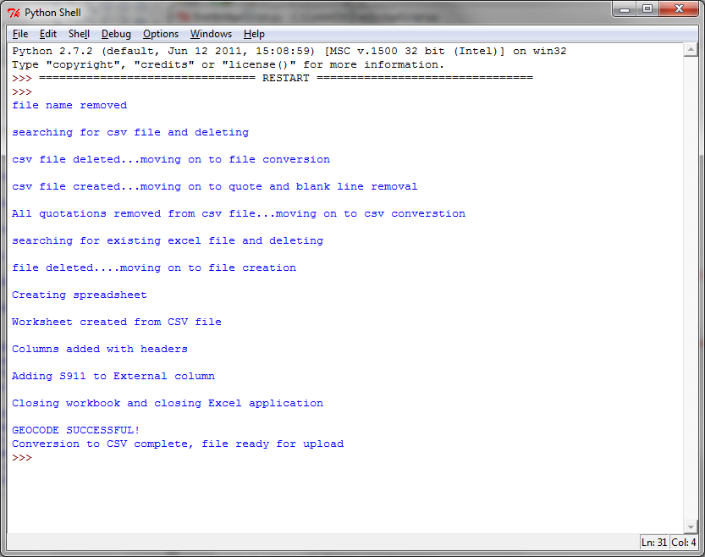
SUCCESS!!!

Slide 13
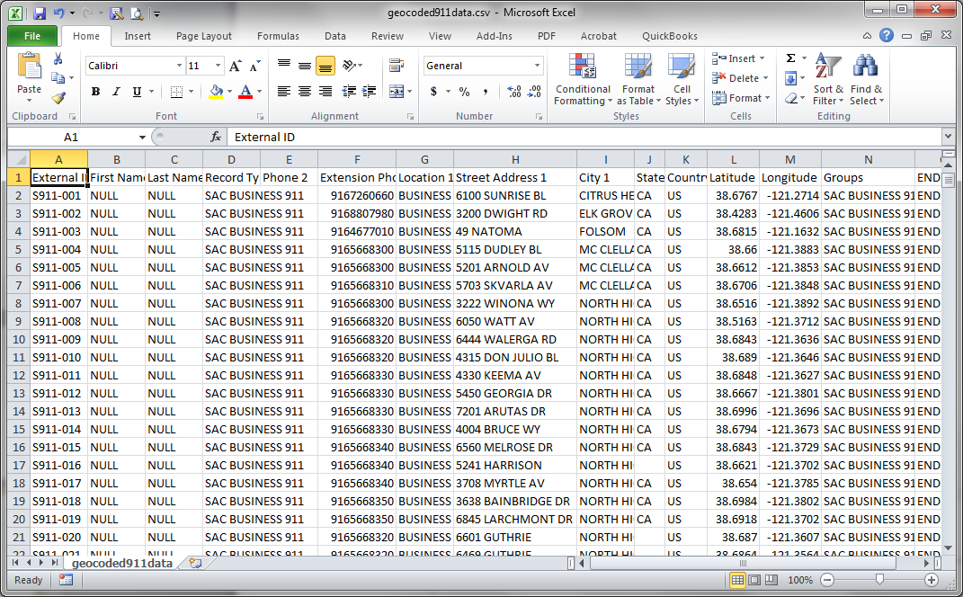
Final product ready for upload

