Slide 1
Dynamic DeliveryRoute Map generation Program
Takeo Shibata
takeofuture@hotmail.com

Slide 2
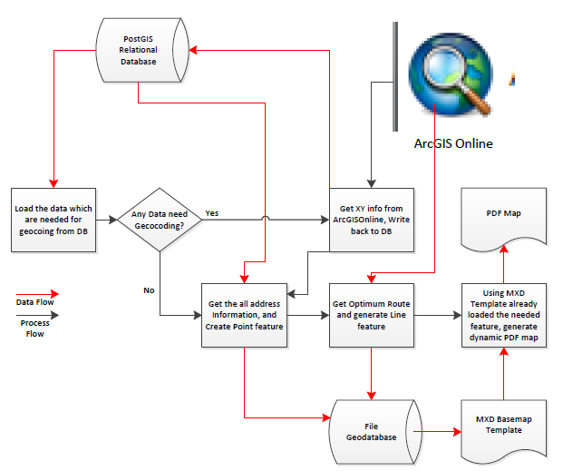
The Process Flow of the program

Slide 3
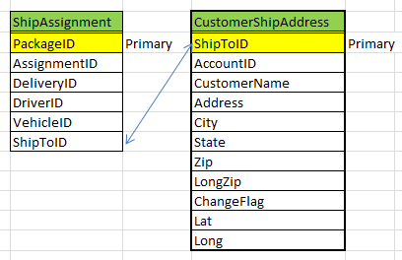
PostGIS Table Used
PostgreSQL Server is used to store the data.
This is the main database that we assume that business data is stored and update often. So the program will generate different output data with the same format if the table is updated.

Slide 4
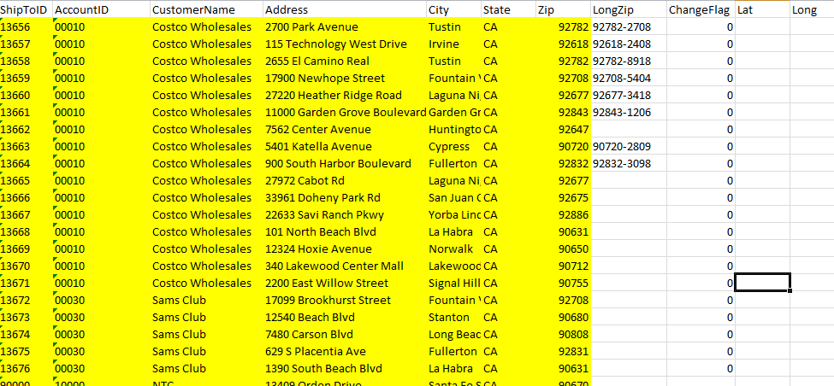
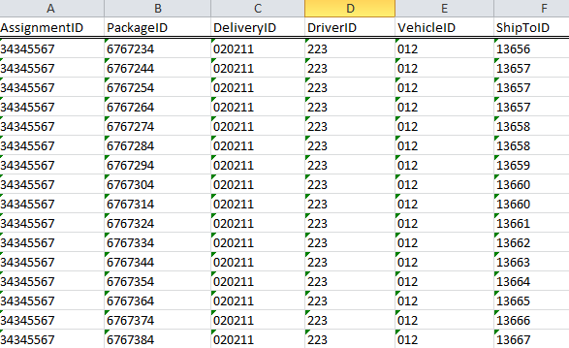
Sample Data Used for this program

Slide 5
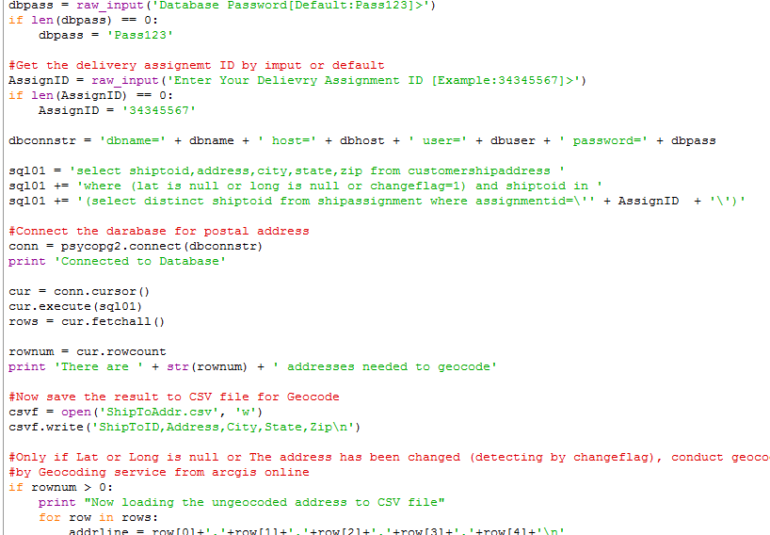
This part of code select the address information which does not have XY or changed since last geocoded and then saved to CSV file

Slide 6
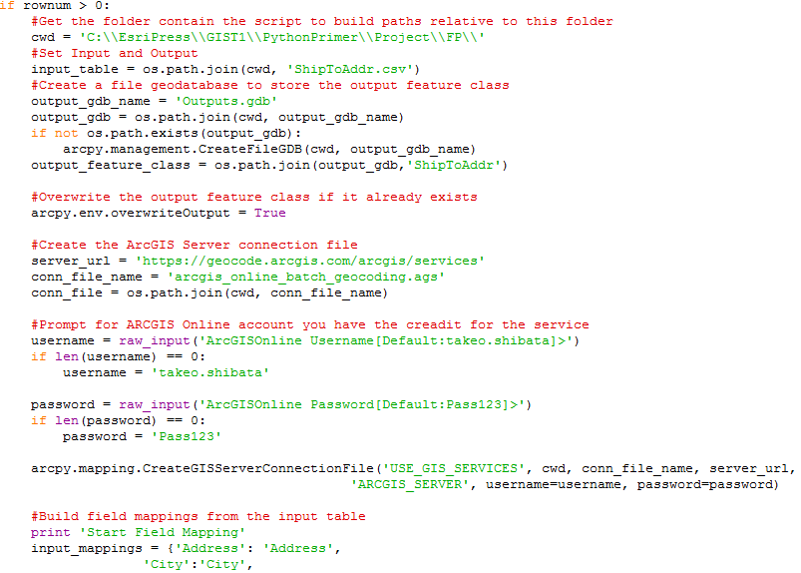
This part of code actually geocode the address and save as point feature into the personal geodatabase as temporary feature, get xy from it and write back to the PostGIS

Slide 7
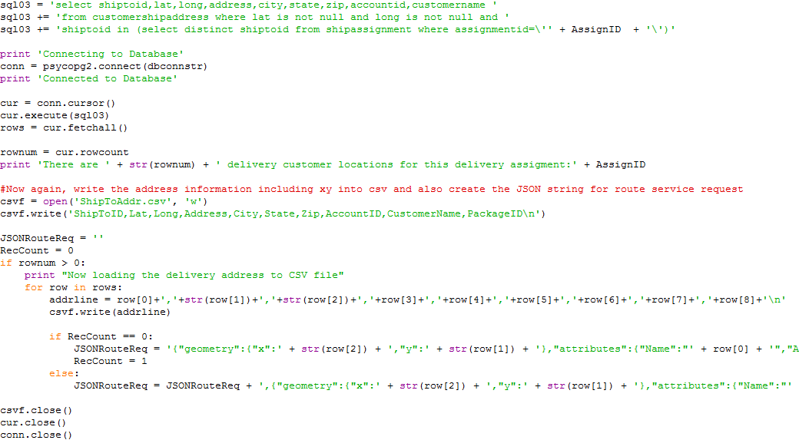
Now all delivery location data is load from postgis again and save as CSV. At the same time, JSON request string for the optimal route generation is created. Once CSV is created, point feature named Delivery is saved into the personal geodatabase which is preloaded at the mxd tenplate

Slide 8
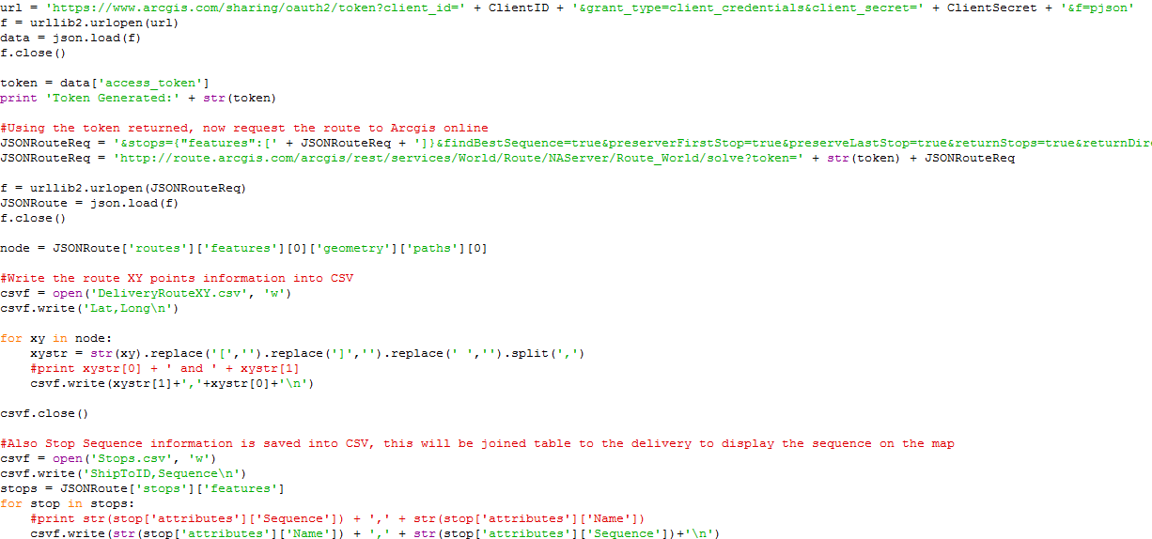
Token is generated and final optimal route request JSON string is generated and send to ArcGIS Online, then the response is decoded.

Slide 9
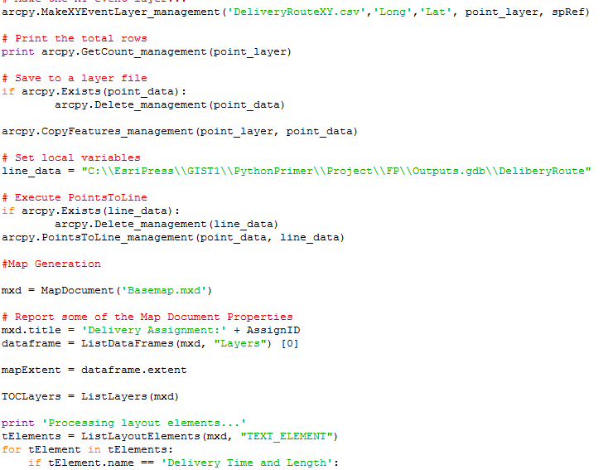
After the optimal route is returned as JSON and decoded (Those are points data on the route), the point data is converted to a line feature and saved into the file geodatabase as DeliveryRoute.
And finally, those are exported as PDF using the basemap.mxd.

Slide 10
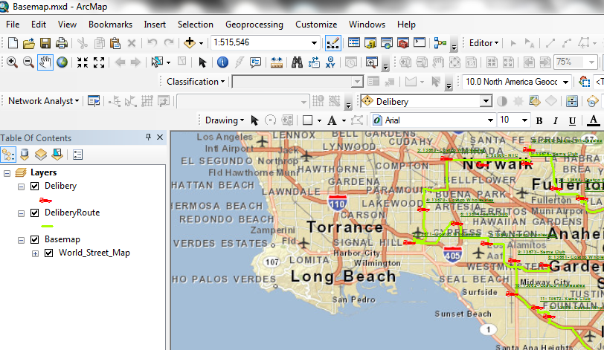
Base map

Slide 11
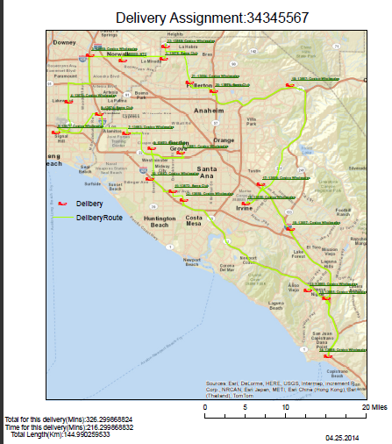
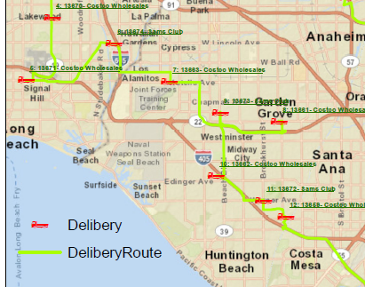

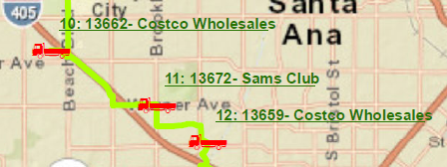
Final Output Sample of Dynamic Map

