Slide 1
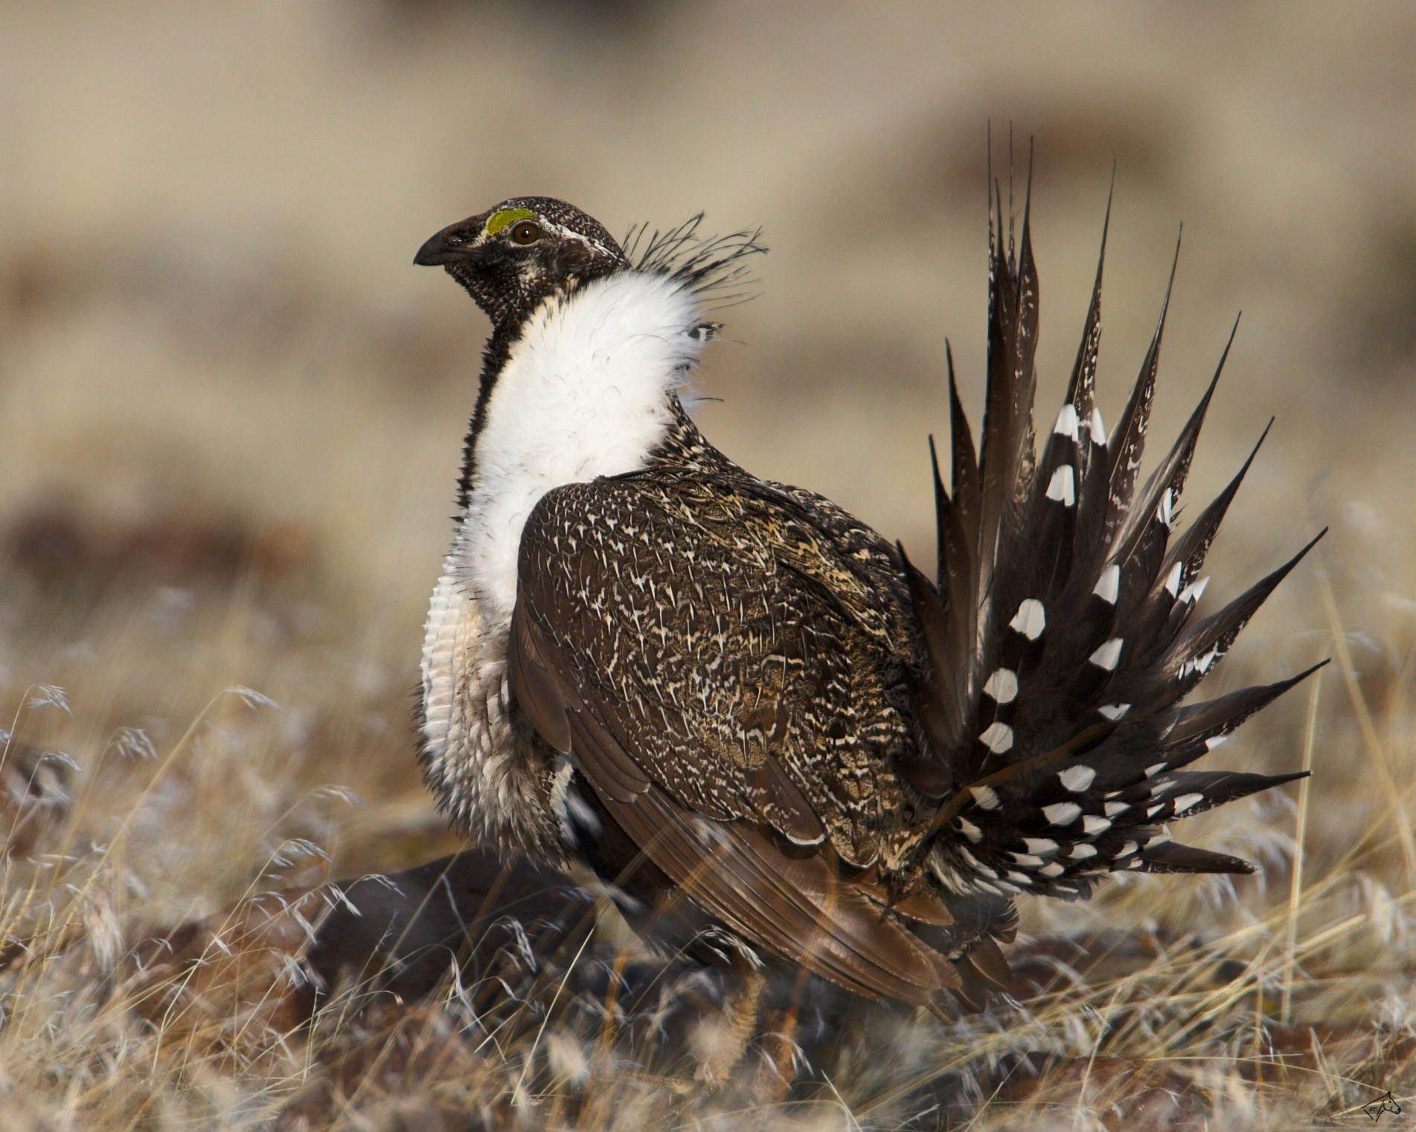
Development of a Web-based Map Service for Nevada
Greater Sage-Grouse Management

Slide 2
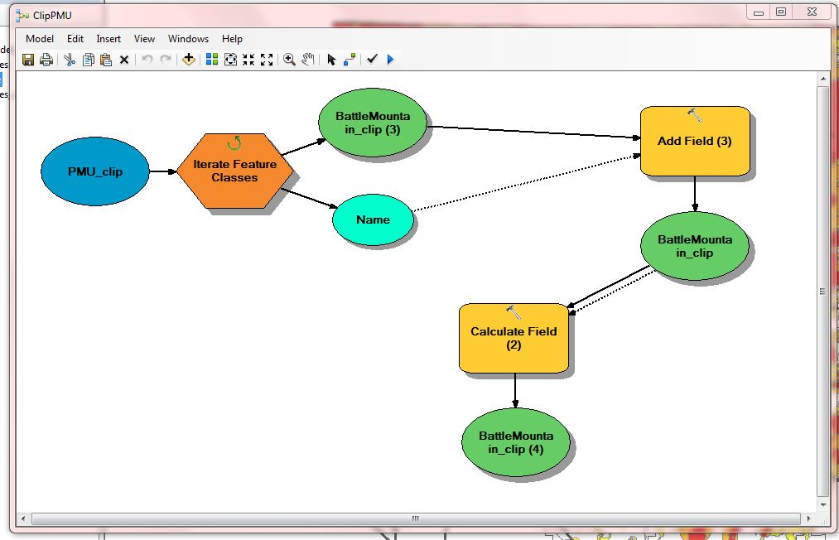
Pre-processing of datasets that would be incorporated into the published map service was necessary to ensure that simple queries would work efficiently. Models were built to automate the processing tasks.

Slide 3
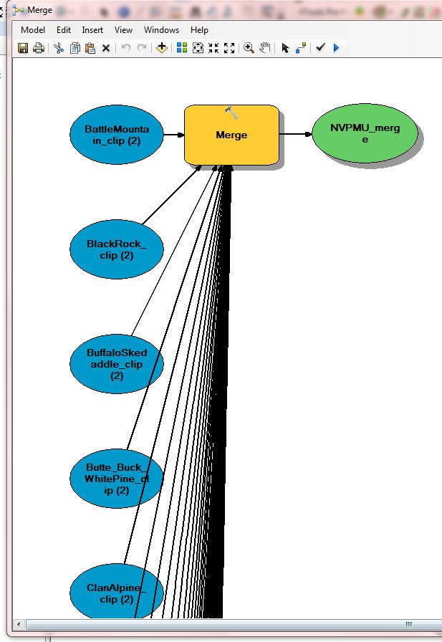
This pre-processing model merges all the clipped Population Management Units (PMUs) together into a single dataset, with each PMU containing accurate area calculations and discrete polygons representing the three sage-grouse habitat management categories.

Slide 4
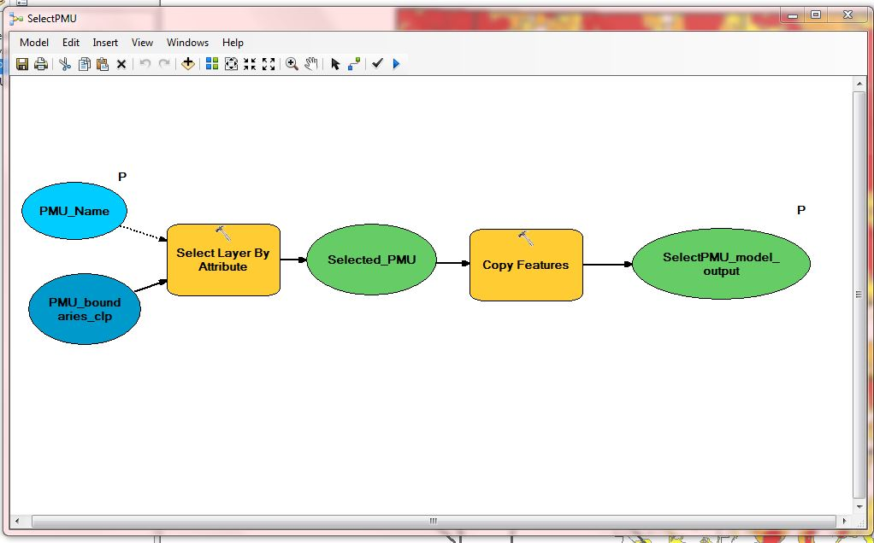
Four geoprocessing widgets were created for web-based map service. This model represents selecting a specific PMU. The output yields information for that specific PMU, including the status of the conifer extraction project for the PMU, total imagery tile count and analyst.

Slide 5
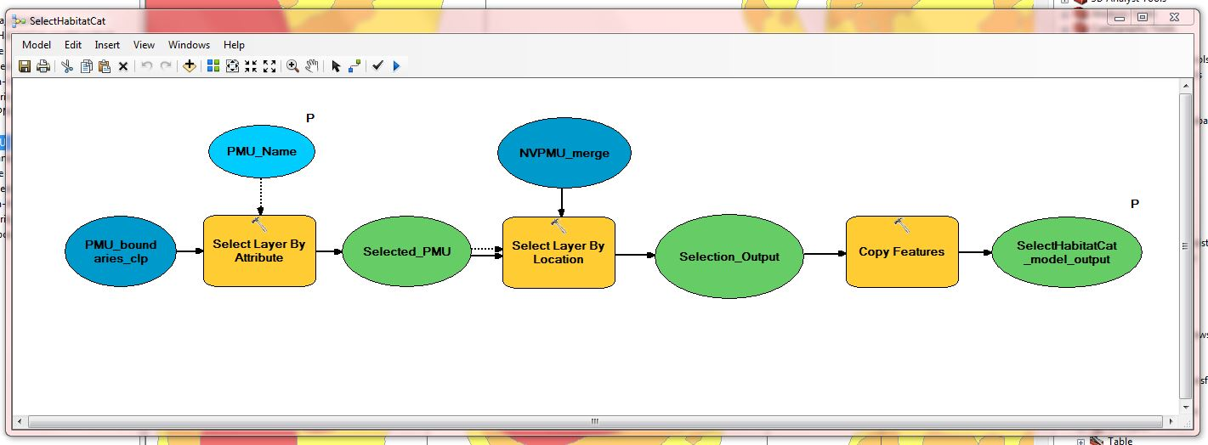
This model selects sage-grouse habitat management categories by PMU.

Slide 6
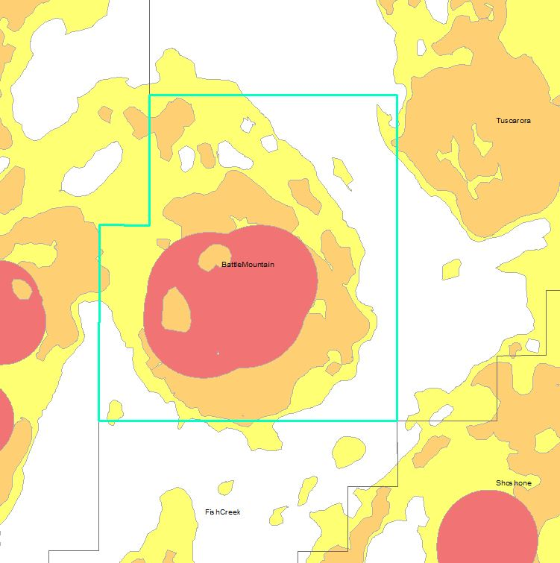
Before the map service was published, the selected features, in this case the specific PMU, is highlighted in aqua, similar to how features are highlighted in ArcMap.

Slide 7
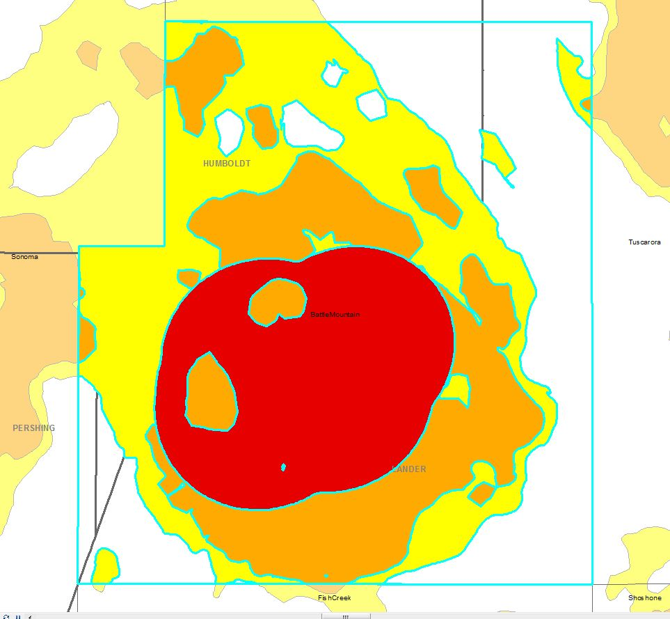
Habitat management categories selected appear as non-transparent in order to stand out from the rest of the habitat layer, which appears as semi-transparent.

Slide 8
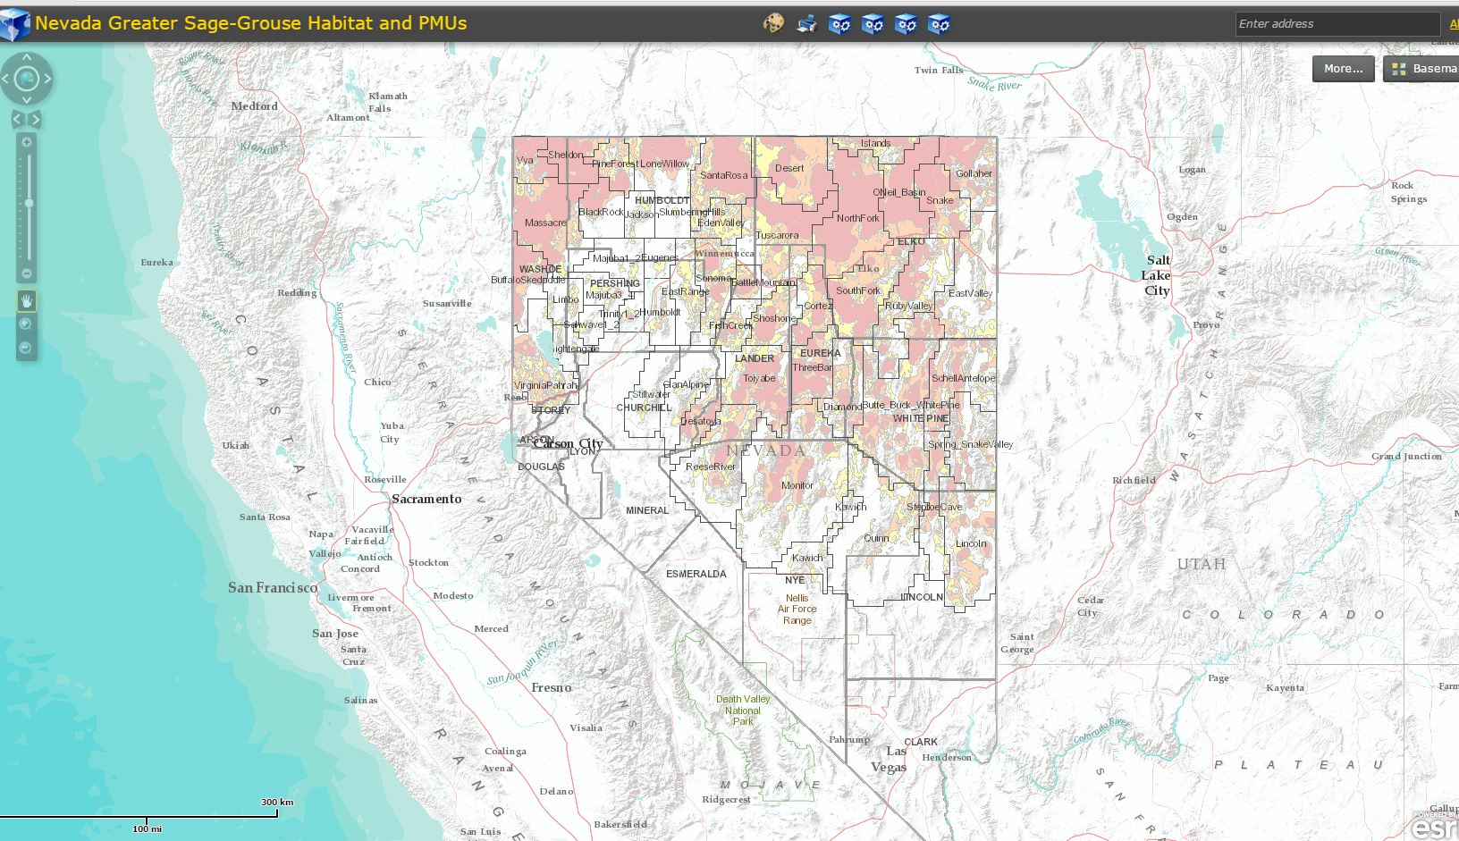
After the geoprocessing widget models were created and the outputs symbolized appropriately, the map service was published. This shows the base terrain map used for the background layer, and the three sage-grouse habitat management categories symbolized in red, orange and yellow. The habitat layer is displayed as semi-transparent in order to still see the background terrain.

Slide 9
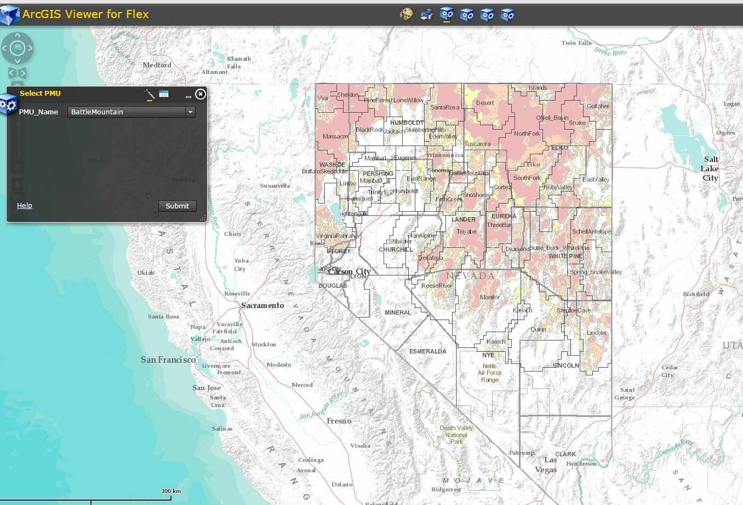
This shows the first geoprocessing widget: Select by a specific PMU. Area information, total imagery tile count for the PMU and analyst information are displayed.

Slide 10
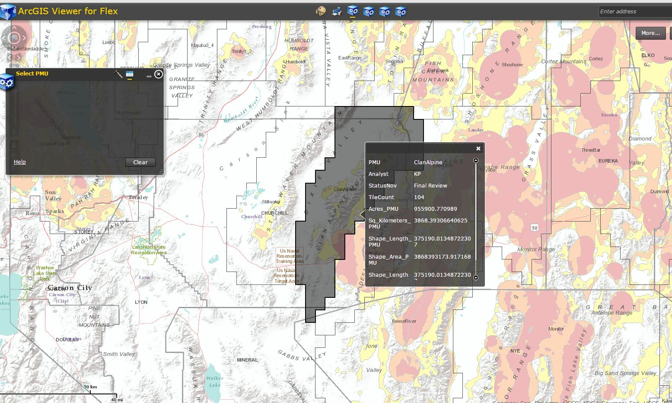
This shows the first geoprocessing widget: Select by a specific PMU. Area information, total imagery tile count for the PMU and analyst information are displayed.

Slide 11
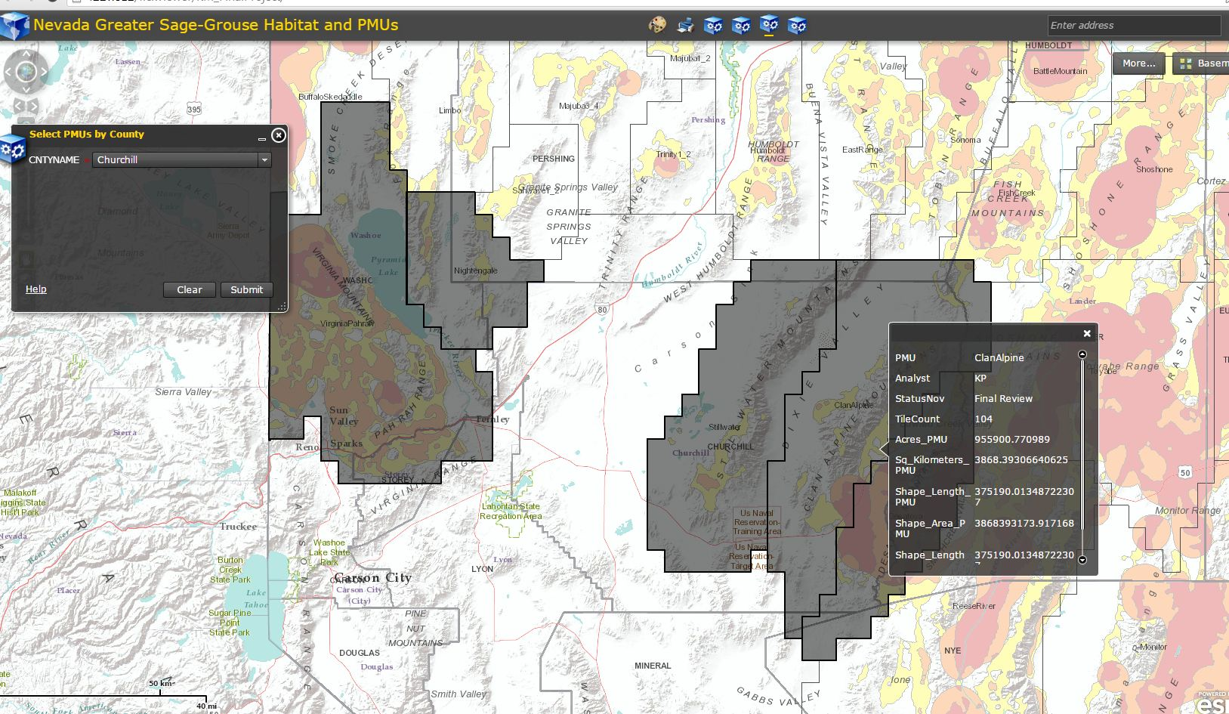
The third geoprocessing widget: Select PMUs by county, in this case Churchill County. The resulting table gives information for Clan Alpine PMU.

Slide 12
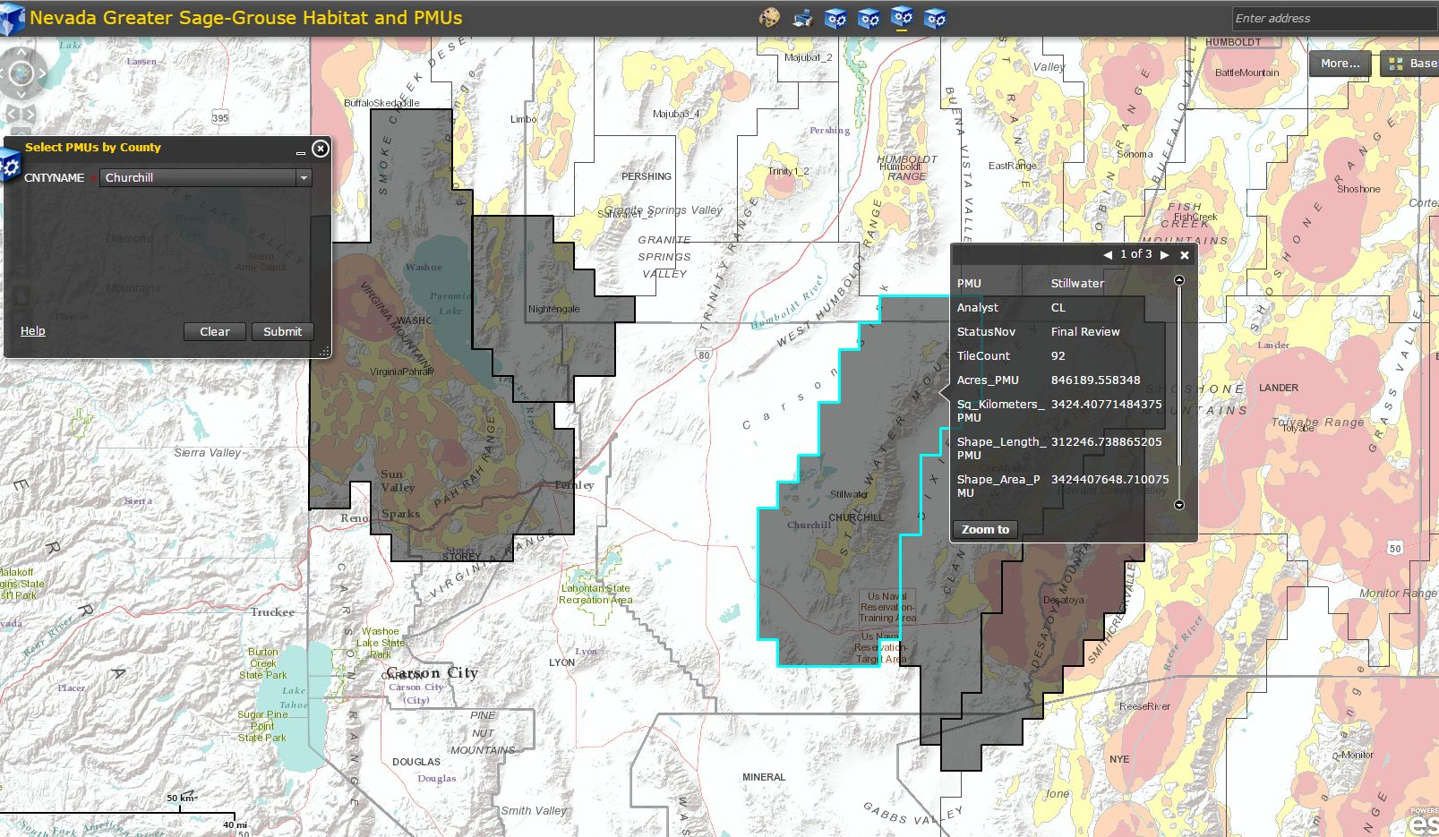
Selecting with the cursor the adjacent county yields information on Stillwater PMU.

Slide 13
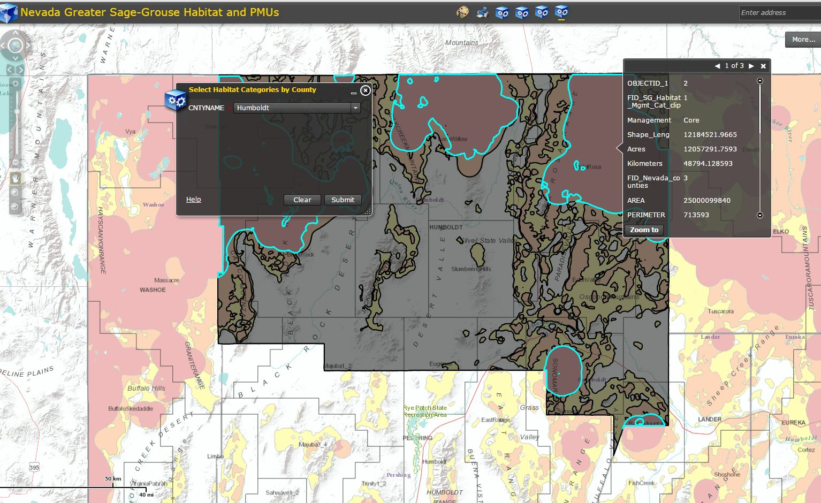
The fourth geoprocessing widget: Select sage-grouse habitat management categories by county. The Core habitat management category is selected, as shown by the highlighted aqua polygons of Core habitat within Humboldt County. The table yields information relating to the specific habitat category.

Slide 14
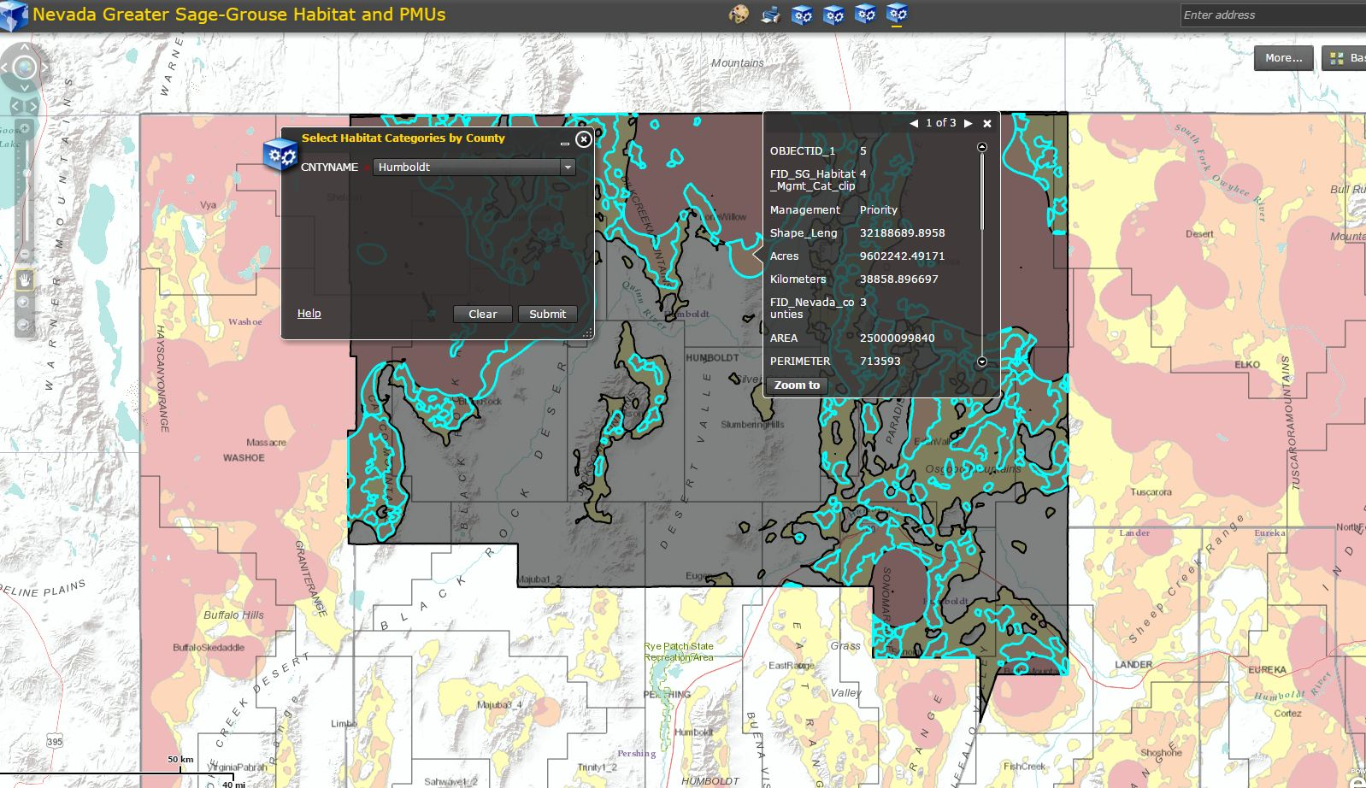
One major issue is how the selected feature is displayed within FlexBuilder, as dark gray. Another issue is the annoying habit of the information tables being displayed directly on top of the top of the selected feature and necessitating that always be moved out of the way.

