Slide 1
The Use of ArcGIS for Reconnaissance Geologic Mapping
By Sara J. King
GEOG 342
December 15, 2014

Slide 2
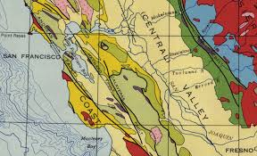
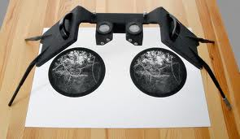
Purpose of my Project
To determine if GIS and satellite spectral data would be helpful for reconnaissance geologic field mapping

Slide 3
Process and Methods
Locate good spectral data to use as a test area.
Load the data into ArcGIS.
Clean it up to a manageable chunk of material.
Run a unsupervised classification of the target area.
Run a supervised classification of the target area.
Compare and contrast results for accuracy and effectiveness.

Slide 4
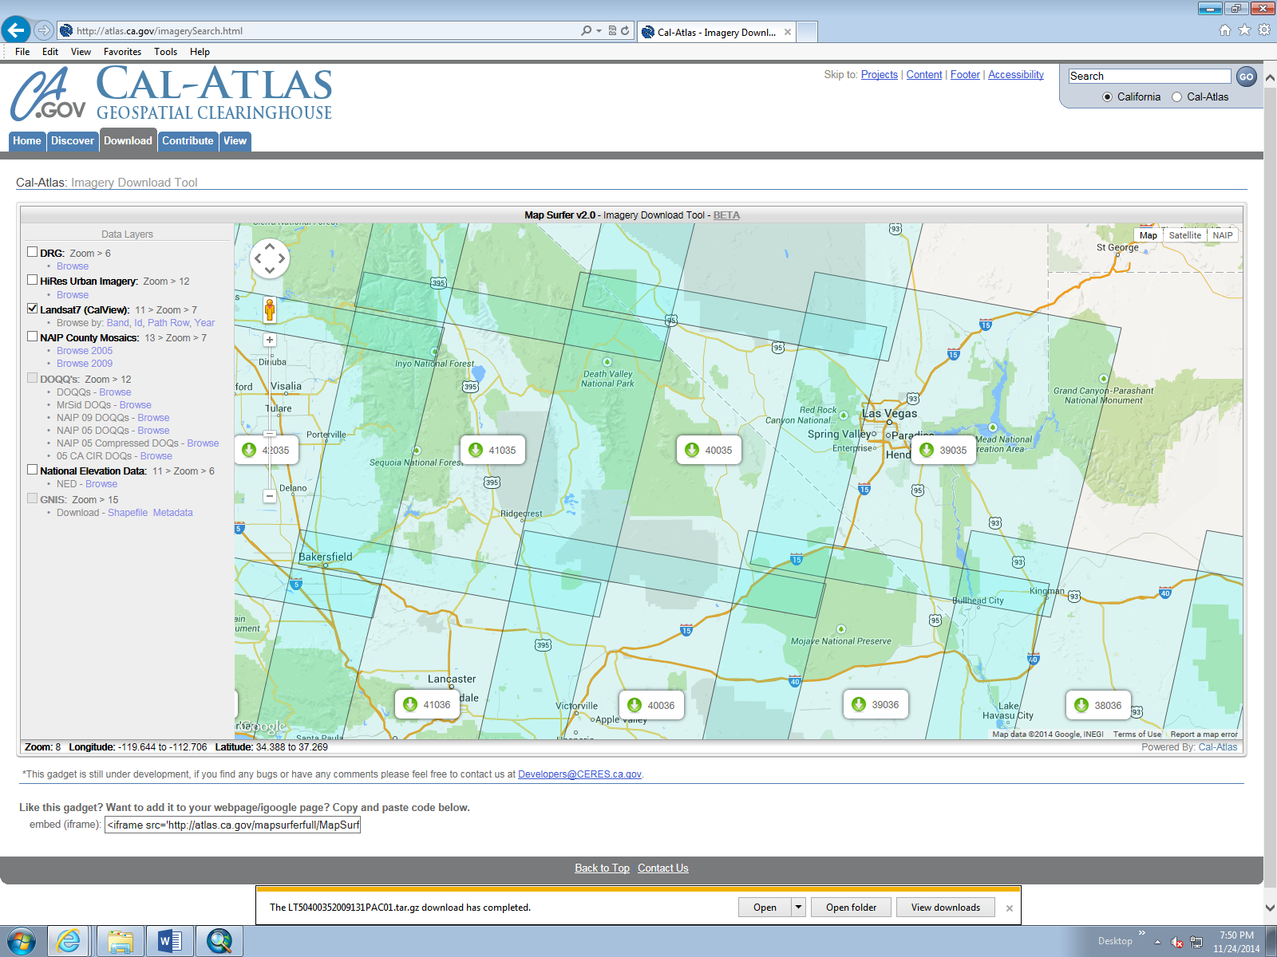
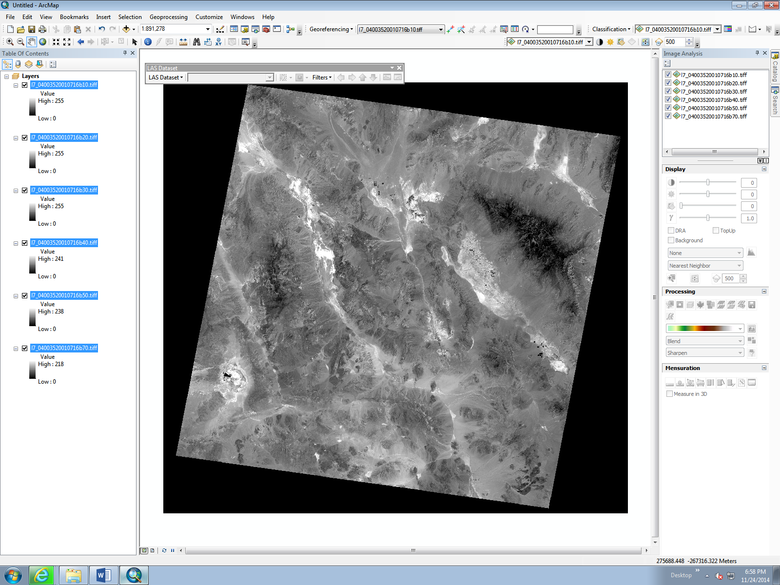
Locate Data and Load it into GIS
Three requirements:
  Accessible data
  Low vegetation
  High hard rock exposure
So I focused on the Mojave Desert region in the southeast of California

Slide 5
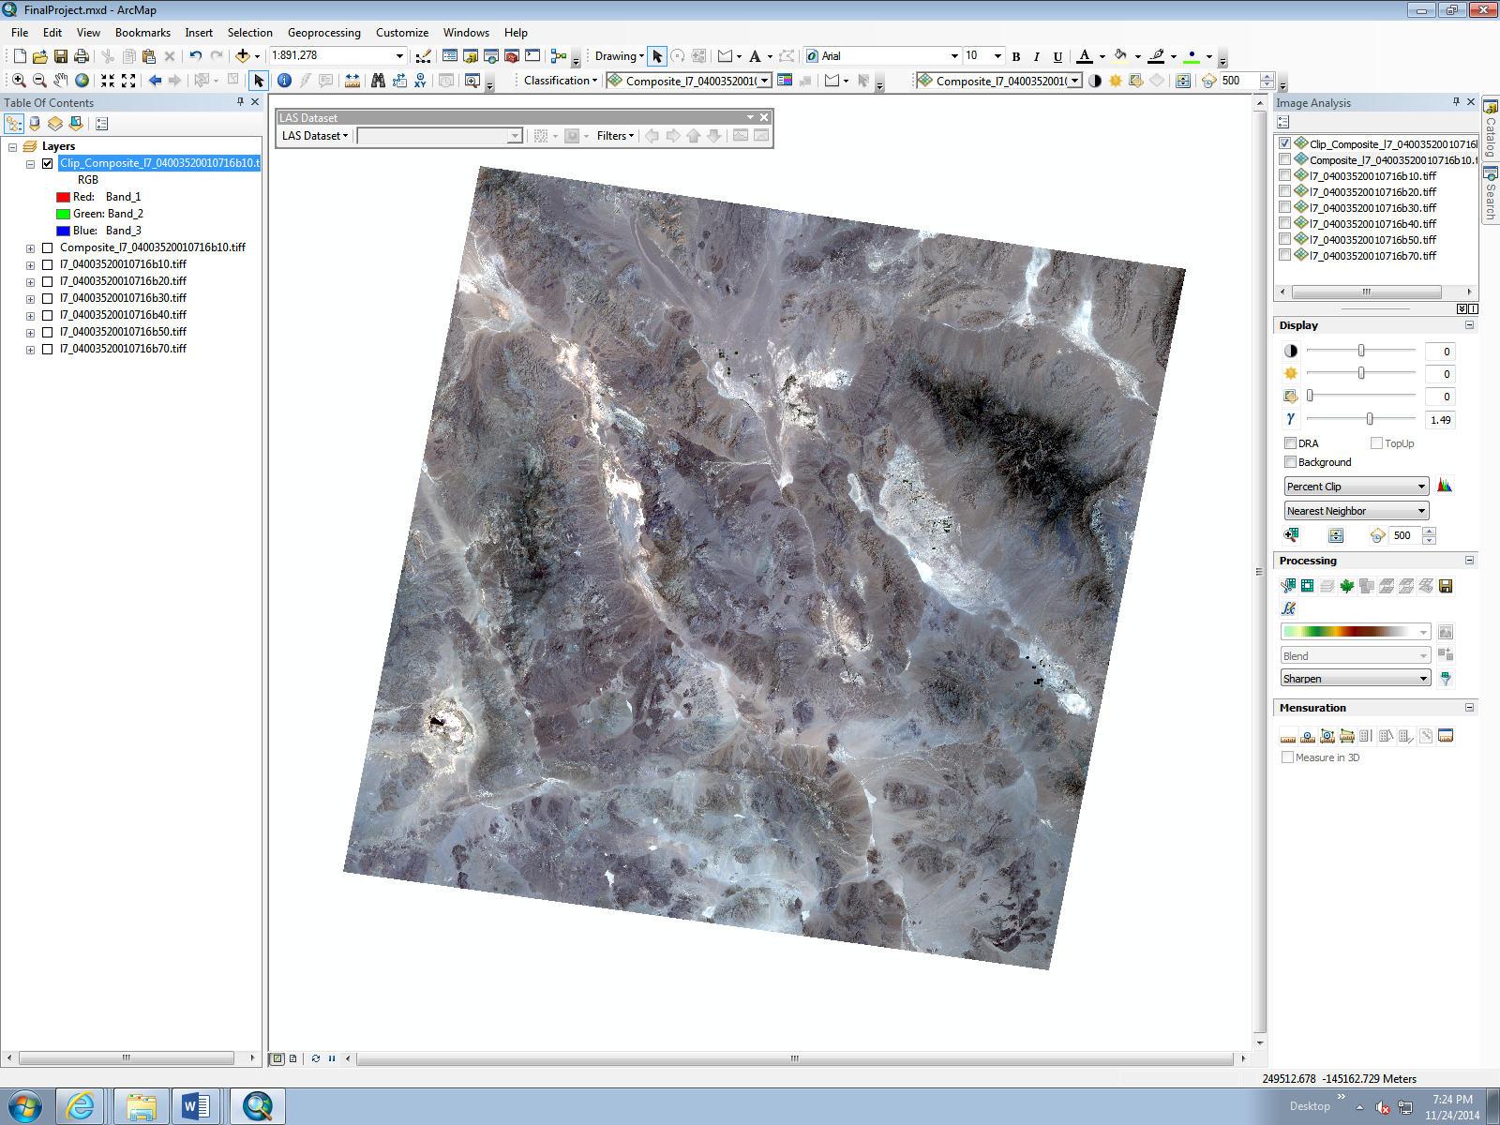
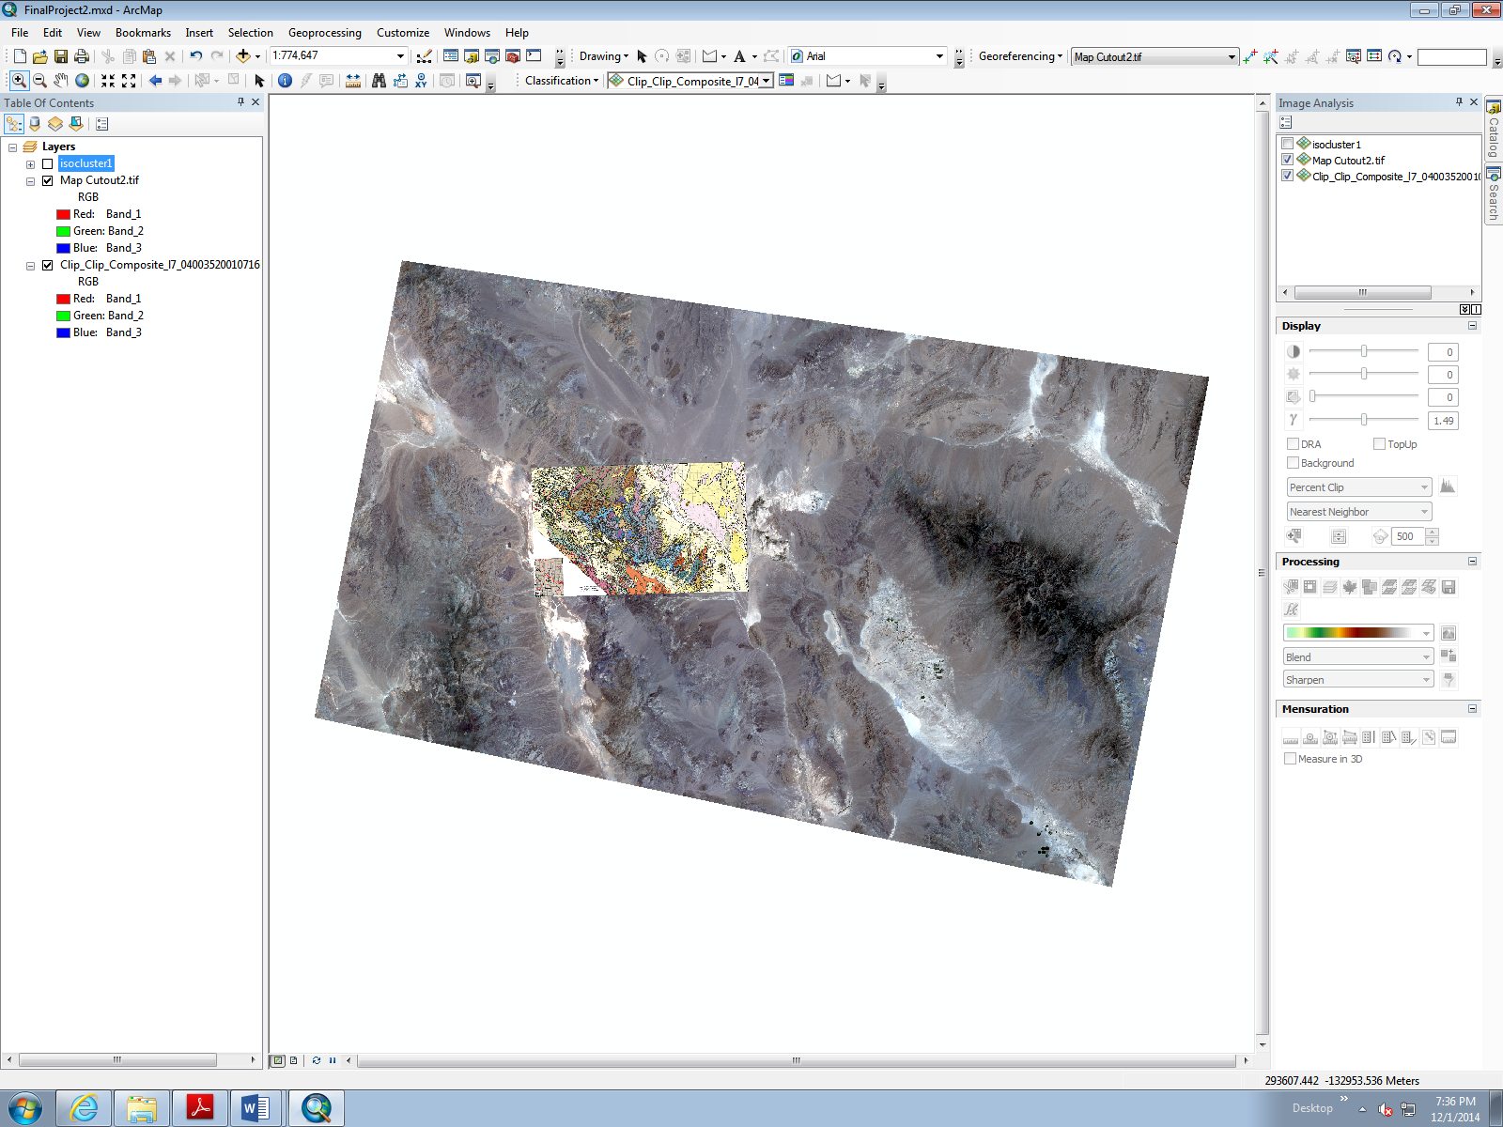
Trim Data to Make it Manageable
Condensed data and removed black outline
Cut area in half and georeferenced geologic map

Slide 6
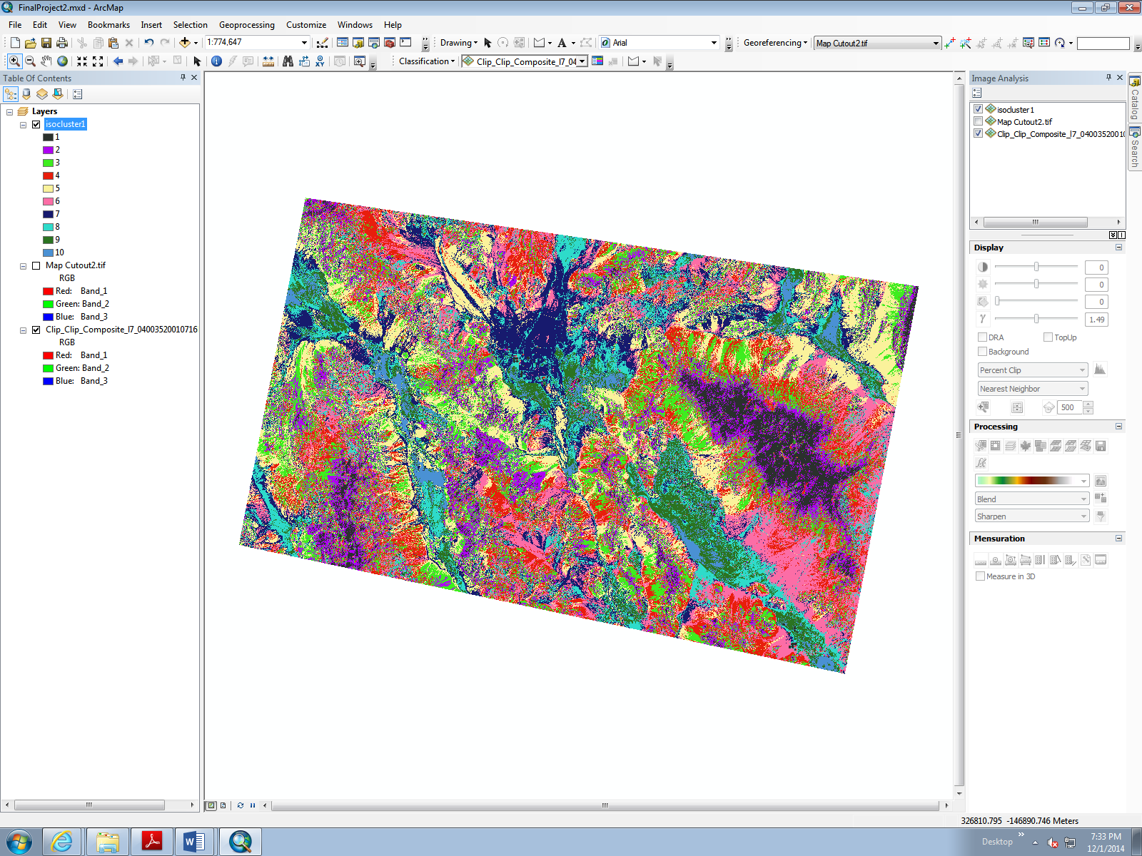
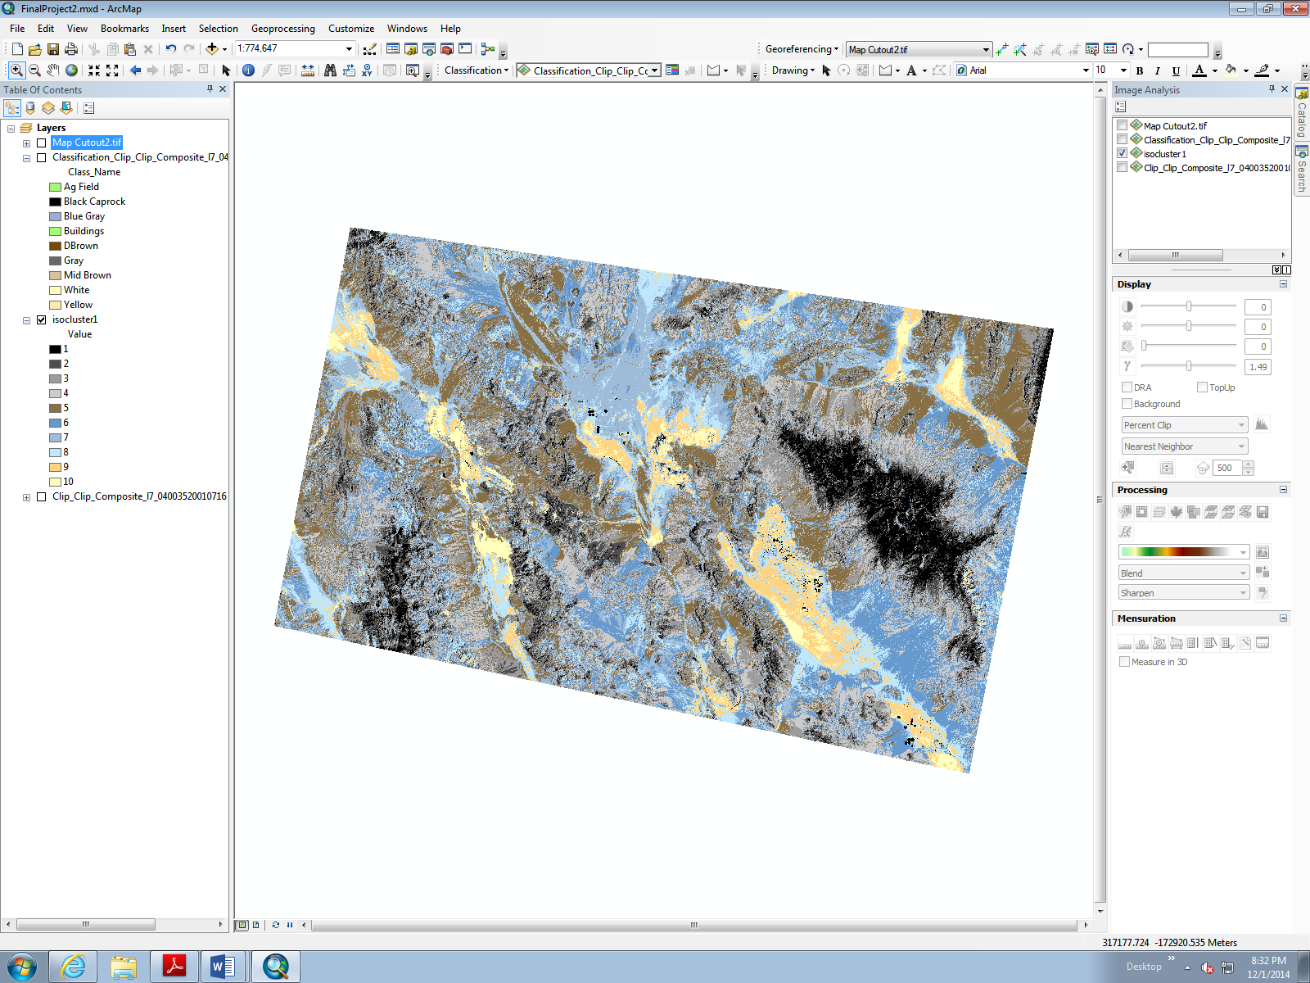
Run a Unsupervised Classification
(10 breaks)
Original result
Color adjusted result

Slide 7
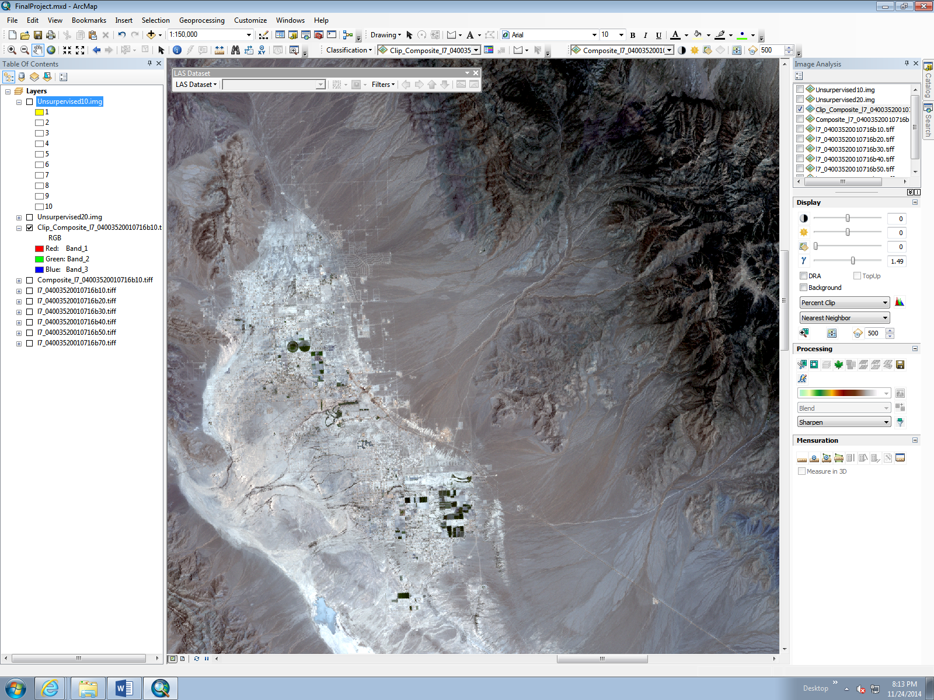
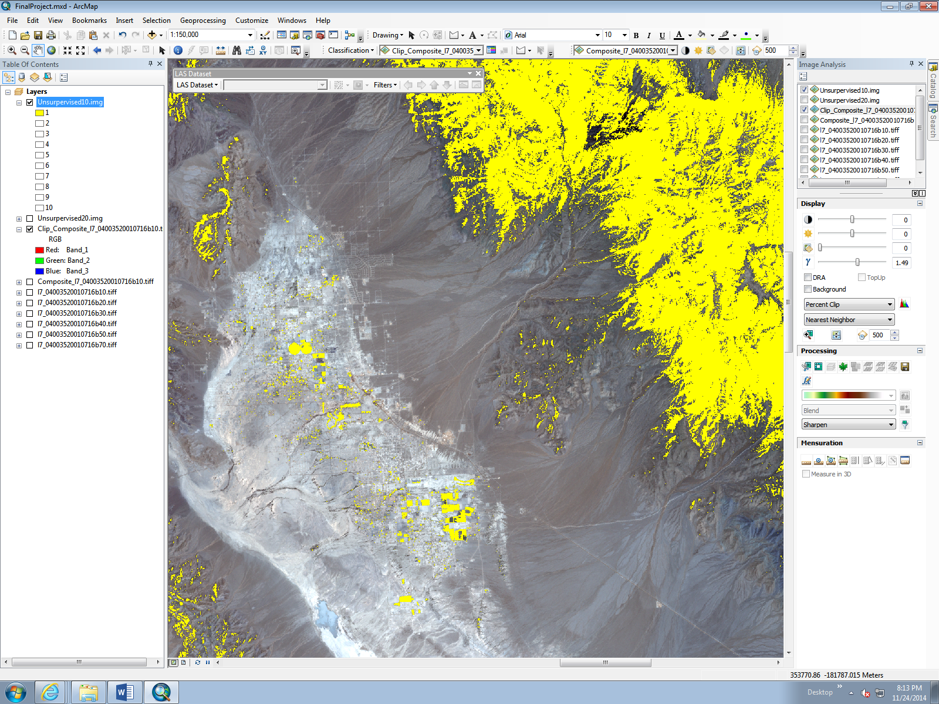
Unsupervised Classification Analysis
Using yellow to highlight one class at a time I compared the results with the original Landsat imagery
Difficulty with man-made objects classifying as rock
Otherwise it appeared to create good accurate outlines

Slide 8
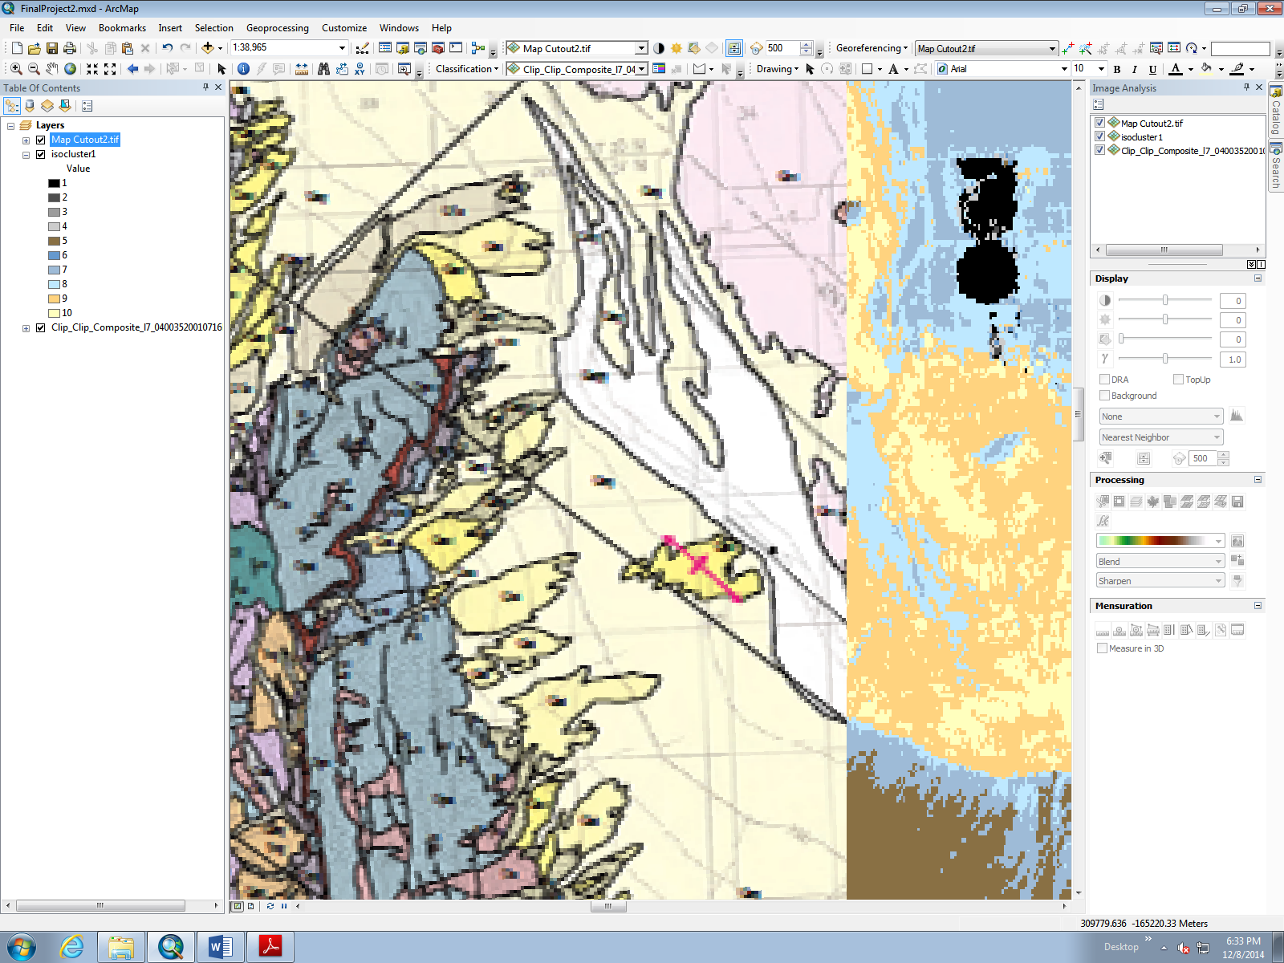
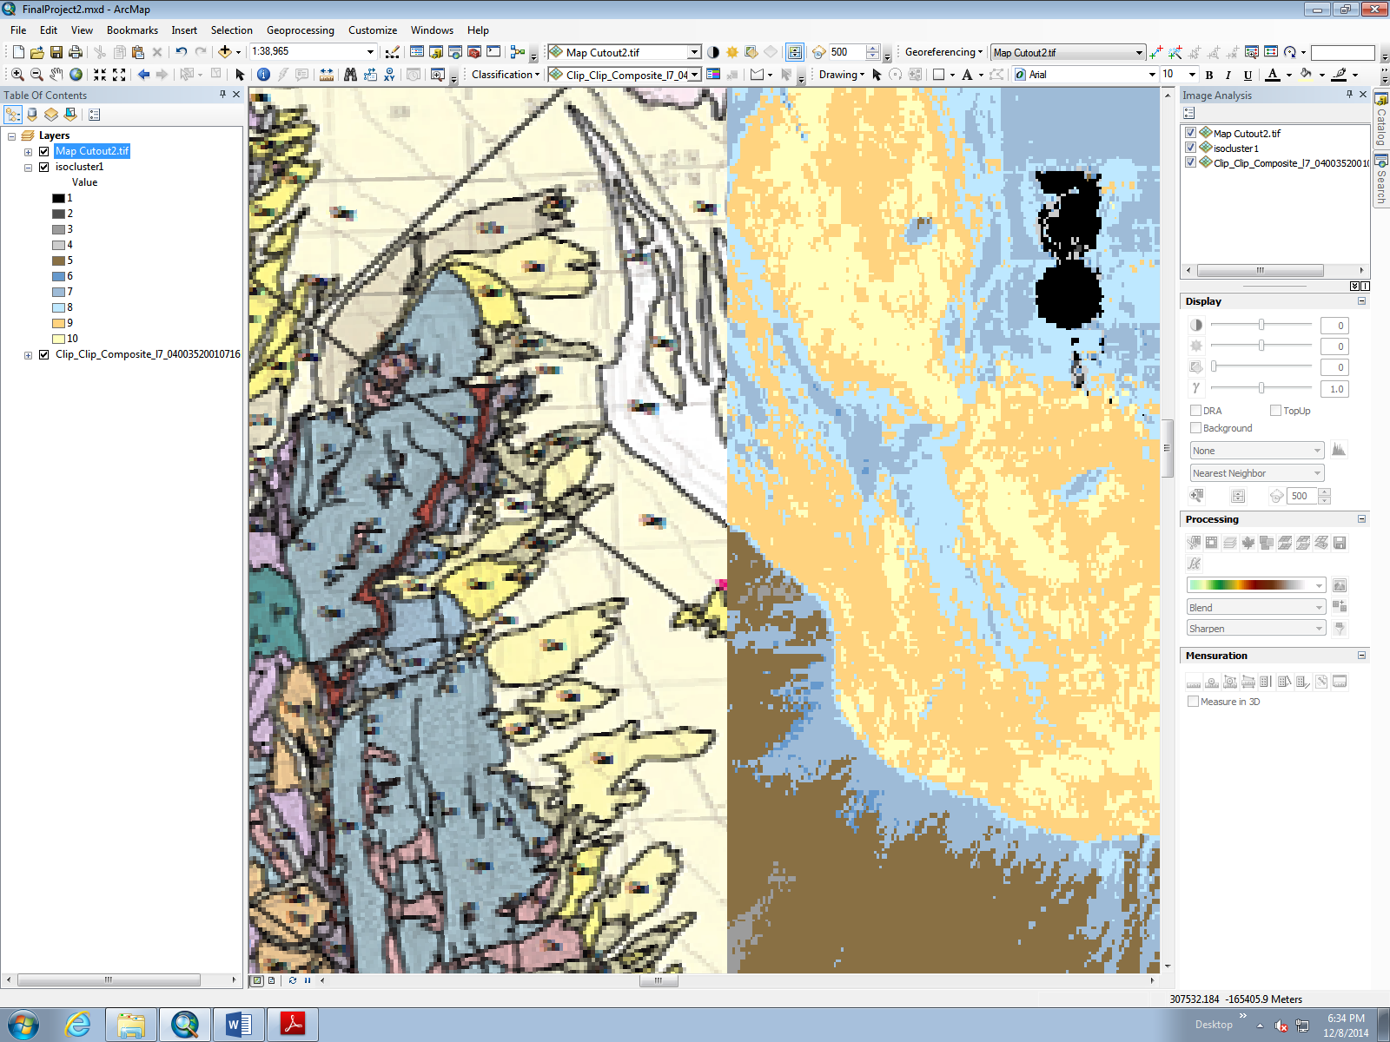
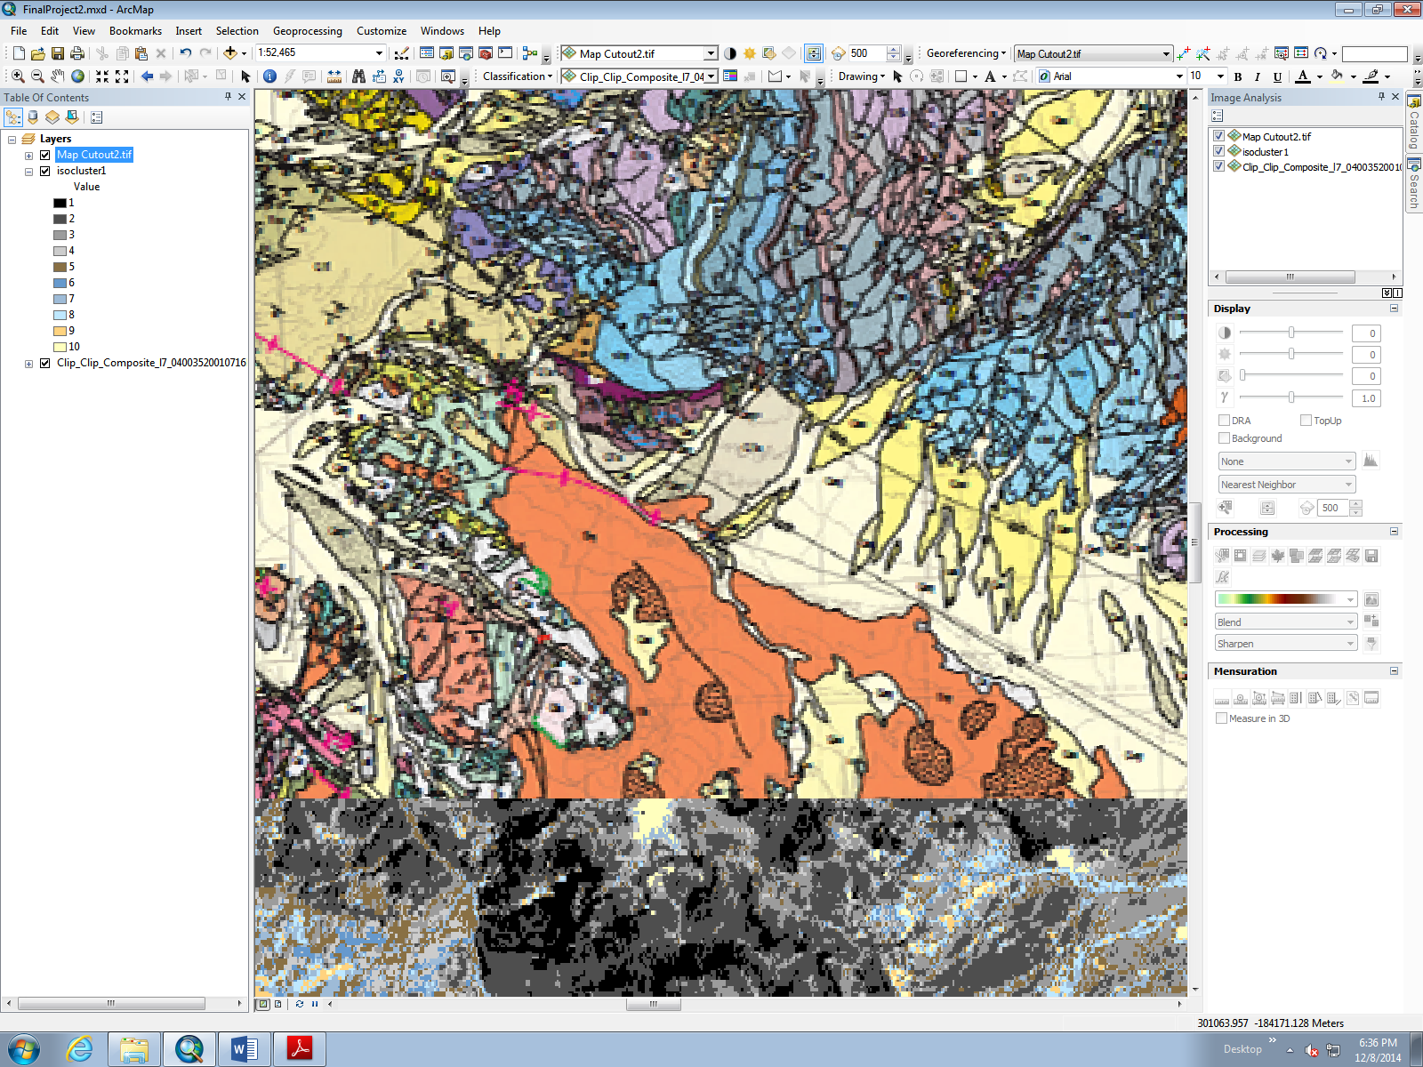
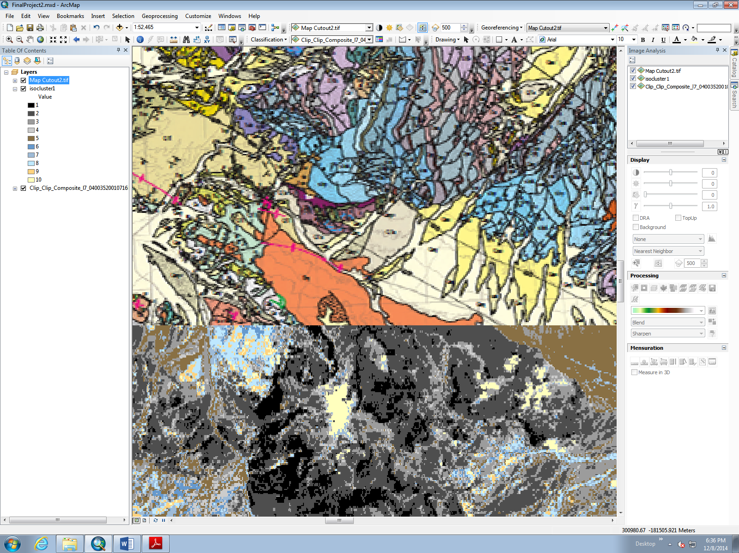

Slide 9
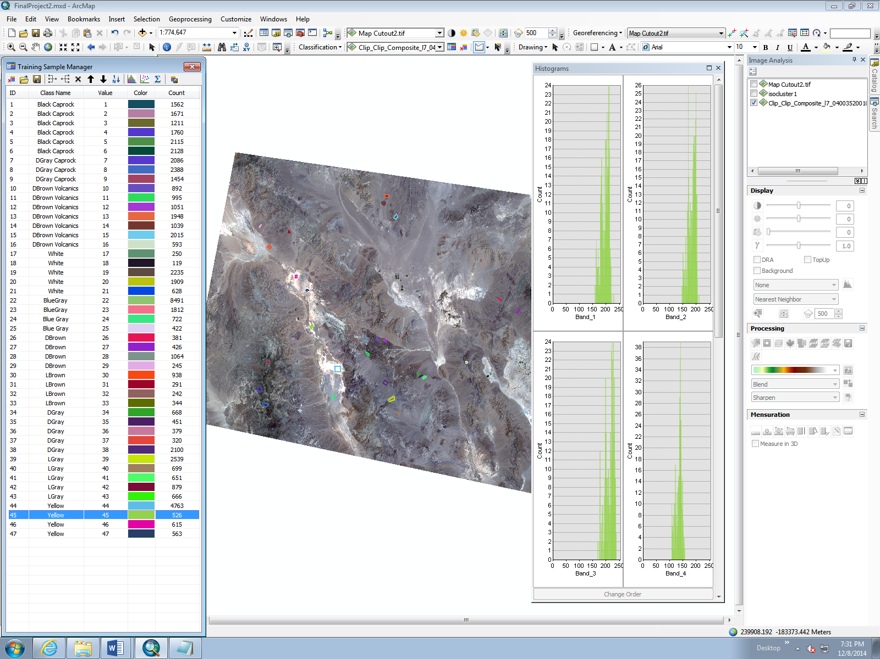
Run a Supervised Classification
Started by creating training samples
Ran into a couple problem areas
  My first training samples were alright until I created the dendogram. Class types that should have been similar were scattered apart. I had to try again being more careful.
  Second, my yellow rock type has a really broad histogram despite repeated sampling attempts

Slide 10
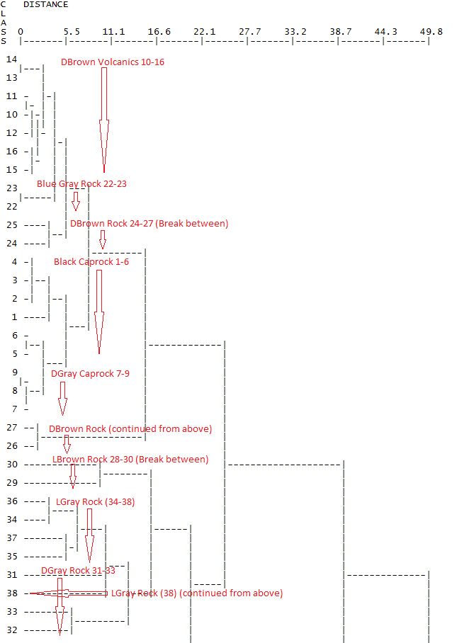
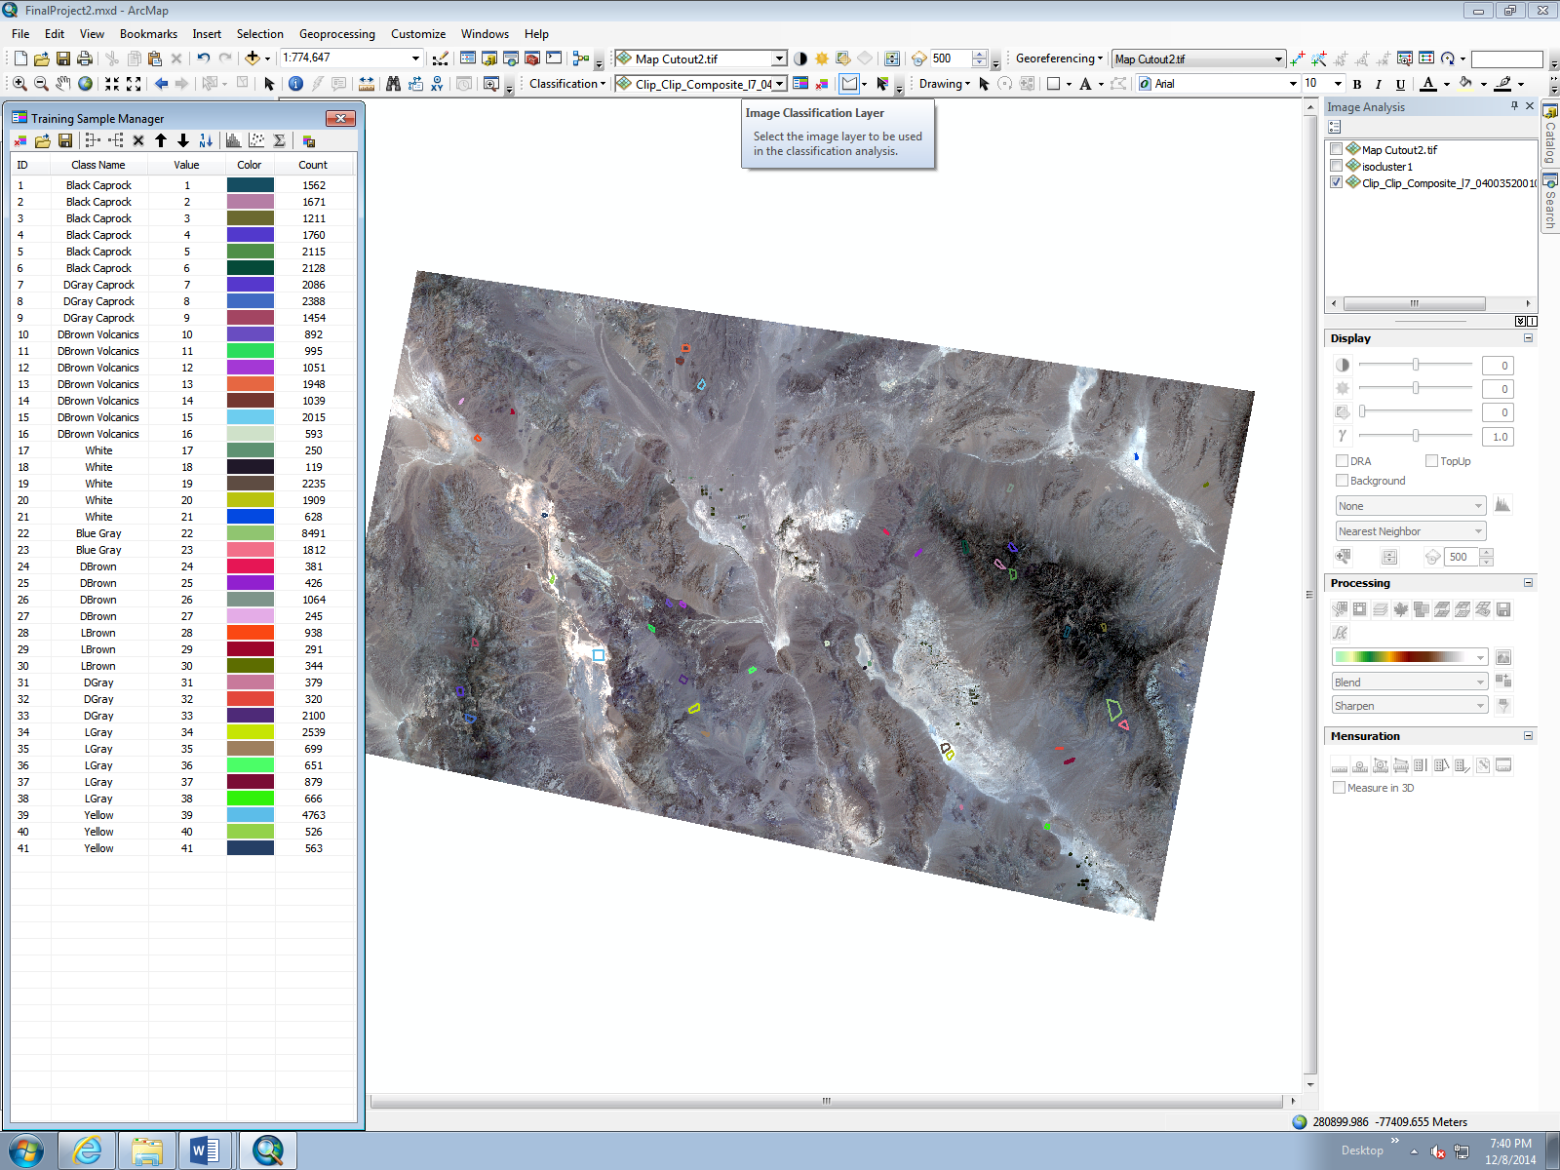
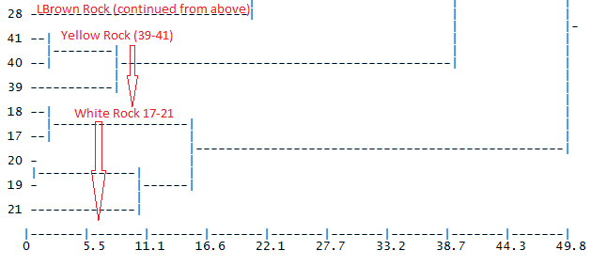
Final Supervised Training Set
Still some problems
  24 & 25 separate from 26 & 27.
  28 separate from 29 & 30.
  This set suffered from ‘yellow’ broad histograms too.
  I would have liked to try and refine this some more, but time limits prevented me.

Slide 11
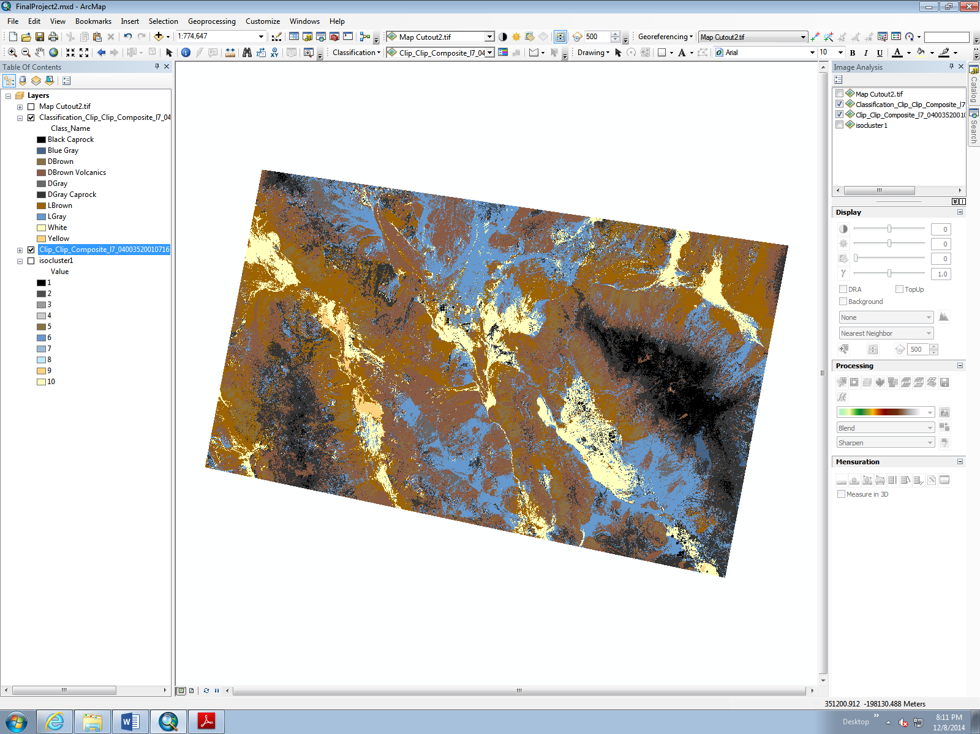
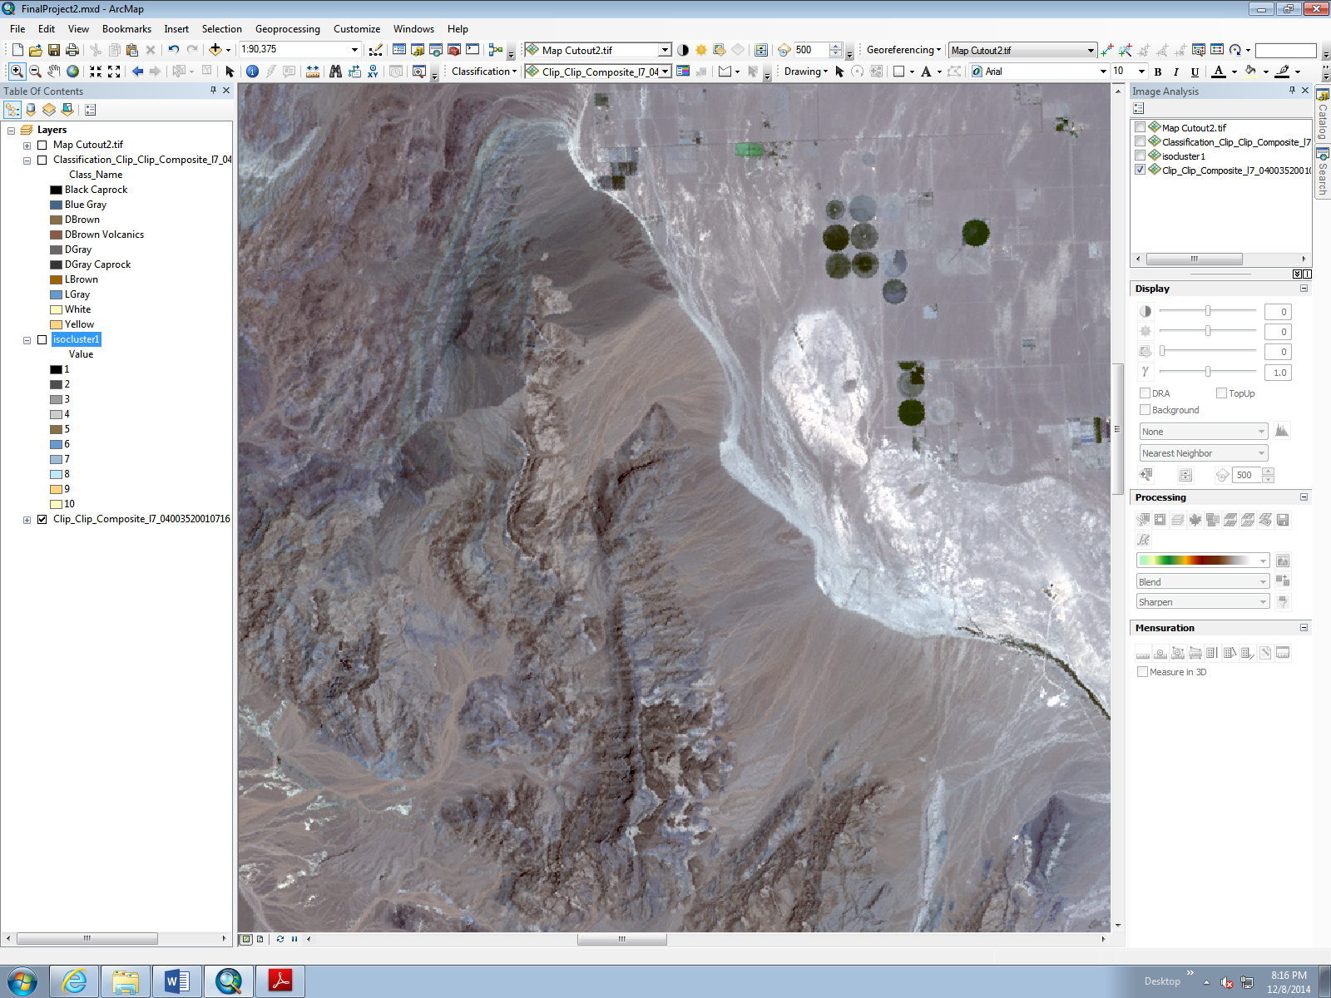
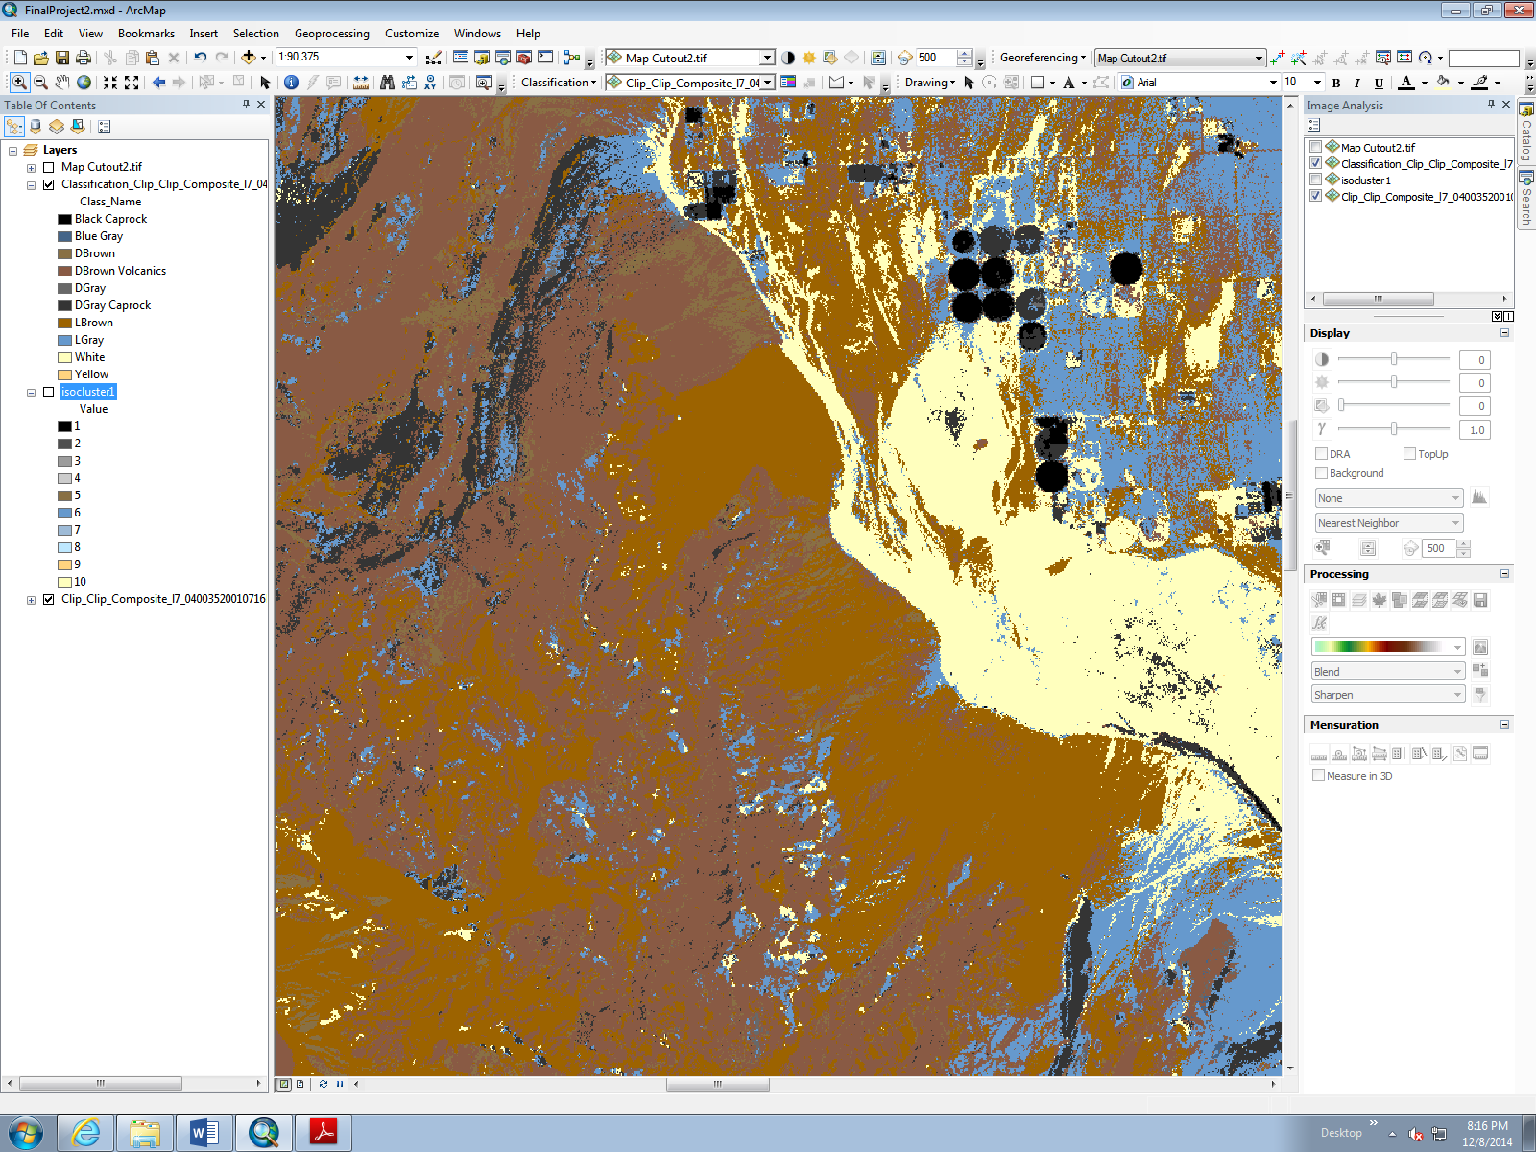
Result of Running the Training Set
The supervised classification suffered the same man-made object issue as the unsupervised. It took these agriculture fields and classified them with the dark rock type.

Slide 12
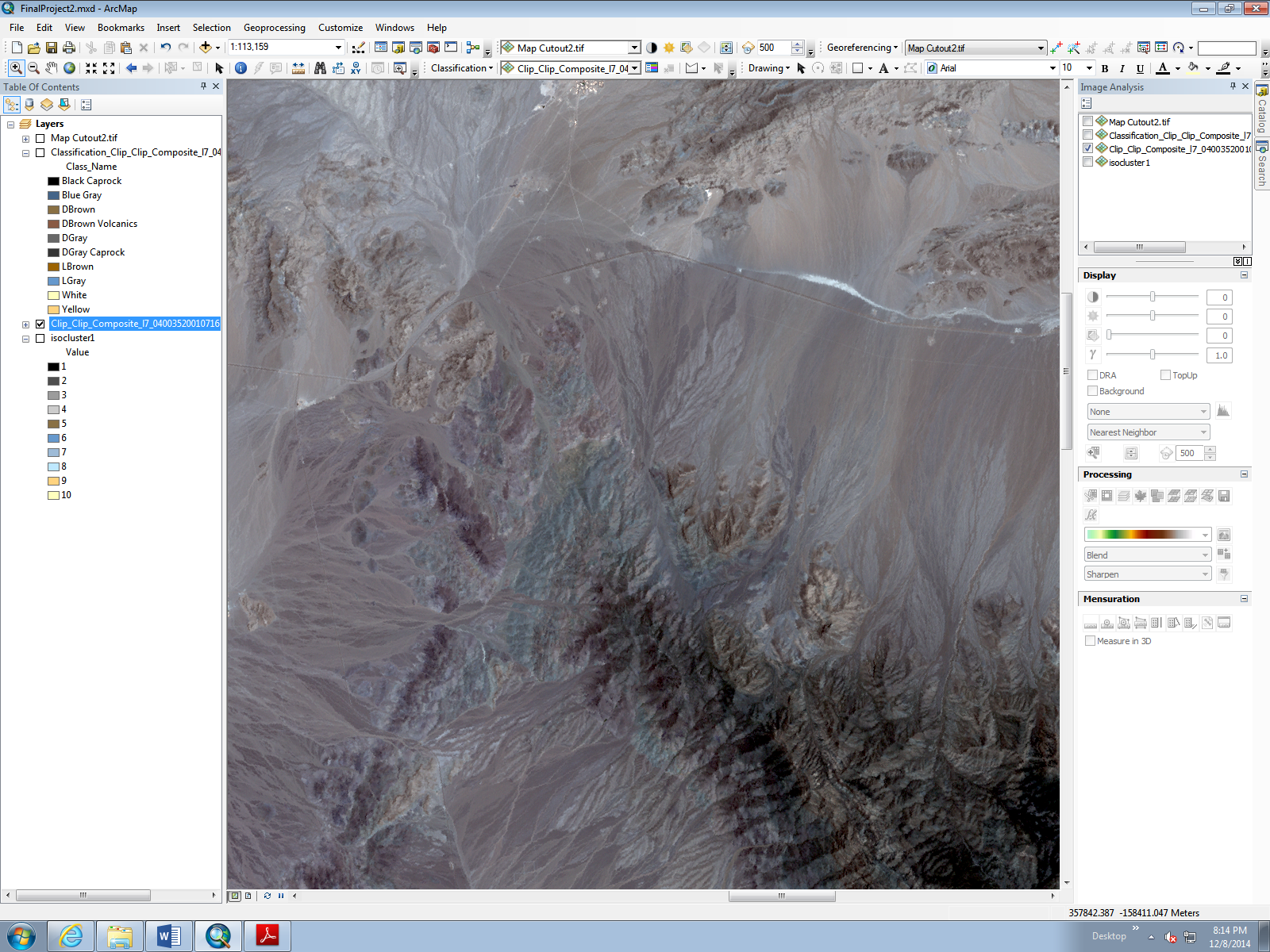
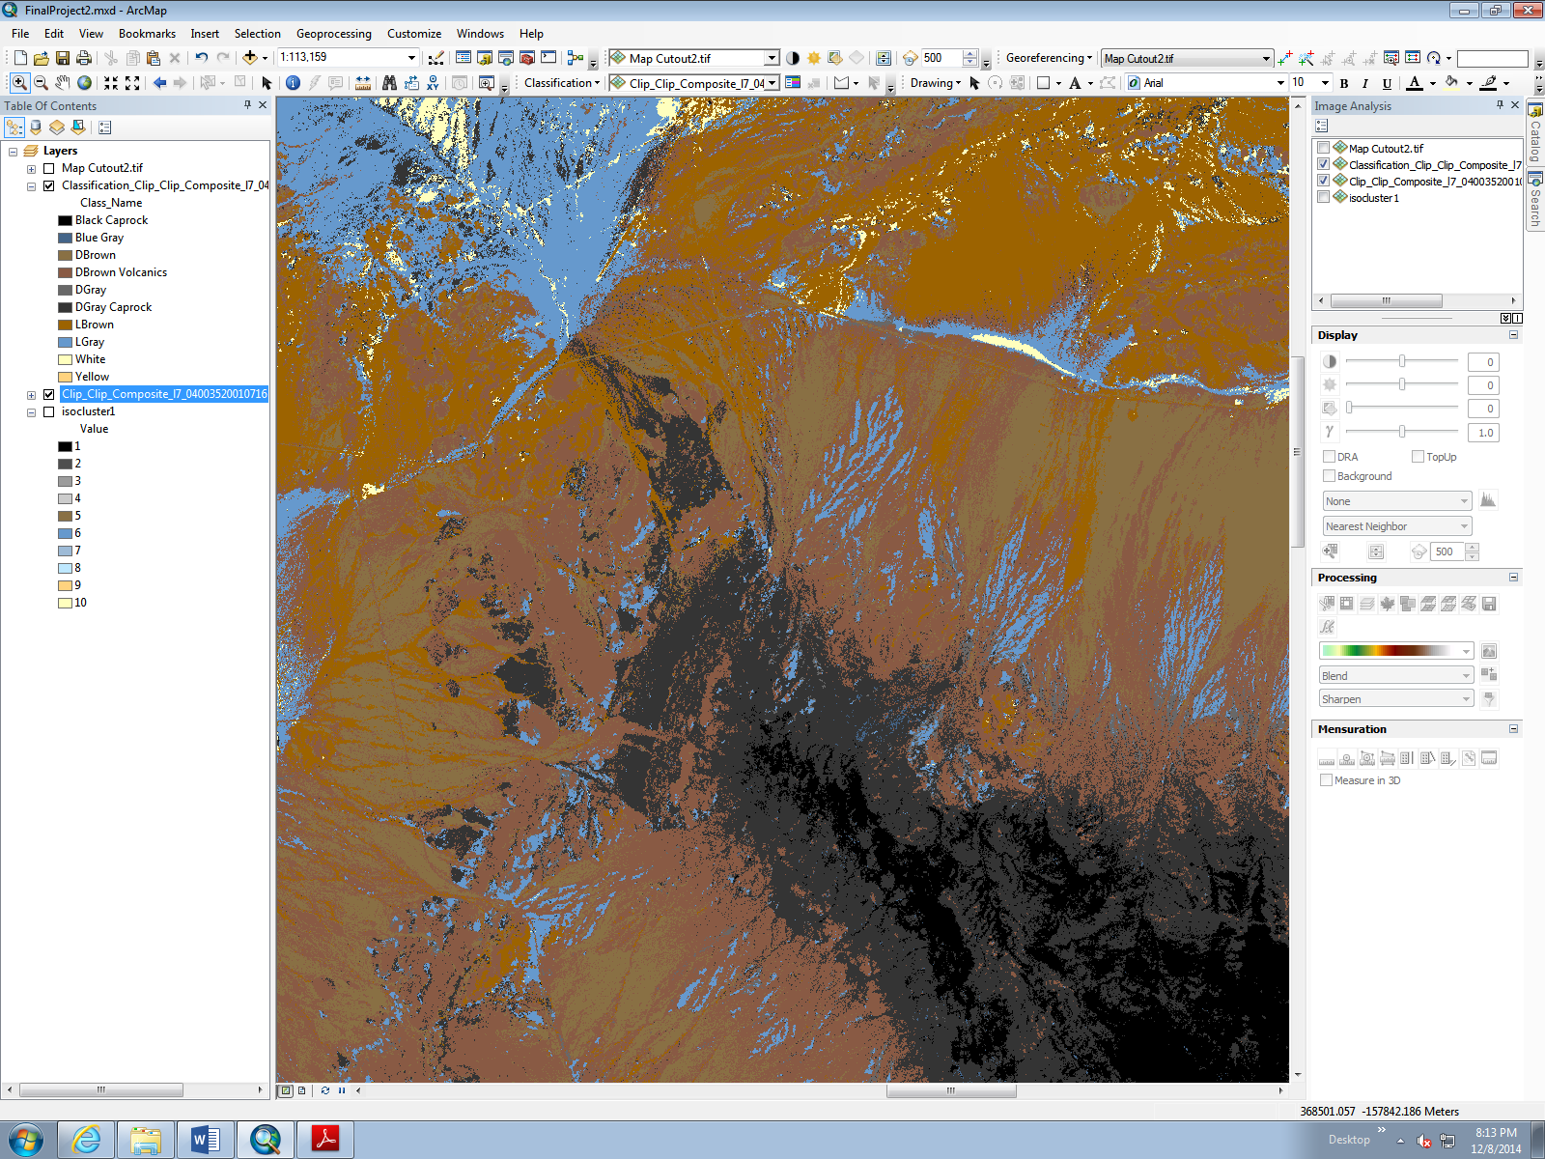
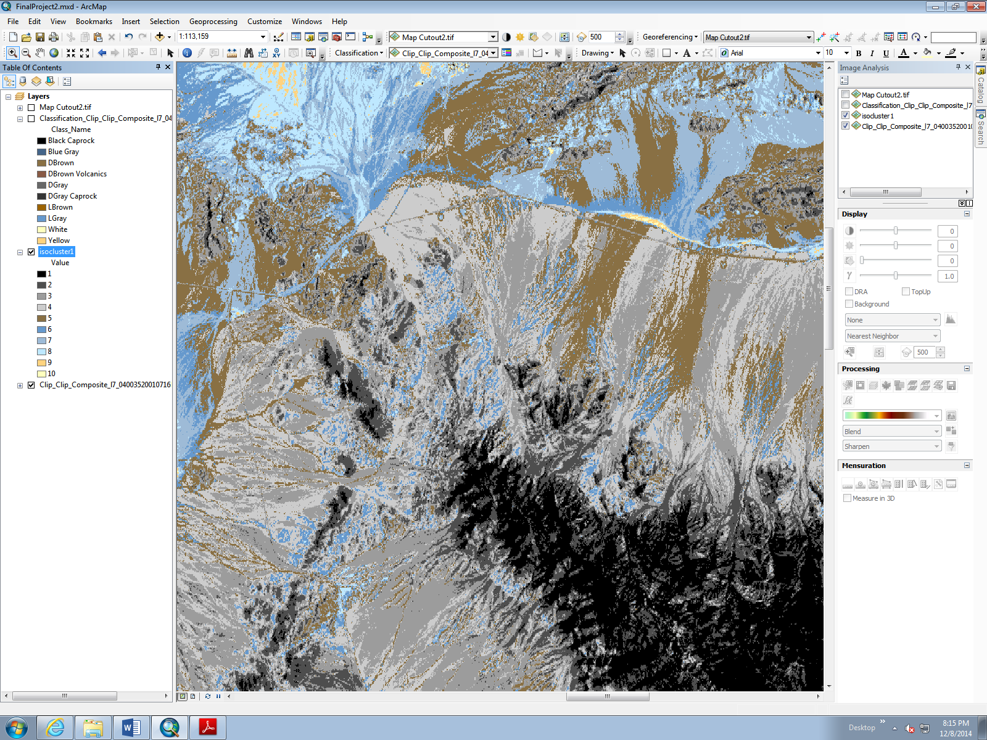
Compare and Contrast Results
Original image
Supervised Classification
Unsupervised Classification
Unsupervised classified has more ‘gray’ materials while the supervised classified more ‘brown’ materials.
Because reconnaissance mapping is intended to be a sort of rough draft to identify areas of interest that will then be refined, that variance itself wasn’t excessively concerning to me. As can be seen from the original image, the browns and grays tended to be difficult to pick apart. These details can be hammered out in the final map after field work is done.
Of more interest was the additional amount of detail that appears to be present in the unsupervised over the supervised classification.
For example, in considering the three prior images, the upper left corner of the unsupervised better and more accurately details the tendril interweaving of material than the supervised.

Slide 13
Conclusions
Among the two current products the Supervised is mildly inferior in detail and application than the Unsupervised.
With more time and energy put into the Supervised training set I’m confident I could produce fairly equivalent quality maps.
However, the Supervised classification already took significantly more time than the Unsupervised map.
If time is money, and your paying someone to do such a project, given equivalent outcomes, the faster approach becomes more efficient.
I believe the unsupervised approach would be the best method to use if attempting to generate a geologic reconnaissance map using spectral data and ArcGIS.

Slide 14
Any Questions?

