Slide 1
GeoFileDatabase
Geog 375
Gary Kean
5/16/14

Slide 2
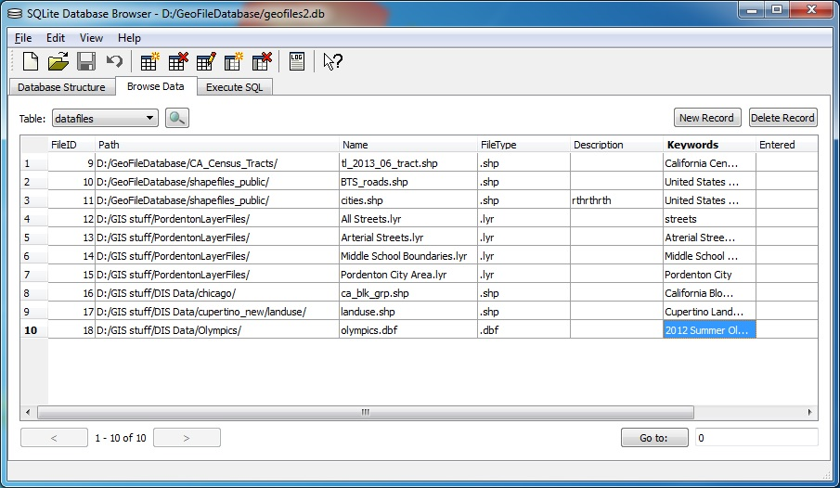
GeoFileDatabase
Description
  Toolbox that gives the user access an existing SQLite database file that has been pre-populated with Local GIS datafiles:
    Hard disk Location/Path
    Filename
    File Type
      .dbf
      .shp
      .img
      …
    Description
    Keywords

Slide 3
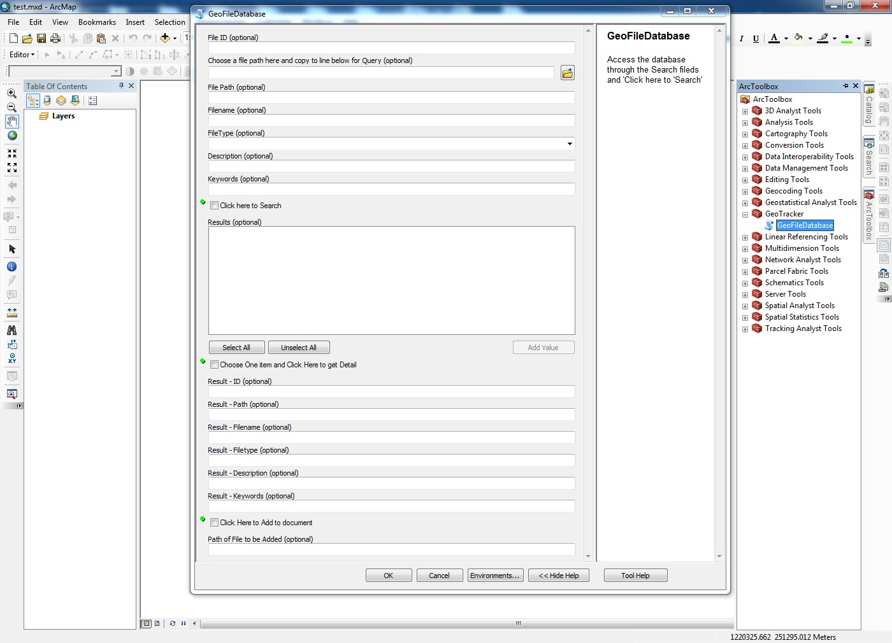
GeoFileDatabase
Empty Toolbox

Slide 4
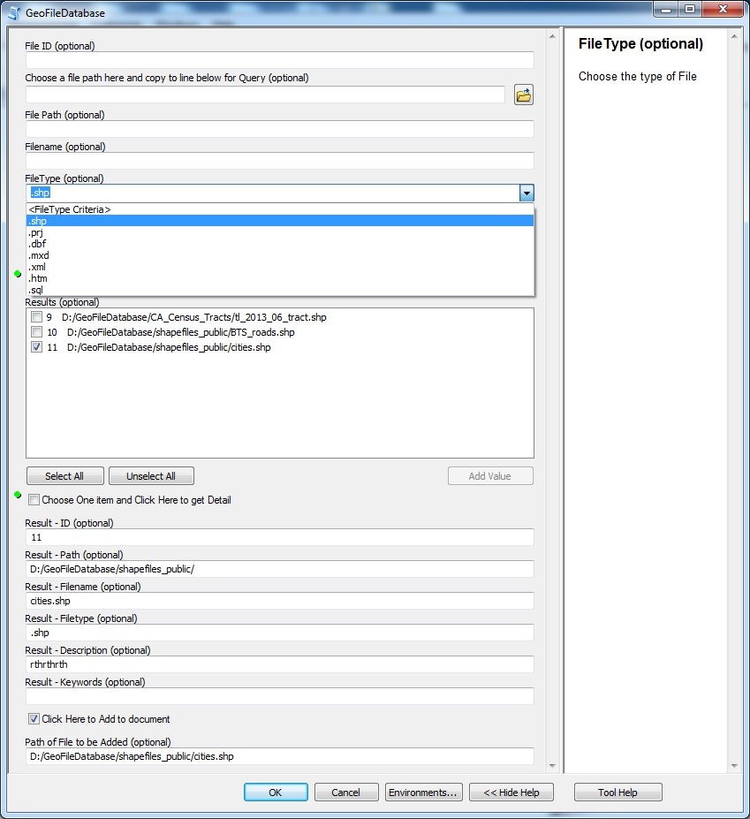
GeoFileDatabase
Form filled out

Slide 5
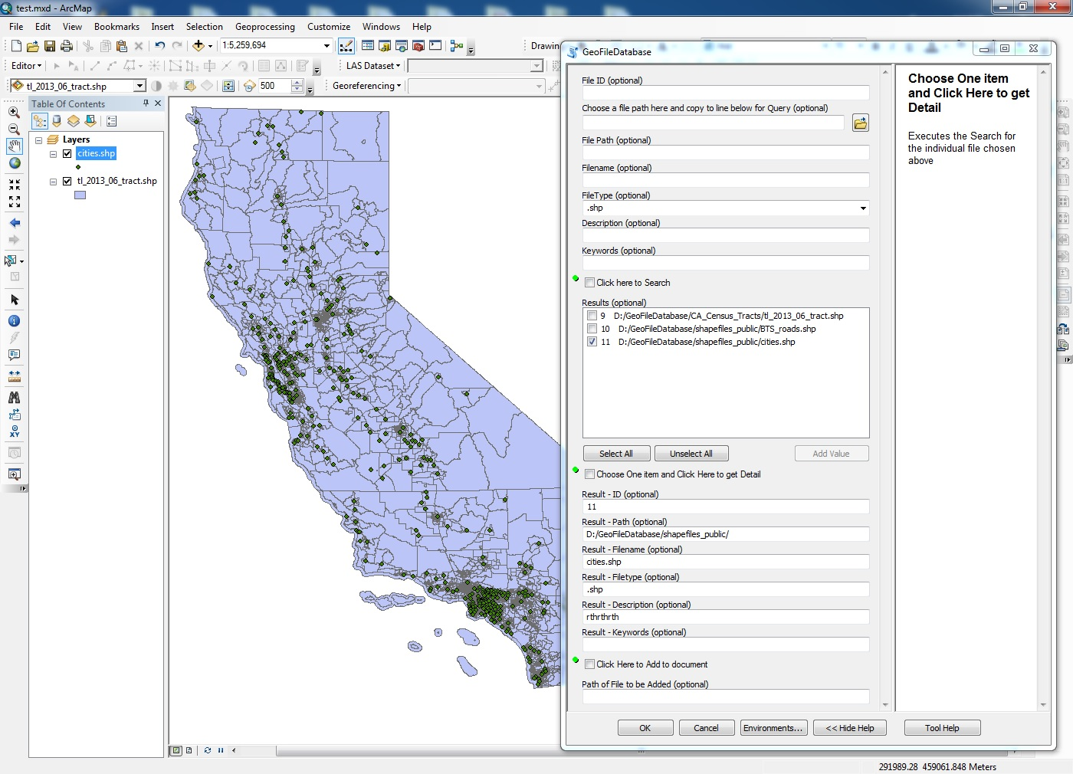
GeoFileDatabase
Data files added directly to Current Document

Slide 6
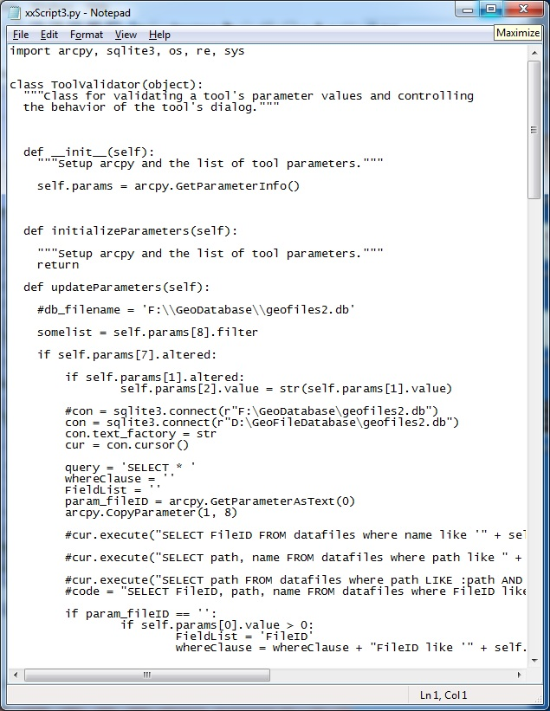
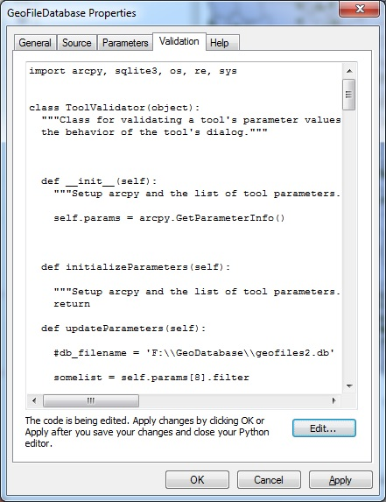
GeoFileDatabase
Entirely ToolValidator Code

Slide 7
GeoFileDatabase
Summary
Simple to use
You never have to leave ArcMap to search for files
Can search through a list of thousands of files extremely fast
Entirely ToolValidator Code – no external scripts required

