Slide 1
Final Project:
Read from a csv file and write to a database table
Bibek Joshi
5/16/2014

Slide 2
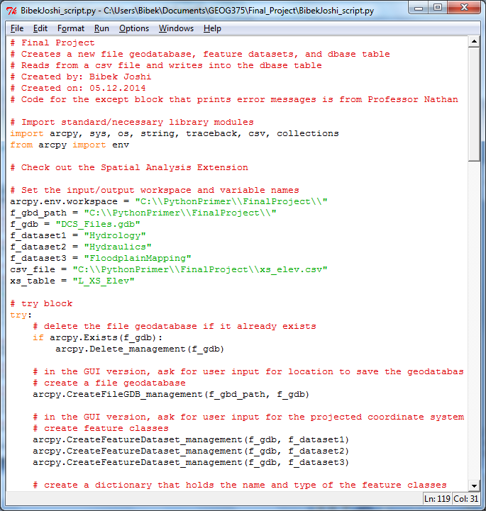
Python Script
Set Workspace
Import csv and collections module
Delete the geodatabase if it already exists
Create file geodatabase and feature dataset

Slide 3
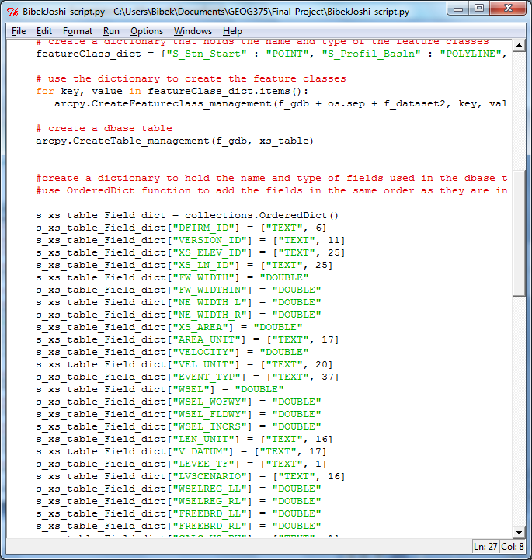
Python Script
Use dictionary to store feature class name and type
Create feature classes
Use collections.OrderedDict() method to create field in the same order as it is read from the csv file header
Use the dictionary to store field name and type

Slide 4
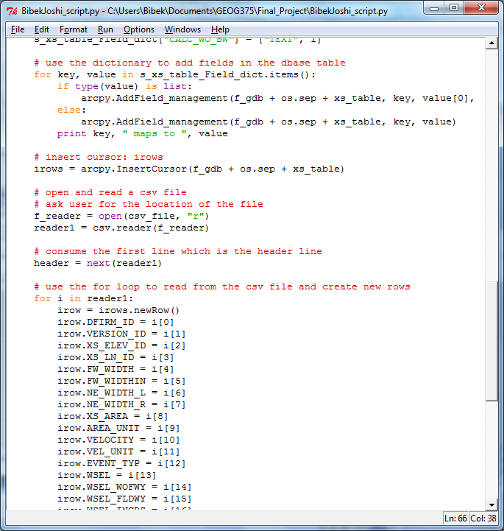
Python Script
Create an insert cursor
Read a csv file
“Consume” the header line from the csv file using header variable
Iterate through the reader object
Add new rows

Slide 5
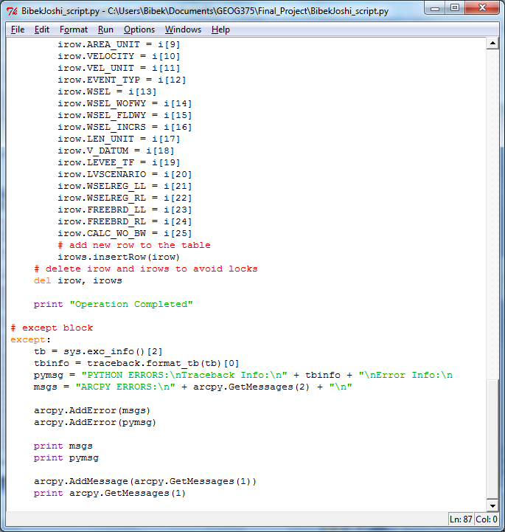
Python Script
Insert rows to the table
Delete insert cursor to prevent file lock
Except block for error handling/printing error messages

Slide 6
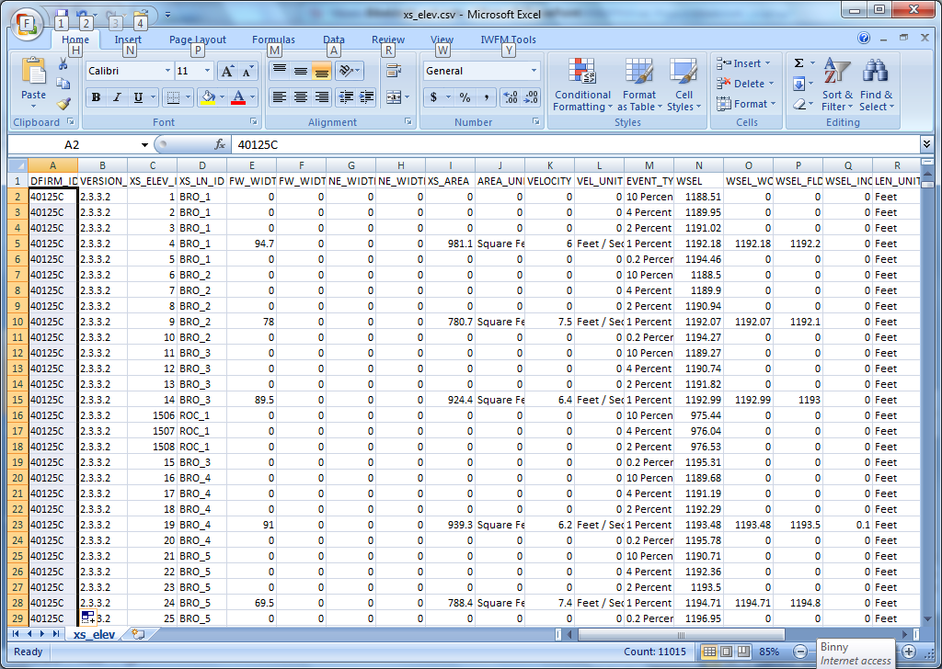
Input: csv file

Slide 7
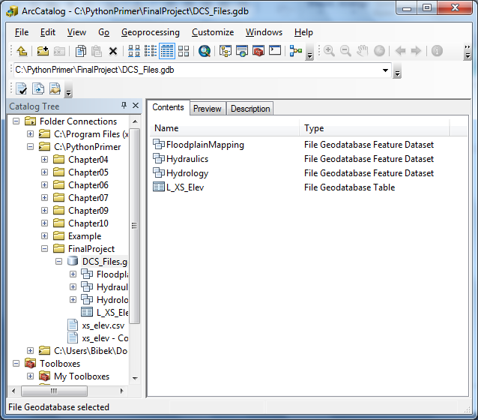
Output: File Geodatbase and Feature Dataset

Slide 8
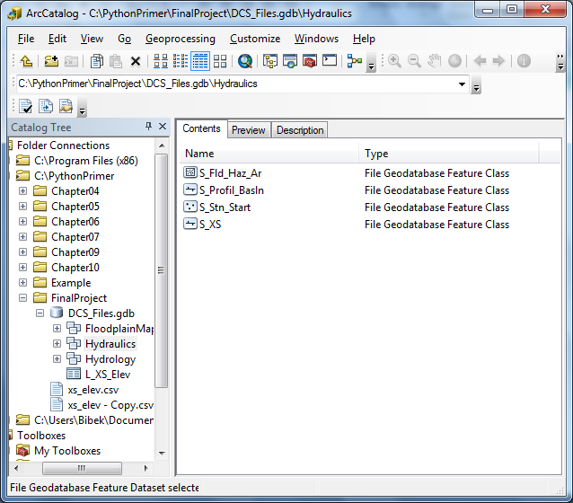
Output: Feature Classes

Slide 9
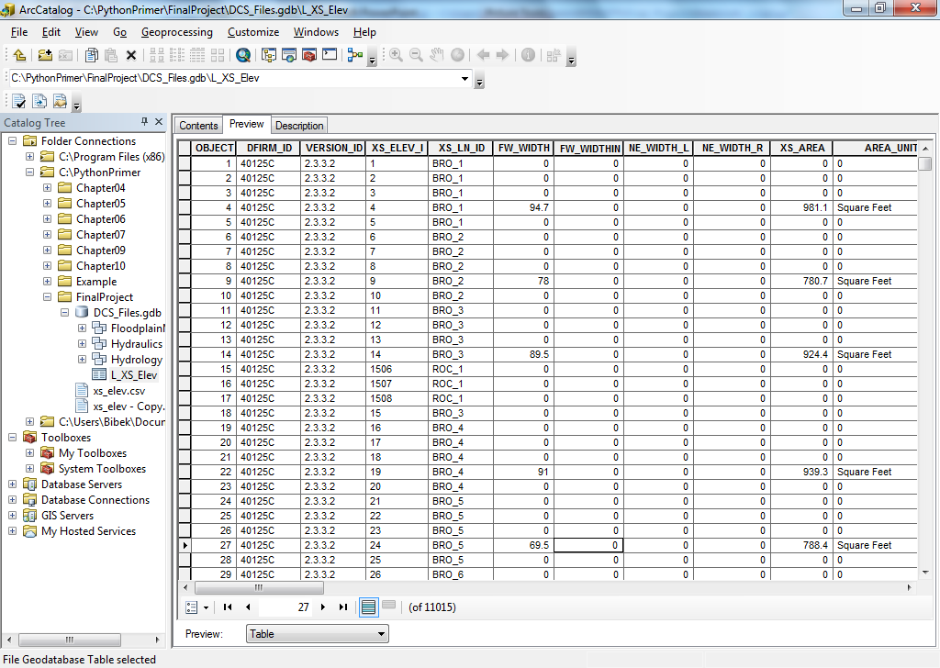
Output: Database Table

