Slide 1
Guided Tour of Yolo Bypass Wildlife Area
Samantha Haynes
Geog 385

Slide 2
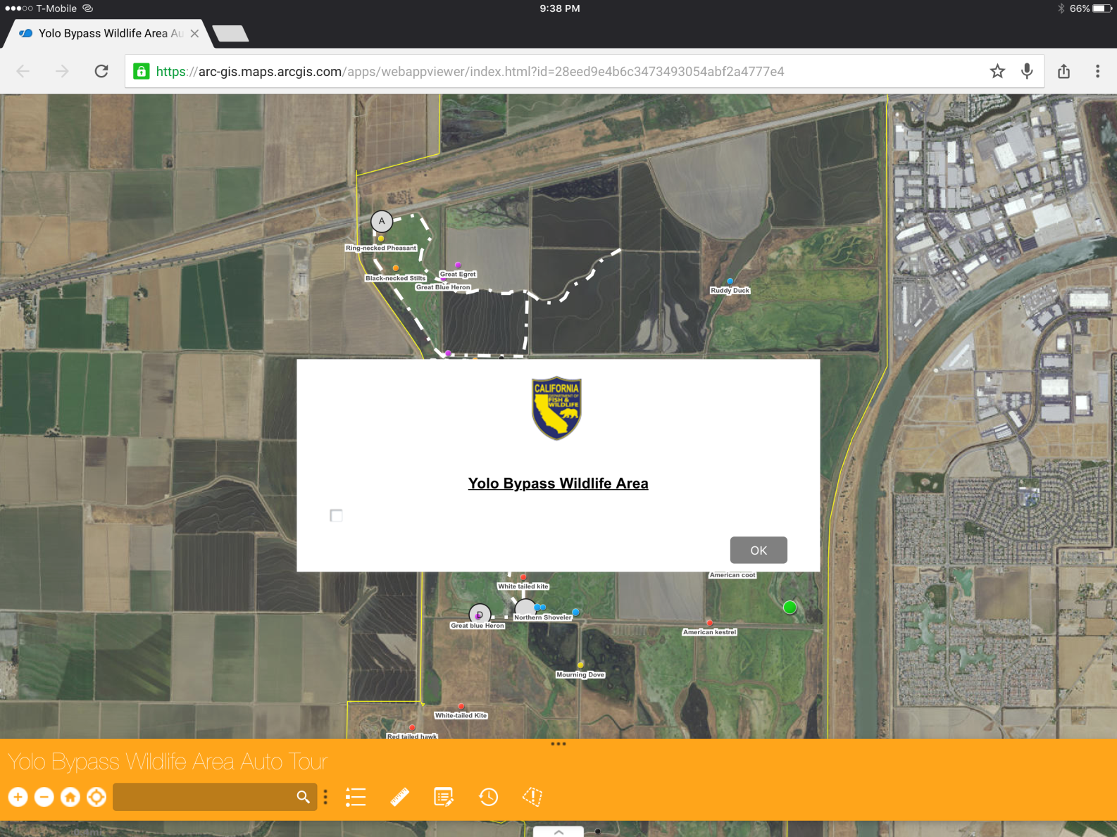
Splash page
-Displays link to department webpage with rules and regulations
-Had issues formatting the font and background colors

Slide 3
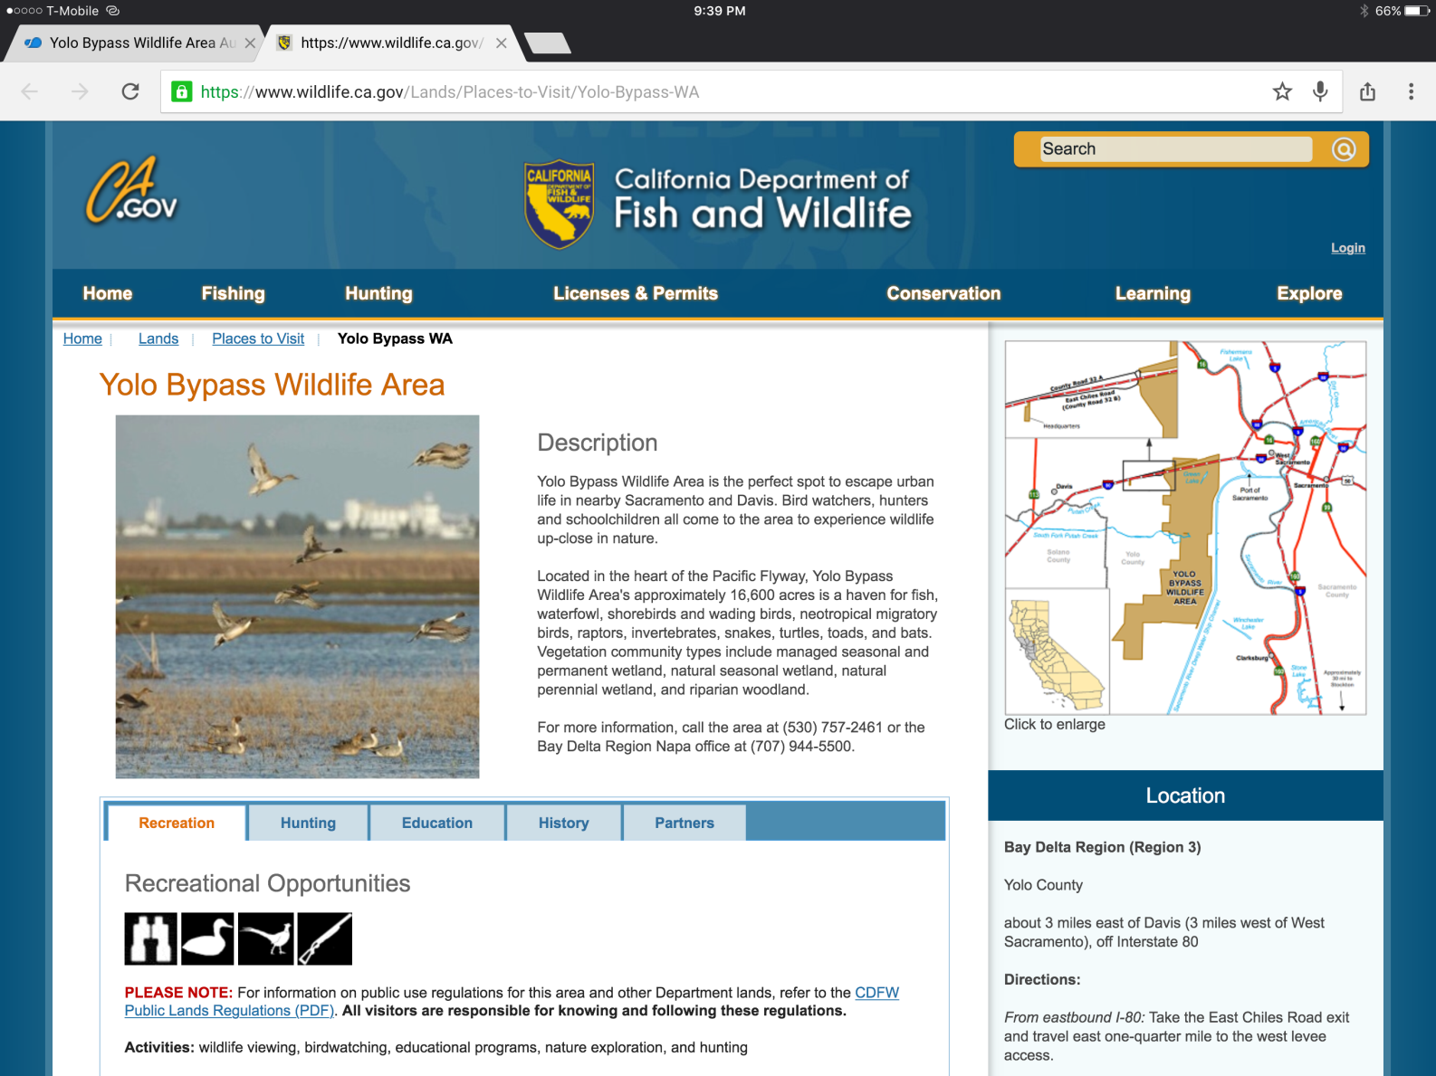
The splash page links to the department webpage for the Yolo Bypass Wildlife Area to display more information in detail

Slide 4
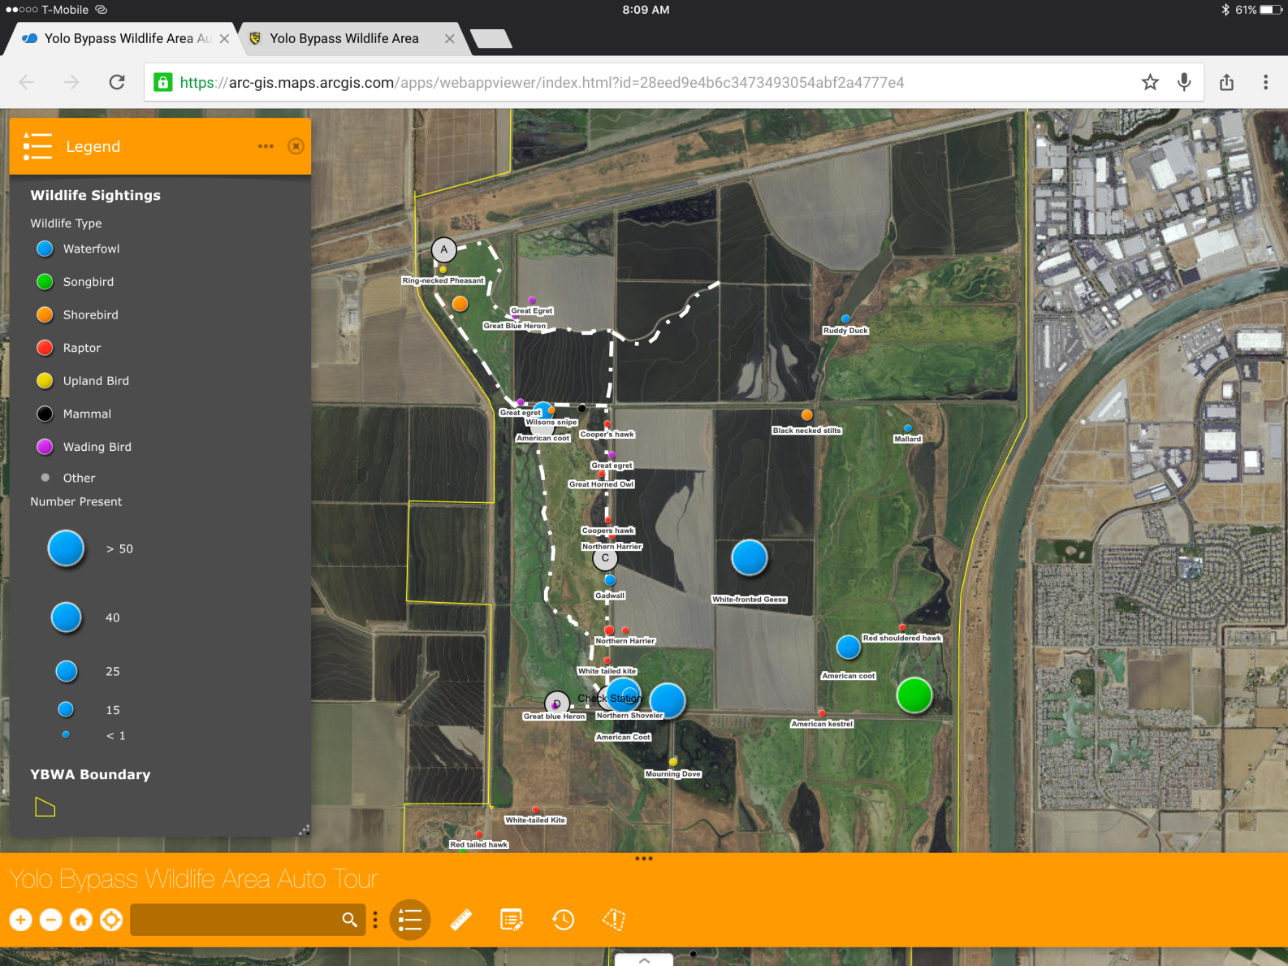
The app displays the wildlife types and the number of wildlife present within the legend

Slide 5
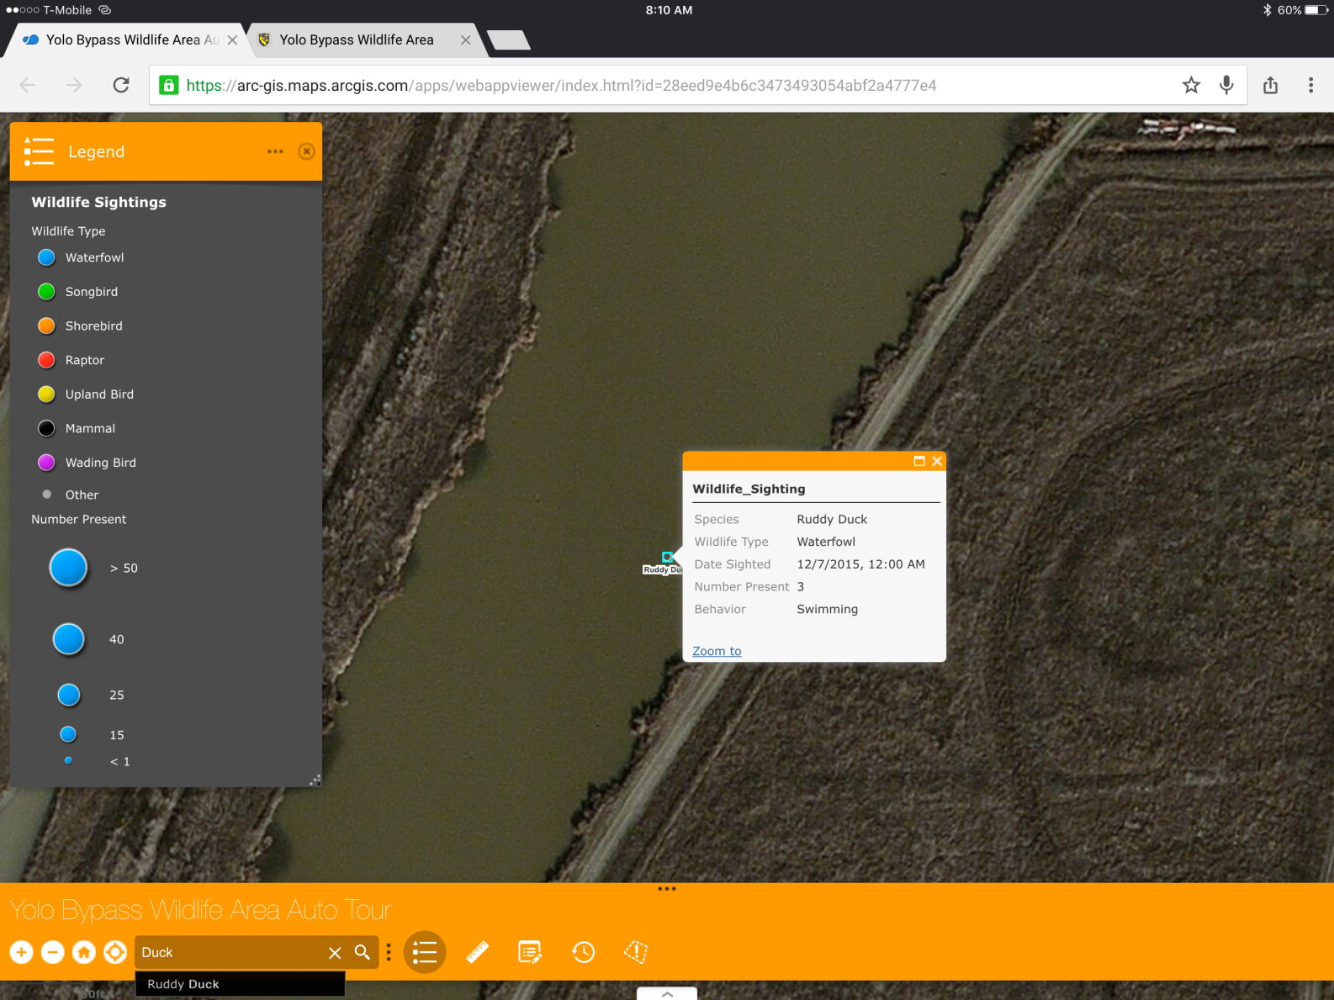
You may search a partial term and automatically zoom to the species sighted that matches

Slide 6
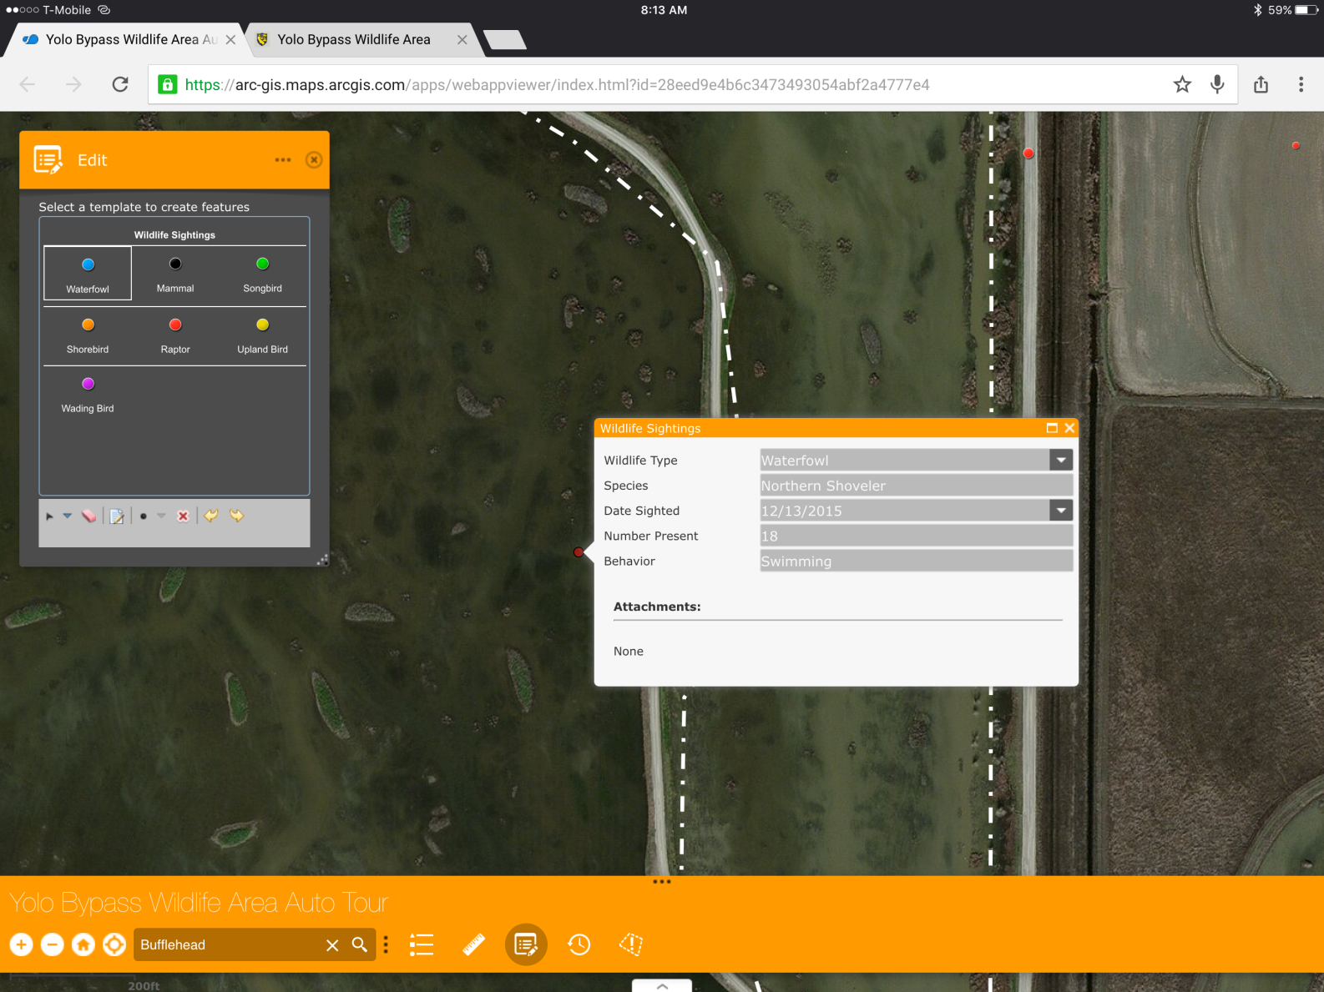
To add a wildlife sighting, click the edit widget, select the wildlife type, and select the location sighted. If location services are enabled the map with zoom to your current location or you may choose to place the sighting somewhere else. Then you may fill in the needed information in the pop up attribute table.

Slide 7
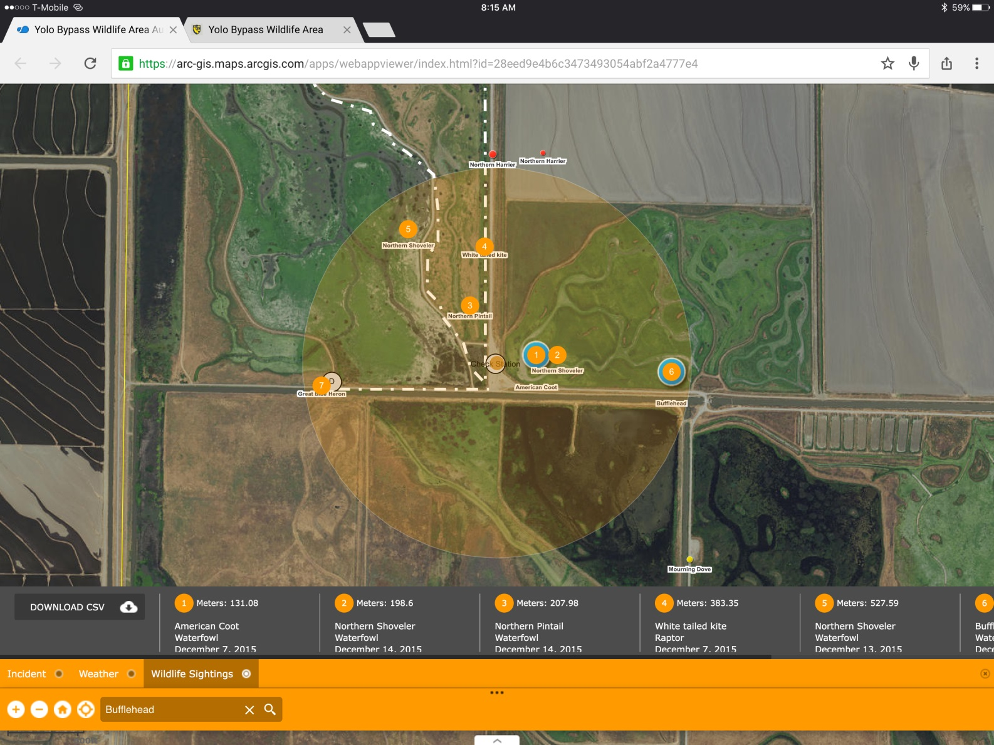
The situation awareness widget allows the user to place an incident, define the buffer radius, and see the results displayed.

Slide 8
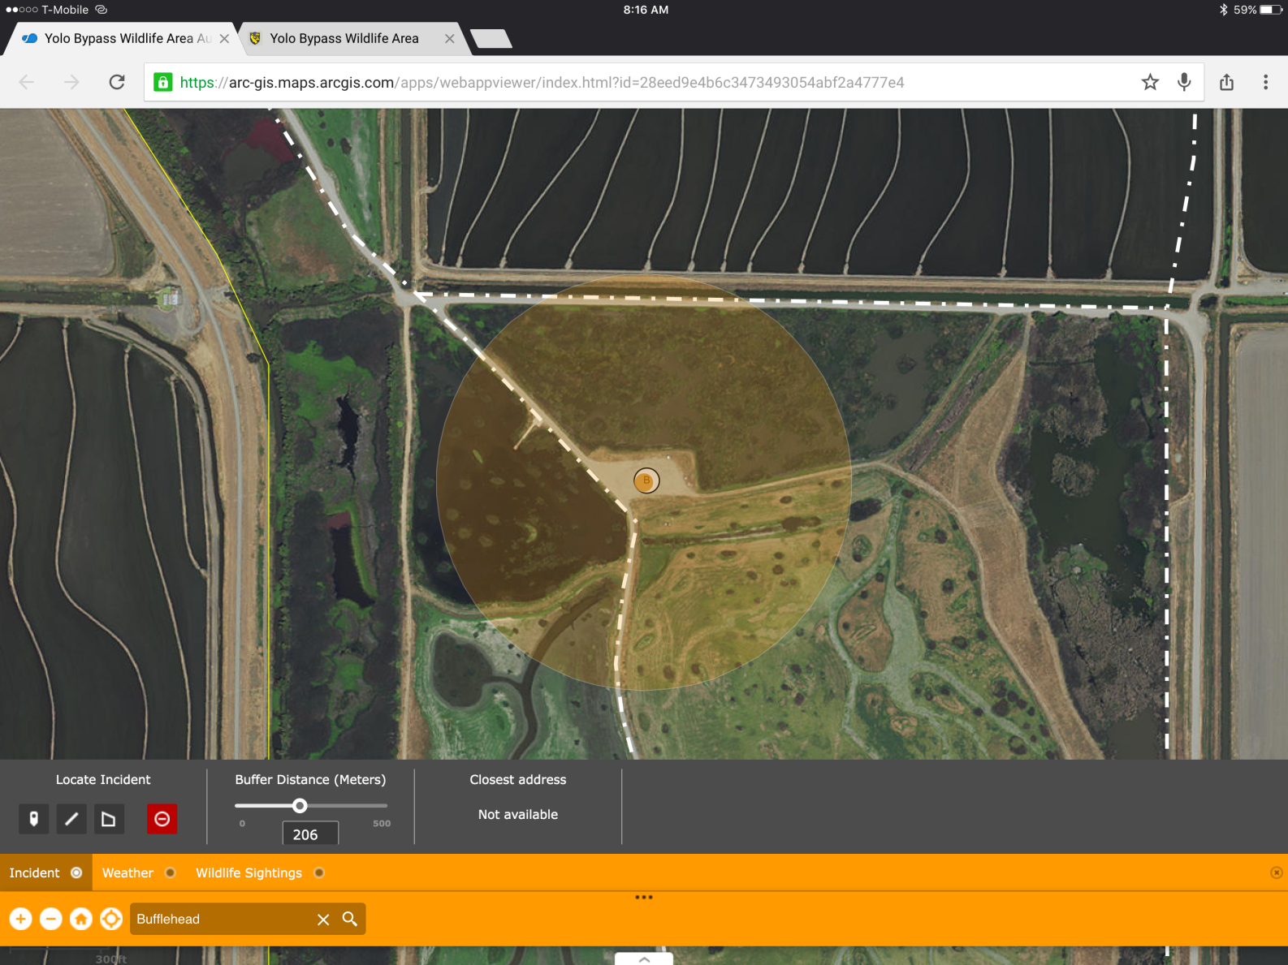
Situation Awareness widget
-Place a point, line, or polygon for the “incident”

Slide 9
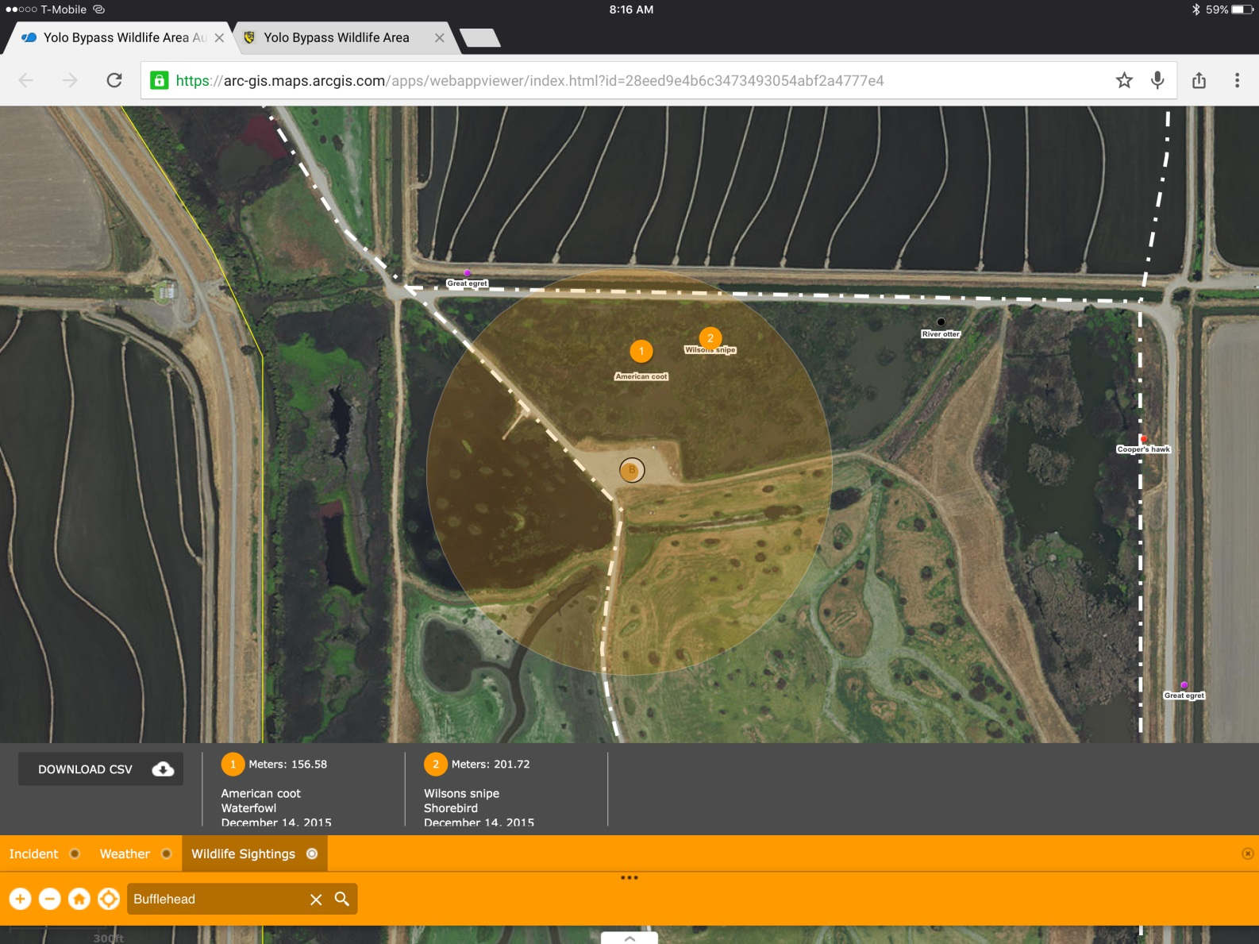
Situation Awareness widget
-Choose the wildlife sightings tab to display the results within your search area

Slide 10
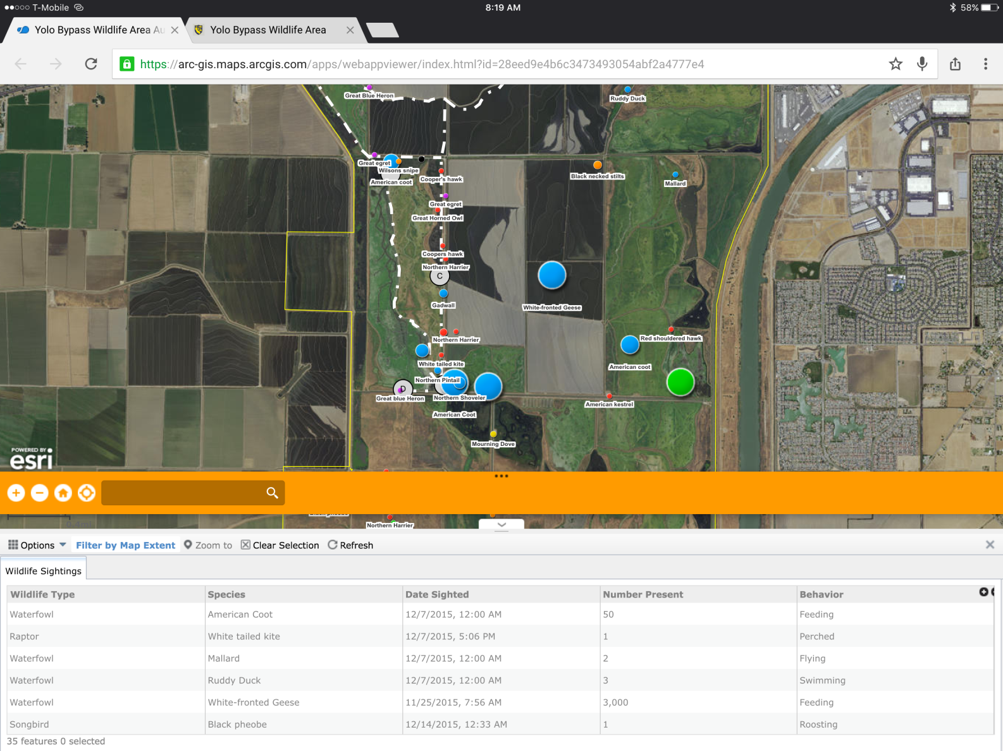
Pull up on the bottom tab to display a list of features that are within the map extent in an attribute table

Slide 11
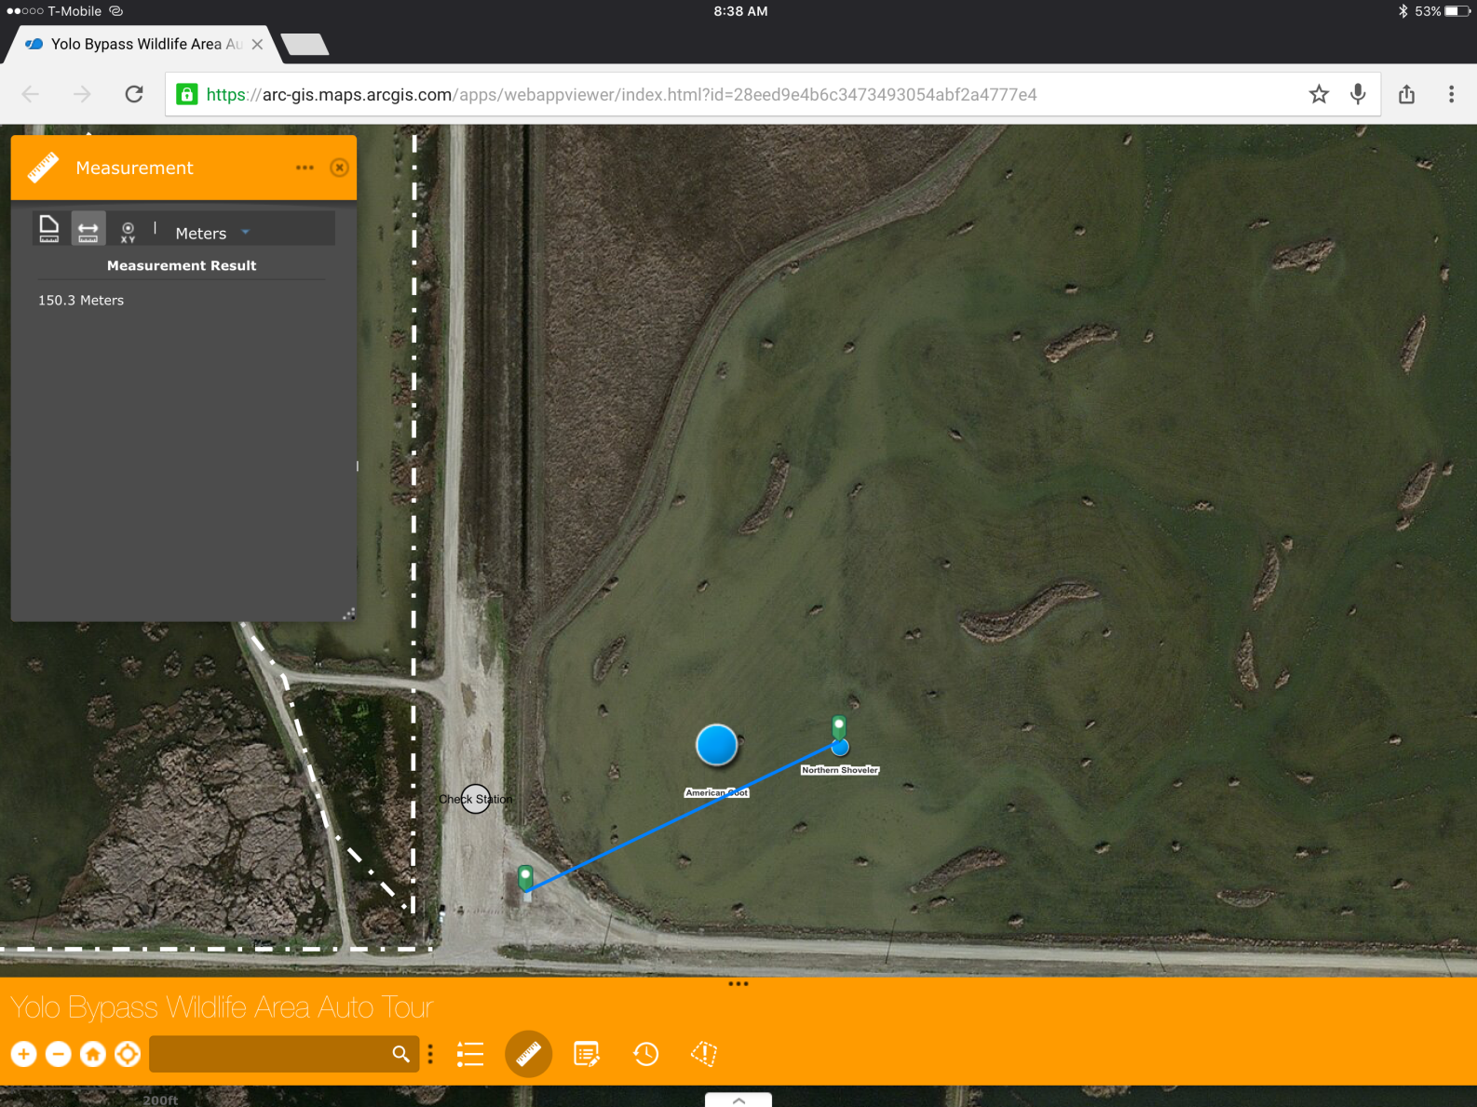
Use the measure tool to get the distance to a specific point

Slide 12
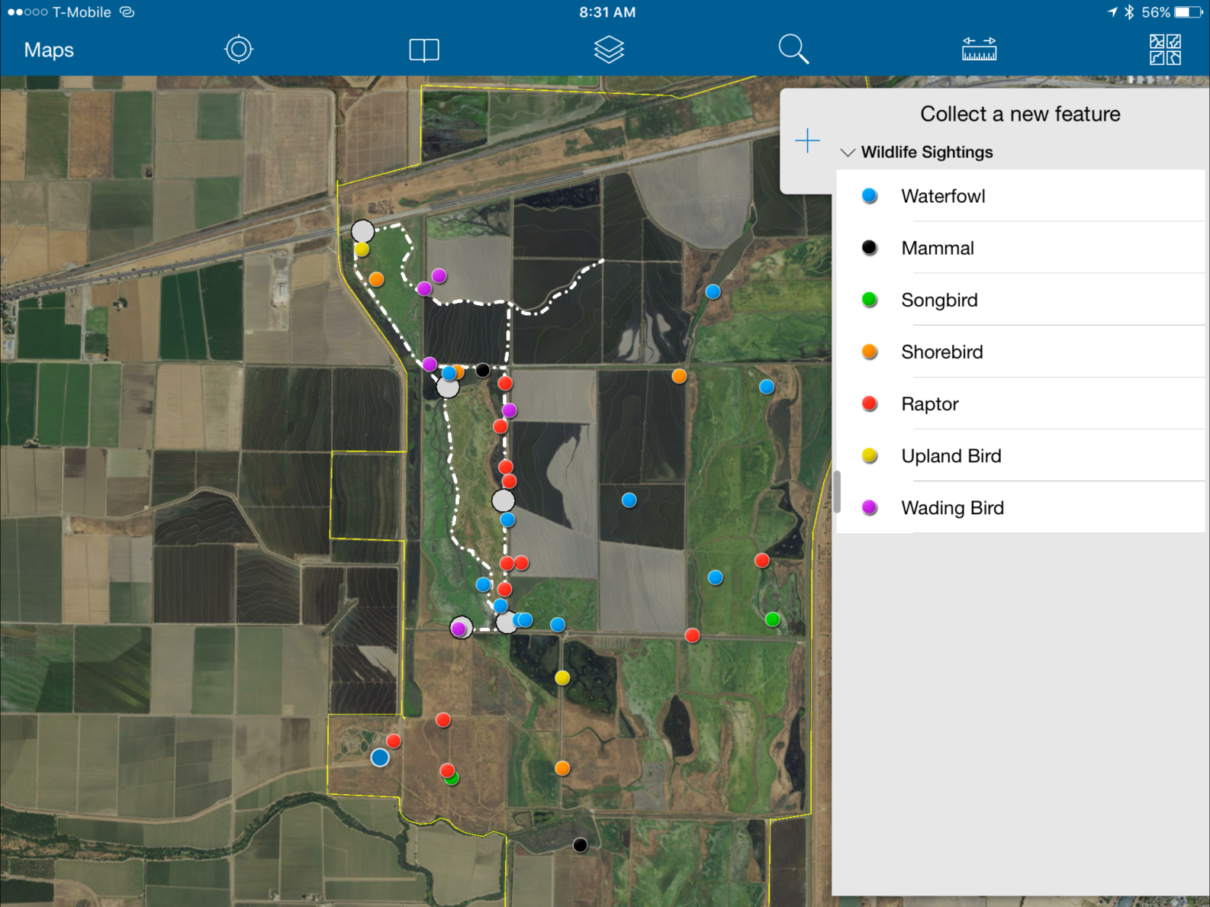
The data collector app makes for a simpler more streamlined collection of data without the additional widgets displayed

Slide 13
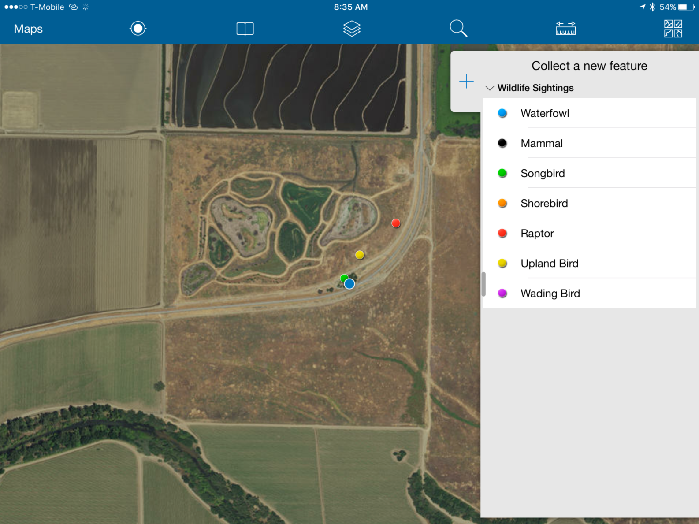
Easily able to find your current location to collect data while viewing the app on a mobile device

Slide 14
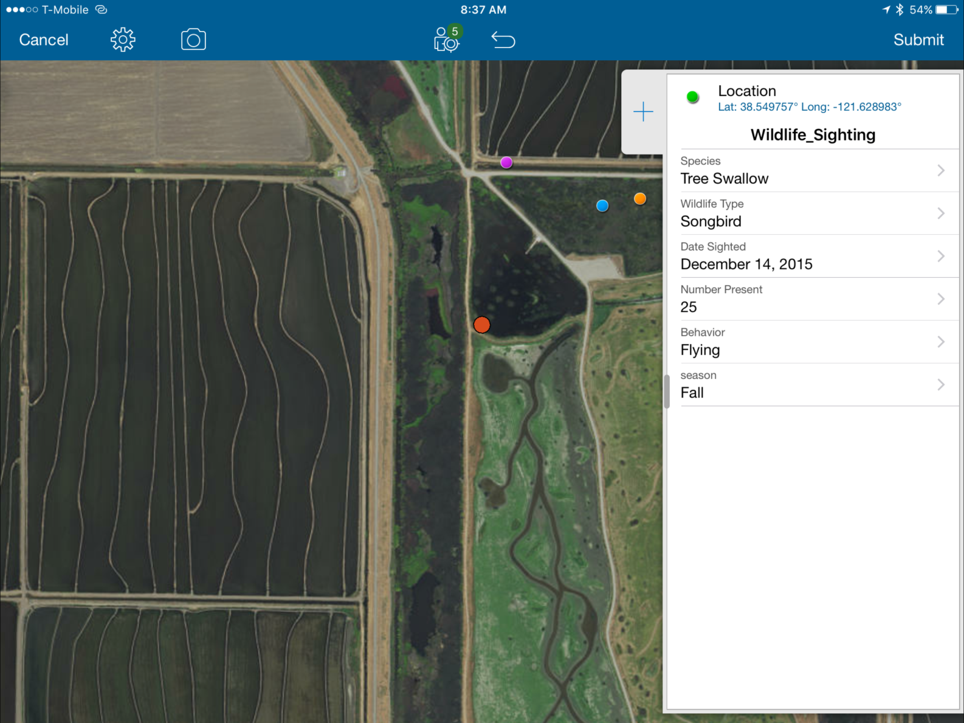
Clean workspace to add data into the attribute table. Also possible to take photos and add attachments with the camera button on the top left banner.

