Slide 1
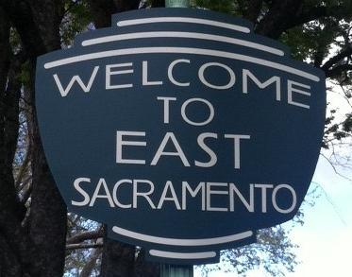
Measuring
Vegetation Health
NDVI Analysis of East Sacramento

Slide 2
Project Summary
The years of 2011 to 2014 were the driest years in recorded California history.
Reduction in annual rainfall and the Sierra snowpack has increased a need for water conservation and responsible practices.
Mandatory and voluntary cuts in water usage have been issued statewide.
Winter of 2014, with rain totals significantly below average, Governor Jerry Brown declared a State of Emergency. Locally, Sacramento is in a Stage 2 Water Shortage Contingency Plan – requiring a 20% reduction in water use.

Slide 3
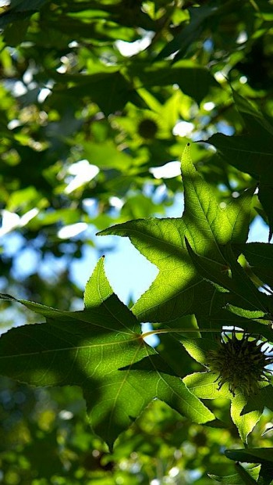
Purpose
The focus of the project will be on the neighborhood of East Sacramento and the vegetation’s health in the area. Using 4 band NAIP aerial imagery and ArcMap’s image analysis tools, I will construct an NDVI comparison of the most recent available imagery from June 2014 with the year prior to the assumed beginning of the California drought, June 2010. By making 2010 a control year, I hope to be able to measure the percentage of healthy vegetation reduction in 4 years of conservation efforts and drought conditions.

Slide 4
Normalized Difference Vegetation Index
The Normalized Difference Vegetation Index (NDVI) is a standardized index allowing you to generate an image displaying greenness (relative biomass). This index takes advantage of the contrast of the characteristics of two bands from a multispectral raster dataset—the chlorophyll pigment absorptions in the red band and the high reflectivity of plant materials in the near-infrared (NIR) band.
NDVI = (NIR – Red Band) / (NIR + Red Band)

Slide 5
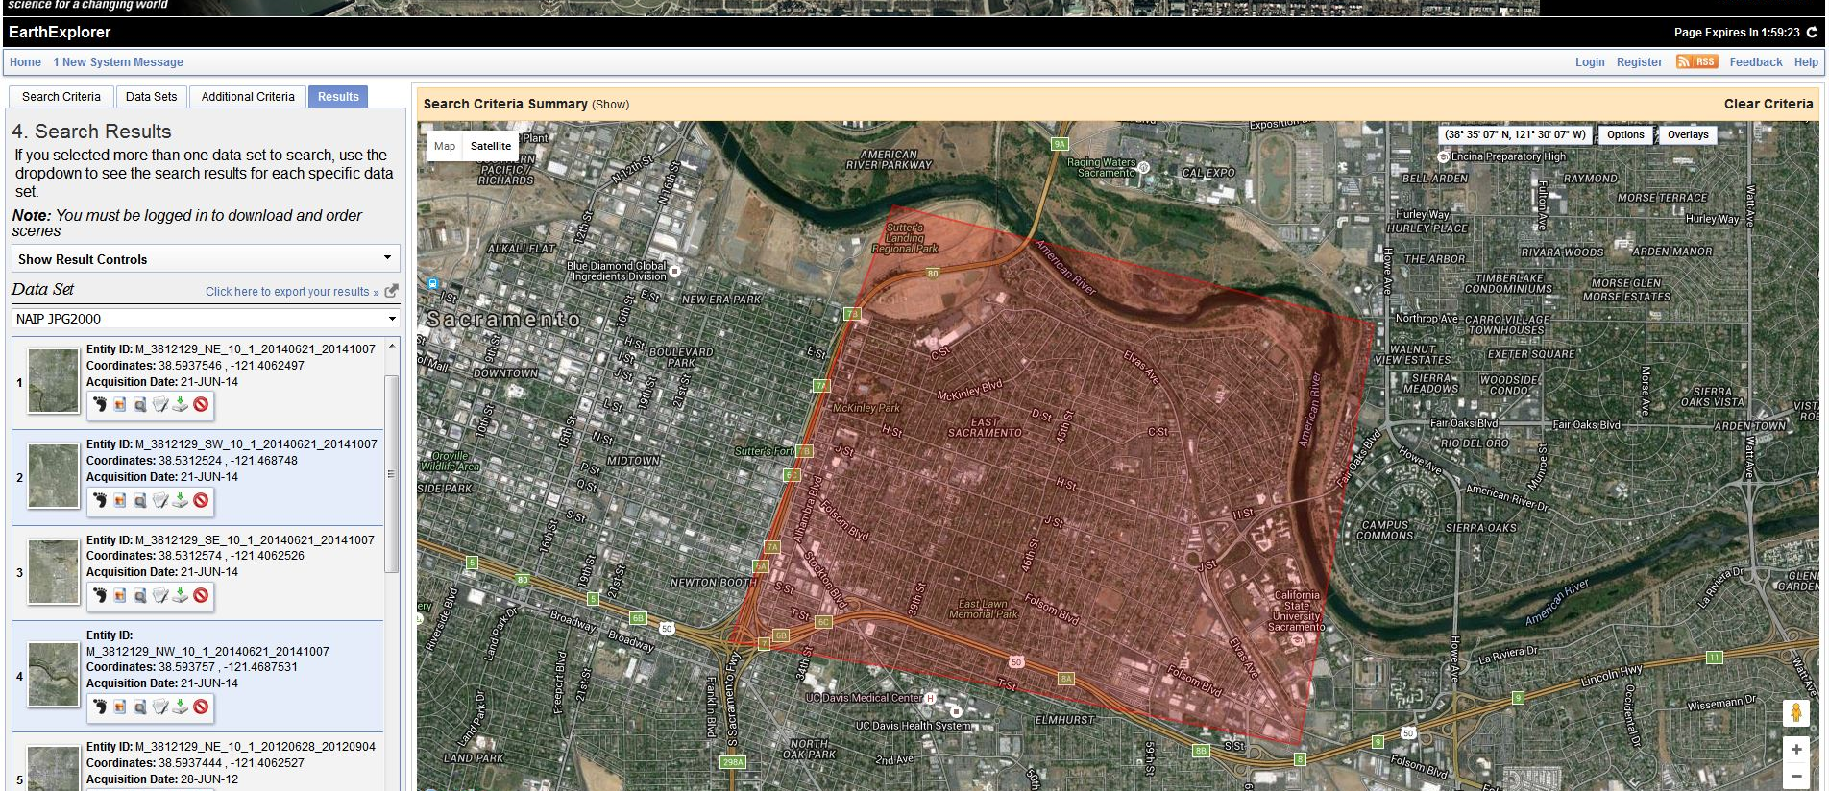
NAIP - The National Agriculture Imagery Program
The default spectral resolution is natural color (Red, Green and Blue, or RGB) but beginning in 2007, some states have been delivered with four bands of data: RGB and Near Infrared. (USDA.gov)

Slide 6
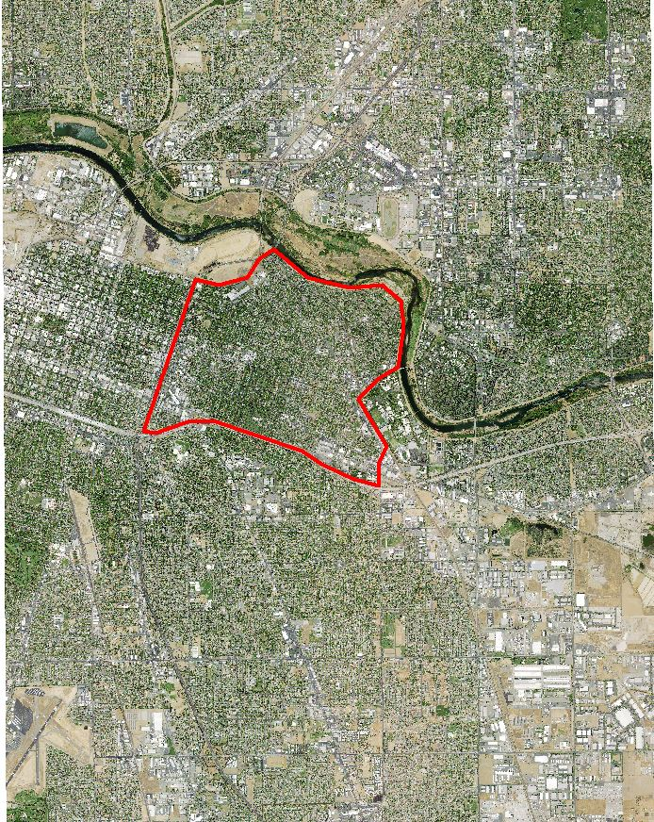
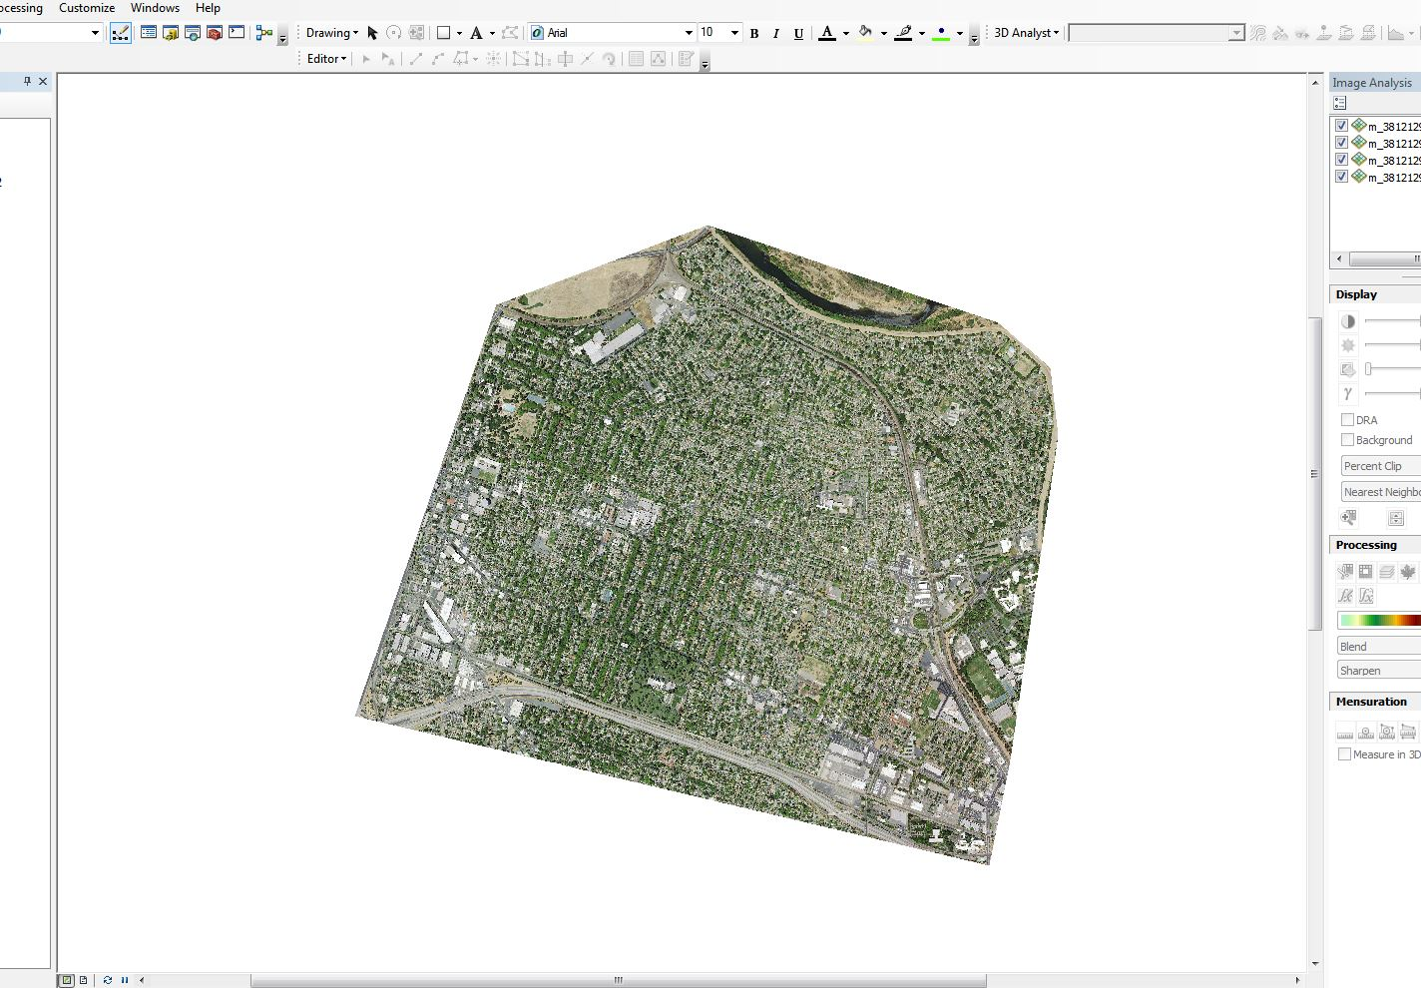
Four images for 2010 and 2014 downloaded and mosaicked together.
Study area outlined.
Clipped both mosaicked images within data frame properties to the shape of the study area.

Slide 7
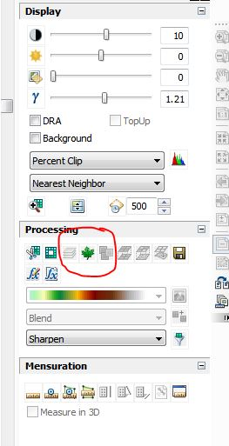
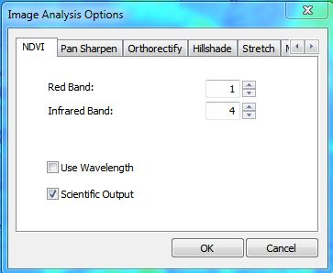
Automatic NDVI Process
Easy.
Can produce NDVI image with either:
  A color map with values of 0-255
  Ratio gradient of -1 to 1.
Not selected because it produces a lighter image with less contrast which would skew results.

Slide 8
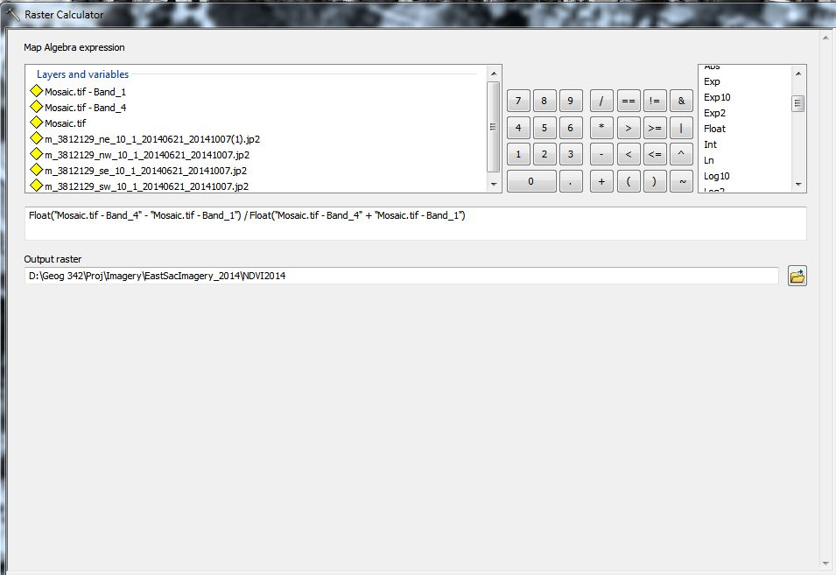
Manual NDVI Process

Slide 9
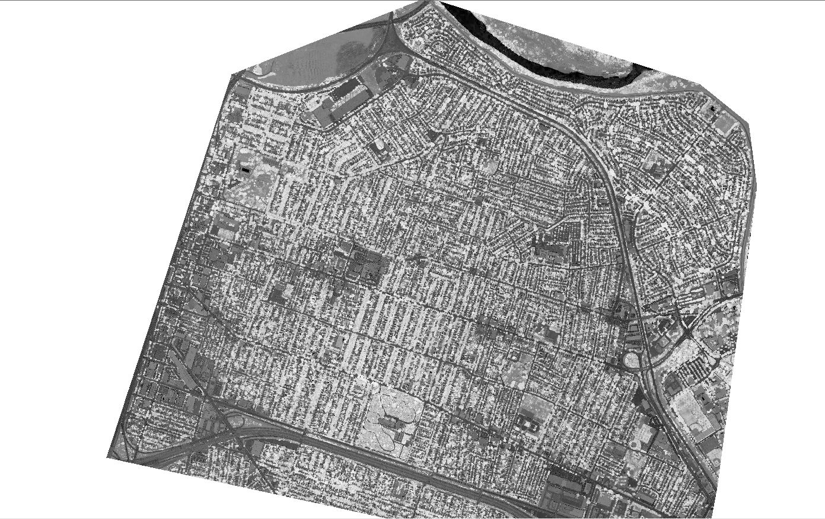
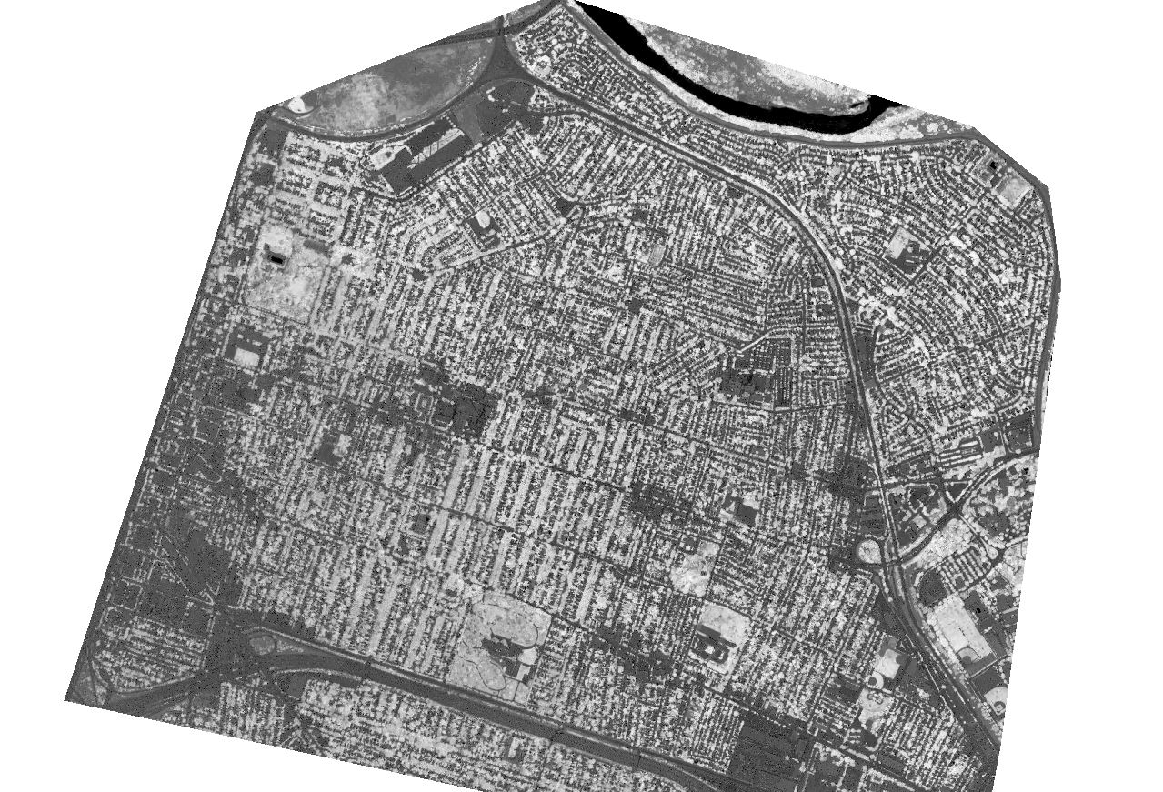
2014 NDVI in black to white
2010 NDVI in black to white

Slide 10
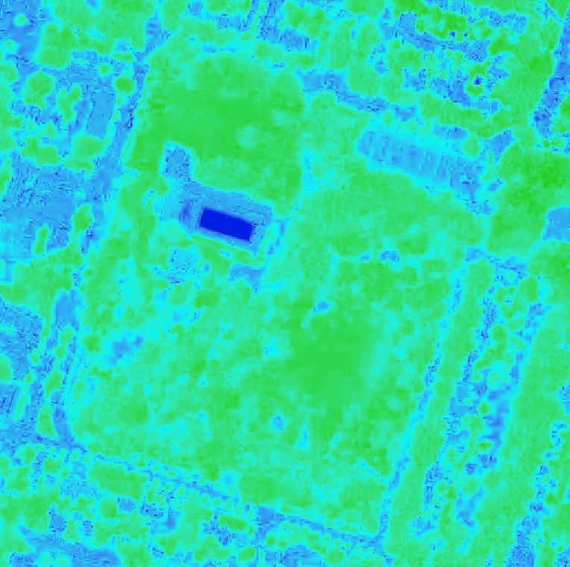
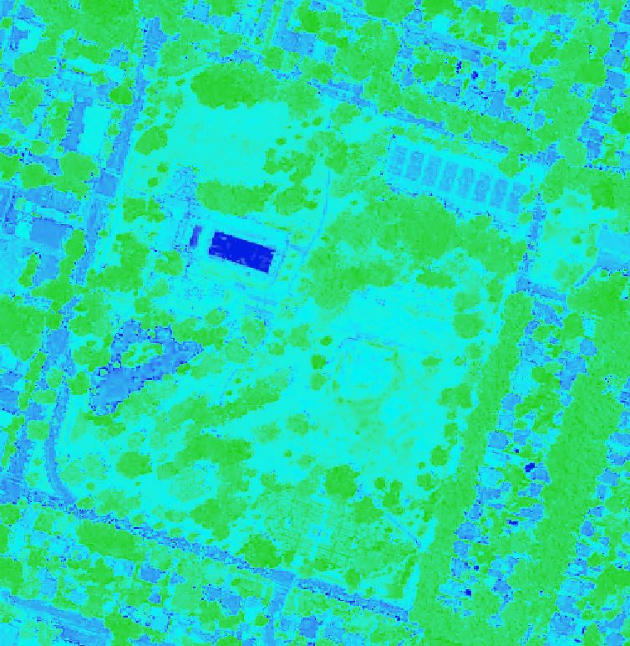
2010
2014
To make it more visible the symbology was changed to green to blue and inverted.

Slide 11
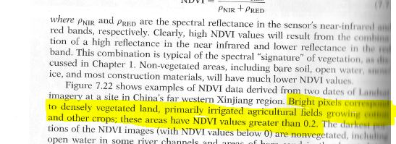
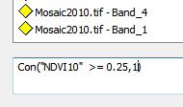
Measuring the Difference
Need to compare the two years to see a change in the amount of healthy vegetation.
Remote Sensing and Image Interpretation( pg. 520)
Create two images that represent every pixel that has a value >= 0.25

Slide 12
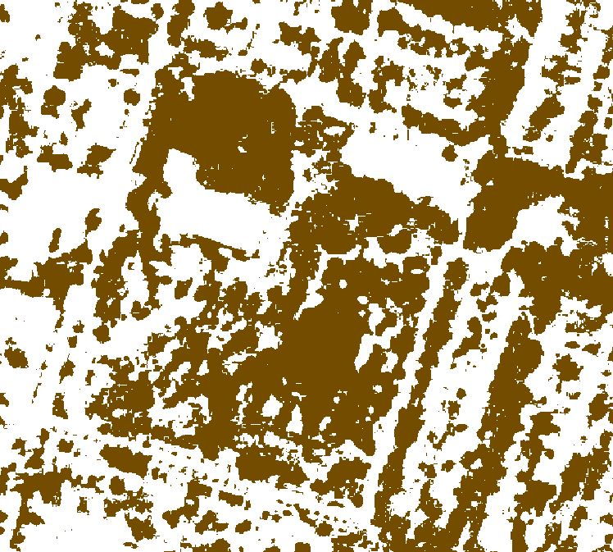
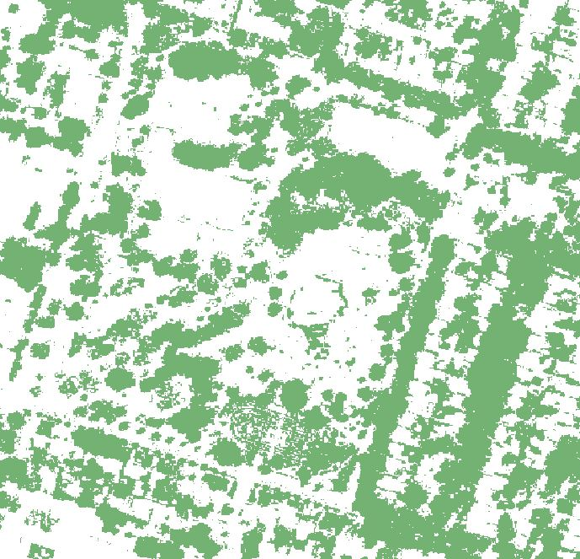
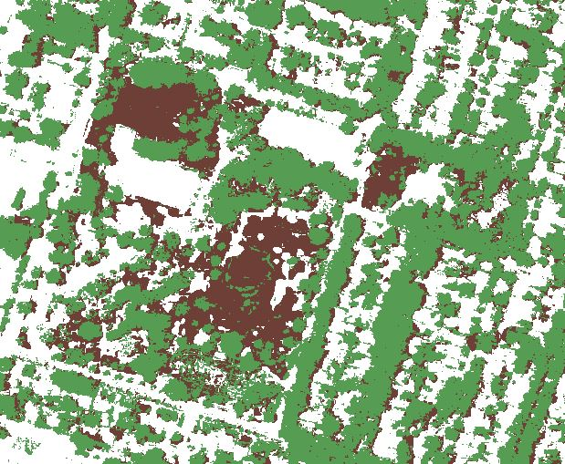
2010
2014
Overlap Comparison

Slide 13
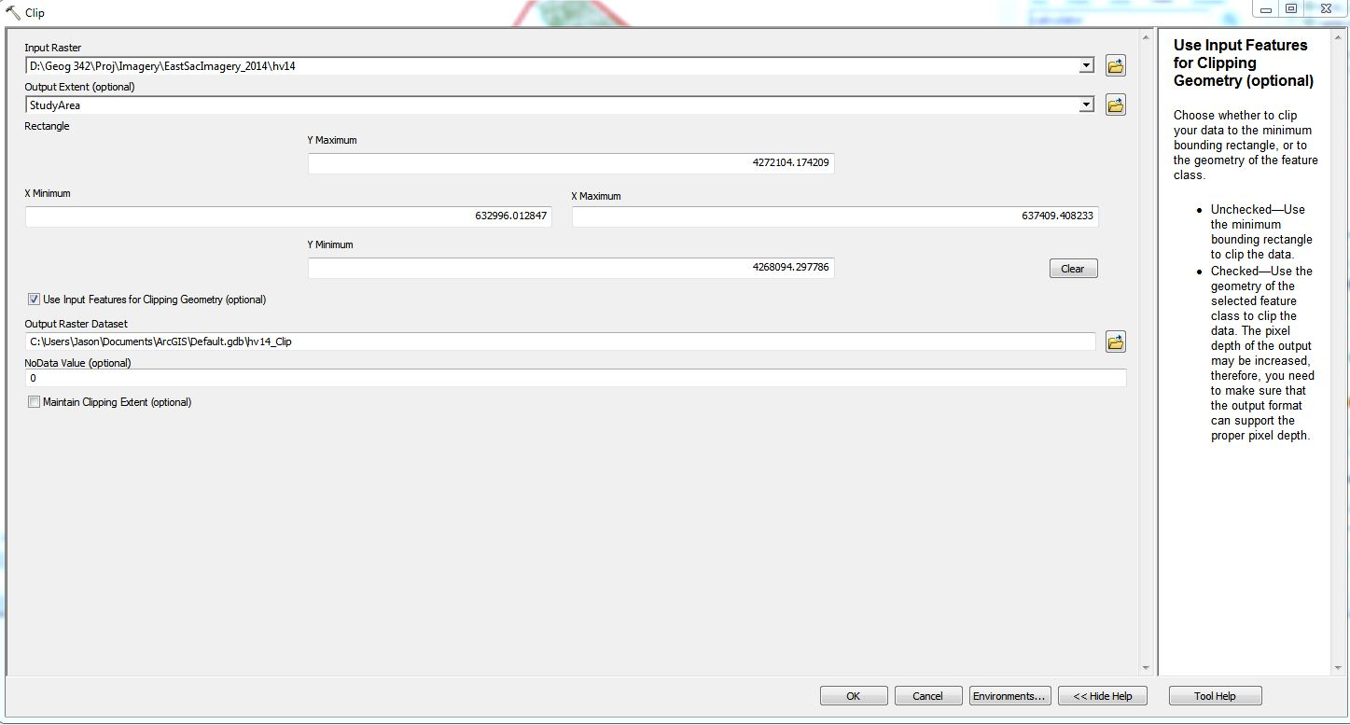
Set up a Raster clip to eliminate the background information hidden by the data frame clip. The result will leave only the cells in the study area.

Slide 14
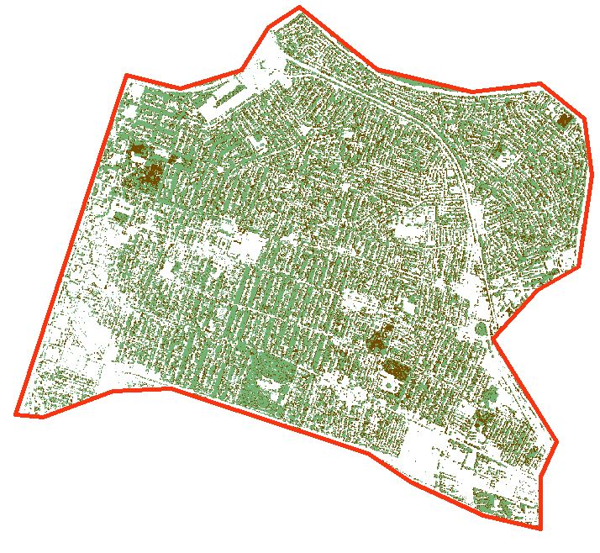
Clip Result

Slide 15
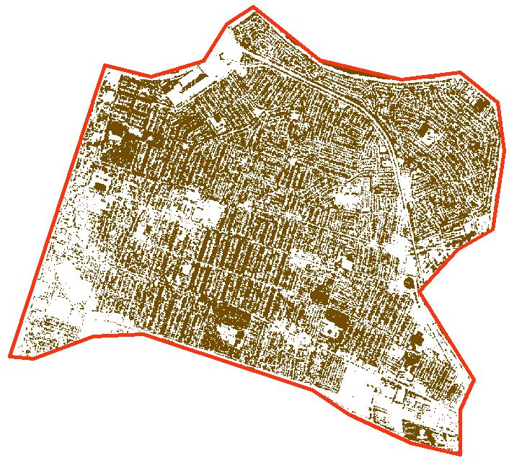
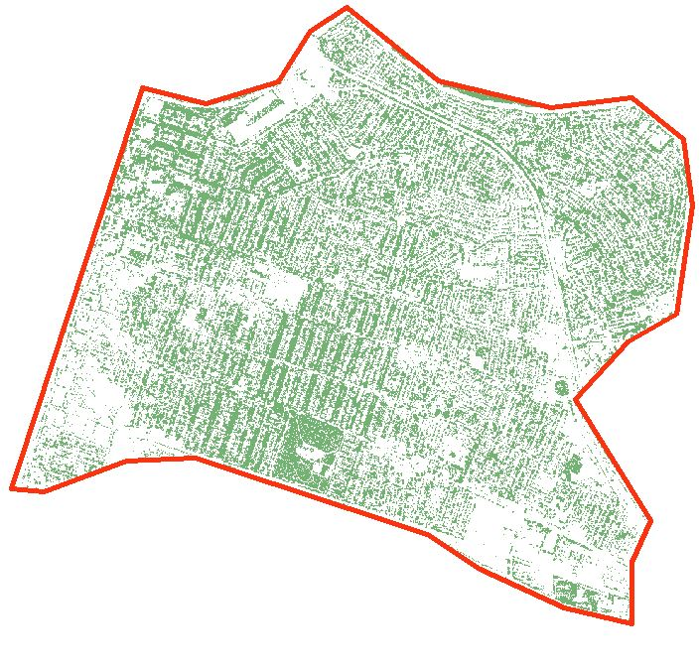
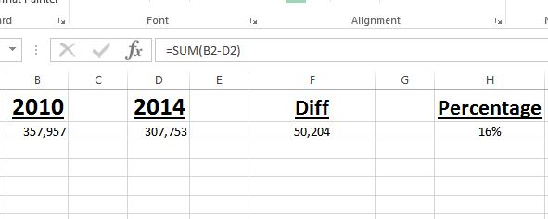
Simple Math
2010
2014
-
357,957 cells
307,753 cells

Slide 16
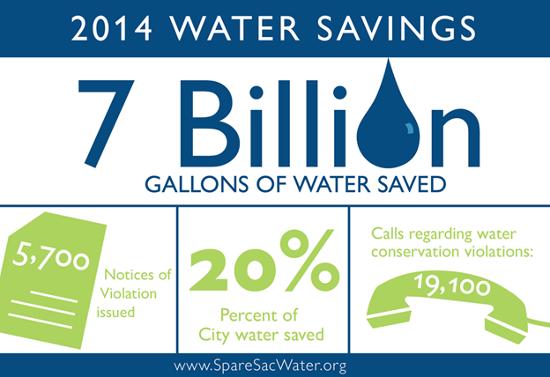

Slide 17
References
“City of Sacramento: Department of Utilities, Conservation FAQs”, http://www.cityofsacramento.org/Utilities/Conservation/FAQs
“Measuring Vegetation (NDVI & EVI)”, Earth Observatory, NASA.gov
http://earthobservatory.nasa.gov/Features/MeasuringVegetation/measuring_vegetation_2.php
“Remote Sensing and Image Interpretation 7th Edition” Lillesand, Keifer and Chipman,
Digital Image Analysis - Pg 520.
“California’s Drought”, Public Policy Institute of California
http://www.ppic.org/main/publication_show.asp?i=1087

