Slide 1
Nevada County Grown
Accessing Locally Produced Food in Nevada County
Dennis Decelle
GEOG 385
American River College
Fall 2014

Slide 2
Purpose of Project
Create an interactive web map for user to find the nearest local food sources from a location
Local food sources include farms/ranches, farmer’s markets, restaurants and grocery stores
Inform the user about the many local food sources available in Nevada County
Foster a deeper connection to the community through food

Slide 3
Create Map Service
Map displays point features for farms/ranches, farmer’s markets, restaurants and grocery stores where locally produced food is offered
Data layers styled and labeled
Zoom levels set for layers and labels
More detail and labels as user zooms in

Slide 4
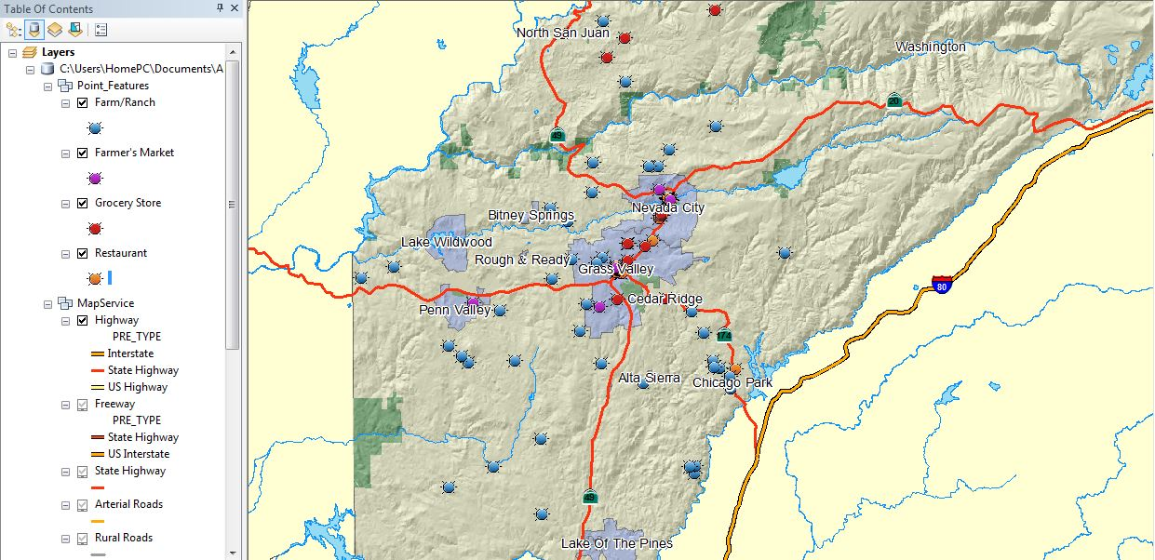
Create Map Service
1:250,000

Slide 5
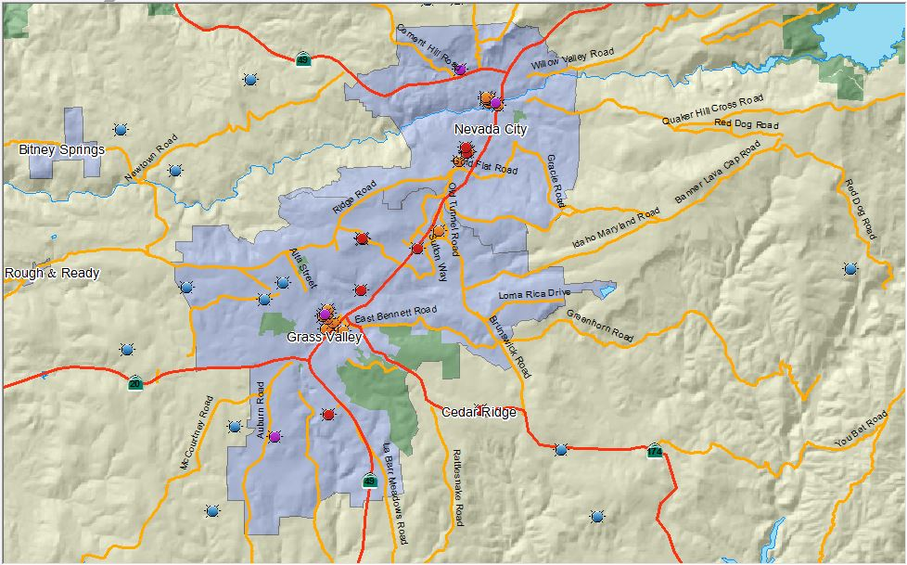
Create Map Service
1:80,000

Slide 6
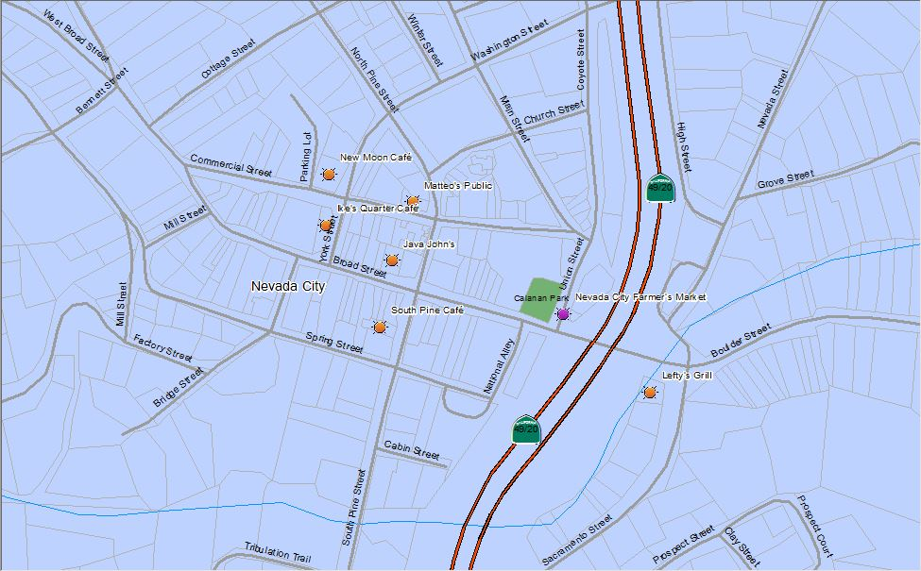
Create Map Service
1:3,000

Slide 7
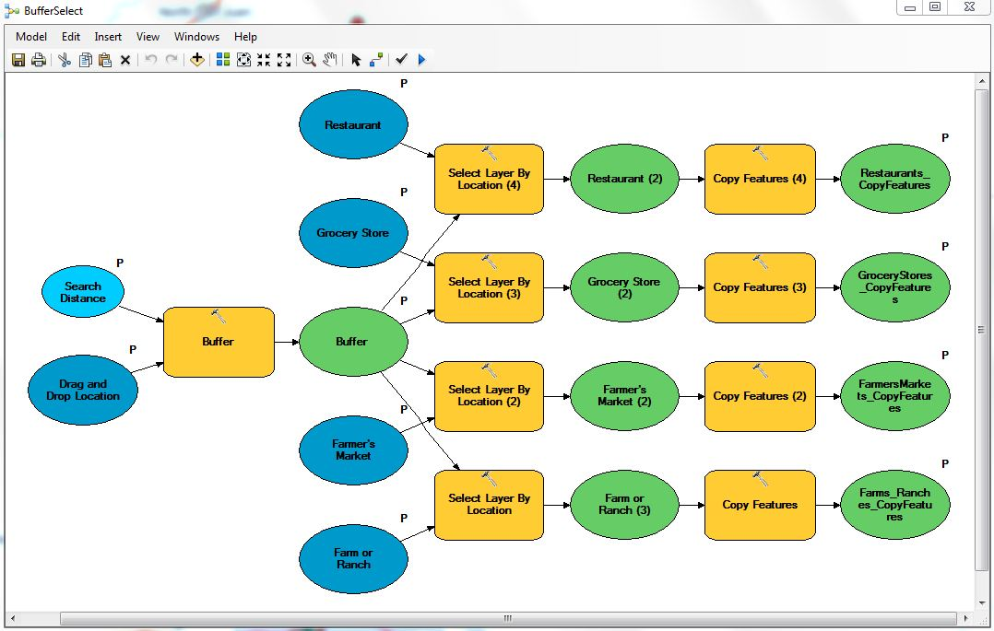
Geoprocessing Service
Geoprocessing Model

Slide 8
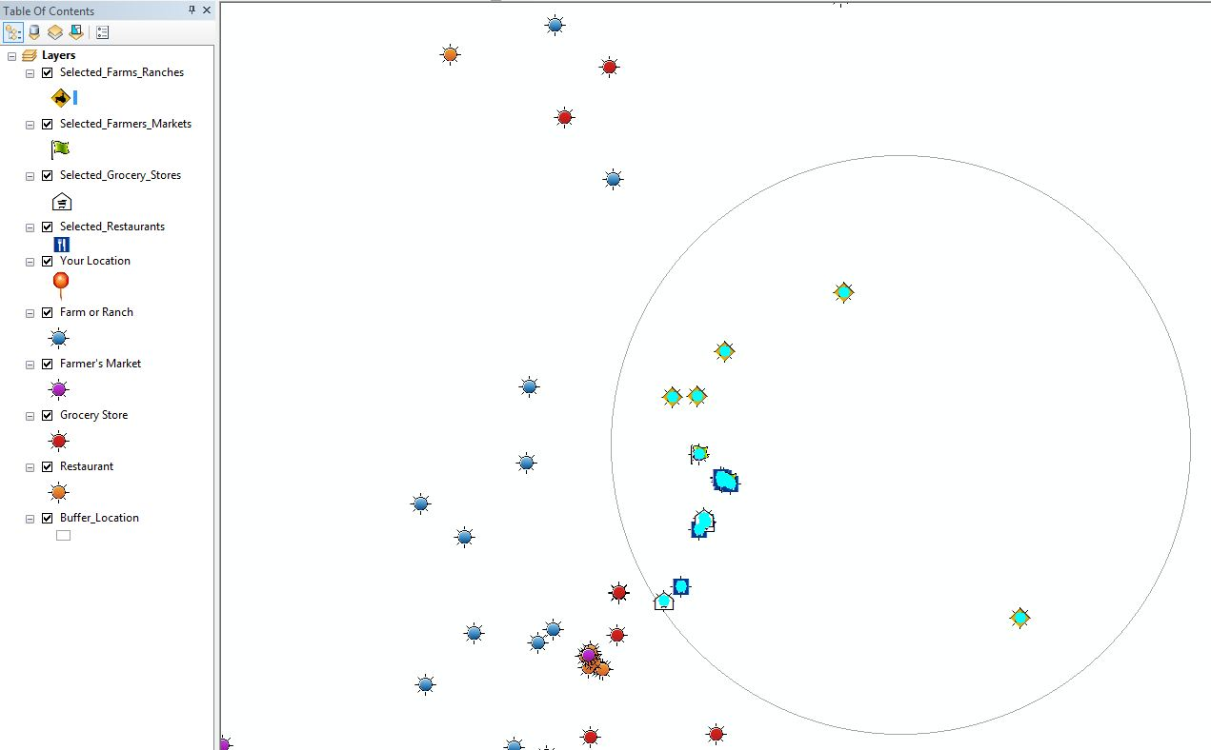
Geoprocessing Service
Geoprocessing Model Output

Slide 9
Geoprocessing Service
User drops a location point on map
User inputs a search distance
Search distance buffer is created around point
All farms/ranches, farmer’s markets, grocery stores and restaurants within buffer are selected and copied to a new feature
Selected points are graphically symbolized

Slide 10
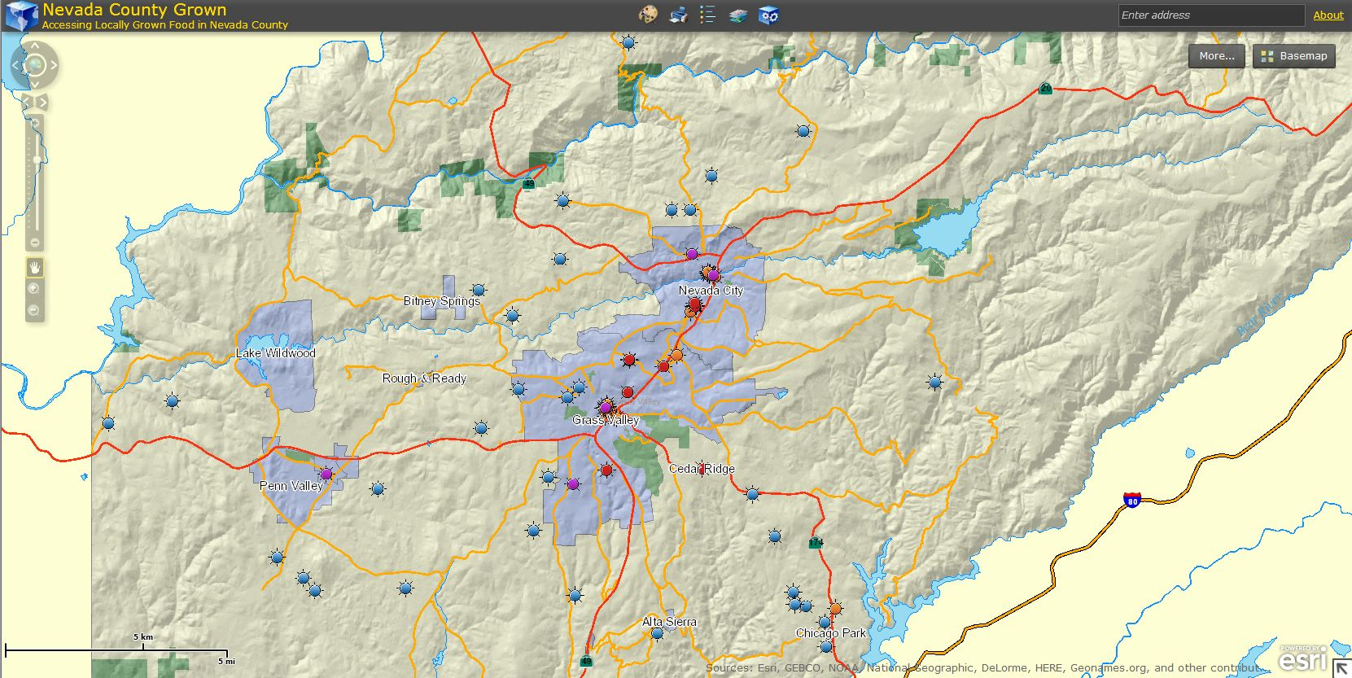
Web Application
Map Service opened in Browser

Slide 11
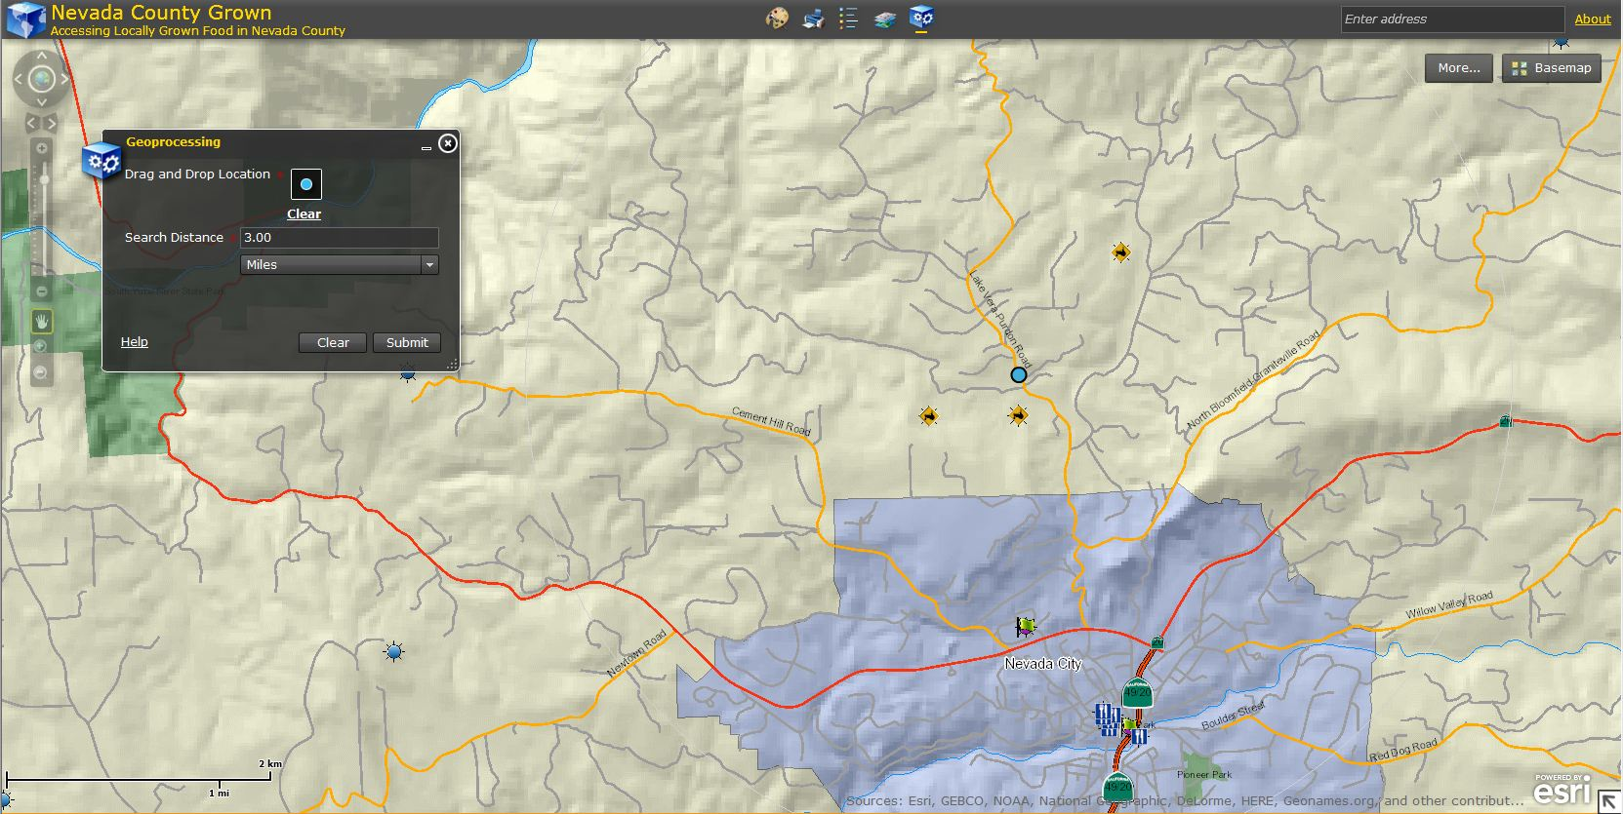


Web Application
Geoprocessing Widget with user inputs and selected features

Slide 12
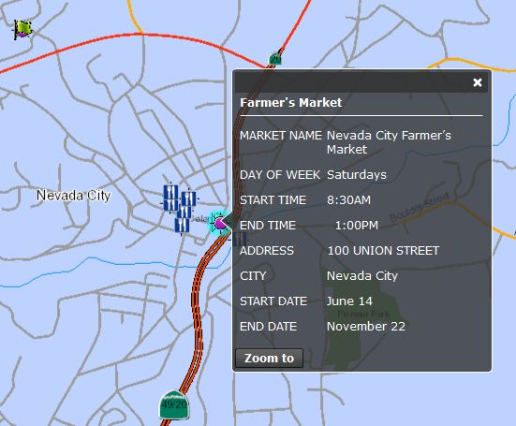
Web Application
Configured Pop-up Window

Slide 13
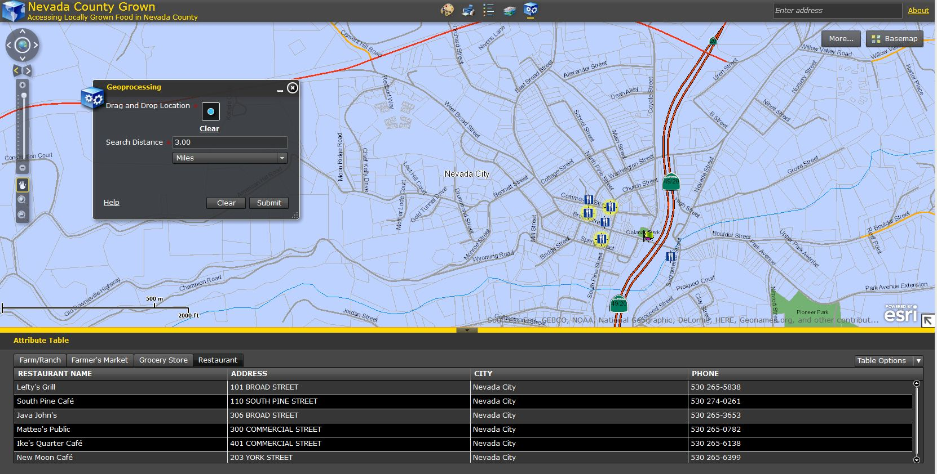
Web Application
Attribute Table with Selected Restaurants

Slide 14
Difficulties
Hiding fields prior to publishing Map Service resulted in empty tables in Map Service
Opening Map Service in Google Chrome only displays ESRI base map
Buffer outline virtually invisible in web app
Selected features within buffer are selected in tables in ArcMap but not in web map
Zoom levels in web map limited so you can’t zoom in far enough to see labels of points

Slide 15
Improvements
Add a Select by Attribute geoprocess to query farms and ranches for organic certification, CSA subscription service or direct to consumer sales
Add hyperlinks in pop-ups for one click navigation to websites
Enable geoprocessing widget to output tables of selected features
Create a search by drive time or miles on a road network instead of distance “as the crow flies” since much of Nevada County is mountainous

