Slide 1
Final Project
GEOG 375
Elyse Cheung-Sutton

Slide 2
Three Programs Created
Summary Statistics
PDFs of Map
Data Files
Purpose:
To create programs that automate common tasks for the CalEnviroscreen (CES) project. CalEnviroscreen ranks CA communities based on pollution burden and vulnerability.

Slide 3
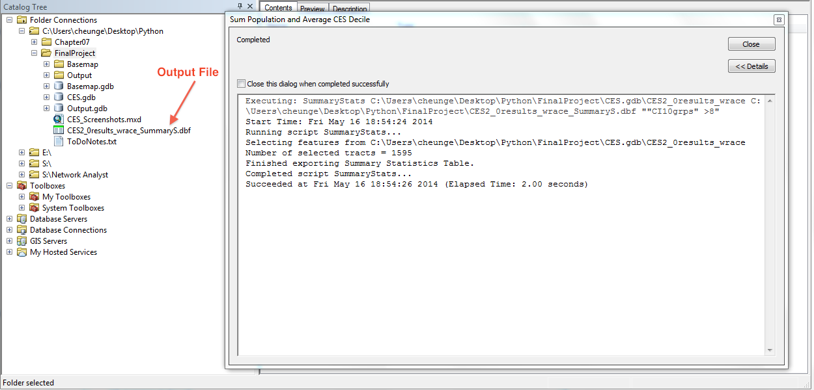
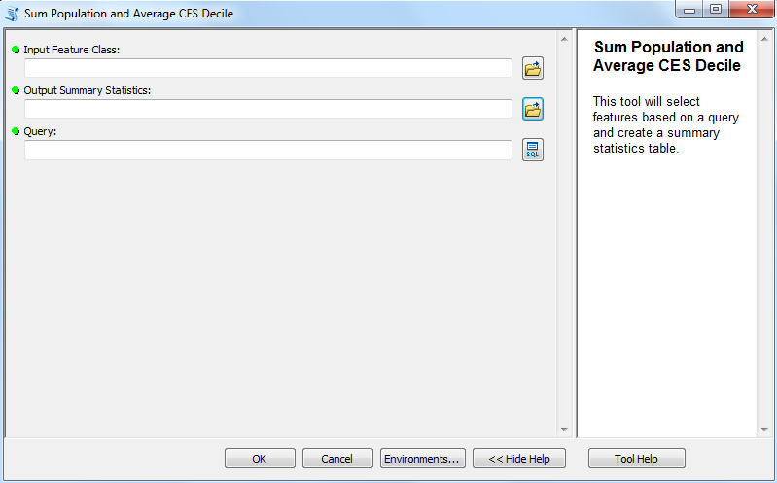
Summary Statistics
Creates a Summary Statistics table based on CES ZIP or Census Tract results
  Sums population
  Averages CES Decile Score
GUI created using ArcCatalog

Slide 4
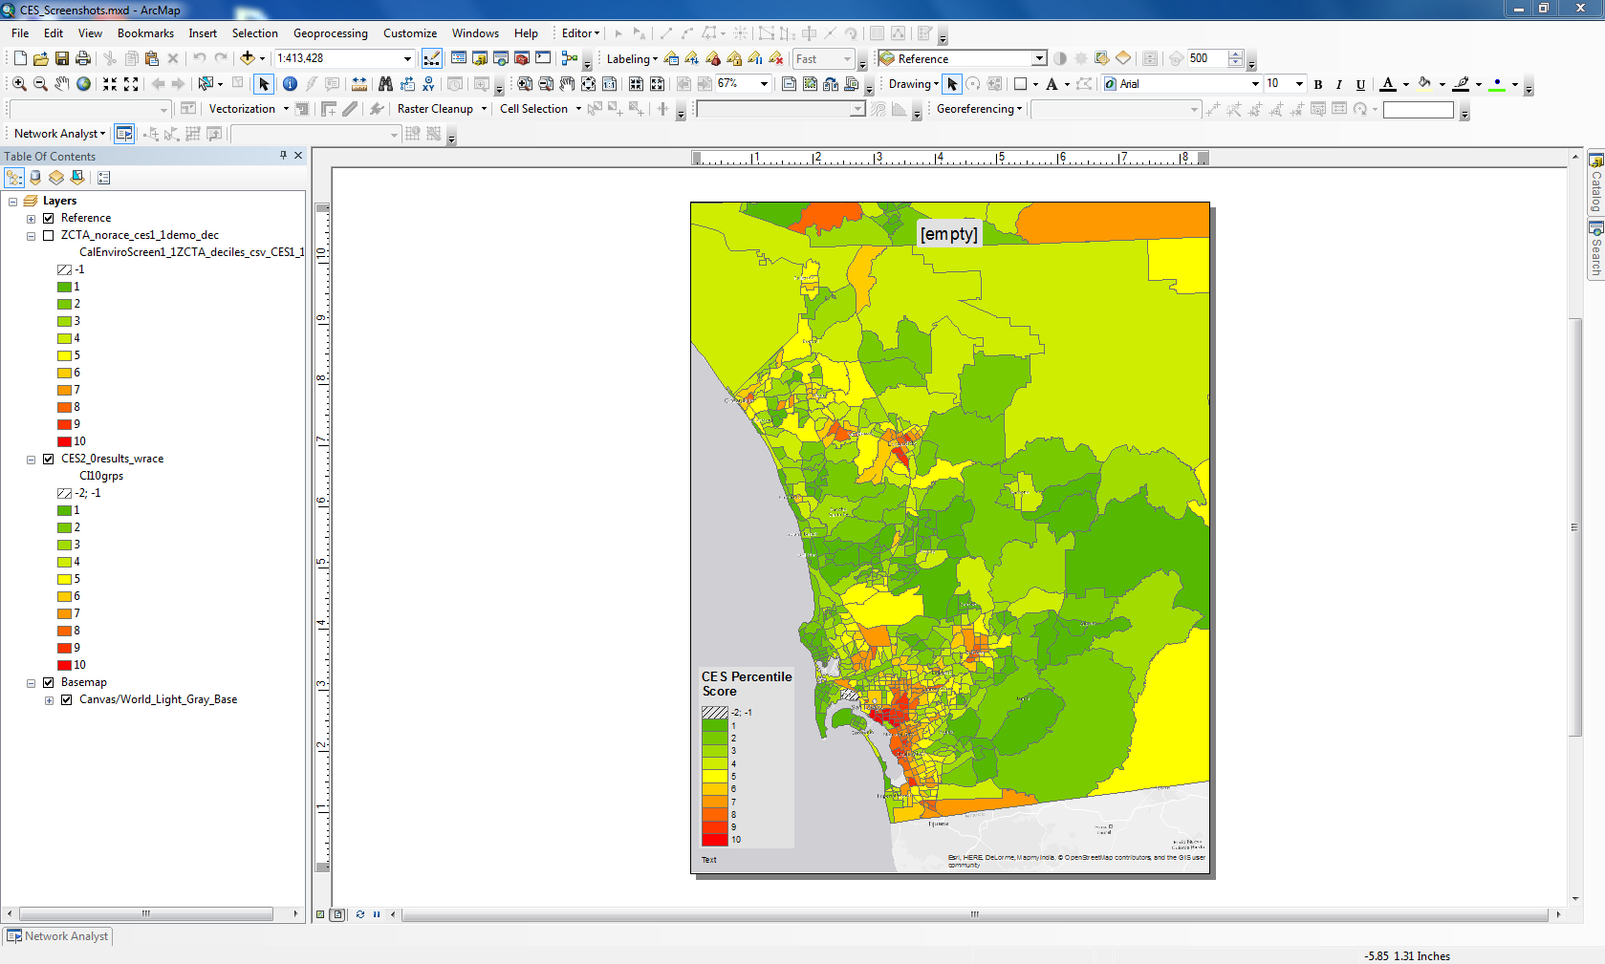
PDFs of Maps
Creates series of PDFs based on bookmarks and ArcMap document

Slide 5
Data Files
Creates a feature class, database table, and Excel spreadsheet based on a “Select by Location” using a user’s input shapefile or feature class

Slide 6
Noteworthy
Use of “raw_input” and if statements to give user choices when program is executed
Difficulty coding input file for Data Files program
GUI for Summary Statistics

