Slide 1
MSSA Mapping Script
Sean Carroll
Final Project
GEOG 375

Slide 2
Introduction
MSSA – Medical Service Study Area
The goal of my script was to automate the creation of MSSA maps with census tract boundaries.
Allow for the user to input demographic attributes to print specific MSSA maps.

Slide 3
Code
Place a query in the beginning of code to allow for the user to search for certain areas with the demographic needs they might be searching for.
query = """"PCT_ASIAN" > 50 AND "PCT_65OVER" > 10"""

Slide 4
Code
Then once the MSSAs desired are selected to loop through MSSA IDs and select them.
field_name = ["MSSA_ID"]
with arcpy.da.SearchCursor(MSSALayer, field_name) as MSSArows:
for MSSArow in MSSArows:

Slide 5
Code
Then create a variable that uses the MSSA ID and assigns it to the layers definition query.
query1 = """"MSSA_ID" = '""" + MSSAName + """'""“
TOCLayer.definitionQuery = query1
TOCLayer.definitionQuery = query1

Slide 6
Code
Then I created a for loop to loop through text elements and change the subtitle, author and date.
for tElement in tElements:
if tElement.name == 'MSSA ID':
tElement.text = "MSSA" + " " + MSSAName
tElement.elementPositionX = 8.9

Slide 7
Code
Lastly I exported the maps to PDF
ExportToPDF(mxd, mappath + MSSAName + "_map.PDF")
print 'Map' + ' ' + MSSAName + ' ' + 'Was Created'

Slide 8
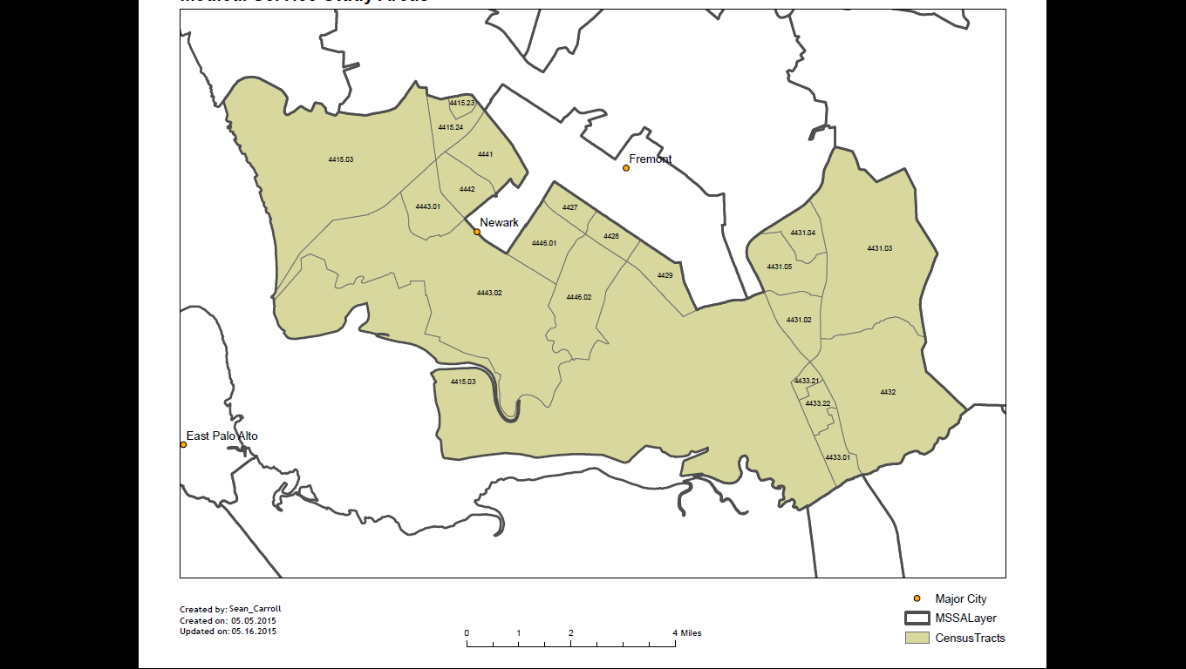
Results

