Slide 1

Geography 375
Final Project
Python Automation…
a presentation about nothing
by: Justin Cahoon
jrockcahoon@gmail.com

Slide 2
Project Summary
Use the Seinfeld sitcom and a previously constructed geodatabase as a basis to develop automation scripts that could be used to manage, maintain, and manipulate data.

Slide 3
Seinfeld Project Scripts:
Three Scripts
  Join Tables
  Pivot Tables
  Map Creation and Export

Slide 4
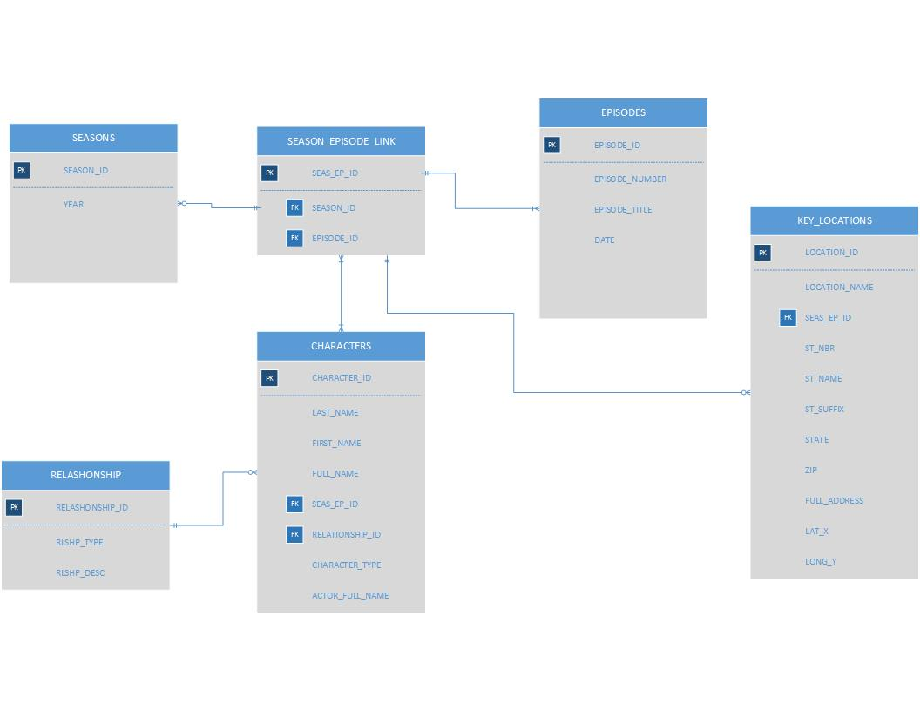
Tables to be used:

Slide 5
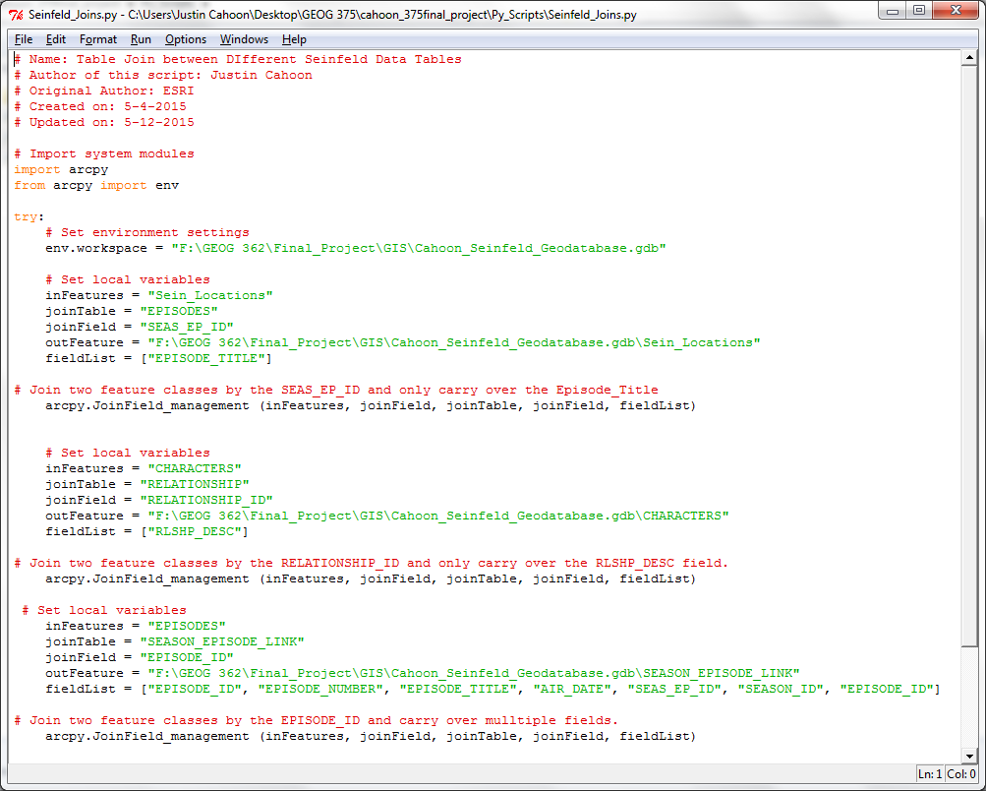
Python Task 1 – “Add Join”

Slide 6
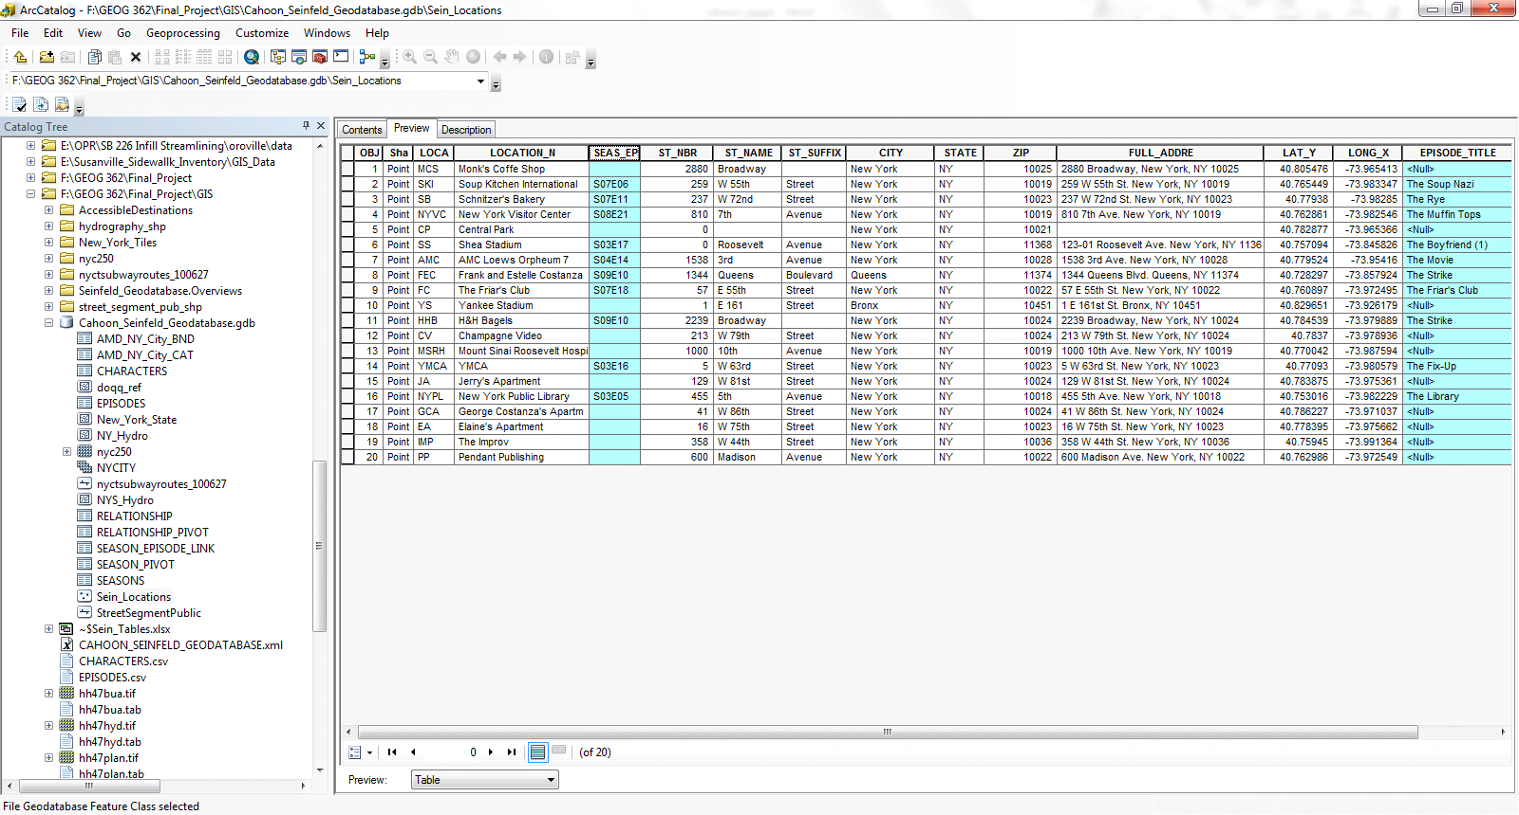
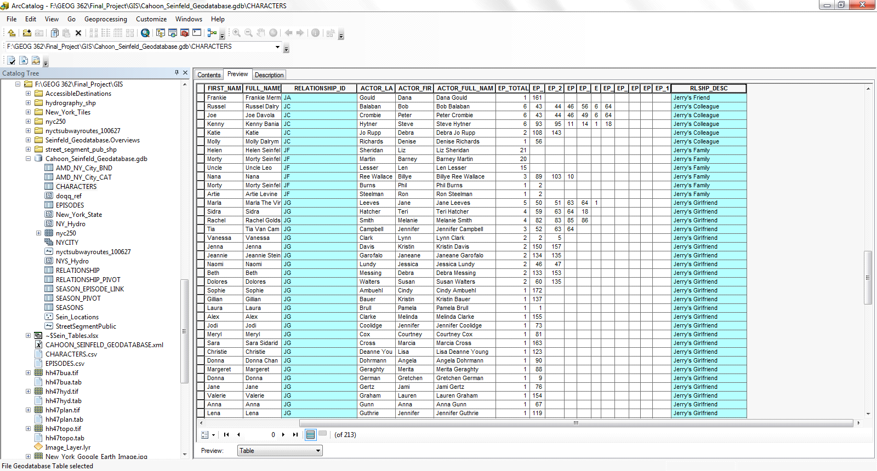
Task 1 Results:

Slide 7
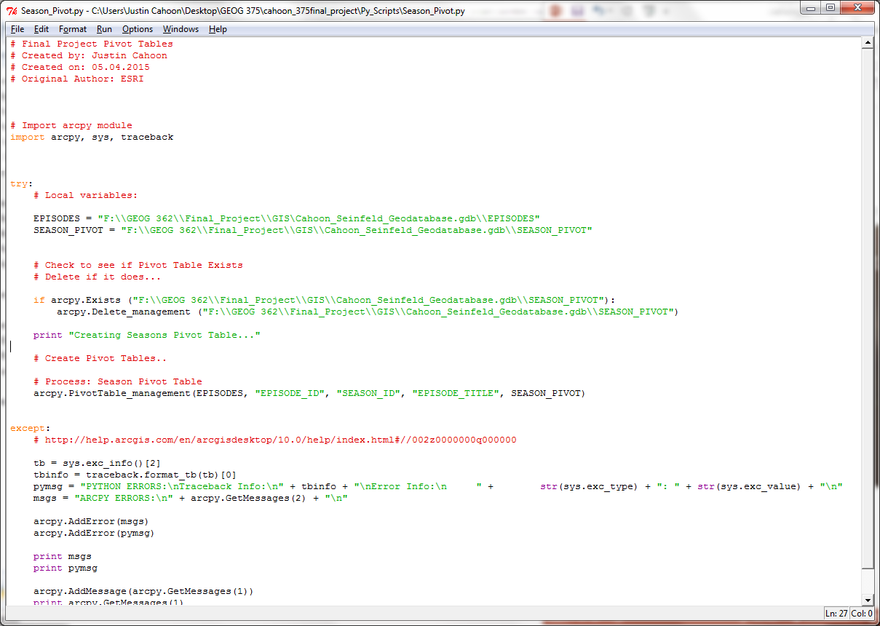
Python Task 2 – “Pivot Tables”

Slide 8
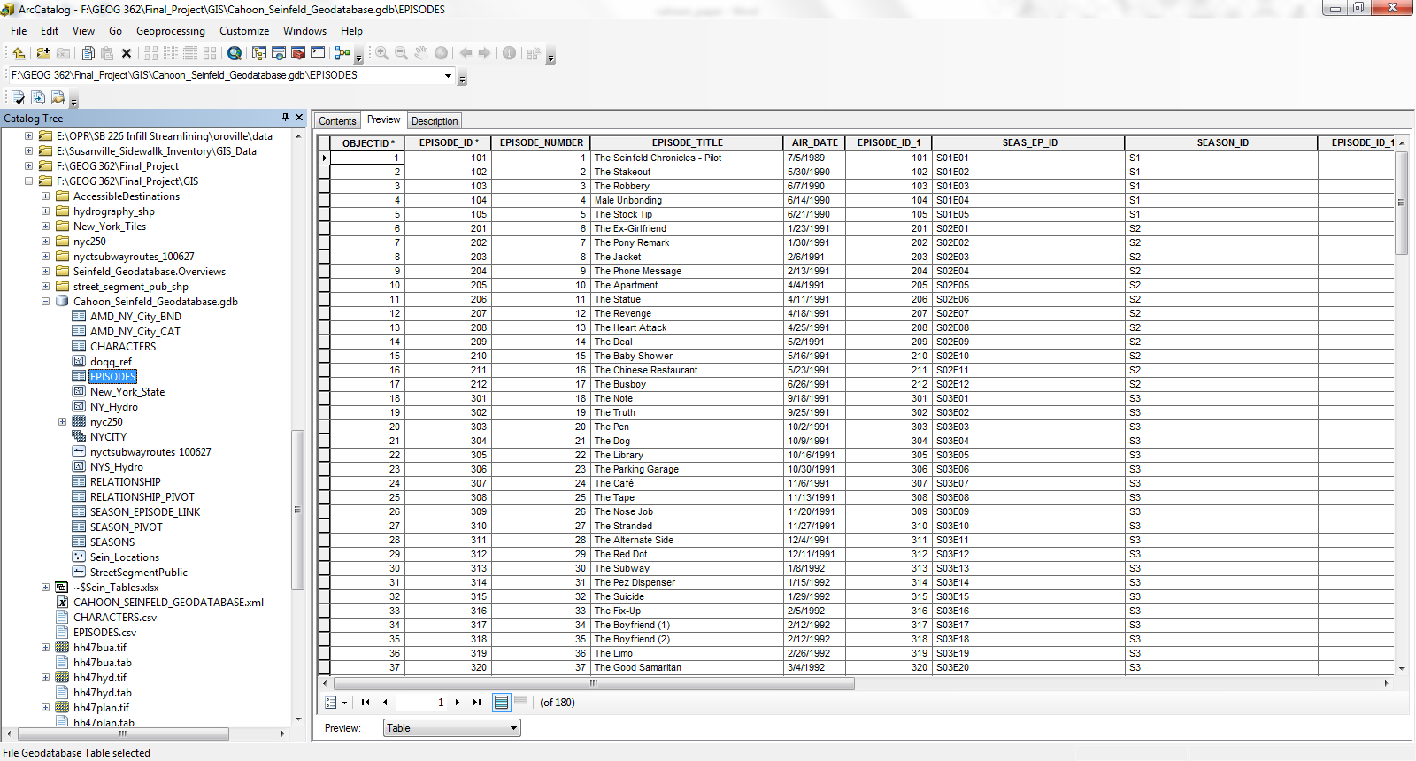
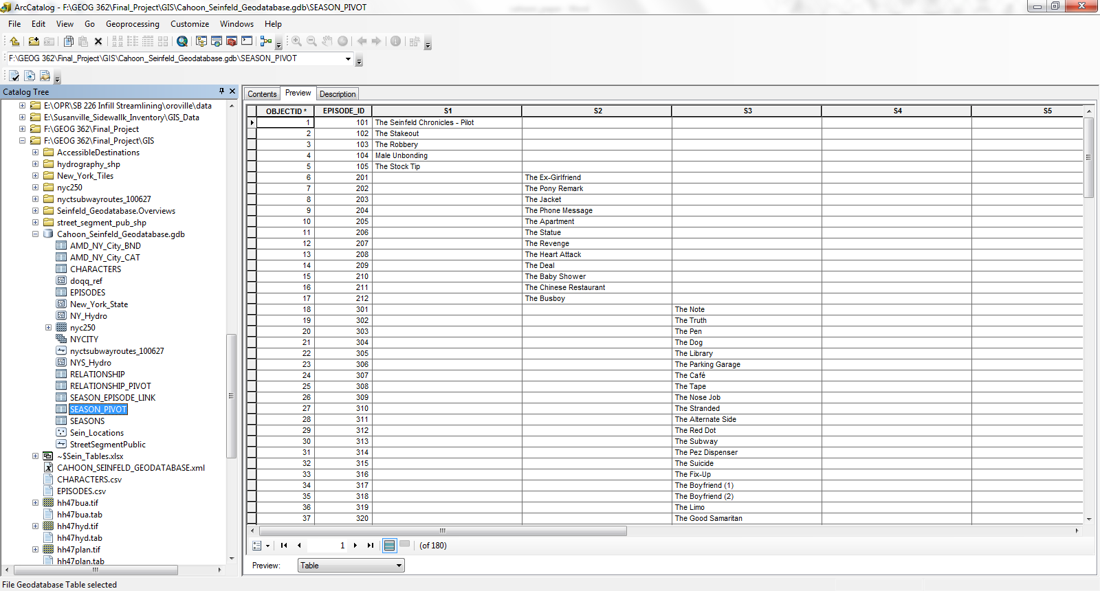
Task 2 Results:
From
To

Slide 9
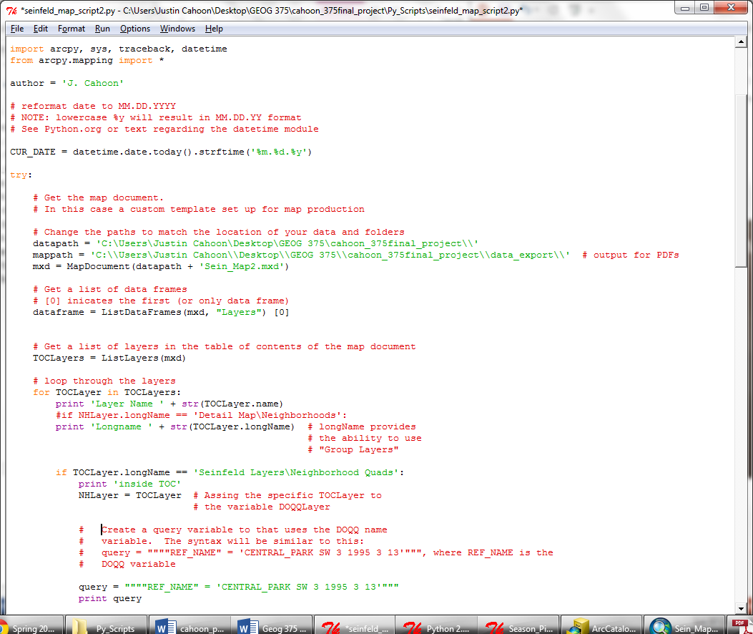
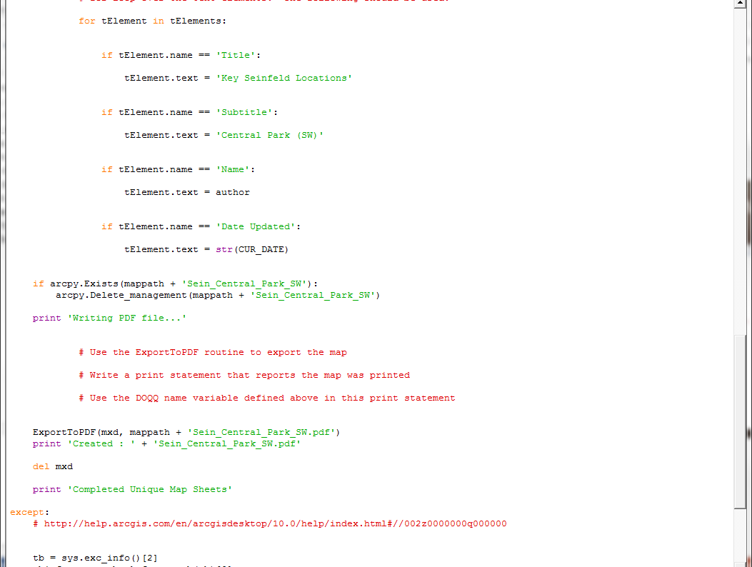
Python Task 3 – “Mapping Module”

Slide 10
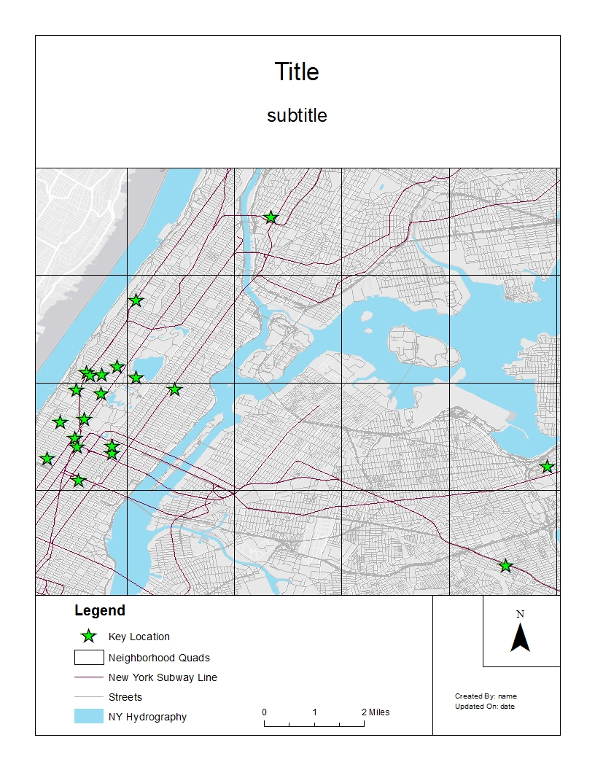
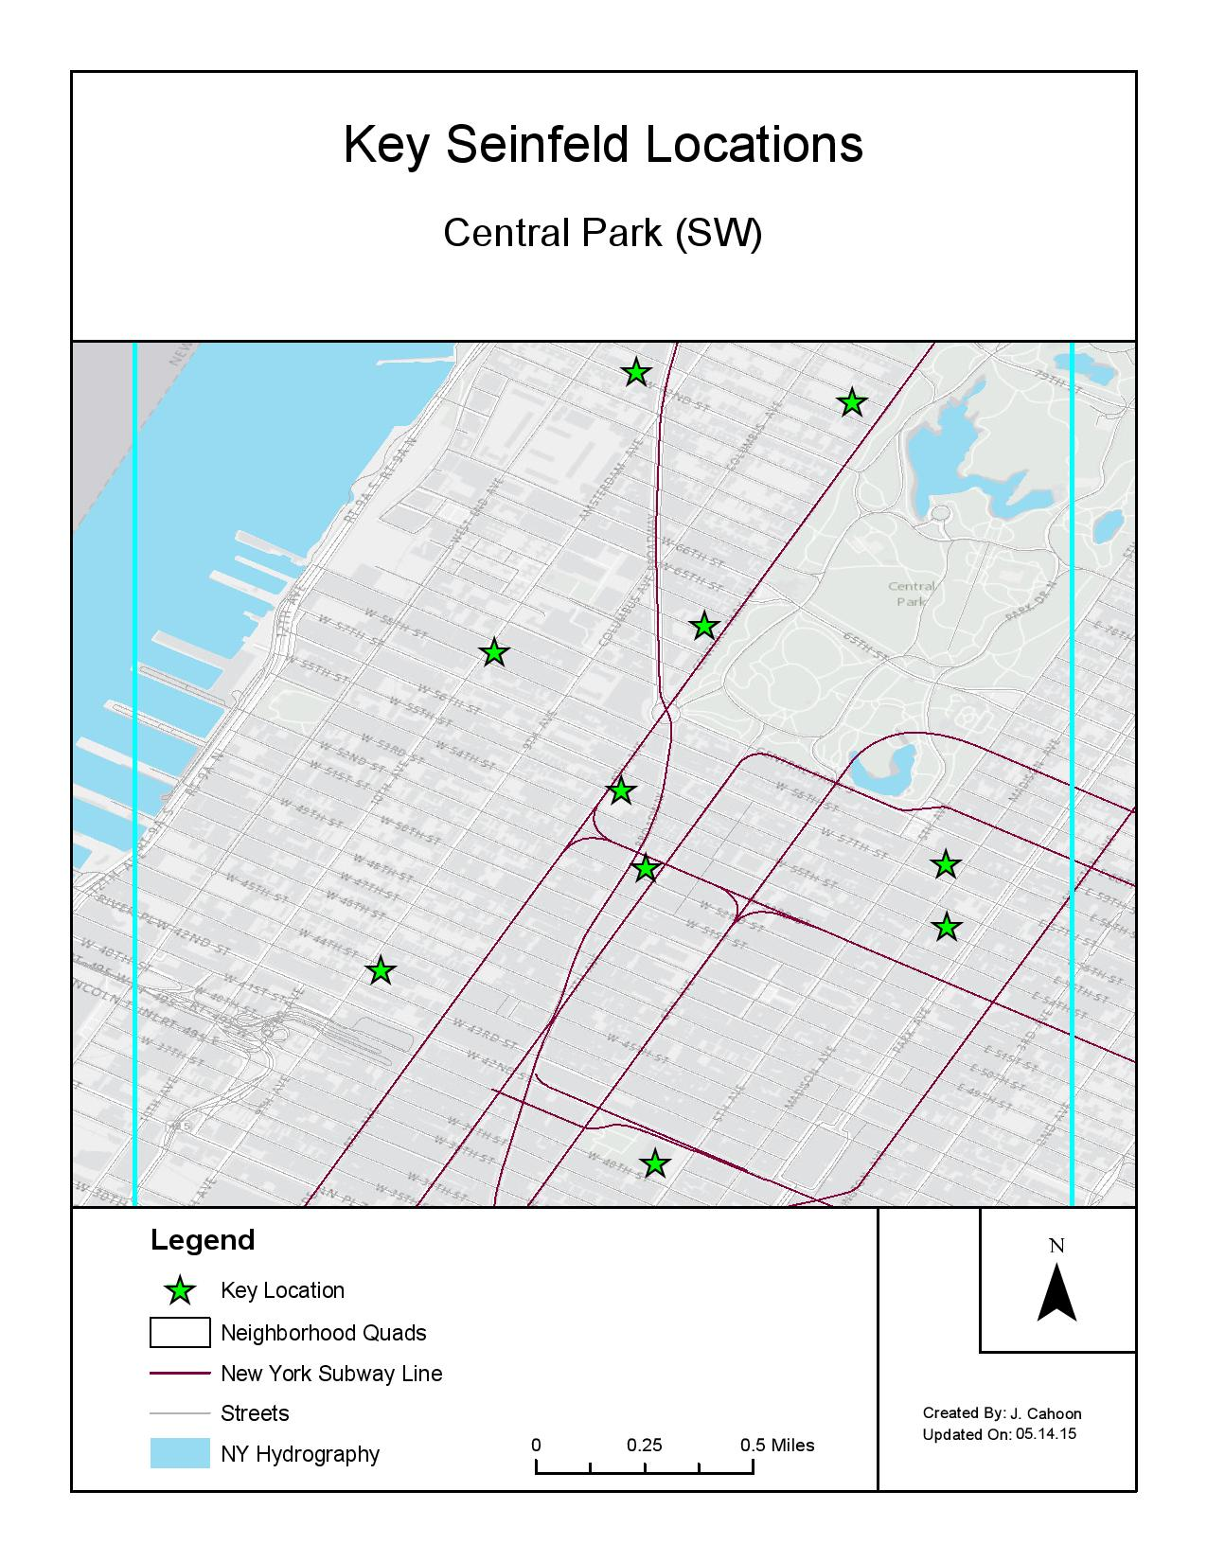
Task 3 Results:
=

Slide 11
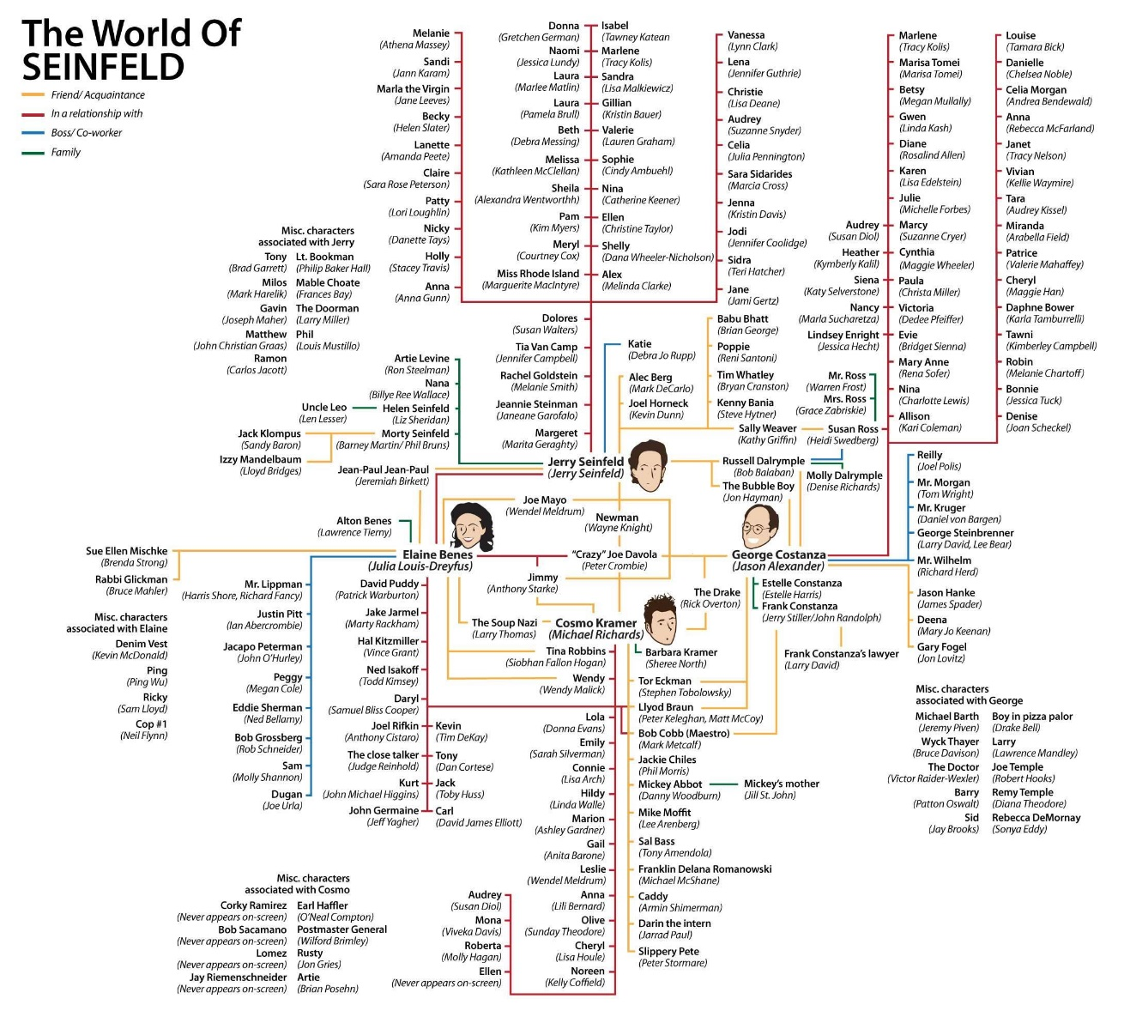
Questions/Comments:
“The World of Seinfeld” Diagram: http://www.dula.tv/blog/picture/seinfeld-people-chart/

