Slide 1
Exploring Unsupervised Classification and Interactive Supervised Classification in Order to Characterize Impervious Cover
Walker Wieland
GEOG 342

Slide 2
Outline
Introduction
Isocluster Unsupervised
Interactive Supervised
Raster Analysis
Conclusions

Slide 3
Introduction
GIS work, watershed analysis
Characterize amounts of impervious cover (IC) at spatial extents
Impervious surface coefficients are used along with land use categories
  Example: residential: 44% impervious cover, open space 2% impervious cover, heavy industry: 91% impervious cover

Slide 4
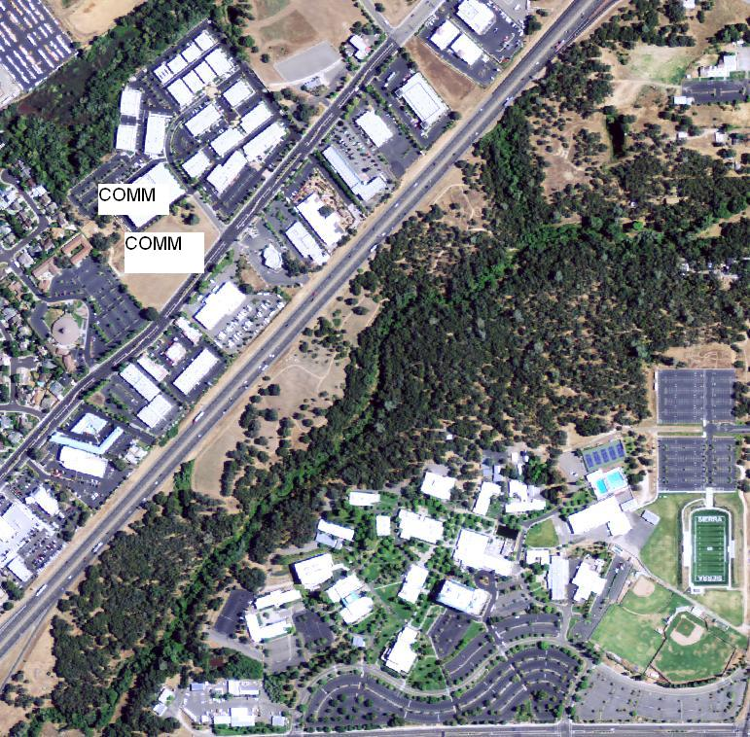
Introduction
Use land use layer in GIS and impervious cover coefficients to calculate IC
Check for non-conforming land uses at 100-foot buffer

Slide 5
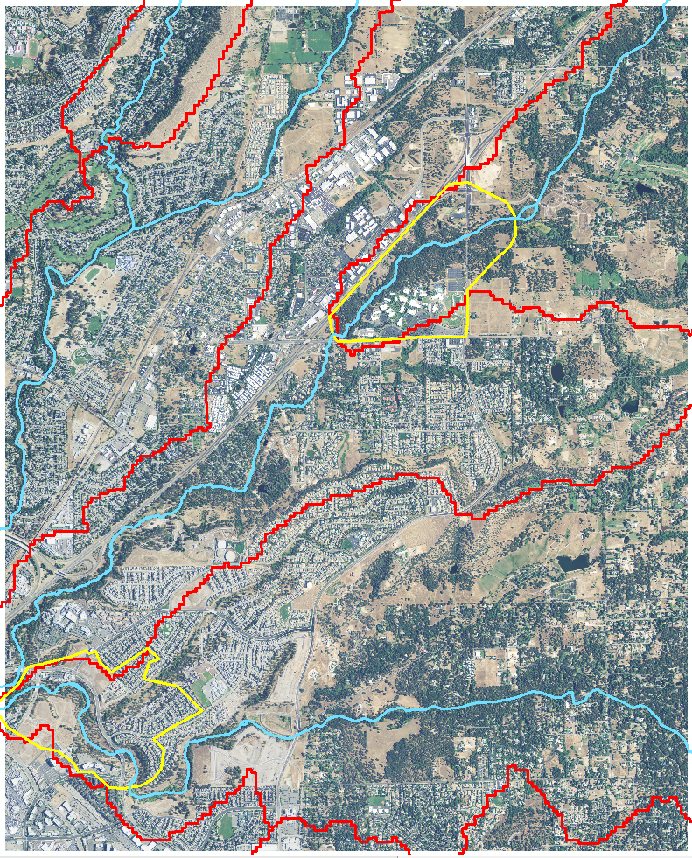
Introduction-data acquisition

Slide 6
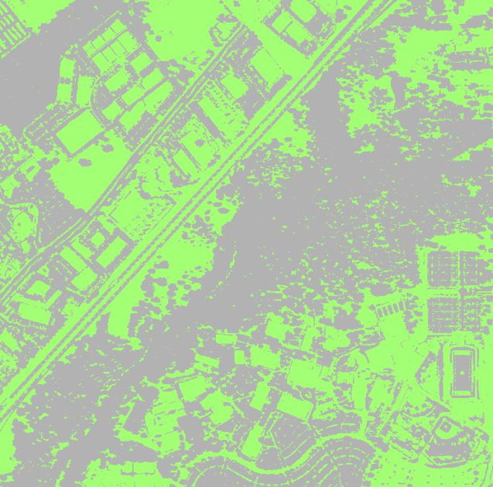
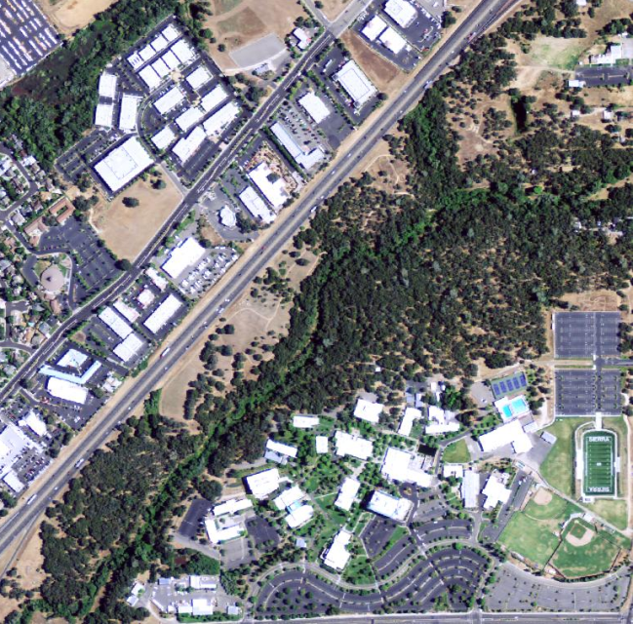
Isocluster Unsupervised Classification
2 classes
Original image

Slide 7
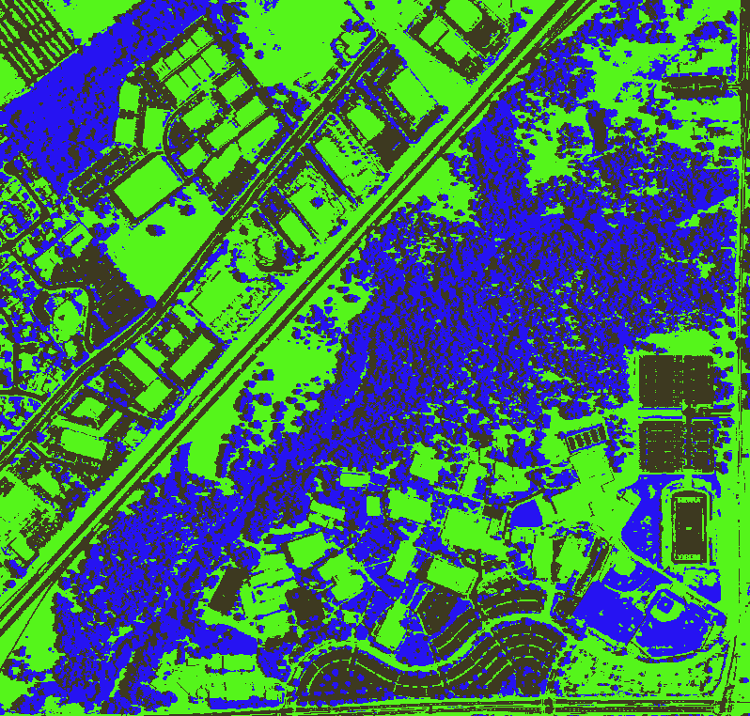
Isocluster Unsupervised Classification
3 classes

Slide 8
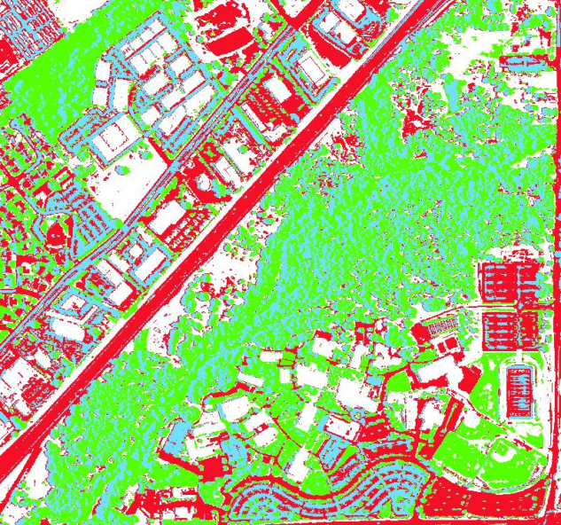
Isocluster Unsupervised Classification
4 classes

Slide 9
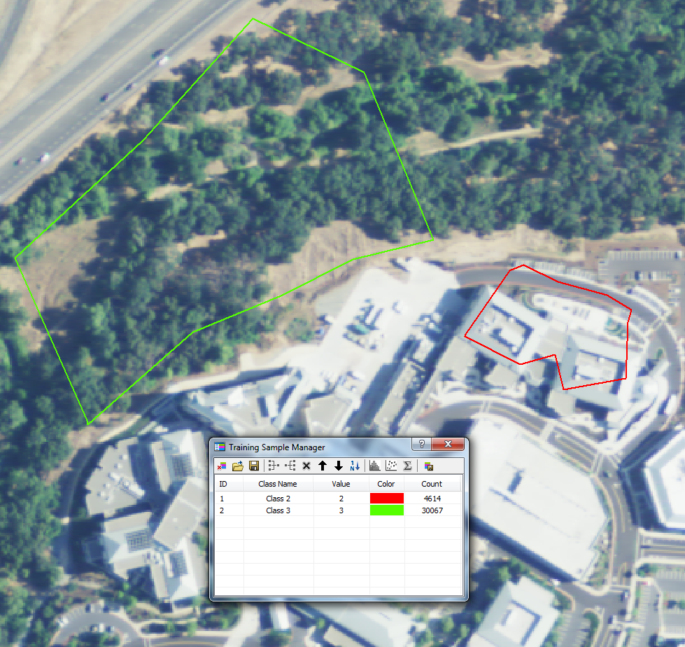
Interactive supervised: training samples

Slide 10
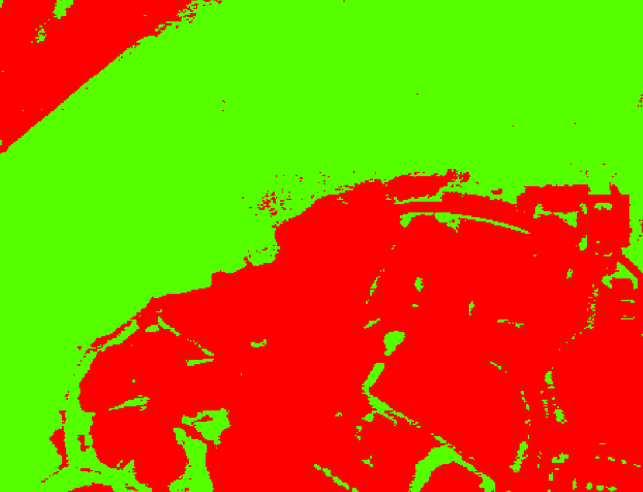
Interactive supervised

Slide 11
Analysis
Converted raster to polygon features
Created field in new feature class, calculated geometry in square feet
  Pervious: 10,823,961
  Impervious: 4,029,042
Spatial analyst tool: Zonal geometry as table
  Pervious: 10,830,614
  Impervious: 4,030,196

Slide 12
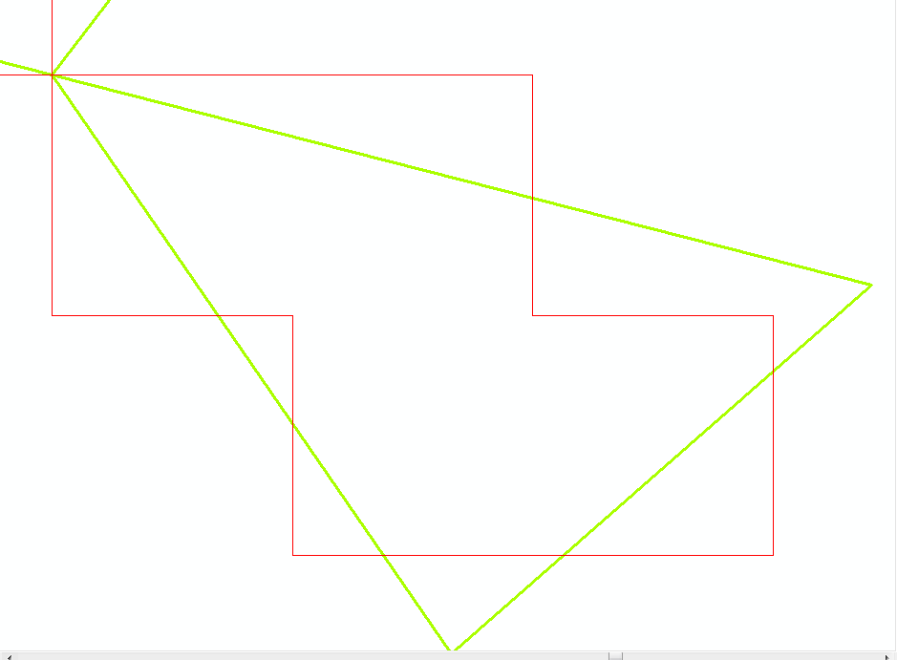
Checked conversion tool
Option to ‘simplify polygons’
If unchecked (not default), process takes longer, but more accurate
“unsimplify” output
  Pervious: 10,825,112
  Impervious: 4,028,149

Slide 13
Conclusions
With polygons unsimplified, pervious land was closer to the zonal statistics output, while impervious land was further away
  Don’t know enough about what could cause error in zonal statistics
  Used unsimplified output for percentage calculation
Results: polygon area is 27% impervious
  ISC method: polygon area is 32% impervious
  Close to one another, would like to try different spatial extents, more knowledge of zonal statistics

Slide 14
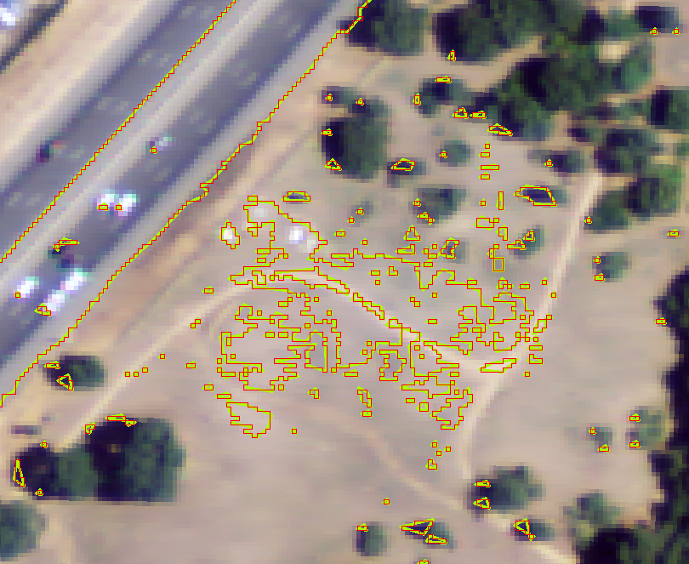
Questions?

