Slide 1
Environmental Justice on the web
GIS web applications
Jennings
12-18-12

Slide 2
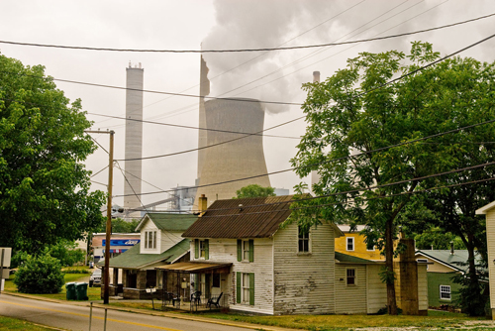
What is Environmental Justice?

Slide 3
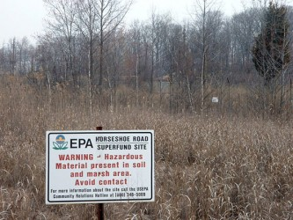
Datasets Used
Superfund sites (DTSC)
Census datasets
  % HS grads
  Vacant housing units
  % under age 5
  % Spanish speaking at home
  Census tracts
Bing road

Slide 4
Methods
Symbolized census data into 3 classes to represent gradient across state
Plotted superfund sites on top
GP Model
  Choose a census tract you’re interested in (select by attributes)
  See the superfund sites in that tract (intersect)

Slide 5
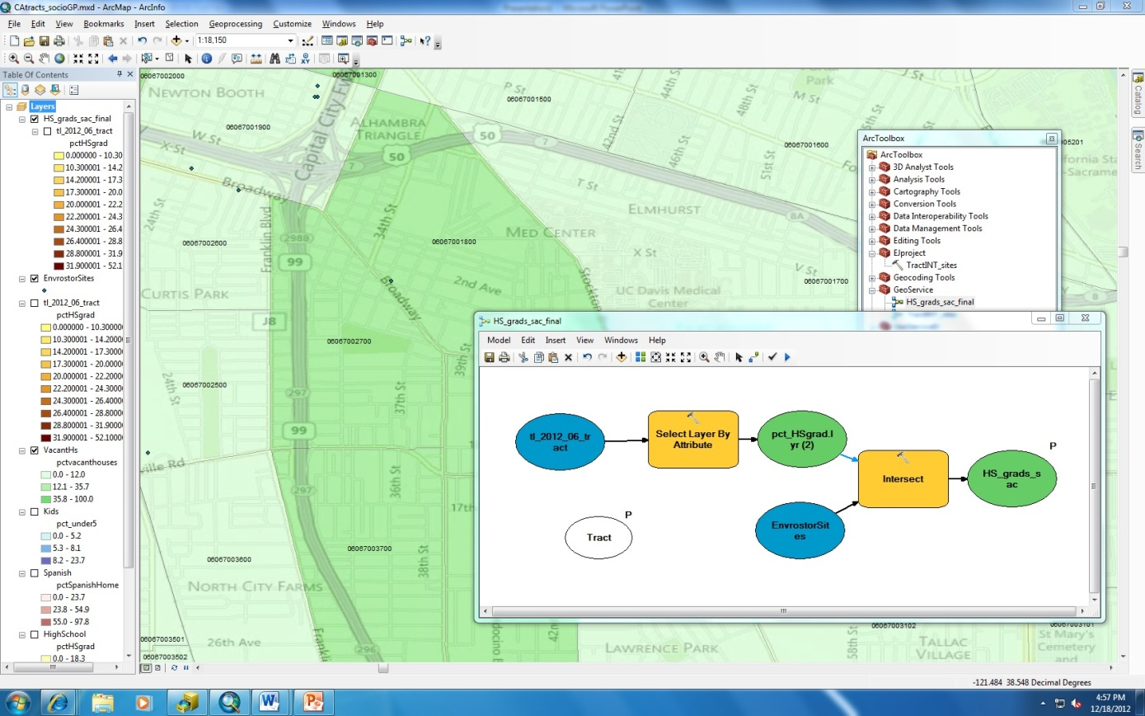

Slide 6
Challenges
Lots
  Geodatabase locked
  SOC crashed
  Switched comps
  I clicked too many things
  Model pointed to layer file instead of shapefile (so it showed up as not existing)

