Slide 1

Python Automation v1.0
Created by Mike Tuck
5/13/2011

Slide 2
Data Structure
The gis data is isolated from program data and the two interact with each other through a csv file exchange.
The GIS unit manages spatial data only.
All the business table information are pulled from a csv updated on a daily basis.

Slide 3
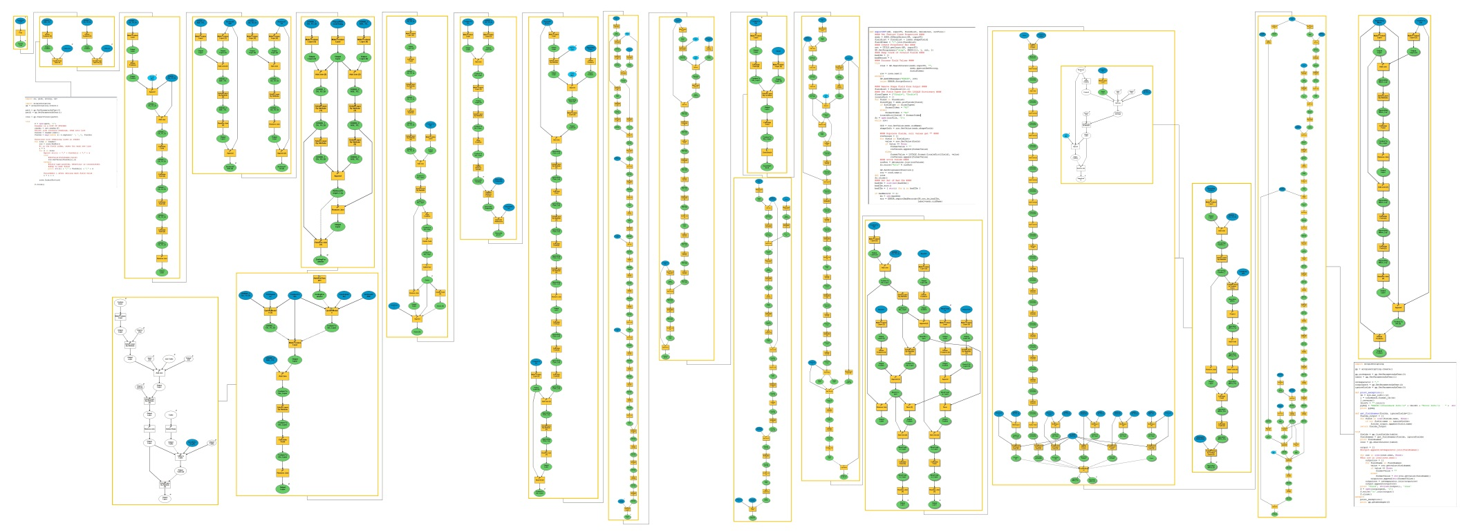
Daily Data maintenence
The process of importing, geocoding, analyzing and returning information from the program database and the GIS database would not be possible manually with a daily turn over.

Slide 4

Using a shell script to automate this process would save a GIS analyst an entire day of
Running process models.
The first step of the process is backing up data, this allows you to make mistakes
And not panic when you accidentally delete your database or recalculate over
A primary key.

Slide 5
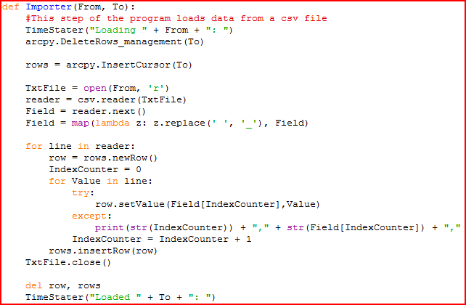
Next is the process of importing data from the csv file. This function uses a InsertCursor
To load data from csv to a temp table. The reason for the temp table is because of date
Fields acting unexpectedly.
A neat step in this function was the use of lambda. Lambda creates a mini function without
Having to call itself. Here it replaces ‘ ‘ with ‘_’ so that my field names can be read into
A geodatabase which does not allow spaces.

Slide 6
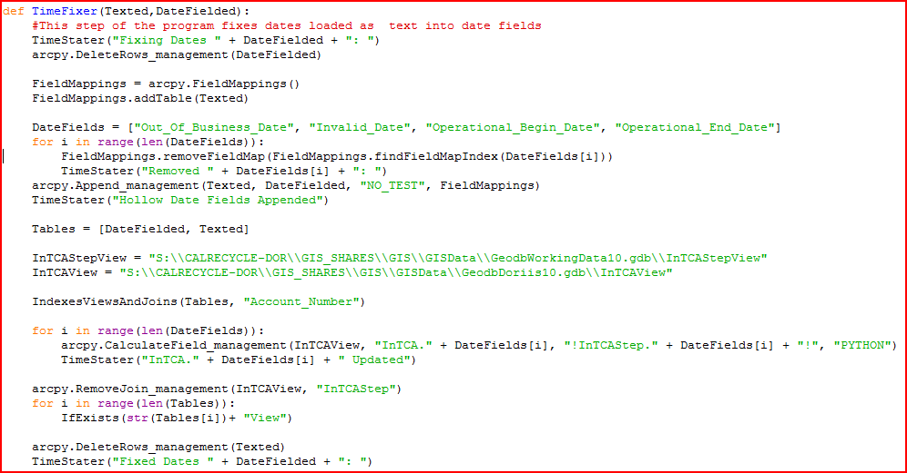
I’m not particularly fond of this function but it works. It resolves the problem earlier mentioned with date fields. It appends the temp table to a production table but uses fieldmapping to drop the date fields while appending. Then cycles through this list of fields and calculates the date values in. Calculate seems to be the most consistent way for loading date fields from a text source. Like I said it’s clunky and retroactive, but it works.

Slide 7
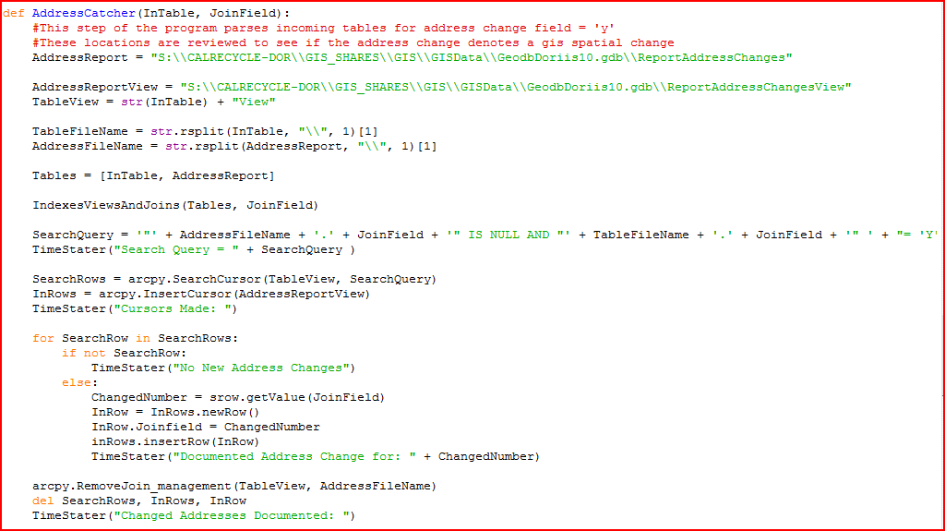
This function uses a search cursor to query the newly imported tables for address change = ‘y’ This produces a list of records where the programs users changed an address and now a GIS analyst must review to see if the change in address requires a spatial change in the GIS database.

Slide 8
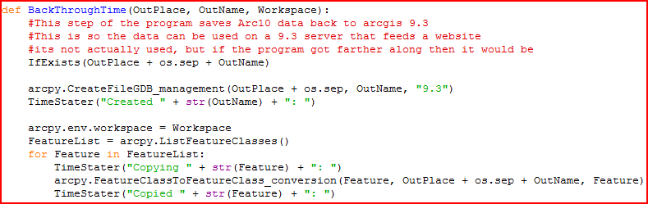
This function creates a version 9.3 database and saves all feature classes from a version 10 back to version 9. This function was not yet used in the model but it was written for another need at work and will fill in a niche later about 6 steps down the road.

Slide 9
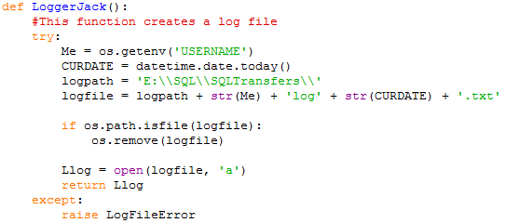

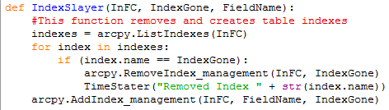
Reusable Functions
LoggerJack:
Gets user name, date/time, and a path. Concatenates them into one string. Checks if the string finding file exists, deletes it, opens a log there. This is independent of arcpy.
LogAndShell:
Writes lines to the log file, the shell window, and arc interface
Indexslayer:
Loops through tables removing and creating indexes

Slide 10
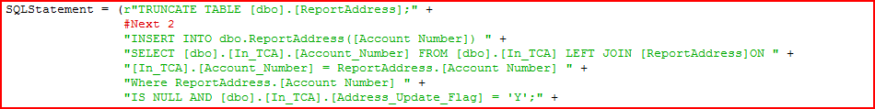
Luckily while taking this class I also enrolled in a SQL server class.
This allowed the opportunity to compare the same process using different options of execution.
The arcpy script above and the sql statement below do the same thing. The SQL statement was sent from python to SQL server, so you still have the option of using arcpy commands in the script.

Slide 11
Future Development
Going forward I plan to automate the entire process with a hybrid combination of arcpy and SQL Server.
Using SQL commands for the table manipulation and arcpy for spatial tools allows maximum efficiency and speed of execution.

