Slide 1
LAS for Topographic Analysis Using Python
Theodore Smith
May 22, 2013

Slide 2
Goals
Demonstrate learning of Python programming methods.
Produce a program that produces specified outputs needed for analysis of debris flow susceptibility ala Smith (1988).
Grapple with and solve programming problems, learning in the process.

Slide 3
Overview
The program consists of three modules:
  Module 1 creates initial files, imports lidar data, and produces a point summary.
  Module 2 creates a raster ground surface.
  Module 3 creates a series of surfaces (hillshade, slope, curvature, etc.) needed for the analysis.
Modules 2 and 3 could be easily combined once the code is fully tested.

Slide 4
Typical Starting Code Sample
print "Final Project - LAS for Topographic Analysis Using Python\n"
print "by Theodore C. Smith, May 2, 2013\n"
print "Sub-program Module 1\n"
import arcpy, sys, os, traceback
# set the current workspace (in the case a folder)
arcpy.env.workspace = 'J:\\LiDAR_Proj\\workspace\\'
# Create variable definitions for file paths, file names, and projection.
# The next two lines will need to be changed for each study area.
quadDesig = "MM" # Variable designates a study area (in this case, a quadrangle) that coincides with a folder name.
quadTif = "o37122e4.tif" # File name of topographic map image
outpath = "J:\\LiDAR_Proj\\Quads\\" + quadDesig + "\\output\\"
outmxd = outpath + quadDesig + "_dfa.mxd"
topo = "J:\\LiDAR_Proj\\Quads\\" + quadDesig + "\\topobase\\" + quadTif
topoLyrOut = outpath + quadDesig + "topo.lyr"
inLas = "J:\\LiDAR_Proj\\Quads\\" + quadDesig + "\\ldata\\"
lasDatasetOut = outpath + quadDesig + "lidar.lasd"
outgdb = quadDesig + "lidar.gdb"
lasMP = outgdb + os.sep + quadDesig + "test.lyr"
ptSumFC = outpath + quadDesig + "PtSumFC"
coordSys = "J:\\ArcFave\NAD 1983 UTM Zone 10N.prj"
Notes:
Modules typically all define variables, call on ArcGIS and operating system processes, and define workspace.

Slide 5
Typical Exception Routine
except:
# http://help.arcgis.com/en/arcgisdesktop/10.0/help/index.html#//002z0000000q000000
tb = sys.exc_info()[2]
tbinfo = traceback.format_tb(tb)[0]
pymsg = "PYTHON ERRORS:\nTraceback Info:\n" + tbinfo + "\nError Info:\n " + str(sys.exc_type) + ": " + str(sys.exc_value) + "\n"
msgs = "ARCPY ERRORS:\n" + arcpy.GetMessages(2) + "\n"
arcpy.AddError(msgs)
arcpy.AddError(pymsg)
print msgs
print pymsg
arcpy.AddMessage(arcpy.GetMessages(1))
print arcpy.GetMessages(1)

Slide 6
Part of Module 1 Try Subroutine
try:
# Copy the existing mxd template to the project output directory.
mxd = arcpy.mapping.MapDocument("J:\\LiDAR_Proj\\_templateUTM10N.mxd")
mxd.saveACopy(outmxd)
print "New mxd created at " + outmxd + "\n"
# Make a dataset using las files in the quadDesig las data directory.
# The next four lines may be commented out if the dataset is not desired.
# Check to see if the las dataset already exists, if so, delete it
if arcpy.Exists(lasDatasetOut):
arcpy.Delete_management(lasDatasetOut)
arcpy.CreateLasDataset_management(inLas, lasDatasetOut)
print "New las dataset created at " + lasDatasetOut + "\n"
# Make a raster layer using the georeferenced topographic map image; save as new layer.
# The next four lines may be commented out if the topo map layer is not desired.
# Check to see if the topographic map layer already exists, if so, delete it
if arcpy.Exists(topoLyrOut):
arcpy.Delete_management(topoLyrOut)
arcpy.MakeRasterLayer_management(topo, "topoLyr")
arcpy.SaveToLayerFile_management("topoLyr", topoLyrOut, "ABSOLUTE")
print "New topographic map layer created at " + topoLyrOut + "\n"

Slide 7
Screen OutPut from Module 1
Python 2.7.2 (default, Jun 12 2011, 15:08:59) [MSC v.1500 32 bit (Intel)] on win32
Type "copyright", "credits" or "license()" for more information.
>>> ================================ RESTART ================================
>>>
Final Project - LAS for Topographic Analysis Using Python
by Theodore C. Smith, May 2, 2013
Sub-program Module 1
New mxd created at J:\LiDAR_Proj\Quads\MM\output\MM_dfa.mxd
New las dataset created at J:\LiDAR_Proj\Quads\MM\output\MMlidar.lasd
New topographic map layer created at J:\LiDAR_Proj\Quads\MM\output\MMtopo.lyr
Pointfile summary created at J:\LiDAR_Proj\Quads\MM\output\MMPtSumFC.dbf
Please review the point file summary to determine the average point spacing.
Then put the value in the code of the second sub-program.
>>>

Slide 8
Point File Summary from Module 1
File Name | Pt_Count | Pt_Spacing | Z_Min | Z_Max
ARRA-CA_GoldenGate_2010_42505700.las | 10450178 | 0.46401221681 | -69.65100000000 | 751.50600000000
ARRA-CA_GoldenGate_2010_42505850.las | 13043726 | 0.41532724894 | -43.02100000000 | 765.94600000000
ARRA-CA_GoldenGate_2010_42506000.las | 11500616 | 0.44231402230 | -87.71700000000 | 774.20300000000
ARRA-CA_GoldenGate_2010_44005700.las | 11643314 | 0.43959521266 | 83.57300000000 | 652.35500000000
ARRA-CA_GoldenGate_2010_44005850.las | 9933729 | 0.47592125932 | 4.19900000000 | 772.86800000000
ARRA-CA_GoldenGate_2010_44006000.las | 8237973 | 0.52261404493 | -89.43100000000 | 772.60200000000
ARRA-CA_GoldenGate_2010_45505700.las | 8028488 | 0.52938834758 | 101.32500000000 | 642.75900000000
ARRA-CA_GoldenGate_2010_45505850.las | 8142413 | 0.52567181932 | -30.66200000000 | 724.43800000000
ARRA-CA_GoldenGate_2010_45506000.las | 7966833 | 0.53143285716 | 39.35700000000 | 763.57700000000
ARRA-CA_GoldenGate_2010_47005700.las | 7087137 | 0.56345059911 | 110.06200000000 | 749.09800000000
ARRA-CA_GoldenGate_2010_47005850.las | 7121150 | 0.56210337400 | 59.03900000000 | 712.87500000000
ARRA-CA_GoldenGate_2010_47006000.las | 8219604 | 0.52319768254 | 46.09400000000 | 741.75200000000
Average Point Spacing |  | 0.49958572372
Notes:
The bottom line is manually added.

Slide 9
Module 3 Output
Final Project - LAS for Topographic Analysis Using Python
by Theodore C. Smith, May 22, 2013
Sub-program Module 3
Uses existing surface raster at J:\LiDAR_Proj\Quads\MM\output\MM_DF_Proj.gdb\MM_Terr_Raster_20
Creating hillshade . . .
New hillshade raster at J:\LiDAR_Proj\Quads\MM\output\MMhillshade1
New slope raster at J:\LiDAR_Proj\Quads\MM\output\MMslope1.tif
New flow direction raster at J:\LiDAR_Proj\Quads\MM\output\MMflowdir1
New flow accumulation raster at J:\LiDAR_Proj\Quads\MM\output\MMflowacc1
New curvature raster at J:\LiDAR_Proj\Quads\MM\output\MMcurvature1
>>>

Slide 10
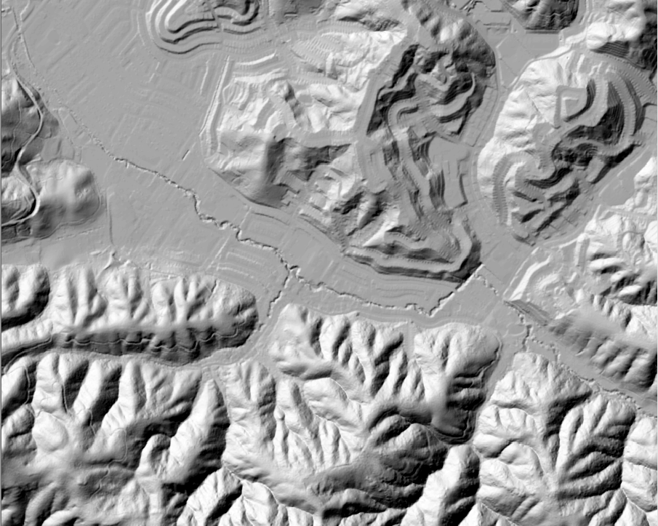
Hillshade Output

Slide 11
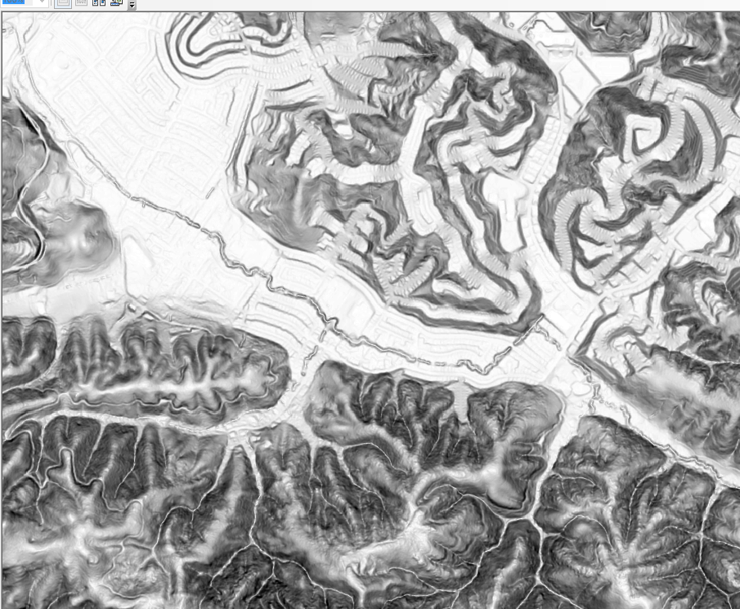
Slope Output

Slide 12
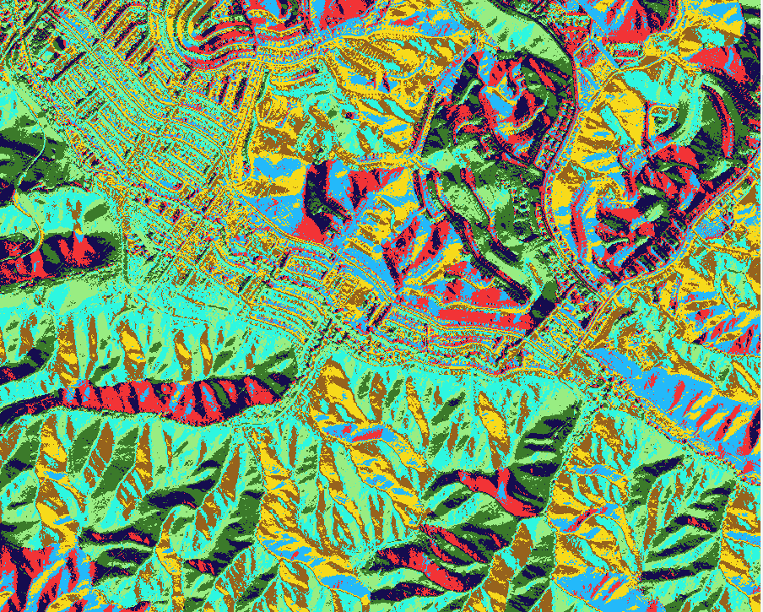
Flow Direction Output

Slide 13
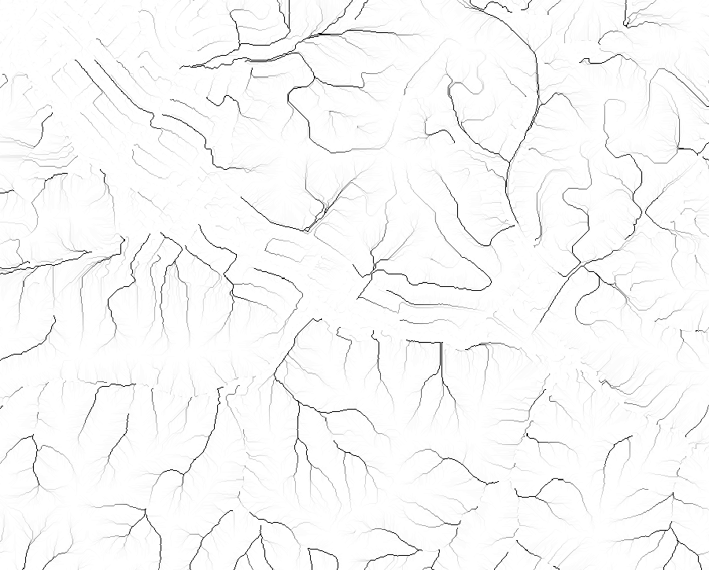
Flow Accumulation Output

Slide 14
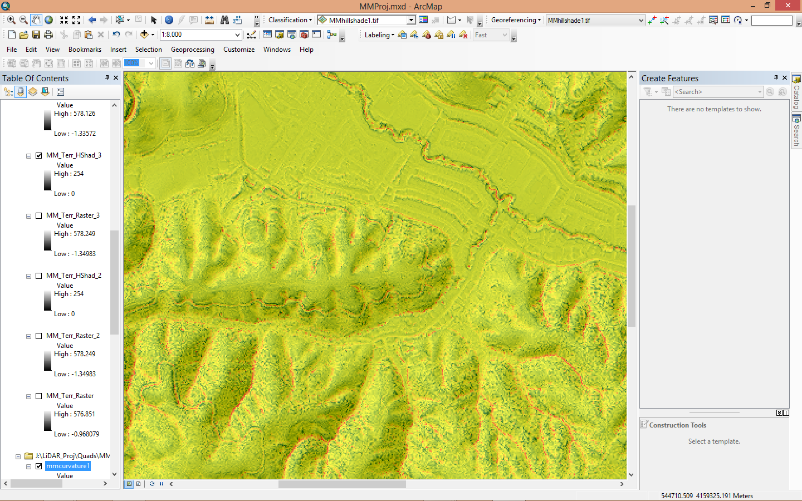
Curvature plus Hillshade

Slide 15
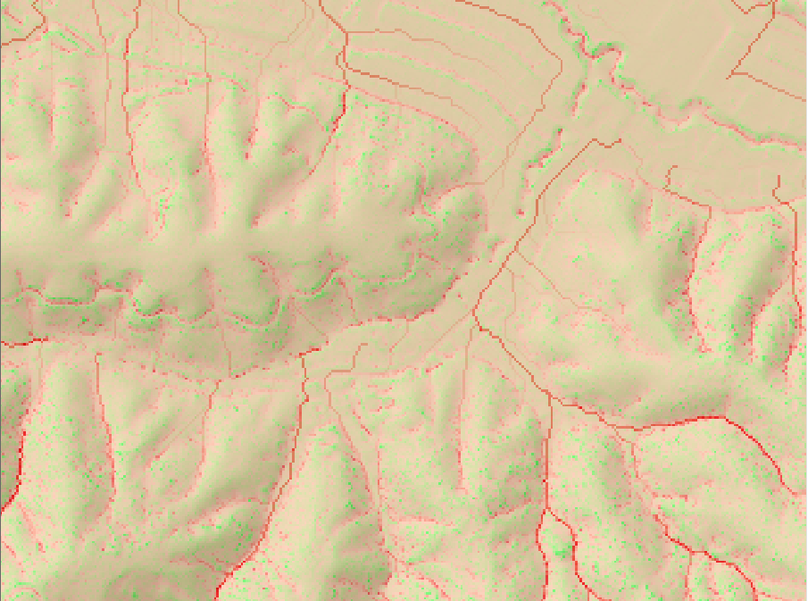
Curvature, Flow Accumulation, & Hillshade
Notes:
Compare this slide with the upper left corner of the image on the following slide. What appears as yellow-green here equates to red on the next slide.

Slide 16
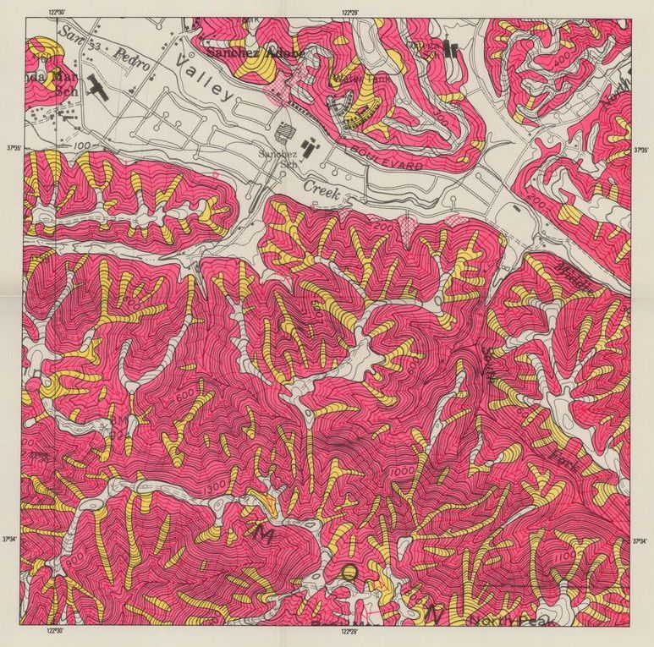
Smith (1988) Prototype

Slide 17
Programming Problems Encountered
Typical difficulty catching typographical errors and incorrect case.
Some ArcGIS online helps are outdated; the 10.1 tool help content was better but was not always clear.
The program needed to be broken into modules to expedite testing and to assure that required parameters were available.
ESRI no longer distributes the various projection data files with ArcGIS 10.1, so projection file needed to be saved to disk.

Slide 18
Outcomes
Demonstrated ability to produce some reasonable programs using several ArcGIS tools and extensions.
Identified some methods that will automate testing to identify optimal parameters for the spline tool.
I recognize that I need to clean up the code more, improving standardization of file locations and variables.

