Slide 1
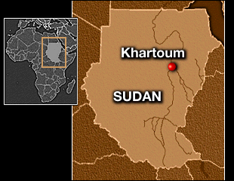
An Image Classification of
Khartoum, Sudan
by Lia Sullivan

Slide 2
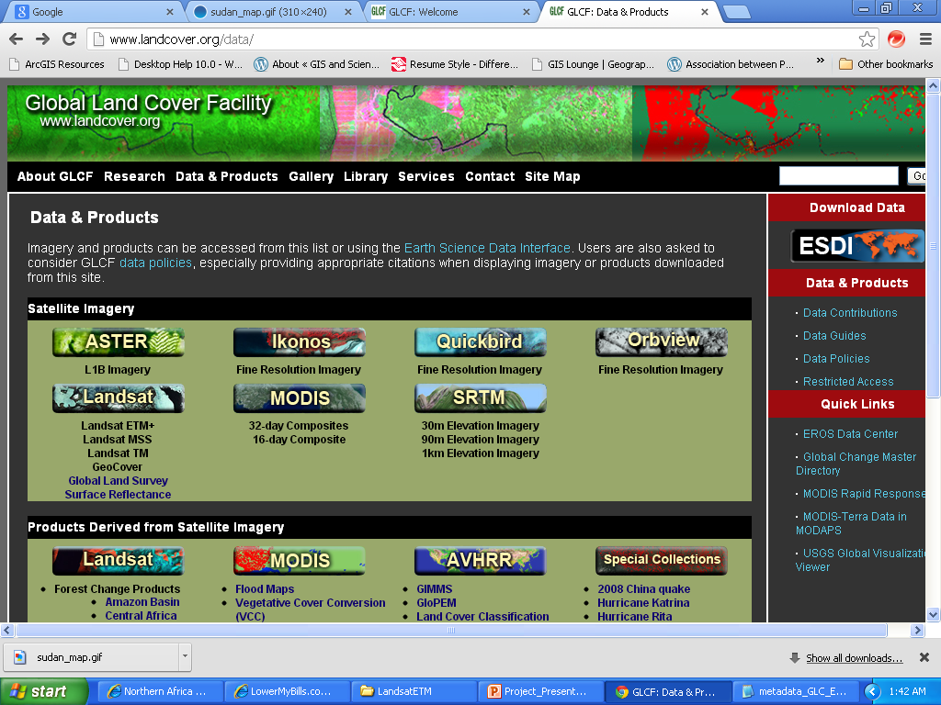
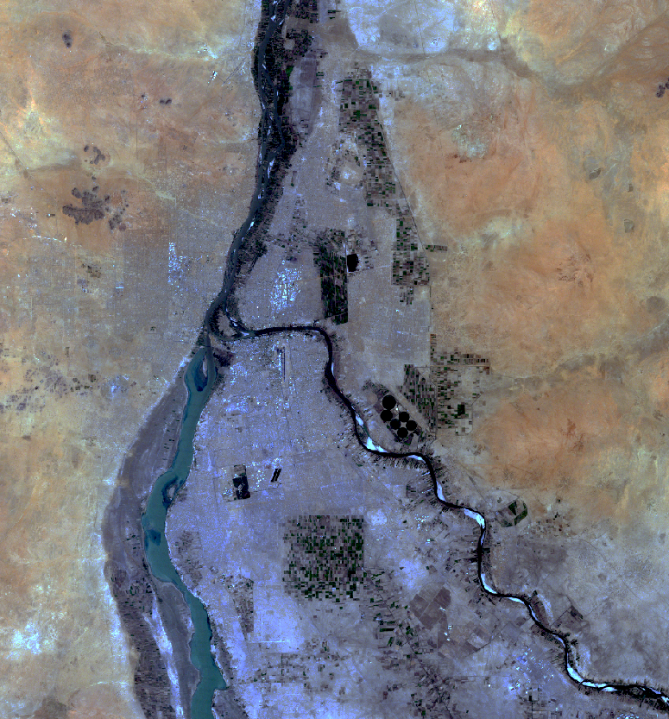
Global Land Cover Facility
Landsat ETM+ 2006 Image of Khartoum
www.landcover.org

Slide 3
Project Goals
Delineate the urban extent of Khartoum.
Create 5 output classes in the process:
    urban
    desert
    fallow
    agriculture
    water
Become acquainted with the classification process in ENVI.

Slide 4
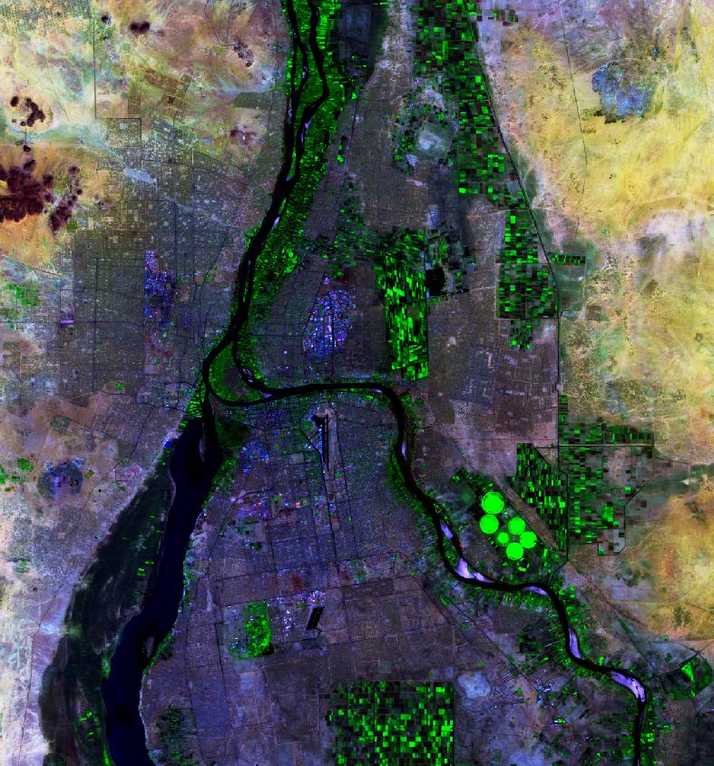
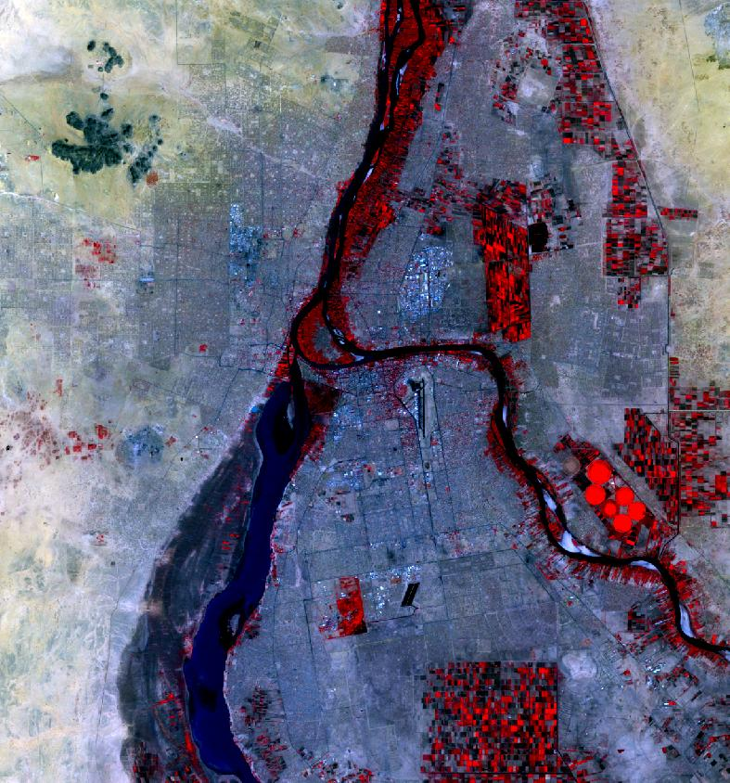
Composite Bands Used -
Bands 7,4,2
Bands 4,3,2
Equalization Stretch
Linear 5% Stretch
Notes:
These were the composite band images I used throughout my project to identify cover types: the 742 and 432/ I also played around with the different stretch types that ENVI offers. I found these stretch types allowed me to see a crisper image of my study area when compared to the traditional Gaussian stretch.

Slide 5
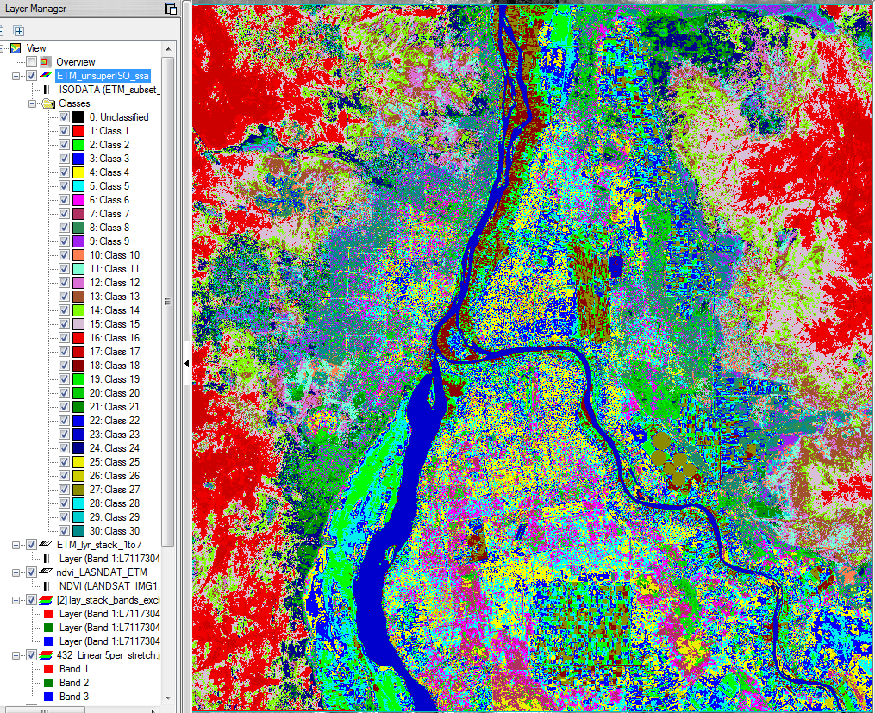
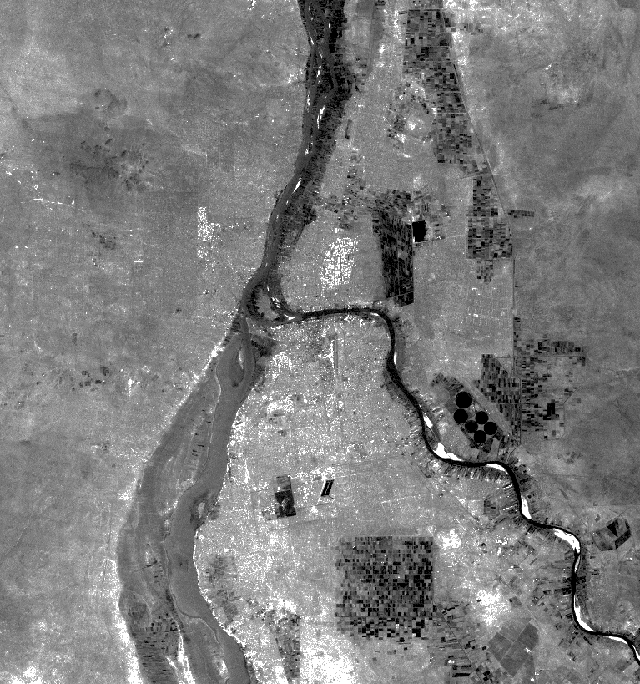
Processes Used
Bands 1,2,3,4,5,7 were combined using layer stacking tool.
UnsupervisedClassification of 30 classes.

Slide 6
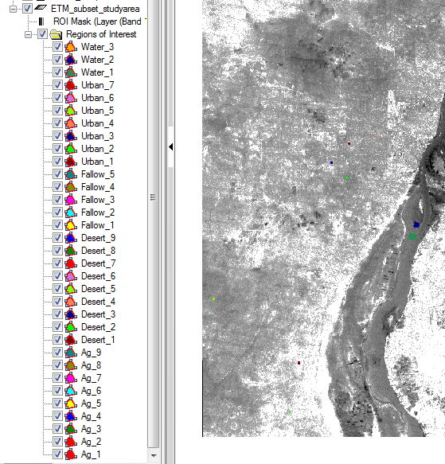
Supervised Classification
33 training samples drawn using false color images and unsupervised classification to identify class types.
Regions of Interest: ROI’s
Using Roi’s ran a Maximum Likelihood Classsification and a Mahalanobis Classification
Notes:
The training samples were then converted to ROI’s or regions of interest. Using my roi file I ran both a maximum likelihood classification and a mahalanobis classification.

Slide 7
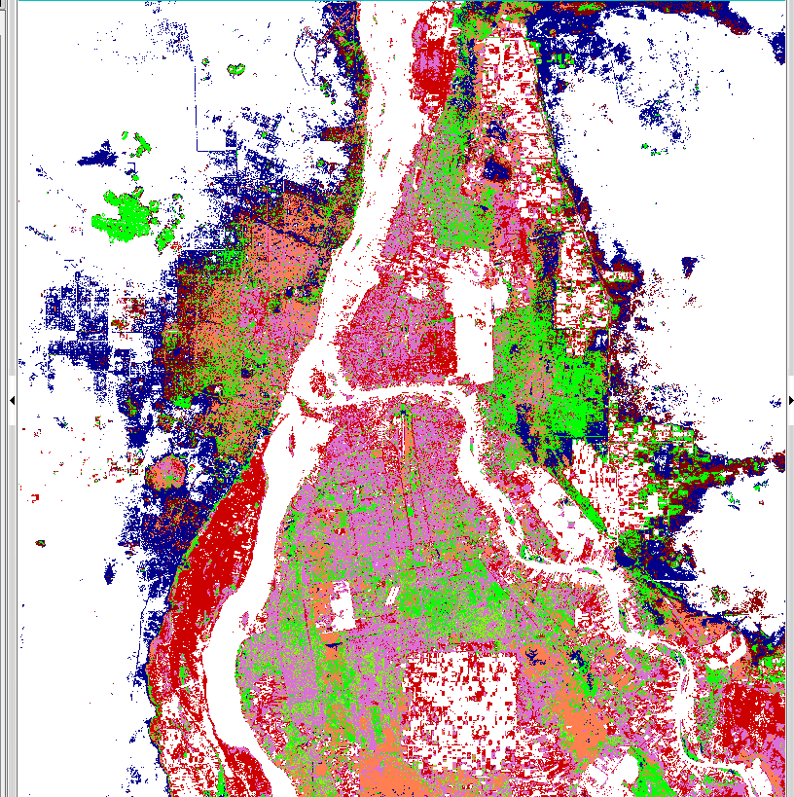
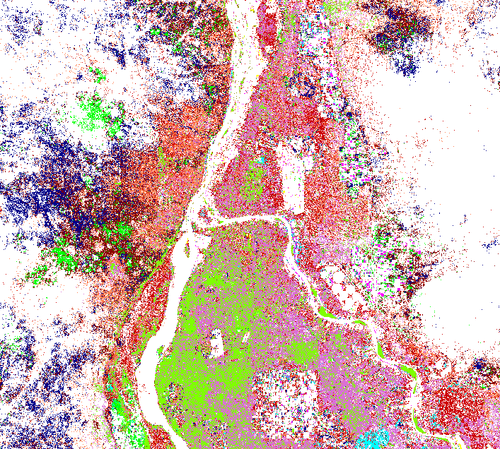
Output Comparison of Urban Classes
Maximum Likelihood
Mahalanobis
Urban/Fallow/Ag confusion
Urban/Desert confusion
Notes:
Here is an output comparison of the urban classes as captured by these two algorithms. I was disappointed with the results of both especially regarding the urban classification. Both displayed confusion the only difference being in the source of the urban training sample which caused the confusion. With the maximum likelihood the large flood plain along the western White Nile was classed as urban. You can see that with the red. With the Mahalanobis the urban area of Omdurman was also picking up pixels of the surrounding desert. You can see that with the blue.

Slide 8
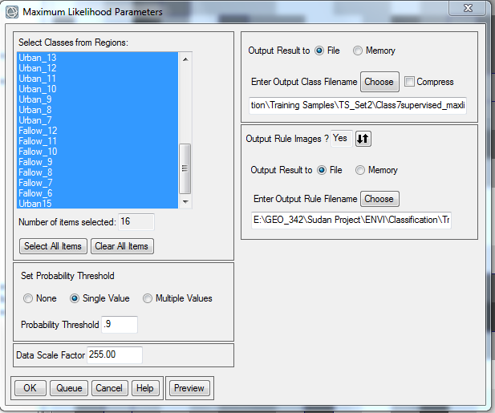
Troubleshooting
Used thresholding
Set Maximum Likelihood parameter to a probability of .9 or 90%
Notes:
My next step was to use thresholding to resolve the confusion

Slide 9
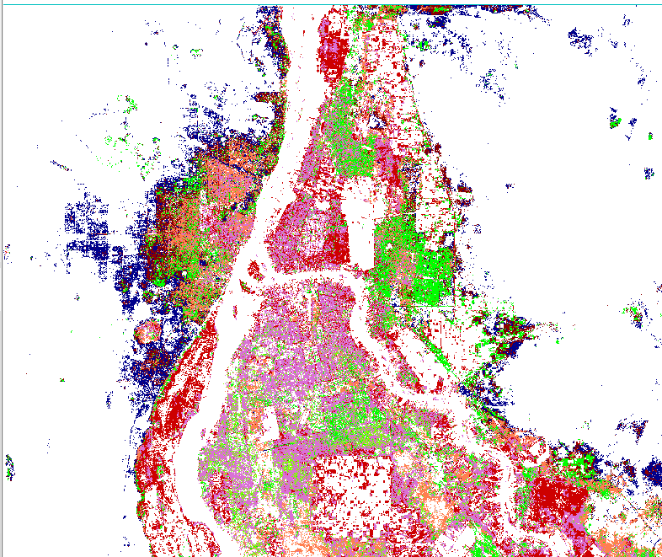
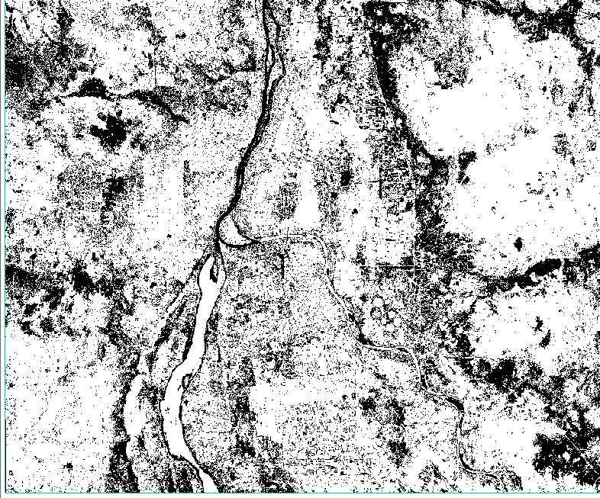
Output Comparison Of UrBan Classes
Thresholding
No Thresholding
Unclassified
Notes:
Here is an output comparison of urban classes with thresholding and without thresholding. I did see considerable improvement in results for this class especially when examing the western flood plain of the White but these results were largely due to the fact that confused areas were unclassified in the thresholding output.

Slide 10
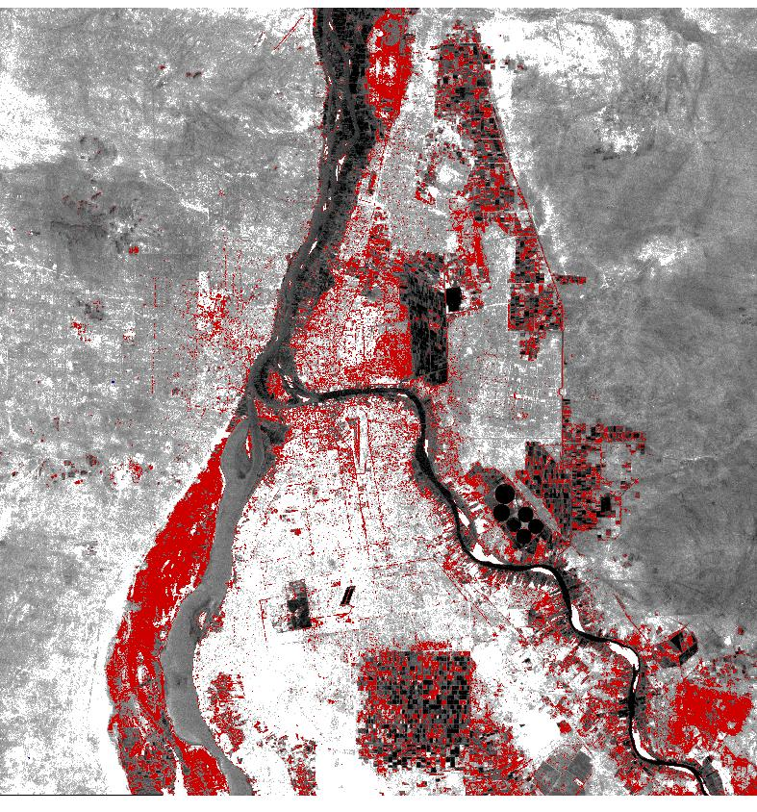
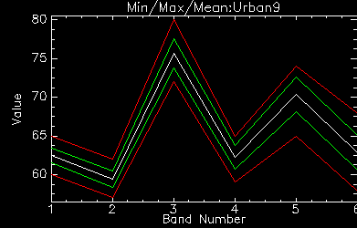
Troubleshooting Cont.
Exported the “problem” class to a vector file. Drew 15 more training samples within its boundary paying close attention to the spectral profile of my samples.
Notes:
Show spectral profiles of pixels and drawing polygons

Slide 11
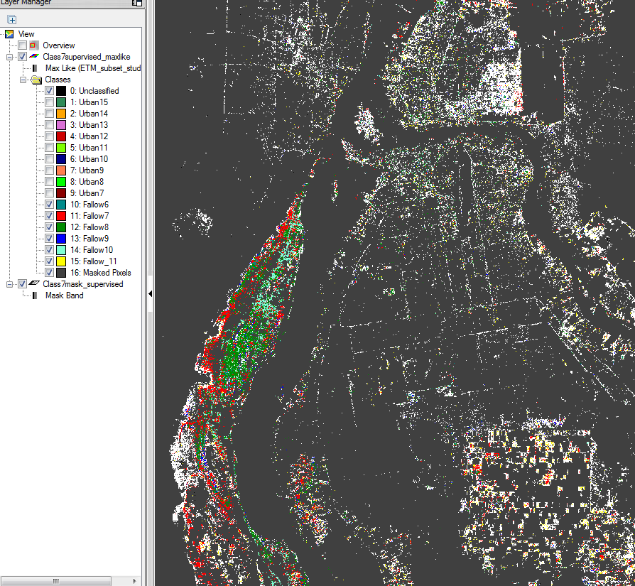
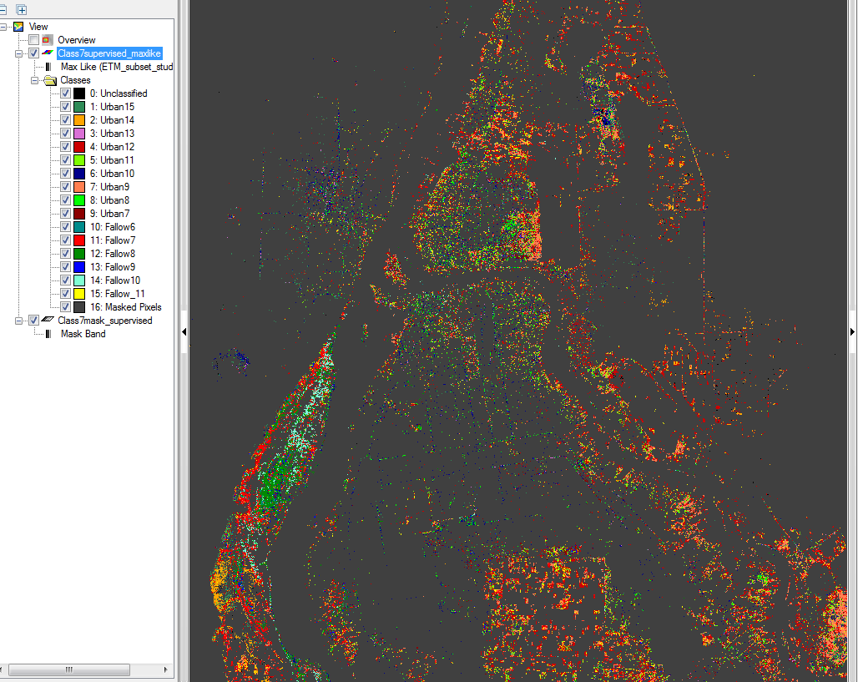
Performed a supervised classification, using the mask option along with thresholding so that only areas within the confused class were reclassified. The goal being to test the efficacy of these training samples on the problem area alone.
Fallow Classes On
Improved Results
Notes:
Overall content with the results, particularly with the level of differentiation on the western flood plain of the White Nile where most of the confusion previously lay. Reclassified one of my output classes from urban to agriculture.

Slide 12
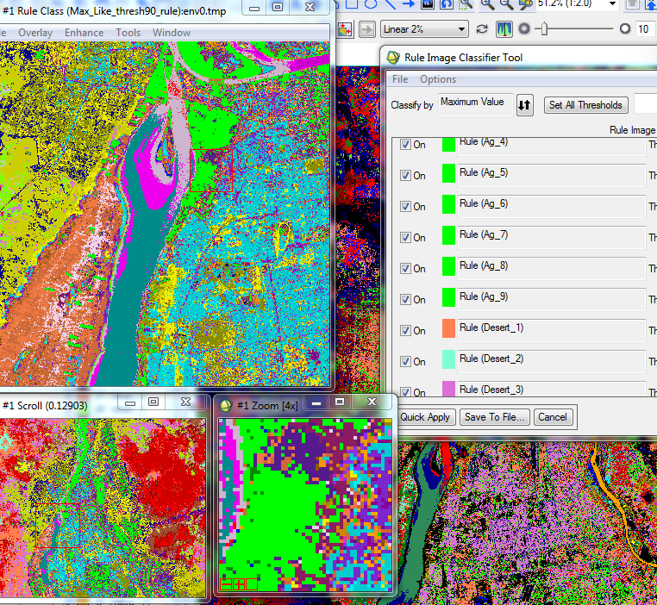
Final Output
Combined new training samples with first set.
Ran another maximum likelihood classification with thresholding
Used the Rule Classifier Tool to combine class

Slide 13
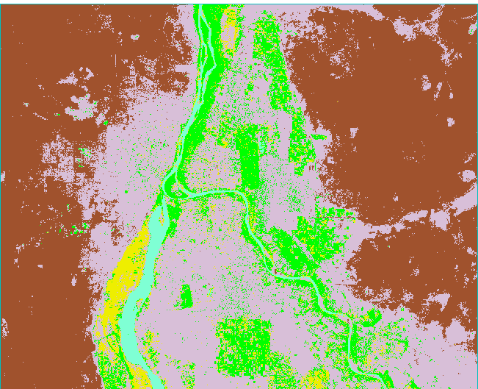
Final Output: Problem Areas
Notes:
Problem areas the result of the unclassified class morphing into the urban class when using the image classifier.

Slide 14
Challenges Encountered
Potential Solutions
Unclassified area: More training samples taken within the unclassified area.
Problematic spectral profile: More than one class shared the same spectral profile. Develop an effective decision tree to try to resolve confusion.
Notes:
Unfortunately due to time constraints and open lab hours I was not able to draw more training samples in order to resolve the large nubmer of unclassified pixles I still encountered in my final output. A more difficult problem was posed by the fact that more that many barren areas shared a near identical spectral profile with some urban areas. Perhaps the only was to resolve such confusion is by implementing a decision tree or some type of “localized” algorithm that is not solely based on spectral signatures alone.

