Slide 1
Cascade.py
C. Justin Mayers
cjmayers@usgs.gov

Slide 2
Geoprocessing Tasks/Logic
Start geoprocessing
Gather input from user
Set workspace
Make a feature layer of entire input feature class
Collect information about the feature class
Gather info about each polygon in the feature class

Slide 3
Geoprocessing Tasks/Logic (Con’t)
Cycle through individual polygons and select all polygons that touch that polygon (inclusive)
Collect elevation data and assign CascadeID
Create feature class with polylines with cascades, add fields and populate feature class
Catch and report errors

Slide 4
Key Code – get/parse user input
#input variables
inputDIR = os.path.dirname(sys.argv[1]) #parse input directory
inFC = os.path.basename(sys.argv[1]) #parse input FC name
fieldID = sys.argv[2] #identify unique field name
fieldElev = sys.argv[3] #identify elevation field name
outputDIR = os.path.dirname(sys.argv[4]) #parse output directory
outFC = os.path.basename(sys.argv[4]) #parse output FC name

Slide 5
Key Code – get polygon info
#cycle through each polygon record
while row:
ID_va = row.getvalue(fieldID) #unique ID of polygon
geometry = row.getvalue(shapefieldname) #object with geometry info
polygonInfo[ID_va] = {}
polygonInfo[ID_va][fieldElev] = row.getvalue(fieldElev) #elevation
polygonInfo[ID_va]['x'] = geometry.truecentroid.x #x coord value
polygonInfo[ID_va]['y'] = geometry.truecentroid.y #y coord value
polygonInfo[ID_va]['CascadeID'] = '' #place holder cascade ID
row = rows.Next()

Slide 6
Key Code – collect neighbors
#select individual polygon
where_clause = FCchar + fieldID + FCchar + ' = ' + str(ID_va)
selection_type = 'NEW_SELECTION‘
gp.SelectLayerByAttribute_management (inFC_lyr, selection_type, where_clause)
#select all polygons that touch individual polygon (inclusive)
overlap_type = 'SHARE_A_LINE_SEGMENT_WITH‘
selection_type = 'NEW_SELECTION‘
gp.SelectLayerByLocation_management (inFC_lyr, overlap_type, inFC_lyr,'#', selection_type)

Slide 7
Key Code – create polylines and populate fields
#create polylines and populate fields
for ID_va in polygonInfo.iterkeys():
#set the x and y coordinates for origin vertex.
point.x = polygonInfo[ID_va]['x']
point.y = polygonInfo[ID_va]['y']
lineArray.add(point) # add point to line array
#set the x and y coordinates for destination vertex
cascadeID = polygonInfo[ID_va]['CascadeID']
point.x = polygonInfo[cascadeID]['x']
point.y = polygonInfo[cascadeID]['y']
lineArray.add(point) # add point to line array

Slide 8
Key Code – create polylines and populate fields (Con’t)
#insert the new polyline into the feature class.
newFeature = rows.NewRow()
newFeature.shape = lineArray
if ID_va == cascadeID: #check for source == destination
newFeature.Swale = 1
else:
newFeature.Swale = 0
newFeature.HRU_Up = ID_va
newFeature.HRU_Down = cascadeID
newFeature.Percent = 1.0
rows.InsertRow(newFeature)
lineArray.RemoveAll() #clear line array

Slide 9
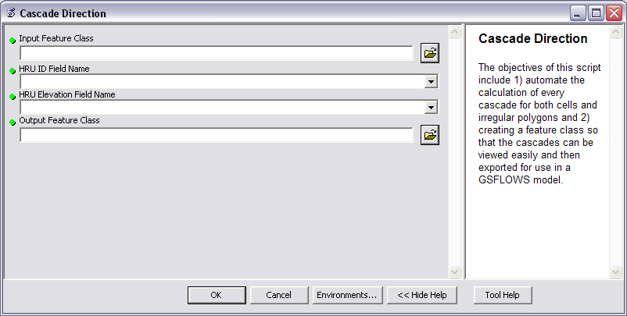
ARC Toolbox

Slide 10
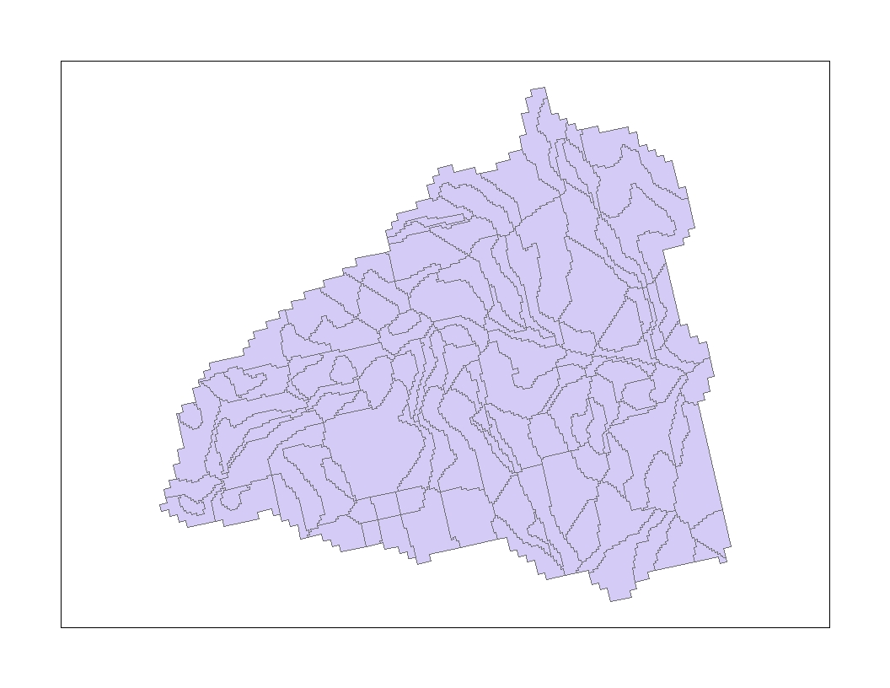
Irregular Polygons: User Input

Slide 11
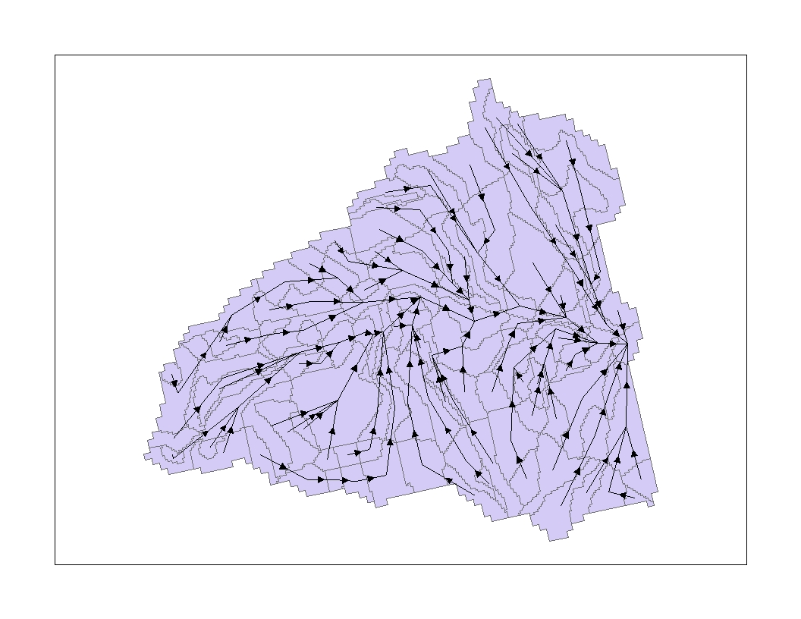
Irregular Polygons w/ Cascade Output

Slide 12
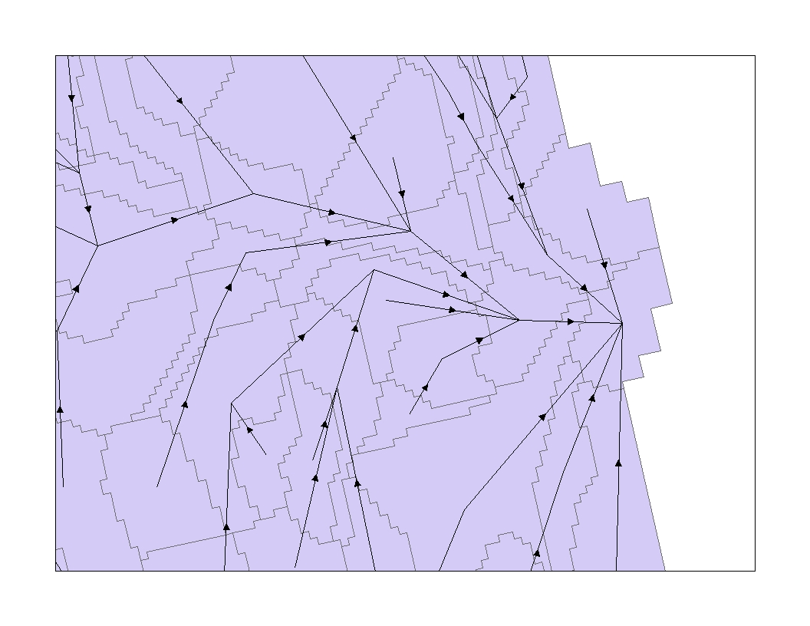
Irregular Polygons w/ Cascade Output
Note: Due to the irregular shape of some polygons the polygon’s centroid may fall outside of the polygon and the cascade may appear to link two unconnected polygons.

Slide 13
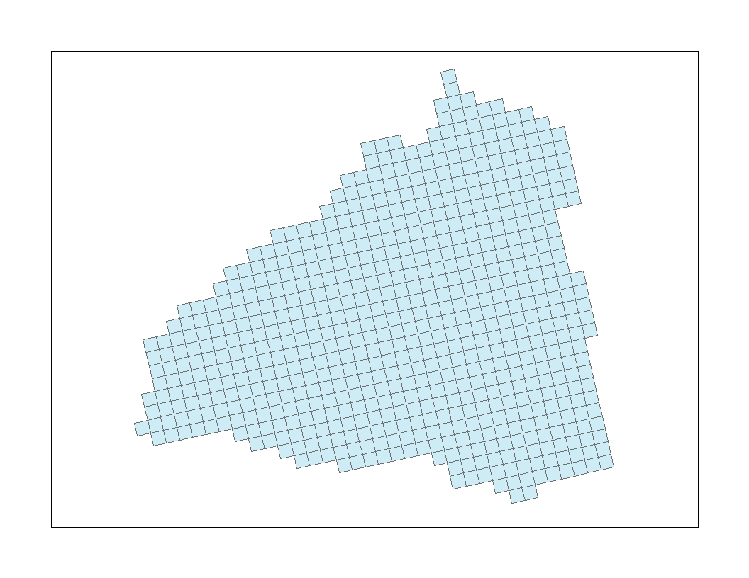
Cell Based Polygons: User Input

Slide 14
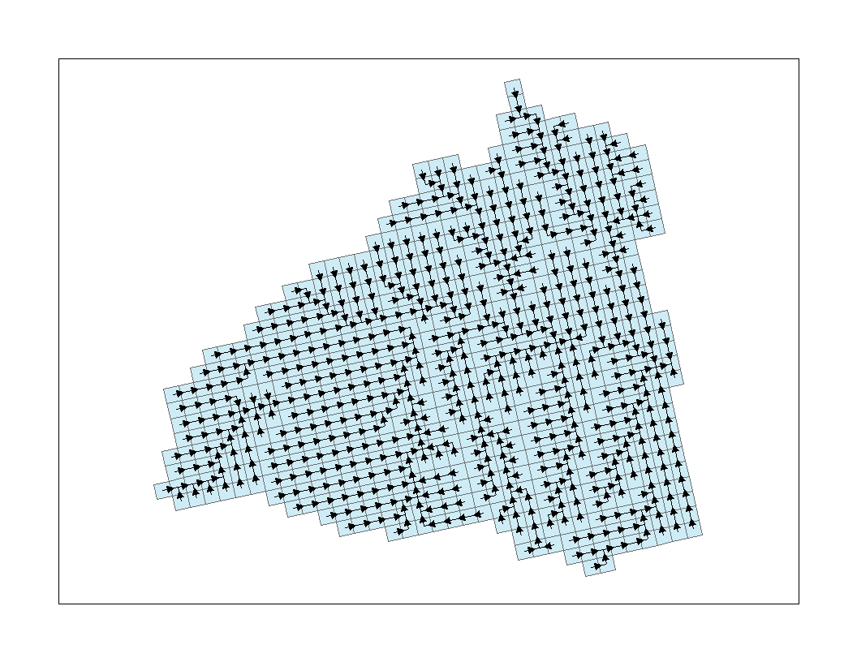
Cell Based Polygons w/ Cascade Output

Slide 15
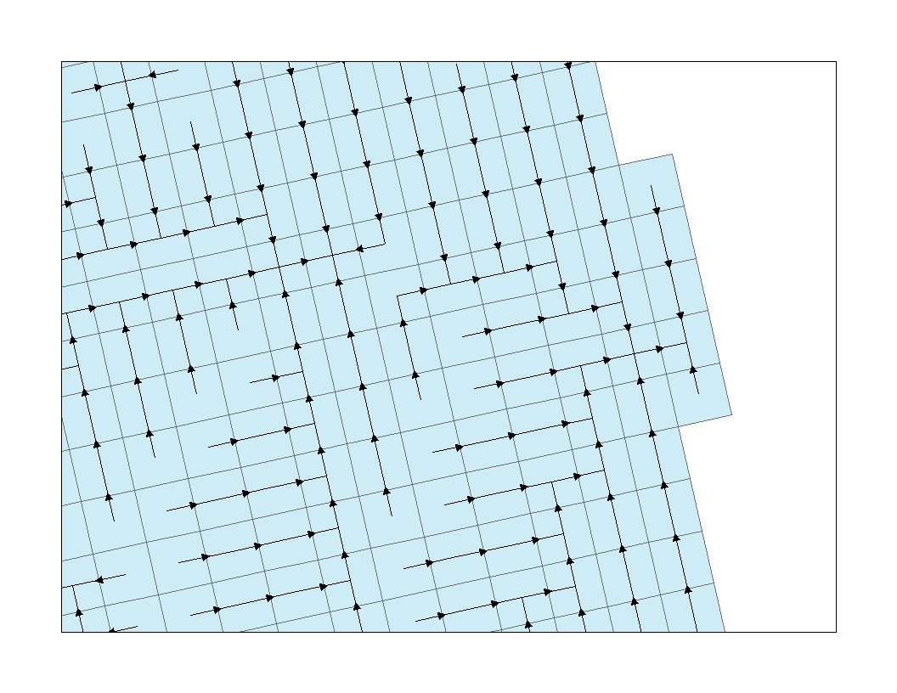
Cell Based Polygons w/ Cascade Output

