Slide 1
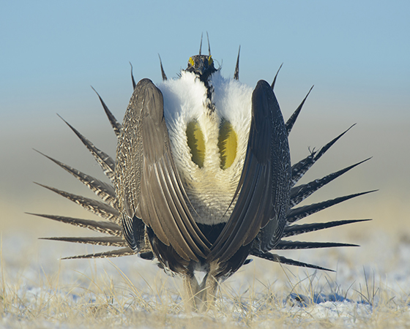
Remote Sensing of Isolated Wetlands in the Great Basin Region of Nevada Using Landsat-8 Data
By Kim Mauch

Slide 2
Purpose: to detect & extract isolated depressional wetland (IDW) features in the Basin and Range region of Nevada for a spatial data layer for the Greater Sage-Grouse Project.
Project Parameters:
  Following procedures as outlined in Satellite Remote Sensing of Isolated Wetlands Using Object-Oriented Classification of Landsat-7 Data.
  Satellite imagery must be multispectral, at least 30 meter resolution, & must contain a 15-meter panchromatic layer. Landsat-8 data (June 2013) was used due to lack of availability & suitability of LS-7 data of project area.
  Used ENVI and Feature Analyst software to perform all transformations and classification procedures.

Slide 3
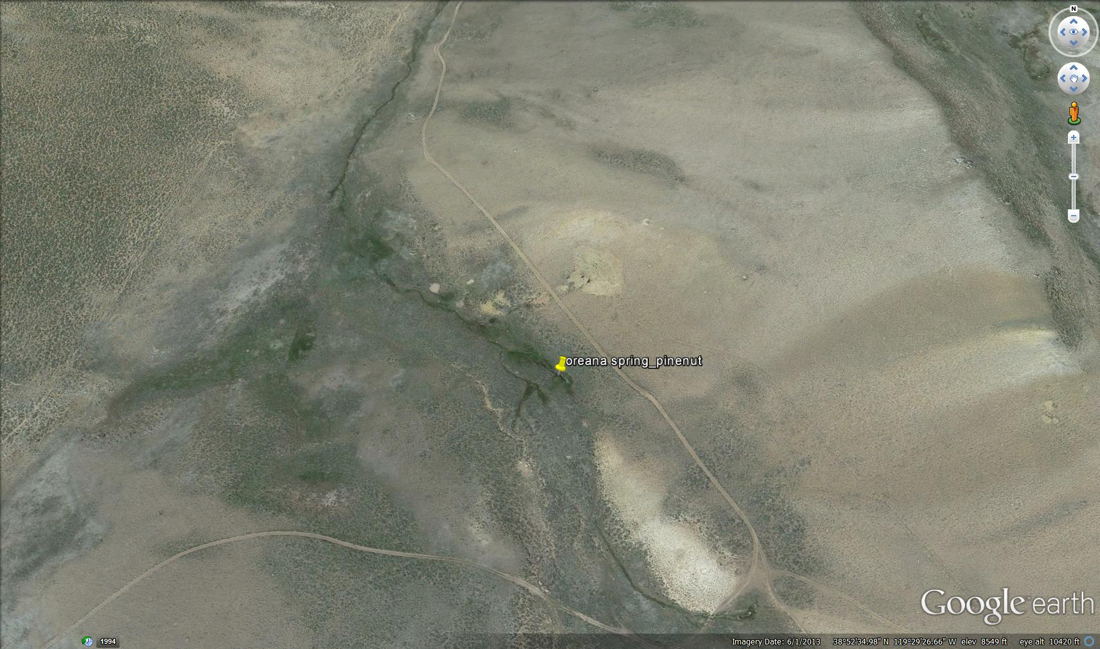

Slide 4
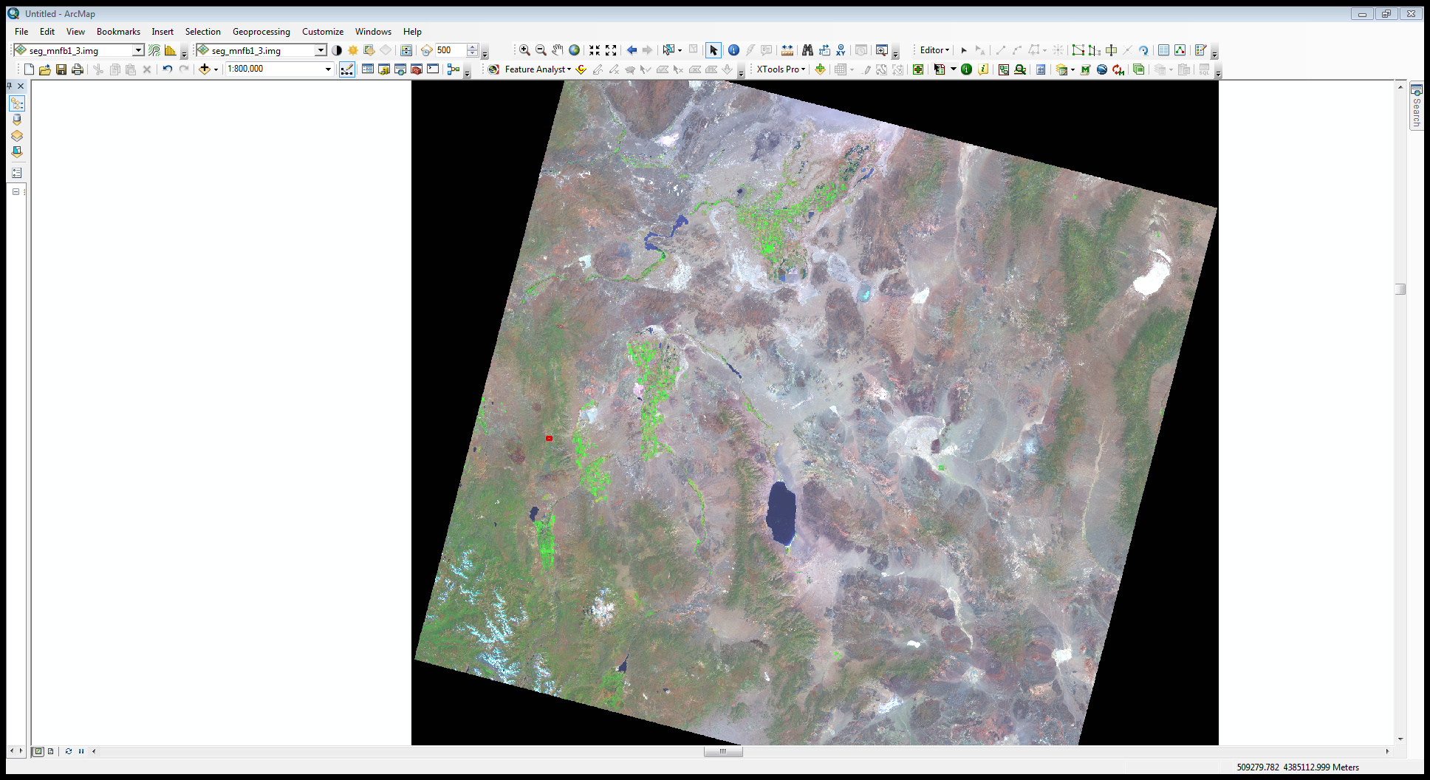

Slide 5
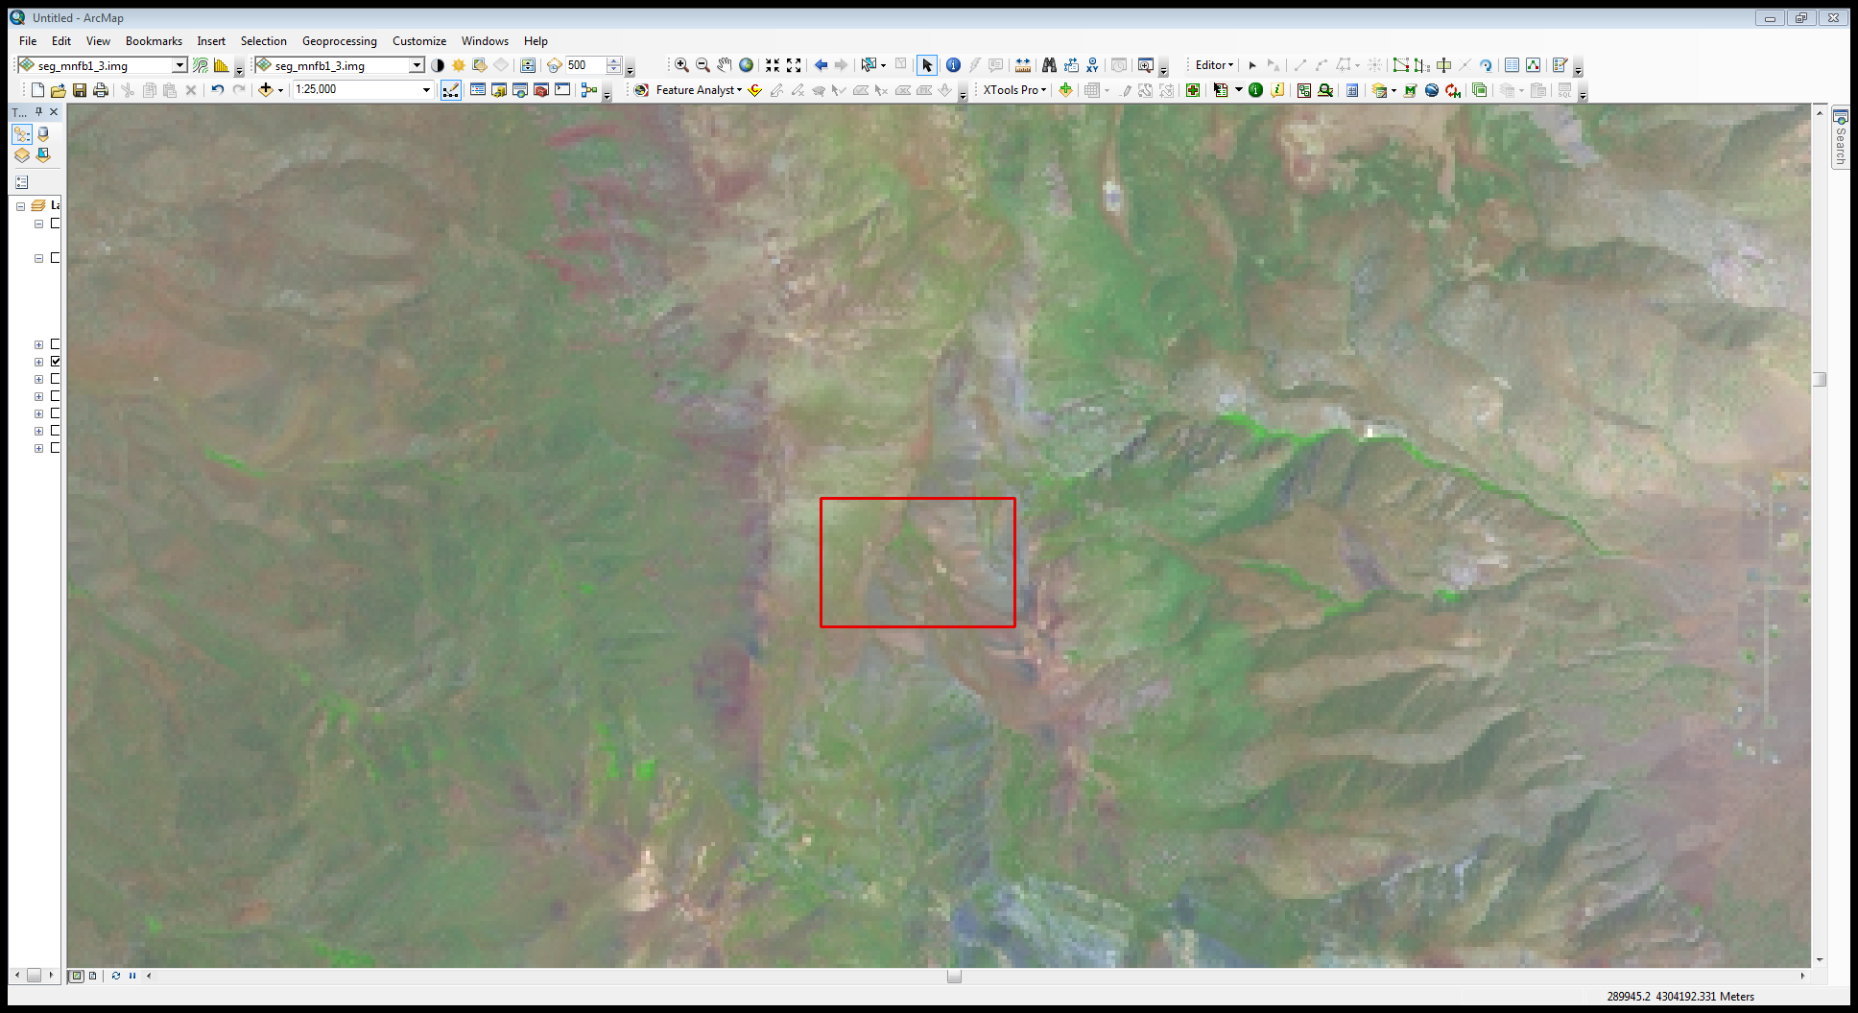

Slide 6
3 image transformations applied:
Minimum Noise Fraction (MNF) transformation:
  Segregate noise in spectral data;
  Reduce complexity of data;
  Determine dimensionality of data.
  Noise is produced by thermal effects, sensor saturation, transmission errors, etc. Degrades the data’s usefulness for interpretation.

Slide 7
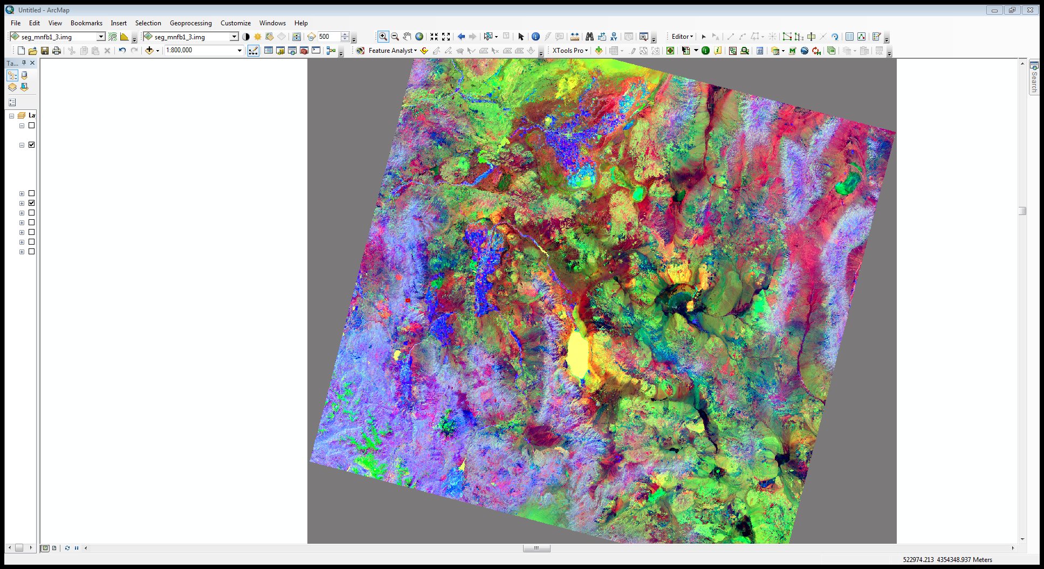

Slide 8
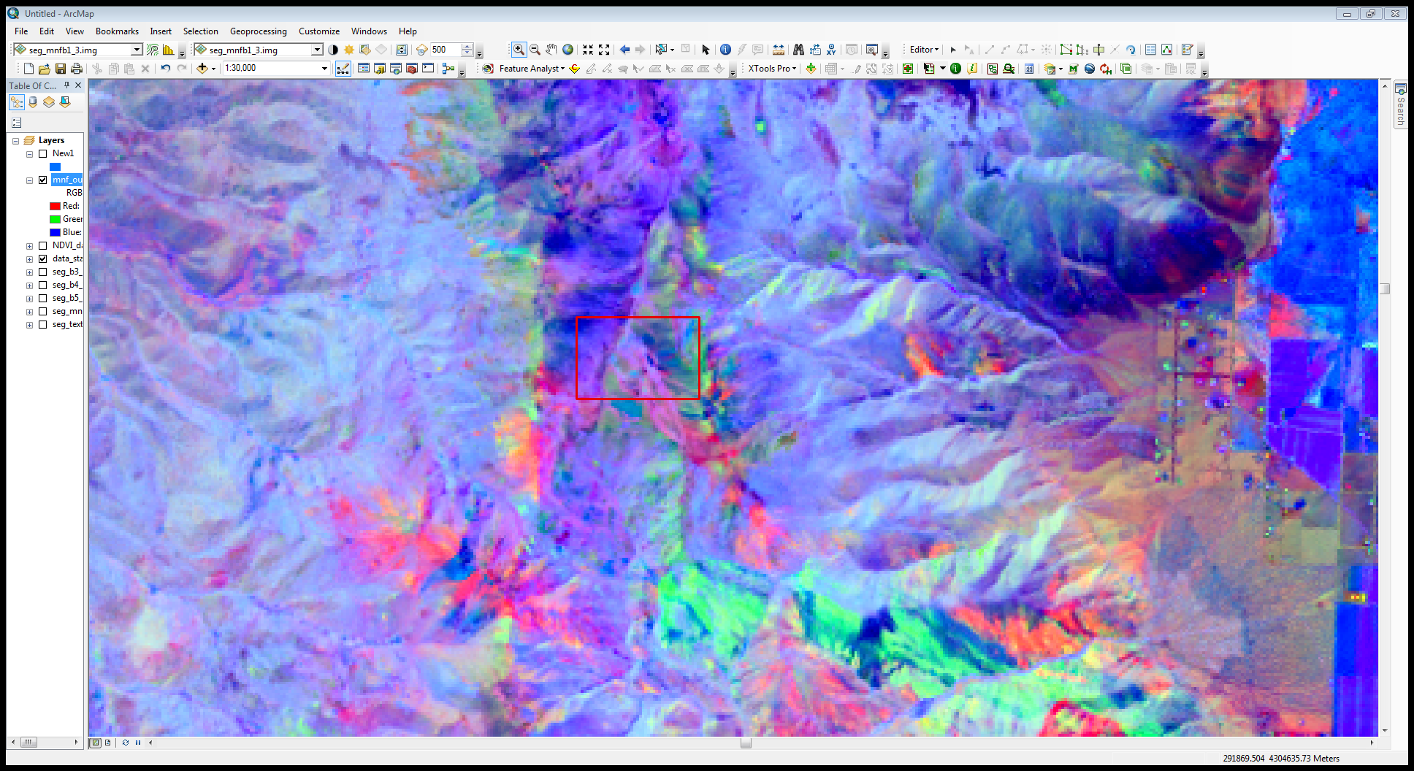

Slide 9
Texture Transformation
  Run on Band 5 of LS-8 satellite image only.
  Spatial variation if image tone ; to be classified as a distinct textural area, gray levels must be more homogeneous than areas having a different texture.

Slide 10
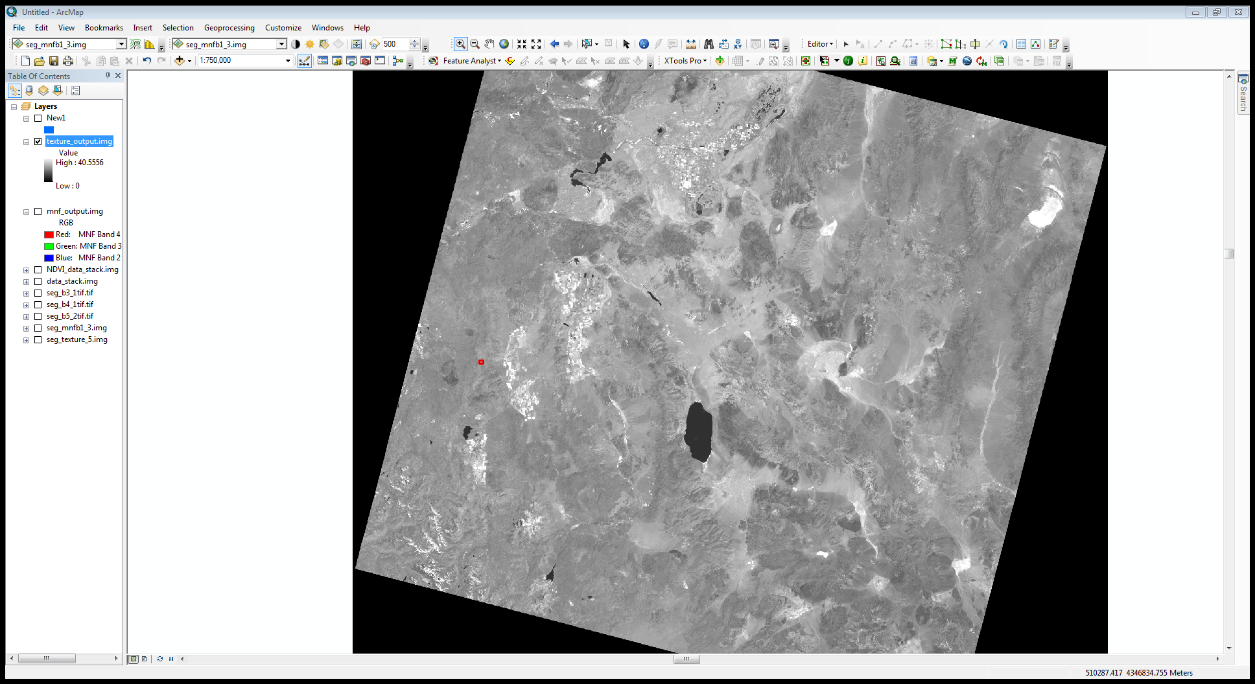

Slide 11
Gram-Schmidt Pan Sharpen Transformation
  Merges the 15 meter panchromatic band with the 30 meter spectral bands using a sharpening algorithm.
  Result is 15 meter merged spectral dataset.

Slide 12
Object-Oriented Classification
  Wetland boundaries are highly contrasted to the surrounding uplands; should therefore be able to distinguish these boundaries.
  Image Segmentation:
    ‘segmenting’ the spectral characteristics of imagery into discrete objects.
    Uses ‘low-level’ (pixel-based features) to create ‘higher-level’ image objects.
    Textural, contextual & shape as well as spectral characteristics that can also be used for classification.

Slide 13
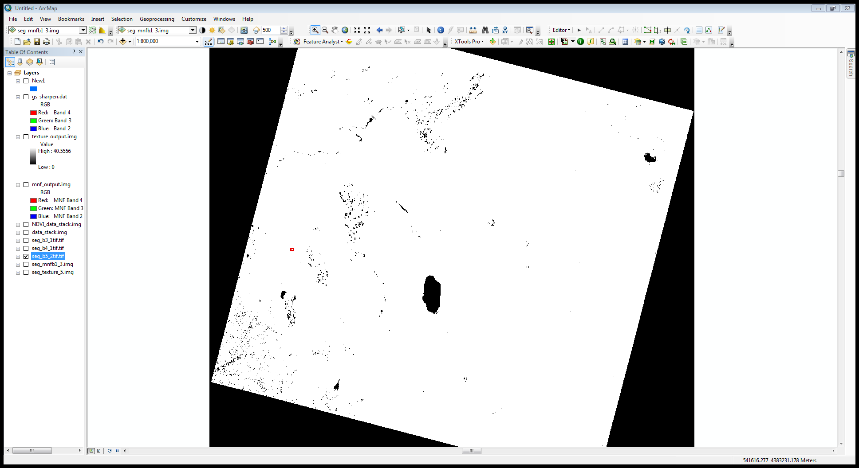

Slide 14
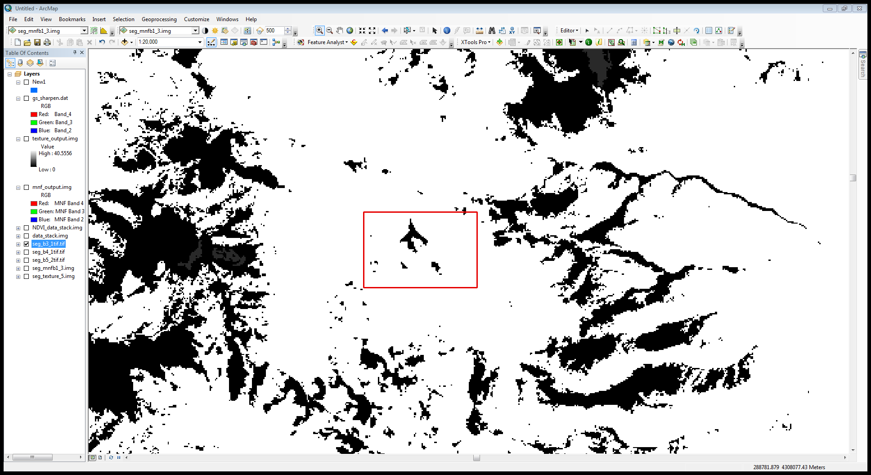

Slide 15
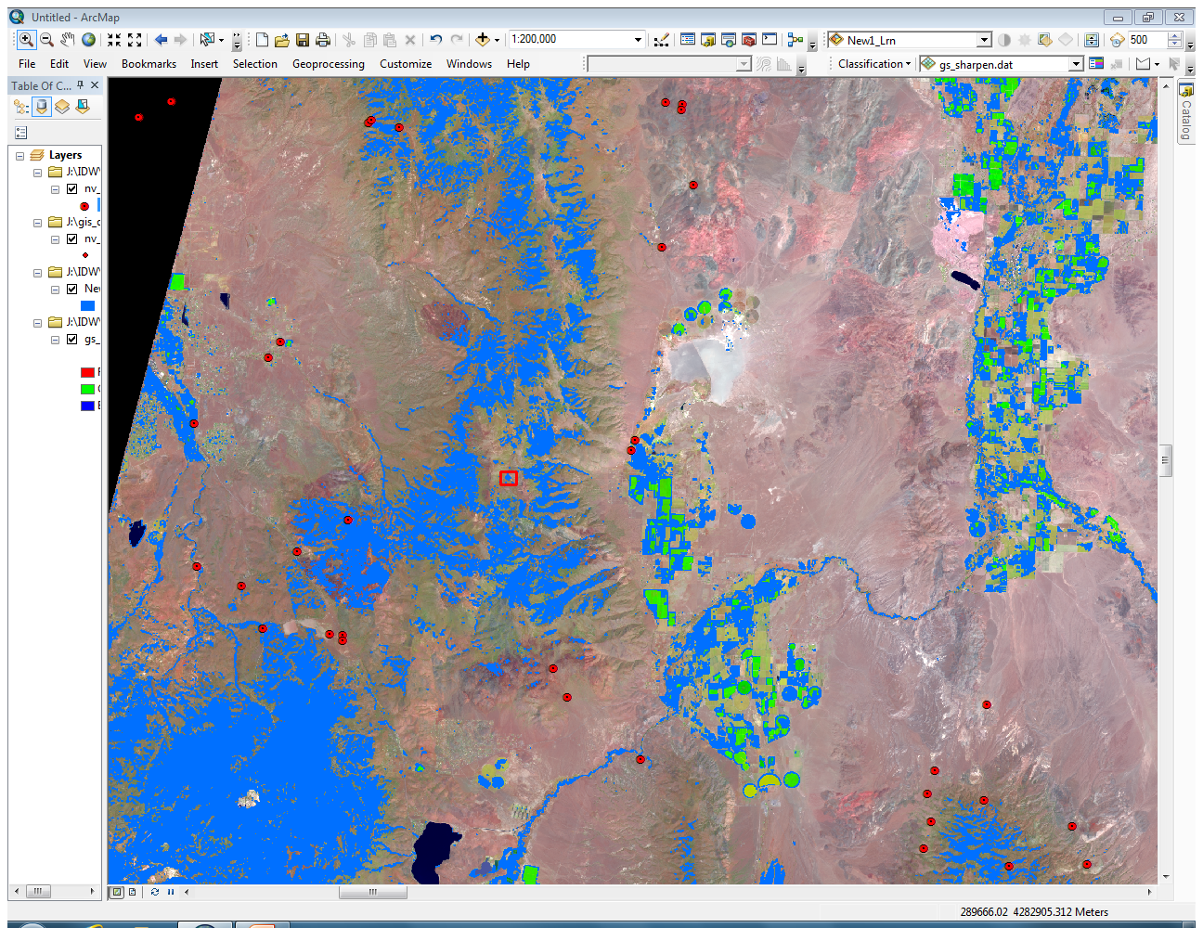

Slide 16
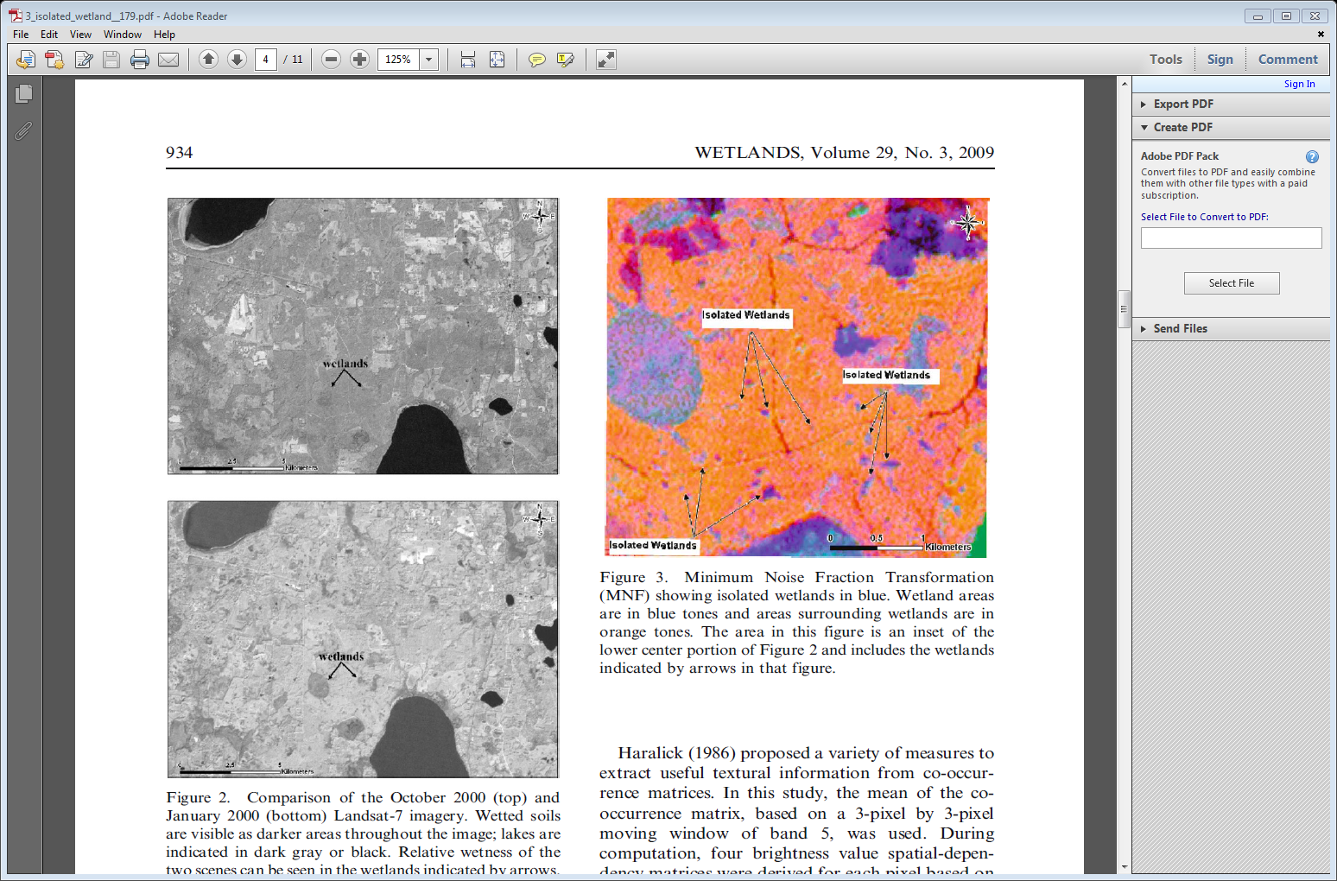

Slide 17
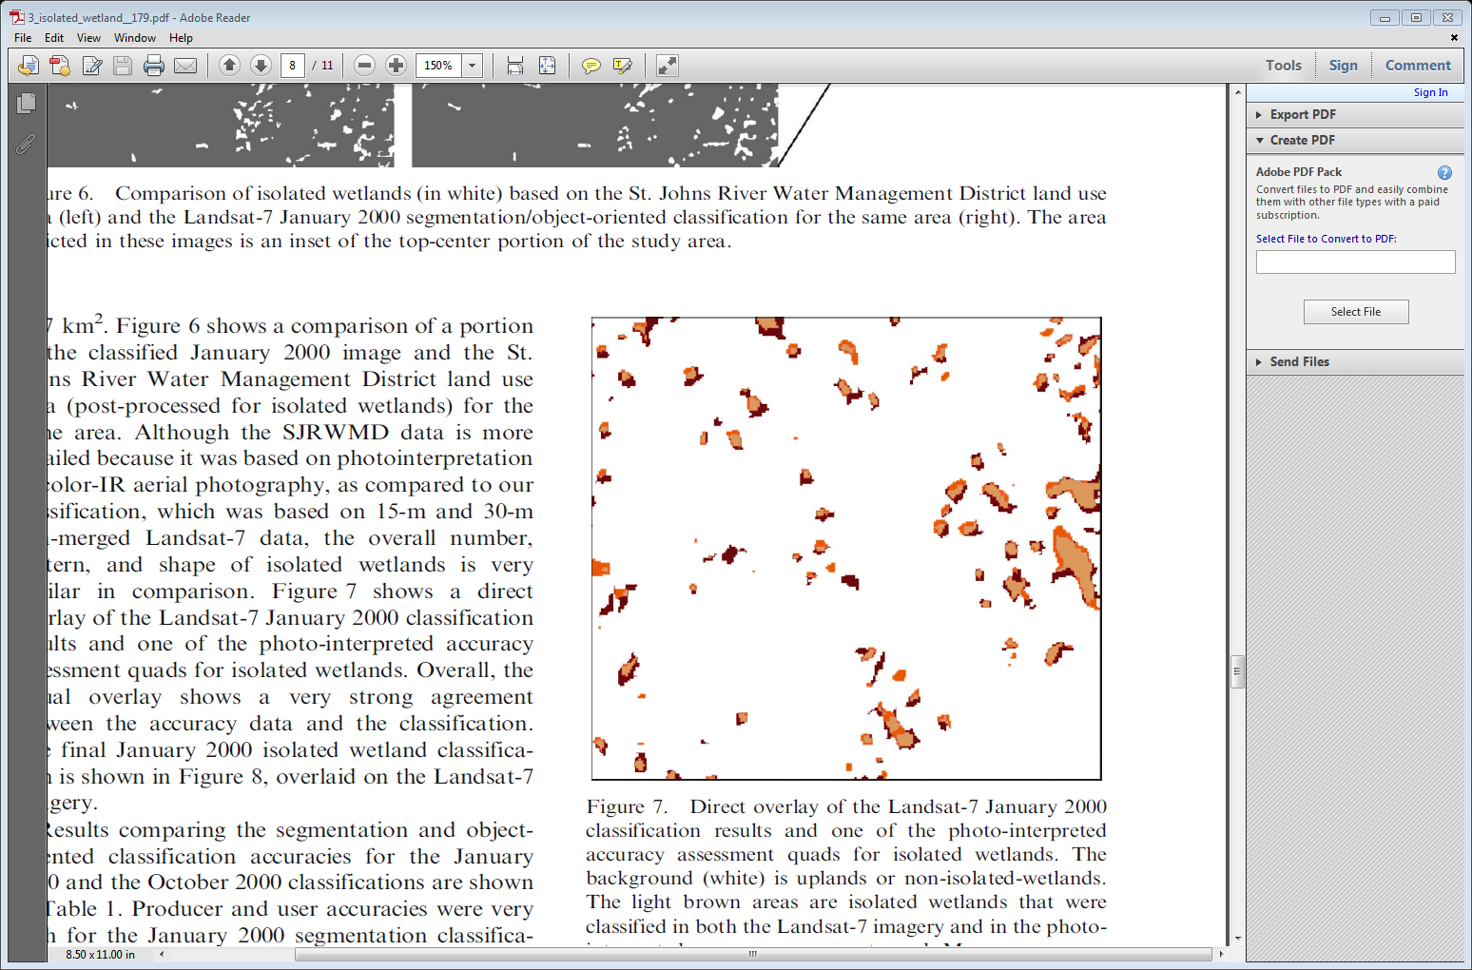

Slide 18
